Slide 1

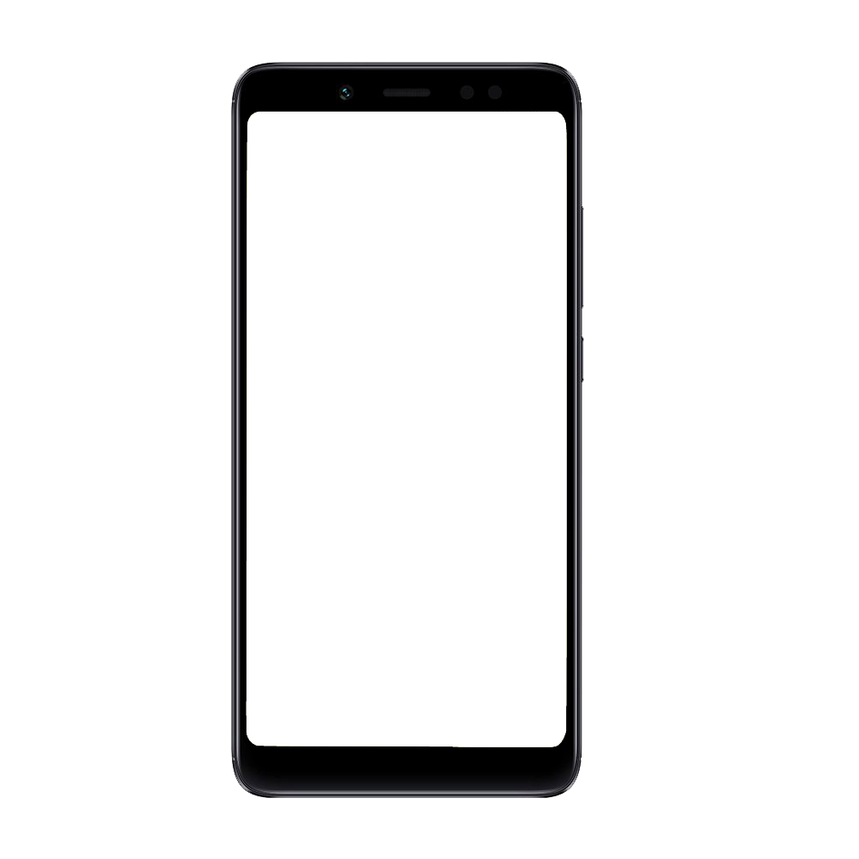
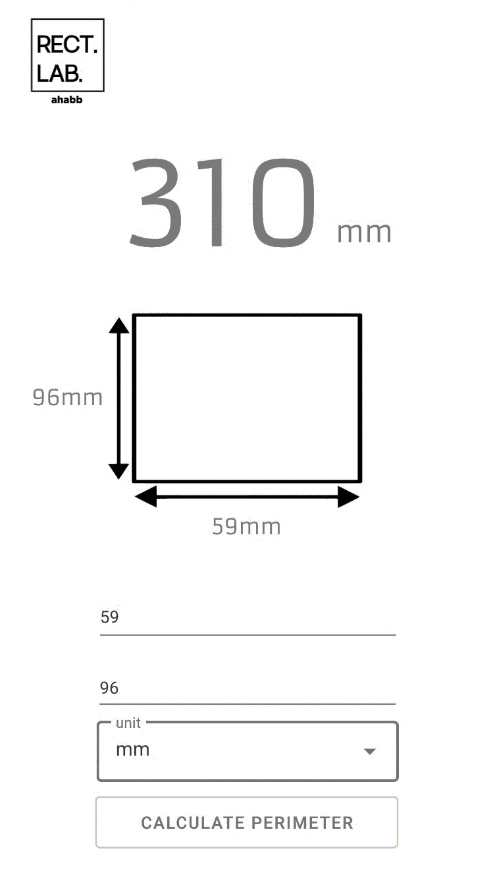
By
M. Ahabb Sheraz
Semester Project
CS121 B
Reg.
2021327
Introducing
RectLab

Slide 2
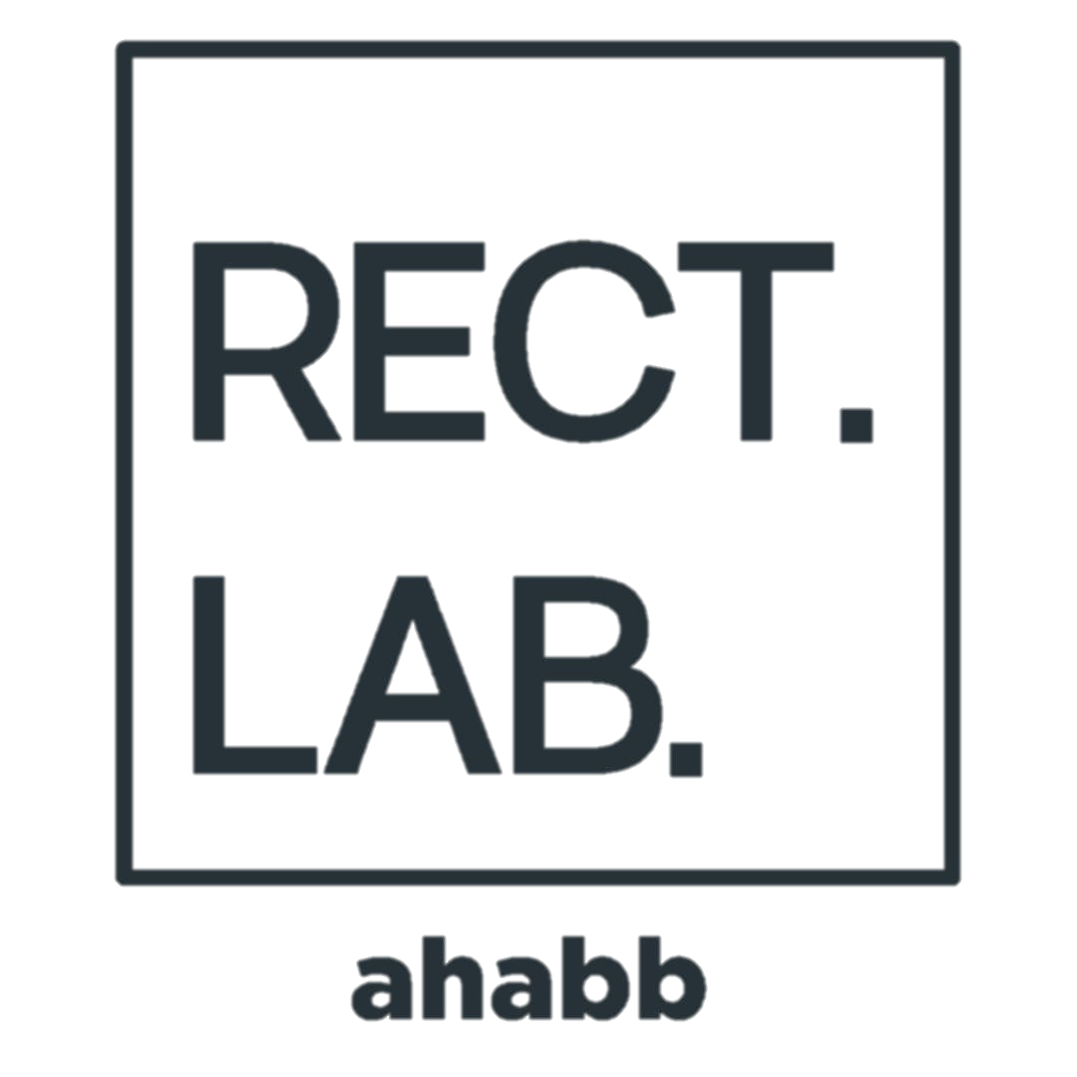
Purpose
Rectangle Laboratory, RectLab for short, is a simple application that can calculate the perimeter of almost any rectangle. The naming convention was inspired by the much capable MATLAB.

Slide 3


Technologies

Slide 4
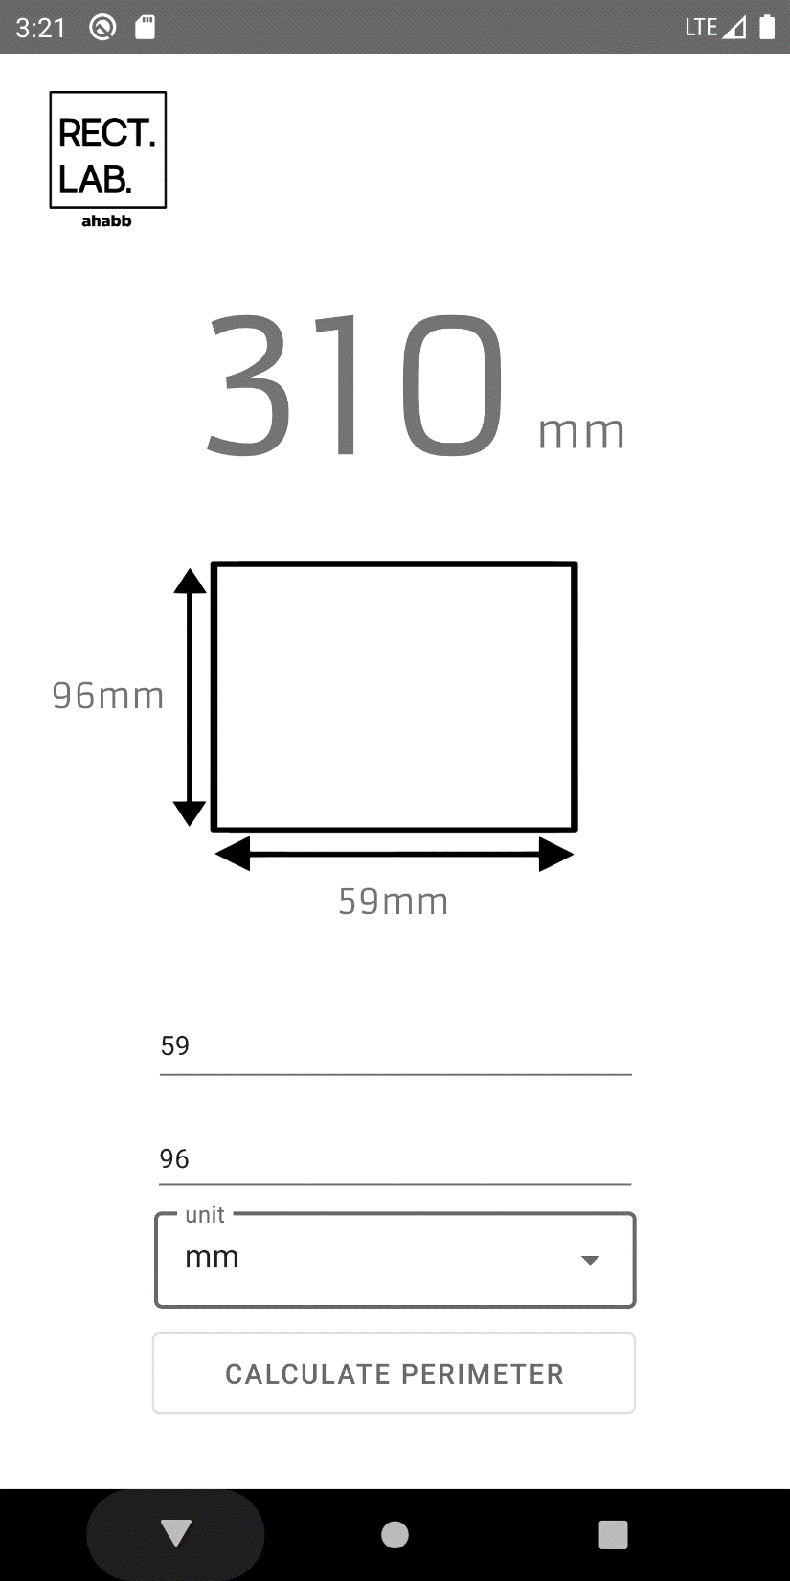
Features
5
1
Number-only TextFields
2
Exposed Drop-Down Menu
4
3
Button
4
TextViews
1
5
Scalable Vector Graphics
2
3

Slide 5
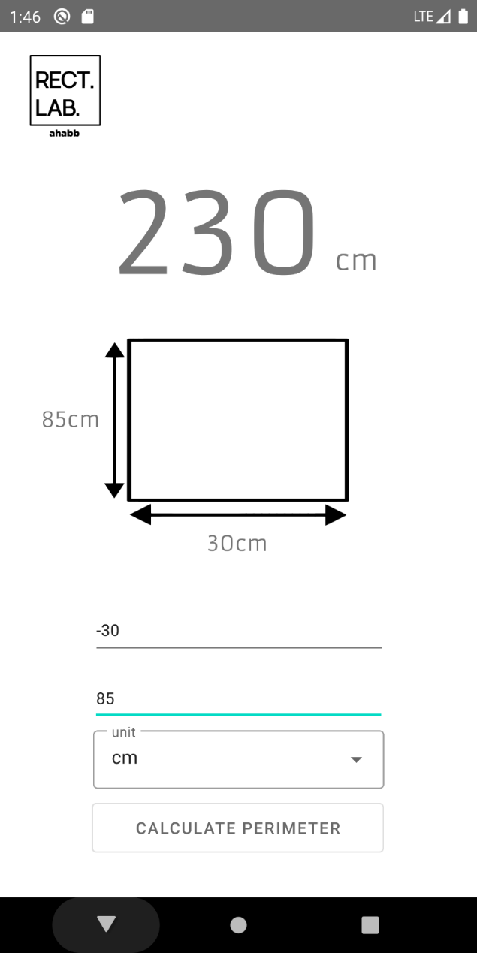
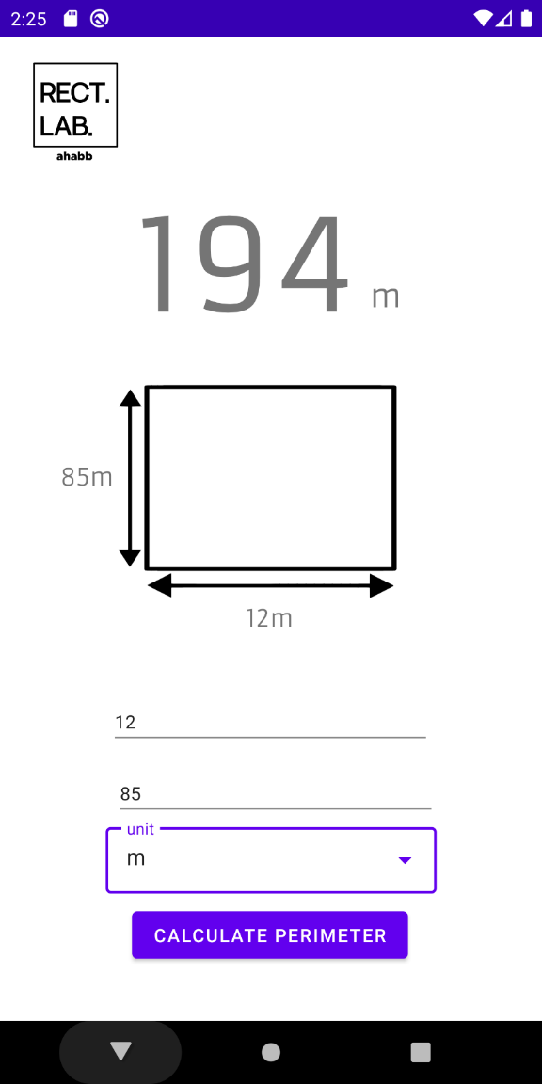
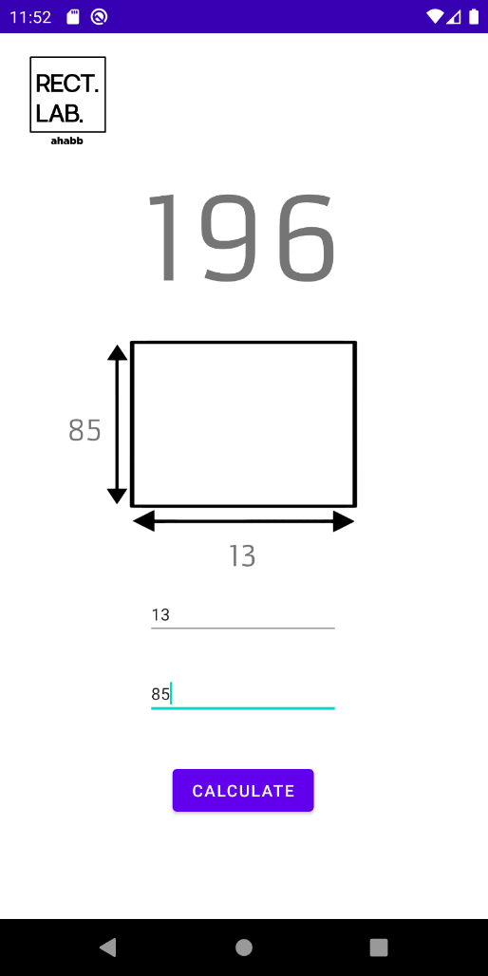
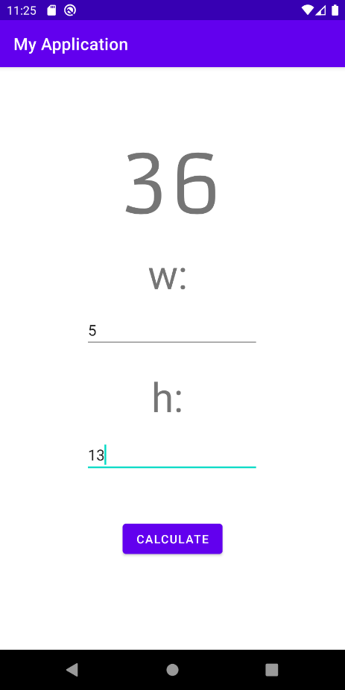
Prototypes and Demos

Slide 6
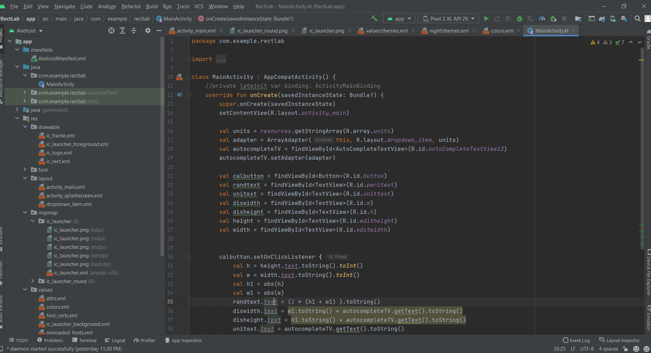
The
Code

Slide 7
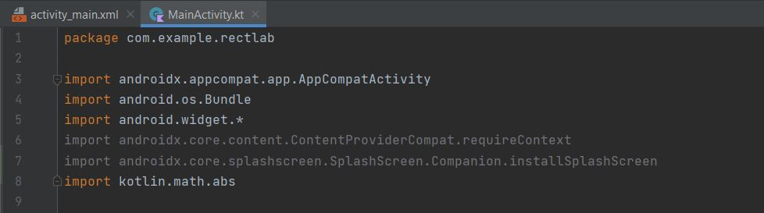
Importing Essential Libraries
MainActivity.kt

Slide 8
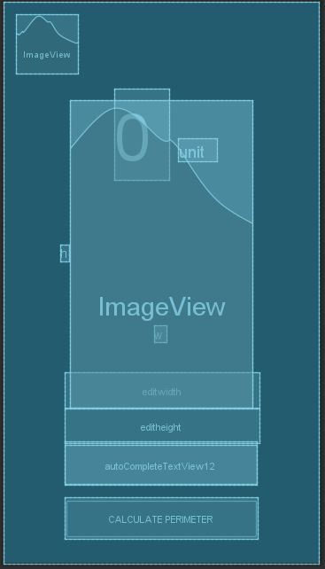
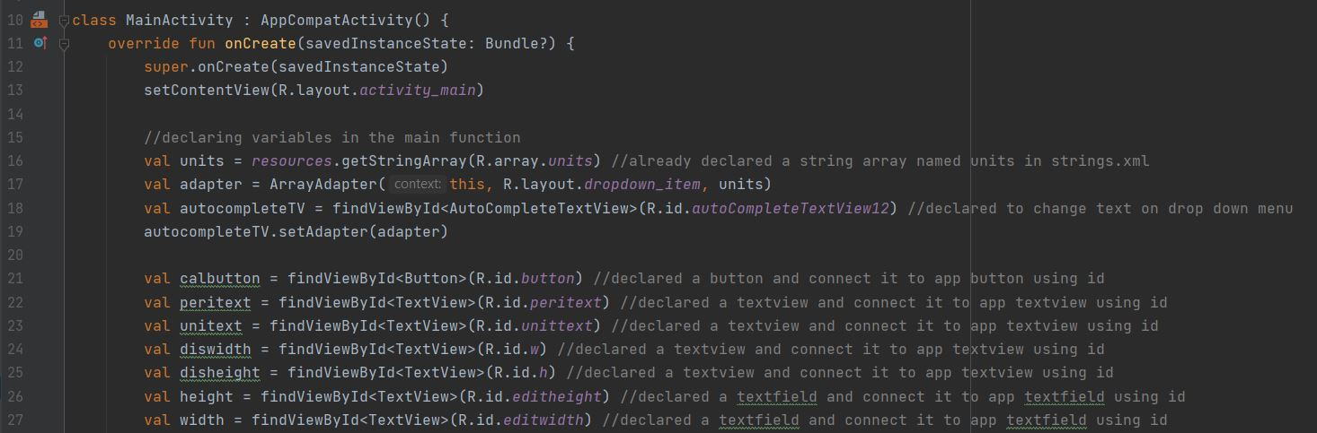
Declaring Variables
Id: peritext
Id: unitext
MainActivity.kt

Slide 9
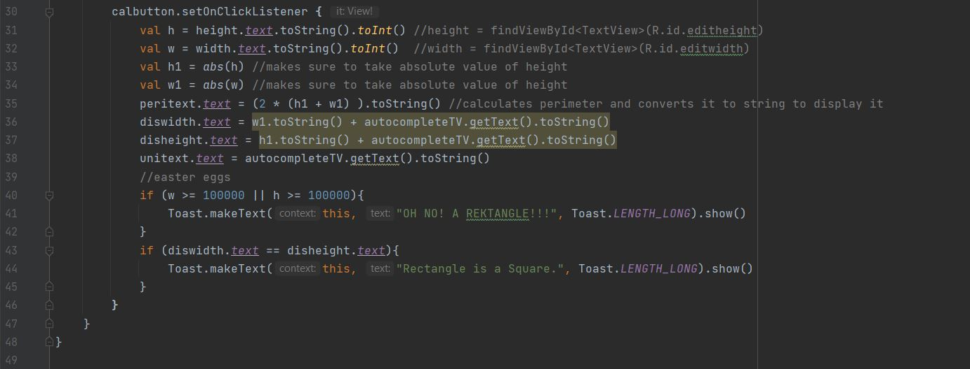
Button Call Function
MainActivity.kt

Slide 10
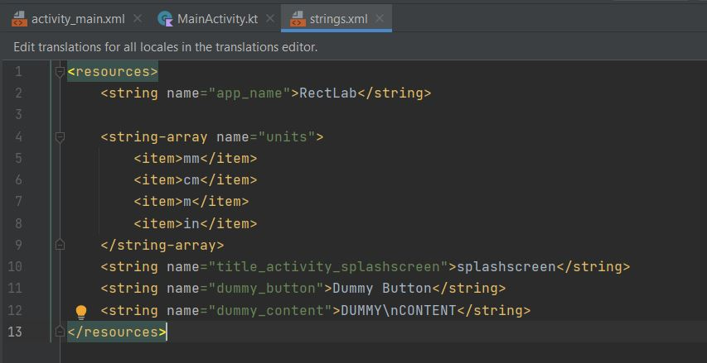
Exposed Drop Menu Implementation
MainActivity.kt
strings.xml

Slide 11
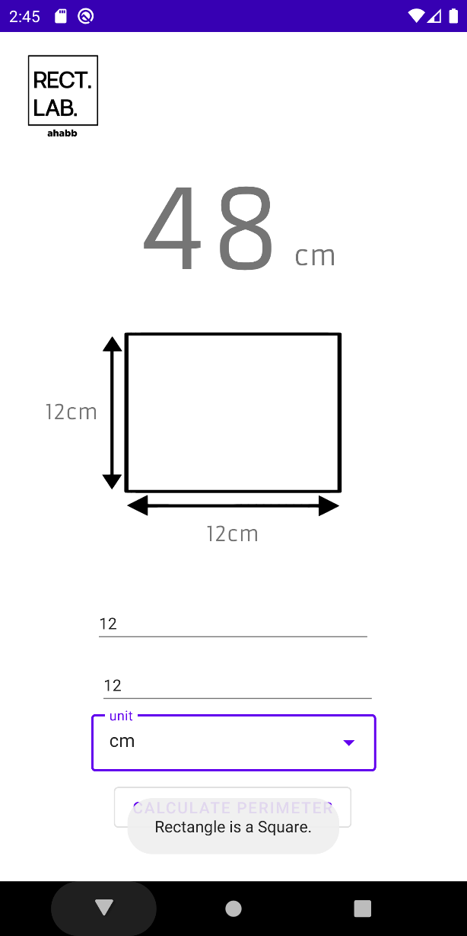
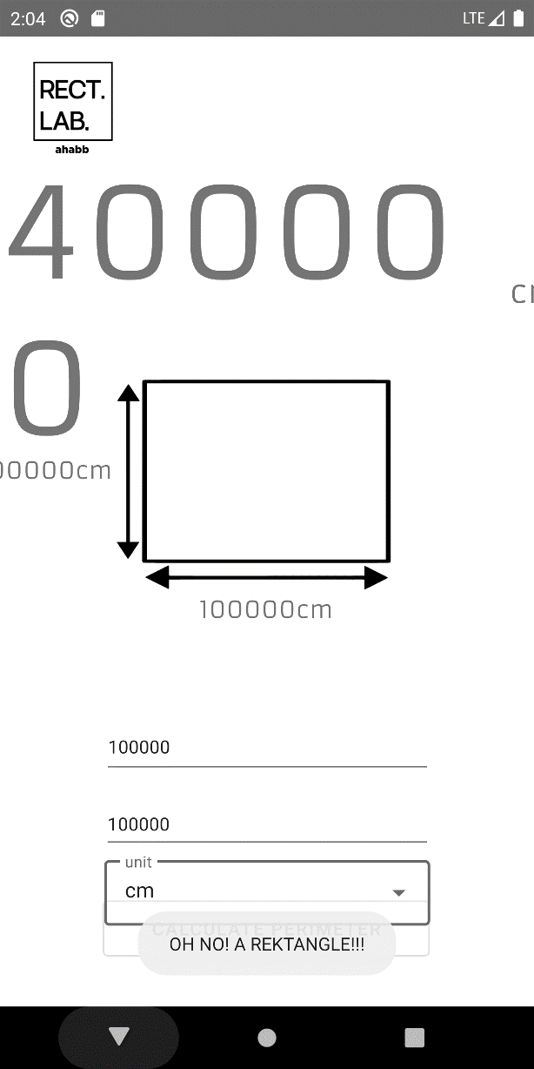
Easter Eggs
MainActivity.kt

Slide 12

Conclusion
This project introduced me to the world of Android Application Development and gave me the chance to learn a lot of new things. Through this project, I was introduced to Kotlin for Android Studio. As for the project, I am happy with how it turned out to be. In the future, I plan to add more features such as the ability to convert units of both the height and width.

Slide 13
Thank
You!

