Slide 1

By
M. Ahabb Sheraz
Semester Project
CS103 B
Reg.
2021327
Introducing
E-voting system

Slide 2

Problem Statement
A valid voter will be casting their ballot for the candidates in provincial and federal general elections. After ending the election, the results of the election will be announced.

Slide 3

Instructions
1) Users will register as a voter using their IDs (CNICs). This will be done using voter_registration.cpp program.
voter_registration.cpp
2) Voters will vote for their parties in the election.cpp program.
election.cpp

Slide 4
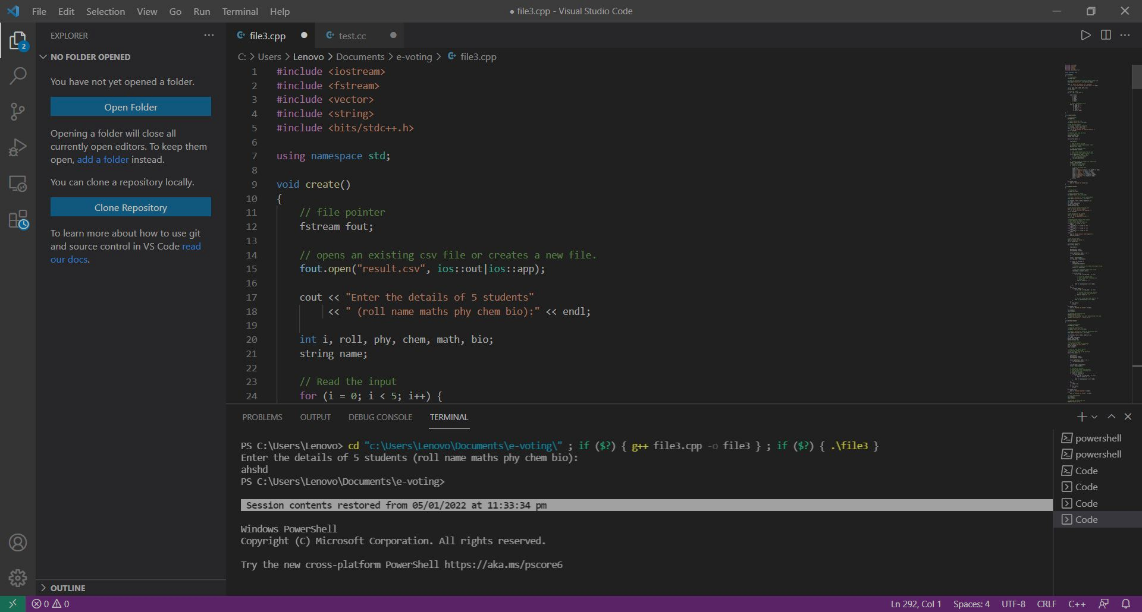

The Algorithm
and Code

Slide 5

How are 2 programs linked?
Users will register their IDs in the voter_registration.cpp program. Then these IDs get stored into voters.csv file. The elections.cpp program will then fetch these IDs from the voters.csv file.
voters.csv
voter_registration.cpp
election.cpp

Slide 6
voter_registration.cpp
This code consists of the following functions:
authenticate():
This function verifies if the typed ID has already been registered or not. It returns the boolean value of 0 if ID has not been registered before.
voter():
Unregisters IDs get stored into the voters.csv using this function. No return value.

Slide 7
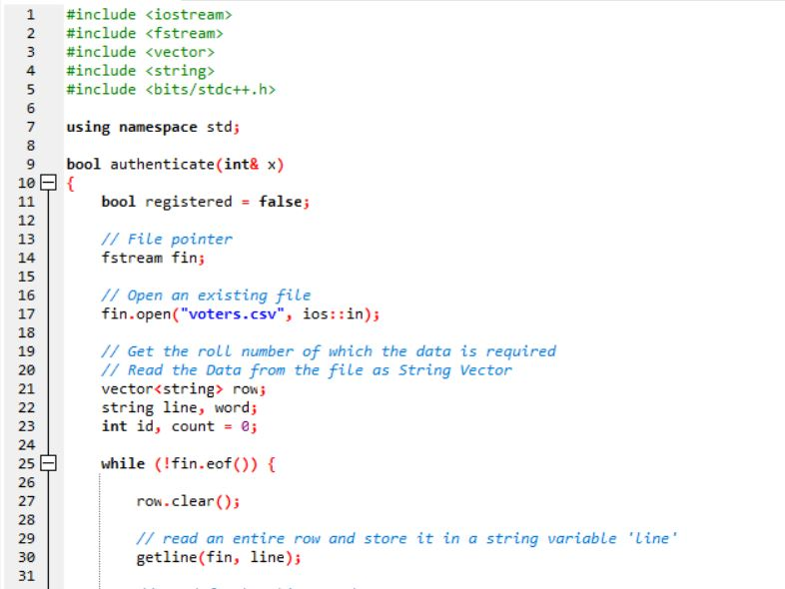
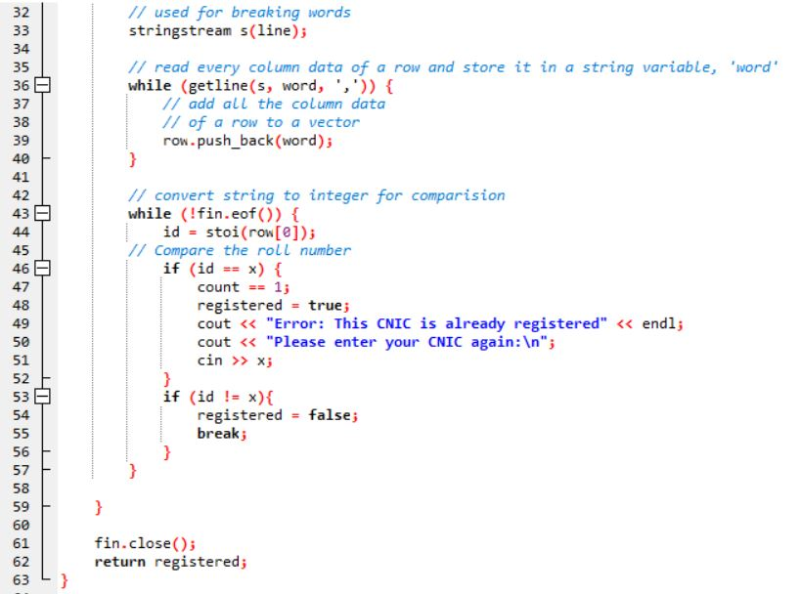
authenticate()

Slide 8
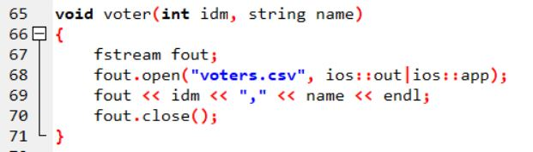
voter()

Slide 9
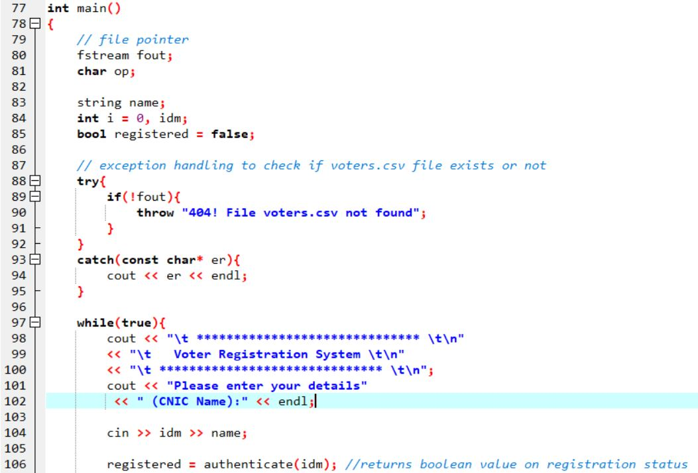
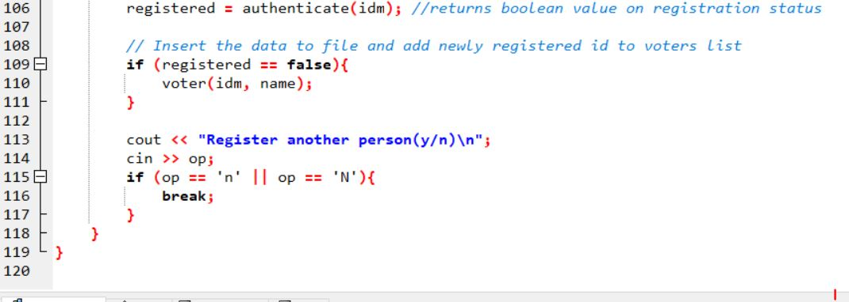
main()

Slide 10
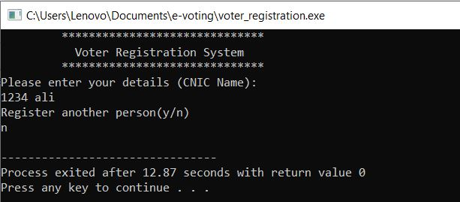
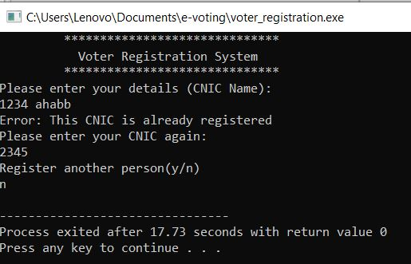
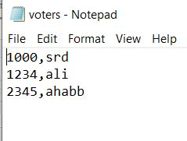
Program in action

Slide 11
election.cpp
This code consists of the following functions:
voter():
This function verifies if the typed ID has already been registered or not. It returns the boolean value of 0 if ID has not been registered before.
vote_status():
This function will not allow users to vote again who have already casted their vote as records of those who have already voted are kept in voted.csv file. It also returns a Boolean value.

Slide 12
election.cpp
record_vote_n():
Updates vote for National Assembly candidates.
record_vote_p():
Updates vote for National Assembly candidates.
na_displayresults():
Displays National Assembly election results.
pa_displayresults():
Displays Provincial Assembly election results.

Slide 13
voter()

Slide 14
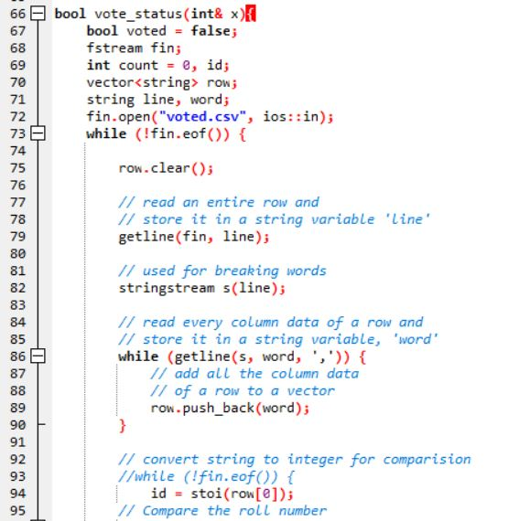
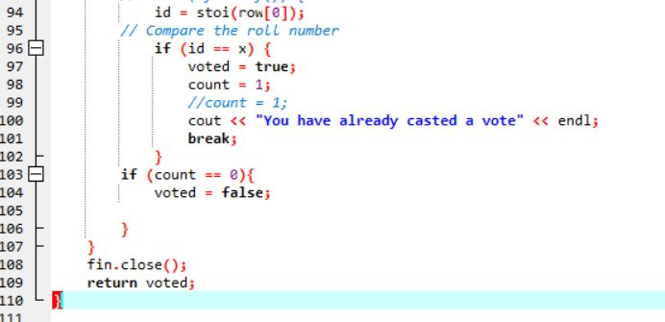
vote_status()

Slide 15
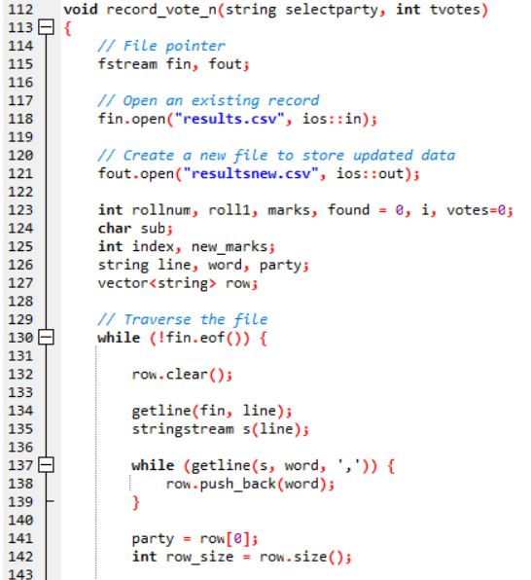
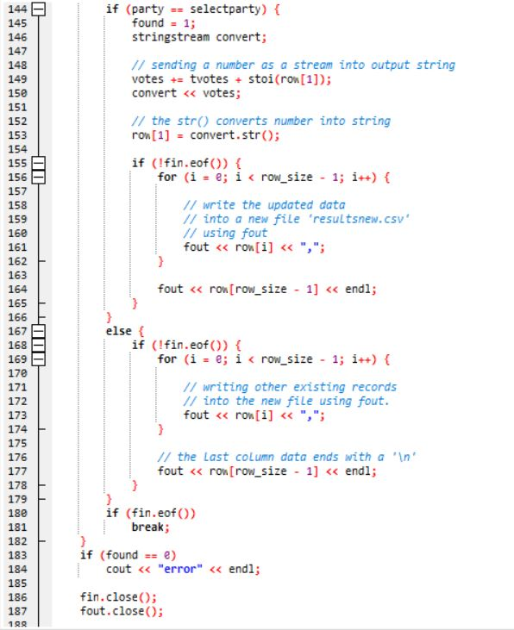
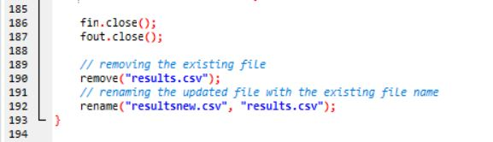
record_vote_n()
similar for record_vote_p()

Slide 16
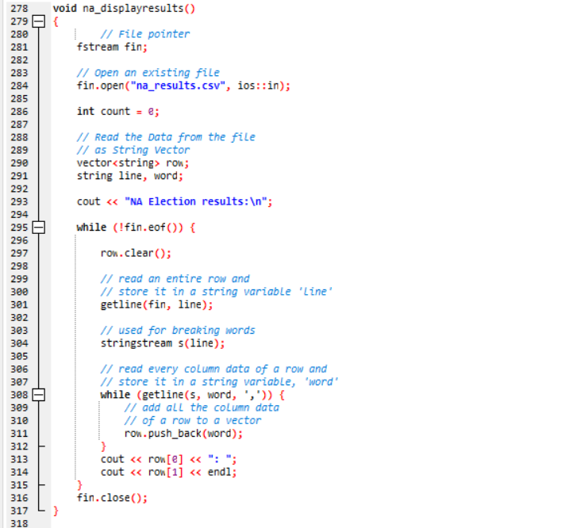
na_displayresults()
similar for pa_displayresults()

Slide 17
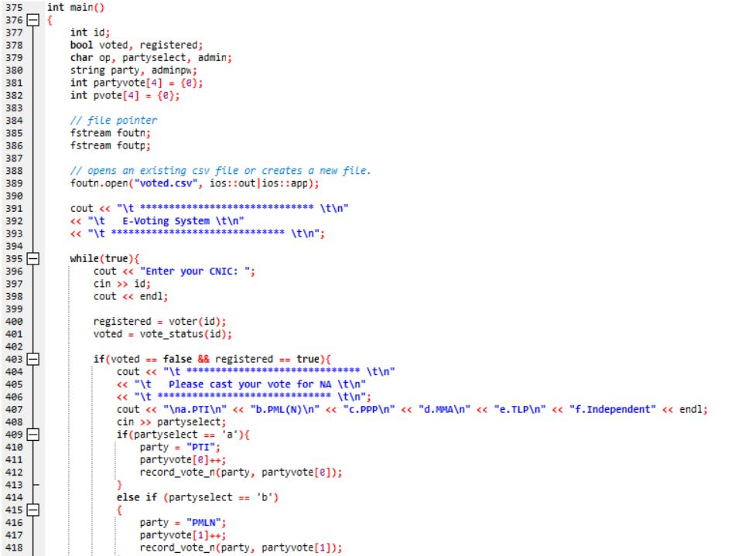
main()

Slide 18
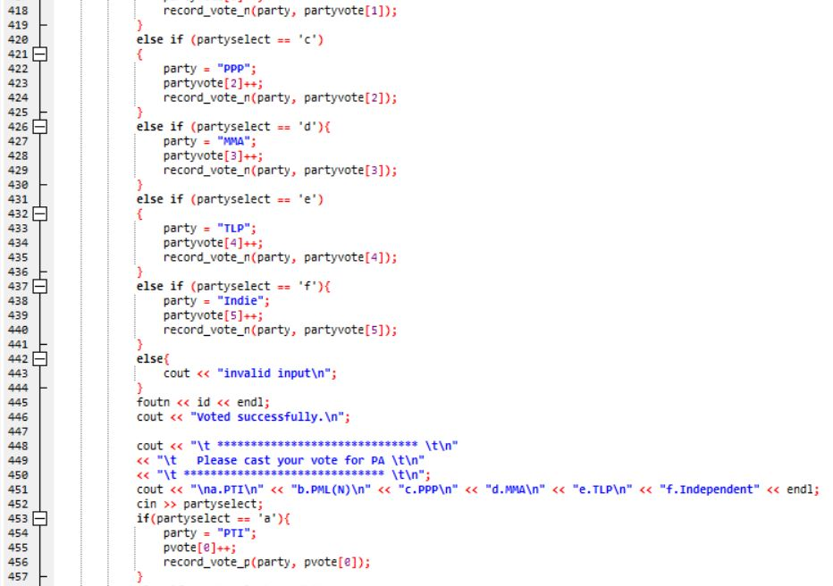

Slide 19
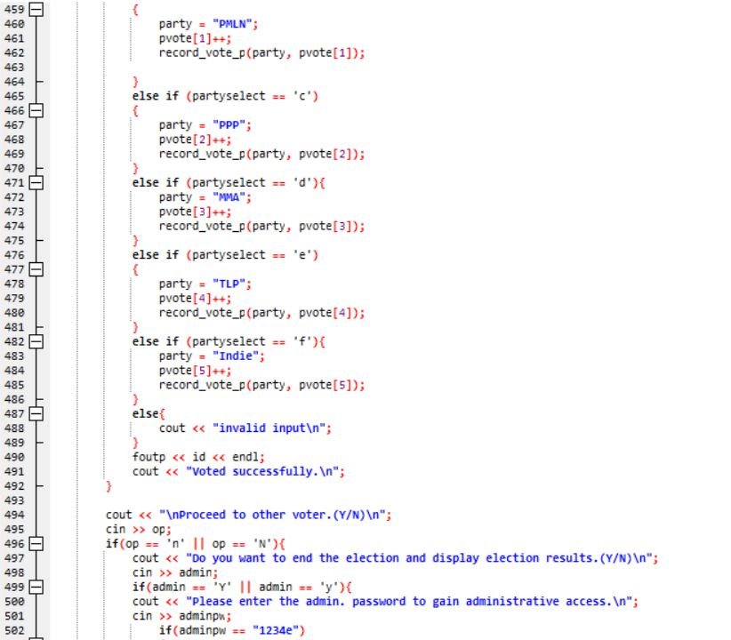
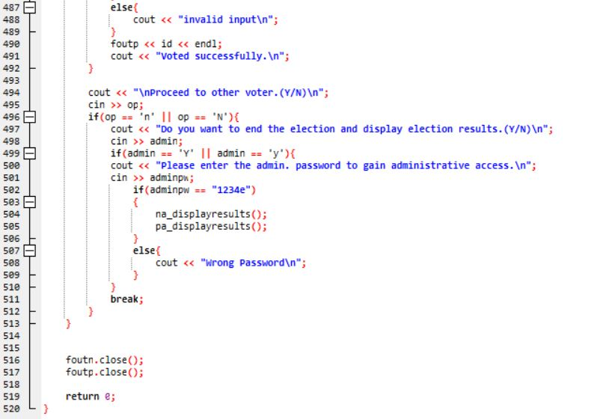

Slide 20
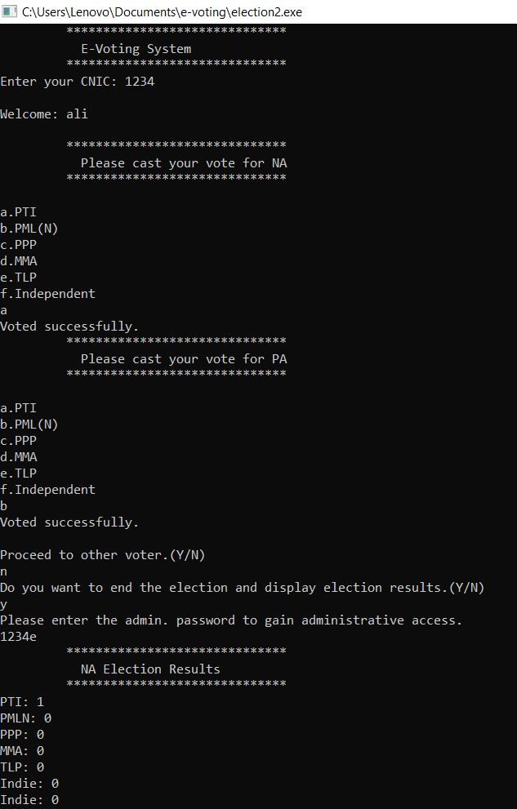
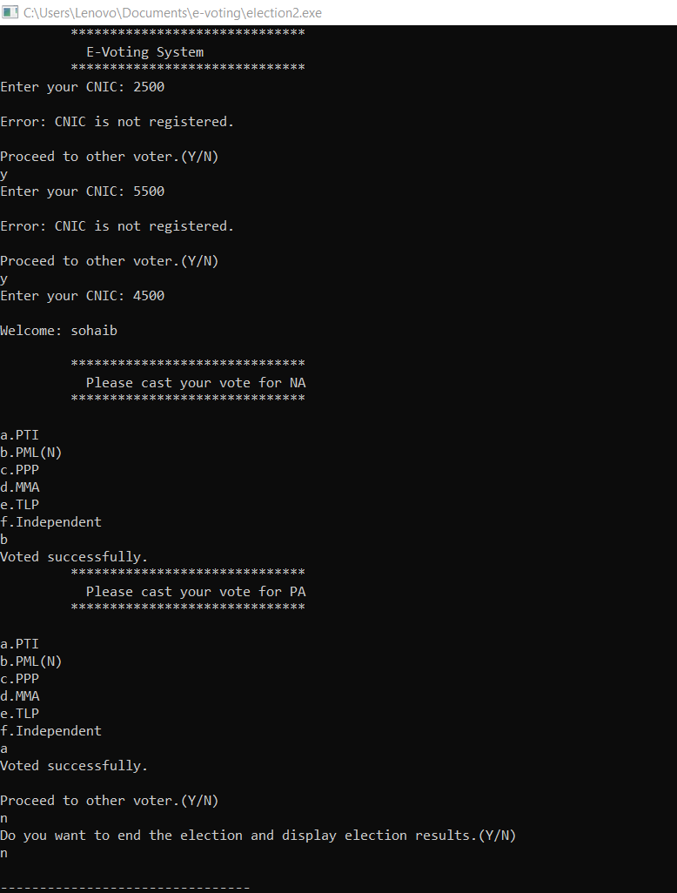
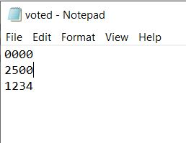
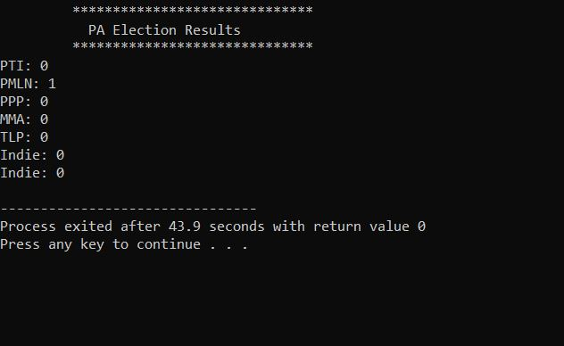
Program in action

Slide 21
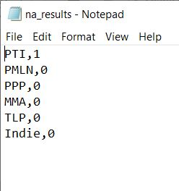
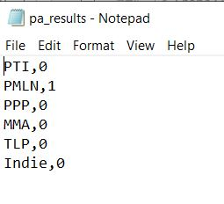

Slide 22

Conclusion
This project was definitely interesting but also challenging. It tested my knowledge of CS103 to its full extend. By making File-based databases using File handling, I was able to complete this task. It was fun creating this project.

Slide 23
Thank
You!

