Slide 1
Graph database creation and Assortativity analysis in the context of online discourse
Individual Project
Alexander Haberling Matrikel-Nr.: 1450868

Slide 2
Introduction
Data & Structure
Graph Database
Conceptualizing
Populating
Exportation
Analysis
Preprocessing
Descriptives
Assortative Mixing
Limitations
Lessons Learned

Slide 3
Data & Structure
Provided by Esin Durmus & Claire Cardie [1]
Scrapped of debate.org (Window 2007-2017)
Semantic data
Debates
Opinions
Polls
Demographic data
User age
User ethnicity
Etc.
Relational data
User friendships
Voting behavior
Etc.

Slide 4
Data & Structure
78.376 debates
606.102 comments (debate related)
560.799 blog posts (debate related)
398.412 vote maps (debate related)
28.580 polls
288.649 poll votes
24.209 opinions
60.449 user giving opinions
45.348 user profiles
Fraction covered by the used data sets according to [4]:
91.93% of all debates
6,55% of all user accounts
4.203 debates created explicitly in 2018

Slide 5
Graph Database Concept
Poll
Comment
Opinion
HAS_COMMENT
GIVES_POLLVOTE
Argument
GIVES_COMMENT
GIVES_OPINION
HAS_ARGUMENT
GIVES_ARGUMENT
Debate
DEBATES_IN
User
FRIENDS_WITH
GIVES_VOTEMAP
HAS_VOTEMAP
REFERES_TO
GIVES_ISSUES
VoteMap
Issues

Slide 6
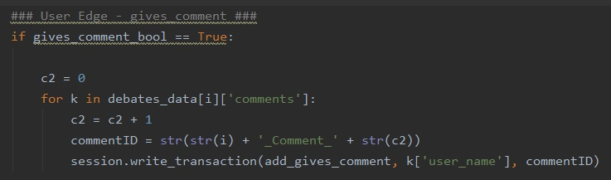
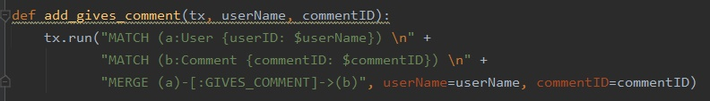
Graph Database Population
Node creation - users.json
Node creation - debates.json
Indexing
Edge creation - users.json
Edge creation - debates.json

Slide 7
Graph Database Exportation
Exportation using APOC library, a Neo4j lab project
Graphml of full data base
Graphml of User and Issues subset (used in the following)
Manual modification of the Graphml needed for GraphTool
<key id=”labels” for=”node” attr.name=”labels” attr.type=”string”/>
<key id=”label” for=”edge” attr.name=”label” attr.type=”string”/>

Slide 8
Preprocessing
Utilization of GraphTool via Docker (combability issues)
GraphTool and Neo4j handle a bidirectional edge as two unidirectional reciprocal edges
The data set contains 94.376 Friendships
44.804 are unidirectional due to privacy settings
331 are unjustified/faulty due to 187 malicious users
Approach 1: make all 45.135 unidirectional edges bidirectional (data conservative approach)

Slide 9
Descriptives
Friendship network (FN)
45.348 User nodes and 188.752 FRIENDS_WITH edges
28.737 components (mostly isolated nodes)
Largest component (LC):
16.382 User nodes (36,125 %)
187.478 FRIENDS_WITH edges (99,325 %)
Density (FN): 0,00018%
Density (LC): 0,0014%

Slide 10
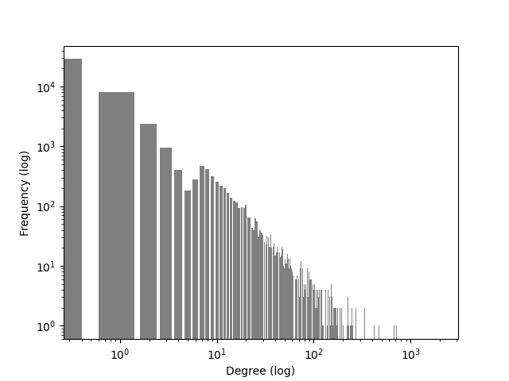
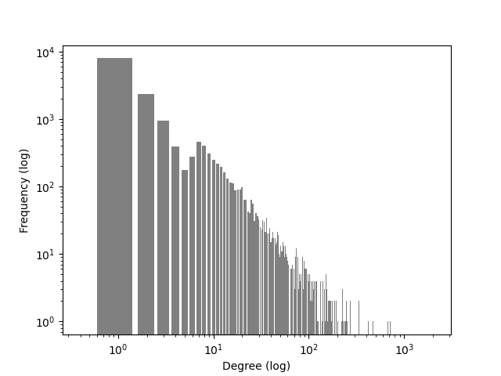
Descriptives
Maximum Degree (FN): 2.025
Average Degree (FN): 4,16
Maximum Degree (LC): 2.025
Average Degree (LC): 11,44

Slide 11
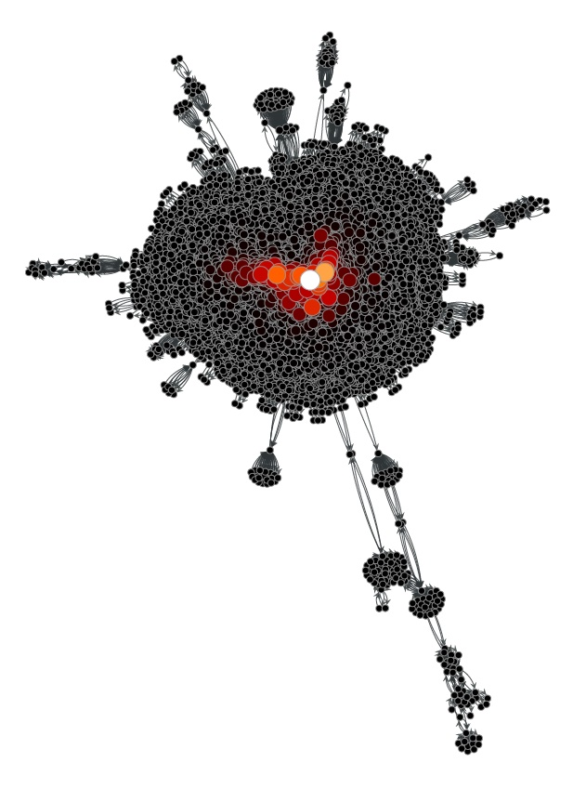
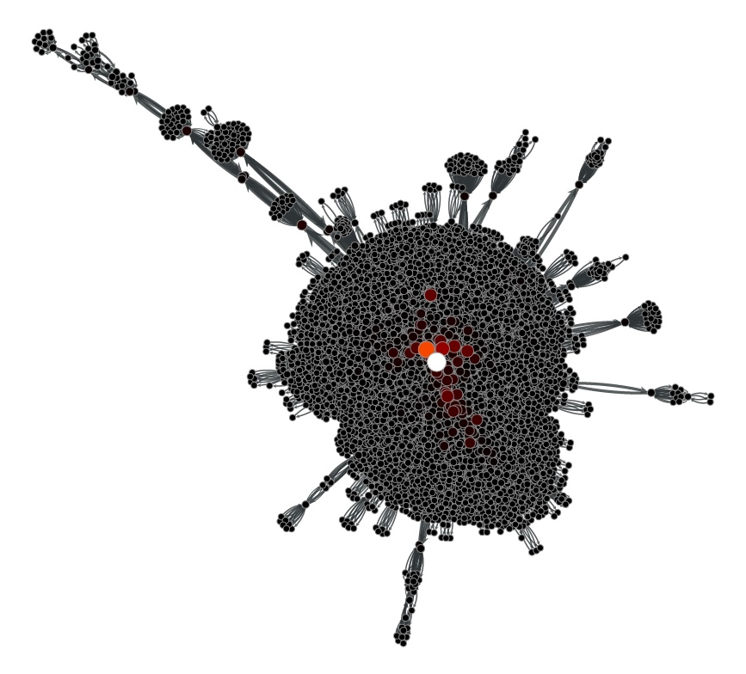
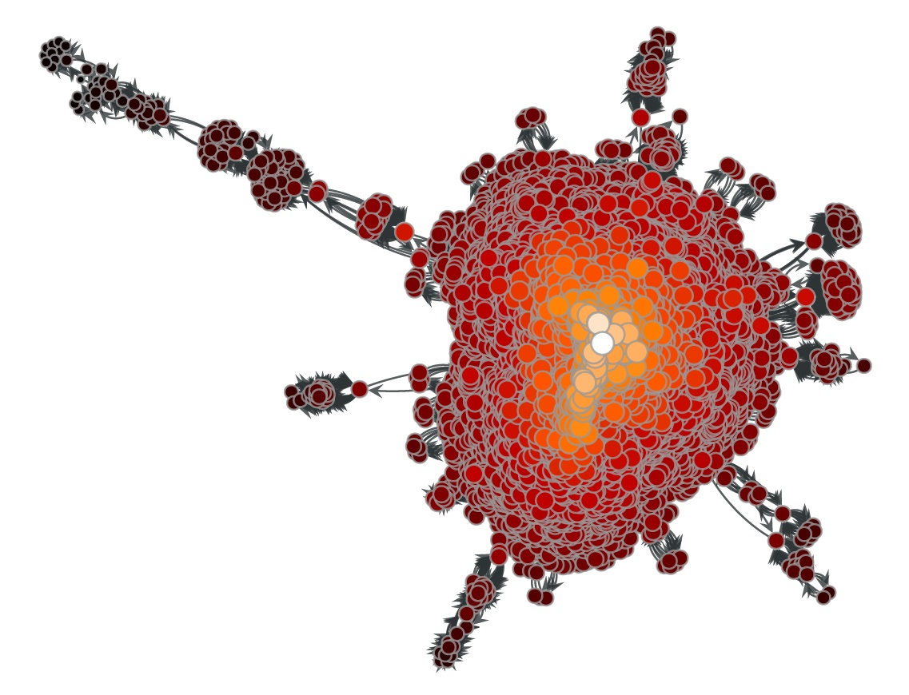
Descriptives
Closeness Centrality
Eigenvector Centrality
Node Betweenness Centrality

Slide 12
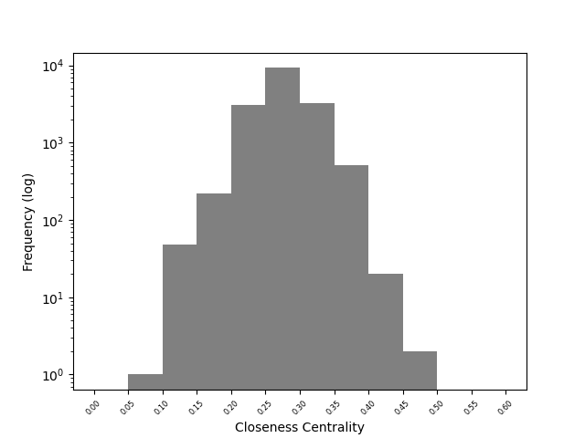
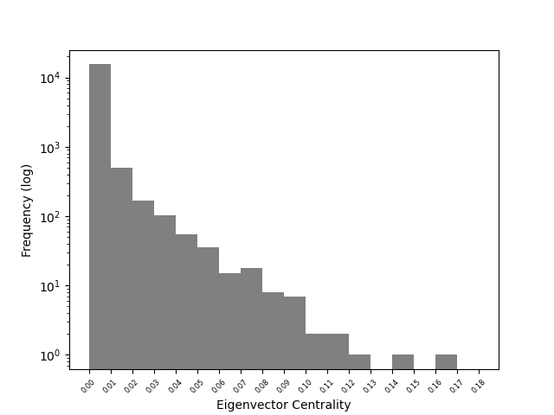
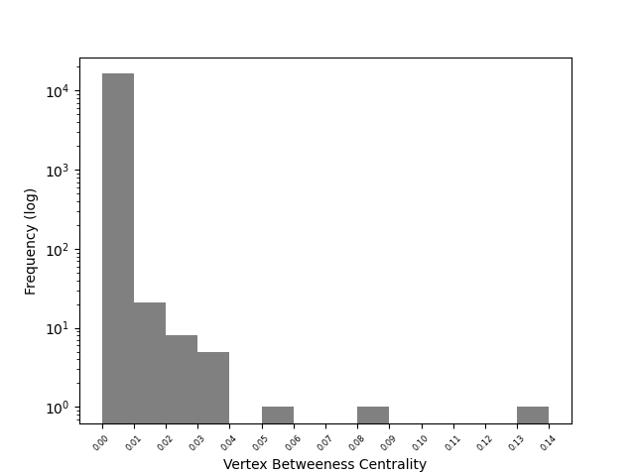
Descriptives
Closeness Centrality (LC)
Eigenvector Centrality (LC)
Node Betweenness Centrality (LC)
Average: 0,277
Average: 0,0024
Eigenvector (LC): 3028,057
Average: 0,00016

Slide 13
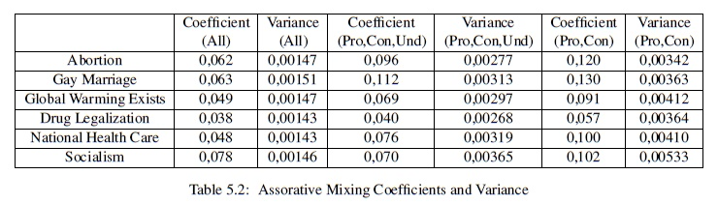
Assortative Mixing
Additional small preprocessing
Node feature transfer
Non-negative skalar values
Value range:
Pro
Con
Und (undecided)
N/S (not saying)
N/O (no opinion).

Slide 14
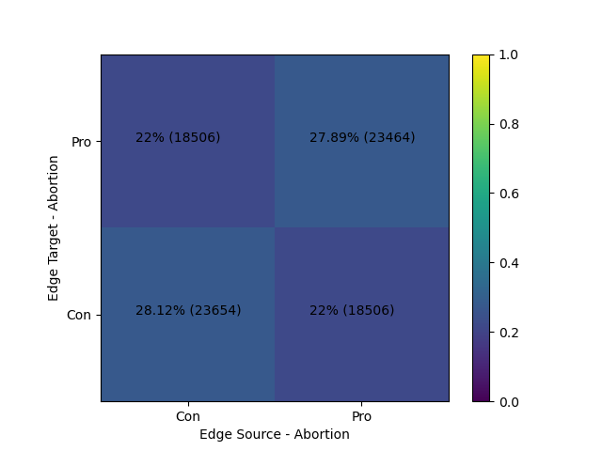
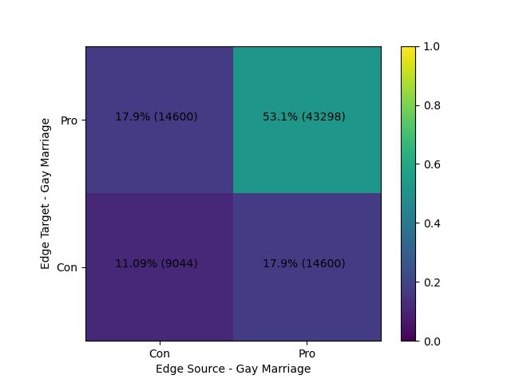
Assortative Mixing
Strong Opinion (Pro/Con) – Abortion
Strong Opinion (Pro/Con) – Gay Marriage
Con-Con: 23.654 / 6.798 = 3,47955
Pro-Pro: 23.464 / 6.877 = 3,41195
Con-Con: 9.044 / 3618 = 2,5
Pro-Pro: 43.298 / 8.756 = 4,945

Slide 15
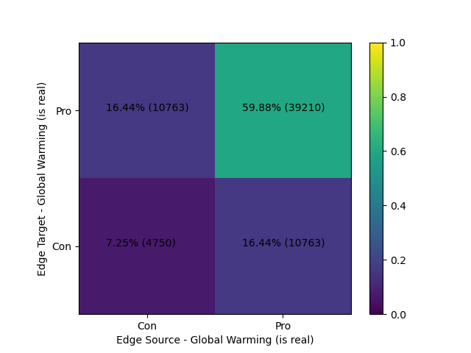
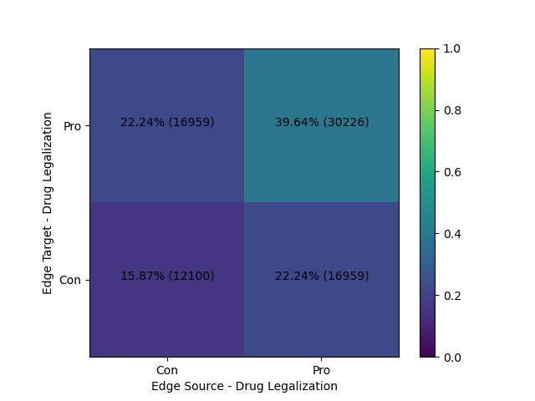
Assortative Mixing
Strong Opinion (Pro/Con) – Global Warming
Strong Opinion (Pro/Con) – Drug Legalization
Con-Con: 4.750 / 2.804 = 1,694
Pro-Pro: 39.210 / 7.925 = 4,948
Con-Con: 12.100 / 5.802 = 2,086
Pro-Pro: 30.226 / 6.207 = 4,89

Slide 16
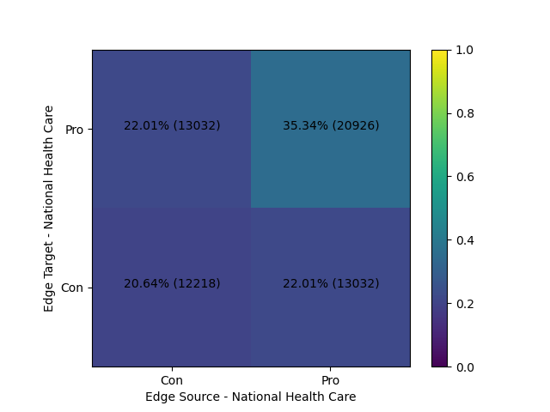
Assortative Mixing
Strong Opinion (Pro/Con) – National Health Care
Con-Con:
12.218 / 3.206 = 3,811
Pro-Pro:
20.926 / 5.873 = 3,563

Slide 17
Limitations
Graph Database:
Optimization of Neo4j population (utilizing APOC)
Overcoming anomalies in time dimension (contacting authors)
More fine-grained time representation (currently in year-grain)
Incorporating Issues nodes in User nodes
Preprocessing:
Revising approach 2 & 3 (arbitrary exclusion)

Slide 18
Limitations
Descriptives:
More Measures in general
Measures of graphs resulting from other preprocessing approaches
Assortative Mixing:
Normalization for inter-stance edges (not only intra)
More sophisticated normalization
More sophisticated measures in general
Investigating Progressiveness Score
I’m pretty sure the Score is accurate -> interesting pattern?

Slide 19
Lessons Learned
Familiarization with and more intuitive understanding of Neo4j and GraphTool
Experience in
Designing Graph Databases
Employing query language Cypher
Network analysis and manipulation
Python
Utilizing Docker to overcoming compatibility issues

Slide 20
Sources
[1] Esin Durmus and Claire Cardie. 2019. A Corpus for Modeling User and Language Effects in Argumentation on Online Debating. In Proceedings of the 57th Conference of the Association for Computational Linguistics. Florence, Italy. Association for Computational Linguistics.
[2] Esin Durmus and Claire Cardie. 2018. Exploring the Role of Prior Beliefs for Argument Persuasion. In Proceedings of the Conference of the North American Chapter of the Association for Computational Linguistics: Human Language Technologies (NAACL).
[3] http://www.cs.cornell.edu/~esindurmus/ddo.html Accessed: 2021-02-02
[4] https://www.debate.org/about/demographics/ Accessed: 2021-02-02

