Slide 1
PID-Based Line Following Robot
Individual Contribution Presentation — Coding & PID Algorithm Development
Robotics Project

Slide 2
Presented by:
Muhib Al Ahad
Reg ID: 22201207
Presented to:
Dr. Nazmun Nahid
Assistant Professor
University of Asia Pacific

Slide 3
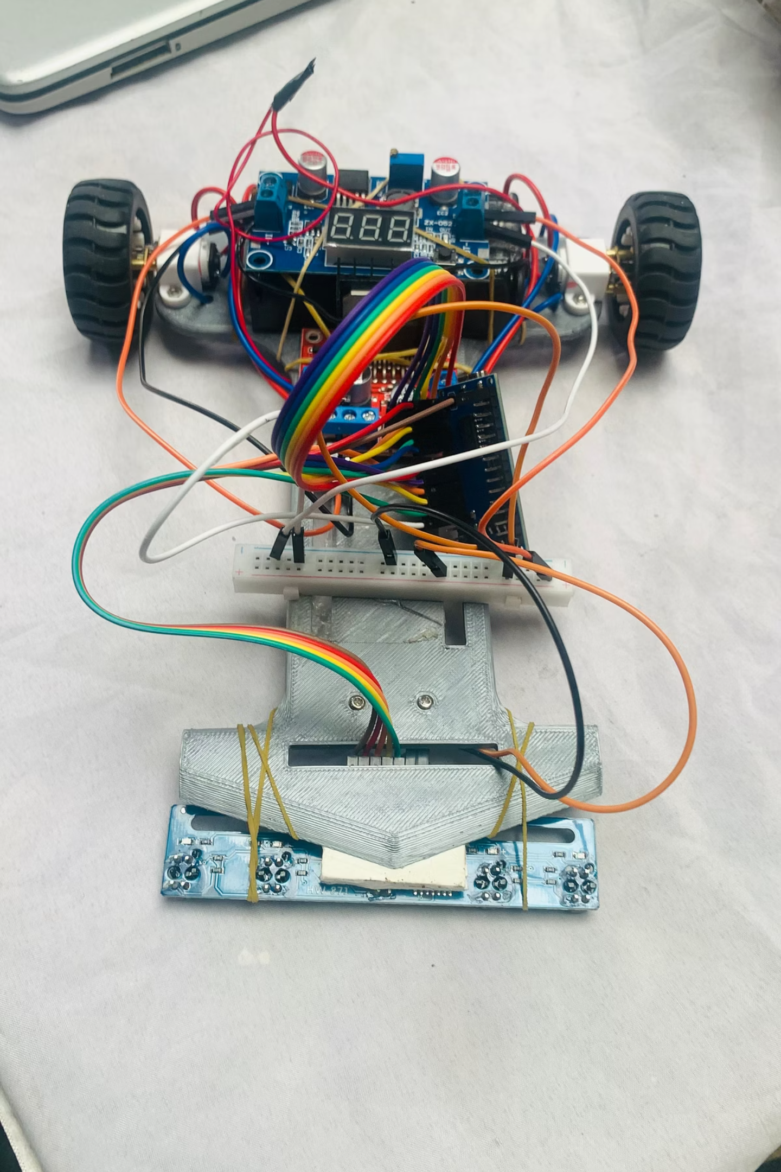
Executive Summary
What It Does
Why PID?
Key Result
Autonomously tracks a line using IR sensors and real-time motor correction
Proportional-Integral-Derivative control eliminates oscillation and ensures smooth, stable tracking
Achieved smooth, continuous line tracking with minimal deviation at speed

Slide 4




My Contribution
PID Algorithm
Hardware Integration
Developed the PID control loop in C++ for the Arduino NANO
Built and wired the IR sensor array, motor driver connections, buck converter, and Arduino NANO connections
Motor Speed Correction
Tuning & Optimization
Mapped PID output to differential PWM signals for the left and right motors
Iteratively tuned Kp, Ki, and Kd values while calibrating the hardware for stable performance

Slide 5

Algorithm Flow
START Initialize Sensors, Motors & PID Values WHILE robot is running Read IR Sensor Values Calculate Line Error Apply PID Control (P + I + D) Generate Correction Value Adjust Left & Right Motor Speed using PWM Move Robot Forward END WHILE
Kp = 7
Strong proportional response — fast correction
Ki = 0.001
Low integral — prevents drift without windup
Kd = 0.4
Moderate derivative — smooth, stable turns
Correction = (Kp × Error) + (Ki × Integral) + (Kd × Derivative)
Github Project Link here
The control loop runs continuously at a fixed sampling rate, enabling real-time correction with minimal latency.
Full Pseudocode & Flow Diagram here

Slide 6
Code Logic
getError()
moveForward()
int getError() {
int pos = 0, sum = 0;
for (int i=0; i<5; i++) {
pos += sensorVal[i] * weight[i];
sum += sensorVal[i];
}
return (pos / sum) - CENTER;
}
void moveForward(float correction) {
int leftSpeed = BASE + correction;
int rightSpeed = BASE - correction;
leftSpeed = constrain(leftSpeed, 0, 255);
rightSpeed = constrain(rightSpeed, 0, 255);
analogWrite(LEFT_PWM, leftSpeed);
analogWrite(RIGHT_PWM, rightSpeed);
}
PID()
float PID(int error) {
integral += error;
float deriv = error - prevError;
prevError = error;
return Kp*error
+ Ki*integral
+ Kd*deriv;
}

Slide 7
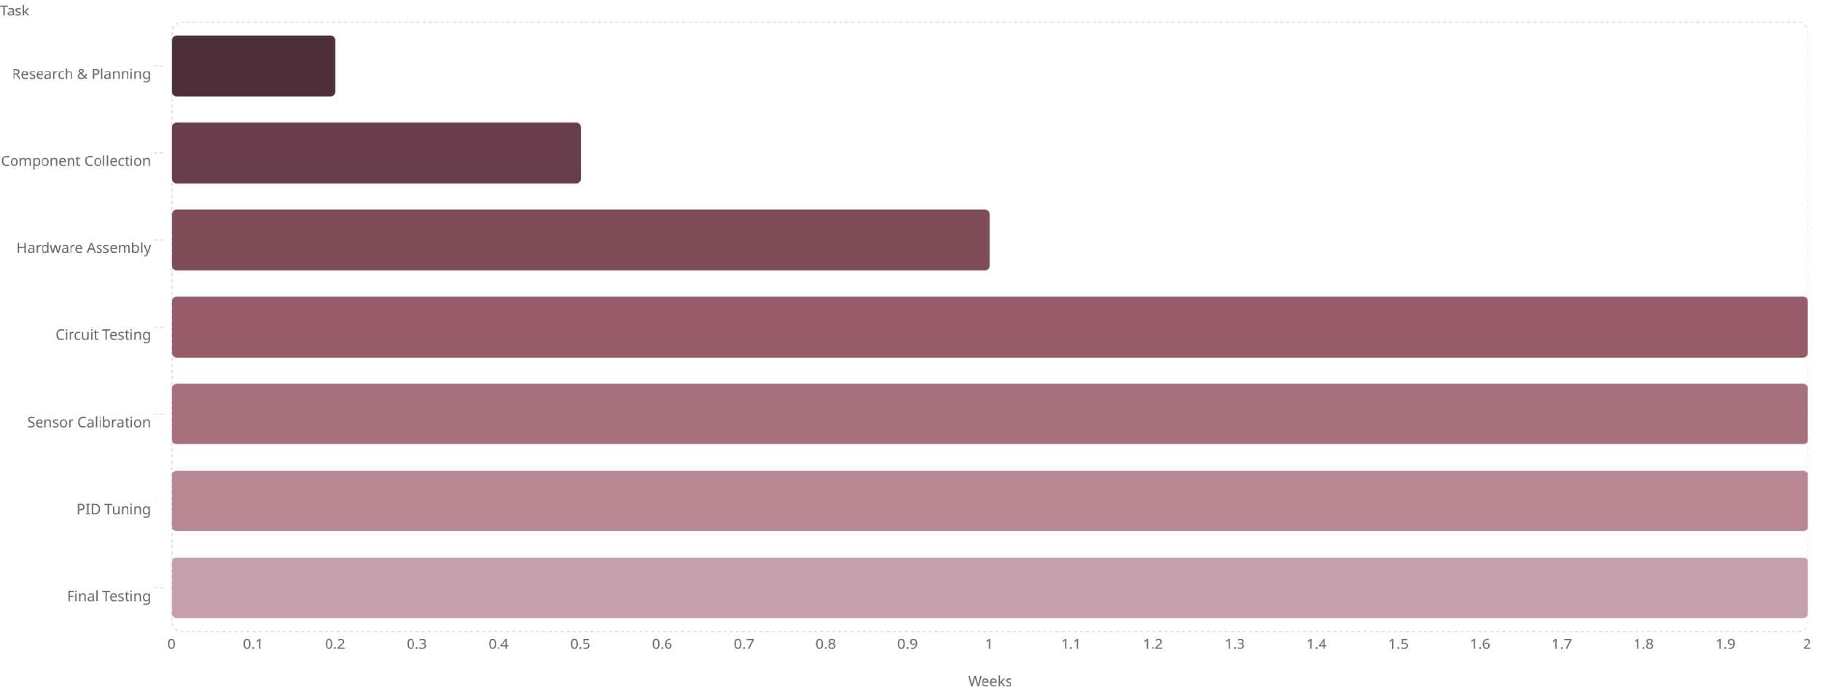
Project Timeline (Gantt)
Parallel workstreams: assembly and wiring done first, then iterative calibration and PID tuning before competition validation.

Slide 8
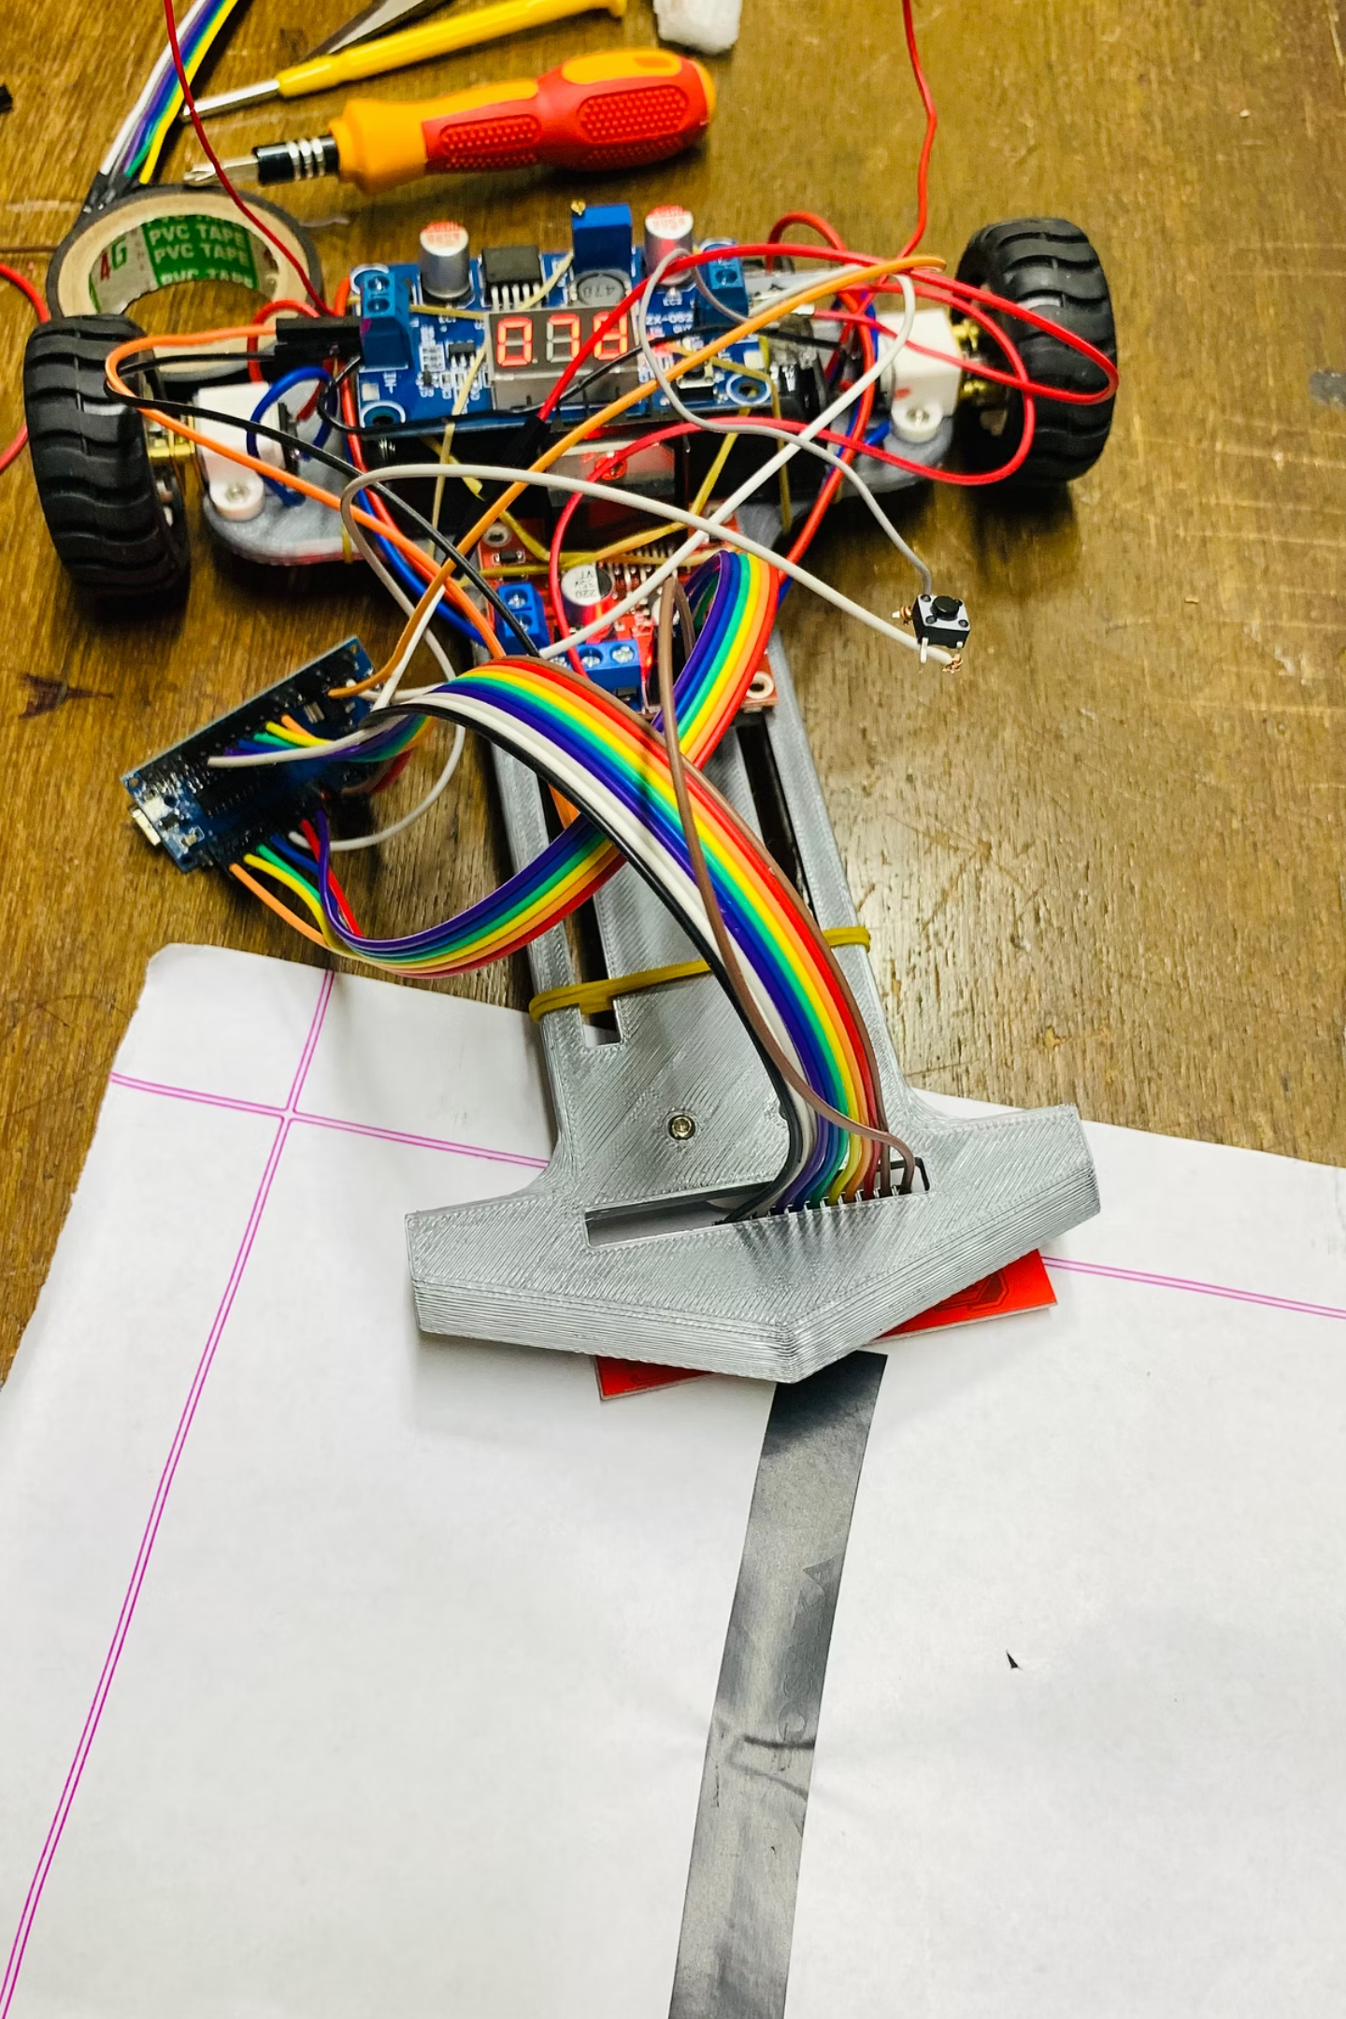
Conclusion & Future Scopes
Conclusion
Functional Line Tracking
Coding Impact
Software contribution was the core differentiator in robot performance
Achieved functional line tracking with room for improvement in accuracy and stability

Slide 9
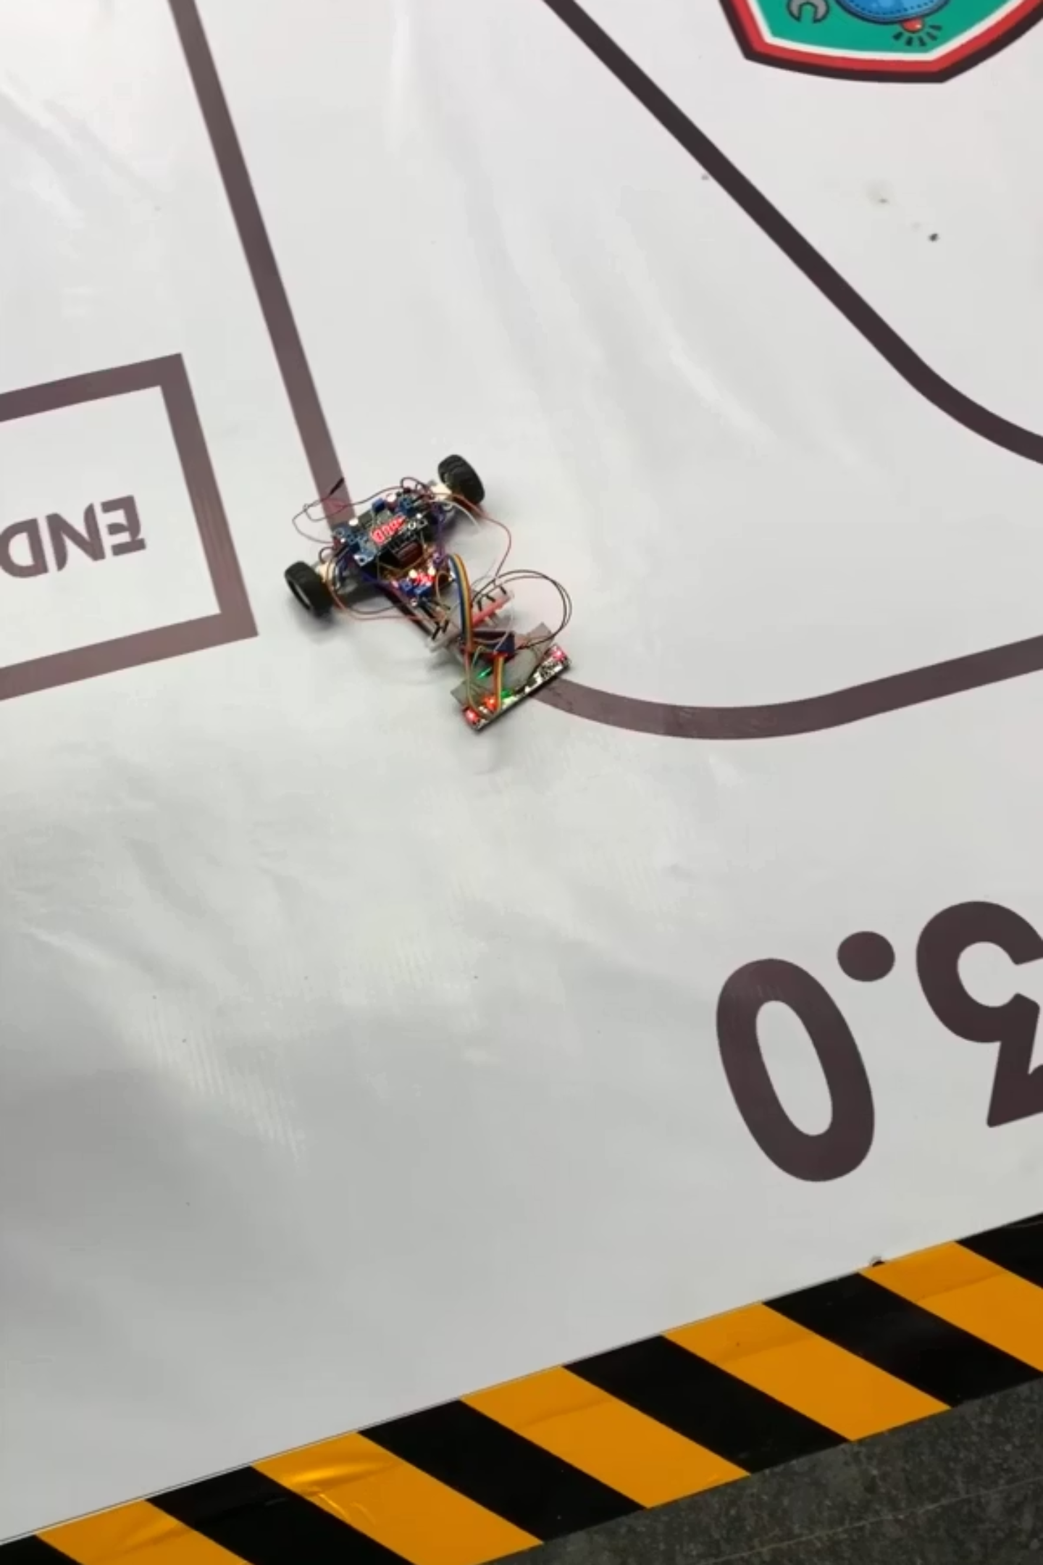

Conclusion & Future Scopes(Cont…)
Future Scopes
8-Sensor Array Upgrade
Code Stability
Migrate to Pololu 8-sensor array for better line detection coverage and edge cases
Refine PID tuning and control logic for more stable performance across varying conditions
Increase Motor Speed
Low-Light Filtering
Test robot performance at higher velocities to improve speed while maintaining accuracy
Enhance sensor robustness and filtering algorithms for reliable operation in varying lighting conditions
Robot Demo Video Here

Slide 10
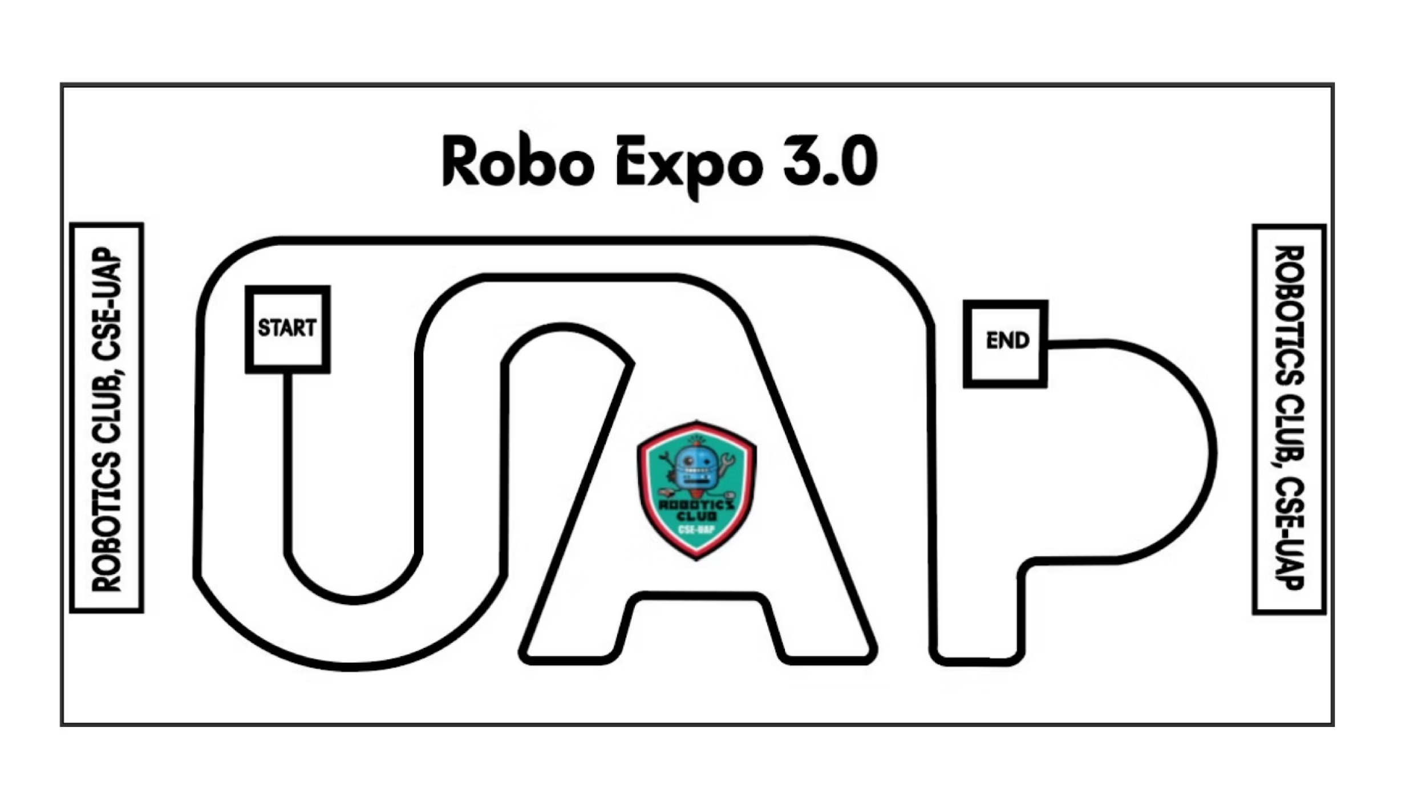

Slide 11
Thank You
Questions?

