Slide 1
Computer Organization & Assembly Language
Chapter 3

Slide 2
Flag Register:
The FLAGS register is the status register in Intel x86 microprocessors that contains the current state of the processor.
This register is 16 bits wide.
Nine individual bits called as flag are used to represent the 8086 processor state.
Flags are placed in FLAG Register.

Slide 3
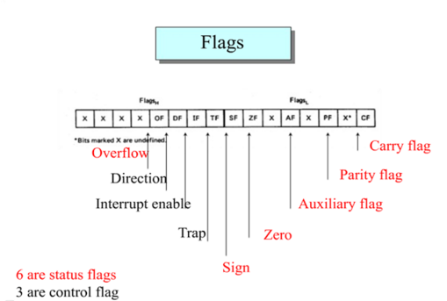

Slide 4
Category of FLAGS Registers:
There are 2 types of FLAGS register.
Status Flags:
Reflects the result of a computation. Located in bits: 0, 2, 4, 6, 7 and 11.
Control Flags:
Used to enable/disable certain operations of the processor. Located in bits 8, 9 and 10. 3

Slide 5
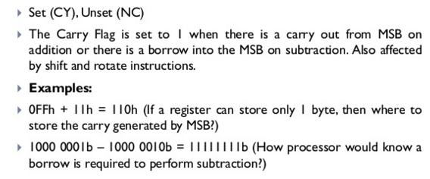
Carry Flag:

Slide 6
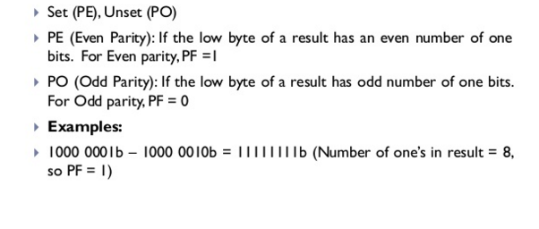
Parity Flag:

Slide 7
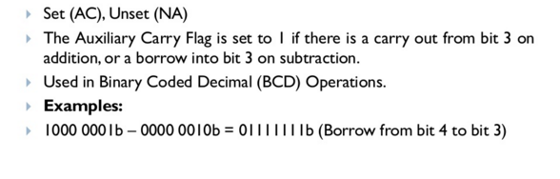
Auxiliary Carry Flag:

Slide 8
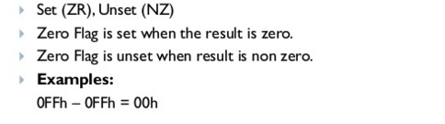
Zero Flag:

Slide 9
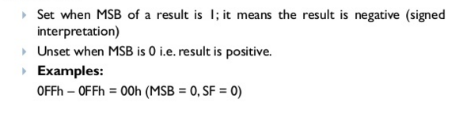
Sign Flag:

Slide 10
How the Processor indicates overflow?
The Processor sets:
Overflow Flag = 1 for Signed Overflow
Carry Flag = 1 for Unsigned Overflow

Slide 11
How the Processor determines that overflow occurred?
Unsigned Overflow:
Addition: Carry out from MSB
The correct Answer is largest than the biggest unsigned number FFFFh for a word and FFh for a byte.
Subtraction: Borrow into MSB
Signed Overflow:
Addition: Same sign but sum has a different sign (e.g.: when you add two positive numbers and answer is negative)
Subtraction: If result has different sign than expected
In Addition/Subtraction of two numbers with different signs, overflow is impossible.
E.g.:A + (-B) = A – B 16

Slide 12
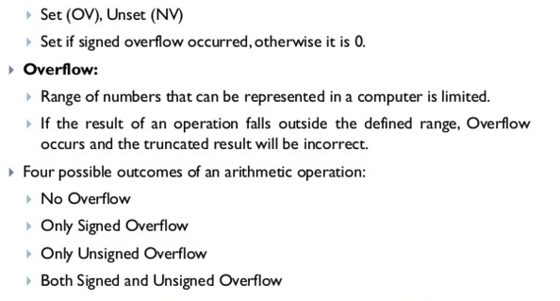
Overflow Flag:

Slide 13
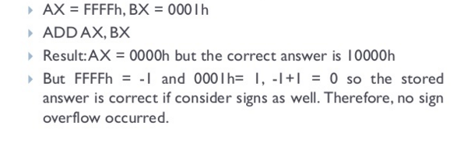
Example of Unsigned Overflow:

Slide 14
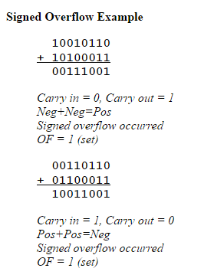
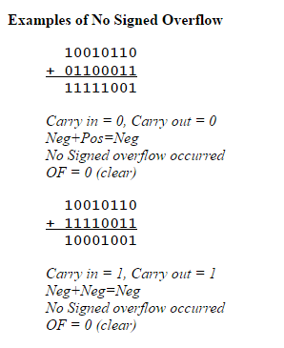
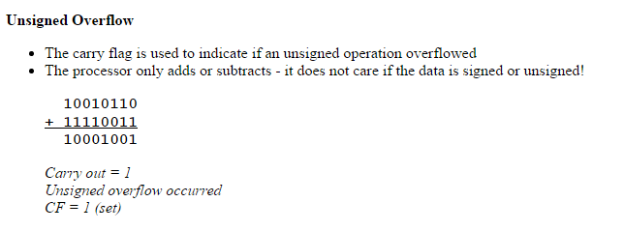

Slide 15
Control Flags:
There are 3 Control flags in 8086 processor.
Trap Flag
Interrupt Enable Flag
Direction Flag

Slide 16
Trap Flag:
A trap flag permits operation of a processor in single-step mode. If such a flag is available, debuggers can use it to step through the execution of a computer program.
The 8086 has no instruction to directly set or reset the trap flag.
These operations are done by pushing the flag register on the stack, changing the trap flag bit to what the programmer wants it to be, and then popping the flag register back off the stack.
If TF=1, the CPU automatically generates an internal interrupt after each instruction, allowing a program to be inspected as it executes instruction by instruction.

Slide 17
Trap Flag:
If trap flag is set to 1
CPU: Execute one instruction
CPU: Call debug interrupt (int 0x01)
INT 0x01:Execude debugger
Debugger: check for problems
INT 0x01: Return to CPU
CPU: Repeat

Slide 18
Interrupt Enable Flag:
If interrupt flag is set to 1,hardware interrupts are handle by the CPU.
If interrupt flag is set to 0,hardware interrupts are ignore by the CPU.

Slide 19
Direction Flag:
Often use for string processing.
The direction flag is a flag that controls the left-to- right or right-to-left direction of string processing, stored in the FLAGS register on all 8086 processors. It is bit number 10.
This flag is used to determine the direction (forward or backward) in which several bytes of data will be copied from one place in the memory
When it is set to 0 (using the clear-direction-flag instruction CLD),it means that instructions that auto increment the source index and destination index (like MOVS) will increase both of them.
In case it is set to 1 (using the set-direction-flag instruction STD), the instruction will decrease them.

Slide 20
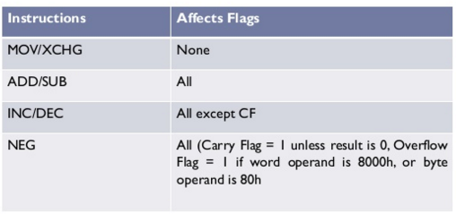
How Instructions Affect the Flags:

Slide 21
Example 5.1:
ADD AX, BX, where AX contains FFFFh, BX contains FFFFh
Solution:
Actual Result = 1FFFEh
Result stored in AX = FFFEh
Flags:
SF = 1 because the MSB is 1
PF = 0 because there are 7 (odd number) of 1 bits in the low byte of the result.
ZF = 0 because nonzero result
CF = 1 because there is a carry out of the MSB on addition
OF = 0 because the sign of the stored result is the same as that of the numbers being added (in binary addition, there is a carry into the MSB and carry out from MSB also)

Slide 22
Example 5.2:
ADD AL, BL where AL contains 80h, BL contains 80h
Solution:
Actual Result = 100h
Result in AL = 00h
Flags:
SF = 0 because MSB is 0
PF = 1 because all bits in result are 0
ZF = 1 because result is 0
CF = 1 because there is a carry out from MSB
OF = 1 because the numbers being added are both negative but the MSB in result is 0 (in binary addition, there is a no carry into the MSB but there is carry out from MSB.

Slide 23
Example 5.3:
SUB AX, BX where AX contains 8000h and BX contains 0001 h
Solution:
Actual Result = Result in AX = 7FFFh
Flags:
SF = 0 because MSB is 0
PF = 1, Parity is Even because there are 8 one bits in the low byte of the result
ZF = 0 because result is nonzero
CF = 0 because a smaller unsigned number is being subtracted from a larger one
OF =1 because we are subtracting a positive number from a negative number but the result is positive (wrong sign of result)

