Slide 1

IBM University Engagement | Project Submission
Project Title:Intelligent Classification of Rural Infrastructure Projects
Using IBM watsonx.ai AutoAI
Domain: Rural Infrastructure & Government Digital Governance
Student Name:
Ahad Gour
Mobile (WhatsApp):
9588435658
Email ID:
ahadgour0211@gmail.com
Institute:
MIT Academy of Engineering

Slide 2
Problem Statement
Intelligent Classification of Rural Infrastructure Projects
The Pradhan Mantri Gram Sadak Yojana (PMGSY) is a flagship rural development program in India, initiated to provide all-weather road connectivity to eligible unconnected habitations. Over the years, the program has evolved through different phases or schemes (PMGSY-I, PMGSY-II, RCPLWEA, etc.), each with potentially distinct objectives, funding mechanisms, and project specifications.
For government bodies, infrastructure planners, and policy analysts, efficiently categorizing thousands of ongoing and completed projects is crucial for effective monitoring, transparent budget allocation, and assessing the long-term impact of these schemes. Manual classification is time-consuming, prone to errors, and scales poorly.
Your specific task is to design, build, and evaluate a machine learning model that can automatically classify a road or bridge construction project into its correct PMGSY_SCHEME based on its physical and financial characteristics.
2

Slide 3
Proposed Solution
IBM watsonx.ai Studio – AutoAI powered classification pipeline
Step 1 – Data Collection
Historical PMGSY sanction records (state, district, road works sanctioned, length, bridges) are compiled and uploaded to IBM watsonx.ai as training data.
Step 2 – AutoAI Pipeline
AutoAI automatically performs data preprocessing, feature engineering, algorithm selection and hyperparameter optimization no manual coding needed.
Step 3 – Model Selection
Multiple pipelines (Random Forest, XGBoost) are ranked by cross-validated accuracy. Best pipeline: Batched Tree Ensemble Classifier (XGB) - Pipeline 10.
Step 4 – Scheme Prediction
Deployed model classifies each new sanction record into the correct PMGSY scheme (PMGSY-I / PMGSY-II / RCPLWEA) via a live REST API endpoint.
3

Slide 4
Technology Used
IBM Cloud / Cloud Pak for Data
Provides infrastructure to build, train, deploy and scale the PMGSY classifier secure, reliable and managed environment with one-click online deployment.
ML Algorithm / Model Used
XGB Classifier → enhanced to Batched Tree Ensemble Classifier by AutoAI (gradient-boosted decision trees with ensemble batching specialization INCR).
Accuracy Obtained
92.4% cross-validation accuracy (best pipeline: Pipeline 10). Pipeline 9 & 8 also achieved 92.4% without batching.
Enhancements & Hyperparameter Tuning
HPO-1 → Feature Engineering (FE) → HPO-2 → BATCH ensemble applied progressively across 10 generated pipelines within 7 minutes total.
4

Slide 5
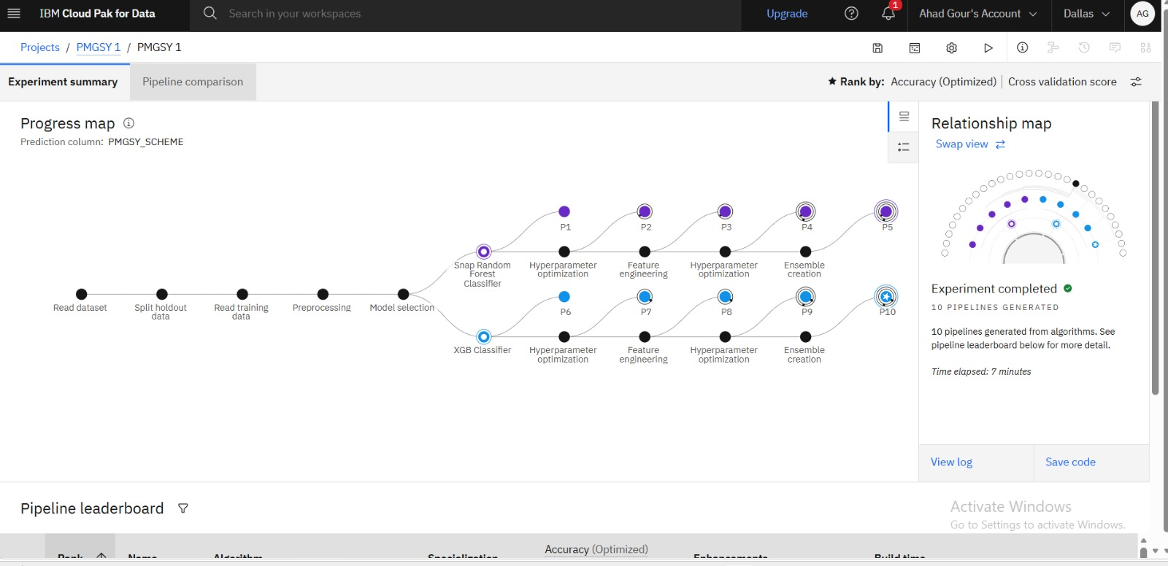
Training Screenshot
AutoAI Progress Map : Snap Random Forest & XGB Classifier pipelines trained on PMGSY_SCHEME
IBM Cloud Pak for Data: PMGSY 1 experiment: 10 pipelines generated in 7 minutes.
5

Slide 6
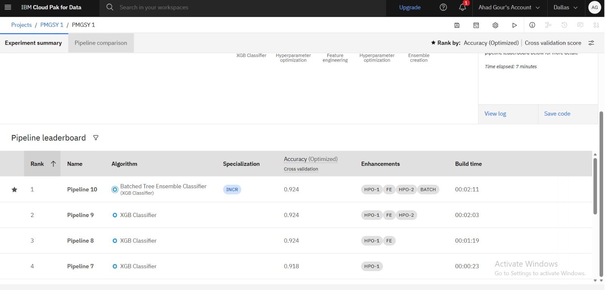
Best Model Screenshot
Pipeline Leaderboard : Pipeline 10: Batched Tree Ensemble (XGB) ranked #1 with 92.4% accuracy
Enhancements: HPO-1 → Feature Engineering → HPO-2 → BATCH. Build time: 00:02:11.
6

Slide 7
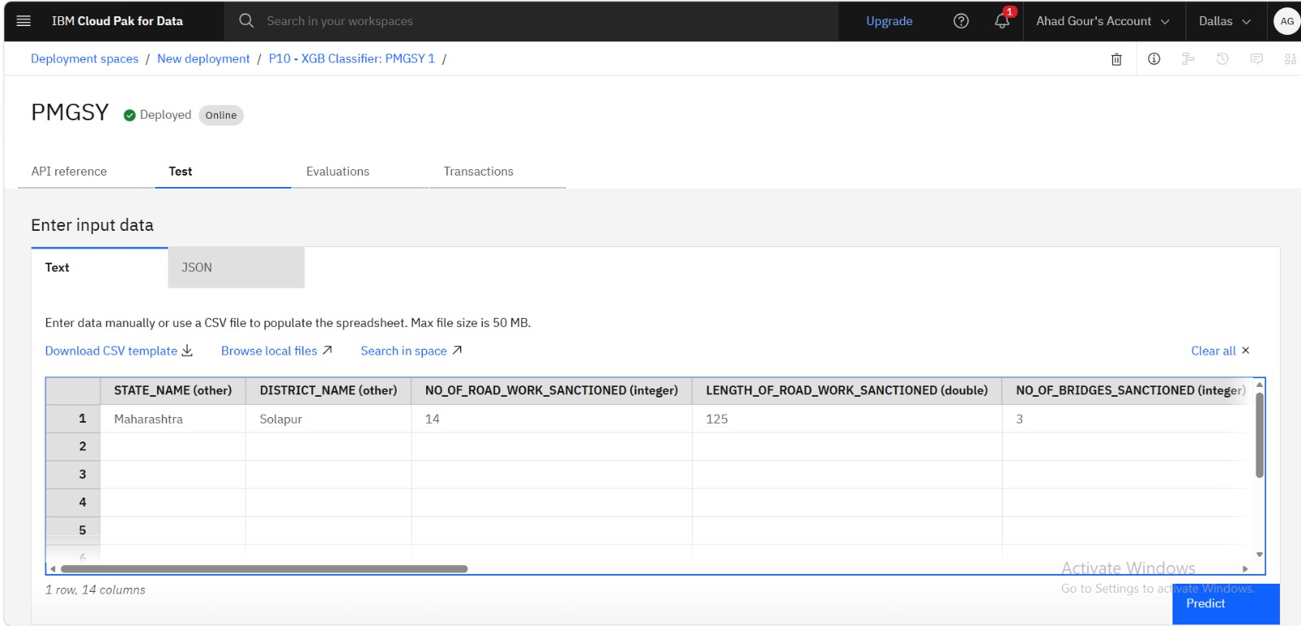
Testing Screenshot
Deployed Model (Online) : Sample input data entered for prediction
Input: State=Maharashtra, District=Solapur, 14 road works, 125 km length, 3 bridges sanctioned.
7

Slide 8
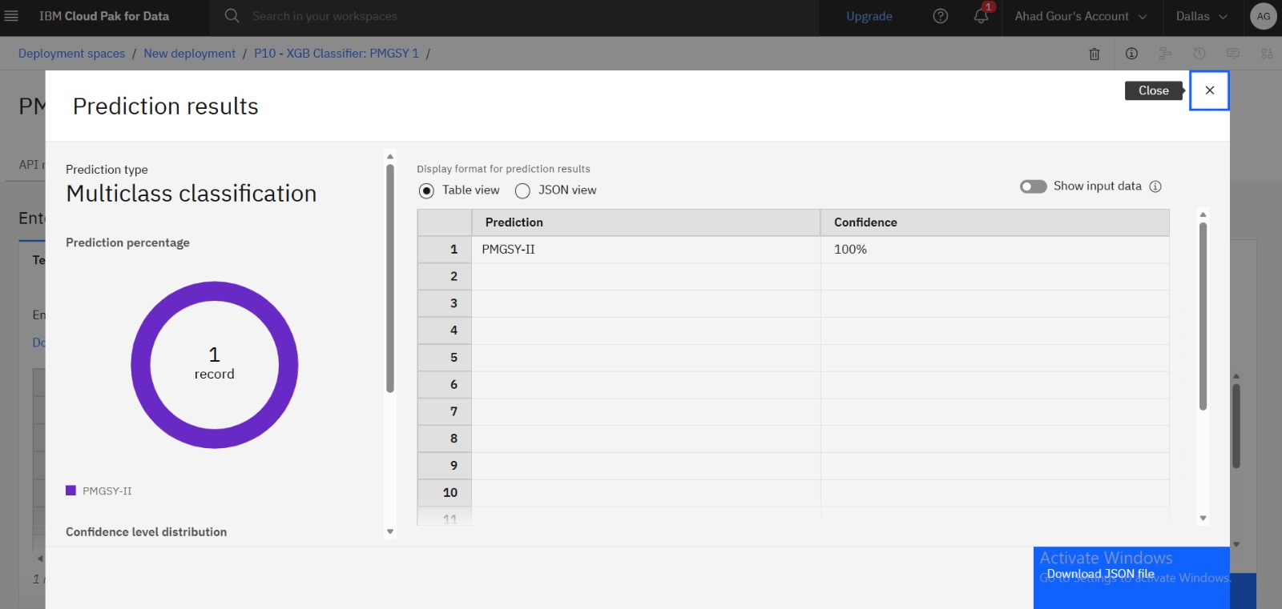
Testing Screenshot :- Prediction Result
Multiclass Classification result returned by deployed PMGSY Classifier
Predicted scheme: PMGSY-II | Confidence: 100%
8

Slide 9
Novelty and Uniqueness
1
Automates PMGSY scheme identification end-to-end, removing slow and error-prone manual classification of sanction records.
2
Uses IBM watsonx.ai AutoAI to auto-discover, tune and batch the best ML model minimal hand-written code required.
3
Single platform classifies road sanction works across all PMGSY phases (PMGSY-I, PMGSY-II, RCPLWEA) simultaneously.
4
Automated feature engineering surfaces hidden patterns across state, district, road length and bridge-sanction data.
5
Ensemble batching (BATCH) on top of dual hyperparameter runs pushes accuracy to 92.4% consistent, unbiased results.
6
REST API deployment allows direct integration into any government portal for real-time scheme prediction.
9

Slide 10
GitHub Repository
Public GitHub repository created with README enabled.
Repository URL: AhadGour/PMGSY-Scheme-Classification-ML: Intelligent Classification of Rural Road Infrastructure Projects under PMGSY using Machine Learning - IBM Watson AutoAI
Files uploaded to the repository:
1. Data.csv — PMGSY sanction dataset used for model training
2. ProblemStatement.pdf — Formal problem statement document
3. PMGSY_Project_Presentation.pptx — This project presentation
4. PMGSY_AutoAI_Notebook.ipynb — Python notebook exported from IBM Cloud
10

Slide 11
Future Scope
1
Integrate with official PMGSY / Ministry of Rural Development portals to automate end-to-end sanction verification and scheme tagging.
2
Extend the model to cover additional rural infrastructure schemes enabling a unified AI-based public-works recommendation platform.
3
Connect real-time data feeds from state PWDs and treasury systems to improve fund-tracking accuracy and detect anomalies or fraud.
4
Use advanced IBM watsonx.ai foundation models to continuously retrain and improve prediction accuracy as new sanction data arrives.
5
Scale the solution nationwide across all states/UTs for faster, transparent and data-driven rural connectivity planning.
6
Add a GIS/geospatial dashboard layer to visualize sanctioned vs completed road works mapped against scheme predictions.
11

Slide 12

Certificates Earned
IBM SkillsBuild Lab: Getting Started With Artificial Intelligence
12

Slide 13
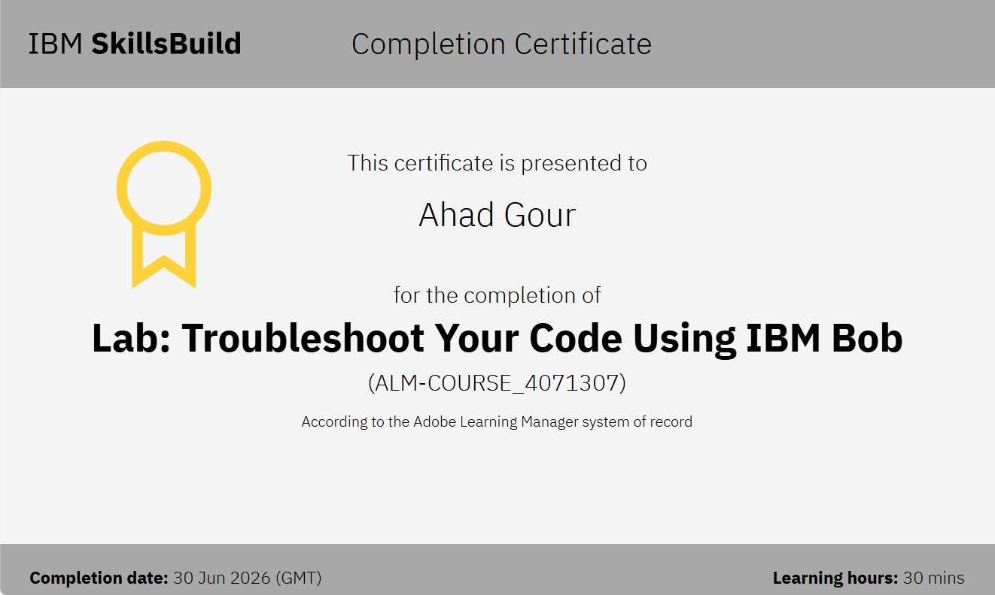
Certificates Earned
IBM SkillsBuild Lab: Troubleshoot Your Code Using IBM Bob
12

Slide 14
Thank You!
AI-Powered Classification of PMGSY Road Scheme Eligibility
Ahad Gour | 9588435658 | ahadgour0211@gmail.com
MIT Academy of Engineering

