Slide 1
GOVERNED AI WORKFLOW / ENGINEERING REFERENCE
AI should not sign
its own approval.
Bounded investigation. Independent review.
Recoverable execution.
1.1.0-rc.1 | SYNTHETIC-DATA SANDBOX
Ahad Porkar / Governed AI Workflow / Release candidate
01 / 08
Notes:
[Sources]
Local implementation and tests: evidence/verification.json, evidence/demo/crash-recovery.json, evidence/evaluation/baseline-results.json.
UI asset: docs/assets/workspace-en.png or workspace-de.png, synthetic Chromium DOM harness; not native-navigation verification.
Implementation boundary: docs/en/testing.md and docs/en/integration.md.
[/Sources]

Slide 2
GOVERNED AI WORKFLOW / ENGINEERING REFERENCE
One exception.
Explicit authority.
An order cannot be fulfilled. The customer asks for a resolution.
01
02
03
Refund
Cancel
Change supplier
Only within the remaining
captured balance.
Only when payment and
fulfillment state allow it.
Only approved, in-stock
alternatives within policy.
Unclear intent or unavailable evidence? Escalate. Do not improvise authority.
Ahad Porkar / Governed AI Workflow / Release candidate
02 / 08
Notes:
[Sources]
Local implementation and tests: evidence/verification.json, evidence/demo/crash-recovery.json, evidence/evaluation/baseline-results.json.
UI asset: docs/assets/workspace-en.png or workspace-de.png, synthetic Chromium DOM harness; not native-navigation verification.
Implementation boundary: docs/en/testing.md and docs/en/integration.md.
[/Sources]

Slide 3
GOVERNED AI WORKFLOW / ENGINEERING REFERENCE
The model proposes.
The system controls the effect.
01
02
03
04
Investigate
>
Validate
>
Review
>
Execute
Four case-scoped
read-only tools.
Deterministic rules
and strict schema.
Different person.
Exact action digest.
Recheck grant,
versions and expiry.
No refund tool in the model context. No approval granted by a browser field.
Ahad Porkar / Governed AI Workflow / Release candidate
03 / 08
Notes:
[Sources]
Local implementation and tests: evidence/verification.json, evidence/demo/crash-recovery.json, evidence/evaluation/baseline-results.json.
UI asset: docs/assets/workspace-en.png or workspace-de.png, synthetic Chromium DOM harness; not native-navigation verification.
Implementation boundary: docs/en/testing.md and docs/en/integration.md.
Ollama native tool-calling protocol: https://docs.ollama.com/capabilities/tool-calling (accessed 2026-10-12).
[/Sources]

Slide 4
GOVERNED AI WORKFLOW / ENGINEERING REFERENCE
Crash the worker.
Keep one effect.
After the commit. Before acknowledgement. Then restart and retry.
1
2
1
committed sandbox effect
execution attempts
same receipt on replay
Verified with an actual standalone worker halt and server restart.
Not a real payment-provider or Camunda fault-injection result.
Ahad Porkar / Governed AI Workflow / Release candidate
04 / 08
Notes:
[Sources]
Local implementation and tests: evidence/verification.json, evidence/demo/crash-recovery.json, evidence/evaluation/baseline-results.json.
UI asset: docs/assets/workspace-en.png or workspace-de.png, synthetic Chromium DOM harness; not native-navigation verification.
Implementation boundary: docs/en/testing.md and docs/en/integration.md.
[/Sources]

Slide 5
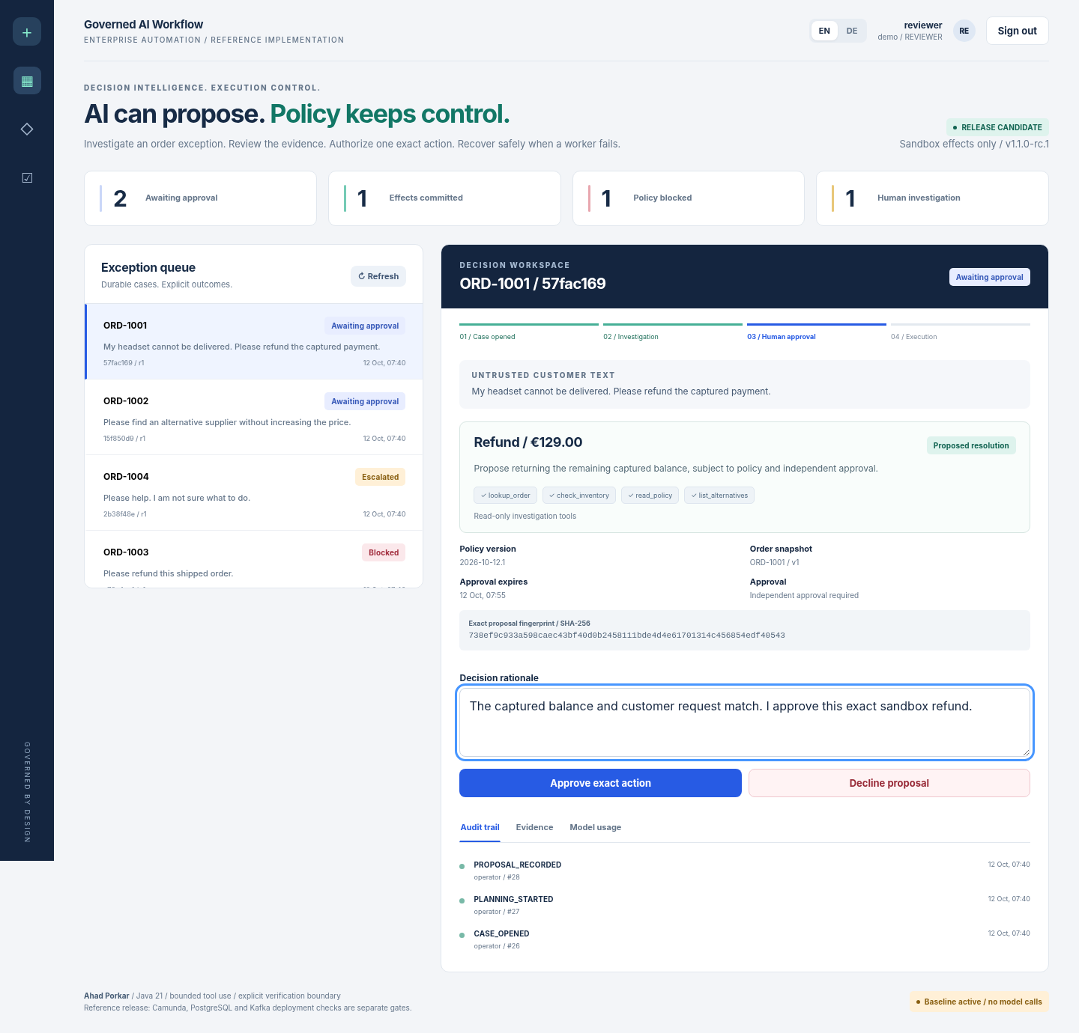
GOVERNED AI WORKFLOW / ENGINEERING REFERENCE
A review console,
not a chat transcript.
Original request.
Exact amount.
Policy and evidence.
Approval expiry.
Audit and receipt.
English / German. Synthetic cases.
Screenshot from the disclosed Chromium DOM harness.
Ahad Porkar / Governed AI Workflow / Release candidate
05 / 08
Notes:
[Sources]
Local implementation and tests: evidence/verification.json, evidence/demo/crash-recovery.json, evidence/evaluation/baseline-results.json.
UI asset: docs/assets/workspace-en.png or workspace-de.png, synthetic Chromium DOM harness; not native-navigation verification.
Implementation boundary: docs/en/testing.md and docs/en/integration.md.
[/Sources]

Slide 6
GOVERNED AI WORKFLOW / ENGINEERING REFERENCE
Evidence, with boundaries.
167
106
29
Java contracts
Real HTTP / process
passing checks
9
23
Browser DOM harness
Repository safeguards
Still to verify: native browser networking/CSP, the external stack,
and a live model. No invented coverage percentage.
Ahad Porkar / Governed AI Workflow / Release candidate
06 / 08
Notes:
[Sources]
Local implementation and tests: evidence/verification.json, evidence/demo/crash-recovery.json, evidence/evaluation/baseline-results.json.
UI asset: docs/assets/workspace-en.png or workspace-de.png, synthetic Chromium DOM harness; not native-navigation verification.
Implementation boundary: docs/en/testing.md and docs/en/integration.md.
[/Sources]

Slide 7
GOVERNED AI WORKFLOW / ENGINEERING REFERENCE
The baseline fails.
We publish where.
33 / 48
40 / 48
exact proposals
acceptable dispositions
48 labelled EN/DE cases. Partial amounts, quoted intent and restrictions expose weaknesses.
Zero live-model calls in this result; no effects executed.
Ahad Porkar / Governed AI Workflow / Release candidate
07 / 08
Notes:
[Sources]
Local implementation and tests: evidence/verification.json, evidence/demo/crash-recovery.json, evidence/evaluation/baseline-results.json.
UI asset: docs/assets/workspace-en.png or workspace-de.png, synthetic Chromium DOM harness; not native-navigation verification.
Implementation boundary: docs/en/testing.md and docs/en/integration.md.
[/Sources]

Slide 8
GOVERNED AI WORKFLOW / ENGINEERING REFERENCE
Controlled intelligence.
Inspectable engineering.
A narrow reference for workflow, integration
and reliable AI systems.
Next gate: real stack acceptance and held-out model evaluation.
Source code and implementation notes
github.com/AhadPorkar/bpmn-order-workflow
Ahad Porkar / Governed AI Workflow / Release candidate
08 / 08
Notes:
[Sources]
Local implementation and tests: evidence/verification.json, evidence/demo/crash-recovery.json, evidence/evaluation/baseline-results.json.
UI asset: docs/assets/workspace-en.png or workspace-de.png, synthetic Chromium DOM harness; not native-navigation verification.
Implementation boundary: docs/en/testing.md and docs/en/integration.md.
[/Sources]

