Slide 1
AnimaticVision: AI Powered Story to Animation
Muhammad Abdullah (2280214)
Atta ur Rehman (2280138)
Muhammad Humam Khan (2180125)
Supervisor: Ms. Tehreem Saboor
Department of Computer Science, SZABIST Islamabad
BSSE (Fall 2025)

Slide 2
Team Structure
S.No | Team Member | Role
1 | ATTA UR REHMAN | Project Manager MERN Developer
2 | Muhammad Abdullah | QA Engineer Frontend Developer
3 | Muhammad Humam Khan | Research AI/LLM Engineer

Slide 3
Project Description
Animatic Vision: is AI-powered platform that converts written stories into animated videos.
Uses LLMs + LangGraph for story analysis and scenes breakdown.
Generates avatars with lip-sync, backgrounds, and dynamic scenes.
Provides an end-to-end pipeline:
Text → Avatars → Scenes → Video.
Designed for filmmakers, educators, marketers, and storytellers.
Aims to make animation faster, cheaper, and accessible to non-experts.

Slide 4
Application / Literature Review
Existing Tools
Wav2Lip-HD
✔ Accurate lip-syncing + video enhancement
❌ GPU intensive, works only on provided clips
MuseTalk
✔ Real-time, multilingual lip-sync (30+ FPS)
❌ Low resolution, single-face videos only
FaceFusion
✔ Realistic face swapping with expressions
❌ Struggles with extreme poses, raises ethical issues

Slide 5
Application / Literature Review
Gap Identified
Current tools handle isolated tasks only (lip-sync, face swap, enhancement).
No complete story-to-animation pipeline exists.
Limited scene generation & creative flexibility
Hard for non-experts to use
Our project fills this by offering an integrated platform:
Text → Avatars → Scenes → Animated Video.

Slide 6
Problem Statement
Traditional animation is time-consuming, costly, and requires expert skills. Current AI-based solutions only handle isolated tasks like lip-syncing or face swapping, but they lack integration for a complete story-to-animation pipeline. As a result, creators, educators, and marketers face barriers in producing engaging animated content quickly and affordably. There is a clear need for a unified AI-powered platform that transforms written stories directly into fully animated videos with avatars, scenes, and lip-syncing in one streamlined workflow.

Slide 7
Scope and Objectives
Scope:
Development of an AI-powered story-to-animation platform
Covers text understanding, avatar creation, lip-sync, scene generation, and video synthesis
Provides a web-based interface for easy access and export of animations
Target users: filmmakers, educators, marketers, and storytellers

Slide 8
Scope and Objectives
Objectives:
Integrate LLMs + LangGraph to process and structure story scripts
Implement lip-syncing avatars for realistic speech animation
Build a seamless pipeline: text → image → video
Design a user-friendly interface (no technical expertise required)
Ensure scalability, customization, and creative freedom

Slide 9
Targeted Market / Audience
Filmmakers & Animators
Rapid visualization of scripts & storyboards
Educators & Trainers
Create engaging lessons & interactive content
Marketing & Advertising Agencies
Personalized promotional videos at scale
Content Creators & Storytellers
Quick prototyping of narrative ideas

Slide 10
Development Methodology
1. Research Phase
Review existing AI animation tools and pipelines.
Study LLMs, LangGraph, lip-sync models, and video synthesis.
Collect user needs from filmmakers, creators, and marketers.
2. Design Phase
Define system architecture (modules for text, avatars, scenes, video).
Create workflow design from text input → final animation.

Slide 11
Development Methodology
Develop UI mockups and prototypes.
Select suitable AI models for each module
Development Phase
Backend: APIs for text analysis, image generation, and video synthesis.
Frontend: Interactive web interface for input and customization.
Integration: Connect LLMs, lip-sync, avatars, and scene generation into one pipeline.

Slide 12
Development Methodology
4. Testing & Optimization
Test for accuracy, performance, and user experience.
Optimize for GPU efficiency, scalability, and speed.
Fix bugs and improve system stability.

Slide 13
Tools And Techniques
Programming & Frameworks
Python – AI models, backend logic
MERN Stack (MongoDB, Express, React, Node.js) – Web application development
LangGraph – Workflow orchestration for story-to-scene breakdown
AI Models & Libraries
Large Language Models (LLMs) – Text understanding & script structuring
Wav2Lip / MuseTalk – Lip-syncing for avatars
Stable Diffusion / GANs – Image & scene generation

Slide 14
Tools And Techniques
Real-ESRGAN – Video & image super-resolution
Stable Diffusion / GANs – Image & scene generation
Real-ESRGAN – Video & image super-resolution
Deployment & Infrastructure
Cloud-based GPU servers – Model inference & video rendering
APIs – Integration of AI modules
Web Interface – Multi-platform accessibility

Slide 15
Tools And Techniques
Development Tools
VS Code / PyCharm – Coding IDEs
GitHub – Version control & collaboration
Figma / Wireframing tools – UI/UX design

Slide 16
Work Distribution
Sr. No. | Team Member | Key Responsibilities | Timeline (Weeks)
1 | Muhammad Humam Khan | R&D of LLM Models, NLP Implementation | 1–6
2 | Muhammad Abdullah | Frontend Development, UI Prototyping | 3–6
3 | Atta-ur-Rehman | Backend Development, API Integration | 3–7
4 | Muhammad Humam Khan | LLM Model Fine-Tuning, Text-to-Animation Pipeline | 4–8

Slide 17
Work Distribution
Sr. No. | Team Member | Key Responsibilities | Timeline (Weeks)
5 | Muhammad Abdullah | QA Testing, Bug Fixing | 7–10
6 | Atta-ur-Rehman | System Optimization, Deployment & Documentation | 8–12

Slide 18
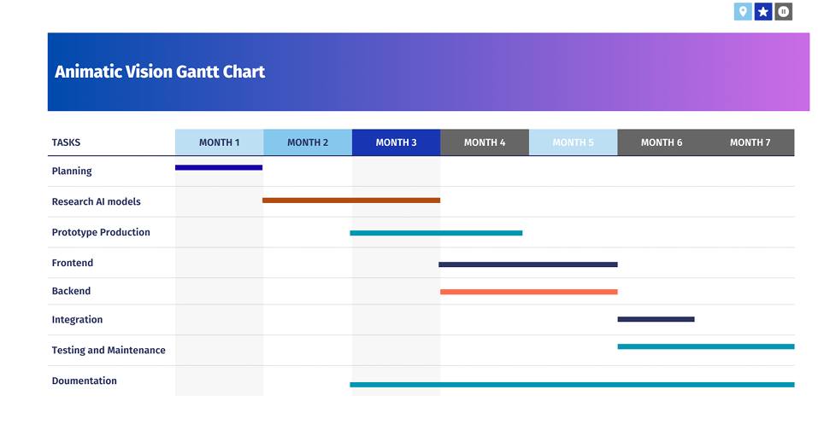
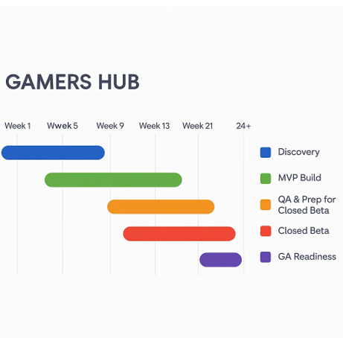
Work Plan (Gantt Chart)

Slide 19
References

Slide 20
Thank You
Department of Computer Science, SZABIST Islamabad
BSSE (Fall 2025)

