Slide 1
CHATBOT DEPLOYMENT WITH IBM CLOUD WATTSON ASSISTANT PHASE3
TEAM LEADER –DHANALAKSHMI C-731221205006
TEAM MEMBERS
AHALYA.JC-731221205301
MANILA.K-731221205020
MAHADEVAMMA.S-731221205017
RATHNA.R-731221205033

Slide 2
ABOUT WATSON ASSISTANT
Summary
Watson Assistant lets you build conversational interfaces into any application, device, or channel.
Add a natural language interface to your application to automate interactions with your end users. Common applications include virtual agents and chat bots that can integrate and communicate on any channel or device. Train Watson Conversation service through an easy-to-use web application, designed so you can quickly build natural conversation flows between your apps and users, and deploy scalable, cost effective solutions.

Slide 3
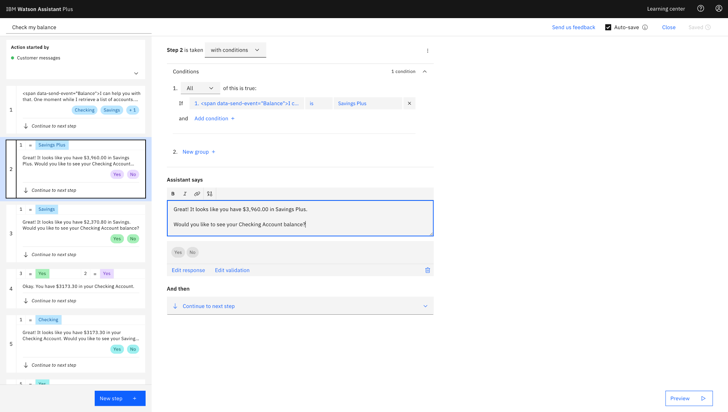

Slide 4
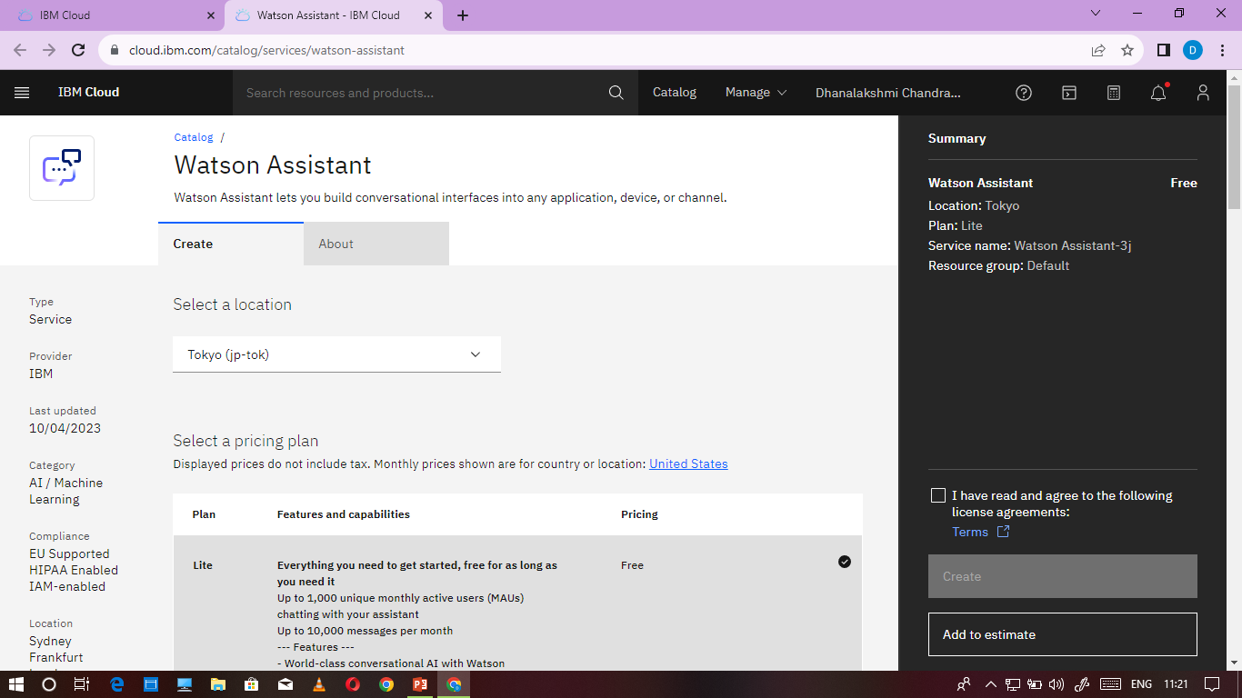
SPEECH TO TEXT

Slide 5


Slide 6


Slide 7


Slide 8
EVALUATOR SIGNATURE:
MENTOR SIGNATURE:
SPOC SIGNATURE:
HOD SIGNATURE:

