Slide 1
Assignment #2
Nabeel Sawafta 1220869
Ahmad Karmi 1220003

Slide 2


Topics
1- Non-Linear Regression
Problem overview (Part 1)
Data visualization
What is Ridge Regression?
Ridge Regression
What Are RBFs?
RBFs
Best model for Part1
2- Logistic Regression
Problem overview (Part 2)
What is Linear Regression?
What is Non-Linear Regression?
What are ROC and AUC?
Best model for Part2
Data visualization
Effect of Model Complexity

Slide 3
Problem overview (Part 1)
** So, what the problem that we are trying to solve?
Generate dataset S with:
y=sin⁡(5πx)+ϵ where ϵ ∈ [−0.3,0.3]
Apply Ridge Regression using degree-10 polynomial features
Apply RBF Regression with different numbers of basis functions
Compare models and discuss which one generalizes best

Slide 4
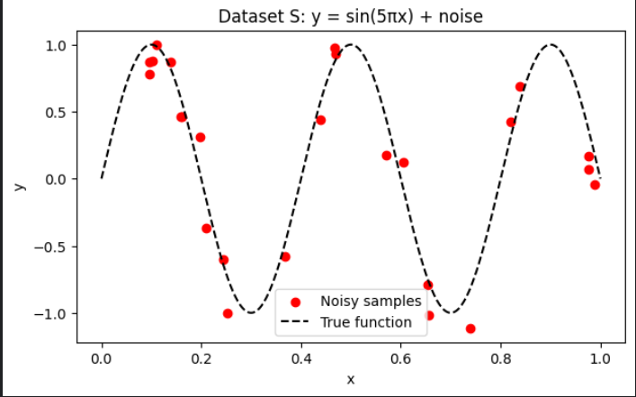
Data visualization
This plot shows the dataset S that we randomly generated 25 x-values in the interval [0, 1].
And to make it more realistic, we added uniform noise between –0.3 and 0.3 to each point.
But because the dataset is very small (only 25 points) and the noise is relatively high.

Slide 5

What is Ridge Regression?
Before we start talking about how we used Ridge Regression on the function lets talk about (What is Ridge Regression?)
Ridge Regression is a regularized version of polynomial linear regression that adds penalty on large coefficients to help control overfitting
Parameter λ controls strength of regularization
With λ = 0 → ordinary least squares
With large λ → smoother, less flexible curve
Ridge penalty equation
$w=\left(X^{T}X+λI{\left.)\right.}^{−1}X^{T}y\right.$

Slide 6
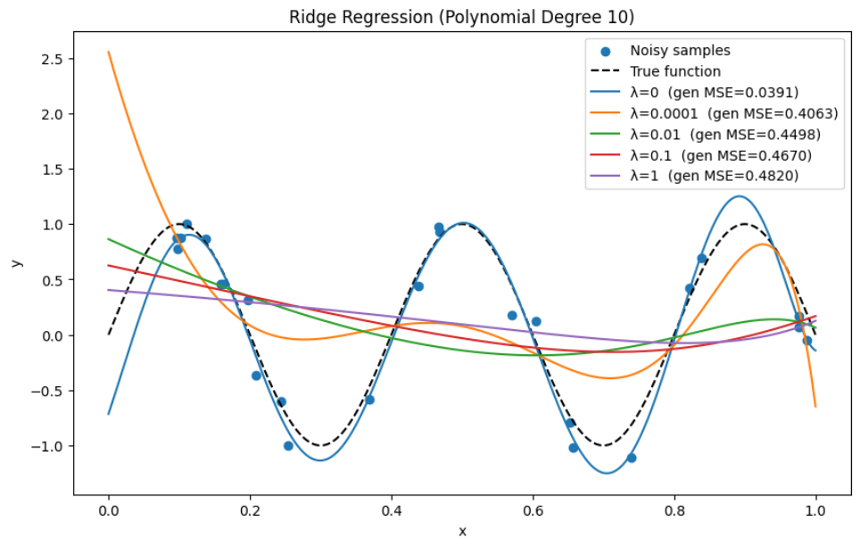
Ridge Regression
λ = 0: The generalization error is still the lowest.
This is because our dataset is very small, and randomly the degree-10 polynomial fit happens to follow the true function nicely.
λ = 0.01: the weights become much smaller. This means the curve becomes smoother and less wiggly.
Generalization gets WORSE as λ increases
λ | generalization MSE
0 | 0.039 (BEST)
0.0001 | 0.406
0.01 | 0.449
0.1 | 0.467
1 | 0.482

Slide 7
What Are RBFs?
Before we start talking about how we used RBFs on the function lets talk about (What is RBFs?)
Radial Basis Function: It’s another way to build a regression model, but instead of using polynomial features like in Ridge Regression, we create features based on distances from certain points called centers.
Each RBF creates a smooth “bump” around its center, and the model becomes a weighted sum of these bumps.
The width of each bump is controlled by a parameter called sigma (σ). A small sigma gives sharp bumps, and a large sigma gives wide, smooth bumps.
By choosing more centers, the model becomes more flexible. With fewer centers, it becomes smoother.

Slide 8
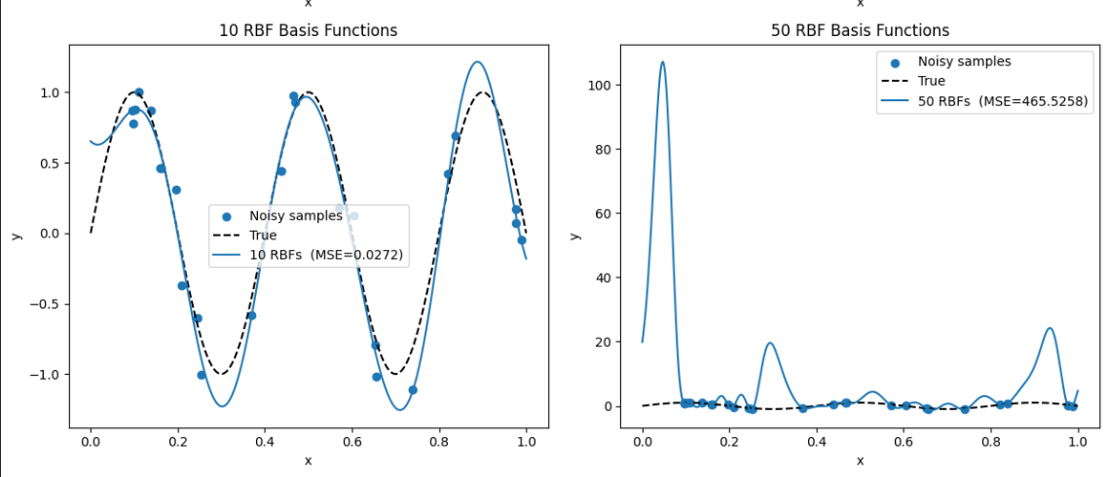
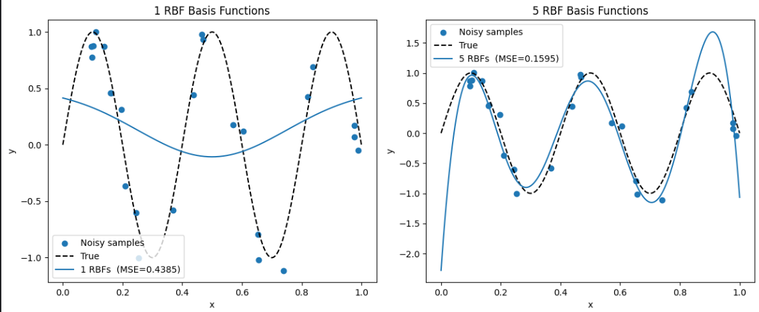
RBFs
As we can see from the plots:
k=1 → too simple
k=5 → better
k=10 → best fit
k=50 → extreme overfitting

Slide 9
Best model for Part1
Ridge Regression
λ=0 performed best on this dataset
But weights were very large
So, we might say λ = 0.01 was better since the weight was much smaller
RBF Regression
Best performance at k=10
k=1 → underfit
k=50 → overfit massively
RBFs captured oscillations better than polynomials
Best overall model in Part 1 👉 RBF Regression with 10 basis functions

Slide 10
Problem overview (Part 2)
So, what problem are we trying to solve?
Predict customer churn using Logistic Regression
Prepare and preprocess the customer churn dataset
Split the data into training, validation, and test sets
Apply Logistic Regression with a linear decision boundary
Apply Logistic Regression with polynomial features (degrees 2, 5, and 9)
Compare all models using accuracy, precision, and recall
Select the best model and plot its ROC curve and AUC score

Slide 11
What is Linear Regression?
Linear Regression is a simple supervised learning method used to model the relationship between
input features and a continuous output.
It assumes the data can be approximated by a straight line (or a linear combination of features)
The goal is to find the best-fitting line that minimizes the error between predicted and actual values
Linear Regression estimates model parameters (weights) using the Least Squares method
It finds the line that minimizes the sum of squared errors (SSE) between predictions and true values
Linear model equation: ŷ = w₀ + w₁x₁ + w₂x₂ + … + wₙxₙ
Parameter estimation formula: w = (XᵀX)⁻¹ Xᵀy
Linear Regression works well when the relationship is approximately linear, but struggles when the data is highly non-linear,
which is why polynomial or regularized models are sometimes needed.

Slide 12
What is Non-Linear Regression?
Non-Linear Regression is used when the data cannot be fitted with a straight line.
It assumes the relationship between inputs and outputs is curved or complex
The goal is to find a non-linear function that best fits the data
It can use polynomial terms, exponential functions, or other transformations
Instead of fitting a line, it fits a curve that follows the data pattern
The model parameters are chosen to minimize the sum of squared errors (SSE)
Non-Linear Regression is useful when linear regression is too simple to capture the real shape of the data.

Slide 13
What are ROC and AUC?
AUC (Area Under the Curve):
AUC measures the overall ability of the model to distinguish between the classes
Values range from 0.5 (no skill) to 1.0 (perfect classifier)
Higher AUC means better performance and better class separation
We used the selected model to draw its ROC curve and compute the AUC score.
The ROC curve (Receiver Operating Characteristic) shows how well a classification model separates the two classes at different threshold values.
It plots the True Positive Rate vs. the False Positive Rate
A good model has a curve that rises sharply toward the top-left corner
The ROC curve helps us see how the model performs across all possible classification thresholds

Slide 14
Best model for Part2
Non-Linear
Degree 2: Validation 0.9840, Test 0.9840
Degree 5: Validation 0.9880, Test 0.9820 Best overall
Degree 9: Validation 0.9840, Test 0.9800
Polynomial degree 5 gives the highest validation
accuracy and balances precision/recall for both classes
Linear
Validation Accuracy: 0.9800
Test Accuracy: 0.9760
Performs well, but recall for class 1 (churn)
is lower (~0.48–0.53), so it misses some churn cases.

Slide 15
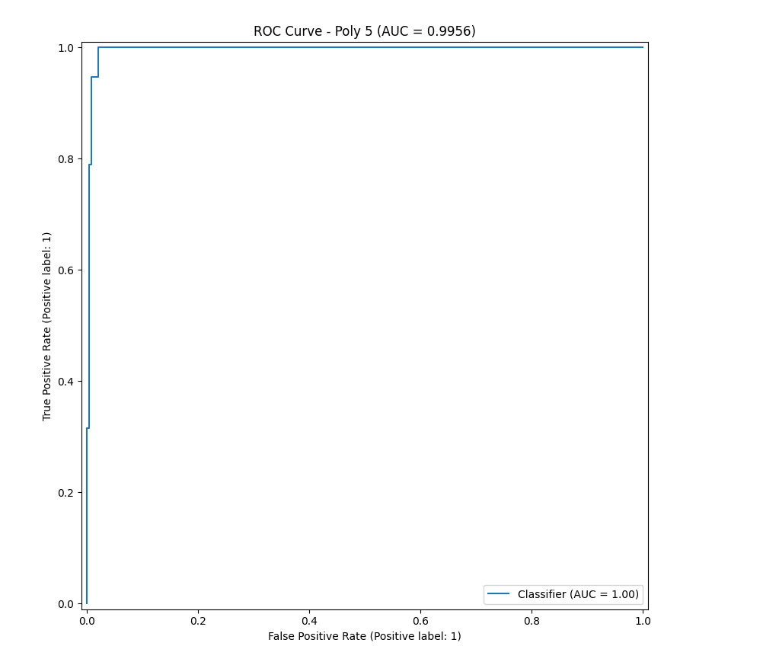
Data visualization
The ROC curve shows that the polynomial degree-5 model performs extremely well. The curve stays very close to the top-left corner, which means the model correctly identifies positive and negative cases with very few mistakes.
The AUC score is about 0.996, which is almost perfect. This suggests the model is excellent at distinguishing between the two classes. However, because the model is complex, it might be overfitting if this result comes from the training data rather than a separate test set.

Slide 16
Effect of Model Complexity
Low-degree models (linear, degree 2) may underfit, missing patterns in the data.
Moderate-degree models (degree 5) capture patterns well and generalize best.
High-degree models (degree 9) may overfit, fitting noise and performing worse on new data

