Slide 1
KubeCart
Secure E-Commerce Platform on Microsoft Azure
A monolithic Node.js and React application built with managed Azure platform services.
01

Slide 2
TECHNOLOGY
Azure PaaS Services Used
Managed services keep KubeCart scalable, secure, and easier to operate.
AS
KV
BS
DB
Azure App Service
Azure Key Vault
Azure Blob Storage
Cosmos DB
Hosts the Node.js API and serves the React frontend as one managed web application.
Protects connection strings, credentials, and application secrets outside the codebase.
Stores product images, uploads, invoices, exports, and other object data.
Provides a MongoDB-compatible database for products, carts, orders, and profiles.
AZURE PAAS
AZURE PAAS
AZURE PAAS
AZURE PAAS
02

Slide 3
IMPLEMENTATION
Infrastructure as Code & Identity
Repeatable Azure provisioning with centralized application access management.
TF
Terraform Provisioning
ID
Microsoft Entra ID
INFRASTRUCTURE AS CODE
IDENTITY & ACCESS MANAGEMENT
1
Reusable Terraform modules
1
Application authentication
Resources are organized into reusable, maintainable building blocks.
Users sign in through Microsoft Entra ID and App Service Authentication.
2
Terraform workspaces
2
Centralized IAM
Separate environments and state while using the same infrastructure code.
Identity and access policies are managed centrally without storing user passwords.
03

Slide 4
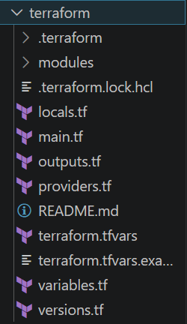
IMPLEMENTATION
Terraform Structure
03

Slide 5
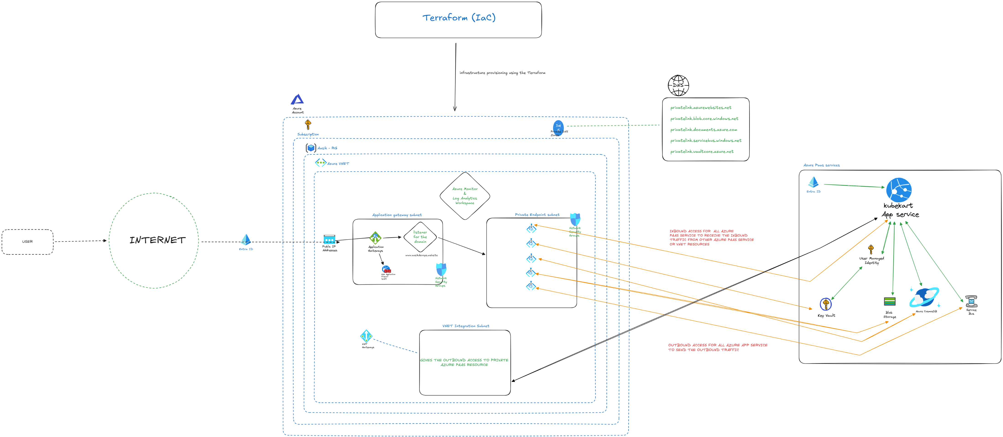
Cloud Architecture

Slide 6
Thank You
05

