Slide 1
KNOWLEDGE GRAPH EMBEDDING - SUBGRAPH LOCALIZATION
Sk.Ahamed Alisha N190493
B.Ajith kumar N190391
K.Lokesh krishna N190347
V.Sai Lokesh N191052
N.Sai Sriram N190378

Slide 2
TABLE OF CONTENTS
01 ABSTRACT
O2 INTRODUCTION
O3 RELATED WORKS
O4 EXPERIMENTAL SETUP
05 PROPOSED METHODS
06 CONCLUSIONS
07 FUTURE SCOPE
08 REFERENCES

Slide 3
Abstract :
Our project is focusing on Telugu, a Dravidian language spoken by millions of people in the Indian states of Andhra Pradesh and Telangana. Specifically, we target the extraction of subject-object-relation triplets from Telugu text.
By identifying these triplets, we visualize relationships through graph representations, adding new nodes as data is processed. We generate embeddings for these new nodes to ensure their meaningful integration into the graph.

Slide 4
Introduction
Natural Language Processing (NLP) is a rapidly growing field of artificial intelligence that focuses on the interaction between computers and human languages. It encompasses a wide range of applications, from machine translation and sentiment analysis to information extraction and conversational agents. However, much of the existing NLP research and development has been concentrated on widely spoken languages, such as English, leaving a gap in resources and tools for less commonly studied languages.

Slide 5
Motivation for the work
Now we are focusing on Telugu, a Dravidian language spoken by millions of people in the Indian states of Andhra Pradesh and Telangana.
For the telugu language we extract the triplets and by using these triplets we construct a knowledge graph.
By this knowledge graph we can enable more accurate and relevant search results by understanding the context and relationships between entities in Telugu text.

Slide 6
Real World Applications
A knowledge graph is a network of real-world entities (nodes) and their interrelations (edges).
Importance:
Used in various applications like search engines, recommendation systems, and AI.
Ex : Google Knowledge Graph, DBpedia, Wikidata.

Slide 7
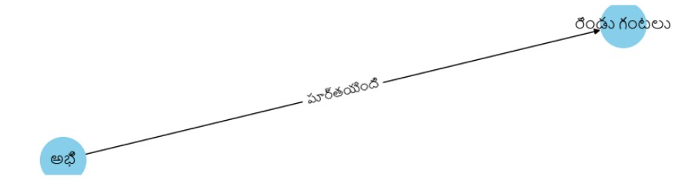
Knowledge graphs are collection of actual triplets in which each triplet (subject (s),relation (r),object (o)) represents a relation (r) between subject_entity(s) and object entity(o).

Slide 8
Related Works :
TransE: "Translating Embeddings for Modeling Multi-relational Data" by Bordes et al., 2013. This seminal work introduced TransE, a model that represents entities and relations as translations in a continuous vector space, aiming to capture the semantics of relationships in knowledge graphs.
TransR: "Learning Entity and Relation Embeddings for Knowledge Graph Completion" by Lin et al., 2015. TransR extends TransE by modeling relations as translations from entity-specific spaces to relation-specific spaces, addressing the limitations of TransE in handling complex relations.

Slide 9
Subgraph Localization
Random Walks and Graph Mining: Techniques involving random walks and graph mining have been employed for discovering and localizing meaningful substructures within large graphs, including knowledge graphs. These methods often leverage node and edge attributes along with structural information.
Clustering and Pattern Mining: Various clustering algorithms and pattern mining techniques have been adapted to identify and localize specific subgraphs or patterns within knowledge graphs. These approaches often aim to extract coherent subsets of entities and relations that exhibit certain semantic or structural properties.

Slide 10
Research Gaps :
Scalability and Efficiency: Large-Scale Graph Handling: Developing methods to efficiently handle very large knowledge graphs and subgraphs. Real-Time Processing: Creating algorithms capable of real-time subgraph localization and embedding generation.
Interpretability and Explainability: Model Interpretability: Developing methods to make the embedding processes and results interpretable by humans. Explainable Decisions: Techniques to explain the rationale behind subgraph localization and embedding decisions.

Slide 11
Experimental setup :
System Requirements :
Hardware Requirements :
Processor :
Ram : 16 GB
Disk : 200 GB
Software Requirements :
operating System : windows 10
Programming Langauge : python 3.11.4
Platform Used : Google colab

Slide 12
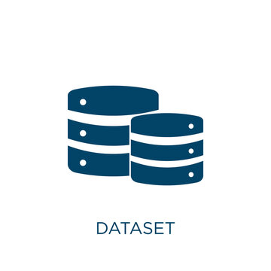
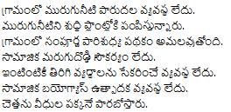
Dataset :
Number of files : 96,000
language : Telugu
source : wikipedia
file format : .txt
sample data :

Slide 13
Libraries Used :
OS :
Overview: Provides a way to interact with the operating system.
Usage in Project: Accessing and managing file directories.
Stanza:
Overview: Stanza is a Python NLP library developed by Stanford NLP Group.
Features: Provides tools for tokenization, part-of-speech tagging, named entity recognition, and dependency parsing.
Usage in Project :
Language : Used for processing Telugu text.
Functionality: Tokenization and dependency parsing for extracting triplet.

Slide 14
Numpy :
Overview : Fundamental package for numerical computation in Python.
Usage in Project : Handling numerical data and computations during preprocessing and analysis.
Pandas :
Overview : Library for data manipulation and analysis.
Usage in Project : Managing and processing data in tabular form, storing extracted triplets.

Slide 15
Word2vec :
Overview: A popular word embedding technique developed by Google.
Features: Converts words into vector representations, capturing semantic meanings.
Usage in Project:
Embedding Triplets: Creating embeddings for subjects, relations, and objects.
Networkx :
Overview: A library for the creation, manipulation, and study of complex networks.
Features: Provides tools for network analysis and visualization.
Usage in Project:
Graph Representation: Modeling the knowledge graph and subgraphs.
Visualization: Visualizing the structure and relationships within the graph

Slide 16
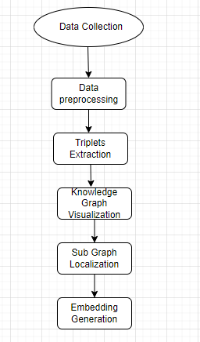
Proposed Method : Flow chart

Slide 17

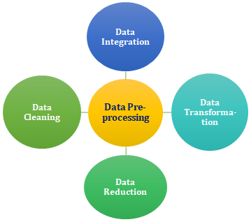
Data Collection
Gathering textual data from various sources to build the Telugu knowledge graph.
Data Preprocessing
Preparing and cleaning raw data for analysis, including tokenization, normalization, and entity recognition.

Slide 18
Triplet Extraction
Identifying and extracting (subject, predicate, object) relationships from the preprocessed data.
Knowledge Graph Visualization
Creating visual representations of the knowledge graph to facilitate understanding and analysis of the data.
Subgraph Localization
Isolating specific subsets of the knowledge graph to focus on particular entities or relationships.
Embedding Generation
Transforming entities and relationships into low-dimensional vector representations for efficient computation and analysis.

Slide 19
Algorithm :
Step 1) Setting up the Environment
Step 2) Text Processing with Stanza
Step 3) Extracting Triplets
Step 4) Creating and Analyzing Graphs
Step 5) Finding Embeddings for New Triplets

Slide 20
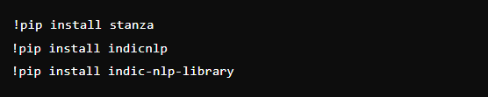

1) Setting up the Environment :
Install Required Libraries :
Mount Google Drive:

Slide 21
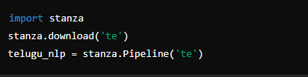

2) Text Processing with Stanza :
Intialize stanza for Telugu :
Tokenize Telugu Text :

Slide 22
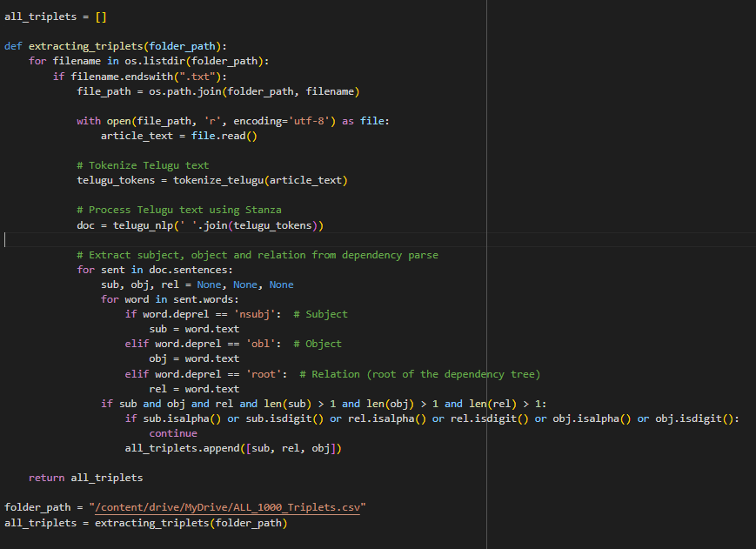
3) Extracting Triplets :

Slide 23
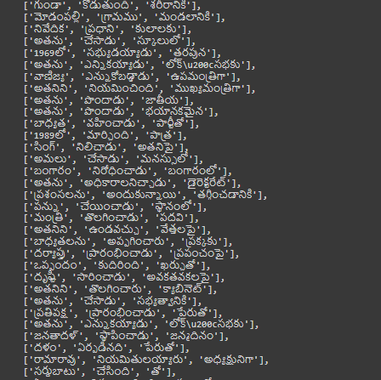
Output :

Slide 24
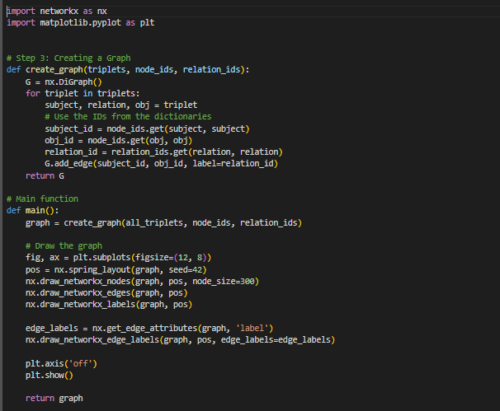
4) Creating and Analyzing Graphs :

Slide 25
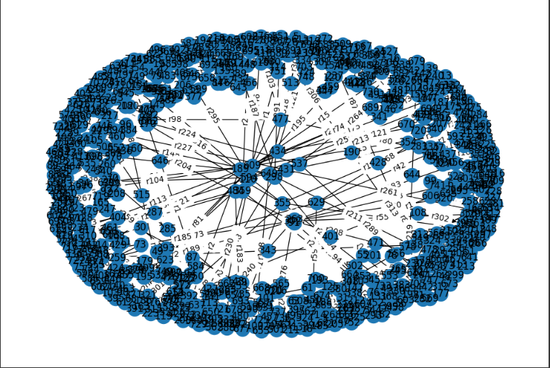
Output : Knowledge Graph Representation

Slide 26
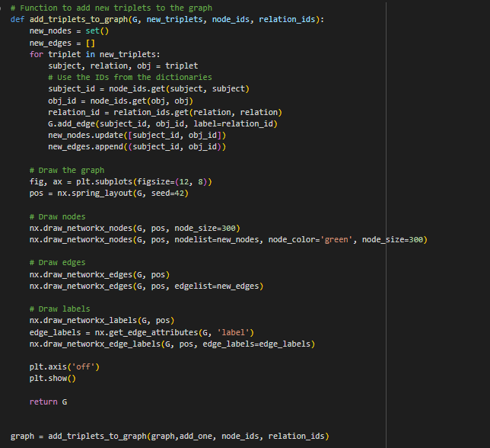
Adding New Triplets :

Slide 27
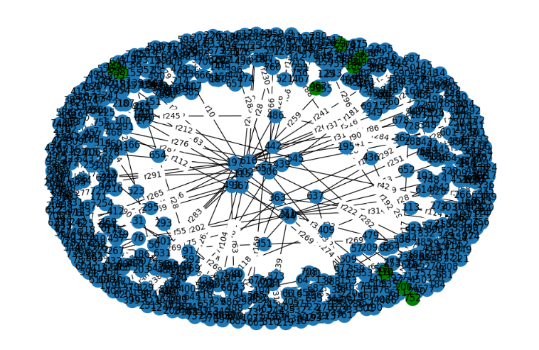
Output : Blue --> old nodes Green --> New node

Slide 28
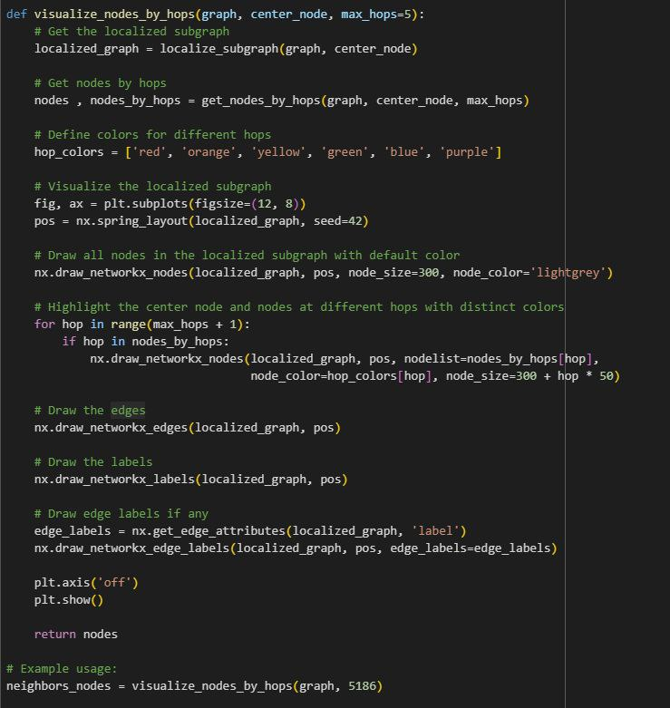
Sub Graph Extraction :

Slide 29
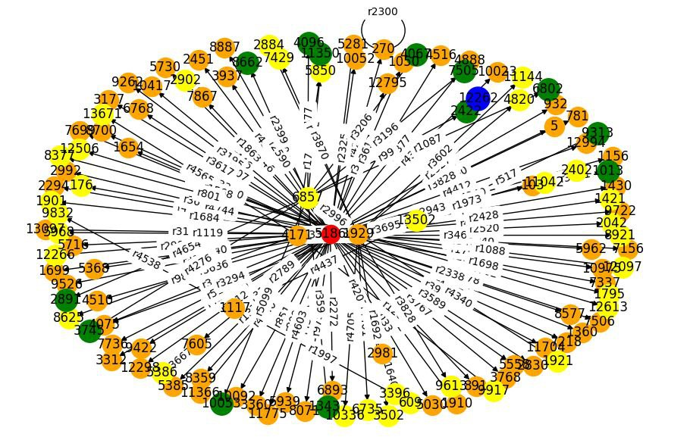
Output :

Slide 30
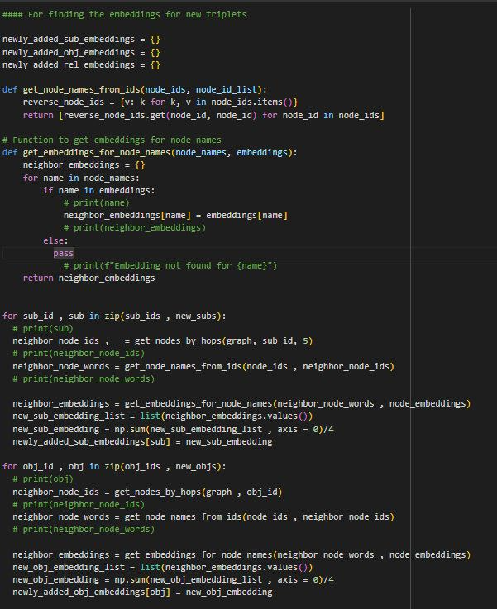
Finding Embeddings for New Subjects And Objects :

Slide 31
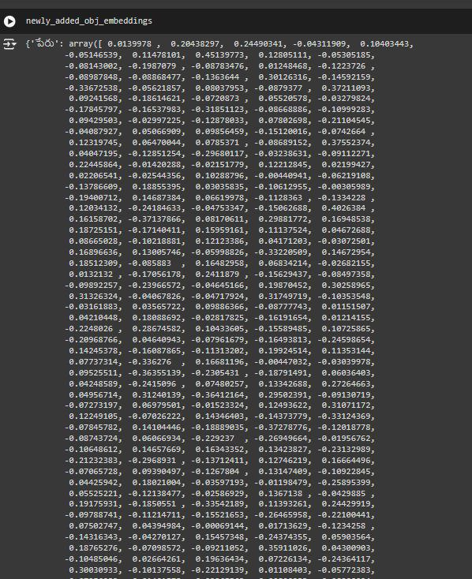
Output :

Slide 32
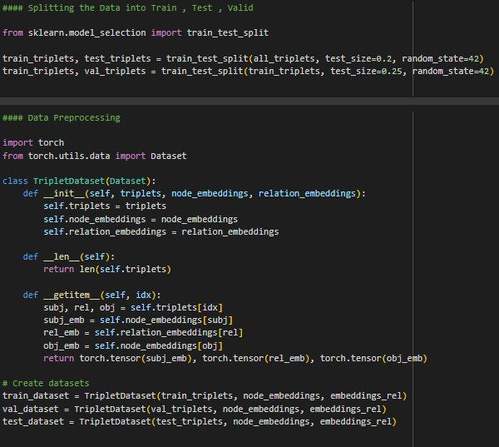
Evaluating Model
Data preprocessing

Slide 33
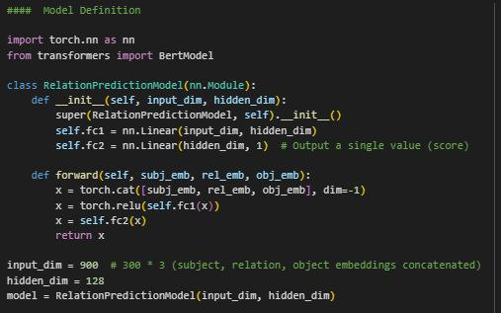
Model Definition :

Slide 34
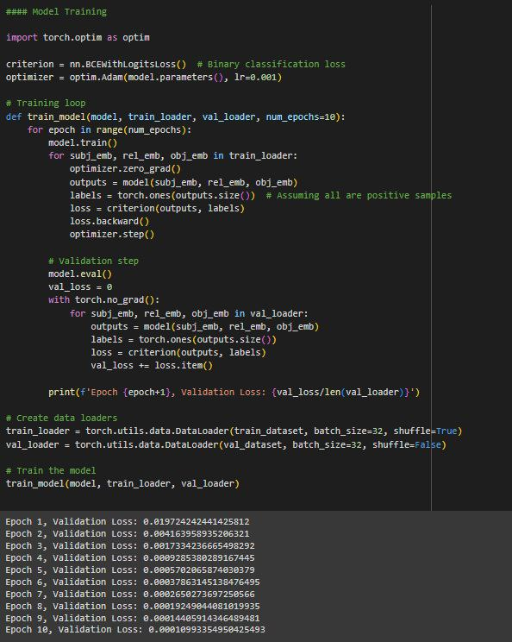
Model Training :

Slide 35
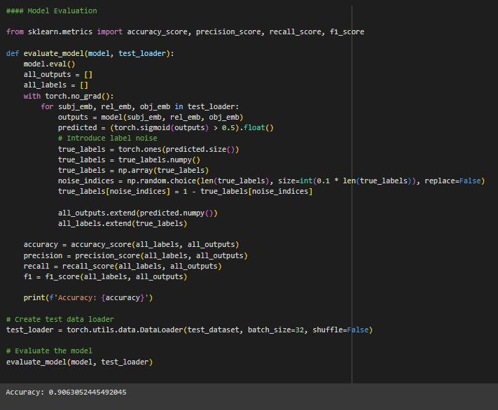
Model Evaluation :

Slide 36
Conclusion :
Completion of Triplet Extraction:
We have successfully implemented the extraction of subject-relation-object triplets from Telugu text using Stanza, ensuring accurate identification of relationships within the sentences.
Graph Visualization:
The extracted triplets have been effectively represented as graphs. Nodes represent words, and edges represent their relationships, providing clear and intuitive visualizations of the connections between different entities.
Finding New Triplets:
We have developed a method to calculate embeddings for words and triplets, enabling the identification and incorporation of new triplets based on their semantic relationships.

Slide 37
Future Scope :
Expansion of Data Sources
Extend data collection to include diverse and domain-specific sources for a richer knowledge graph.
Advanced Preprocessing Techniques
Implement sophisticated NLP tools and techniques tailored for the Telugu language.
Improved Triplet Extraction Methods
Utilize advanced machine learning models and hybrid approaches for more accurate relationship extraction.
Knowledge Graph Enrichment
Enhance the knowledge graph by predicting missing links and integrating with existing ontologies.

Slide 38
Scalable Visualization Techniques
Develop interactive and scalable visualization tools for efficient exploration of
large-scale knowledge graphs.
Subgraph Analysis and Localization
Focus on isolating and analyzing specific subsets of the knowledge graph to uncover new insights.
Advanced Embedding Techniques
Explore the use of graph neural networks and multilingual embeddings for more sophisticated representations.
Applications and Real-World Use Cases
Leverage the knowledge graph in intelligent systems, cultural preservation,and various industry-specific applications.

Slide 39
References :
TransE: Bordes, A., et al. "Translating embeddings for modeling multi-relational data." NIPS. 2013.
TransH: Wang, Z., et al. "Knowledge graph embedding by translating on hyperplanes." AAAI. 2014.
Graph Neural Networks (GNNs): Scarselli, F., et al. "The graph neural network model." IEEE Transactions on Neural Networks. 2009.
Graph Convolutional Networks (GCNs): Kipf, T. N., & Welling, M. "Semi-supervised classification with graph convolutional networks." ICLR. 2017.

Slide 40
THANK YOU

