Slide 1
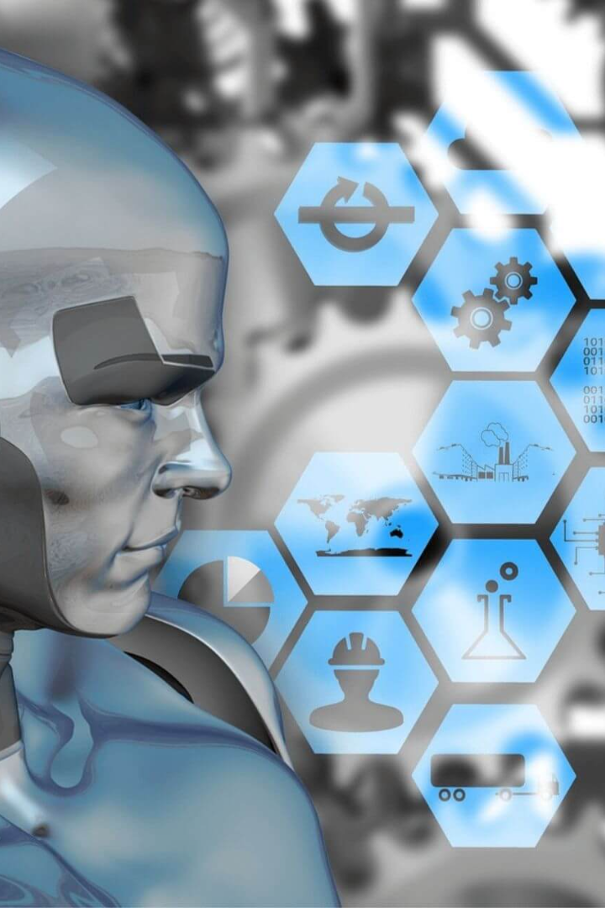


Future Trends of AI
Explore the exciting advancements and potential of AI technologies, and discover the future applications and opportunities they bring.
by Kazi Ahammad Ullah

Slide 2

AI in Healthcare
Medical Diagnosis
Drug Discovery
AI-powered systems analyze patient data to assist doctors in accurate diagnoses and improve treatment outcomes.
Machine learning algorithms help speed up the process of identifying potential new drugs, leading to more effective treatments.
Surgical Robotics
Collaborative robots assist surgeons during complex procedures, enhancing precision and reducing risks.

Slide 3
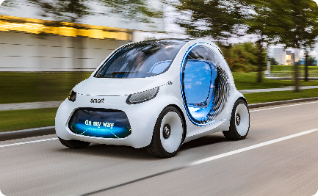
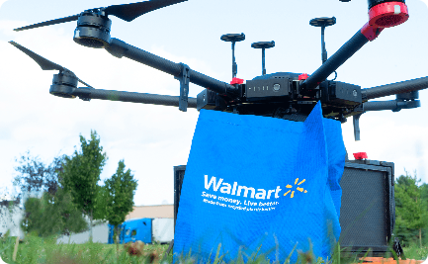
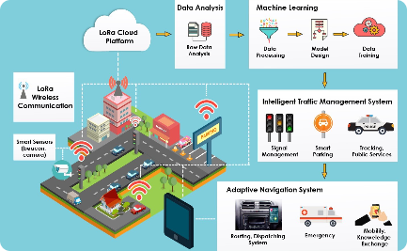
AI in Transportation
Autonomous Vehicles
Delivery Drones
Traffic Management
Self-driving cars are set to revolutionize transportation, improving safety, efficiency, and accessibility.
Unmanned aerial vehicles are transforming the delivery industry, enabling faster and more efficient package transport.
AI-powered traffic control systems optimize traffic flow, reducing congestion and enhancing transportation networks.

Slide 4

AI in Education
1
Personalized Learning
2
Virtual Classrooms
3
Intelligent Tutoring
Virtual reality and AI technologies create immersive learning environments for students around the world.
Virtual tutors equipped with AI capabilities offer personalized guidance and support to students.
AI-powered adaptive learning platforms provide tailored educational content and personalized learning experiences.

Slide 5
AI in Entertainment
Recommendation Systems
Virtual Performances
Emotion Recognition
AI algorithms personalize content recommendations, enhancing user experiences on streaming platforms.
AI-generated virtual characters and performers add new dimensions to live events and entertainment.
AI technologies can analyze facial expressions and gestures, enabling more interactive and emotionally engaging experiences.

Slide 6

The Future of AI
1
Advances in Natural Language Processing
AI systems will continue to understand and process human language, enabling more natural and conversational interactions.
2
Expanded AI Applications
Fields like finance, agriculture, and cybersecurity will increasingly adopt AI to improve efficiency and decision-making.
3
AI and Human Collaboration
The future lies in harmonious collaboration between humans and AI systems, harnessing the strengths of both for greater innovations.

