Slide 1
WELCOME

Slide 2
BLOCKCHAIN VOTING SYSTEM

Slide 3
ABSTRACT
The process of an election and implementing a blockchain-based application which improves the security and decrease the cost of hosting a nation wide election.
It is more secure voting environment.

Slide 4
EXISTING SYSTEM
This scheme is ideally suited for microprocessor based devices such as smart cards, personal computers and remote control system.
Any one with physical access to such machine can damage the machine, there by effecting all votes cast on the machine.

Slide 5
PROPOSED SYSTEM
The system proposed a blockchain-based e-voting system that uses “permissioned blockchain”.
This needed to fullfill voting rights so that voters can cast votes without leading their identity or voting data.

Slide 6
SYSTEM REQUIREMENTS
Pycharm
Android studio

Slide 7
HARDWARE SPECIFICATION
PROCESSOR : Intel Pentium core i3 and above
PRIMARY MEMORY : 4GB RAM and above
STORAGE : 320GB harddisk and above
KEYBOARD : Windows compatible
Mouse : Windows compatible

Slide 8
SOFTWARE SPECIFICATION
OPERATING SYSTEM : Windows 11FRAME
WORK : Flask
SOFTWARE USED : Jetbrains pycharm

Slide 9
MODULES
ADMIN
ELECTION COORDINATOR
STUDENT

Slide 10
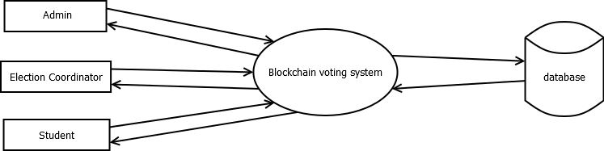

Slide 11
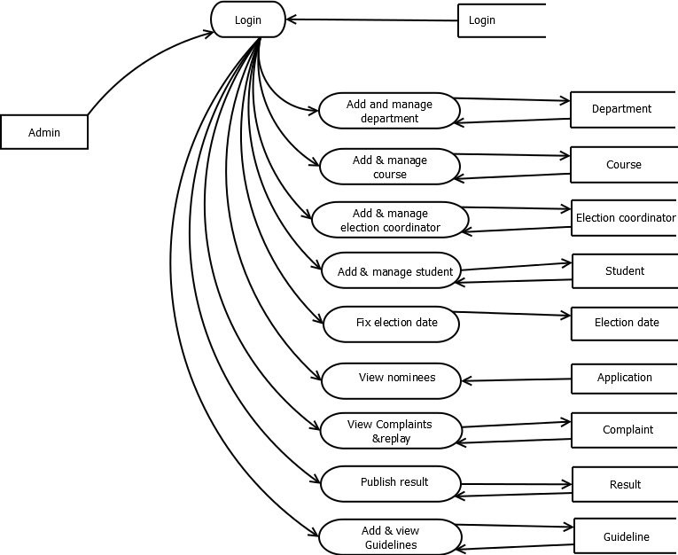

Slide 12
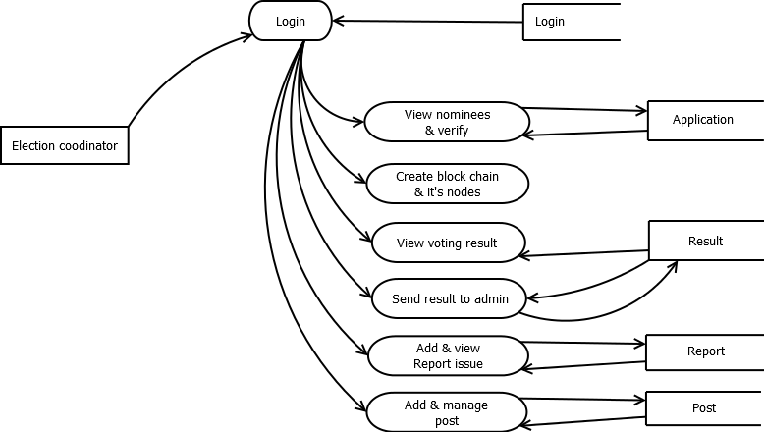

Slide 13
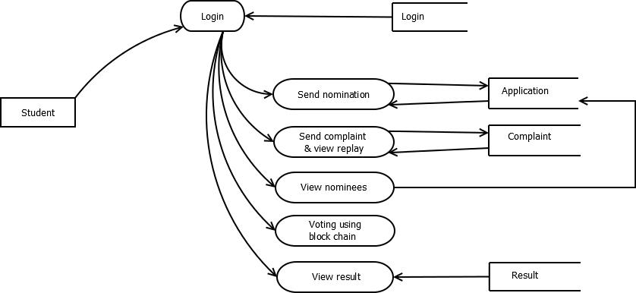

Slide 14
FRONT END
HTML
CSS
JAVASCRIPT

Slide 15
BACK END
MY SQL
PYTHON
ANDROID

Slide 16
SCREENSHOT

Slide 17
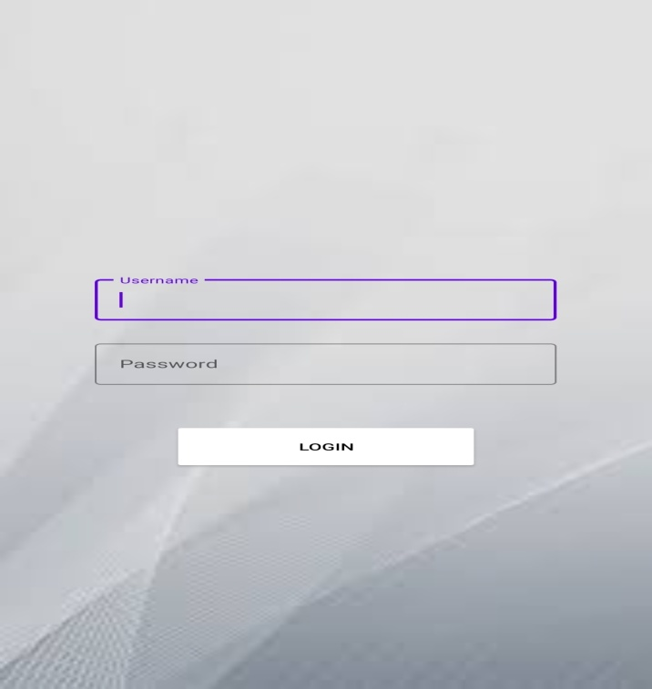
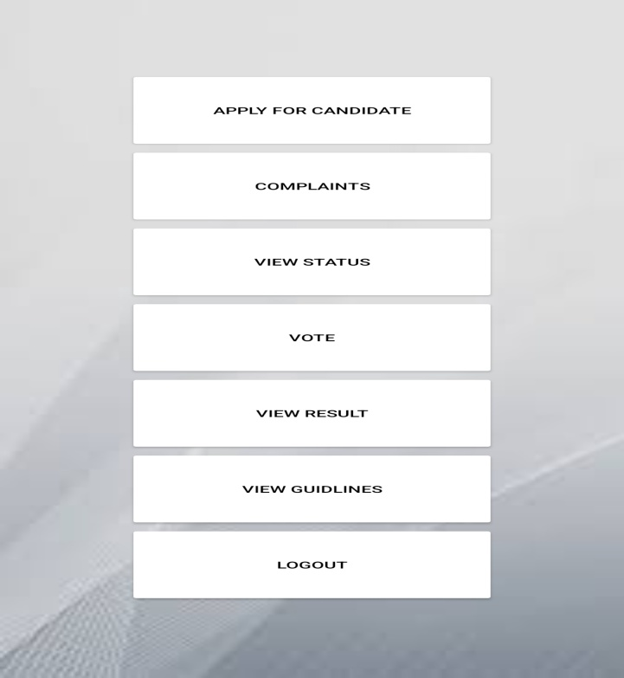

Slide 18
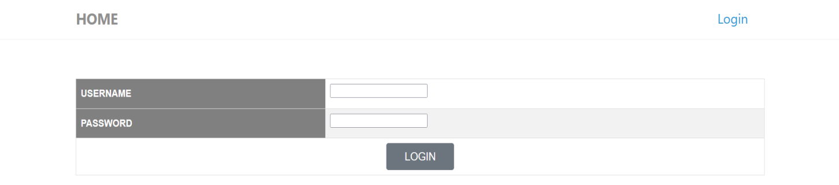
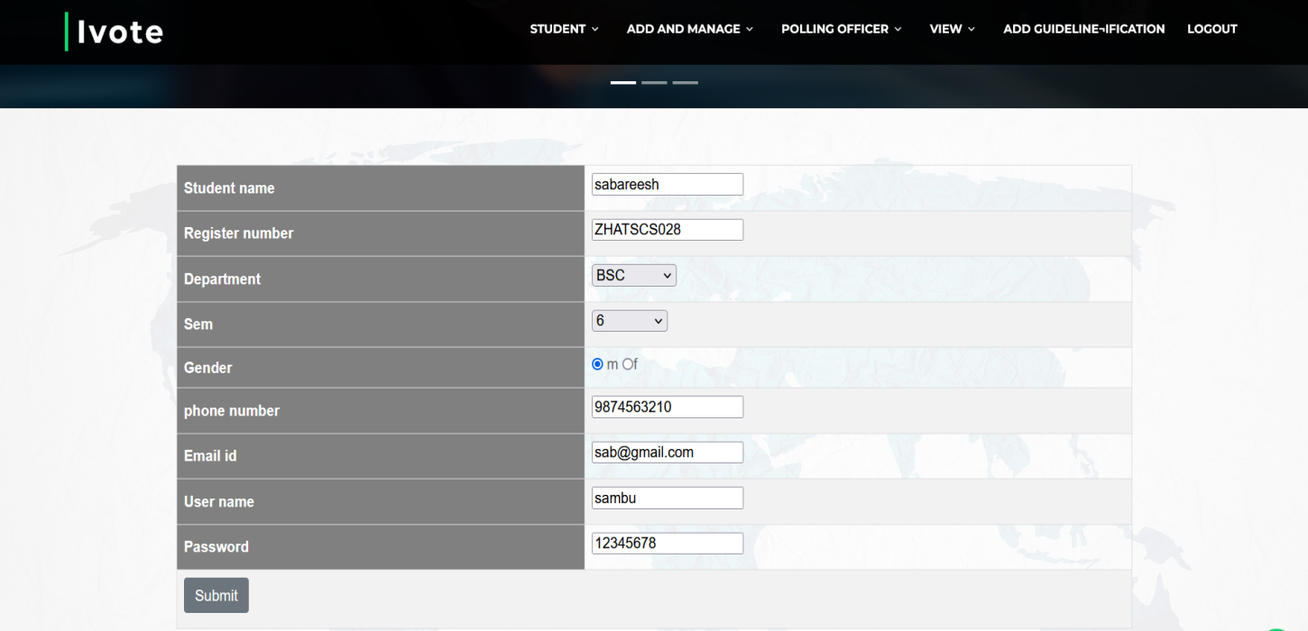

Slide 19
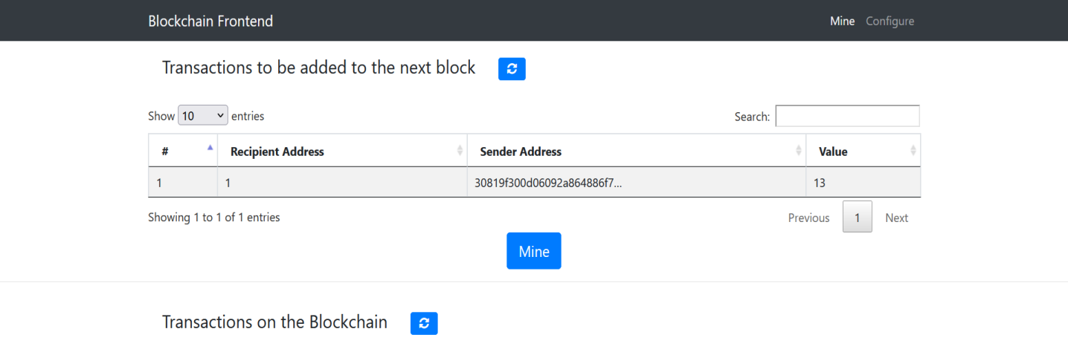

Slide 20
FUTURE ENHANCEMENT
We can take this to next level - For the common elections.
All colleges can implement this voting system in their union election.

Slide 21
CONCLUSION
We tried to make the system maximum efficienct and user friendly.
The system is protected from any unauthorised access by giving the username and password duing the login process.
More designs and decoration should be added to webpage to make them more attractive.
The time and effort that we take today to cast our vote will be reduced.
The main objective of the project is to make the voting more secure and to ensure every students get their chance to cast the vote.

Slide 22
THANK YOU

