Slide 1

AI Engineer Internship — Case Study
Financial Document Intelligence
Intelligent Document Extraction, Validation & API Platform
Ahammed Nujoom YP

Slide 2
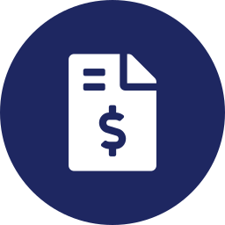


Problem Statement
Mixed, unstructured formats
Slow manual entry
Error-prone & unverified
Invoices and financial statements arrive as PDF, JPG, or PNG with no consistent layout.
Finance teams retype figures by hand from every document into their systems.
Manual entry miss's mistakes totals, tax, and balances often go unchecked.
The result: slower closes, higher error risk, and no automatic financial validation.
Financial Document Intelligence
2

Slide 3






Project Objective
Upload
Validate
Accept financial documents (PDF / JPG / PNG)
Check file type, integrity, and page limits
Extract (OCR)
Extract (AI)
Read native or scanned text from every page
Pull structured fields & tables using an LLM
Validate calculations
Store
Check totals, balances, and formulas
Persist every result for later retrieval
Delivered through both a REST API (with Swagger docs) and a browser dashboard.
Financial Document Intelligence
3

Slide 4
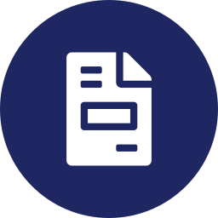



Supported Documents
Invoice
Balance Sheet
Profit & Loss
Cash Flow Statement
Vendor bills with line items, tax, and totals
Assets, liabilities, and equity at a point in time
Revenue, expenses, and net profit over a period
Operating, investing, and financing cash movement
Each type has its own extraction schema and its own financial validation rules.
Financial Document Intelligence
4

Slide 5







System Architecture
→
→
→
→
→
→
→
→
→
User
Frontend
FastAPI
File
Validation
OCR /
PyMuPDF
AI
Extraction
Structured
JSON
Financial
Validation
SQLite
Database
Dashboard
A linear, auditable pipeline every stage is a separately testable service.
Validation first
Stateless services
Persistent + queryable
Rejects bad files before any OCR/AI cost is spent.
Each stage (OCR, extraction, validation) is independently testable.
Every result is stored and retrievable by name via the API.
Financial Document Intelligence
5

Slide 6










Technology Stack
Python
FastAPI
HTML / CSS / JS
PyMuPDF
Tesseract OCR
Core language
REST API + Swagger
Dashboard frontend
PDF parsing
Scanned text extraction
Gemini LLM
Pydantic
SQLite
Docker
Render
Structured field extraction
Schema validation
Persistence layer
Containerized deployment
Cloud hosting
Financial Document Intelligence
6

Slide 7
Document Processing Pipeline
→
→
→
→
→
→
Upload
Validate
OCR / Text
Extraction
AI
Extraction
JSON
Financial
Validation
Store
Result
Every stage fails safely: a bad file is rejected at Validate, never reaching OCR or AI.
Fast path
Fallback path
Native PDF text is read directly no OCR needed when text is already embedded.
Scanned pages or images are rasterized and read with Tesseract OCR.
Financial Document Intelligence
7

Slide 8

Financial Validation
Invoice
Balance Sheet
Quantity × Unit Price = Line Total
Assets = Capital & Liabilities
Profit & Loss
Cash Flow
Income − Expenditure = Profit
Opening Cash + Net Change = Closing Cash
Every check returns one of three statuses:
PASS
Calculated value matches reported value
FAIL
Values differ beyond tolerance
NOT_APPLICABLE
A required field was missing
Financial Document Intelligence
8

Slide 9


Limitations & Future Improvements
Current Limitations
Future Improvements
OCR accuracy drops on poor-quality or skewed scans
Migrate to PostgreSQL for production-scale concurrency
Free-tier LLM API has rate and quota limits
Improve OCR with pre-processing (deskew, denoise)
SQLite is suitable for a prototype, not high concurrency
Add authentication & per-user access control
Move to asynchronous background processing
Add monitoring, logging dashboards, and alerts
Thank you — questions welcome.
Financial Document Intelligence
10

