Slide 1
GLOBAL AIR QUALITY
Data Visualization &
Insight Storytelling
Assignment 2B • Exploratory Analysis of the Cleaned Global AQI Dataset
23,462 cities • 12 variables • 175+ countries
23,462
72.0
81.7%
191
Cities Analyzed
Mean Overall AQI
Good + Moderate
Hazardous Cities

Slide 2
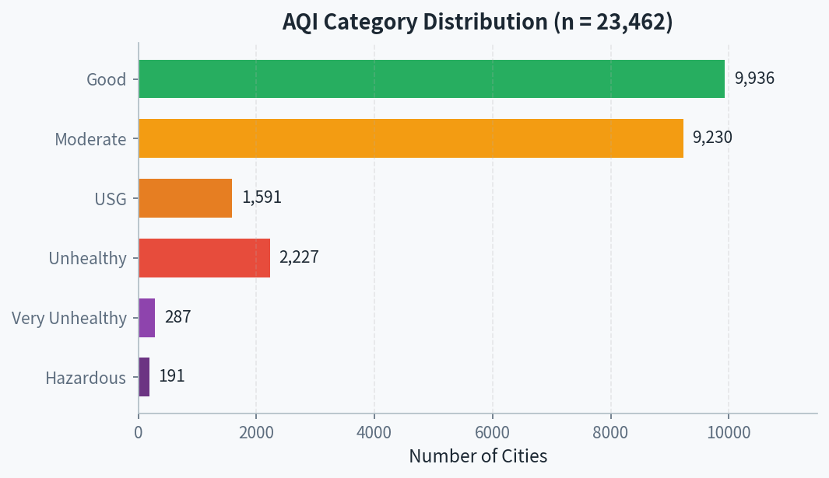
01 | CURRENT AIR QUALITY LANDSCAPE
AQI Category Distribution
KEY INSIGHT
81.7% of monitored cities (19,166) report Good or Moderate air quality. The remaining 18.3% (4,296 cities) experience Unhealthy-for-Sensitive-Groups or worse conditions.
WHY IT MATTERS
Even a minority of severely polluted cities imposes large public-health and economic costs. The 478 cities in Very Unhealthy or Hazardous categories are acute risk zones.
RECOMMENDATION
USG = Unhealthy for Sensitive Groups | Source: Cleaned dataset (n = 23,462)
Direct monitoring upgrades and emission controls first to the 18.3% already above Moderate.

Slide 3
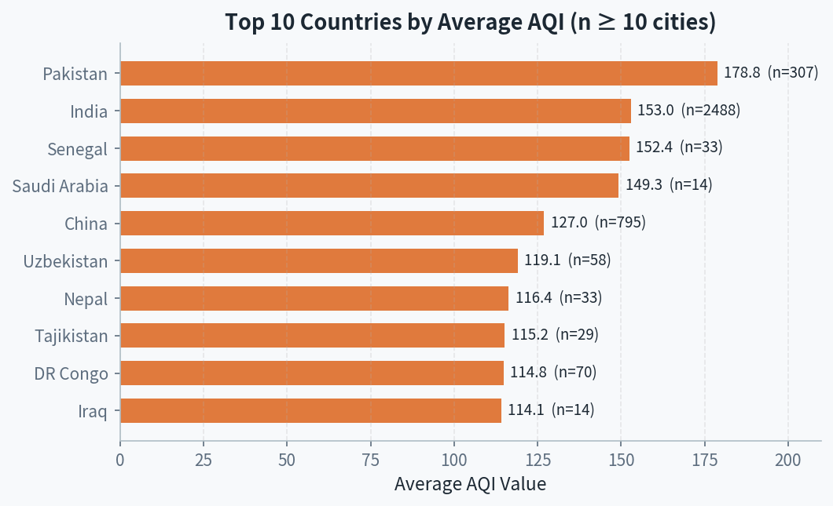
02 | COUNTRIES MOST AFFECTED
Top 10 Countries by Average AQI
KEY INSIGHT
Pakistan (avg 178.8, n=307) and India (avg 153.0, n=2,488) show the highest average AQI among countries with substantial coverage. South Asia and parts of West Africa / Middle East dominate.
WHY IT MATTERS
These nations contain large urban populations. Elevated averages indicate systemic exposure risk — amplifying health and productivity losses.
RECOMMENDATION
Filtered to countries with ≥10 city records for statistical reliability.
Channel clean-air finance and regional policy cooperation toward South Asia and high-burden African/Middle-Eastern nations.

Slide 4
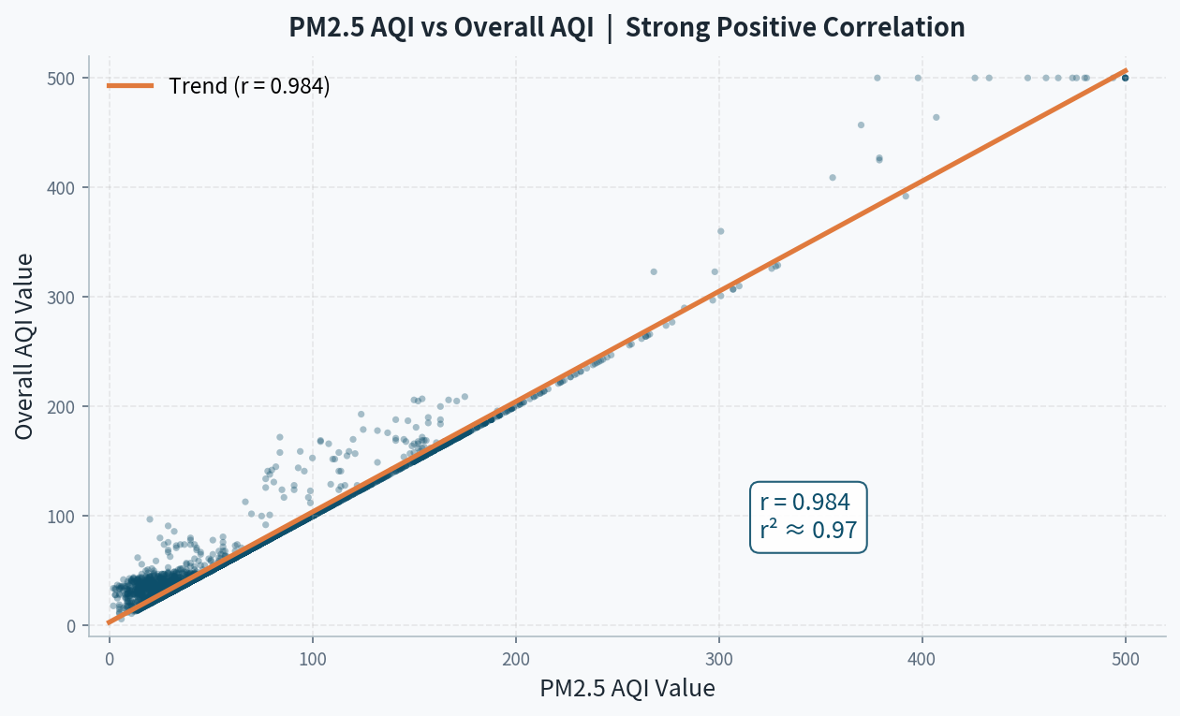
03 | MAJOR CONTRIBUTOR TO POOR AQI
PM2.5 AQI vs Overall AQI — Near-Perfect Correlation
CORRELATION
r = 0.984
r² ≈ 0.97 — PM2.5 explains ~97% of variation in overall AQI.
KEY INSIGHT
Fine particulate matter (PM2.5) is the dominant driver of the composite AQI score. Other pollutants (CO, NO₂, Ozone) contribute far less on average.
WHY IT MATTERS
Interventions that lower PM2.5 will move overall AQI almost one-for-one.
Sample of 4,000 cities shown for clarity; r computed on full n = 23,462.
RECOMMENDATION
Prioritize PM2.5 source controls for maximum AQI improvement.

Slide 5
04 | SYNTHESIS & ACTION
Overall Findings & Recommendations
1
Current State
2
Hotspots
3
Root Driver
81.7% of cities are Good or Moderate; 18.3% face unhealthy or worse air quality.
Pakistan & India lead among large-sample countries; South Asia is the critical region.
PM2.5 correlates with overall AQI at r = 0.984 — the primary lever for improvement.
BUSINESS & POLICY RECOMMENDATIONS
1
Prioritize PM2.5 Reduction
Invest in industrial filtration, cleaner fuels, and dust-control measures — the highest-leverage action for overall AQI improvement.
2
Focus Geographic Resources
Allocate monitoring upgrades and clean-air financing first to South Asia (Pakistan, India) and other high-burden nations identified above.
3
Protect the Majority Base
Maintain strong standards in the 81.7% of cities still in Good/Moderate categories to prevent deterioration as urbanization continues.

