Slide 1
Classification of Legal Text
Predicting the issue area of US Supreme Court opinions
[Member 1 Name / SRN]
[Member 2 Name / SRN]
UE24CS352A Machine Learning · Mini-project review
github.com/AhanaSrinivas/legal-text-classification
Notes:
Introduce the team and the task. We classify US Supreme Court opinions into the 13 issue areas of the Supreme Court Database. The project reproduces the two methods of a Stanford CS229 report, adds strong linear baselines and a legal-domain Transformer, and is fully reproducible: every number on these slides is generated from the files in results/. Then a live demo.

Slide 2
Problem
Input: full text of a US Supreme Court opinion
Output: one of 13 SCDB issue areas
Single-label, multi-class; long documents; strong class imbalance
Reference: Iyer, Stanford CS229 (2020): LDA + LR and Doc2Vec + LR; BERT ran out of memory
Our aim: reproduce the paper methods on a public benchmark, add strong baselines and Legal-BERT, report honestly
Criminal Procedure
Civil Rights
First Amendment
Due Process
Privacy
Attorneys
Unions
Economic Activity
Judicial Power
Federalism
Interstate Relations
Federal Taxation
Miscellaneous
Classification of Legal Text · UE24CS352A Machine Learning
2 / 15
Notes:
The input is the full text of one opinion; the output is exactly one issue area, so this is single-label multi-class classification. Two things make it hard: documents are very long and the classes are very imbalanced. The reference project by Iyer tried LDA topics and Doc2Vec vectors with logistic regression; its BERT attempt ran out of memory, so it has no Transformer result. Our goal is to reproduce those methods on a public benchmark with fixed splits, add TF-IDF baselines and Legal-BERT, and report the results honestly.

Slide 3
Motivation
Case law has to be catalogued by subject before it can be searched; doing it by hand is slow
Legal text is hard for NLP: long, citation-heavy, procedural boilerplate, domain vocabulary
Practical question: whole document with a simple model or only the opening with a pretrained Transformer?
Rare issue areas matter as much as common ones, so we use macro F1 as the primary metric
Reproducibility matters: fixed public splits, saved predictions, generated reports
Classification of Legal Text · UE24CS352A Machine Learning
3 / 15
Notes:
Every opinion has to be catalogued by subject before lawyers and researchers can find it; doing this by hand is slow. Legal opinions are a hard test for NLP: they open with captions, citations and counsel names, the reasoning is long, and the vocabulary is specialised. A practical question follows: is it better to read the whole document with a simple model or only the opening with a strong pretrained model? Because some issue areas are rare, we judge models by macro F1, which weights every area equally, instead of accuracy.

Slide 4
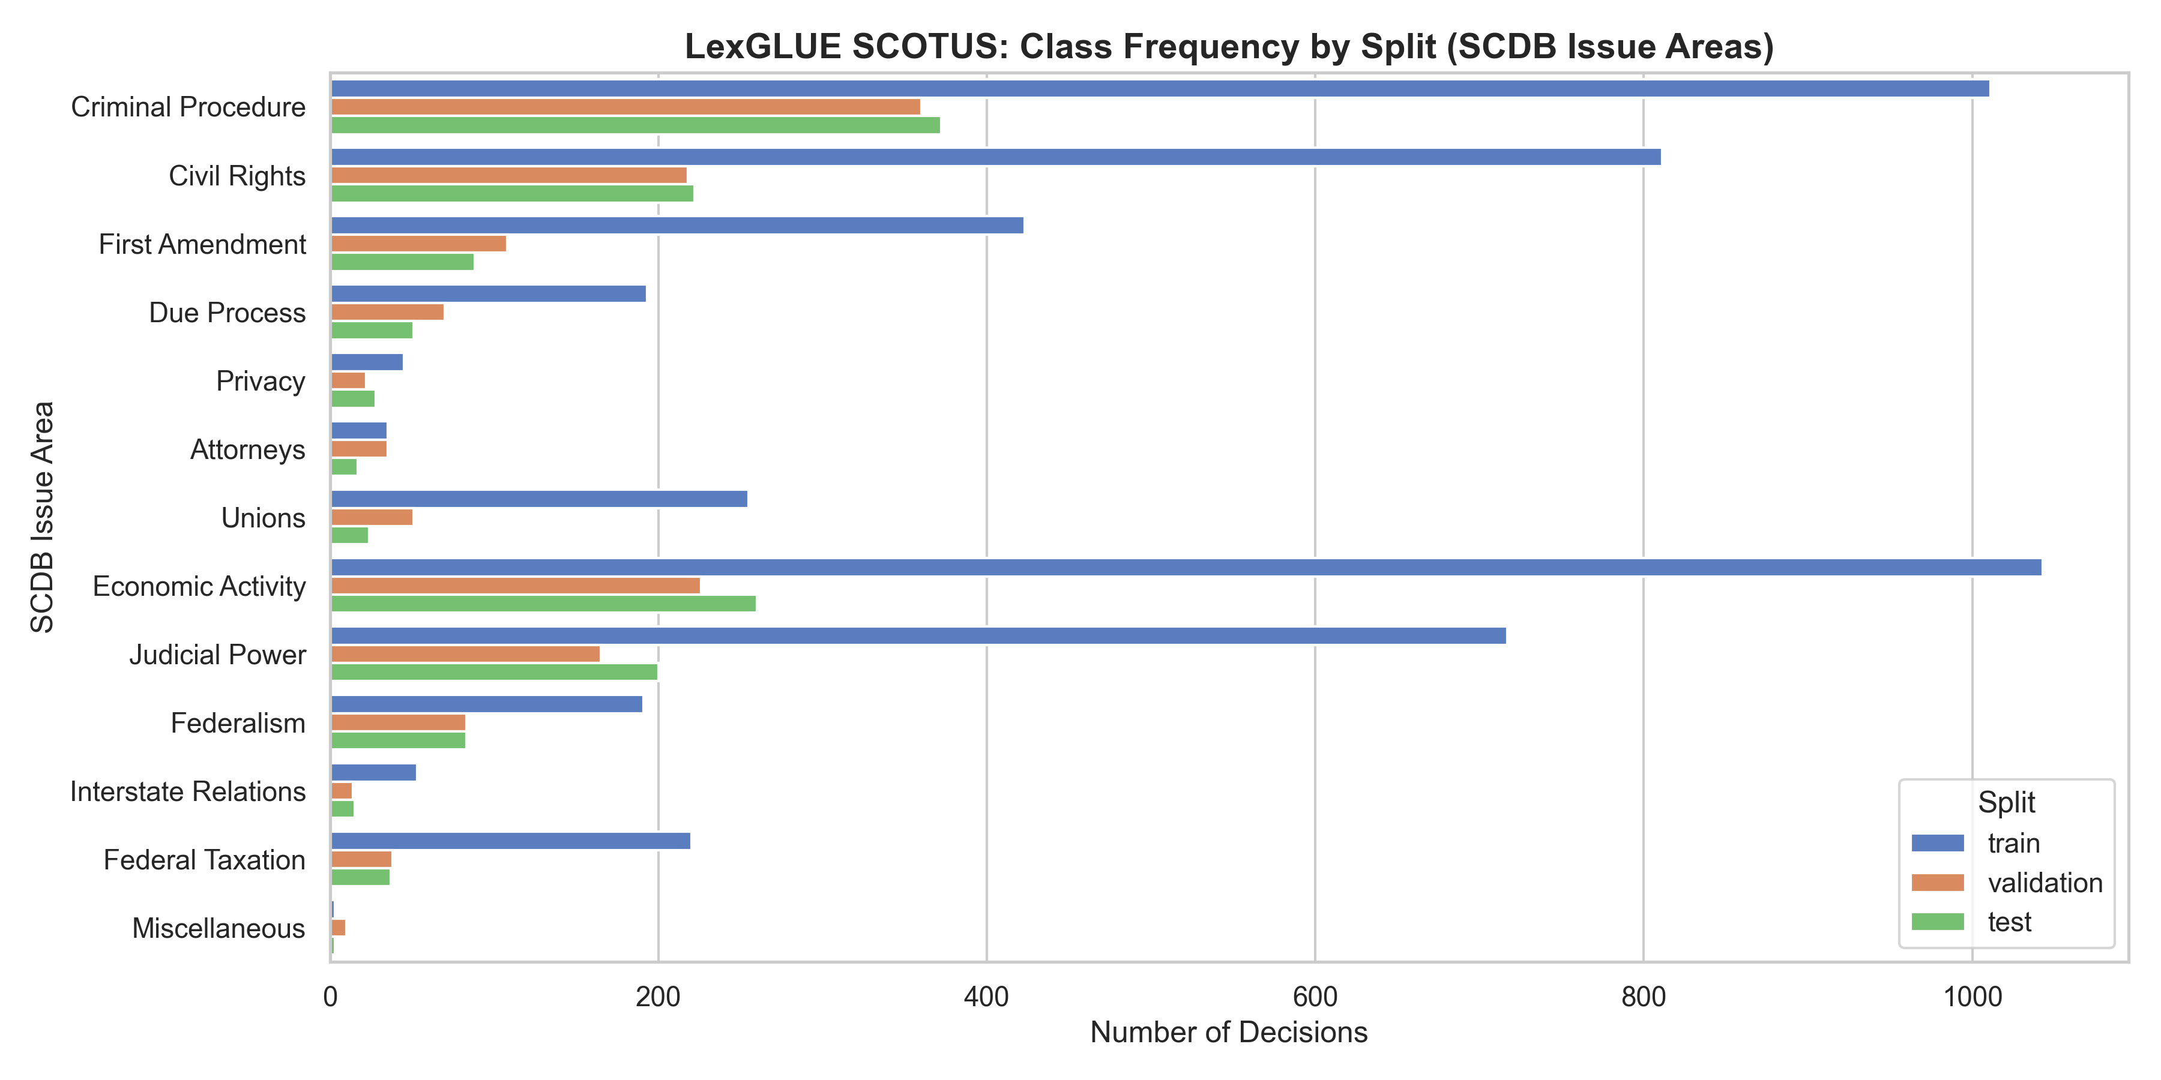
Dataset: LexGLUE SCOTUS
coastalcph/lex_glue, config scotus; SCDB labels
7,800 opinions, official chronological splits
train 5,000 (1946–1982)
validation 1,400 (1982–1991)
test 1,400 (1991–2016)
No empty texts, no duplicates (SHA-256)
Imbalance 347.7 : 1 (Economic Activity vs Miscellaneous)
Rarest test classes: Miscellaneous (3), Interstate Relations (15), Attorneys (17)
Classification of Legal Text · UE24CS352A Machine Learning
4 / 15
Notes:
We use the SCOTUS task of the LexGLUE benchmark from the Hugging Face Hub. It has 7,800 opinions in official splits that LexGLUE created chronologically: training 1946–1982, validation 1982–1991, test 1991–2016. We found no empty texts and no exact duplicates within or across splits. The chart shows the imbalance: Economic Activity has 1,043 training documents and Miscellaneous only 3, a ratio of 347.7 to 1. In the test split the rarest classes have 3, 15, 17 documents, so their F1 scores are very noisy.

Slide 5
Pipeline
TF-IDF (1–2-grams)
LinearSVC · LR (SGD)
Saved predictions
evaluate_all.py
metrics · CIs
confusion · errors
README · PDF
slides · demo
Counts → LDA
Logistic regression
LexGLUE SCOTUS
5,000 / 1,400 / 1,400
train / val / test
Normalise
numbers out, legal
stop-word list
Doc2Vec (PV-DM)
Logistic regression
Word pieces (≤ 512)
Legal-BERT fine-tune
Fit on train only · tune on validation only · test predicted once per model · seed 42
Classification of Legal Text · UE24CS352A Machine Learning
5 / 15
Notes:
The data flows left to right. Text is normalised, and every feature extractor is fitted on the training split only. Each feature type feeds its classifier: TF-IDF into LinearSVC and logistic regression, raw counts into LDA, tokens into Doc2Vec, and word pieces into Legal-BERT. Hyperparameters are chosen on validation; the test split is predicted once per model. Every model saves its predictions, and one script, evaluate_all.py, computes all metrics, confidence intervals, confusion matrices and the error analysis from those files. The README, write-up, slides and demo all read from results/.

Slide 6
Preprocessing
Unicode NFKC, lower case, collapse whitespace
Delete standalone numbers (citations, docket numbers, years identify the era, not the topic); keep 12th, 1st
Stop words: scikit-learn list minus meaning-changing words: not, no, never, shall, may, must, without, unless, …
No stemming or lemmatisation
Leakage control: vectorizers, LDA and Doc2Vec fitted on train only (unit-tested)
Raw opening (train example)
348 U.S. 540 75 S.Ct. 509 99 L.Ed. 624 Louis SHOMBERG, Petitioner,v.UNITED STATES of America. No. 48. Argued March 1,
After normalize_text()
u.s. s.ct. l.ed. louis shomberg, petitioner,v.united states of america. no. . argued march ,
Classification of Legal Text · UE24CS352A Machine Learning
6 / 15
Notes:
Normalisation is deliberately conservative. We apply Unicode NFKC, lower-case the text and collapse whitespace. Standalone numbers are deleted, because reporter citations, docket numbers and years identify the period of a case rather than its topic, and our split is chronological. Tokens like 12th survive. We use scikit-learn's English stop words but keep words that change legal meaning, such as not, shall, must and unless. There is no stemming. A validation-only check with the earlier saga model gave macro F1 0.580 with numbers removed and 0.556 with them kept; that model was under-converged, so this is only a rough indication. Most important: every vectorizer and embedding model is fitted on the training split only, and a unit test checks that a validation-only word never enters the vocabulary.

Slide 7
Classical ML: TF-IDF + linear models
TF-IDF: unigrams + bigrams, 10,000 features, sublinear tf, min_df 2, max_df 0.98
LinearSVC: L2, squared hinge; C = 1.0 chosen from 0.01, 0.1, 1.0
Logistic regression: SGD on log loss, L2; alpha = 1e-5 from 1e-6, 1e-5, 1e-4; converged in 9 / 50 epochs
First LR (saga, max_iter 5, tol 0.5) was under-converged: kept only as a reference
All choices made on validation macro F1
Model | Val macro F1 | Test macro F1
TF-IDF + LinearSVC | 0.724 | 0.635
TF-IDF + LR (SGD) | 0.712 | 0.629
TF-IDF + LR (saga, under-conv.) | 0.580 | 0.470
Classification of Legal Text · UE24CS352A Machine Learning
7 / 15
Notes:
Both classical models share one TF-IDF matrix of word unigrams and bigrams, capped at 10,000 features, with sublinear term frequency, fitted on train. LinearSVC minimises the squared hinge loss with L2 regularisation; C = 1.0 was best of 0.01, 0.1, 1.0 on validation. For logistic regression the first attempt used the saga solver with only 5 iterations and tolerance 0.5, so it stopped long before convergence: validation macro F1 0.580. We kept it only for transparency and replaced it with SGDClassifier on log loss, which is logistic regression trained by stochastic gradient descent. With alpha 1e-5 it converged after 9 of 50 epochs and reached 0.712 on validation. No class weights were used.

Slide 8
Paper methods: LDA and Doc2Vec
LDA + LR: topic mixture of each document as features
raw counts (500 terms, min_df 5), 2 batch iterations
K chosen on validation from 10, 20, 30, 40 → K = 40 (grid edge)
Doc2Vec + LR: PV-DM, 100 dims, window 5, 5 epochs
trained on train only; val/test vectors inferred
first 500 tokens of each document
Reduced CPU configurations: results are a lower bound for these methods
Model / setting | Val macro F1 | Test macro F1
LDA, K = 10 | 0.223 | –
LDA, K = 20 | 0.292 | –
LDA, K = 30 | 0.320 | –
LDA, K = 40 | 0.349 | 0.321
Doc2Vec | 0.406 | 0.322
Classification of Legal Text · UE24CS352A Machine Learning
8 / 15
Notes:
These are the reference paper's two methods. For LDA we use raw word counts, which suit LDA's multinomial model better than the TF-IDF input the paper describes. We swept the number of topics over 10, 20, 30, 40 on validation; K = 40 was best, at the edge of the grid. Doc2Vec is the PV-DM paragraph-vector model with 100 dimensions, trained on train only; validation and test vectors are inferred. Both ran in reduced CPU configurations: LDA with 500 count features and 2 iterations, Doc2Vec with 5 epochs on the first 500 tokens. Their test macro F1, 0.321 and 0.322, is far below TF-IDF, but we do not claim the methods are weak in general.

Slide 9
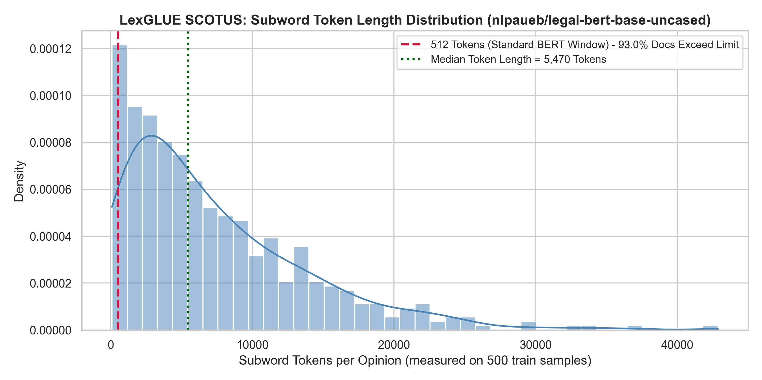
Transformer: Legal-BERT
nlpaueb/legal-bert-base-uncased + classification head
Input: first 512 tokens only
3 epochs, batch 8 × accumulation 2 = 16, lr 2e-5, weight decay 0.01, mixed precision
No class weights; best epoch by validation macro F1
Colab Tesla T4, 19.6 min
Three identical runs: test macro F1 0.5124–0.5319 (reported: 0.5124)
93% of documents exceed 512 tokens
first 512 tokens ≈ 20% of a document (median ≈ 5,470 tokens)
Classification of Legal Text · UE24CS352A Machine Learning
9 / 15
Notes:
We fine-tuned nlpaueb/legal-bert-base-uncased, a BERT model pretrained on legal text, with a classification head. BERT reads at most 512 tokens, and these opinions are long: on a 500-document sample the median is about 5,470 tokens, 93 percent exceed the limit, and the first 512 tokens cover about 20 percent of a document. Training: 3 epochs, batch 8 with gradient accumulation 2, learning rate 2e-5, weight decay 0.01, mixed precision, plain cross-entropy, best epoch by validation macro F1, on a Colab Tesla T4 in 19.6 minutes. Three identical runs gave test macro F1 between 0.5124 and 0.5319; we report the 0.5124 run, and the demo weights come from the rerun.

Slide 10
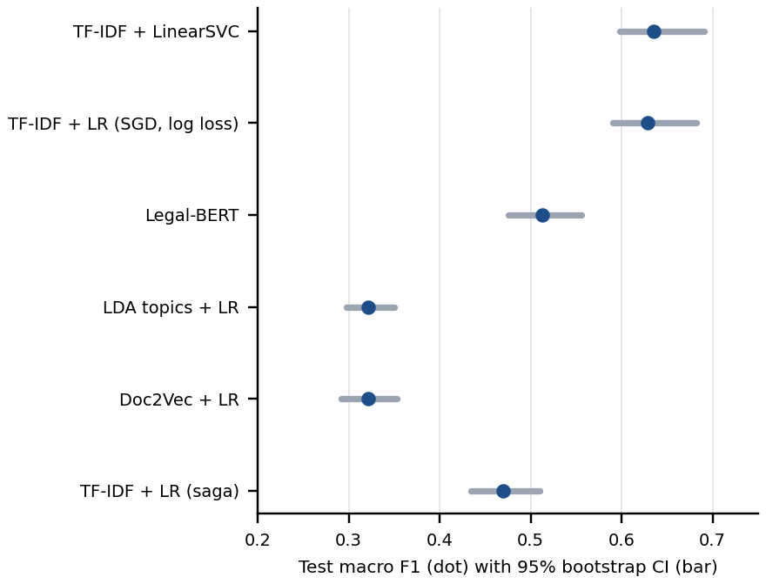
Results (test split)
Model | Macro F1 | 95% CI | Accuracy
TF-IDF + LinearSVC | 0.635 | [0.598, 0.691] | 0.737
TF-IDF + LR (SGD, log loss) | 0.629 | [0.590, 0.682] | 0.732
Legal-BERT (512 tok.) | 0.512 | [0.476, 0.556] | 0.724
LDA topics + LR | 0.321 | [0.298, 0.350] | 0.546
Doc2Vec + LR | 0.322 | [0.292, 0.353] | 0.474
TF-IDF + LR (saga, under-conv.) | 0.470 | [0.434, 0.510] | 0.680
Majority class (train) | 0.024 | [0.022, 0.027] | 0.186
TF-IDF models best; Legal-BERT's CI and LinearSVC's do not overlap
Macro F1 punishes ignoring rare classes
Classification of Legal Text · UE24CS352A Machine Learning
10 / 15
Notes:
Here are the final test results; macro F1 is the primary metric and the intervals are bootstrap 95 percent intervals over 1,000 test resamples. The two TF-IDF models are best, LinearSVC 0.635 and logistic regression 0.629; their intervals overlap, so we do not rank one above the other. Legal-BERT has accuracy close to them, 0.724, but macro F1 only 0.512: it does well on the large classes and badly on the small ones. Its interval and LinearSVC's do not overlap. The paper methods are near 0.321. The saga row is the under-converged reference, and the majority baseline shows why accuracy alone is misleading.

Slide 11
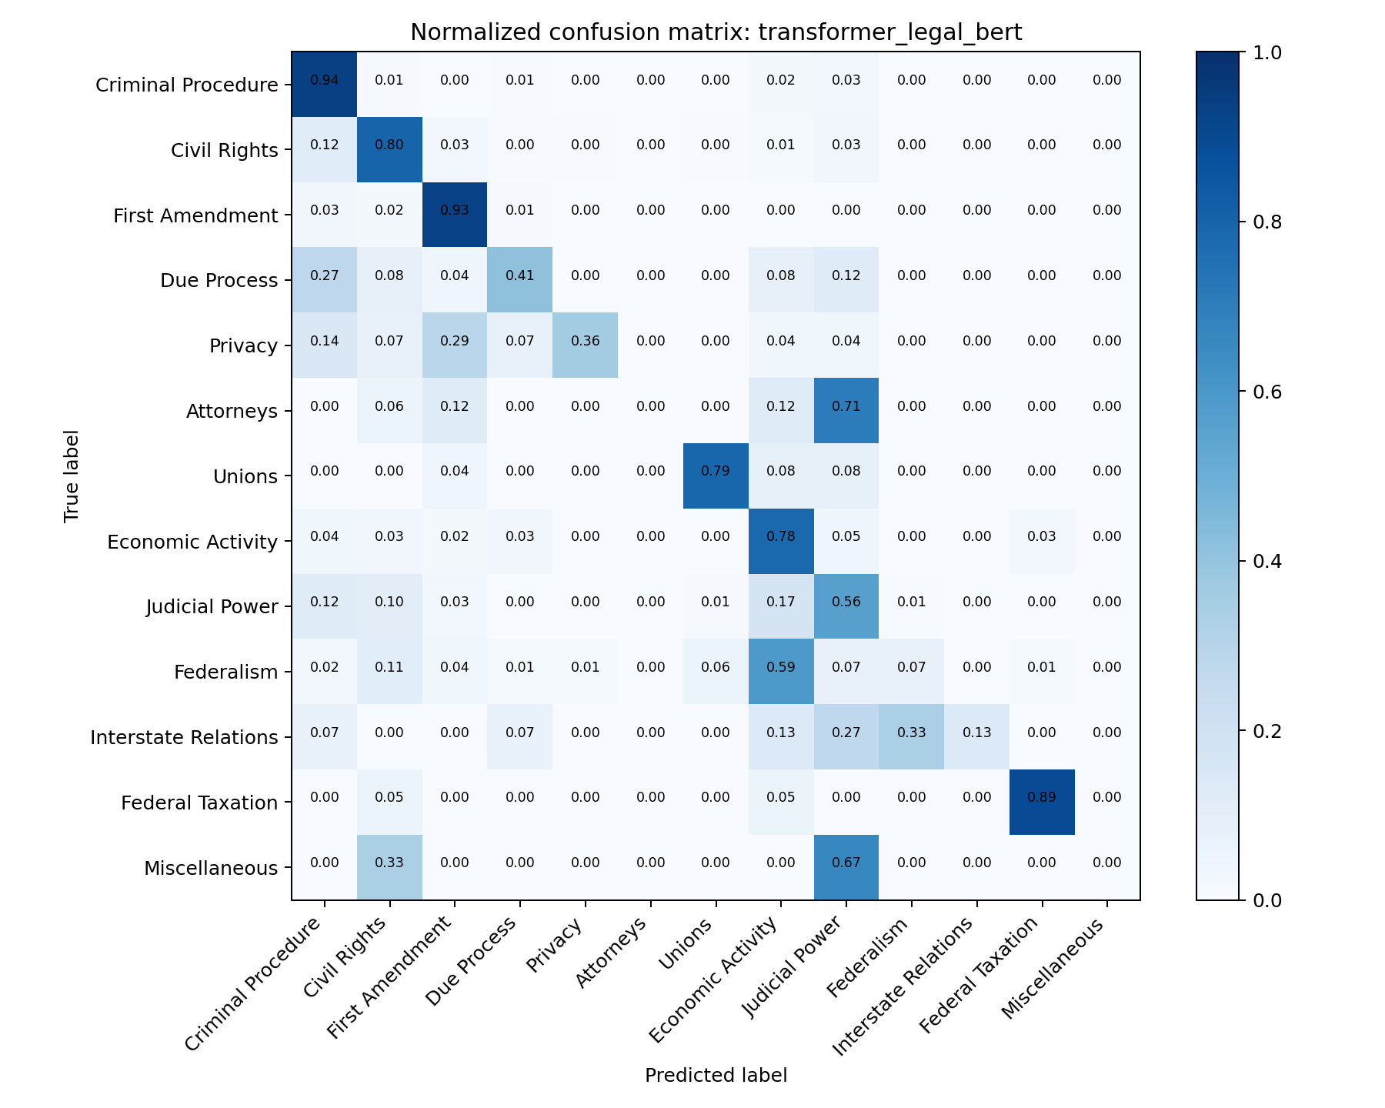
Error analysis
Top confusion: Federalism → Economic Activity for both LinearSVC (37 test cases) and Legal-BERT (49)
Judicial Power is confused with Economic Activity, Criminal Procedure and Civil Rights
Legal-BERT never correctly predicts Attorneys and Miscellaneous; Federalism recall 7%
Different mistakes: 121 cases right only for SVC, 103 only for Legal-BERT
Little length effect: accuracy by length quartile 0.694–0.769 (SVC), 0.706–0.732 (Legal-BERT)
Classification of Legal Text · UE24CS352A Machine Learning
11 / 15
Notes:
This is Legal-BERT's normalised confusion matrix on the test split. The most frequent confusion is Federalism → Economic Activity for both LinearSVC (37 test cases) and Legal-BERT (49). Judicial Power is often confused with Economic Activity, Criminal Procedure and Civil Rights. Legal-BERT never correctly predicts Attorneys and Miscellaneous, and recalls only 7 percent of Federalism and 13 percent of Interstate Relations. The two models make different mistakes: 121 test cases are right only for LinearSVC, 103 only for Legal-BERT, and 265 are wrong for both. Accuracy changes little across document-length quartiles: LinearSVC 0.694 to 0.769, Legal-BERT 0.706 to 0.732. These explanations are hypotheses from saved predictions, not tested causes.

Slide 12
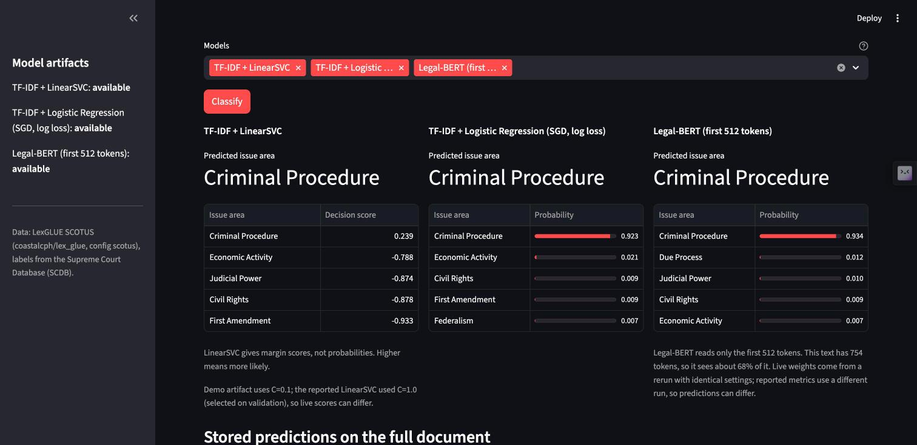
Live demo: Streamlit app
streamlit run app.py
Pick a sample test case or paste an opinion
Live predictions from LinearSVC, LR and Legal-BERT with top-5 scores
Truncation warning: how much text Legal-BERT read
Stored full-document predictions for comparison
Results tab: metrics, CIs, confusion matrices from results/
Classification of Legal Text · UE24CS352A Machine Learning
12 / 15
Notes:
Run streamlit run app.py. In the Classify tab, pick a sample test case, one per class, or paste any opinion, choose models and press Classify. Each model shows its prediction and its top five scores: probabilities for logistic regression and Legal-BERT, margin scores for LinearSVC. Legal-BERT also reports how much of the text it could read. Below, the app shows the stored predictions each model made on the full opinion. The Results tab shows the same metrics as these slides, read from results/. Two honest caveats: the demo Legal-BERT weights are from the rerun, and the demo LinearSVC artifact uses C = 0.1 rather than the reported 1.0; the app says both on screen.

Slide 13
Limitations
Legal-BERT sees only the first 512 tokens (≈ 20% of a typical opinion)
LDA and Doc2Vec ran in reduced CPU configurations (K = 40 at the grid edge)
One seed per model; Legal-BERT runs ranged 0.5124–0.5319
Chronological split: test is a later period; every trained model drops val → test (LinearSVC by 0.089)
Rare classes: test support 3, 15, 17 documents, so macro F1 is noisy
Bootstrap CIs are unpaired and capture test sampling only; no class weighting anywhere
Classification of Legal Text · UE24CS352A Machine Learning
13 / 15
Notes:
We want to be clear about what these results do and do not show. Legal-BERT read only the first 512 tokens, about 20 percent of a typical opinion, so its result is for truncated input. LDA and Doc2Vec ran in reduced CPU configurations. Every model was trained once with one seed, and Legal-BERT alone varied between 0.5124 and 0.5319. The split is chronological, so test cases come from a later period; every trained model drops from validation to test. The rarest test classes have 3, 15, 17 documents, so macro F1 is noisy. Our bootstrap intervals are unpaired and only capture test sampling. No model used class weights.

Slide 14
Conclusion and future work
Whole-document TF-IDF + linear model wins: LinearSVC 0.635, LR 0.629 macro F1
Legal-BERT on 512 tokens: close accuracy (0.724), lower macro F1 (0.512); fails on rare classes
Paper methods 0.321 / 0.322 in reduced configurations
Everything reproducible from saved predictions; numbers generated, not typed
Future work
Hierarchical Legal-BERT or Longformer over the whole opinion
Class-weighted / focal loss for rare classes
Several seeds; paired bootstrap or McNemar tests
Full-size LDA and Doc2Vec; wider K grid
Strip caption and counsel header before classifying
Classification of Legal Text · UE24CS352A Machine Learning
14 / 15
Notes:
To conclude: simple linear models that read the whole document were the best, at about 0.635 macro F1. Legal-BERT on the opening of each opinion reached similar accuracy but much lower macro F1, mainly because it fails on rare classes; we think truncation and the lack of class weighting explain much of this, but we have not tested it. The paper's methods trail behind in our reduced configurations. Next steps: a hierarchical or long-document Transformer over the whole opinion, class-weighted loss and several seeds with paired tests, full-size LDA and Doc2Vec, and removing the caption and counsel header before classifying.

Slide 15
References
K. Iyer. Classification of Legal Text. Stanford CS229 project report, Spring 2020.
I. Chalkidis, A. Jana, D. Hartung, M. Bommarito, I. Androutsopoulos, D. M. Katz, N. Aletras. LexGLUE: A Benchmark Dataset for Legal Language Understanding in English. ACL 2022 (arXiv:2110.00976).
H. J. Spaeth, L. Epstein, J. A. Segal, A. D. Martin, T. J. Ruger, S. C. Benesh. Supreme Court Database, Version 2020 Release 01. Washington University Law.
I. Chalkidis, M. Fergadiotis, P. Malakasiotis, N. Aletras, I. Androutsopoulos. LEGAL-BERT: The Muppets straight out of Law School. Findings of EMNLP 2020.
Code and results: github.com/AhanaSrinivas/legal-text-classification
Model artifacts: huggingface.co/AhanaSrinivas/legal-text-classification-artifacts
Classification of Legal Text · UE24CS352A Machine Learning
15 / 15
Notes:
These are the four sources we rely on. The chronological split and its years come from the LexGLUE paper, section three; the labels come from the Supreme Court Database. The code, results and these documents are in the GitHub repository; the fitted demo models are on the Hugging Face Hub. Thank you; we are happy to take questions.

