Slide 1

BT-Seg
Brain Tumor Segmentation
ARI AHARON SHEMESH
ITAY ASAEL

Slide 2
Project Overview
Objective: build a reproducible end‑to‑end pipeline that segments brain tumors sub‑regions (ET, TC, WT) from multi‑parametric MRI.
Core ingredients
Data: BraTS‑2019 cohort (uniform 4‑sequence MRI, vetted annotations).
Model: 3D‑TransUNet (ViT + UNet) trained with the nnU‑Net engine.
Execution environment: Google Colab + Drive for storage; single‑GPU, non‑distributed code base.

Slide 3
MRI Modalities & Labels
Modalities (4 channels per subject)
T1 pre‑contrast (structural baseline)
T1 post‑contrast (T1c, captures BBB disruption)
T2‑weighted (T2w, edema / fluid)
T2‑FLAIR (T2f, suppresses CSF to highlight lesions)
Segmentation classes (BraTS convention)
Label 1: Necrotic & non-enhancing tumor core (NETC)
Label 2: Peritumoral edema (ED)
Label 4: Enhancing tumor (ET)
Three composite regions:
Whole Tumor (WT) = labels 1 + 2 + 4
Tumor Core (TC) = labels 1 + 4
Enhancing Tumor (ET) = label 4 only

Slide 4
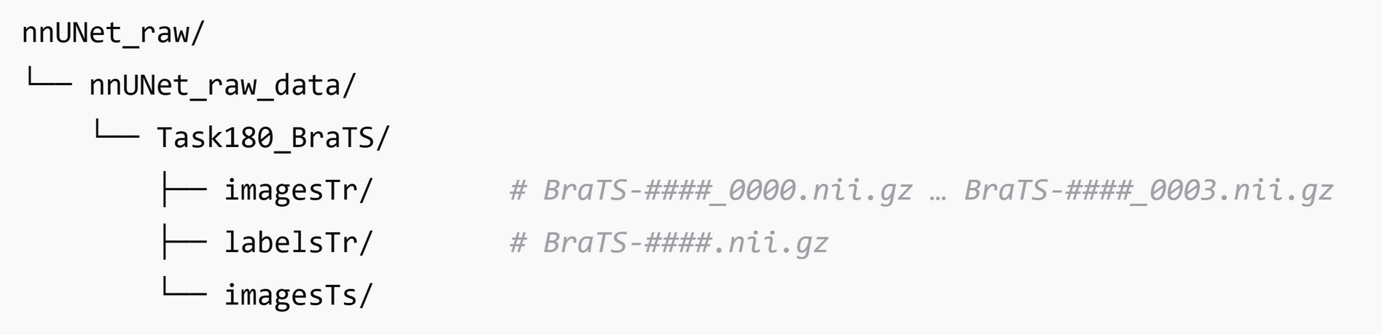
nnU‑Net‑Compatible Folder + JSON
dataset.json auto‑generated with helper function in the notebook; records modalities, label map, training/test IDs, licence, etc.
Guarantees that any nnU‑Net version can “see” the dataset without manual tweaks.

Slide 5
Pre‑processing Workflow
Copy & rename raw NIfTI files ➜ _0000…_0003 pattern.
Compress .nii → .nii.gz (≈ 70 % space saved).
Run nnUNet_plan_and_preprocess
Spacing normalization (1 mm isotropic)
Intensity standardization
Patch‑size search (128 × 160 × 112)
Quick axial‑slab visualization (matplotlib) to verify image/label alignment before training.

Slide 6
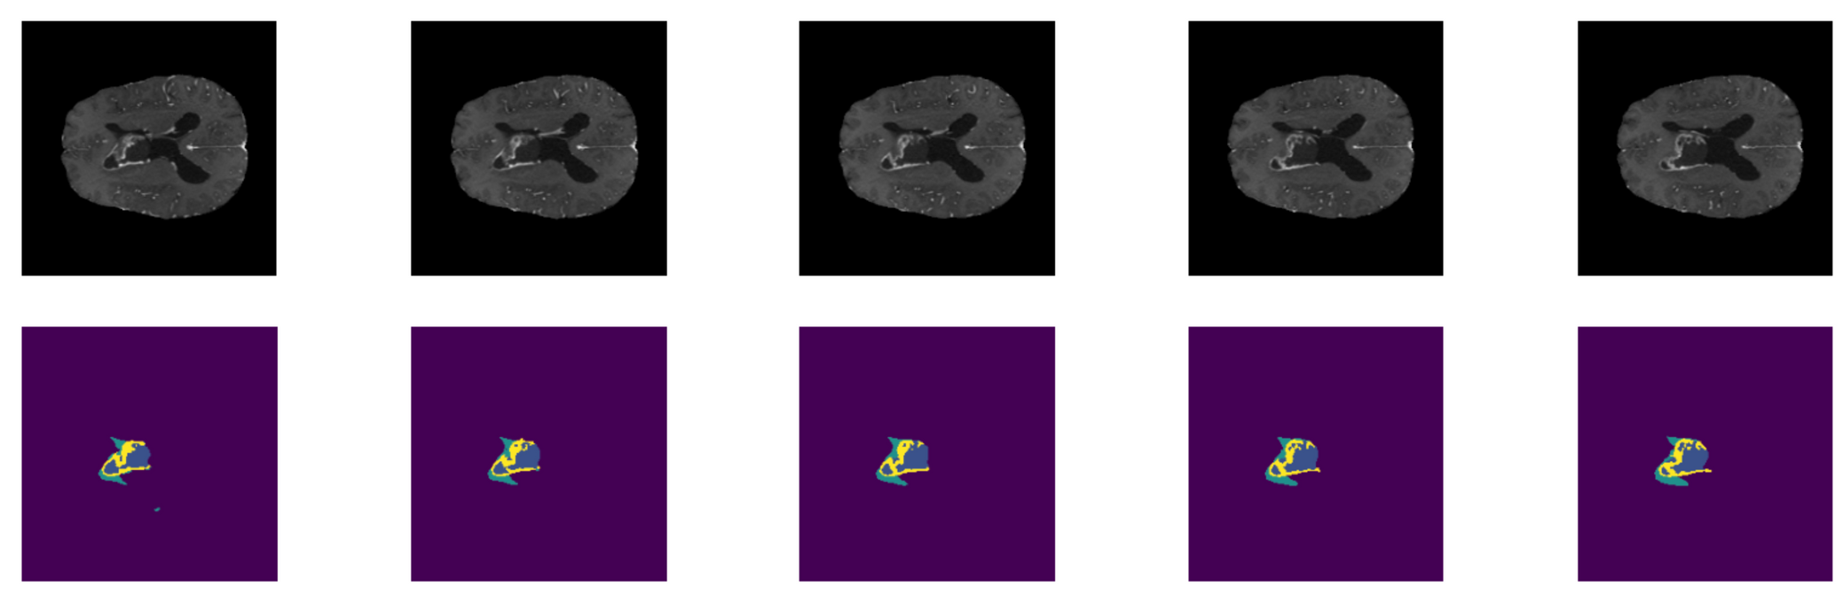
Data Visualization & Sanity Checks
Random 5‑slice slab shows four MRI channels + corresponding mask; confirms contrast, orientation and label integrity.
Helps catch flipped axes or empty masks early, avoiding wasted GPU hrs.

Slide 7
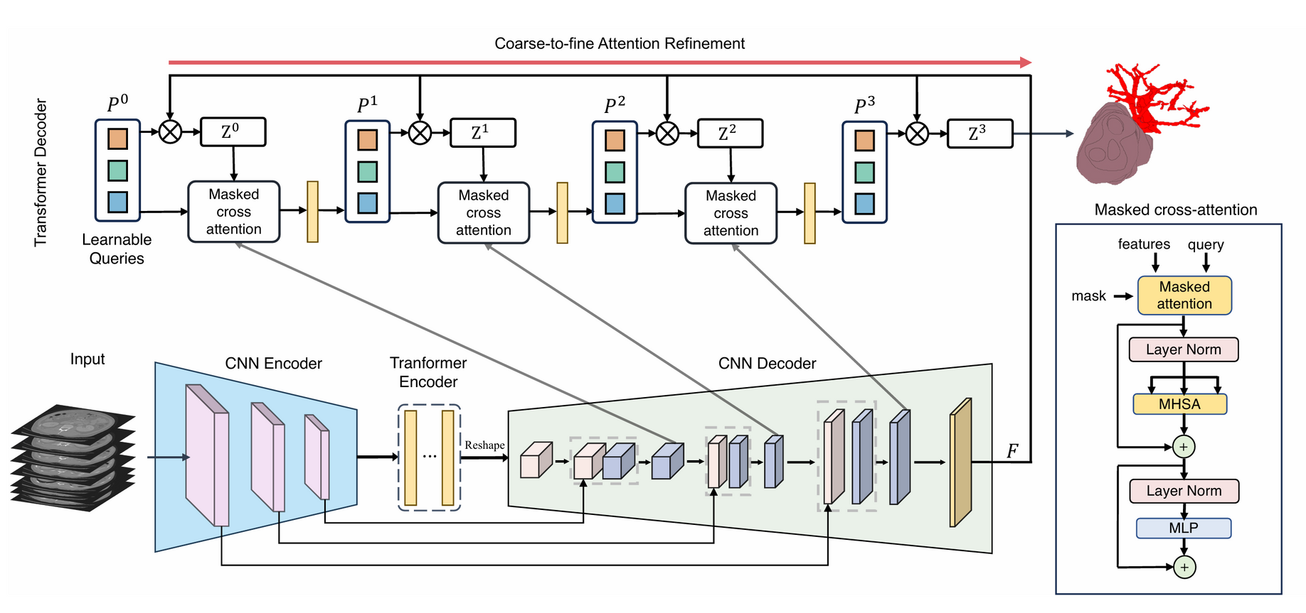
3D‑TransUNet Architecture

Slide 8
3D‑TransUNet Architecture
Encoder: CNN stem ➜ flattened patches ➜ 12‑layer ViT (hidden = 768, heads = 12).
Decoder: Coarse‑to‑fine cross‑attention refinement; CNN skip‑connections for spatial detail.
Strengths:
Combines ViT global context with UNet locality.
Out‑performed pure CNN baselines on BraTS‑MET 2023 (Dice↑).

Slide 9
Custom Trainer: nnUNetTrainerV2
Data Augmentations:
Random rotations about x/y/z: [-30º,+30º]
Isotropic random scaling: [0.7, 1.4]
Random horizontal flips
LR schedule:
Vanilla nnU‑Net: Polynomial decay.
Customized logic: Cosine + warm‑up
Distributed:
Vanilla nnU‑Net: DDP ready.
Customized logic: Stripped for single‑GPU Colab.
Loss:
Vanilla nnU‑Net: Dice + CE.
Customized logic: Multi‑output loss, DS weights (multiple outputs at progressively lower resolutions).

Slide 10
New Contribution:
Hausdorff (HD95) Distance
HD measures the maximum (over boundary points of one mask) of the minimum distance to the other mask boundary, under the image voxel spacing. HD95 uses the 95th percentile instead of the absolute max to reduce outlier sensitivity.
We implemented nnUNetTrainerV2_HD95 to log per-epoch HD95 (mm) for BraTS composite regions:
ET (Enhancing Tumor) = label 4
TC (Tumor Core) = labels {1,4}
WT (Whole Tumor) = labels {1,2,4}
During Validation we convert softmax to hard labels (argmax), read spacing from nnU-Net plans and compute hd95 per case.

Slide 11
Metrics – Dice vs. HD95
Dice:
Pros: robust to class imbalance, soft Dice works well for training.
Cons: boundary-insensitive; can be high despite millimeter-scale shifts or ragged margins; unitless.
HD95:
Pros: boundary‑sensitive and interpretable in mm; highlights spurious islands and missed margins that barely affect Dice; especially informative for small targets (like small metastasis).
Cons: undefined/infinite for empty‑set mismatches (must be handled with NaN/∞ rules), sensitive to spacing/resampling, not differentiable.

Slide 12
Training Configuration
YAML (decoder_only.yaml)
vit_depth = 12, hidden = 768, epochs = 80, batch = 4, AdamW (3 e‑4).
Execution wrapper (train.py)
Copies pre‑processed cache from Drive ➜ Colab SSD.
Sets CUDA_VISIBLE_DEVICES=0, skips distributed init.
Supports mixed precision.

Slide 13
Fold 0 Results (208 train / 53 val cases, 80 epochs)
Experimental split: The five‑fold partition created by nnUNet_split_folds.py assigned 208 subjects to training and 53 to validation for fold 0.
Optimizer & schedule: AdamW (β = 0.9/0.999, weight‑decay 1e‑2) with cosine‑annealing from 3 × 10⁻⁴ → 1 × 10⁻⁶ across 80 epochs.
Convergence profile: Loss curves show a rapid drop during the first 10 epochs followed by a smooth glide‑path to convergence.
Generalization: Parallel trajectories of train/val curves and the absence of late‑epoch divergence indicate minimal over‑fitting despite the relatively small validation cohort.

Slide 14
Fold 0 Results (208 train / 53 val cases, 80 epochs)
Best checkpoint: Validation minimum (‑0.50) reached at epoch 65; this checkpoint has been exported to Drive as fold0_ep065_best.pt for downstream inference.
Throughput:
Mean epoch wall‑time: 17 min on an NVIDIA A100‑40 GB
GPU memory footprint: ≈ 9 GiB (batch = 4, mixed precision)
New validation metric: HD95 (mm) collapses rapidly in the first 10 epochs and flattens around 5-8mm across ET/TC/WT by the end of training – useful signal beyond Dice for boundary quality.

Slide 15
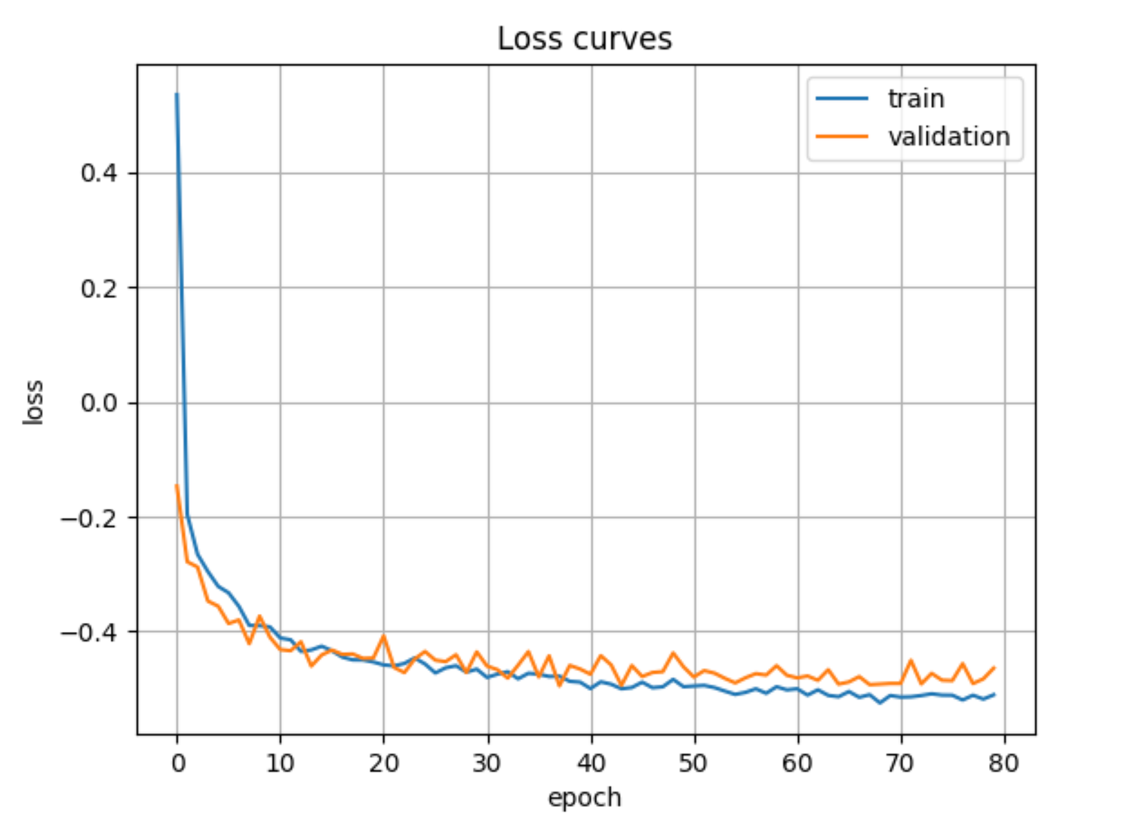
Fold 0 Results (208 train / 53 val cases, 80 epochs)

Slide 16
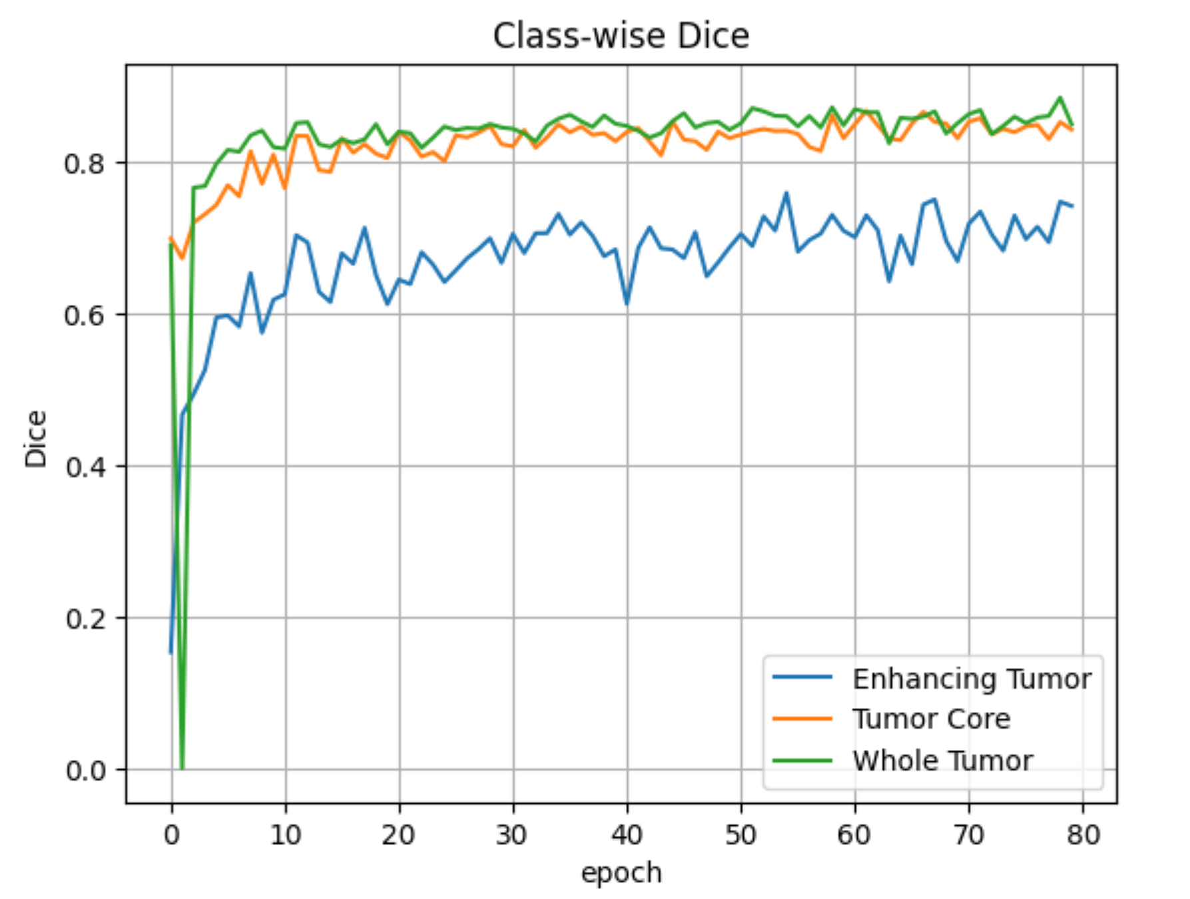
Fold 0 Results (53 validation cases, 80 epochs)

Slide 17
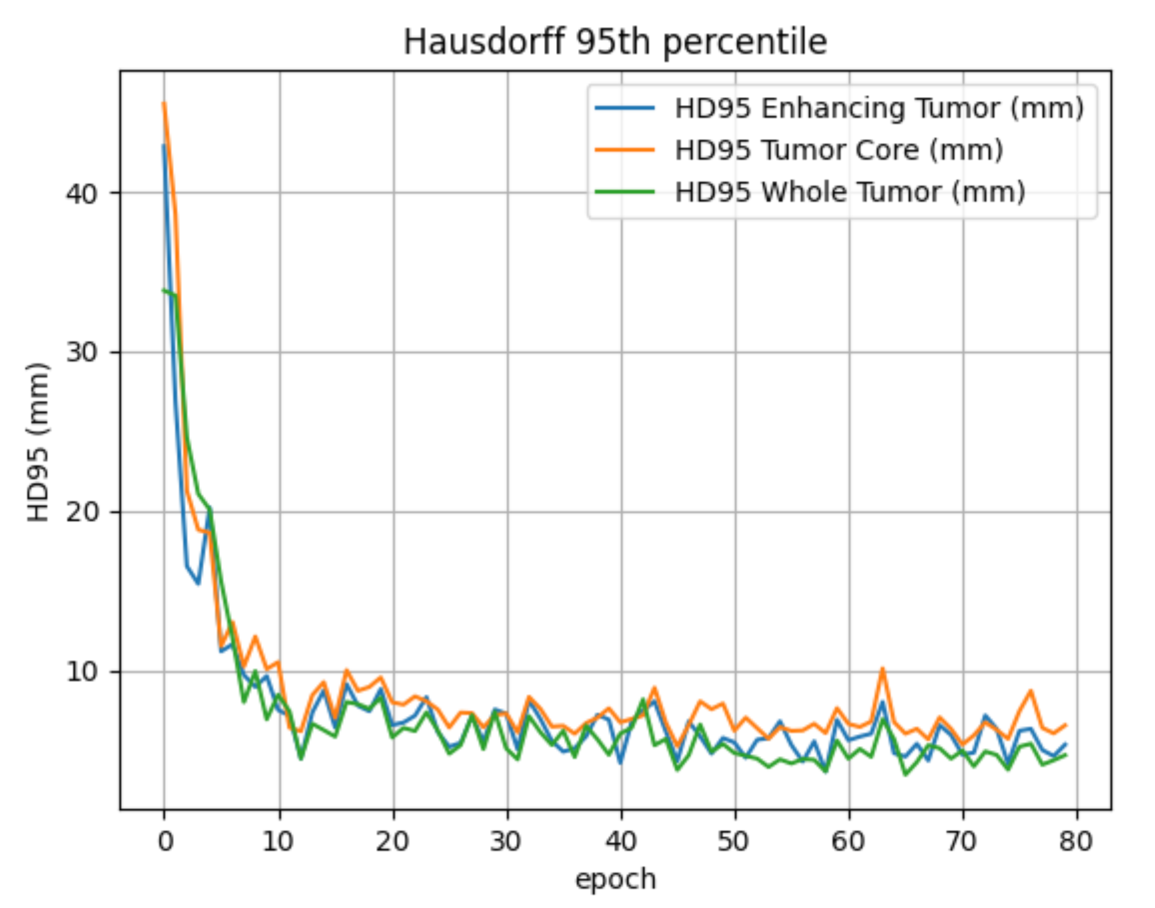
Fold 0 Results (53 validation cases, 80 epochs)

Slide 18
Why do the logged “loss” values end up below zero?
The loss is a composite of two terms with opposite signs:
Soft‑Dice term : Range (0…1); In TransUNet code we minimize the negative of the Dice score so that maximizing Dice (towards 1) drives the total loss down.
Cross‑Entropy (CE) term: Range (≥ 0); Penalizes voxel‑wise class mistakes, especially early in training.
The combined loss implemented in DC_and_CE_loss and wrapped by MultipleOutputLoss2 is roughly loss = (‑soft_dice) + (α · cross_entropy)
As training progresses Dice grows toward 1, so ‑soft_dice approaches –1, while CE shrinks toward 0.
Result: the sum becomes negative once the Dice contribution dominates.

Slide 19
Conclusions
End‑to‑end reproducibility achieved – A complete 3D‑TransUNet pipeline, from BraTS‑2019 data ingestion to checkpoint export, now runs on a single‑GPU Google Colab environment with no manual tweaks thanks to nnU‑Net’s auto‑planning and dataset‑JSON conventions.
Stable convergence in the pilot run – The 80‑epoch experiment on Fold 0 showed a fast initial loss drop and parallel train/val curves, with the best model captured at epoch 65 (loss ≈ ‑0.50), indicating minimal over‑fitting and confirming that the negative composite loss is expected once Dice dominates Cross‑Entropy.

Slide 20
Conclusions
Resource footprint is modest – Average wall‑time of 17 min / epoch and ≈ 9 GiB GPU memory (batch = 4, mixed precision) demonstrate that state‑of‑the‑art volumetric segmentation can be trained on widely‑available cloud GPUs.
Paper‑level performance is within reach – The published TransUNet BraTS‑2023 scores (WT 93.9 %, TC 92.5 %, ET 88.9 %) were obtained with 1 000 epochs over all folds; extending the training schedule and completing the 5‑fold protocol should close the remaining performance gap.
Clear next steps – Scale to the full 1 000‑epoch, 5‑fold regime.

Slide 21
Thank you very much!

