Slide 1
SogeYoung

Slide 2


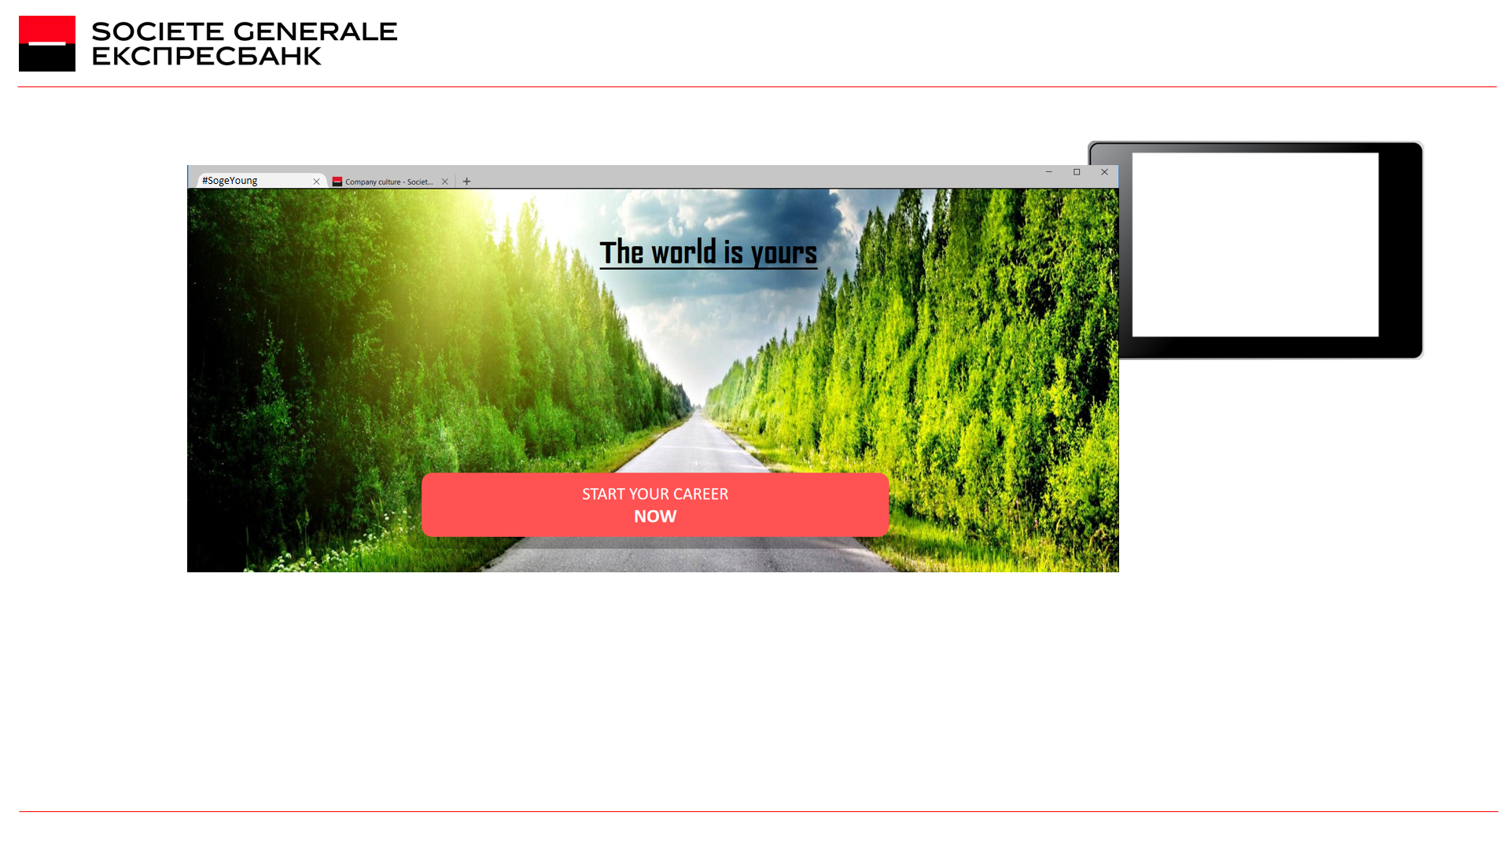



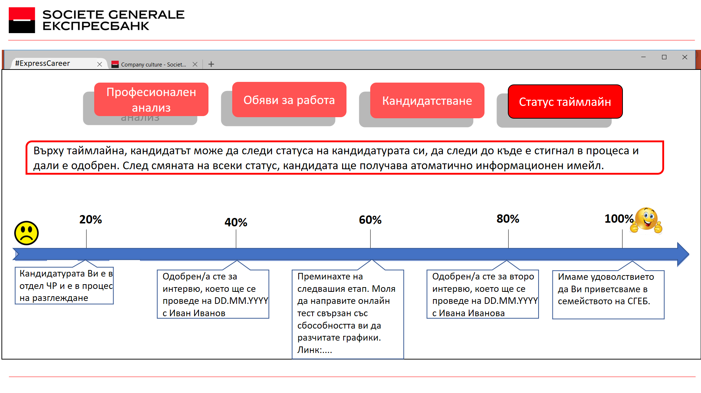
Our project is to find the quick and
easy way to reach students and attract them as future employees of SGEB

Slide 3

Facts: Strong decrease
in the number of
applicants in
SGEB (students and
young professionals).
Last two weeks we explored the biggest obstacles that stop young people from entering the labour market.

Slide 4
Validated Hypothesis:
The biggest issues were “Lack of Experience” and “Respect towards the Institution”
70% of the students feel intimidated to get in contact with the employer.

Slide 5
Validated Hypothesis:
Other validated issues when applying were “Hard to find the right position” and “The actual process of the interview”
70% of the students feel intimidated to get in contact with the employer.

Slide 6

What do we aim to do in the next two weeks?
Training interviews with “chat bot”
Career orientation test
Unofficial language improves the response in young people
Testing whether a branded or unbranded and more social approach yields better results

Slide 7

How we’ll reach them?
Facebook page/adds (one for career testing and one for SG Robo)
Email marketing
Application behaviour test
Field tests
#Soge Young
#Soge Young

Slide 8

Alexander
Student
Jordan
Student
Maria
HR Dept.
Tsvetlena
GSO Dept.
Kristina
Retail Division
Martin
DPO Dept.

