Slide 1
SogeYoung

Slide 2






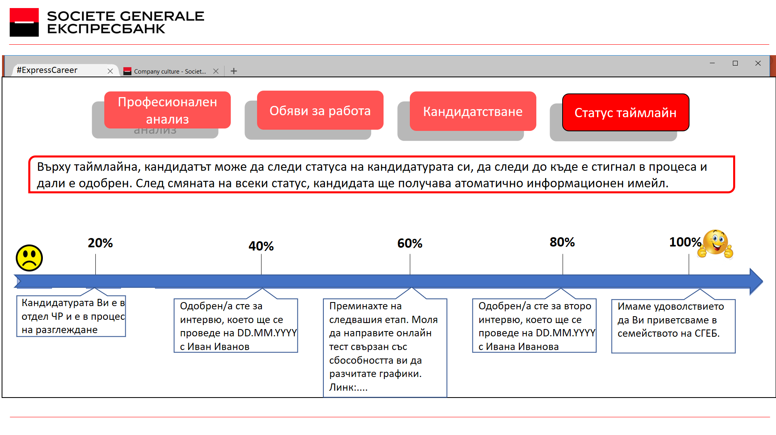
Application for quick and
easy way to reach students
and attract them as future
employees of SGEB

Slide 3

Facts: Strong decrease
in the number of
applicants in
SGEB (students and
young professionals)
Due to:
- Statistical evolution

Slide 4

Validated Hypothesis: Strong decrease
in the number of
applicants in
SGEB (students and
young professionals)

Slide 5

SogeYoung is application providing to students:
useful information
career consultation
training for real interviews

Slide 6

Reaching students?
Where else than online!
5 hours spent daily online
90% search job from mobile device (hypotheses)
#Soge Young
#Soge Young

Slide 7

2000 students applied in SGEB
Pursuit target:
To increase the pool of candidates
To increase the quality of candidates
10 000 students are potential employees
62 000 students graduating every year

Slide 8

How do we approach students currently?
Presentations and workshops
Over 6 career fairs annually
Career centers cooperation
And in the bull’s eye…

Slide 9

Orientation career test
Chat with HR via Viber, Messenger
#Soge Young
Interaction with SogeRobo
Real-time status of the application

Slide 10

More applicants
Better applicants
SGEB as desired and recognized employer

Slide 11

Alexander
Student
Jordan
Student
Maria
HR Dept.
Tsvetlena
GSO Dept.
Kristina
Retail Division
Martin
DPO Dept.

Slide 12

Presentation at UE Varna
Anonymous survey
Customer interviews
Behavioral tests
for the next week:

