Slide 1
Intro to
DDD, CQRS , Event sourcing & Functional Programming
Yordan Yordanov

Slide 2


Domain-Driven Design
placing the project's primary focus on the core domain and domain logic
SYNC Profile
APPLY Permissions
Ubiquitous Language
CREATE Permission UPDATE Role Request

Slide 3

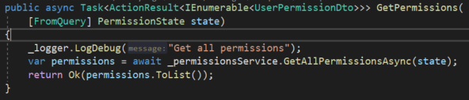
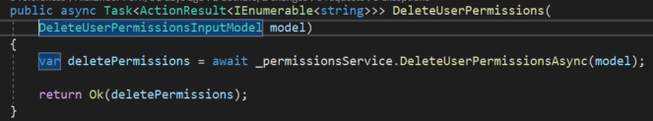
Command Query Responsibility Segregation
Single responsibility
Commands are responsible for changing the application state, i.e. creating, updating and deleting entities (data).
Queries are responsible for reading the application state, e.g. to display information to the user.
MediatR

Slide 4

Event Sourcing
Implementing an event-driven architecture and makes it possible to reliably publish events
Provides a 100% reliable audit log of the changes made to a business entity (Very useful for reports)
Implementation via Marten
Polyglot Persistence using PostgreSQL Database

Slide 5
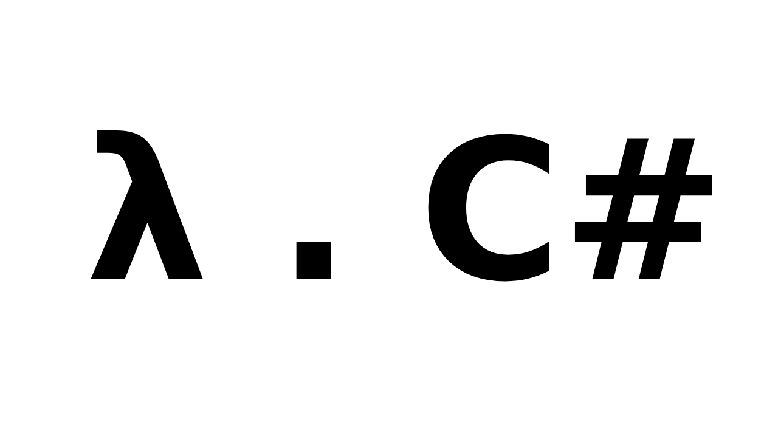
Functional Programming
Why?
Purity
Expressiveness
Parallelism
Type – safety

Slide 6

Example application by Microsoft Team
Sample .NET Core reference application, powered by Microsoft, based on a simplified microservices architecture and Docker containers.

