Slide 1
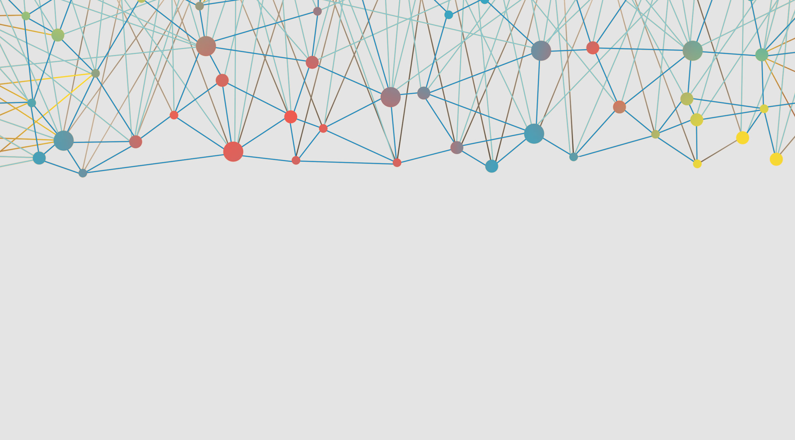


Architecture
overview

Slide 2
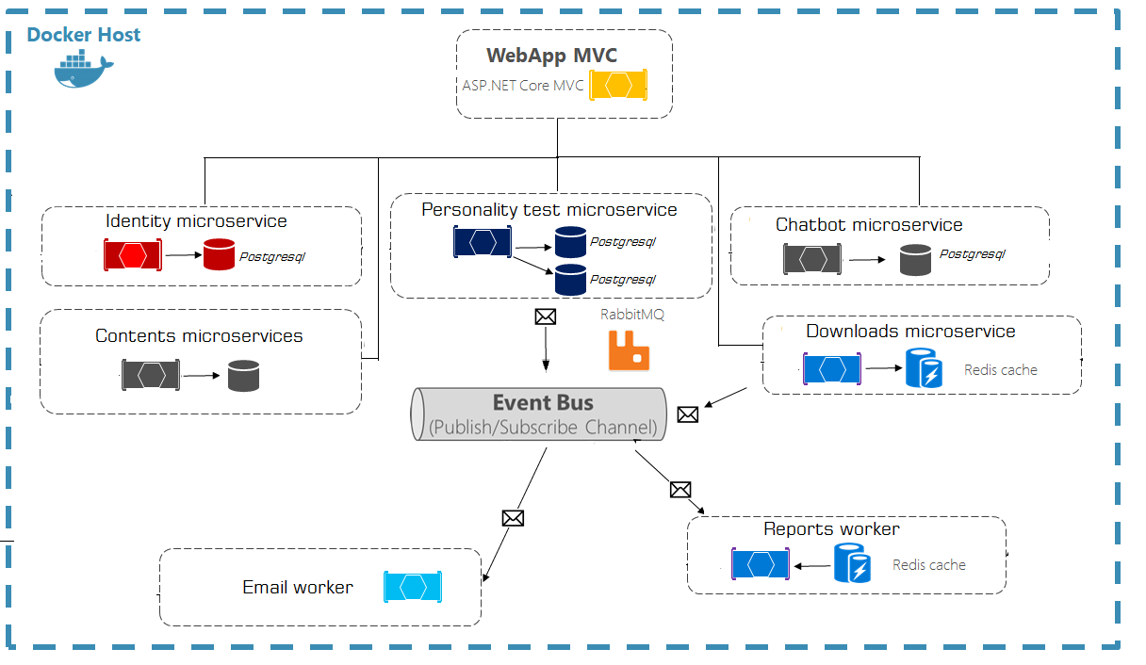

Slide 3
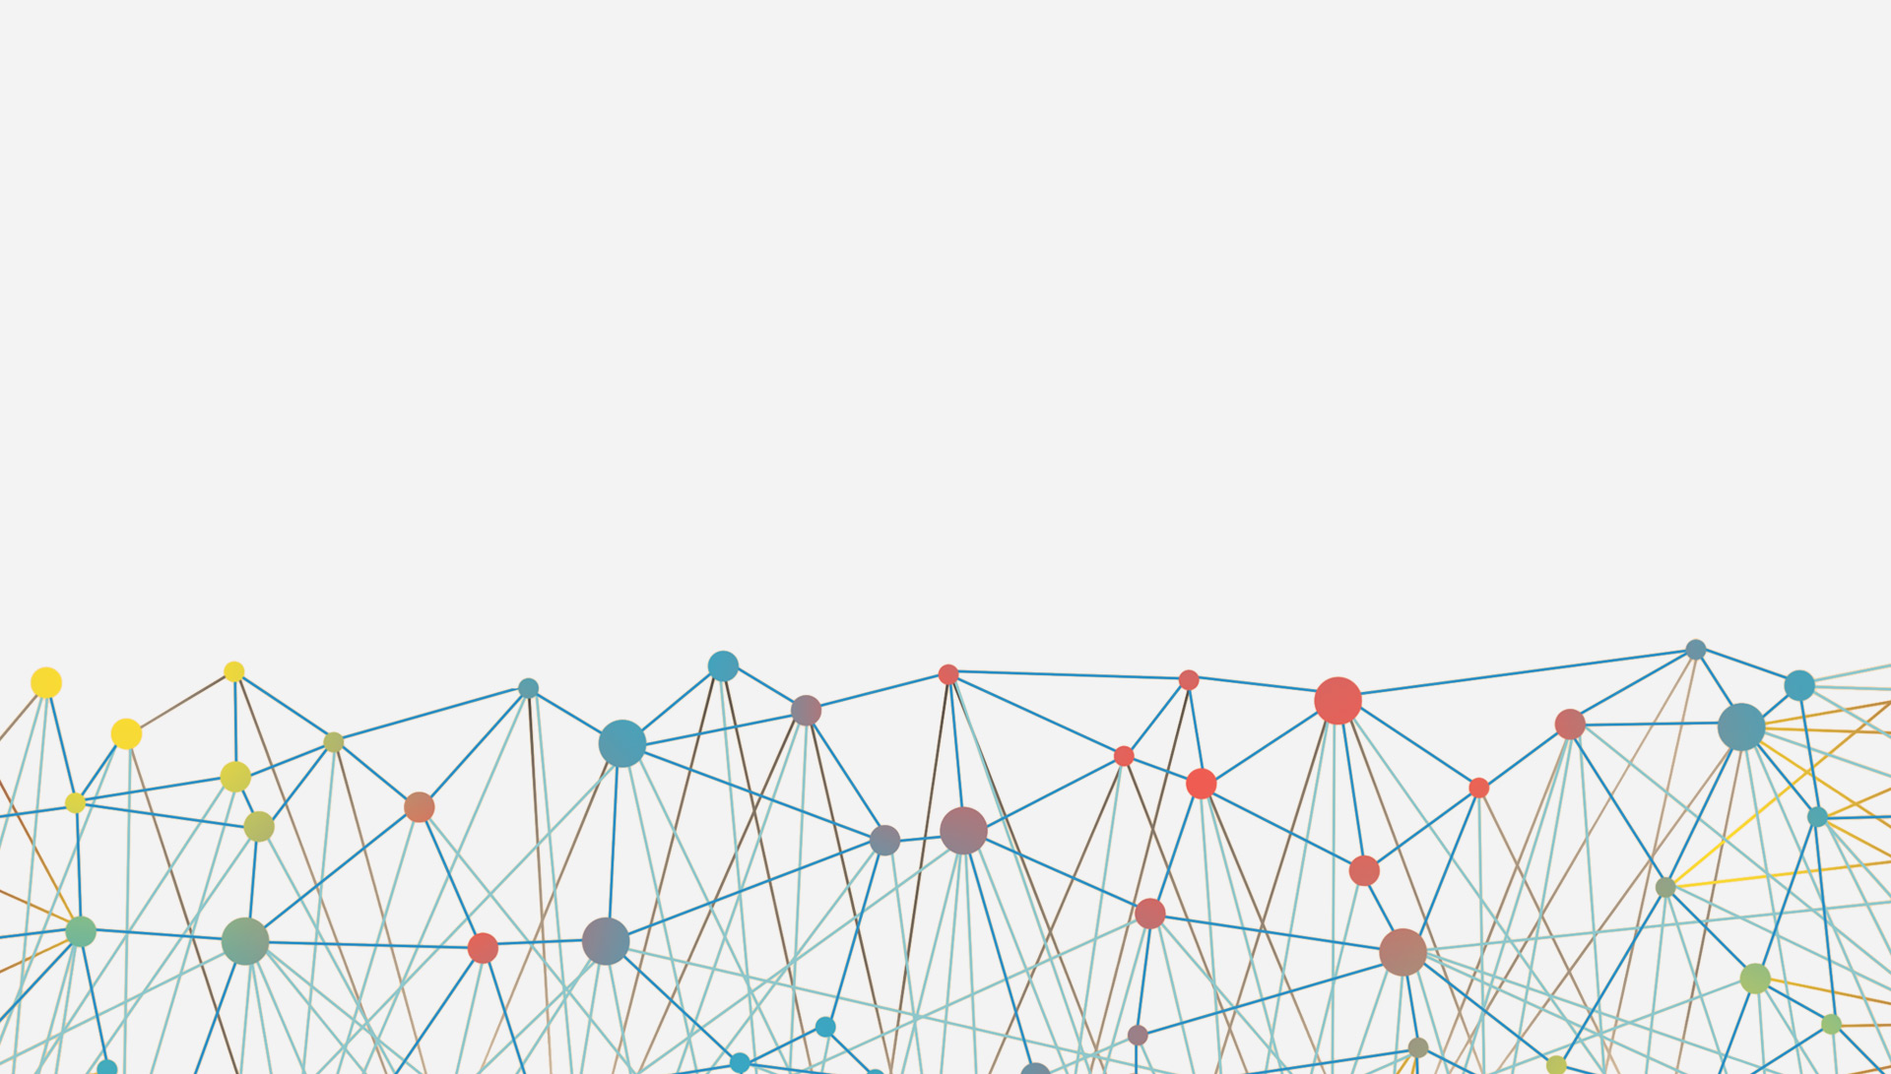
The architecture proposes a micro-service oriented architecture implementation with multiple autonomous micro-services (each one owning its own data or database).
Different approaches are implemented within each micro-service (simple CRUD vs. DDD/CQRS patterns).
HTTP is the communication protocol between the client apps and the micro-services. Asynchronous communication for email sending and reports via Event Bus (RabbitMQ).

Slide 4
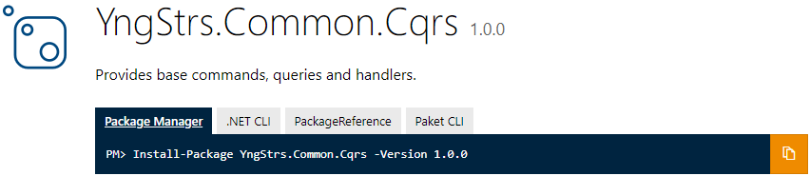
Command and Query Responsibility Segregation
Implemented by

Slide 5
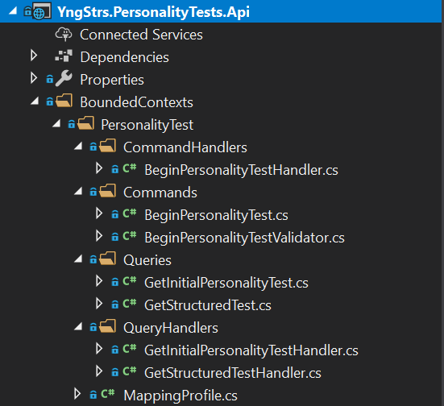

Personality Tests Web Service
Bounded Context is central pattern in
the Domain-Driven Design
A command handler receives a command and
brokers a result. The result is either a successful or an exception.
Fluent Command Validation
Commands are responsible for changing the
application state, i.e. creating, updating and deleting entities.
Queries are responsible for reading the
application state, e.g. to display information to the user.
A query handler implements the logic for the current query.
Implemented with the ediatR

Slide 6

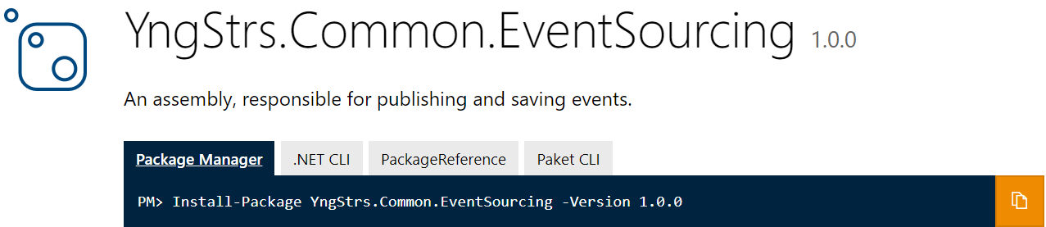
Event Sourcing
Implementing an event-driven architecture and makes it possible to reliably publish events
Provides a 100% reliable audit log of the changes made to a business entity (Very useful for reports)
Implementation via
Polyglot Persistence using PostgreSQL Database

Slide 7




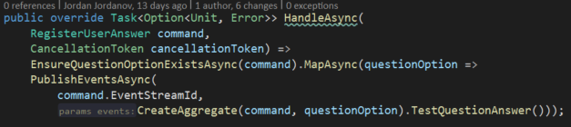
Functional Programming
Why?
Purity
Expressiveness
Type – safety

Slide 8
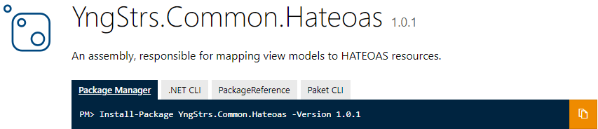
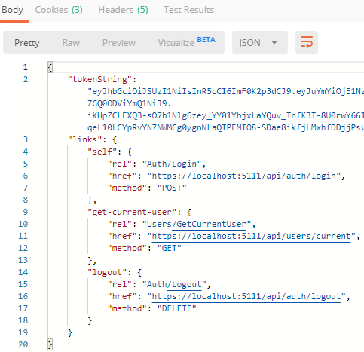
Hypermedia as the Engine of Application State
Provides hypermedia links in the response contents so that the client can dynamically navigate to the appropriate resource by traversing the hypermedia links.

