Slide 1
TITLE PAGE
Problem Statement ID – Question 4
Problem Statement Title- Al-Powered Behavioral Anomaly Detection for Cybersecurity
Theme- Cybersecurity - Industrial-Edge Security
PS Category- Software
Student Name : Ahas Kaushik
Student ID : 1BM24AI401

Slide 2
IDEA TITLE
Challenges Addressed:
Novel & Zero-Day Attacks
Low-and-Slow Threats
Low False Positives
Imbalanced Security Data (~1% attacks)
Objective:
Learn per-entity normal behaviour
Detect, classify & explain cyber threats
Real-time, streaming anomaly detection
Core Approach:
Per-Entity Baseline
↓
Hybrid Anomaly Detection
↓
Attack Attribution
↓
Explainable Alerts
Key Innovations:
Isolation Forest + GRU (Hybrid Detector)
Novel Attack Class
SHAP + Counterfactual Explanations
Streaming-Ready Incremental Features
Risk Calibration & Alert De-duplication

Slide 3
TECHNICAL APPROACH
Technologies
Python, NumPy, Pandas
Scikit-learn (Isolation Forest, Random Forest)
PyTorch (GRU Autoencoder)
SHAP
Streamlit
Pipeline:
Event Stream
↓
9 Incremental Features
↓
Isolation Forest + GRU
↓
Rules + Random Forest
↓
SHAP + Counterfactual
↓
Ranked Alerts
Performance
PR-AUC: 0.42
Recall@2% Budget: 67%
Attack Naming: 100%
Brier Score: 0.007
Model Characteristics:
Unsupervised & Label-Blind Detection
Per-Entity Feature Engineering
Streaming-Ready Architecture
Temporal Train-Test Split

Slide 4
FEASIBILITY AND VIABILITY
Feasibility:
~75 s end-to-end pipeline execution
GRU inference in sub-ms/event
Incremental feature engineering
Streaming-ready (Redis state caching)
System Robustness:
Cold-Start aware detection
Alert De-duplication
Calibrated Risk Ranking
Real-Time Streaming Support
Practical Impact:
Fewer missed intrusions
Reduced alert fatigue
Faster SOC triage
Scalable for IT/OT environments
Challenges & Mitigation:
Low Precision → Alert Budget + Risk Calibration
Concept Drift → Adaptive Per-Entity Baselines
Novel Attacks → Novel/Unknown Detection
Geo-Velocity Errors → Counterfactual Explanations

Slide 5
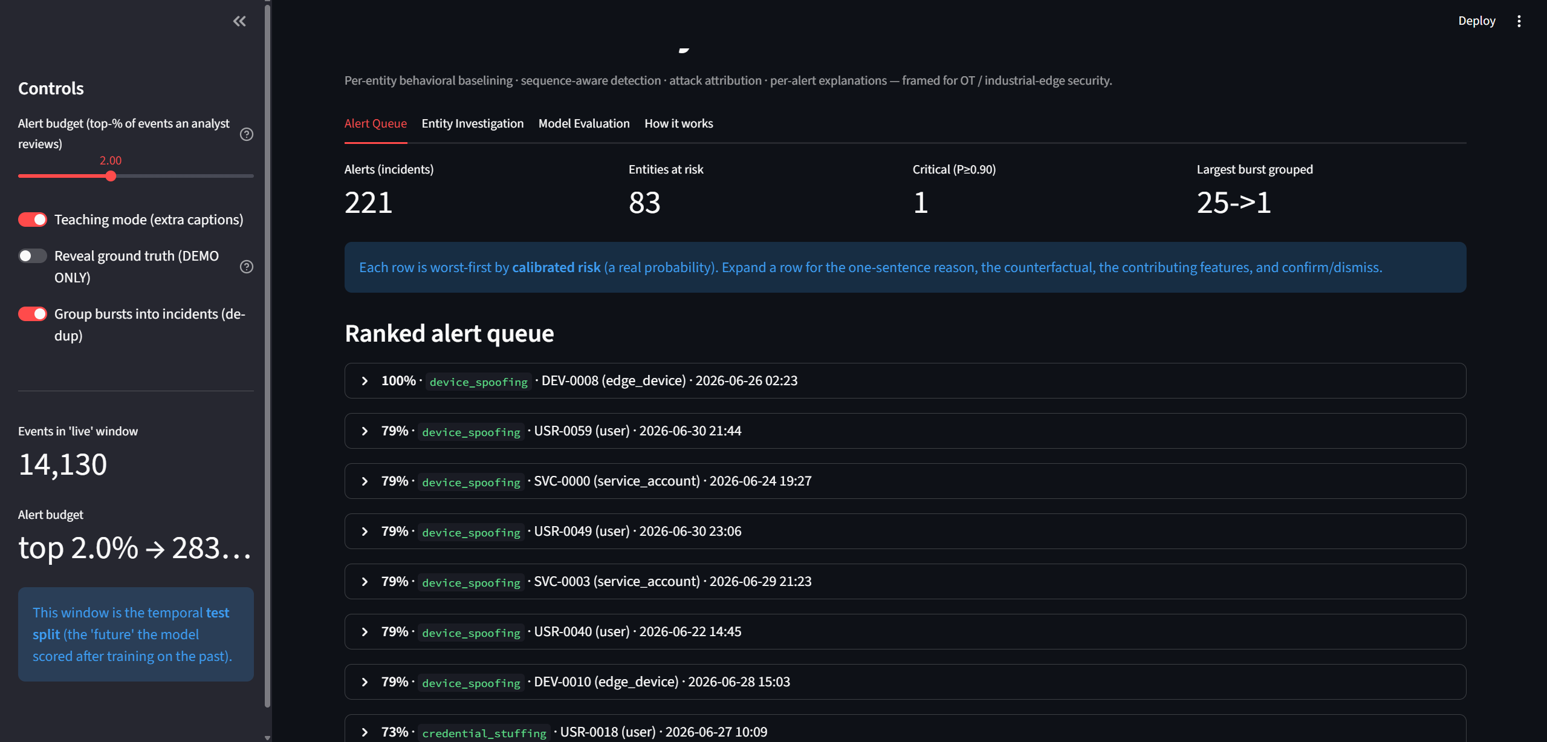
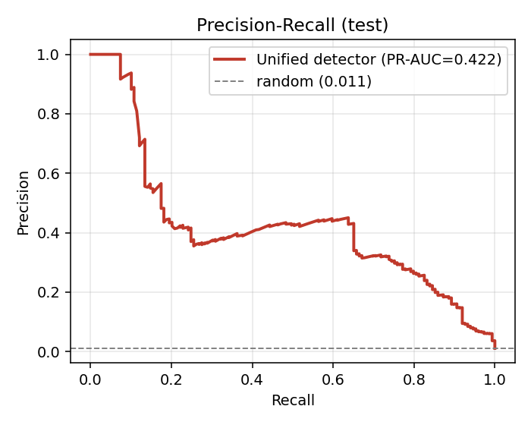
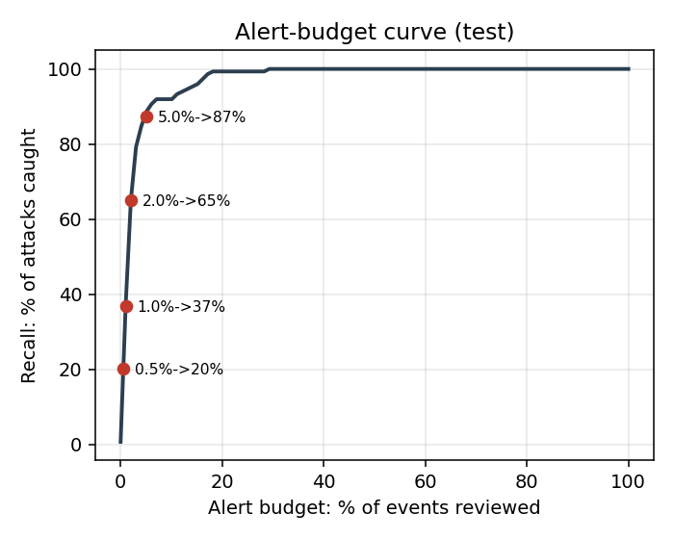
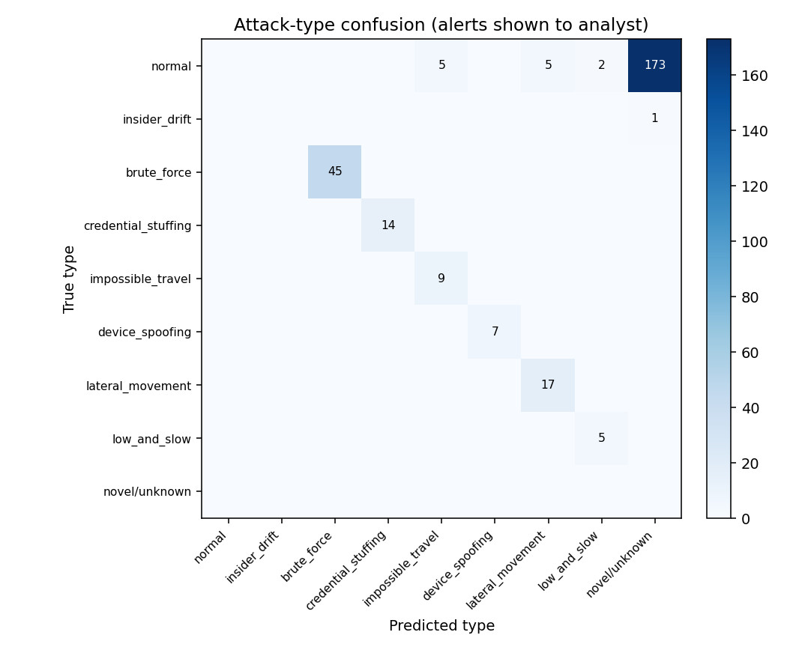
ARTIFACTS
• Source Code: Modular Python implementation
Generator, Models, Dashboard, Evaluation & Reporting Modules
• Project Deliverables: Synthetic Security Dataset and Explainable AI Dashboard
Evaluation Report and Performance Visualizations.
• Result: figures below — PR-AUC · alert-budget · confusion-matrix.

Slide 6
RESEARCH AND REFERENCES
• Liu, Ting & Zhou — Isolation Forest, ICDM 2008.
• Sakurada & Yairi (2014); Malhotra et al. (2016) — autoencoder / LSTM-GRU reconstruction anomaly detection.
• Lundberg & Lee — SHAP unified feature attribution, NeurIPS 2017.
• Zadrozny & Elkan — isotonic calibration of classifier scores, 2002.
• MITRE ATT&CK — attack-technique taxonomy (brute force, lateral movement, exfiltration, valid accounts).
• UEBA (User & Entity Behavior Analytics) & SOC alert-fatigue practitioner literature; Honeywell Q4 brief.

