Slide 1



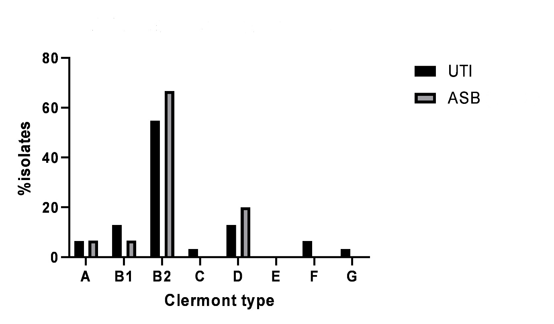

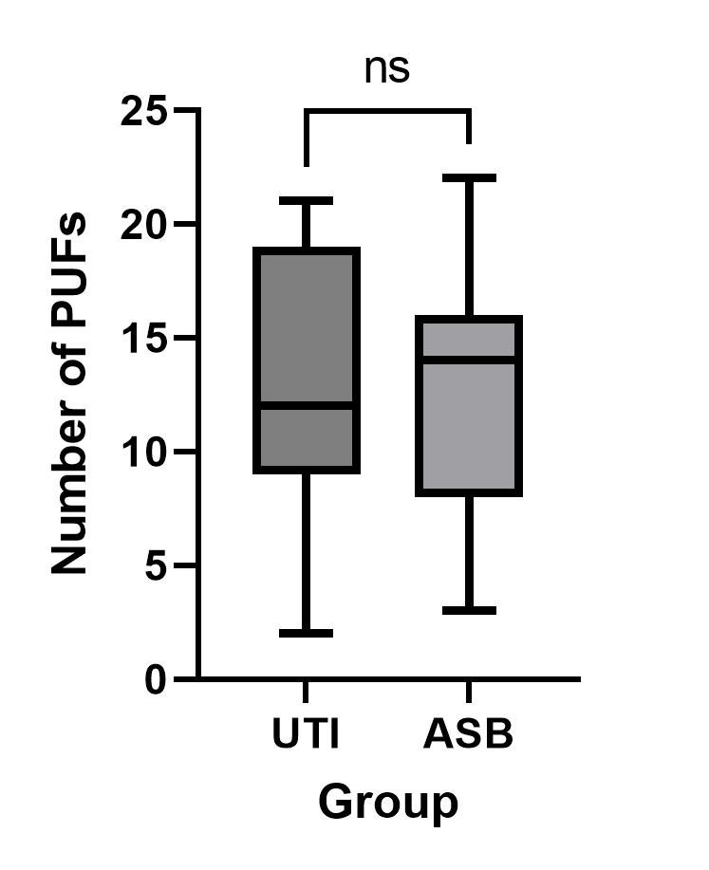




Whole-genome characterisation of Escherichia coli isolates from older women with urinary tract infection and asymptomatic bacteriuria
M. Mulder¹, M.P. Bilsen², M.T. van der Beek², A.P.A Hendrickx³, M.M.C. Lambregts²,
C. Schneeberger-van der Linden⁴
1. Department of Medical Microbiology, Infectious diseases and Infection control, Maastricht UMC+, The Netherlands.
2. Leiden University Center of Infectious Diseases (LUCID), Leiden University Medical Center, Leiden, The Netherlands
3. Center for Infectious Disease Control, National Institute for Public Health and the Environment (RIVM), Bilthoven, The Netherlands.
4. Infectious Diseases in Primary Care, Nivel, Utrecht, The Netherlands.
Contact: Caroline Schneeberger-van der Linden C.Schneeberger@nivel.nl, Marlies Mulder marlies.mulder@mumc.nl
Do pathogen-related factors related to E. coli differ between older women with UTI and those with ASB?
Is there persistence of genetically the same E. coli in these older women with ASB?
In both groups many different sequence types (ST).
Some differences in individual putative urovirulence factors (PUFs), but no significant difference in the number of virulence factors.
Genetically similar E. coli isolates in two consecutive samples (2-4 weeks apart) of women with ASB.
46 Women ≥65 years (31 UTI patients (≥ 2 new-onset lower urinary tract symptoms, pyuria and bacteruria) and 15 ASB patients (E. coli ≥ 10⁴ CFU/mL in two consecutive samples.
Genetical analysis of E. coli isolates (ST, Clermont type, PUFs)
wgMLST-based minimum spanning tree of E. coli isolates analysed in this study
Sequence type
ST type | Overall, n (%) | UTI, n (%) | ASB, n (%)
10 | 2 (4.3) | 2 (6.5) | 0 (0)
12 | 2 (4.3) | 1 (3.2) | 1 (6.7)
59 | 2 (4.3) | 2 (6.5) | 0 (0)
69 | 4 (8.7) | 2 (6.5) | 2 (13.3)
73 | 4 (8.7) | 3 (9.7) | 1 (6.7)
88 | 1 (2.2) | 1 (3.2) | 0 (0)
91 | 1 (2.2) | 0 (0) | 1 (6.7)
95 | 3 (6.5) | 1 (3.2) | 2 (13.3)
127 | 1 (2.2) | 1 (3.2) | 0 (0)
131 | 2 (4.3) | 0 (0) | 2 (13.3)
141 | 4 (8.7) | 4 (12.9) | 0 (0)
162 | 1 (2.2) | 0 (0) | 1 (6.7)
174 | 1 (2.2) | 1 (3.2) | 0 (0)
349 | 2 (4.3) | 2 (6.5) | 0 (0)
357 | 1 (2.2) | 1 (3.2) | 0 (0)
538 | 1 (2.2) | 0 (0) | 1 (6.7)
569 | 1 (2.2) | 1 (3.2) | 0 (0.0)
602 | 1 (2.2) | 1 (3.2) | 0 (0)
636 | 1 (2.2) | 1 (3.2) | 0 (0)
963 | 1 (2.2) | 0 (0) | 1 (6.7)
998 | 2 (4.3) | 2 (6.5) | 0 (0)
1049 | 1 (2.2) | 1 (3.2) | 0 (0)
1193 | 1 (2.2) | 0 (0) | 1 (6.7)
1444 | 1 (2.2) | 1 (3.2) | 0 (0)
2521 | 1 (2.2) | 1 (3.2) | 0 (0)
4360 | 1 (2.2) | 1 (3.2) | 0 (0)
5420 | 1 (2.2) | 0 (0) | 1 (6.7)
8464 | 1 (2.2) | 1 (3.2) | 0 (0)
undefined | 1 (2.2) | 0 (0) | 1 (6.7)
Putative urovirulence factors
PUF | PUF description | Overall, n (%) | UTI group, n (%) | ASB group, n (%)
bmaE | Blood group M-specific adhesin | 0 (0) | 0 (0) | 0 (0)
cdtB | Cytolethal distending toxin | 1 (2) | 1 (3) | 0 (0)
chuA | Heme binding outer membrane | 37 (80) | 24 (77) | 13 (87)
cnf1 | Cytotoxic necrotizing factor 1 (toxin) | 12 (26) | 10 (32) | 2 (13)
cvaC | Colicin V | 6 (13) | 5 (16) | 1 (7)
draB | Dr antigen-specific adhesin | 0 (0) | 0 (0) | 0 (0)
feoB | Ferrous iron transport | 46 (100) | 31 (100) | 15 (100)
fimH | D-mannose–specific adhesin, lining the superficial bladder epithelium. | 46 (100) | 31 (100) | 15 (100)
focH | F1C pili adhesin | 12 (26) | 9 (29) | 3 (20)
fyuA | Yersiniabactin siderophore receptor | 36 (78) | 23 (74) | 13 (87)
hek | Auto-aggregating adhesin and invasin | 17 (37) | 13 (42) | 4 (27)
hlyA | a-Hemolysin (toxin) | 14 (30) | 11 (35) | 3(20)
ibeA | Invasion of brain endothelium | 10 (22) | 7 (23) | 3 (20)
iha | Nonhemagglutinin adhesin | 10 (22) | 4 (13) | 6 (40)
ireA | Iron-regulated element (siderophore receptor) | 4 (9) | 3 (10) | 1 (7)
iroN | Salmochelin siderophore receptor | 23 (50) | 17 (55) | 6 (40)
irp2 | Yersinia biosynthetic protein | 36 (78) | 23 (74) | 13 (87)
iucc | Aerobactin biosynthetic protein | 14 (30) | 7 (23) | 7 (47)
iutA | Ferric aerobactin receptor | 4 (9) | 3 (10) | 1 (7)
malX | Marker of pathogenicity-associated island | 29 (63) | 19 (61) | 10 (67)
ompT | Outer membrane protein T (protease) | 39 (85) | 25 (81) | 14 (93)
papG2 | P pili adhesin - Pyelonephritis-associated papG variant | 16 (35) | 11 (35) | 5 (33)
PapG3 | P pili adhesin - Cystitis-associated papG variant | 16 (35) | 11 (35) | 5 (33)
picU | Protein involved in Intestinal Colonization - serine protease | 8 (17) | 6 (19) | 2 (13)
sat | Secreted autotransporter toxin | 9 (20) | 4 (13) | 5 (33)
sfaH | S pili adhesin (marker for sfa operon) | 11 (24) | 10 (32) | 1 (7)
sitA | Periplasmic iron transport | 38 (83) | 24 (77) | 14 (93)
traT | Temperature-sensitive hemagglutinin - serine protease | 21 (46) | 13 (42) | 8 (53)
tsH | Surface exclusion (toxin) | 26 (57) | 18 (58) | 8 (53)
usp | Uropathogenic-Specific Protein (bacteriocin) | 30 (65) | 20 (65) | 10 (67)
vat | Vacolating autotransporter - serine protease (toxin) | 26 (57) | 18 (58) | 8 (53)
Faculty of Health, Medicine and Life Sciences

