Slide 1
CURRENT PIPELINE REVIEW / LONGITUDINAL VF ANALYSIS
Virulence-factor profiling of longitudinal urinary E. coli isolates
Current pipeline, descriptive longitudinal findings, and cautious clinical-status overlay
Question 1
Question 2
Question 3
What VF repertoire is present?
How stable are profiles over time?
How should clinical status be overlaid?
Describe the observed virulence-factor gene space and curated modules in 556 VF/WGS-ready urinary E. coli isolates.
Use consecutive within-resident isolate-pair comparisons to quantify VF similarity and gene gain/loss.
Treat UTI versus Not_UTI as a sparse, exploratory phenotype annotation rather than the whole study frame.
556
227
394
17
VF-ready episodes
VF gene columns
longitudinal pairs
UTI annotations
Designed for a 22 min scientific review plus discussion

Slide 2
WHY THIS FRAMING
Longitudinal urinary E. coli VF analysis asks about repertoire and stability
Clinical status is an annotation layer; the core object is repeated isolate VF profiles.
Three observable longitudinal patterns
Same resident, repeated isolates
Clinical overlay comes later
Urinary E. coli can recur or persist across serial sampling. A one-time status comparison cannot separate stable carriage, replacement, and longitudinal change.
Persistent lineage
UTI_Status still matters, but the sparse UTI denominator means clinical contrasts should be labelled exploratory. The VF pipeline first establishes what was measured, how profiles are curated, and how stable those profiles are within residents.
High VF similarity across repeated isolates
Replacement
Different lineage or large genomic distance
Gene-content change
Detected VF gains/losses between visits
Not_UTI
UTI
Current pipeline outputs | VF analysis of longitudinal urinary E. coli isolates
02

Slide 3
DATA ASSET
A VF-ready longitudinal isolate dataset links repeated urinary E. coli genomes to clinical episodes
Dataset-level counts are VF-ready denominators; no disputed clinical participant total is displayed.
556
162
227
32
18
episode-level selected assemblies
participants in VF-ready dataset
binary VF gene columns
curated modules
UPEC-candidate modules
Repeated isolate design
Not_UTI
Not_UTI
Not_UTI
UTI
Not_UTI
Episode 1
Episode 2
Episode 3
Episode 4
Episode 5
Interpretation stance
The unit of VF measurement is an episode-level isolate profile. Status labels can be overlaid, but repeated measures, lineage structure, and sparse UTI counts limit causal status claims.
Current pipeline outputs | VF analysis of longitudinal urinary E. coli isolates
03

Slide 4
CURRENT PIPELINE
Numbered clinical-to-VF pipeline with visible denominators at each handoff
Counts come from current denominator summaries and validation checks; assembler alternatives are labelled explicitly.
1
Clinical classification
2
Primary inclusion
3
Assembly QC
00a / 00b
status_map.csv
12a_wgs_qc.R
585 classified episodes before manual exclusions
583 included: 18 UTI, 565 Not_UTI; 2 excluded
1,291 assembly-level QC records incl. assembler alternatives
4
Canonical selection
5
VF P/A matrix
6
VF/model-ready
canonical_assembly_selection.csv
02_gene_presence_analysis.R
22_vf_build_analysis_dataset.R
556 selected episode-level assemblies
556 episode-level VF rows
556 episodes: 17 UTI, 539 Not_UTI; 27 clinical episodes lack VF-ready evidence
7
Feature framework
8
Longitudinal pairs
9
Clinical application
26_vf_define_gene_modules.R
24_vf_longitudinal_dynamics.R
casebook outputs
227 VF gene columns -> 32 modules, incl. 18 UPEC-candidate modules
394 consecutive comparisons from 144 participants
11 Not_UTI -> UTI transitions; 10 WGS/VF-linked; 1 missing endpoint
Current pipeline outputs | VF analysis of longitudinal urinary E. coli isolates
04

Slide 5
VF REPRESENTATION
The analysis separates raw gene burden, curated modules, and longitudinal similarity
Module and score outputs help interpretation, but they are not validated disease-causality scores.
Binary VF gene matrix
Curated modules
Outputs
227 presence/absence gene columns per episode-level isolate.
32 biological curation units, including 18 UPEC-candidate modules.
Burden, prevalence, Jaccard similarity, gain/loss, and exploratory models.
Adhesion
Iron acquisition
Interpretation caution
Secretion
Toxin
Unassigned genes are 25.1% of the VF matrix. Interpret total burden separately from curated and UPEC-candidate summaries.
Capsule
Unassigned
Rows are episode-level isolates; columns are VF genes detected from current selected assemblies.
Descriptive framework
Current pipeline outputs | VF analysis of longitudinal urinary E. coli isolates
05

Slide 6
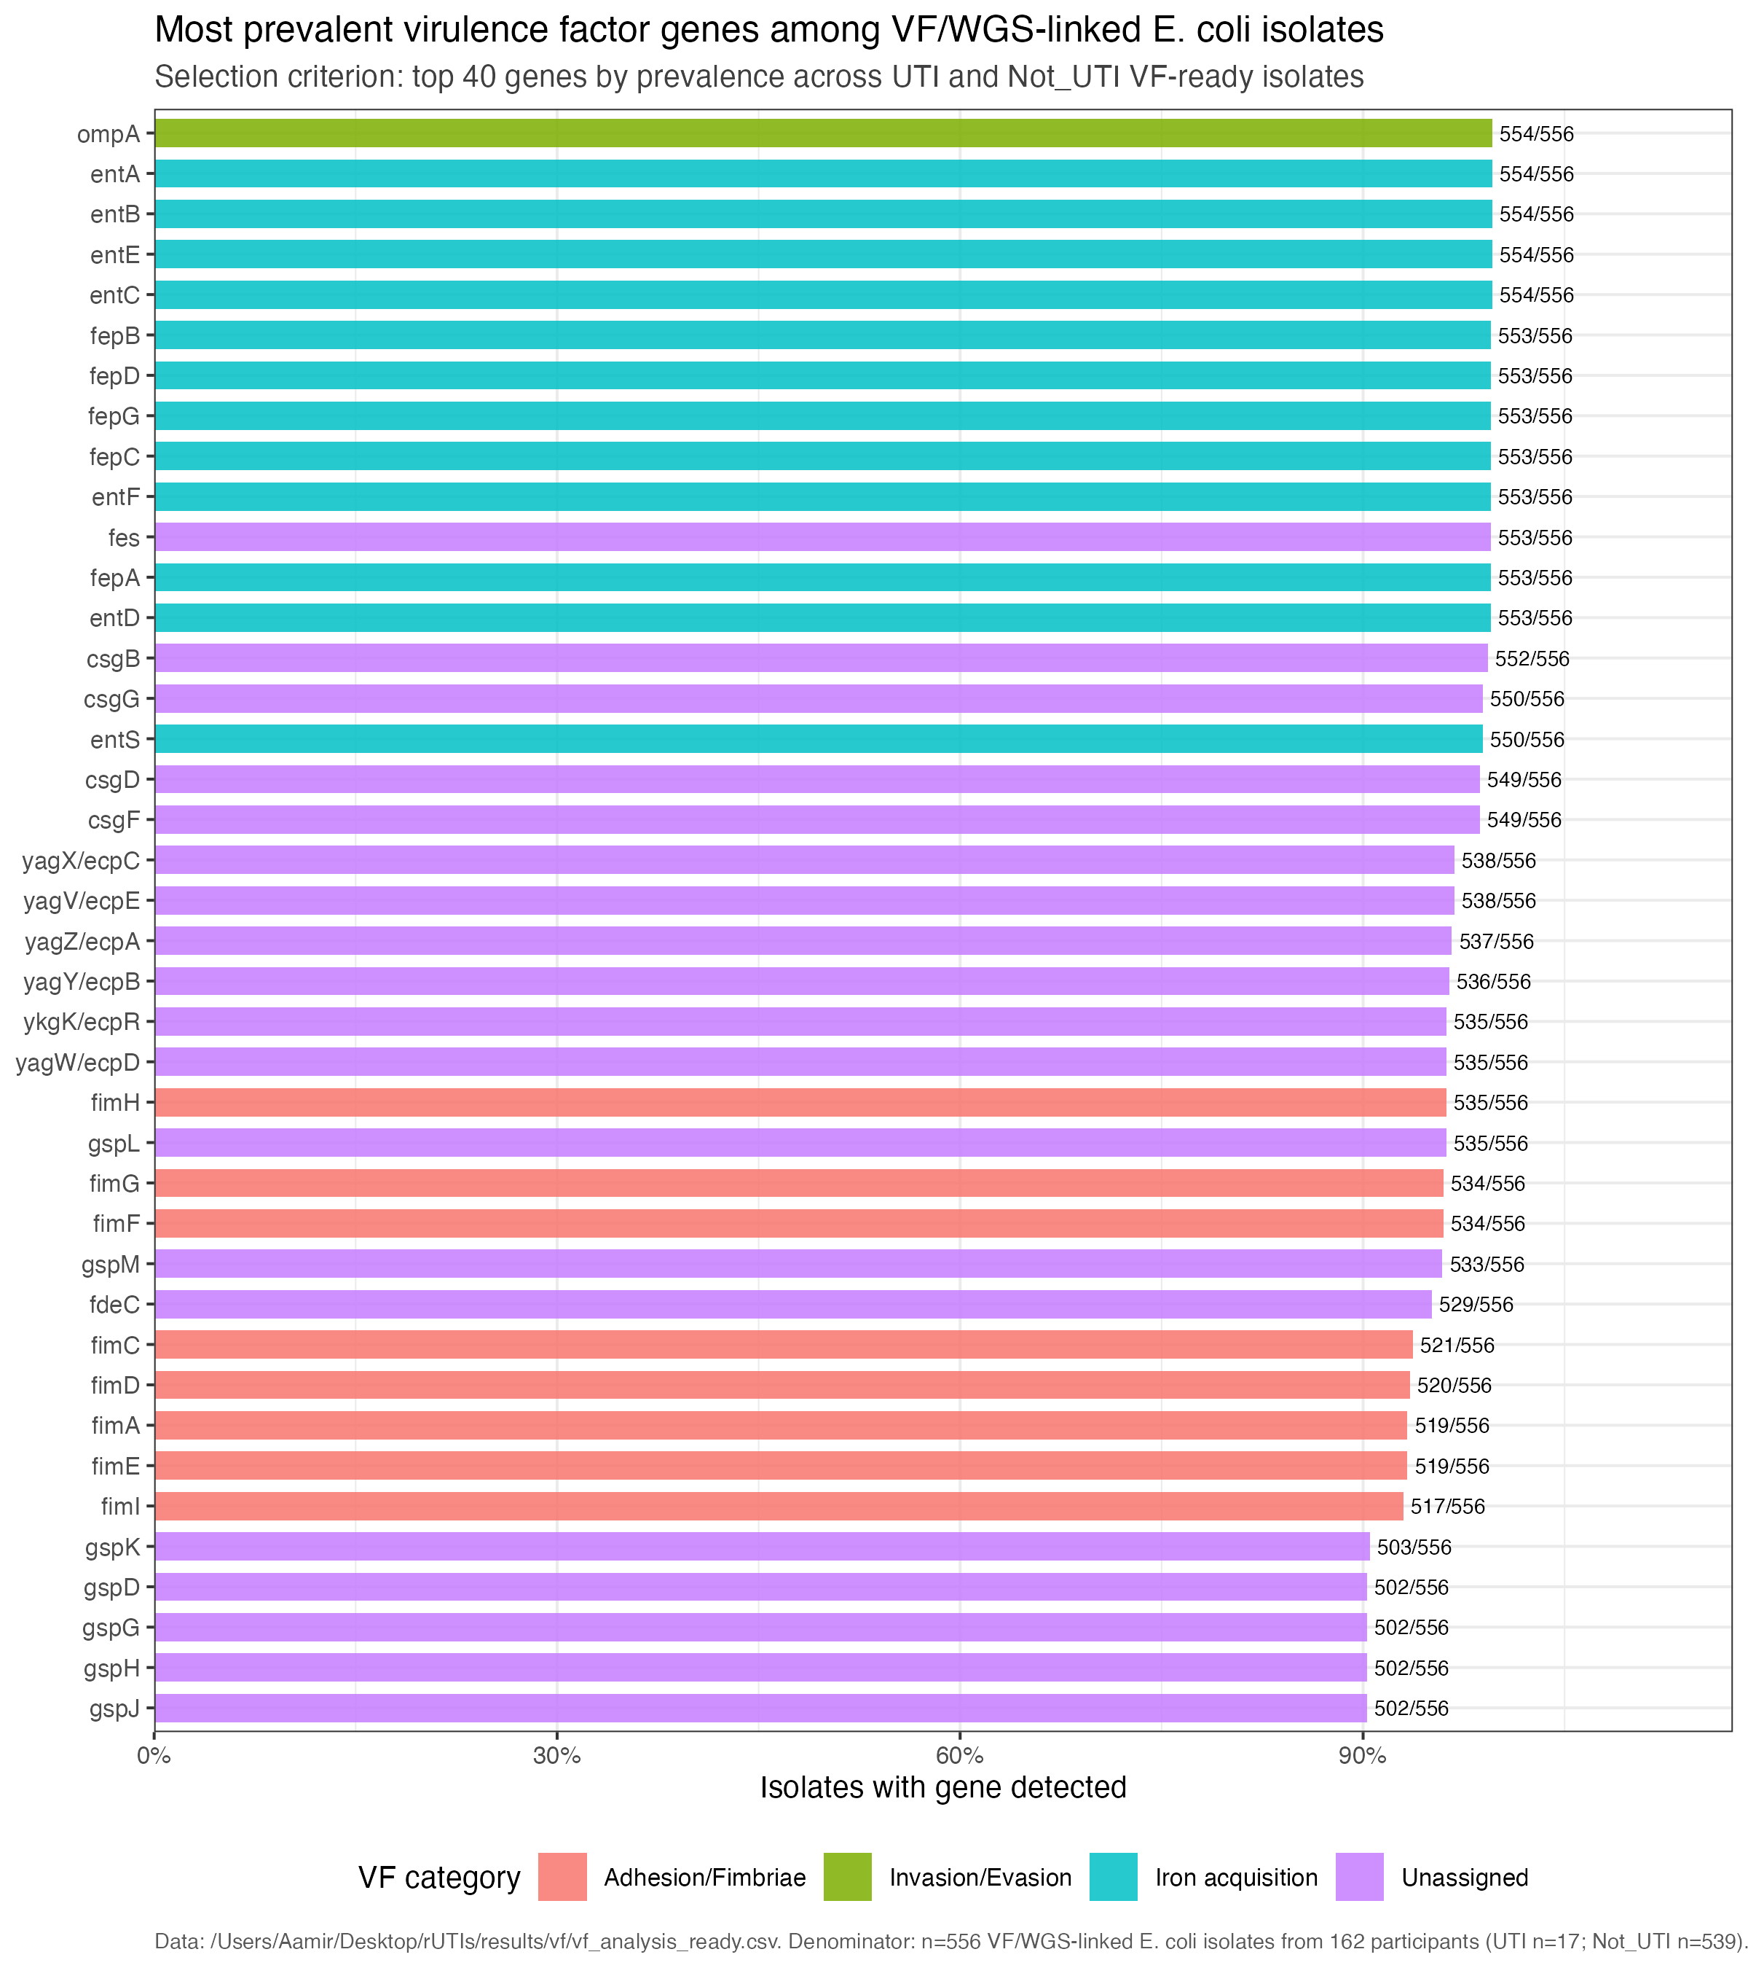
VF REPERTOIRE
Common VF genes describe the observed repertoire, not disease association
Top-gene prevalence across 556 VF/WGS-linked urinary E. coli isolates.
Descriptive
Read as
Descriptive prevalence ranking only. Gene presence does not imply expression, function, or UTI association.
Current pipeline outputs | VF analysis of longitudinal urinary E. coli isolates
06

Slide 7
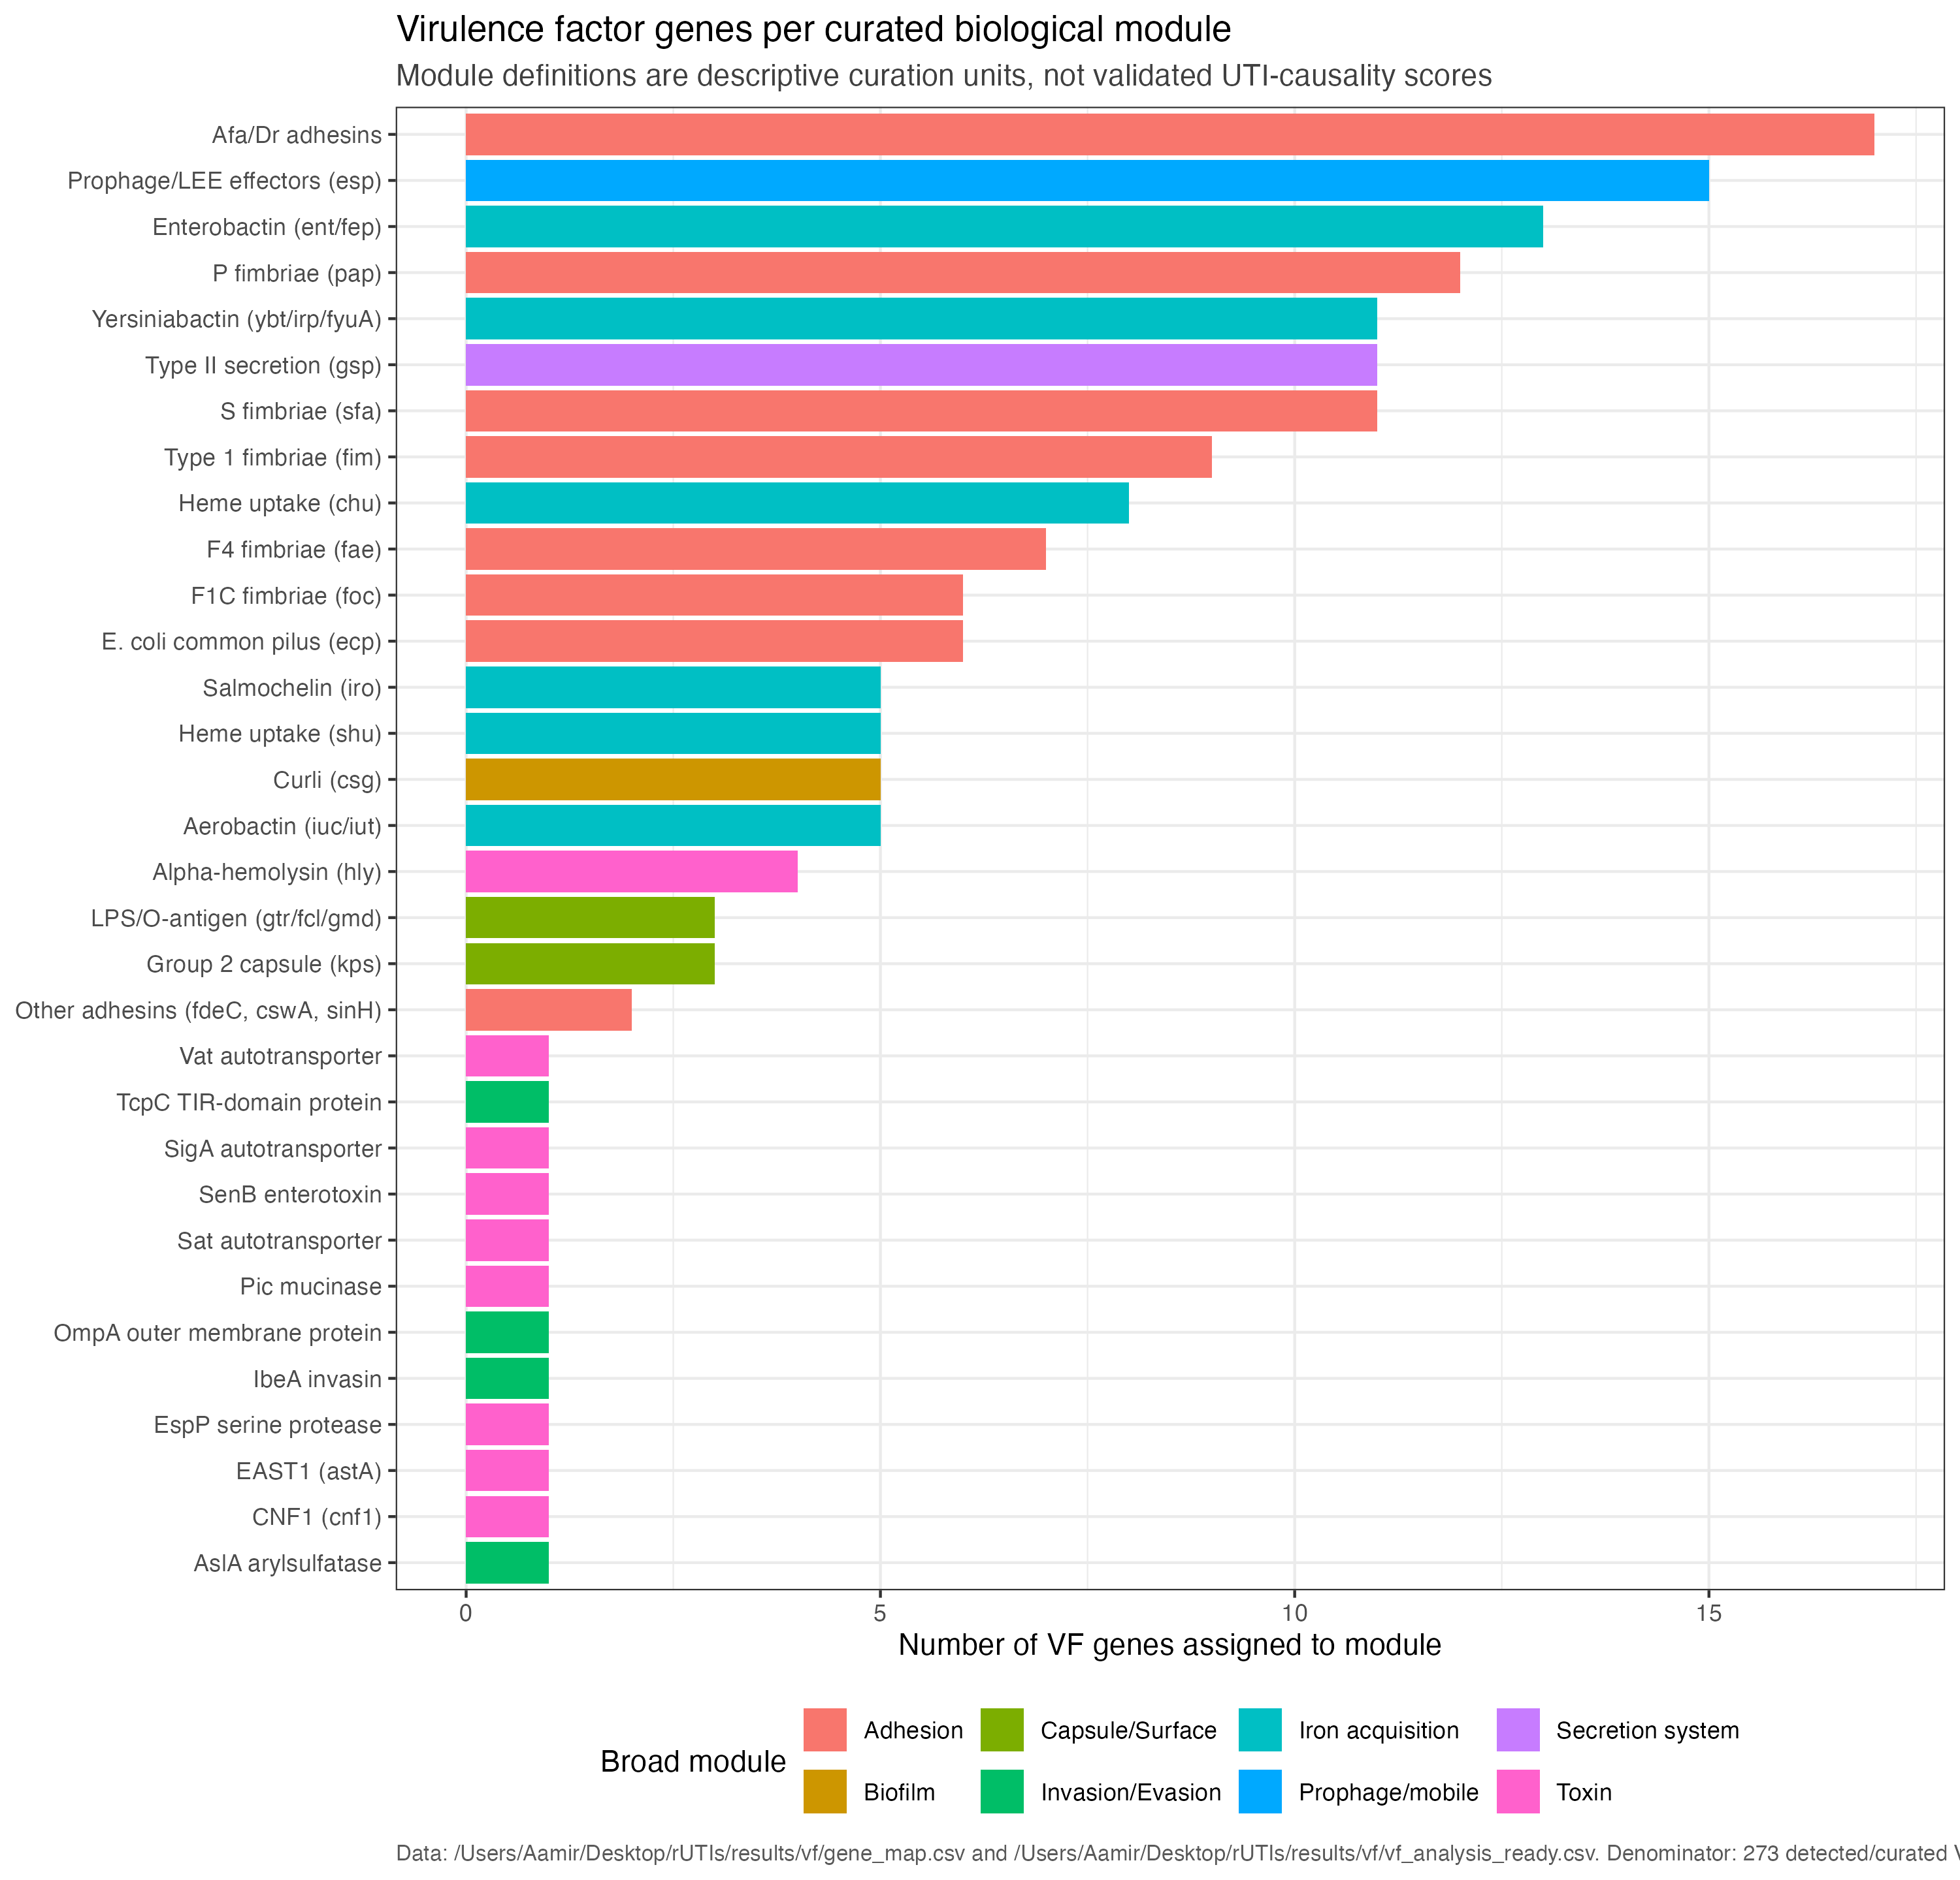
VF FRAMEWORK
Curated modules organise genes into interpretable biological systems
Modules are curation units for navigation; they are not validated disease-causality scores.
Descriptive framework
Why it matters
The framework separates adhesion, iron acquisition, secretion, capsule/surface, toxin and unassigned material before longitudinal or clinical overlays.
Current pipeline outputs | VF analysis of longitudinal urinary E. coli isolates
07

Slide 8
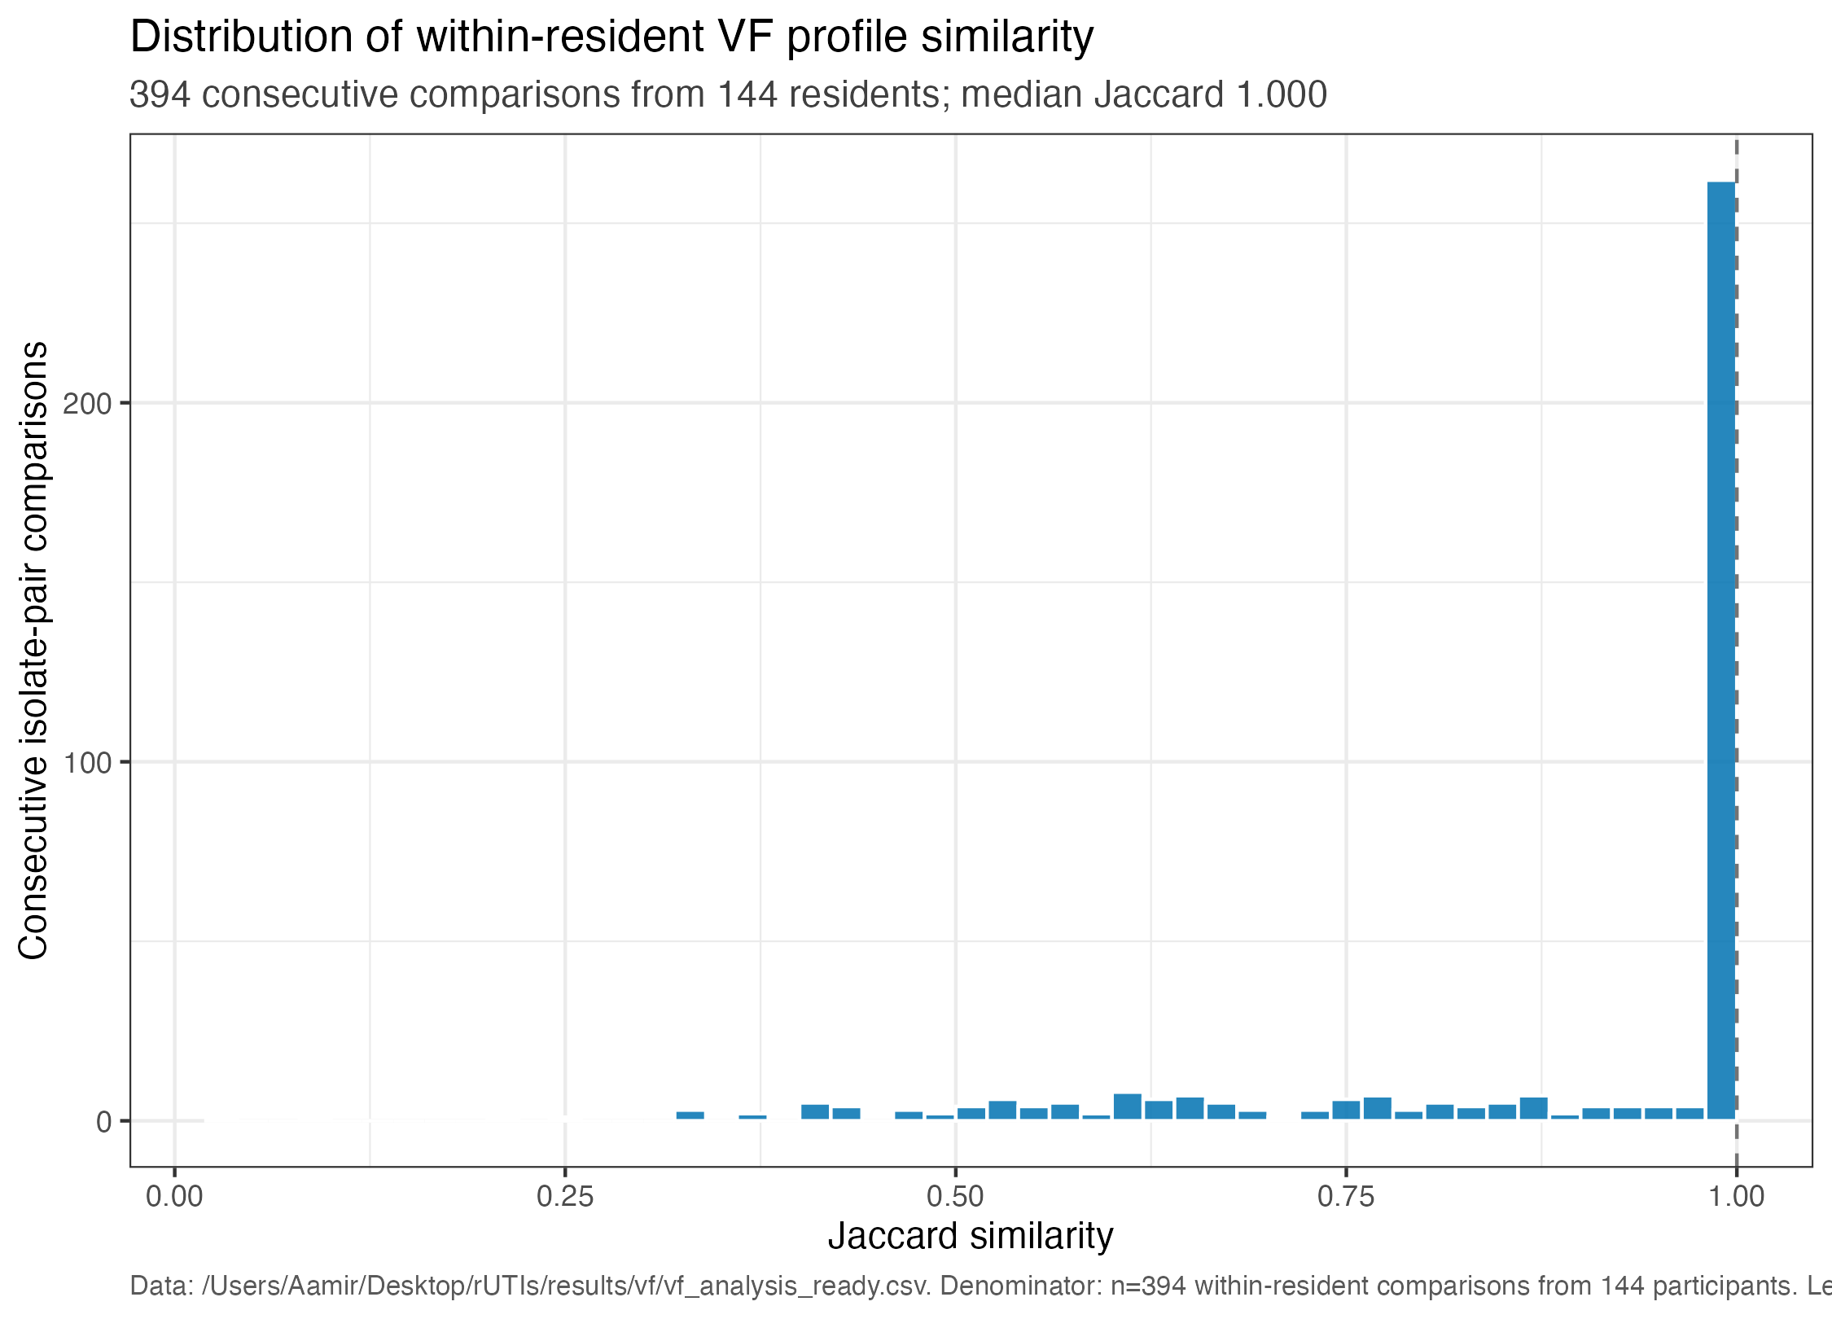
LONGITUDINAL STABILITY
Most repeated within-resident VF profiles are highly stable
394 consecutive comparisons from 144 participants; median Jaccard similarity 1.000; 62.4% no VF change.
Descriptive longitudinal
Central finding
The dominant pattern is VF profile conservation across repeated urinary E. coli isolates from the same resident.
Current pipeline outputs | VF analysis of longitudinal urinary E. coli isolates
08

Slide 9
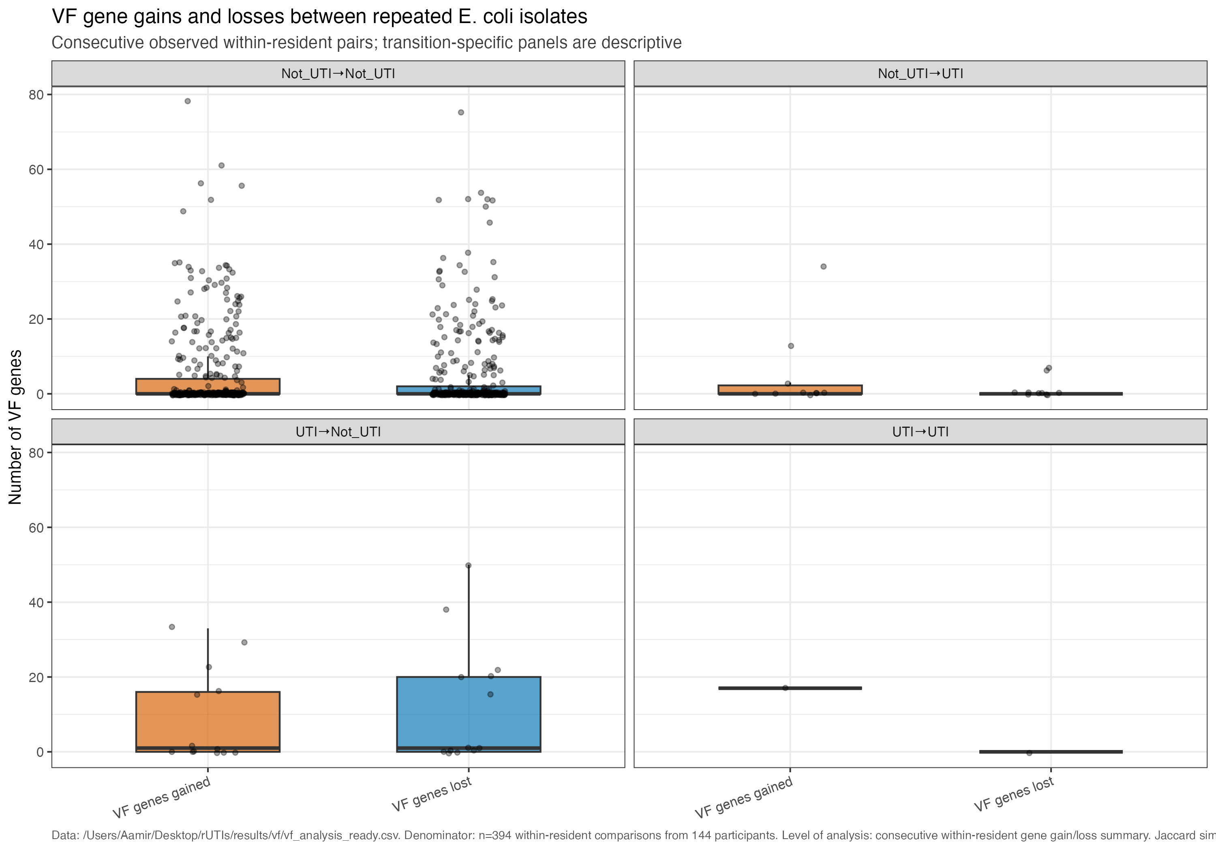
LONGITUDINAL CHANGE
When profiles change, gain/loss summaries flag candidates for follow-up
Observed gain/loss may reflect replacement, assembly/calling differences, or true gene-content change.
Caution
Do not overread gain/loss without lineage and genome-distance context.
Descriptive
Current pipeline outputs | VF analysis of longitudinal urinary E. coli isolates
09

Slide 10
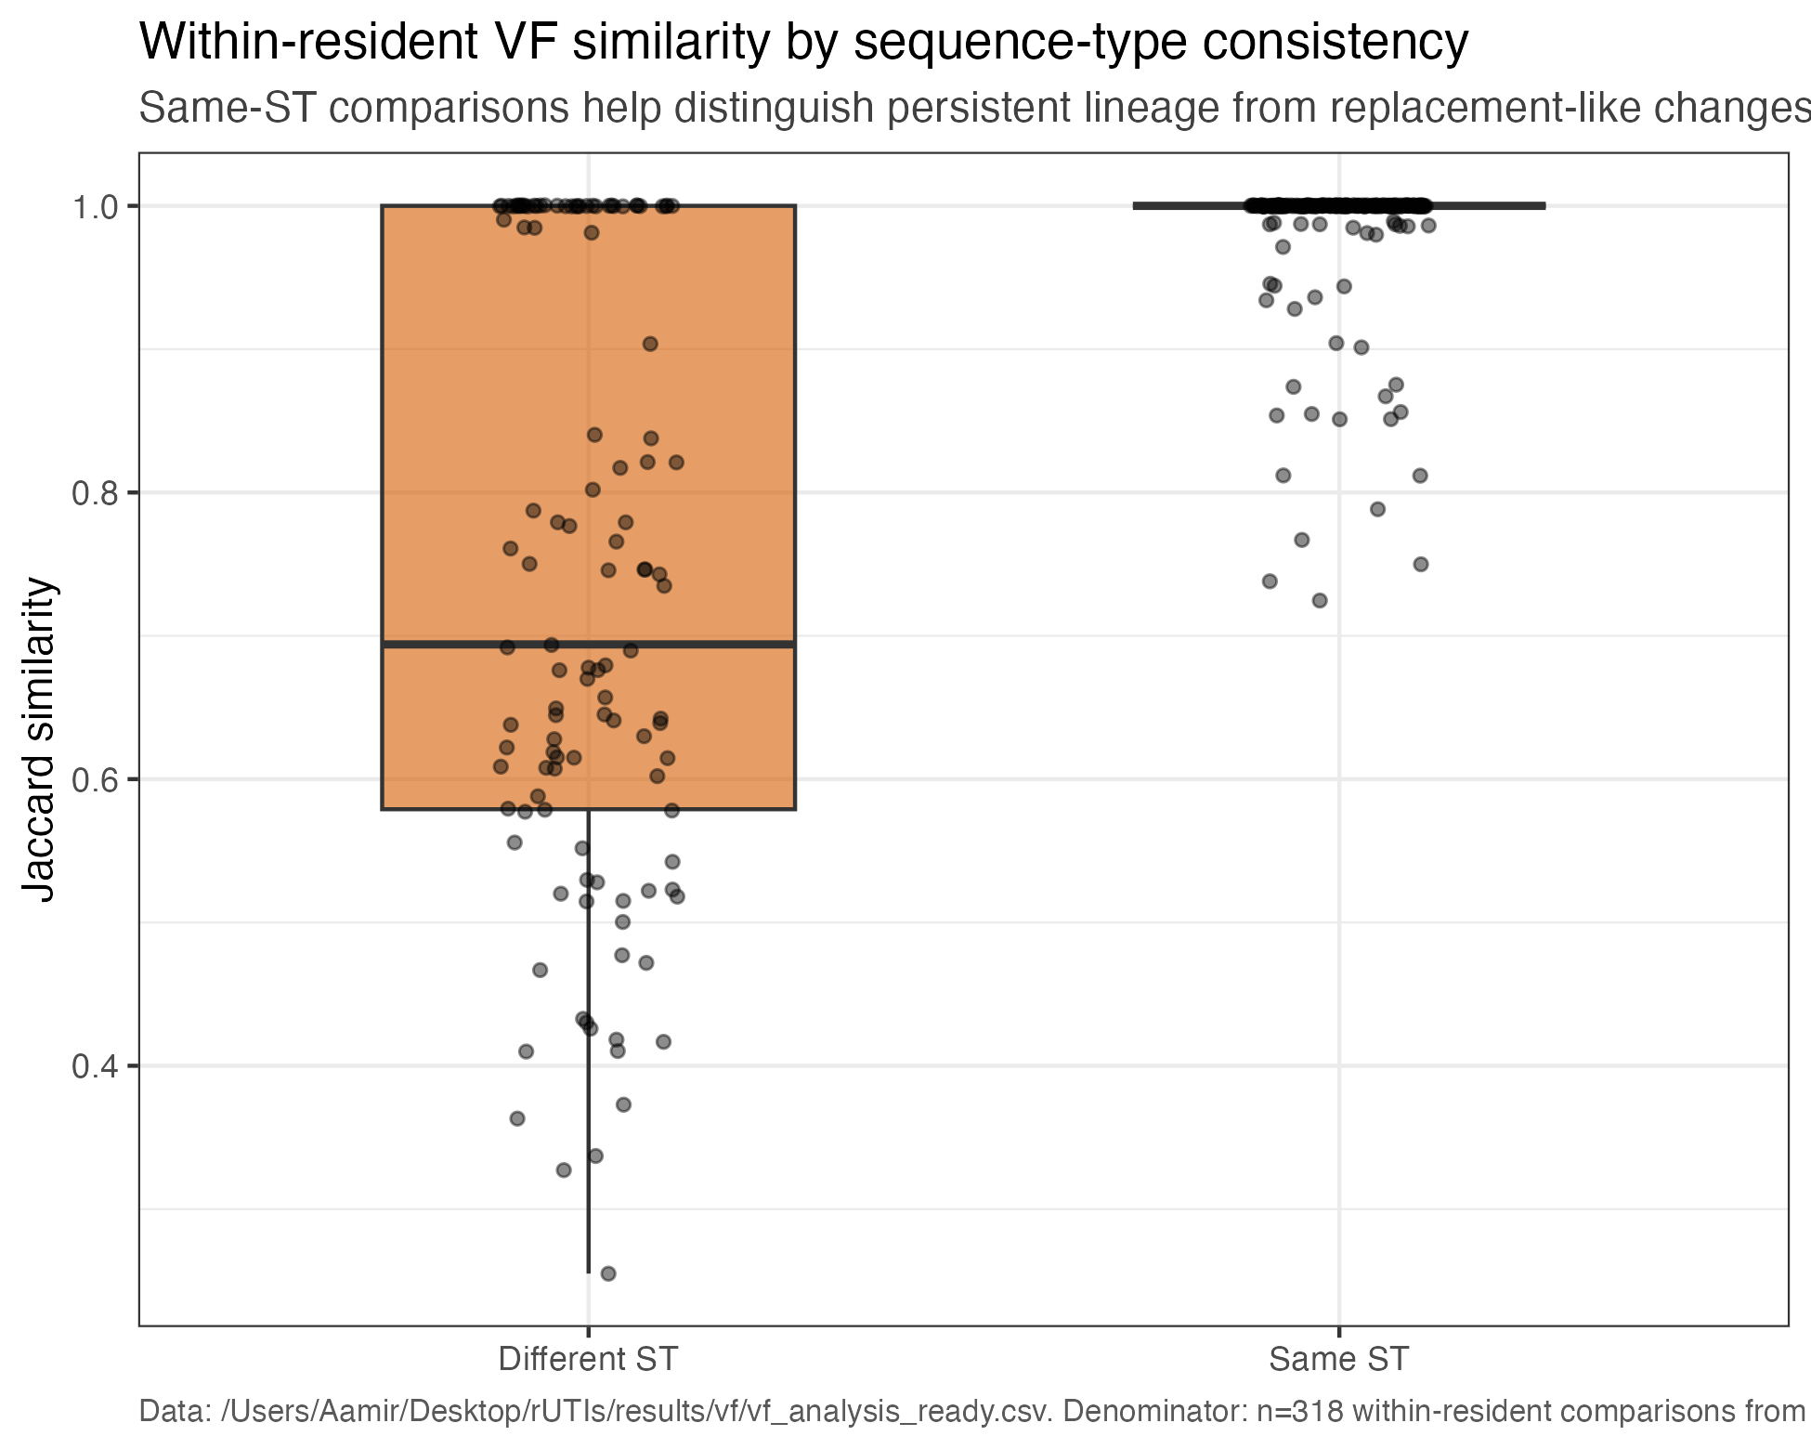
LINEAGE CONTEXT
Sequence-type consistency helps interpret VF stability
Same-ST comparisons support persistent-lineage context, but ST agreement alone does not prove same strain.
Diagnostic / descriptive
Use as diagnostic
Lineage context is essential before interpreting profile changes or clinical-status contrasts.
Current pipeline outputs | VF analysis of longitudinal urinary E. coli isolates
10

Slide 11
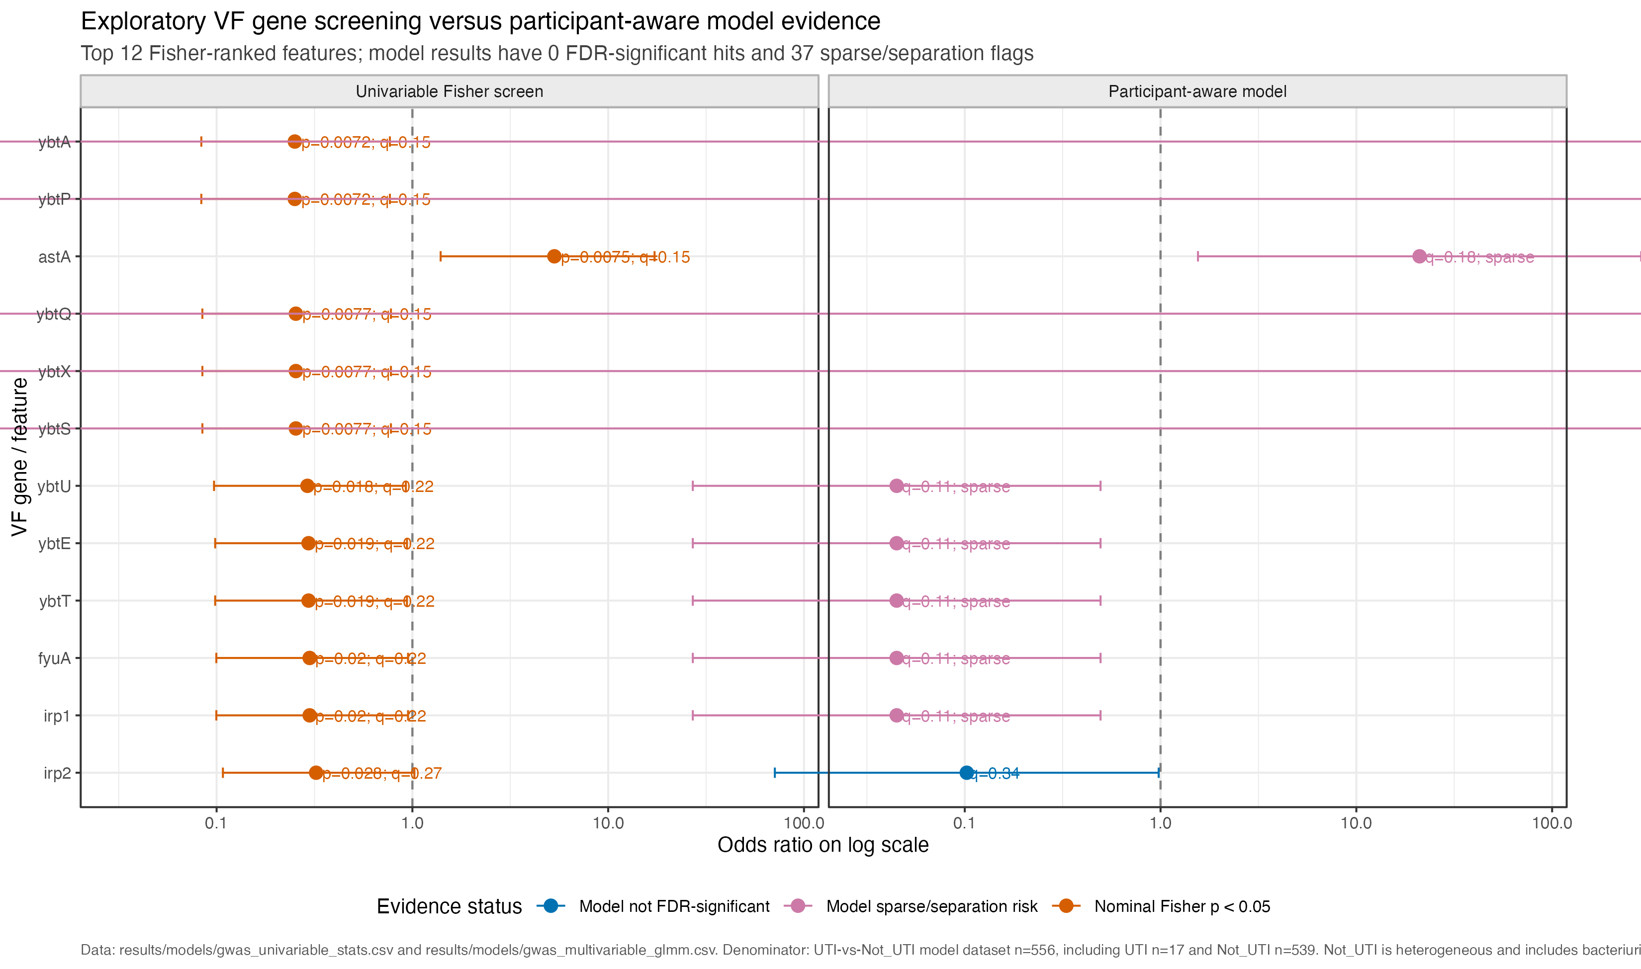
CLINICAL ANNOTATION APPLICATION 1
UTI status overlay remains exploratory under the sparse denominator
556 model-ready episodes: 17 UTI and 539 Not_UTI; no global VF association remains significant after FDR correction.
Exploratory phenotype overlay
Safe claim
Nominal screens and model diagnostics are hypothesis-generating. They do not establish a robust VF status association.
Current pipeline outputs | VF analysis of longitudinal urinary E. coli isolates
11

Slide 12
CLINICAL ANNOTATION APPLICATION 2
Participant 20026 illustrates stable VF profile despite symptom emergence
This is an applied phenotype example, not proof of host-state mechanism.
T3
42 days
UTI-1
Not_UTI
UTI
culture-supported bacteriuria
symptom emergence
5
+0/-0
stable
strong
SNPs
VF genes
VF modules
same-strain evidence
Transition casebook context
Mechanism summary
11 clinical Not_UTI -> UTI transitions; 10 WGS/VF-linked; 1 missing endpoint.
4 stable-profile transitions and 3 replacement-consistent transitions; buckets organise evidence, not mechanism proof.
Current pipeline outputs | VF analysis of longitudinal urinary E. coli isolates
12

Slide 13
CLOSE
What this VF-first review establishes and what remains uncertain
Use these as discussion prompts and handover priorities.
Evidence
Boundary
Next steps
The current pipeline produces a coherent VF-ready longitudinal dataset: 556 isolate profiles, 227 VF gene columns, 32 modules, and 394 consecutive within-resident comparisons.
VF profiles are often stable, but presence/absence does not measure expression or activity. Clinical status associations are exploratory because UTI counts are sparse.
Use the pipeline outputs to prioritise lineage-aware longitudinal follow-up, expression/regulation hypotheses, and targeted review of transition case studies.
Main discussion question: what additional evidence would distinguish stable carriage plus host-state change from unmeasured bacterial regulation?
Current pipeline outputs | VF analysis of longitudinal urinary E. coli isolates
13

Slide 14
APPENDIX / HANDOVER
Practical map: where to enter and rerun the VF pipeline
Keep this as the operational handover slide for the colleague.
Clinical key
results/clinical/status_map.csv
Primary UTI_Status annotation and audit fields
VF matrix
results/vf/vf_pa_all.csv
Episode-level gene presence/absence rows
Analysis dataset
results/vf/vf_analysis_ready.csv
Canonical 556-row VF/model-ready table
Modules
results/vf/gene_module_map.csv
Gene-to-module curation and unassigned review
Longitudinal
results/vf/vf_longitudinal_transitions.csv
Consecutive within-resident VF comparisons
Interpretation
results/vf/vf_longitudinal_summary.txt
Stable-profile and gain/loss summaries
Final figures
35_final_figure_pack.R
Entry point for current final figure pack
Current pipeline outputs | VF analysis of longitudinal urinary E. coli isolates
14

Slide 15
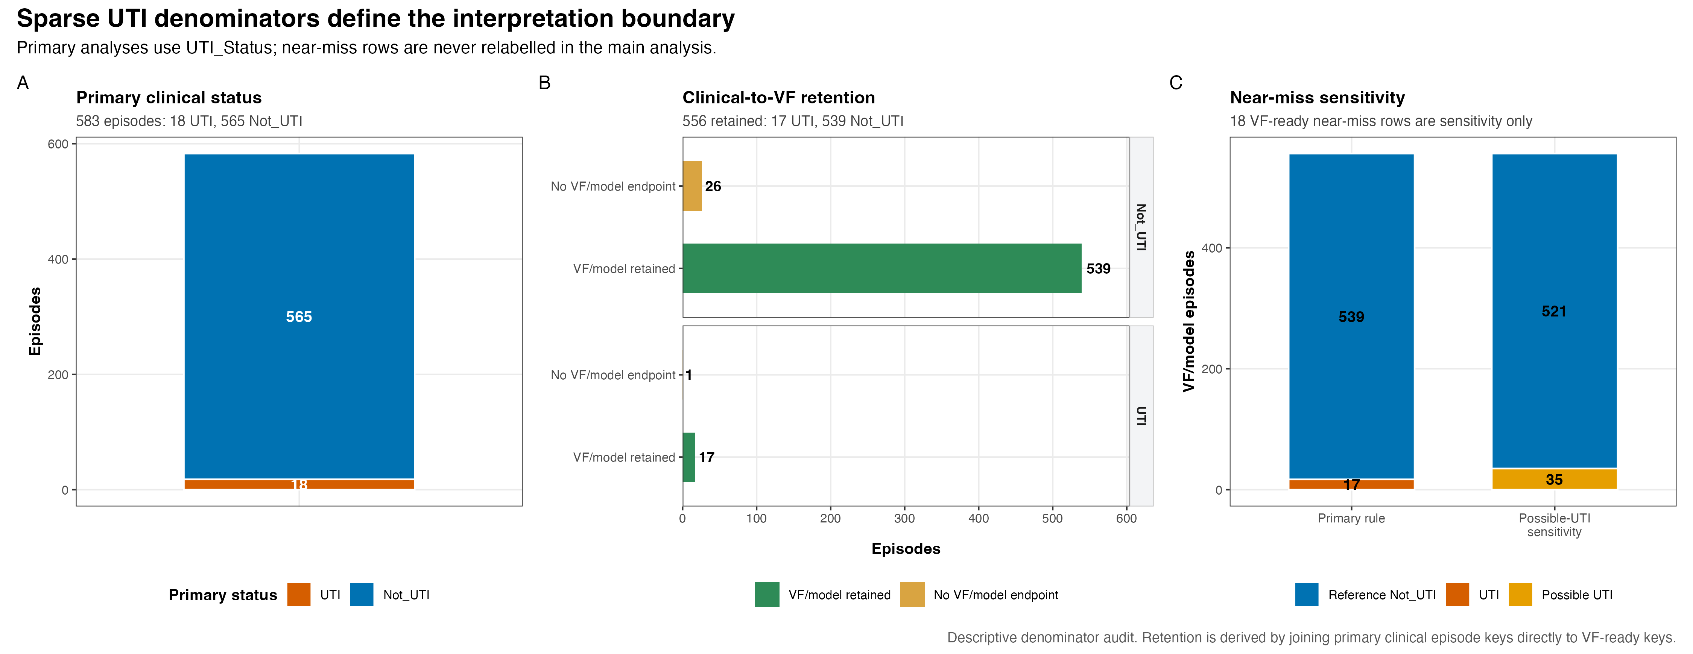
APPENDIX
Clinical phenotype denominator and definition
Clinical status is the annotation layer used for later exploratory overlays.
Denominator audit
Current pipeline outputs | VF analysis of longitudinal urinary E. coli isolates
15

Slide 16
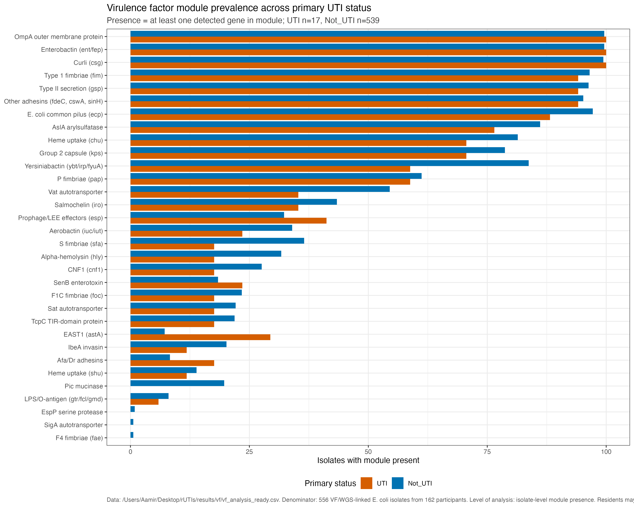
APPENDIX
Module prevalence by status is an exploratory annotation view
Read as descriptive status context; repeated measures and lineage are not fully resolved here.
Label
Exploratory clinical annotation.
Current pipeline outputs | VF analysis of longitudinal urinary E. coli isolates
16

Slide 17
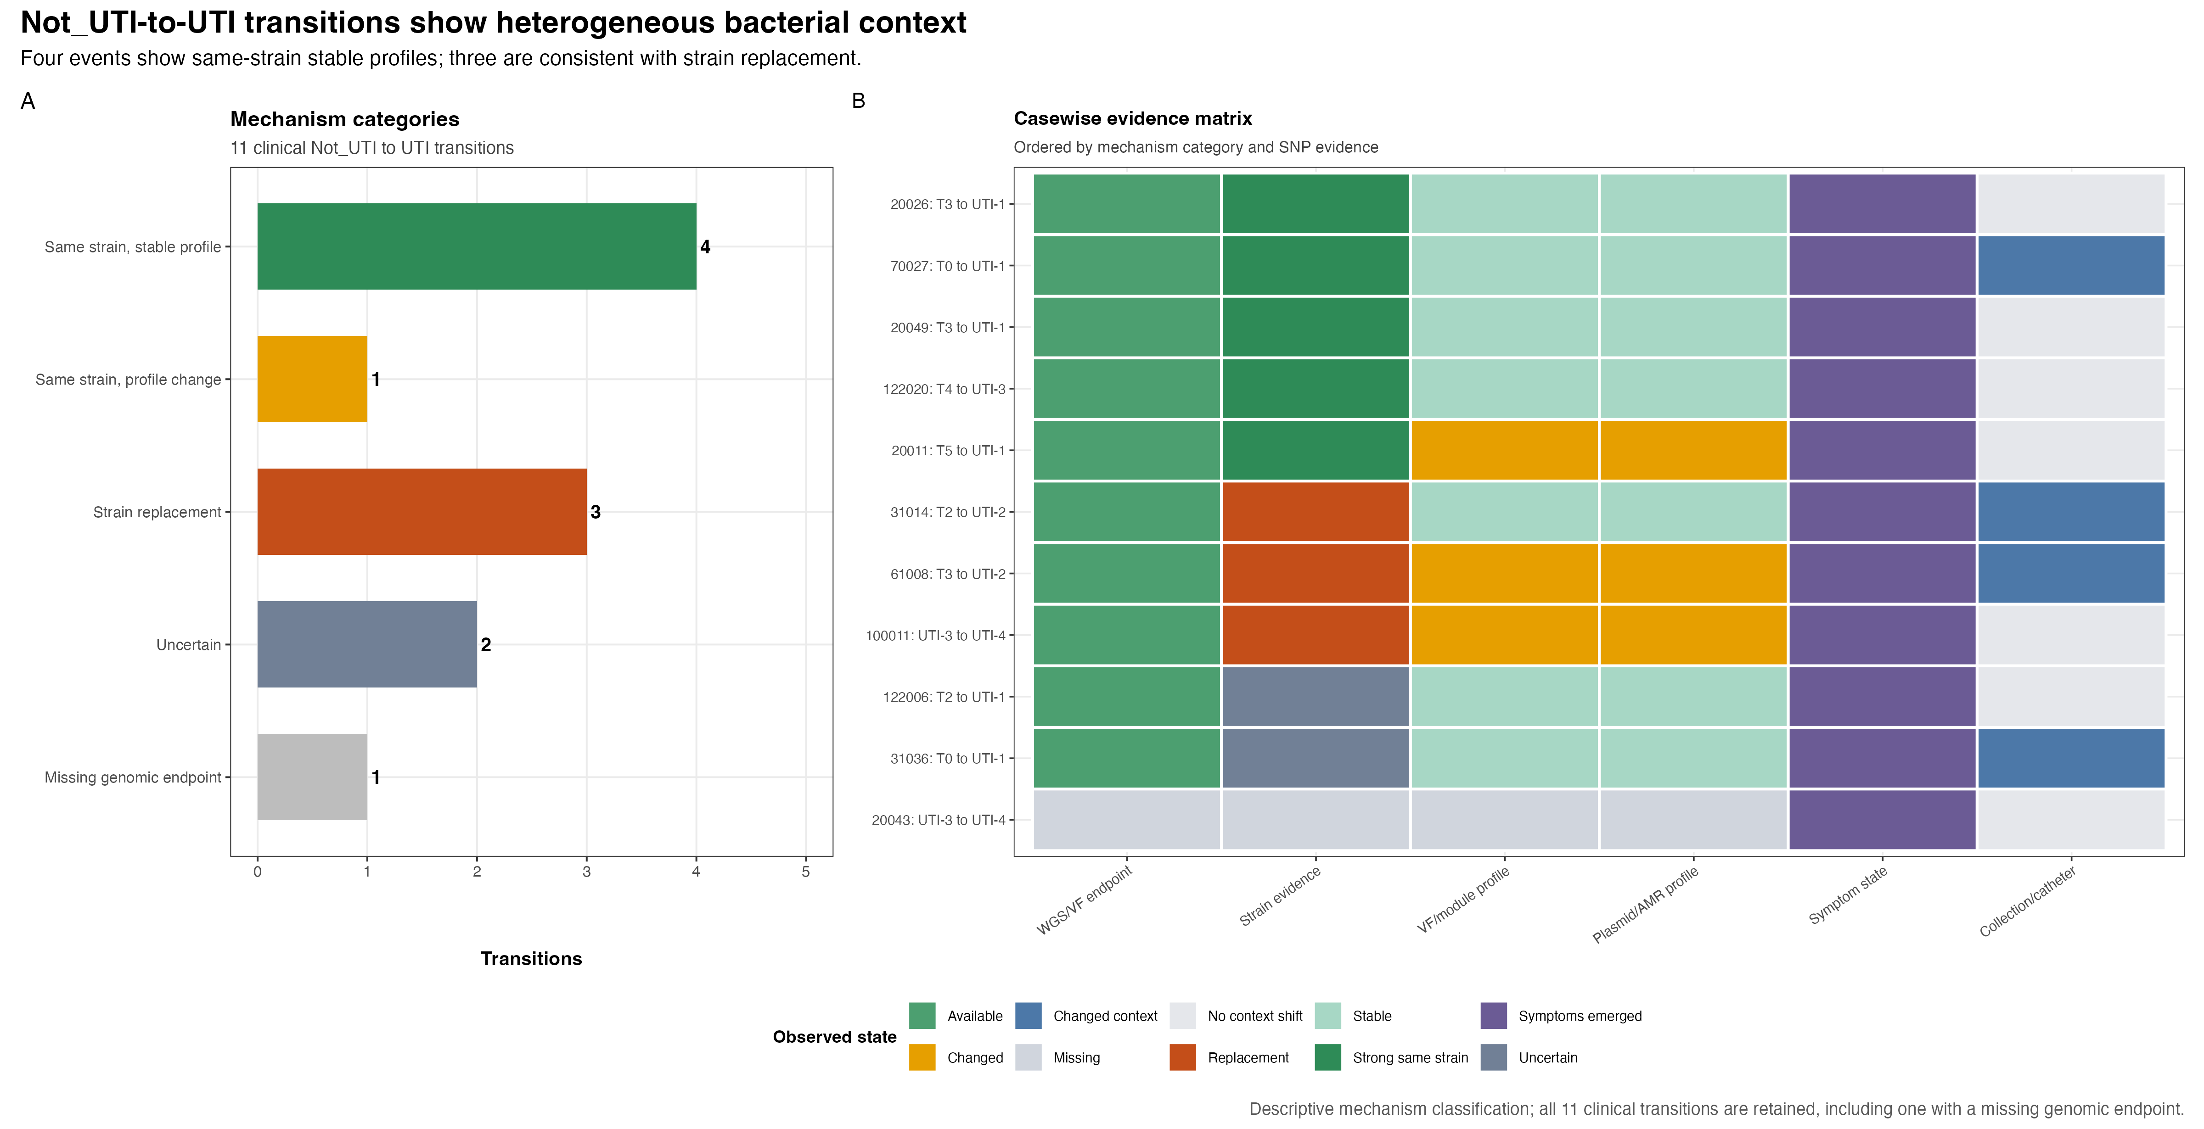
APPENDIX
Full transition mechanism casebook
Available for questions about Not_UTI -> UTI transitions; buckets organise evidence, not proof.
Descriptive casebook
Current pipeline outputs | VF analysis of longitudinal urinary E. coli isolates
17

Slide 18
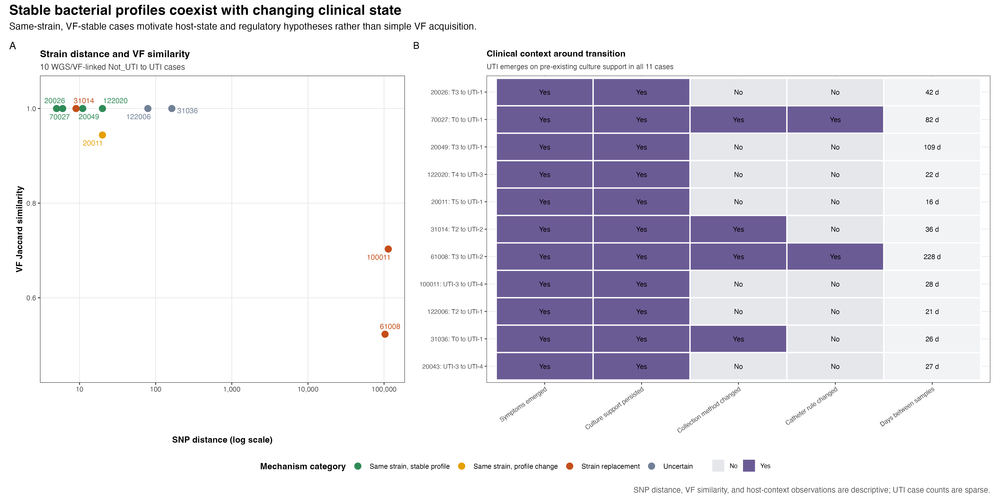
APPENDIX
Stable strain and changing clinical state
Low SNP distance and stable VF profiles support, but do not prove, host-state or regulation hypotheses.
Transition context
Current pipeline outputs | VF analysis of longitudinal urinary E. coli isolates
18

Slide 19
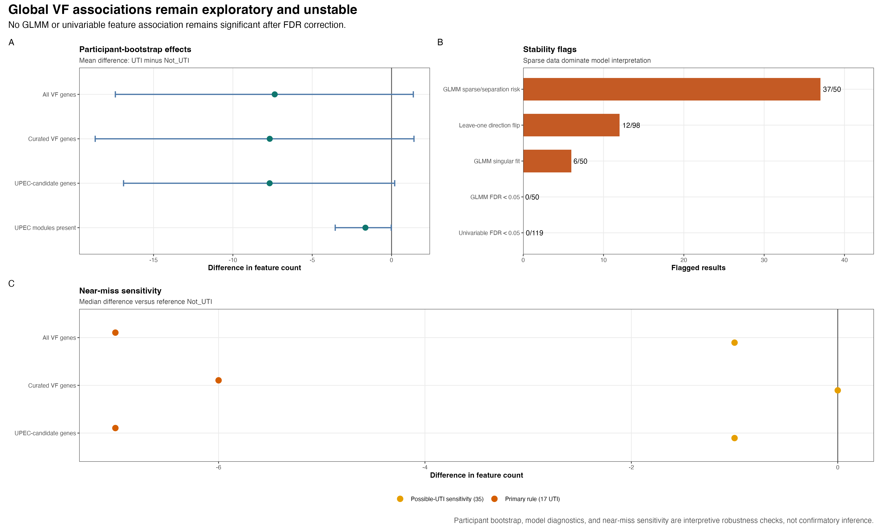
APPENDIX
Population-level robustness boundary
No adjusted VF association is confirmatory with only 17 VF-ready UTI episodes.
Exploratory diagnostics
Current pipeline outputs | VF analysis of longitudinal urinary E. coli isolates
19

Slide 20
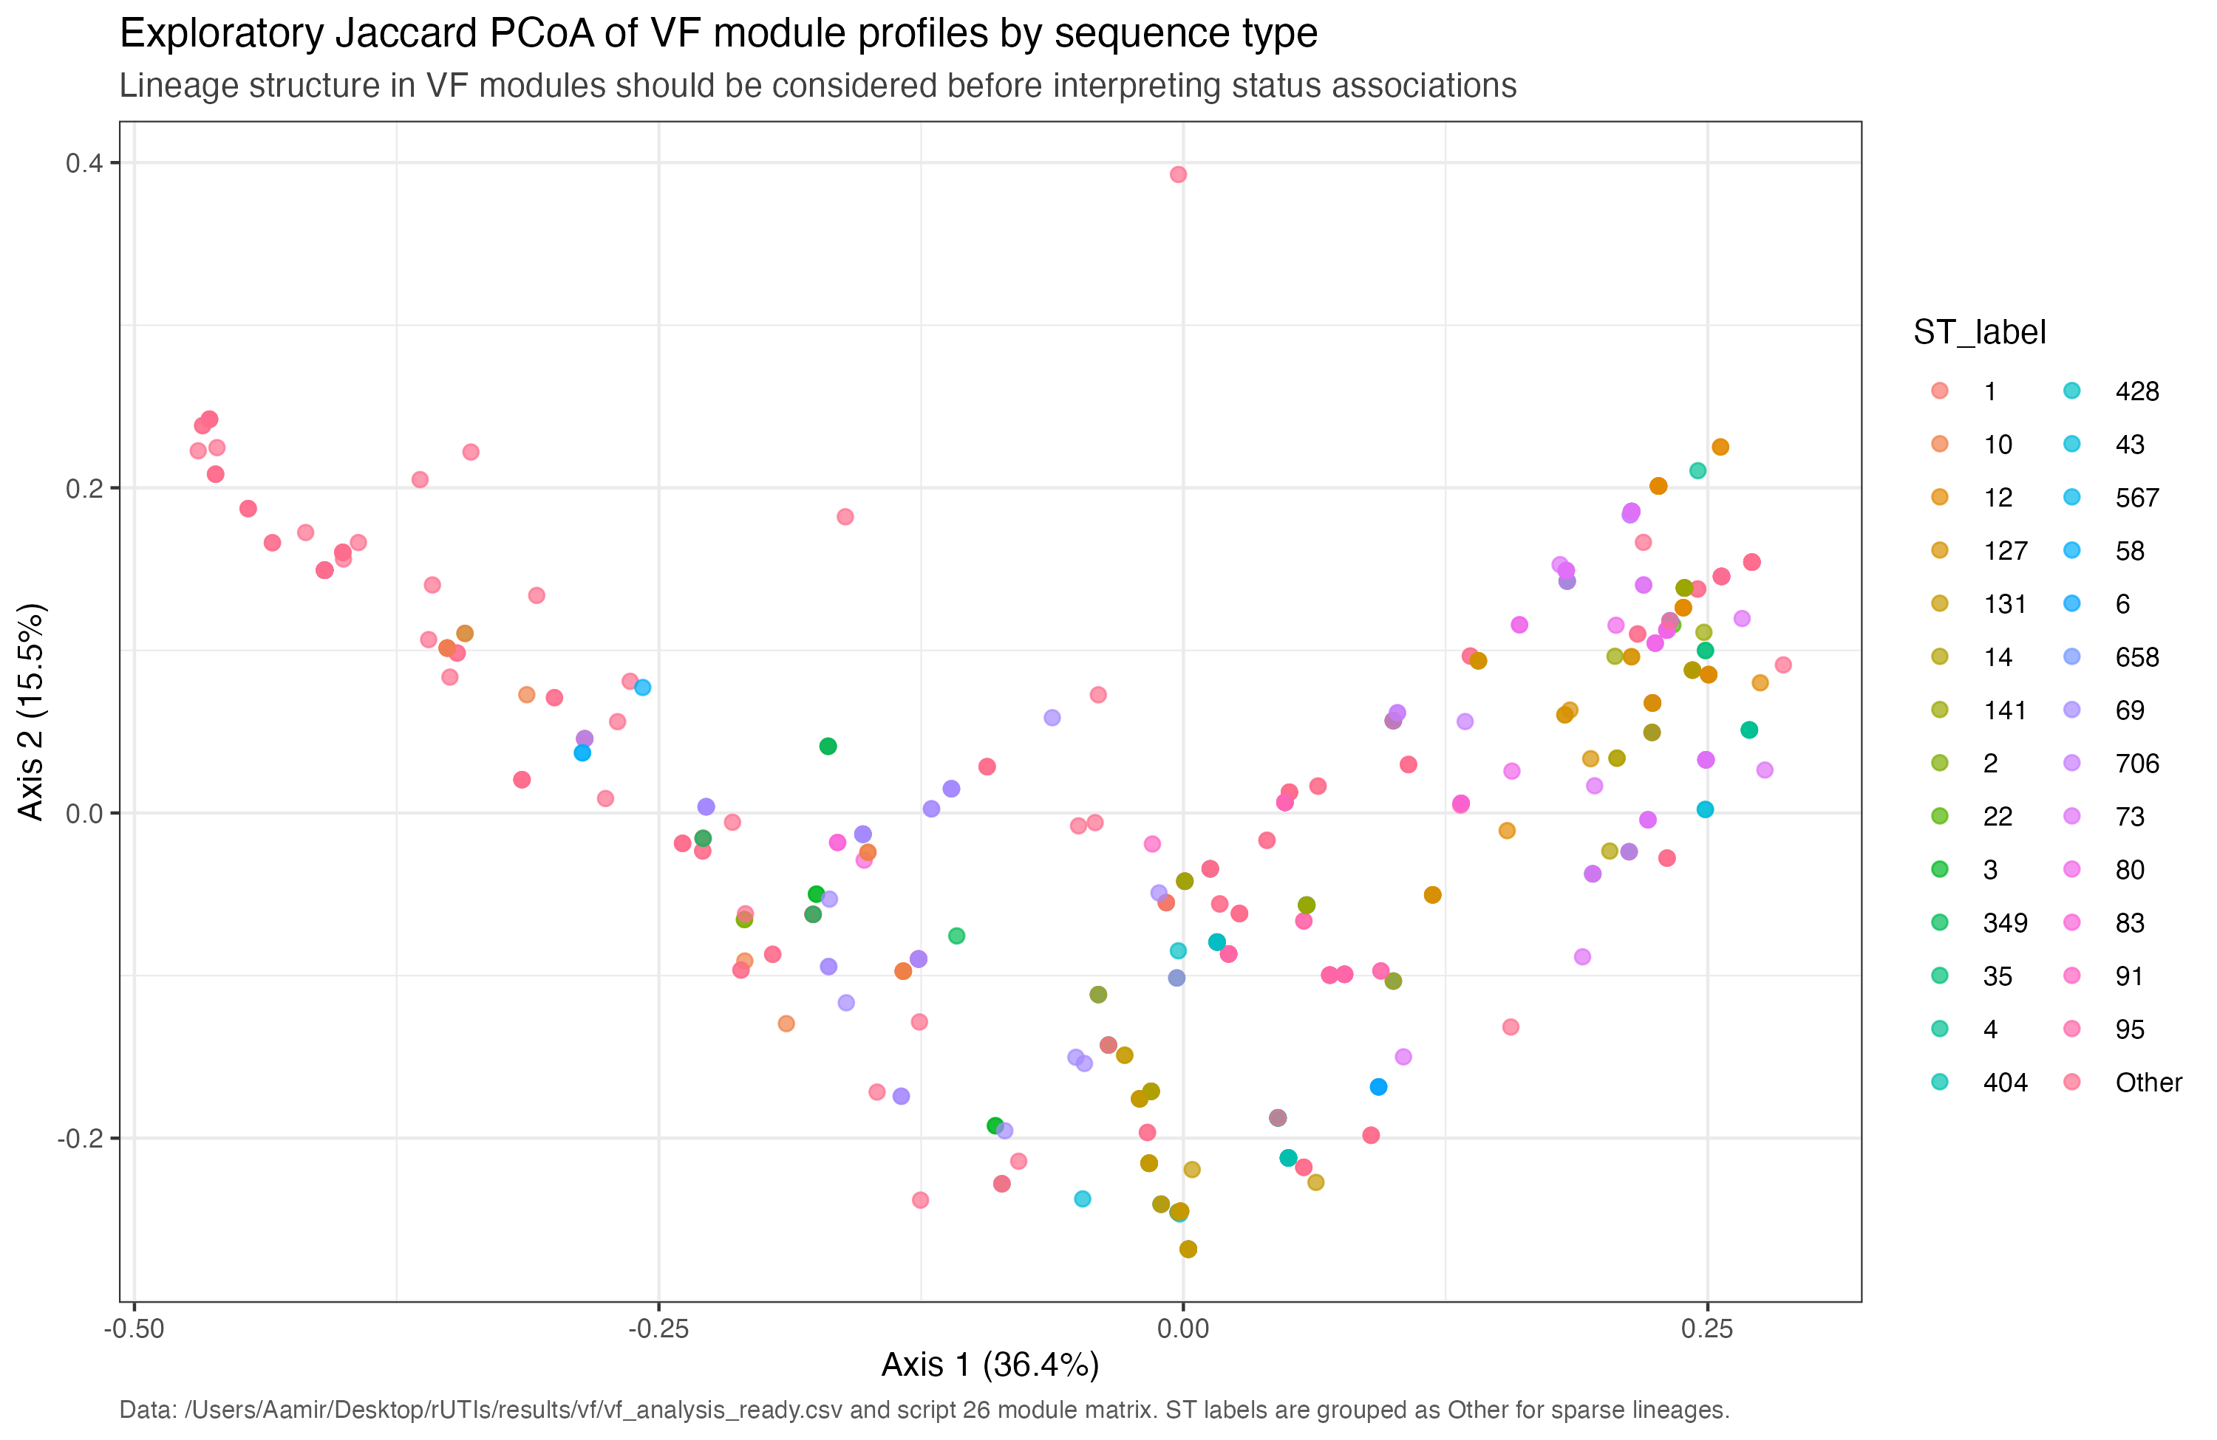
APPENDIX
Lineage structure is an interpretation check
Jaccard PCoA of module profiles by sequence type flags lineage structure before status claims.
Use for
Questions about ST and VF profile clustering.
Current pipeline outputs | VF analysis of longitudinal urinary E. coli isolates
20

Slide 21
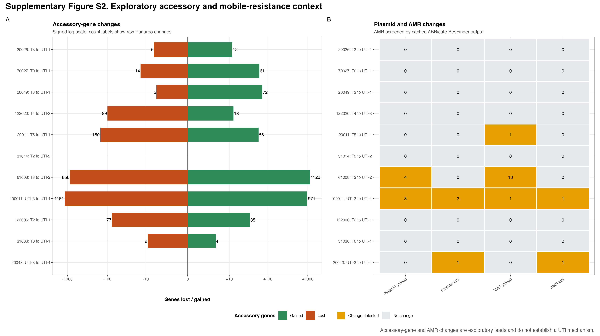
APPENDIX
AMR backup only: exploratory transition-level ResFinder context
This is not a global VF-plus-AMR association analysis and should stay in Q&A backup.
AMR backup only
Current pipeline outputs | VF analysis of longitudinal urinary E. coli isolates
21

Slide 22
APPENDIX / EVIDENCE REGISTRY
Sources of truth and lookup resources for questions
Open these files when the discussion needs provenance rather than a new analysis.
Counts and validation
Longitudinal summary
results/final_figures/final_figure_validation_checks.csv
results/vf/vf_longitudinal_summary.txt
Denominator flow
Module notes
results/qc/pipeline_denominator_summary.csv
results/vf/vf_module_definition_notes.md
VF diagnostics
Casebook
results/vf/vf_dataset_diagnostics.txt
results/mechanism/not_uti_to_uti_casebook.md
VF figure registry
Pipeline explanation
results/vf/vf_figure_index.csv
docs/pipeline_architecture.md
VF visual audit
Dense backup lookup
results/vf/vf_visualisation_audit.csv
results/longitudinal/swimmer_plot.png
Guardrail for Q&A
Use Supplementary Figures S1 and S3-S5 for transition/sensitivity questions; do not convert backup diagnostics into confirmatory VF, AMR, or mechanism claims.
Current pipeline outputs | VF analysis of longitudinal urinary E. coli isolates
22

