Slide 1
CURRENT RESULTS REVIEW / ONBOARDING
Recurrent UTI:
clinical state and genomic evidence
A current UTI versus Not_UTI review for a new project colleague
THREE QUESTIONS
01
Which isolates persist across changing clinical states?
UTI
NOT_UTI
02
Does symptom emergence require a new measured VF profile?
Primary comparison throughout
03
What can the sparse UTI denominator support responsibly?
Prepared for scientific review and practical handover | 27 May 2026

Slide 2
CLINICAL RATIONALE
Repeated bacteriuria is not equivalent to symptomatic UTI
The primary comparison separates culture-supported symptomatic episodes from a heterogeneous remainder.
PRIMARY STATUS
WHY LONGITUDINAL SAMPLING?
UTI
01
Follow the same resident across time
Culture support plus compatible symptoms
02
Separate persistence from replacement
A clinically interpretable symptomatic state.
NOT_UTI
03
Ask whether symptoms emerge without VF gain/loss
Not a single biological condition
May include bacteriuria without compatible symptoms,
negative cultures, or other clinically non-UTI episodes.
Clinical status is the outcome; genomics helps explain transitions.
rUTI clinical-to-genomic review | current UTI_Status analysis | 27 May 2026
02

Slide 3
DESIGN AND STATUS RULE
Repeated clinical episodes link directly to isolate genomes
The same sampling structure supports both clinical classification and VF/WGS comparisons.
LONGITUDINAL STUDY DESIGN
CURRENT PRIMARY STATUS RULE
T0
T3
UTI-1
Culture support
>=10^3 CFU/mL
episode
+
baseline
repeat
symptoms
isolate
Compatible symptoms
catheter-aware
DNA
DNA
DNA
Link episode status to WGS and virulence-factor profiles
UTI
NOT_UTI
Then evaluate persistence, replacement and profile stability.
both present
otherwise
rUTI clinical-to-genomic review | current UTI_Status analysis | 27 May 2026
03

Slide 4
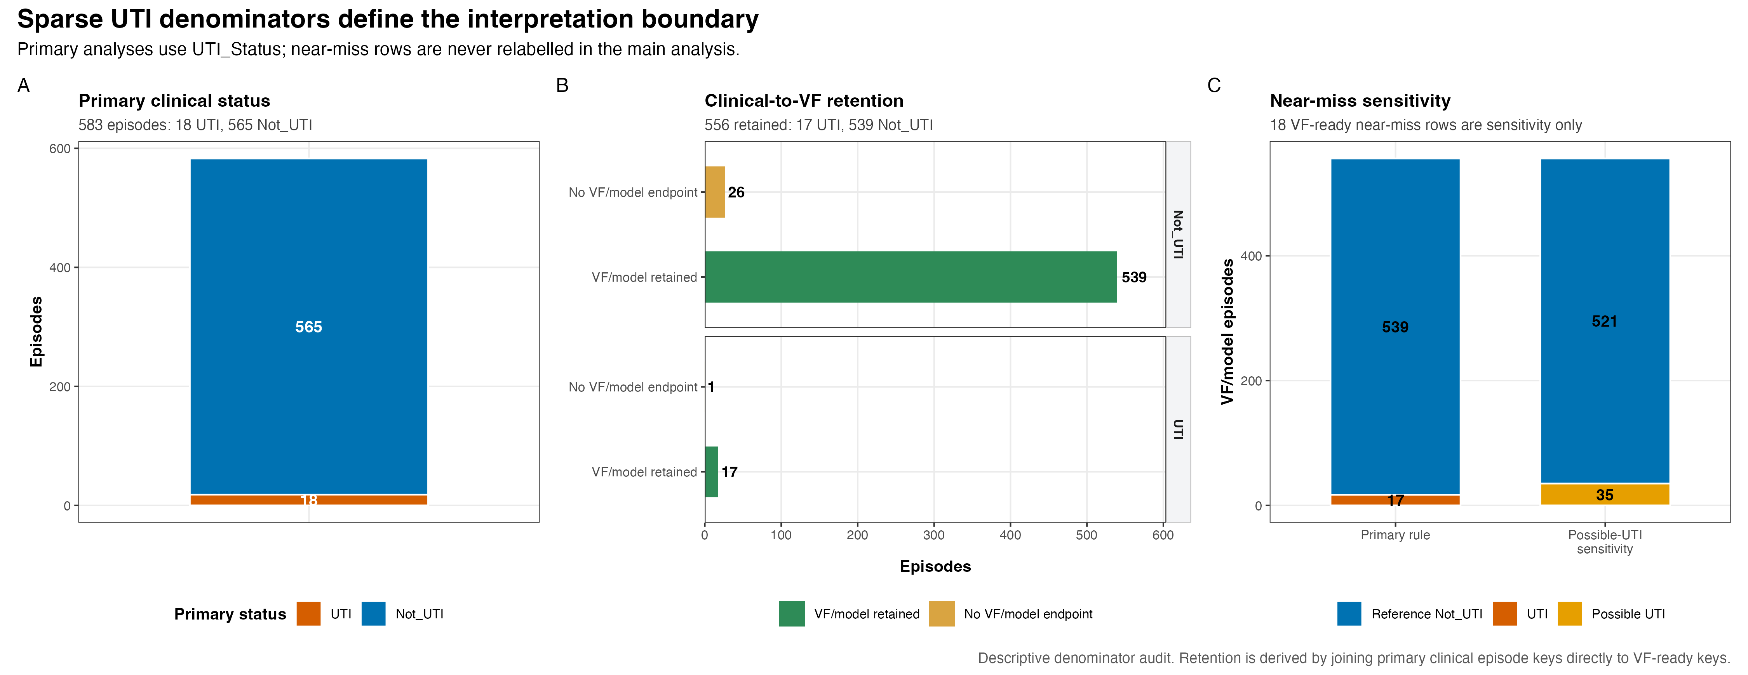
VALIDATED DENOMINATOR
The primary UTI denominator is deliberately narrow
Episode-level counts define the interpretation boundary before any biological claim.
DESCRIPTIVE DENOMINATOR AUDIT
rUTI clinical-to-genomic review | current UTI_Status analysis | 27 May 2026
04

Slide 5
PIPELINE WITH COUNTS
From clinical episodes to virulence-factor interpretation
Counts are shown at their analytical level: assembly-level QC is not an episode denominator.
NUMBERED PROCESS MAP
CLINICAL
GENOMIC PROCESSING
01
Episodes classified
02
Primary included
03
Assembly QC records
04
Canonical episodes
585
583
1,291
556
before primary manual exclusions
18 UTI | 565 Not_UTI | 2 excluded
includes assembler alternatives
one selected assembly per episode
00a / 00b classification
00b status_map_primary_included
12a_wgs_qc.R
canonical selection
VF ANALYSIS AND LONGITUDINAL OUTPUTS
05
VF presence/absence
06
Model-ready
07
VF feature space
08
Transitions
556
556
227 -> 32
11 -> 10
episode-level VF rows
17 UTI | 539 Not_UTI
27 clinical episodes lack VF-ready evidence
genes -> modules
18 UPEC-candidate modules
clinical transitions -> WGS/VF-linked
1 endpoint missing
02_gene_presence_analysis.R
22_vf_build_analysis_dataset.R
26_vf_define_gene_modules.R
mechanism casebook
rUTI clinical-to-genomic review | current UTI_Status analysis | 27 May 2026
05

Slide 6
VF FRAMEWORK
What the virulence-factor analysis actually measures
Presence/absence features describe measured genomic potential, not expression or host response.
ANALYSIS ARCHITECTURE
INPUT
REPRESENTATION
QUESTIONS ANSWERED
556
227 VF genes
Burden
How many detected VF genes?
detected feature columns
descriptive
VF/WGS-linked
episodes
32 modules
Similarity
Is the profile stable over time?
binary presence / absence
descriptive
18 UPEC-candidate systems
Association
Does status track VF signals?
exploratory / FDR-controlled
Interpretation boundary
Stable measured VF does not rule out altered expression, regulation, inoculum or host state.
rUTI clinical-to-genomic review | current UTI_Status analysis | 27 May 2026
06

Slide 7
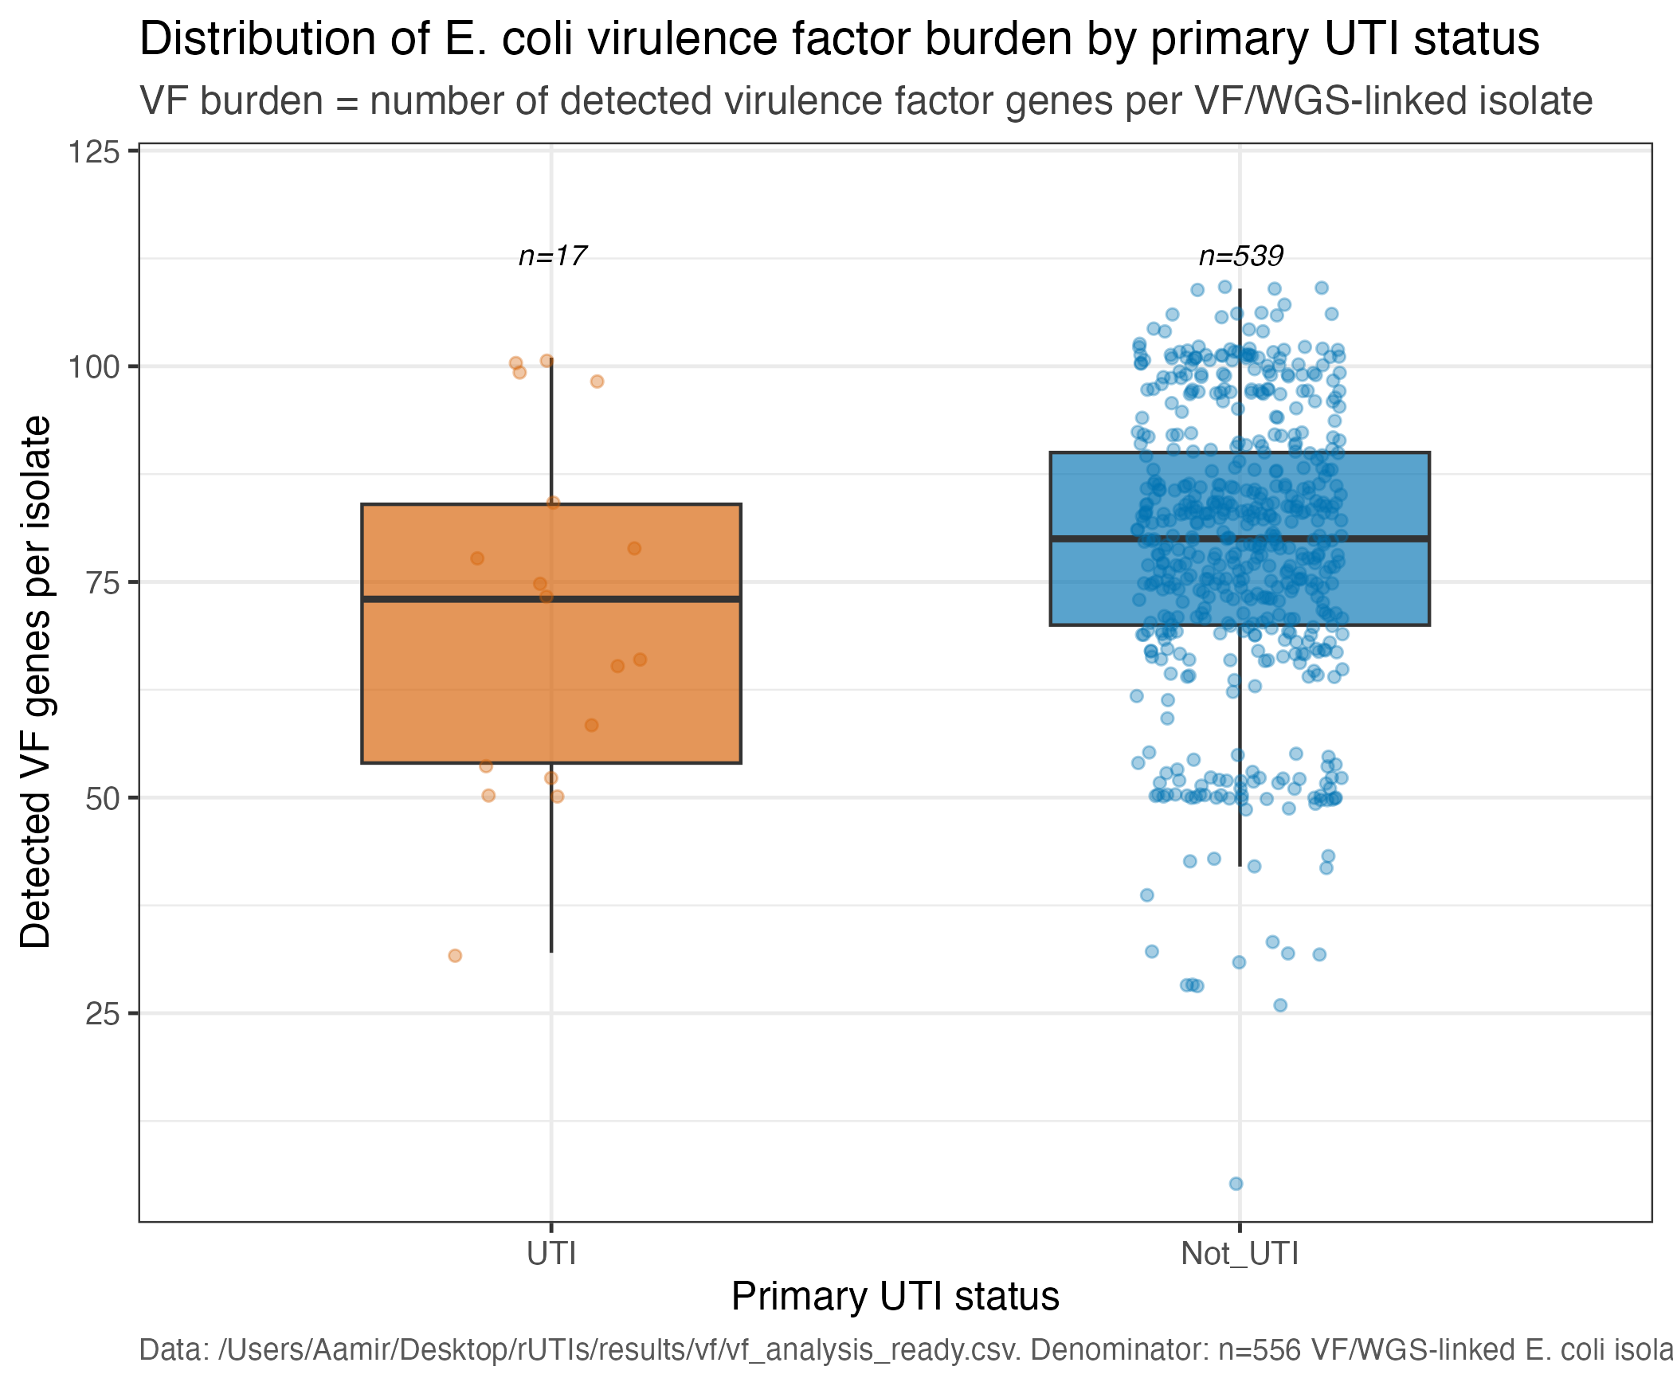
VIRULENCE FACTORS
Observed VF burden overlaps strongly across status groups
The UTI group is sparse (n=17), so this is descriptive distributional evidence rather than a causal test.
DESCRIPTIVE
rUTI clinical-to-genomic review | current UTI_Status analysis | 27 May 2026
07

Slide 8
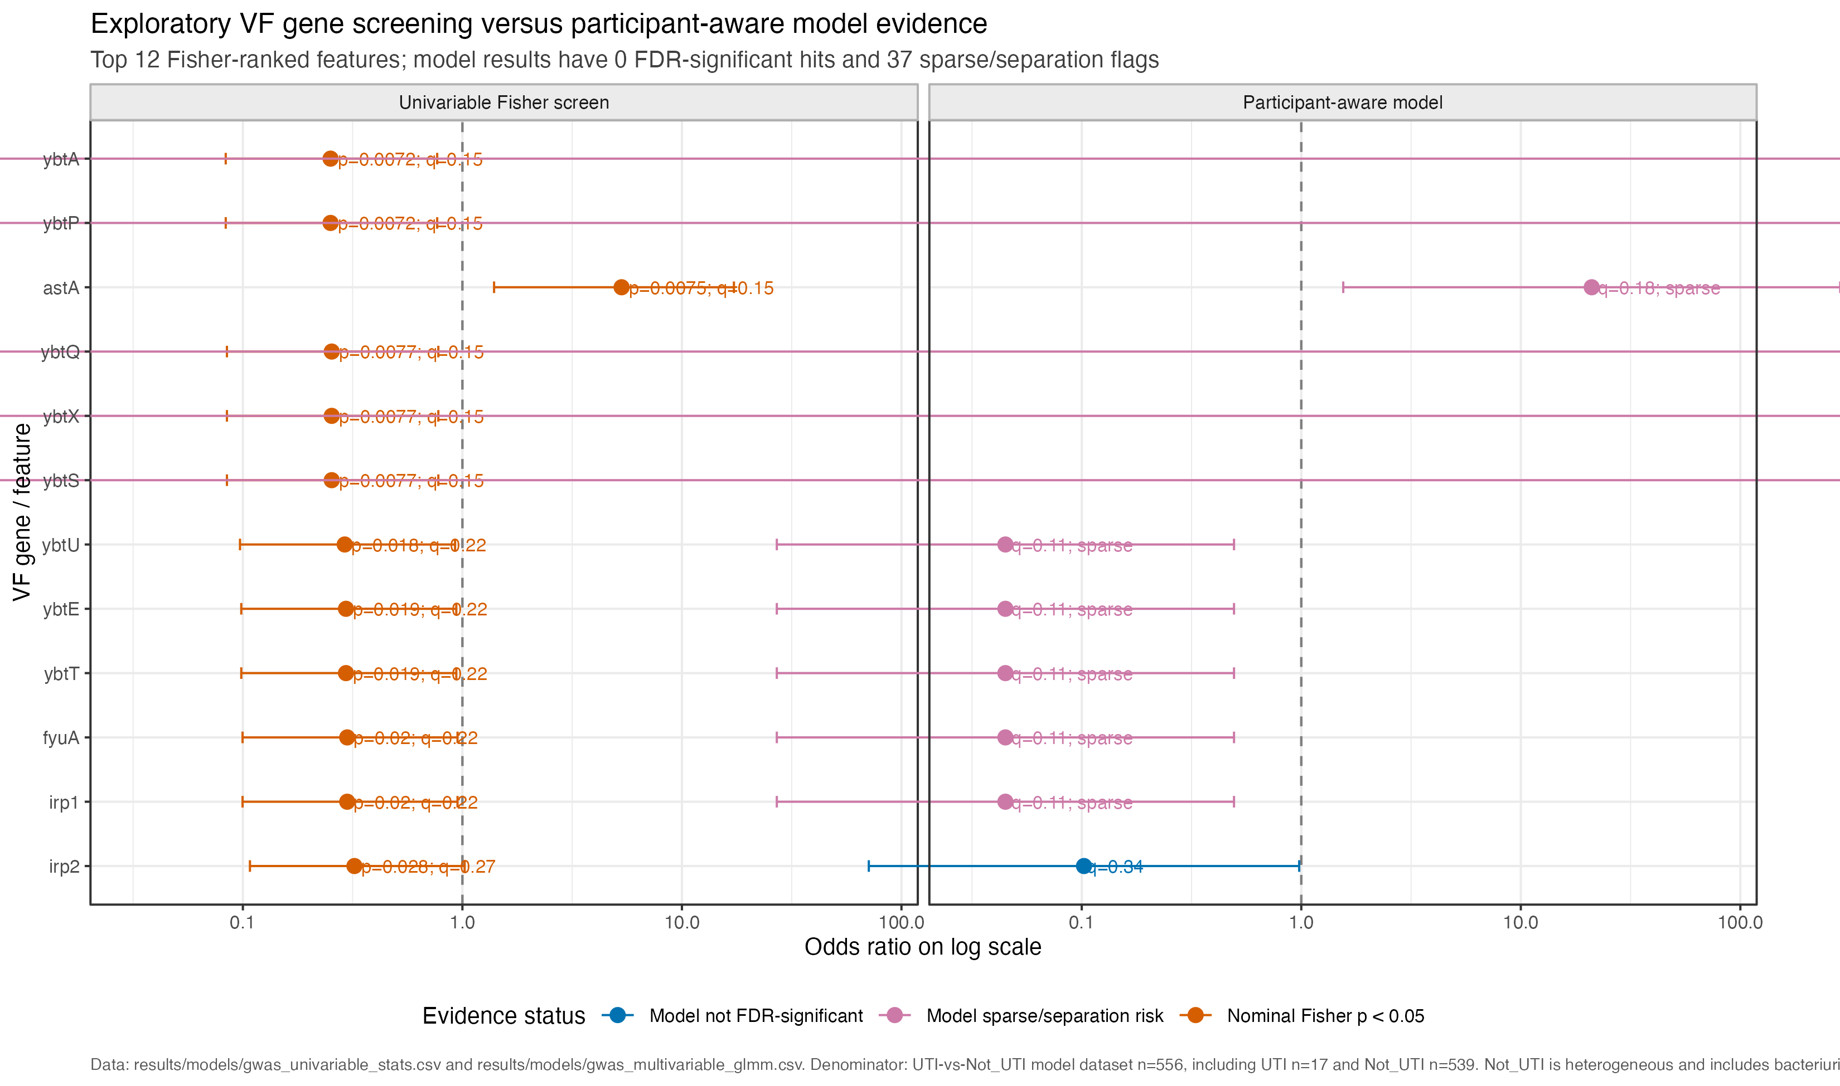
VIRULENCE FACTORS
Nominal VF screens do not become confirmed associations
Participant-aware modelling and FDR correction define the evidential limit of the current dataset.
EXPLORATORY / FDR
rUTI clinical-to-genomic review | current UTI_Status analysis | 27 May 2026
08

Slide 9
LONGITUDINAL EXAMPLE
Participant 20026: symptoms emerge with a stable VF profile
A concrete transition clarifies what same-strain, stable-profile evidence means.
DESCRIPTIVE CASE
NOT_UTI
UTI
T3
42 DAYS
UTI-1
5 SNPs
culture-supported episode
without UTI classification
symptom emergence on
culture-supported bacteriuria
strong same-strain evidence
MEASURED CHANGE
VF PROFILE
SNP DISTANCE
CLINICAL STATE
+0 / -0
5
Not_UTI -> UTI
stable
low
changed
Supports a host-state or unmeasured-regulation hypothesis; it does not prove mechanism.
rUTI clinical-to-genomic review | current UTI_Status analysis | 27 May 2026
09

Slide 10
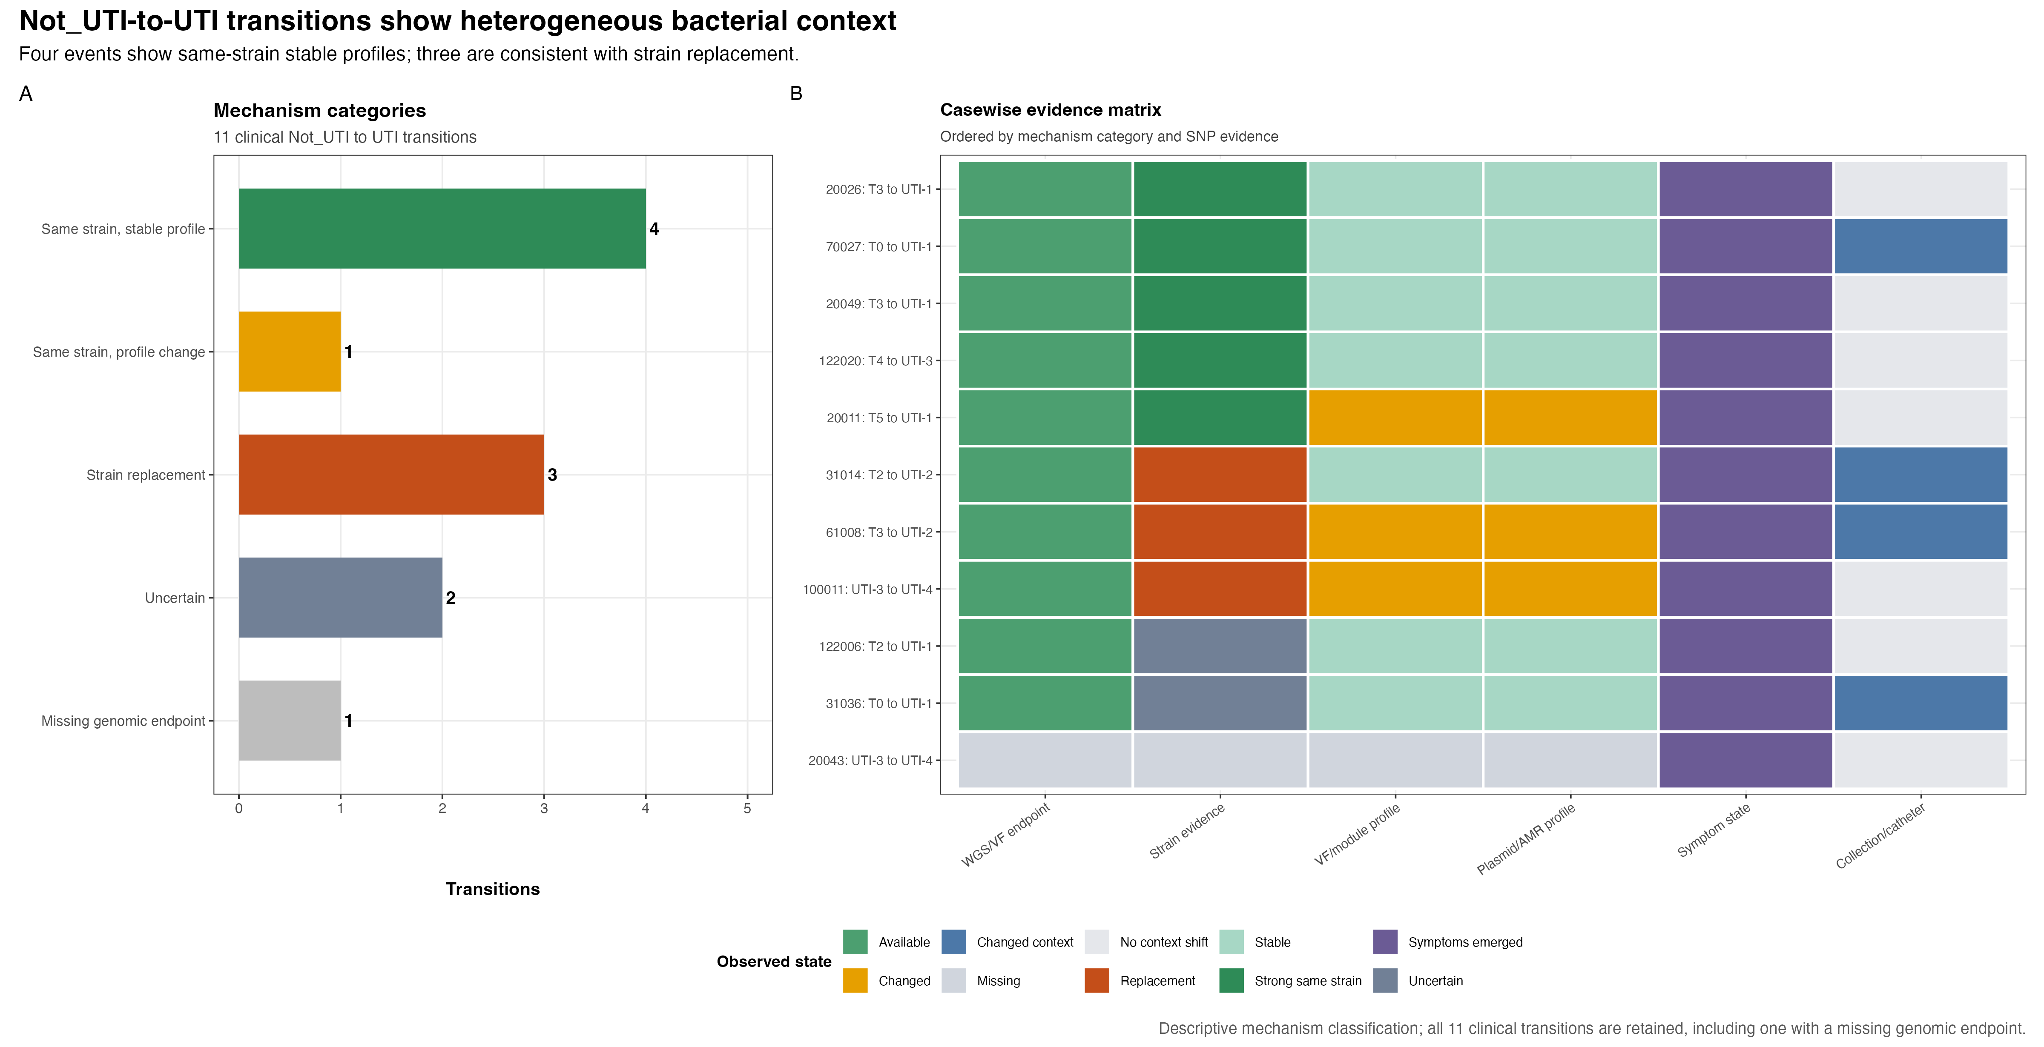
TRANSITION CASEBOOK
Not_UTI-to-UTI transitions are biologically heterogeneous
Eleven clinical transitions include ten with linked WGS/VF evidence and one missing endpoint.
DESCRIPTIVE CASEBOOK
rUTI clinical-to-genomic review | current UTI_Status analysis | 27 May 2026
10

Slide 11
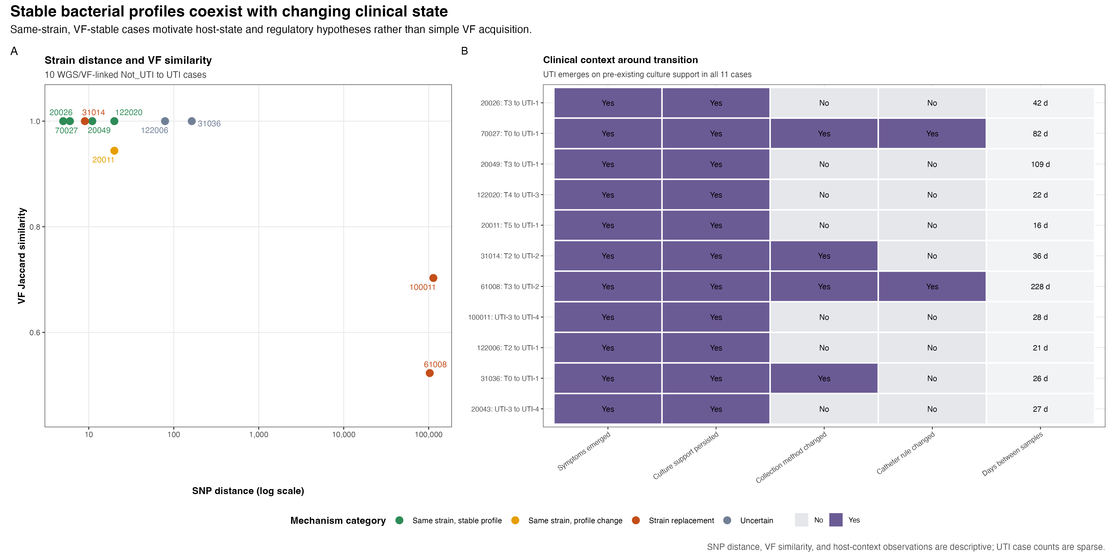
CENTRAL OBSERVATION
Stable measured profiles can accompany changing clinical state
Four transitions show same-strain stable profiles; three are consistent with strain replacement.
DESCRIPTIVE TRANSITION CONTEXT
rUTI clinical-to-genomic review | current UTI_Status analysis | 27 May 2026
11

Slide 12
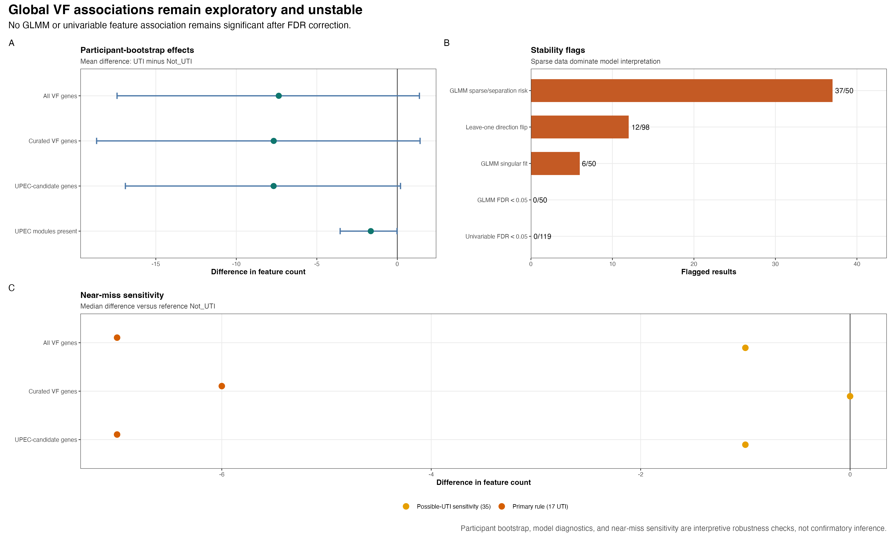
POPULATION-LEVEL INFERENCE
No global VF association remains significant after FDR correction
With only 17 primary UTI VF-ready episodes, global signals remain exploratory.
EXPLORATORY ROBUSTNESS
rUTI clinical-to-genomic review | current UTI_Status analysis | 27 May 2026
12

Slide 13
DISCUSSION
What is known, what is limited, what comes next
The current evidence supports a focused next phase rather than a broad association claim.
EVIDENCE
LIMITATION
NEXT STEP
Stable VF profiles occur across some symptom-emergence transitions.
Only 17 UTI episodes are VF/model-ready.
Prioritise within-strain cases for deeper follow-up.
Replacement is also present; no single mechanism fits all cases.
Presence/absence cannot measure expression or host state.
Pair bacterial genomic hypotheses with host/context data.
Discussion prompt: which transition-level experiment would most sharply distinguish host context from unmeasured bacterial regulation?
rUTI clinical-to-genomic review | current UTI_Status analysis | 27 May 2026
13

Slide 14
APPENDIX / HANDOVER
Canonical outputs and rerun path
Use these files as current sources of truth when navigating or reproducing the review.
PURPOSE
SOURCE OF TRUTH
RERUN ORDER
Headline results
results/summary/final_key_results_summary.md
01 Validate upstream outputs
Interpretation
results/final_figures/final_figure_captions.md
02 Confirm status_map.csv
Validated inventory
results/final_figures/final_figure_manifest.csv
03 Confirm vf_analysis_ready.csv
04 Refresh casebook
Transition cases
results/mechanism/not_uti_to_uti_casebook.md
05 Render final figures
Architecture
docs/pipeline_architecture.md
ENTRY POINT
35_final_figure_pack.R
Operational note
Keep primary UTI_Status outputs separate from superseded legacy labels.
rUTI clinical-to-genomic review | current UTI_Status analysis | 27 May 2026
14

Slide 15
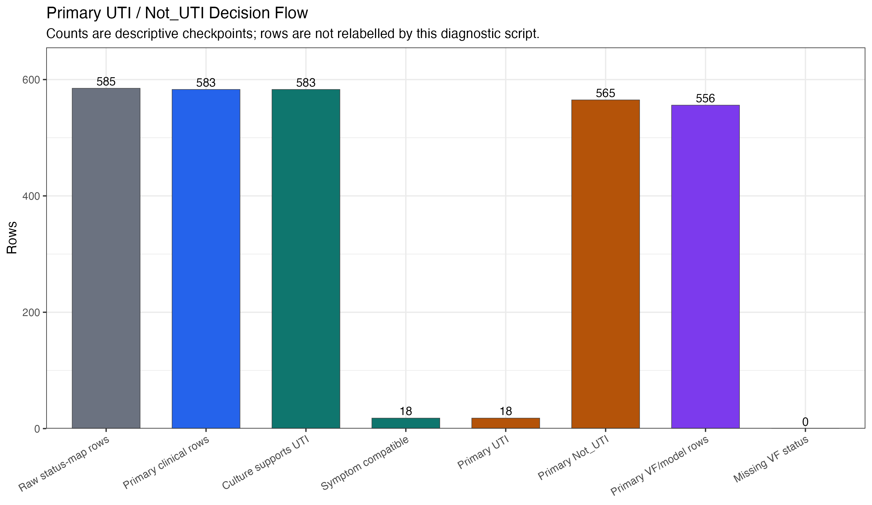
APPENDIX / CLINICAL AUDIT
Current UTI classification audit
Current catheter-aware symptom and culture-support rule; diagnostic context only.
DESCRIPTIVE AUDIT
rUTI clinical-to-genomic review | current UTI_Status analysis | 27 May 2026
15

Slide 16
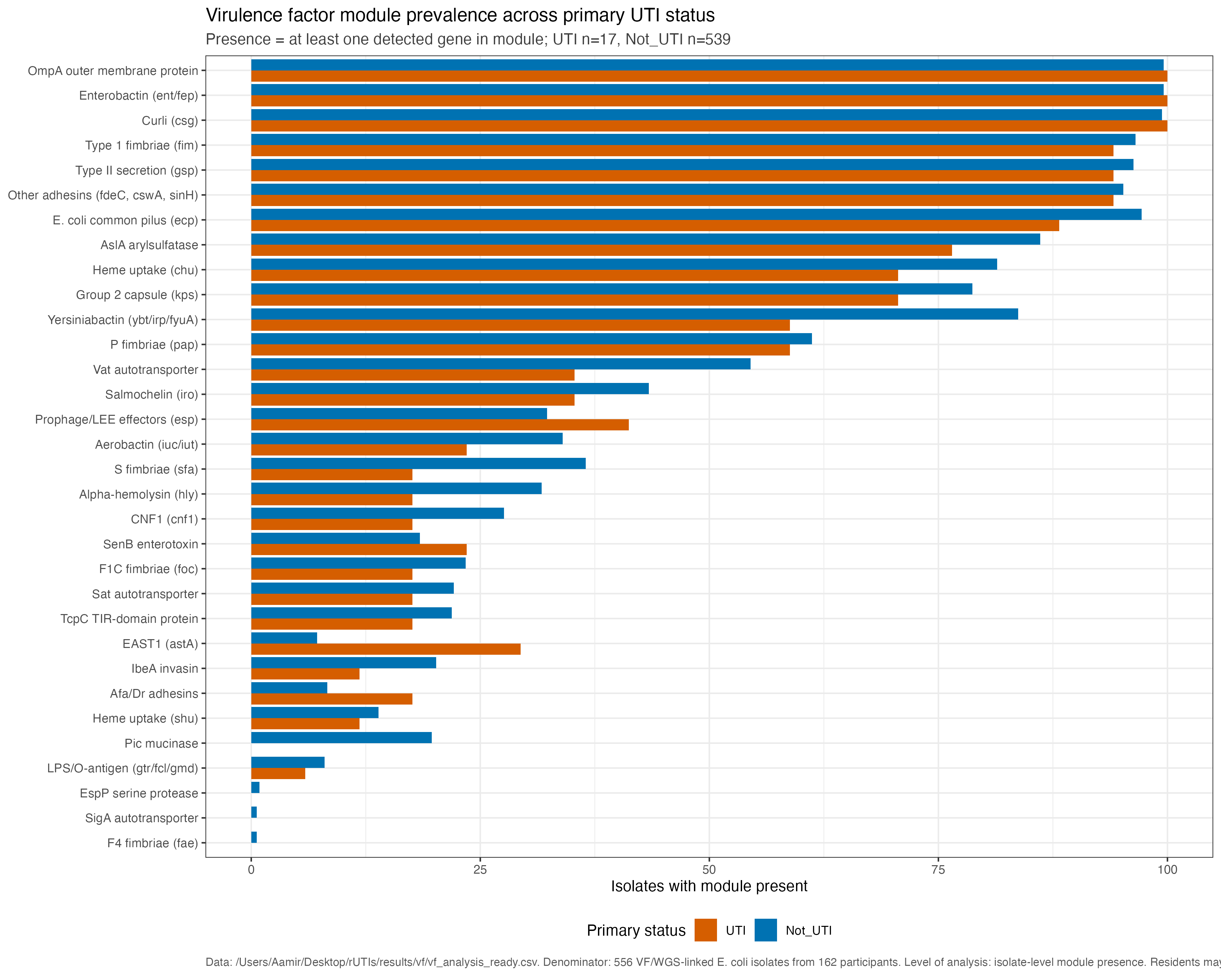
APPENDIX / VIRULENCE FACTORS
VF module prevalence across current clinical status
Module presence is exploratory and does not account for repeated measures or lineage structure.
EXPLORATORY DETAIL
rUTI clinical-to-genomic review | current UTI_Status analysis | 27 May 2026
16

Slide 17
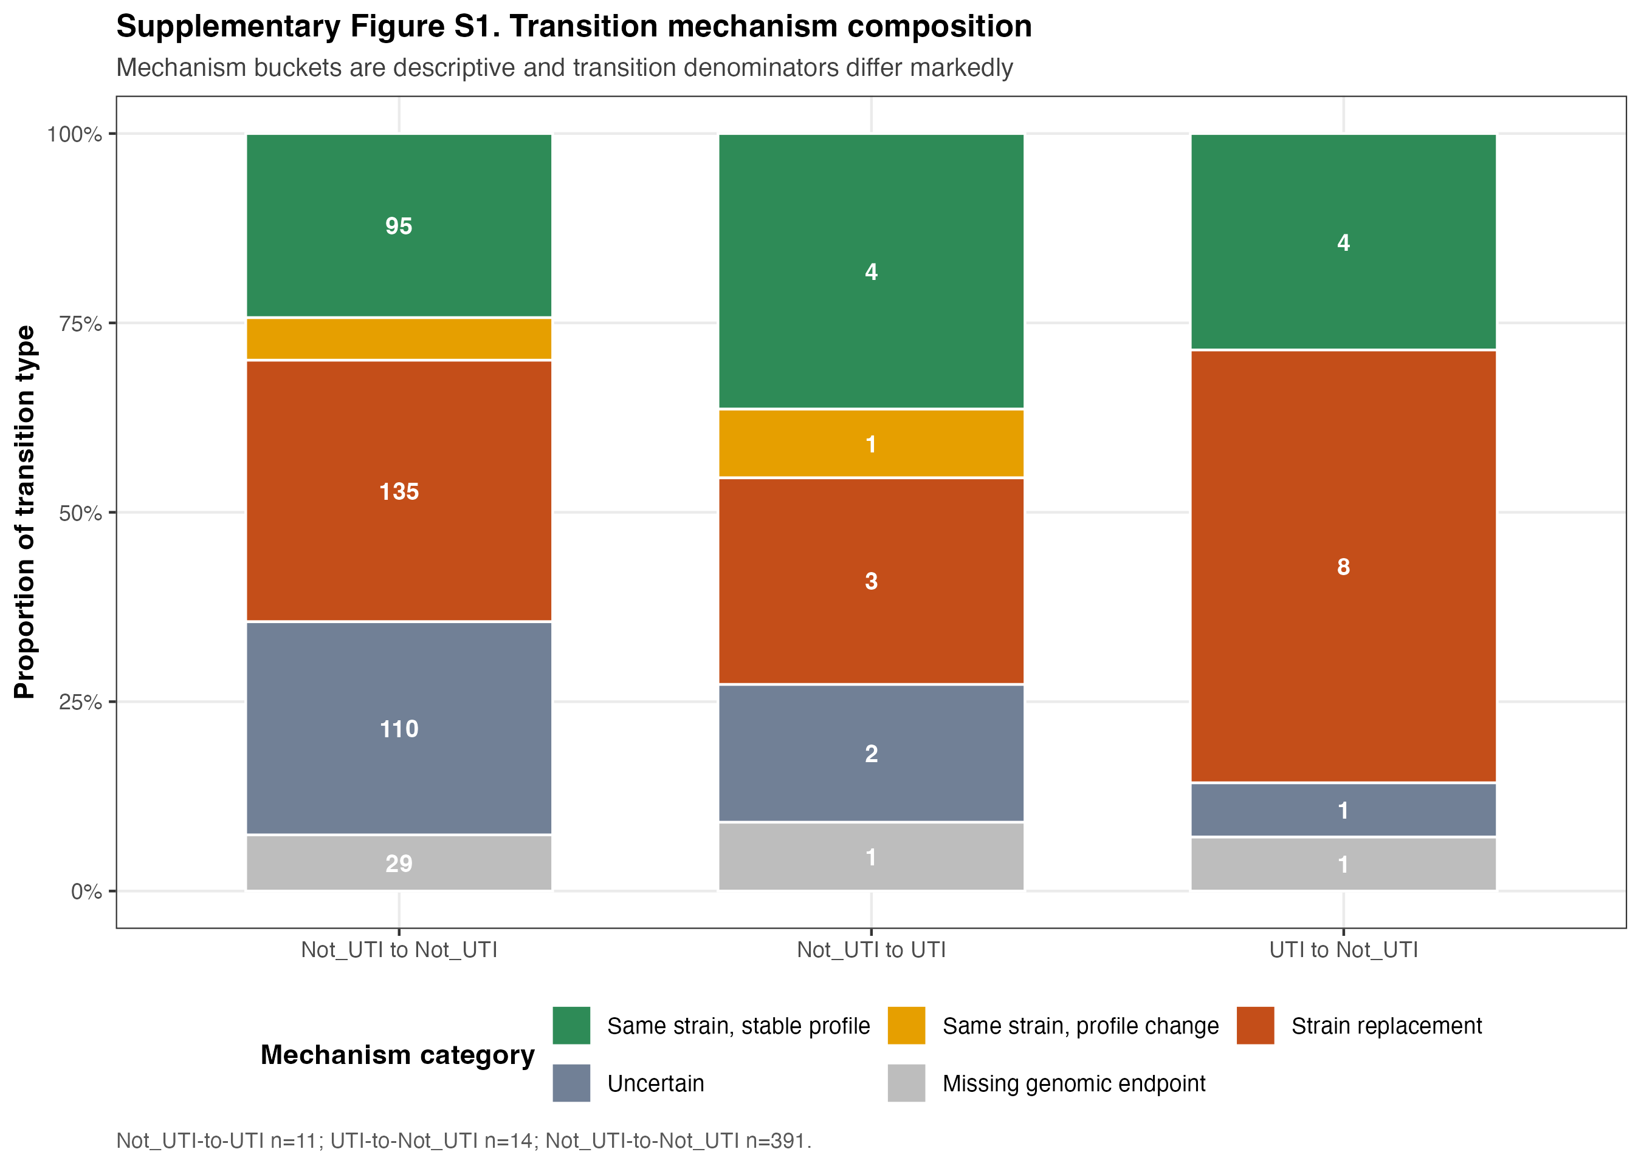
APPENDIX / MECHANISMS
Mechanism composition across transition types
Unequal transition denominators prevent inferential comparison of proportions.
DESCRIPTIVE COMPARISON
rUTI clinical-to-genomic review | current UTI_Status analysis | 27 May 2026
17

Slide 18
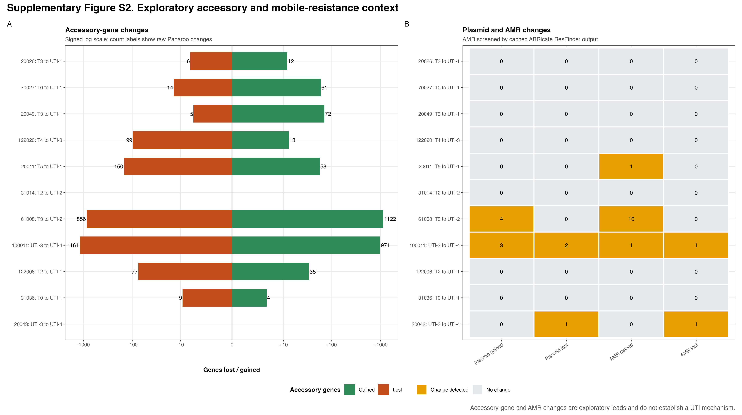
APPENDIX / EXPLORATORY BACKUP
Accessory, plasmid and ResFinder context only
Exploratory transition-level context; not a global VF-plus-AMR association analysis.
EXPLORATORY AMR BACKUP
rUTI clinical-to-genomic review | current UTI_Status analysis | 27 May 2026
18

Slide 19
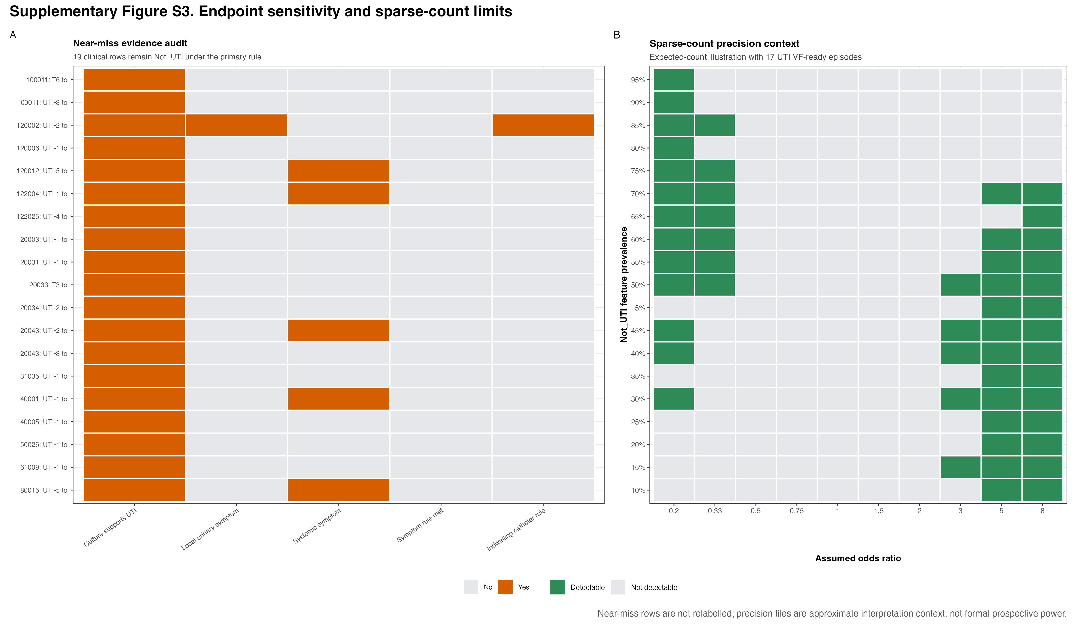
APPENDIX / SENSITIVITY
Near-miss audit and sparse-count precision
Near-miss episodes remain sensitivity-only and do not enter the primary UTI group.
SENSITIVITY DIAGNOSTIC
rUTI clinical-to-genomic review | current UTI_Status analysis | 27 May 2026
19

Slide 20
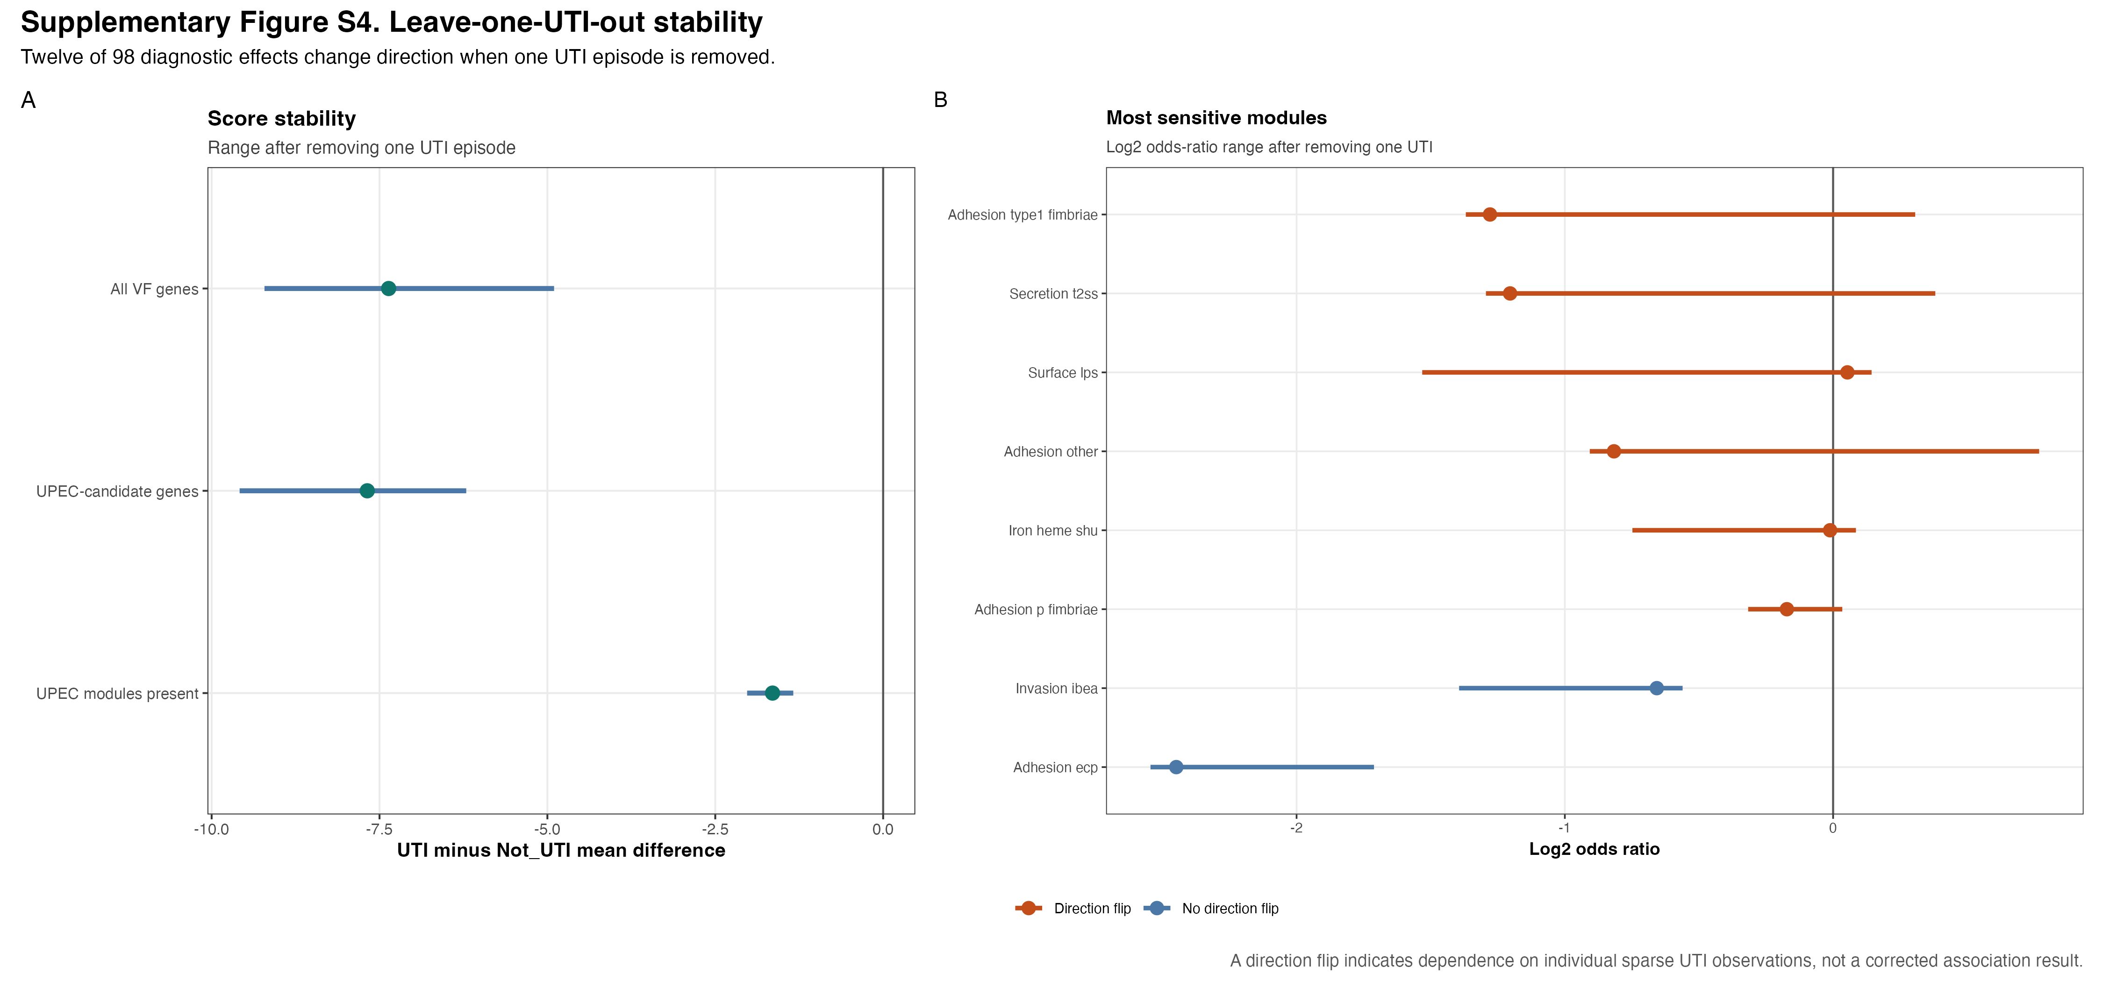
APPENDIX / SENSITIVITY
Leave-one-UTI-out stability
Instability is expected with 17 VF-ready UTI episodes and is not association testing.
SPARSE-CASE DIAGNOSTIC
rUTI clinical-to-genomic review | current UTI_Status analysis | 27 May 2026
20

Slide 21
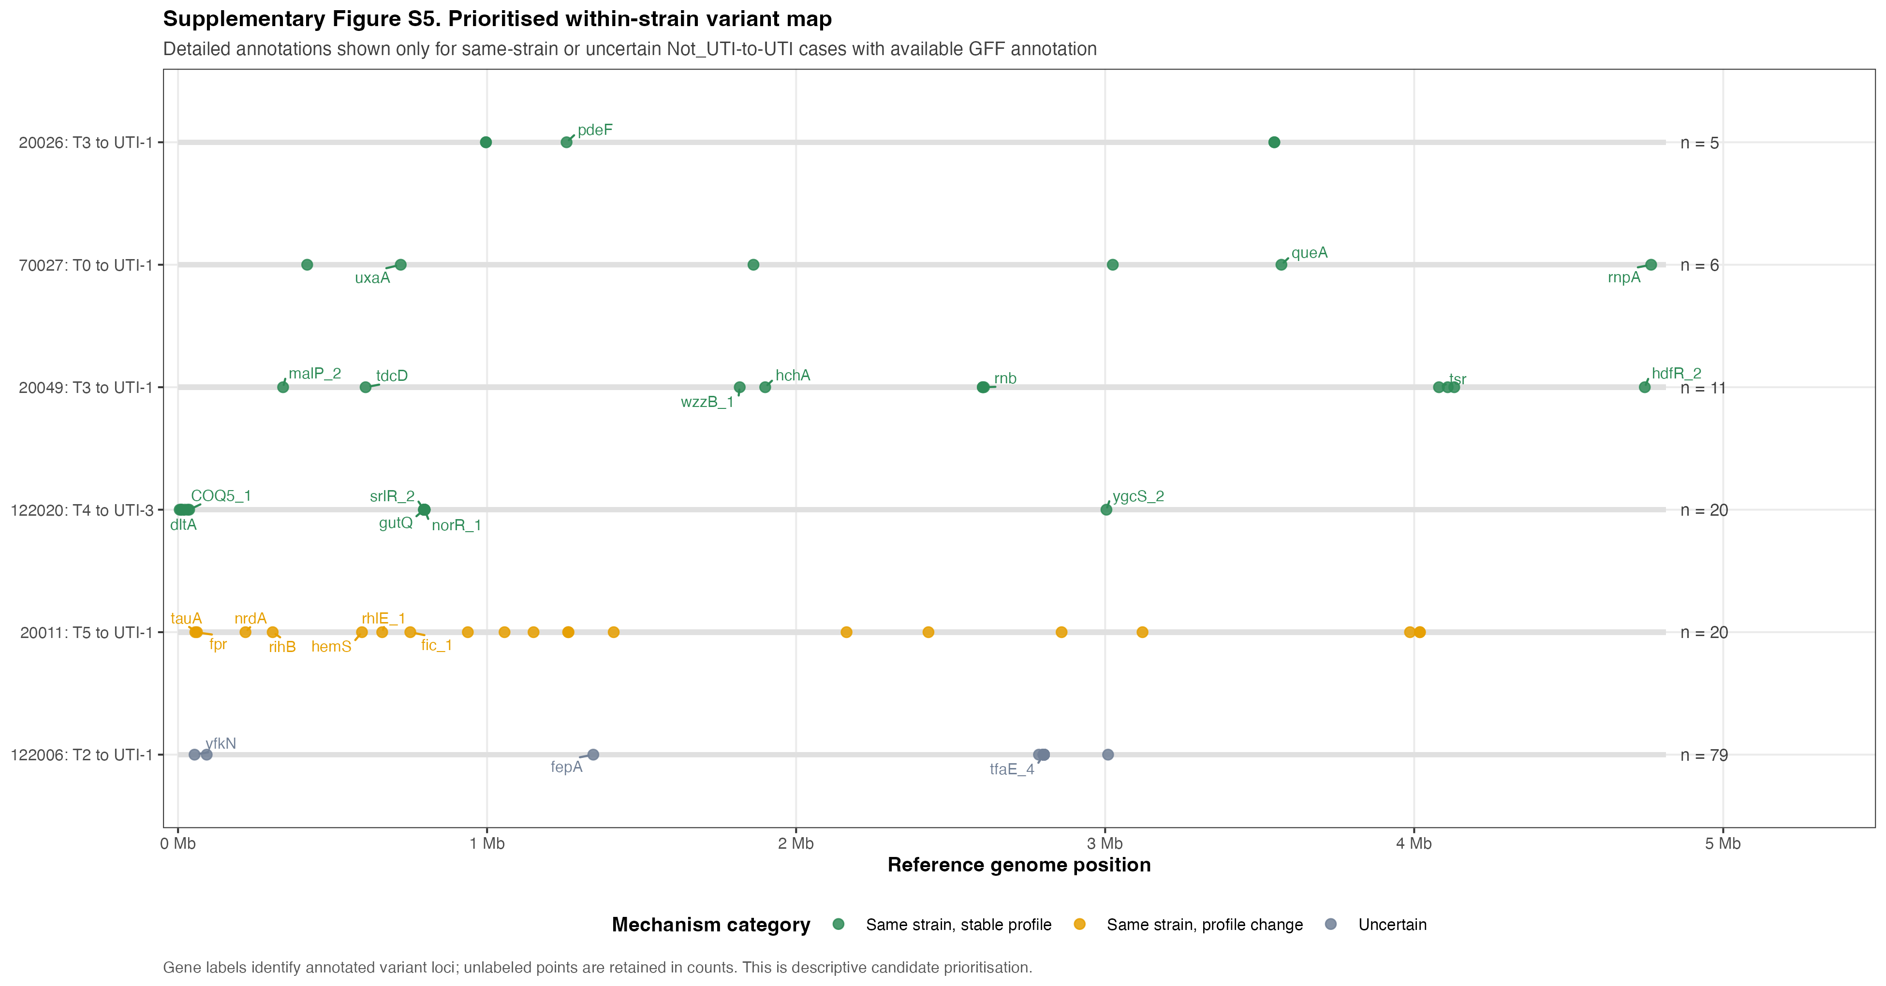
APPENDIX / FOLLOW-UP
Prioritised within-strain variant map
Candidate annotated comparisons only; absence from the panel is not absence of genomic change.
DESCRIPTIVE PRIORITISATION
rUTI clinical-to-genomic review | current UTI_Status analysis | 27 May 2026
21

Slide 22
APPENDIX / EVIDENCE REGISTRY
Interpretation guardrails and lookup resources
Keep current denominators, evidence labels and exploratory boundaries visible when extending this work.
DO SAY
DO NOT CLAIM
- 583 clinical episodes: 18 UTI / 565 Not_UTI
- ASB-versus-UTI as the current comparison
- 556 VF-ready episodes: 17 UTI / 539 Not_UTI
- significant lpf findings as current evidence
- 11 clinical transitions; 10 WGS/VF-linked
- global VF-plus-AMR association inference
- No global VF association significant after FDR
- mechanistic proof from stable VF profiles
ADDITIONAL LOOKUP VISUALS
results/longitudinal/swimmer_plot.png | full longitudinal context
plots/vf/vf_jaccard_by_transition.png | within-resident VF stability
plots/vf/vf_transition_case_timeline.png | transition lookup
rUTI clinical-to-genomic review | current UTI_Status analysis | 27 May 2026
22

