Slide 1
|
LONGCYCLER-ONLY SCIENTIFIC ONBOARDING
When does the same bacterium
become a urinary tract infection?
Three questions
01 Does recurrence reflect strain persistence or replacement?
02 What changes when an episode becomes symptomatic?
03 What can the current denominator support scientifically?
Longcycler-only clinical-to-genomic analysis of the operational UTI phenotype
UTI VS NOT_UTI
CURRENT RELEASE
30 MINUTES
532
16
9
Current framing: operational UTI versus heterogeneous Not_UTI.
All analytical inputs are selected QC-passing Longcycler genomes.
Selected episodes
Operational UTI
Transitions
161 residents
Selected episodes
Not_UTI to UTI
Current evidence pack: results/pipeline/longcycler_release_claim_registry.json
ORIENTATION | 01
Notes:
Release source: /Users/Aamir/Desktop/rUTIs/results/pipeline/longcycler_release_claim_registry.json
Scope: selected QC-passing Longcycler assemblies only.
Clinical phenotype: versioned operational UTI phenotype.
Analytical anchors: 532 episodes; 893 direct pairs; 371 adjacent pairs; RQ01-RQ10.

Slide 2
|
CLINICAL VOCABULARY
Presence is not the same as infection.
The primary contrast uses a versioned operational UTI rule; it does not equate bacterial presence with infection.
Why this matters
UTI
NOT_UTI
A change from Not_UTI to UTI may reflect:
Culture-supported episode
with compatible symptoms
Does not fulfil both
primary UTI conditions
1. strain replacement
2. bacterial genomic change
3. symptoms emerging despite a stable measured profile
516 selected episodes; clinically heterogeneous
16 operational UTI episodes
A participant is observed across episodes, not as a single static label.
T0 | Not_UTI
T3 | Not_UTI
UTI-1 | UTI
Longitudinal question:
what changed between episodes?
Culture recorded
No qualifying symptoms
>
Repeat isolate
Genomic linkage possible
>
Symptoms emerge
Culture support persists
Source: operational UTI phenotype; selected cohort (16 UTI / 516 Not_UTI)
CLINICAL FRAME | 02
Notes:
Release source: /Users/Aamir/Desktop/rUTIs/results/pipeline/longcycler_release_claim_registry.json
Scope: selected QC-passing Longcycler assemblies only.
Clinical phenotype: versioned operational UTI phenotype.
Analytical anchors: 532 episodes; 893 direct pairs; 371 adjacent pairs; RQ01-RQ10.

Slide 3
|
STUDY DESIGN
Repeated clinical episodes are linked to sequenced bacterial isolates.
The analytic value comes from joining clinical state to within-participant genomic change over time.
532
532
227
371
Selected episodes
QC-passing genomes
VFDB features
Adjacent pairs
161 residents
one selected per episode
Canonical VF matrix
139 residents; 9 to UTI
01 SAMPLE
02 LINK
03 PROFILE
04 INTERPRET
Clinical episode
Isolate key
Genome evidence
Transition casebook
Symptoms, culture support,
collection context
>
>
>
Participant + timepoint
joins the layers
VF profile, SNPs,
ST and mobile context
Stable profile,
change or replacement
CLINICAL
defines the outcome
GENOMIC
tests bacterial continuity and measured profile change
Source: results/pipeline/longcycler_release_claim_registry.json
STUDY DESIGN | 03
Notes:
Release source: /Users/Aamir/Desktop/rUTIs/results/pipeline/longcycler_release_claim_registry.json
Scope: selected QC-passing Longcycler assemblies only.
Clinical phenotype: versioned operational UTI phenotype.
Analytical anchors: 532 episodes; 893 direct pairs; 371 adjacent pairs; RQ01-RQ10.

Slide 4
|
PRIMARY OUTCOME
Operational UTI requires culture and compatible symptoms.
The rule is catheter-aware and culture-supported; failure to meet both conditions is classified as Not_UTI.
532
selected Longcycler-linked episodes assessed
↓
CONDITION A
CONDITION B
Culture support
>=10^3 CFU/mL
+
Compatible symptoms
catheter-aware rule
Both required
UTI | 16 episodes
Not_UTI | 516 episodes
Meets culture and symptom requirements
Heterogeneous: do not read as a single biological control state
INTERPRETATION
This versioned operational definition sets the boundary for every genomic result that follows.
Source: selected cohort (n=532, UTI=16, Not_UTI=516)
CLINICAL RULE | 04
Notes:
Release source: /Users/Aamir/Desktop/rUTIs/results/pipeline/longcycler_release_claim_registry.json
Scope: selected QC-passing Longcycler assemblies only.
Clinical phenotype: versioned operational UTI phenotype.
Analytical anchors: 532 episodes; 893 direct pairs; 371 adjacent pairs; RQ01-RQ10.

Slide 5
|
ANALYSIS ARCHITECTURE
Two data lanes meet at participant and timepoint.
Clinical code defines the outcome; genomic code characterises the bacterium and compares episodes.
CLINICAL LANE
Operational phenotype
Selected cohort
Episode key
Integrated episode table
00a / 00b clinical classification
>
analysis_cohort_longcycler.csv
>
Participant_id + tp_lab
>
Participant_id + Timepoint
GENOMIC LANE
Selected assemblies
Genome evidence
Pairwise change
Mechanism casebook
QC-passing Longcycler only
>
VF + ST + direct SNP pairs
>
pairwise_metrics.csv
>
not_uti_to_uti_casebook.csv
OUTPUT
Release layer: denominator -> direct pairs -> transitions -> RQ01-RQ10
RUN_COMPLETE_ANALYSIS.sh
Source: central selected cohort, claim registry and final-run evidence products
PIPELINE | 05
Notes:
Release source: /Users/Aamir/Desktop/rUTIs/results/pipeline/longcycler_release_claim_registry.json
Scope: selected QC-passing Longcycler assemblies only.
Clinical phenotype: versioned operational UTI phenotype.
Analytical anchors: 532 episodes; 893 direct pairs; 371 adjacent pairs; RQ01-RQ10.

Slide 6
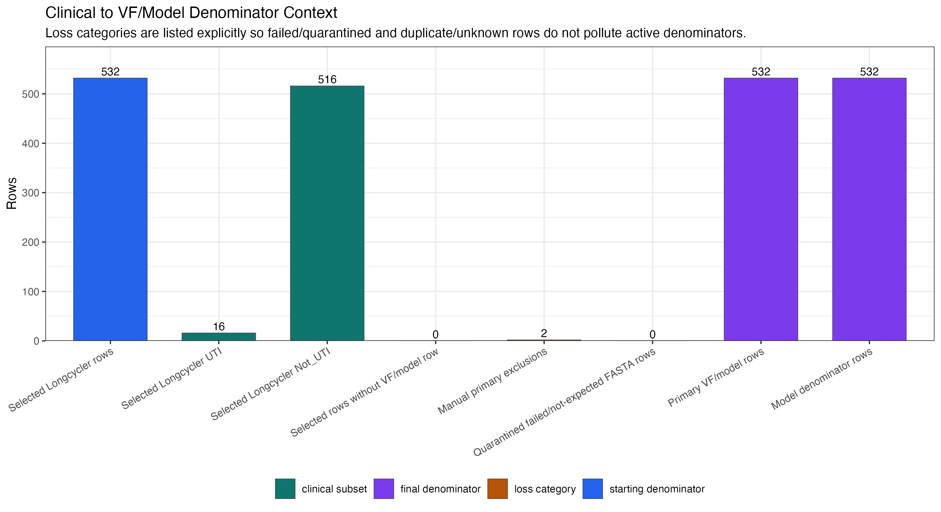
|
INTERPRETATION BOUNDARY
Rich dataset; sparse operational UTI outcome.
Set the denominator before reading mechanisms or population-wide genomic signals.
|
DESCRIPTIVE DENOMINATOR AUDIT
16
operational UTI episodes
in the selected cohort
516
Not_UTI episodes
Read this first
Near-miss definitions test sensitivity; they do not relabel the primary comparison.
SPARSE OUTCOME
Source: current final-run denominator figure; selected cohort only
RESULTS | 06
Notes:
Release source: /Users/Aamir/Desktop/rUTIs/results/pipeline/longcycler_release_claim_registry.json
Scope: selected QC-passing Longcycler assemblies only.
Clinical phenotype: versioned operational UTI phenotype.
Analytical anchors: 532 episodes; 893 direct pairs; 371 adjacent pairs; RQ01-RQ10.

Slide 7
|
WORKED TRANSITION
9 operational Not_UTI-to-UTI transitions are all genomically linked.
Direct pair evidence is primary: 5 of 9 are at or below 25 SNPs.
|
DESCRIPTIVE AGGREGATE
NOT_UTI
9 cases
UTI
9 linked
371 adjacent pairs
25 SNP CUTOFF
9 casebook rows
>
139 residents
5 OF 9 AT OR BELOW
0 endpoints missing
Operational Not_UTI endpoint
Operational UTI endpoint
893
371
140
9
Operational
ALL DIRECT PAIRS
ADJACENT PAIRS
PAIRS <= 25 SNPs
CASEBOOK LINKED
PHENOTYPE
Close direct pairs motivate host-state or regulatory hypotheses; distant pairs remain replacement-consistent. Neither pattern proves mechanism.
Source: direct pair table, canonical transitions and 9-row linked casebook
RESULTS | 07
Notes:
Release source: /Users/Aamir/Desktop/rUTIs/results/pipeline/longcycler_release_claim_registry.json
Scope: selected QC-passing Longcycler assemblies only.
Clinical phenotype: versioned operational UTI phenotype.
Analytical anchors: 532 episodes; 893 direct pairs; 371 adjacent pairs; RQ01-RQ10.

Slide 8
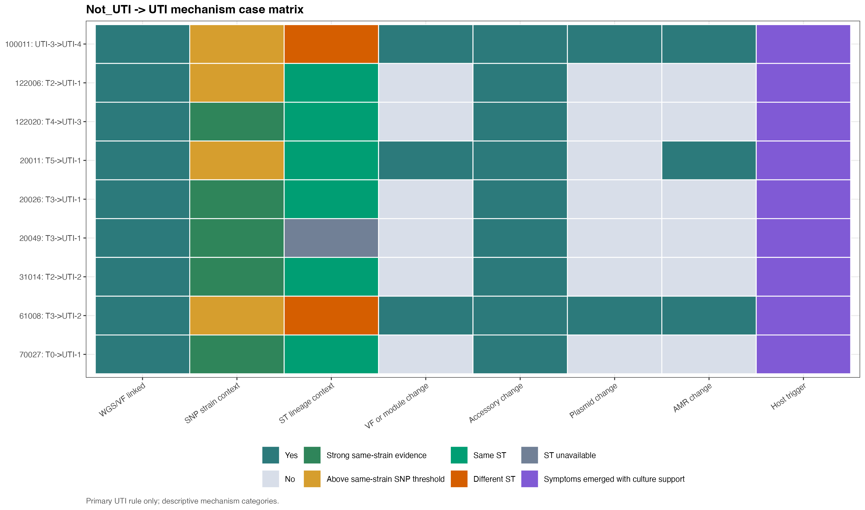
|
TRANSITION CASEBOOK
There is no single biological route from Not_UTI to UTI.
9 operational transitions are tracked; all 9 have linked genomic evidence.
|
DESCRIPTIVE CASEBOOK
9/9 GENOMICALLY LINKED
5 at or below
25 SNPs
4 above the
operational threshold
893 direct pairs
in the selected cohort
0 missing genomic endpoints
mechanism labels are descriptive
Source: current final-run mechanism casebook and direct pair evidence
RESULTS | 08
Notes:
Release source: /Users/Aamir/Desktop/rUTIs/results/pipeline/longcycler_release_claim_registry.json
Scope: selected QC-passing Longcycler assemblies only.
Clinical phenotype: versioned operational UTI phenotype.
Analytical anchors: 532 episodes; 893 direct pairs; 371 adjacent pairs; RQ01-RQ10.

Slide 9
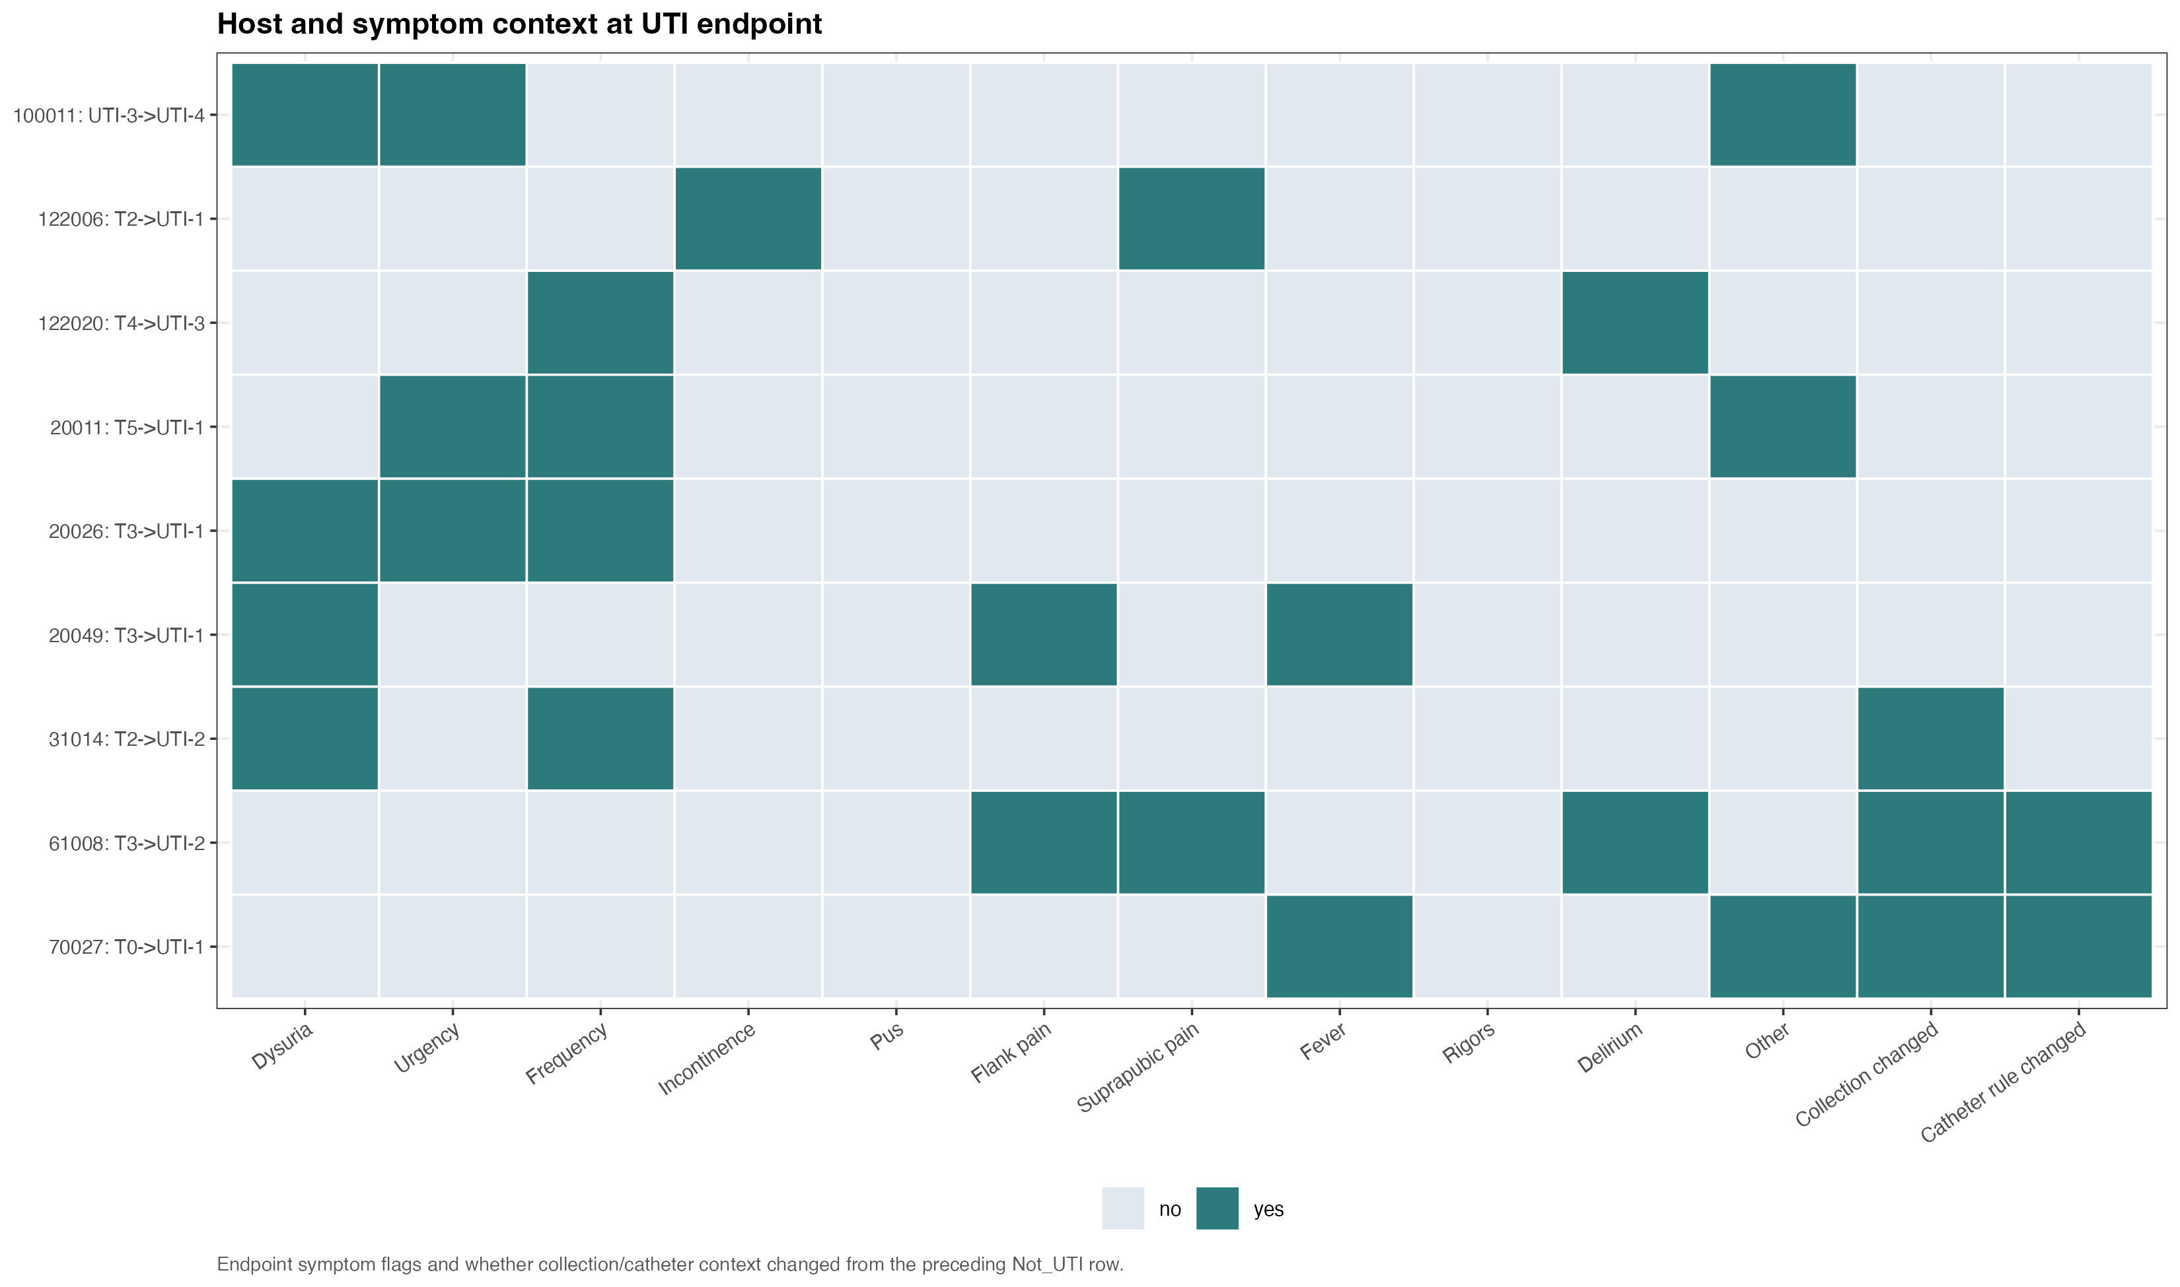
|
LONGITUDINAL INSIGHT
Direct paired evidence separates close and distant clinical transitions.
5 of 9 focused transitions are at or below 25 SNPs; 4 are above.
|
DESCRIPTIVE TRANSITION EVIDENCE
5
focused transitions <=25 SNPs
Interpretation
Close direct pairs move the next hypothesis toward host state or unmeasured regulation.
A distance threshold is operational evidence, not mechanistic proof.
Source: current final-run direct pair and host-context figure
RESULTS | 09
Notes:
Release source: /Users/Aamir/Desktop/rUTIs/results/pipeline/longcycler_release_claim_registry.json
Scope: selected QC-passing Longcycler assemblies only.
Clinical phenotype: versioned operational UTI phenotype.
Analytical anchors: 532 episodes; 893 direct pairs; 371 adjacent pairs; RQ01-RQ10.

Slide 10
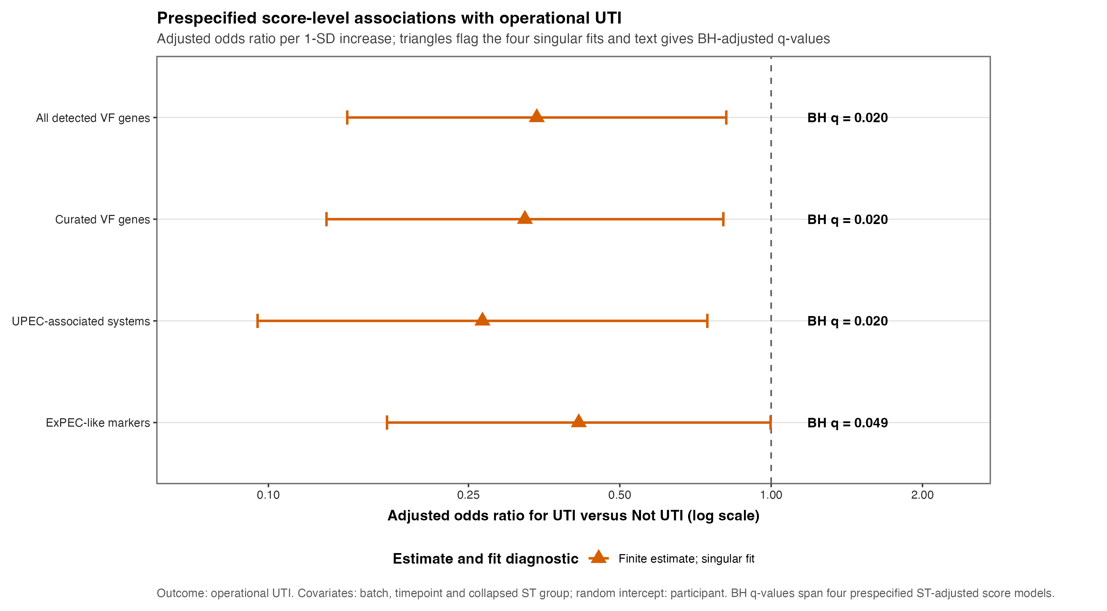
|
POPULATION-WIDE VF ANALYSIS
Global VF signals are exploratory, not confirmatory.
The 16-episode operational UTI group supports exploratory modelling only; no causal claim is made.
|
EXPLORATORY ANALYSIS
16
operational UTI episodes
in the selected cohort
532
selected Longcycler-linked episodes
Guardrail
Do not promote exploratory VF screens, named mutations or AMR context to causal conclusions.
Source: current final-run VF robustness figure; operational phenotype
RESULTS | 10
Notes:
Release source: /Users/Aamir/Desktop/rUTIs/results/pipeline/longcycler_release_claim_registry.json
Scope: selected QC-passing Longcycler assemblies only.
Clinical phenotype: versioned operational UTI phenotype.
Analytical anchors: 532 episodes; 893 direct pairs; 371 adjacent pairs; RQ01-RQ10.

Slide 11
|
OPERATIONAL HANDOVER
One claim registry locates the evidence; the complete runner regenerates RQ01-RQ10.
532 episodes | 893 direct pairs | 371 adjacent pairs from 139 residents | 17 near-miss rows
READ FIRST
TRACE DATA
|
Headline results summary
|
Clinical status truth
results/pipeline/longcycler_release_claim_registry.json
results/clinical/analysis_cohort_longcycler.csv
|
RQ release marker
|
Genome manifest
results/research_questions/RUN_COMPLETE.txt
results/qc/analysis_assembly_manifest.csv
|
Direct-pair evidence
|
Complete runner
results/strain_compare/pairwise_metrics.csv
RUN_COMPLETE_ANALYSIS.sh
|
Transition case detail
|
RQ01-RQ10 runner
results/mechanism/not_uti_to_uti_casebook.csv
scripts/research_questions/run_all.R
RERUN ORDER
SELECT COHORT
>
DIRECT EVIDENCE
>
TRANSITIONS
>
RQ01-RQ10
>
RELEASE
analysis_cohort_longcycler.csv
pairwise_metrics.csv
longcycler_transitions.csv
scripts/research_questions/run_all.R
RUN_COMPLETE_ANALYSIS.sh
Canonical release paths are verified before deck generation
HANDOVER | 11
Notes:
Release source: /Users/Aamir/Desktop/rUTIs/results/pipeline/longcycler_release_claim_registry.json
Scope: selected QC-passing Longcycler assemblies only.
Clinical phenotype: versioned operational UTI phenotype.
Analytical anchors: 532 episodes; 893 direct pairs; 371 adjacent pairs; RQ01-RQ10.

Slide 12
|
CLOSING INTERPRETATION
The next question is what distinguishes close direct pairs from clinical symptom emergence.
Current evidence narrows the biology without overclaiming certainty.
EVIDENCE
LIMITATION
NEXT STEP
5 focused pairs <=25 SNPs
16 operational UTI episodes
Host state + expression
Close direct pairs make host-state and regulation hypotheses testable without proving mechanism.
Global VF tests are exploratory; adjusted associations do not establish a population-wide driver.
Prioritise host context and regulatory hypotheses alongside denser longitudinal sampling.
DISCUSSION | 8 MIN
Which of the 9 linked transitions deserves deeper follow-up?
Which host or expression data could discriminate the remaining mechanisms?
Primary story: operational UTI versus Not_UTI | Longcycler-only release
CLOSE | 12
Notes:
Release source: /Users/Aamir/Desktop/rUTIs/results/pipeline/longcycler_release_claim_registry.json
Scope: selected QC-passing Longcycler assemblies only.
Clinical phenotype: versioned operational UTI phenotype.
Analytical anchors: 532 episodes; 893 direct pairs; 371 adjacent pairs; RQ01-RQ10.

Slide 13
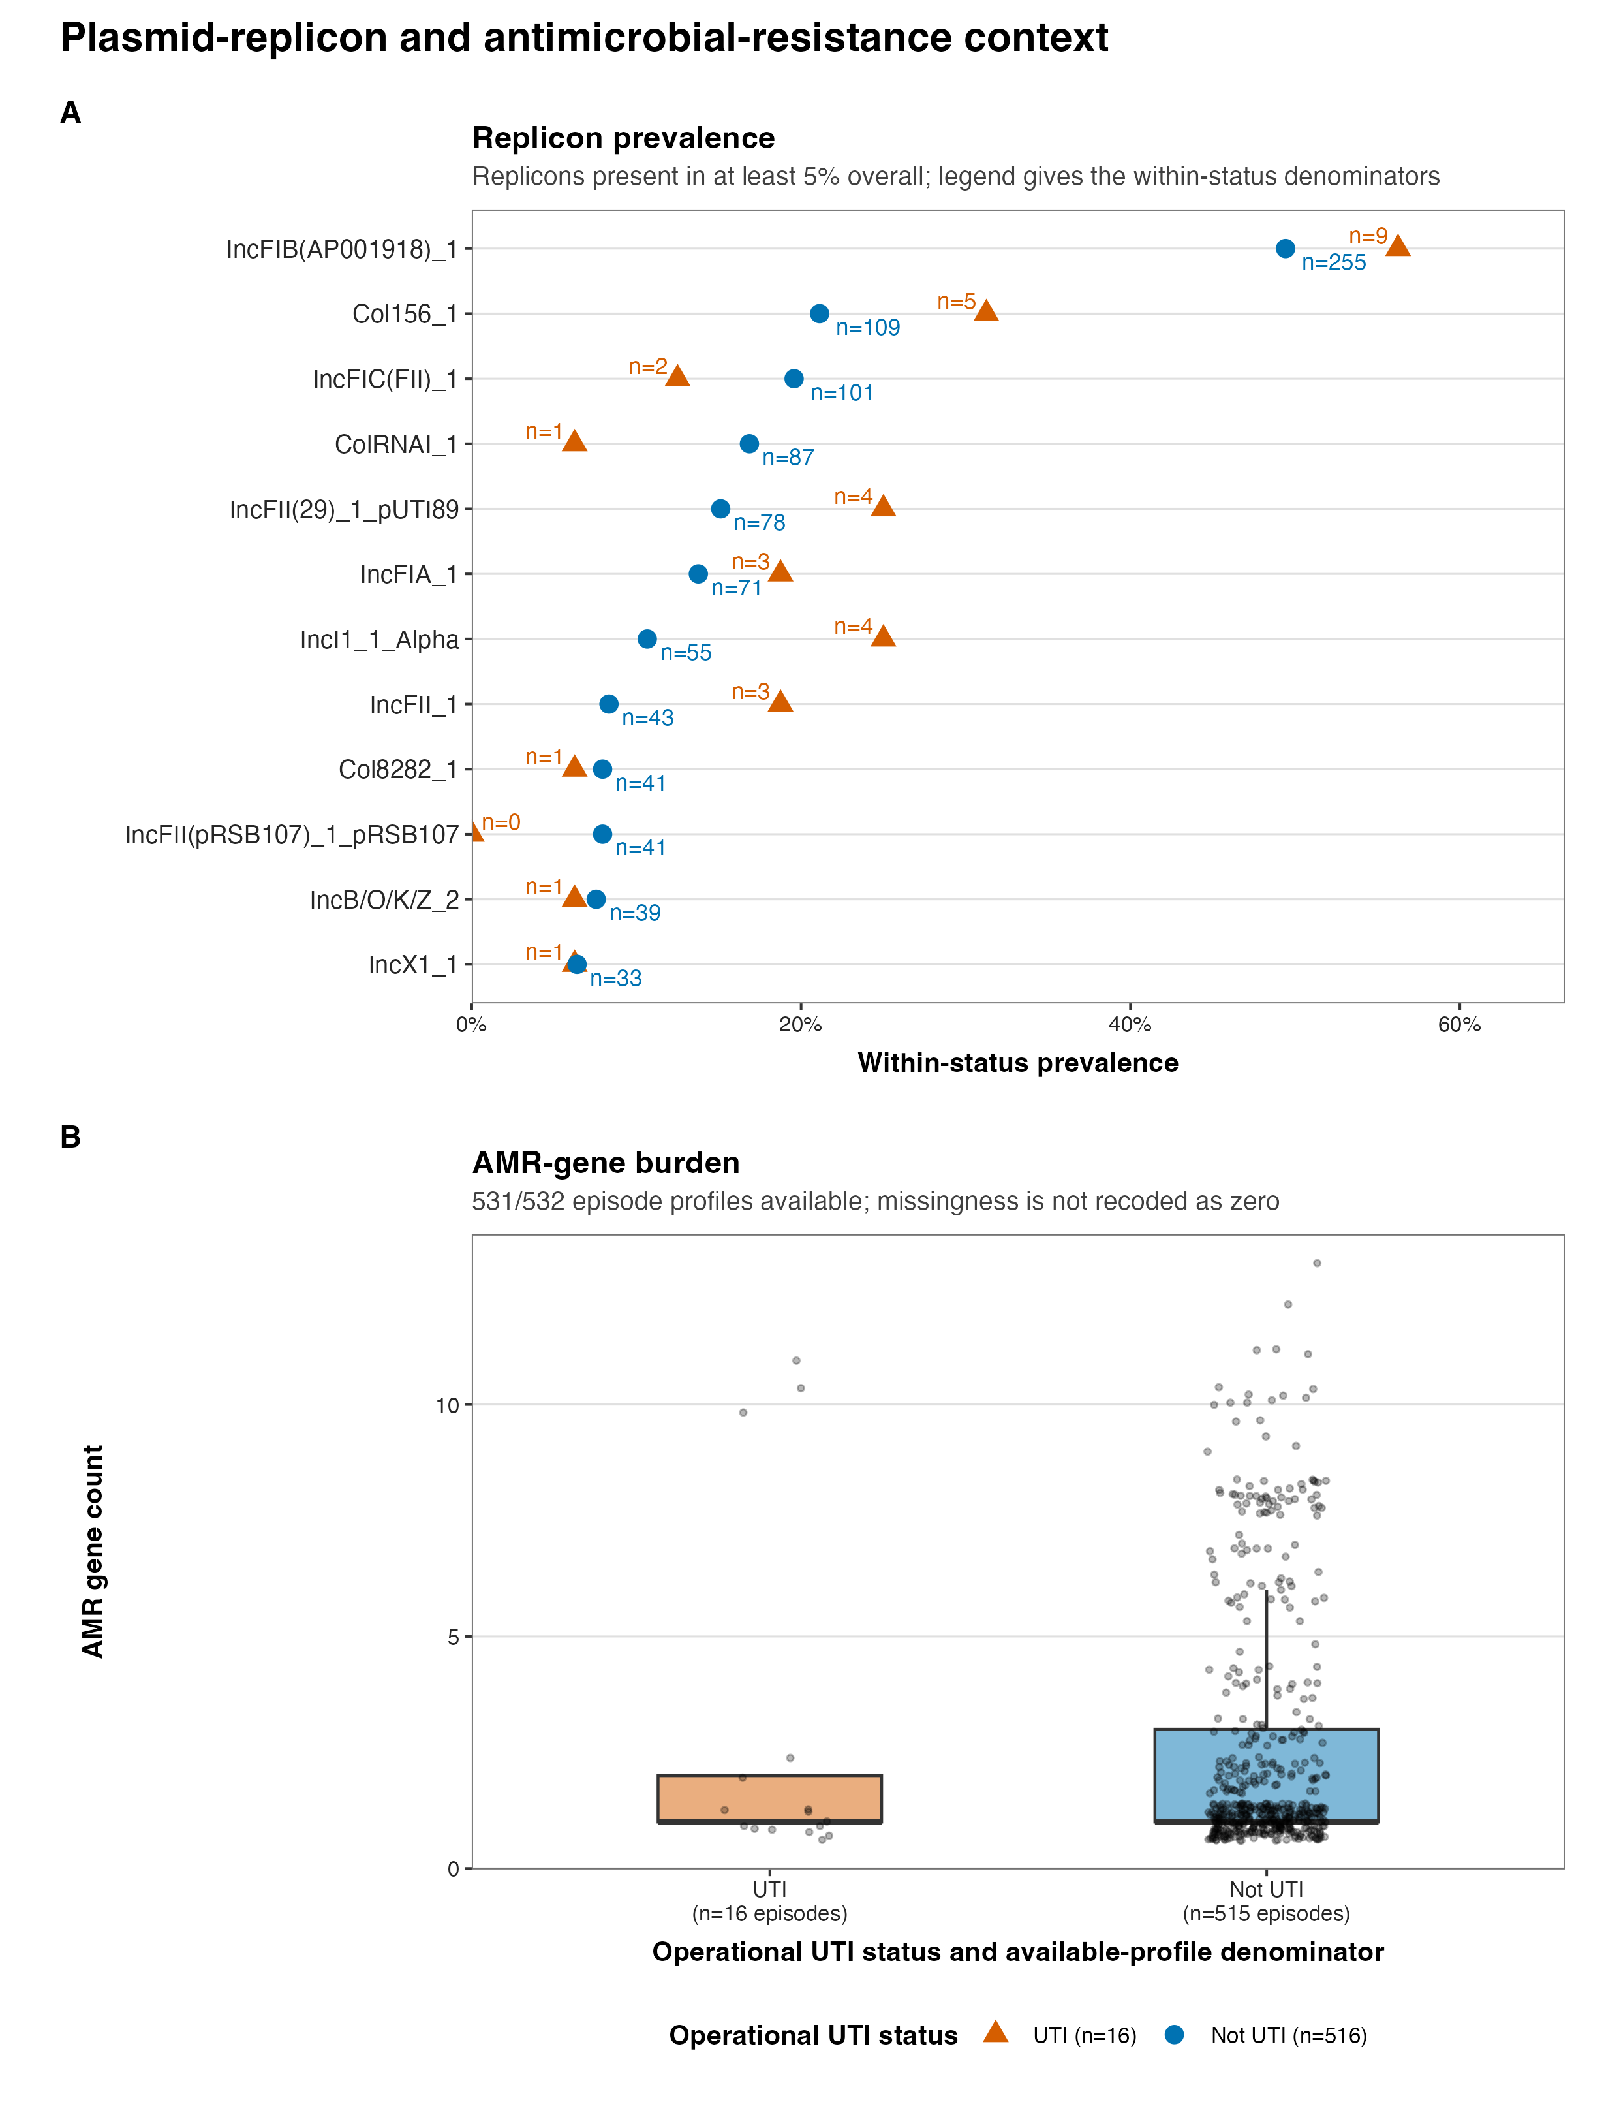
|
BACKUP | ACCESSORY AND AMR CONTEXT
ResFinder screening contextualises transitions; it is not a global association analysis.
Use only when asked about accessory, plasmid, or AMR changes in individual transitions.
|
EXPLORATORY TRANSITION CONTEXT
BACKUP ONLY
What is complete
Current screening provides exploratory accessory, plasmid and AMR context for linked transitions.
Not completed:
a global VF-plus-AMR association analysis.
Source: Supplementary Figure S2; results/mechanism/amr_screen_report.txt
BACKUP | 13
Notes:
Release source: /Users/Aamir/Desktop/rUTIs/results/pipeline/longcycler_release_claim_registry.json
Scope: selected QC-passing Longcycler assemblies only.
Clinical phenotype: versioned operational UTI phenotype.
Analytical anchors: 532 episodes; 893 direct pairs; 371 adjacent pairs; RQ01-RQ10.

Slide 14
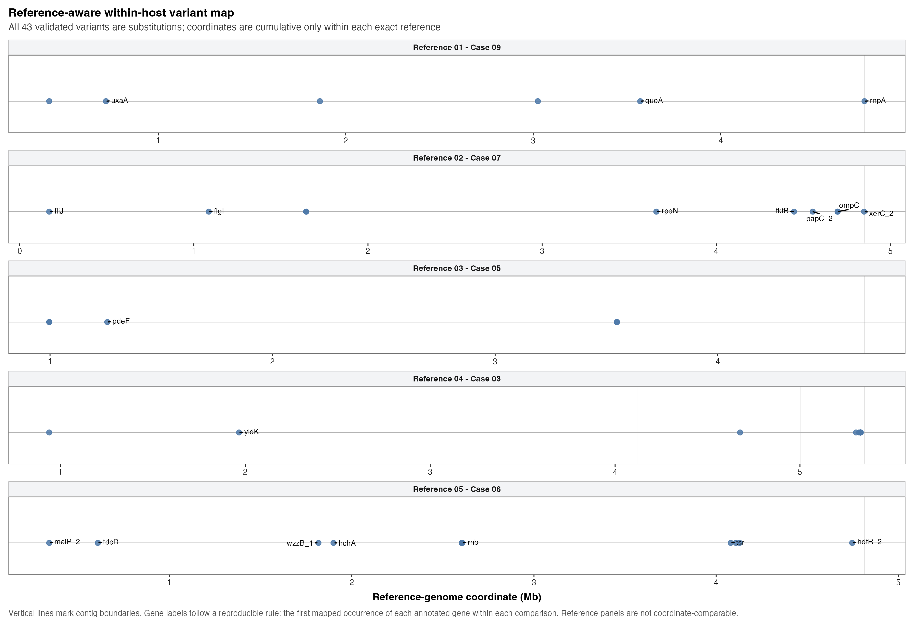
|
BACKUP | VARIANT PRIORITISATION
Within-strain candidates offer follow-up hypotheses, not causal proof.
Bring this map forward for questions about SNP-level changes in linked isolates.
|
DESCRIPTIVE PRIORITISATION
BACKUP ONLY
Use case
Discuss annotated variants in same-strain or uncertain transition comparisons.
The map prioritises candidates; it does not identify the cause of symptom emergence.
Source: Supplementary Figure S5; final_figure_captions.md
BACKUP | 14
Notes:
Release source: /Users/Aamir/Desktop/rUTIs/results/pipeline/longcycler_release_claim_registry.json
Scope: selected QC-passing Longcycler assemblies only.
Clinical phenotype: versioned operational UTI phenotype.
Analytical anchors: 532 episodes; 893 direct pairs; 371 adjacent pairs; RQ01-RQ10.

Slide 15
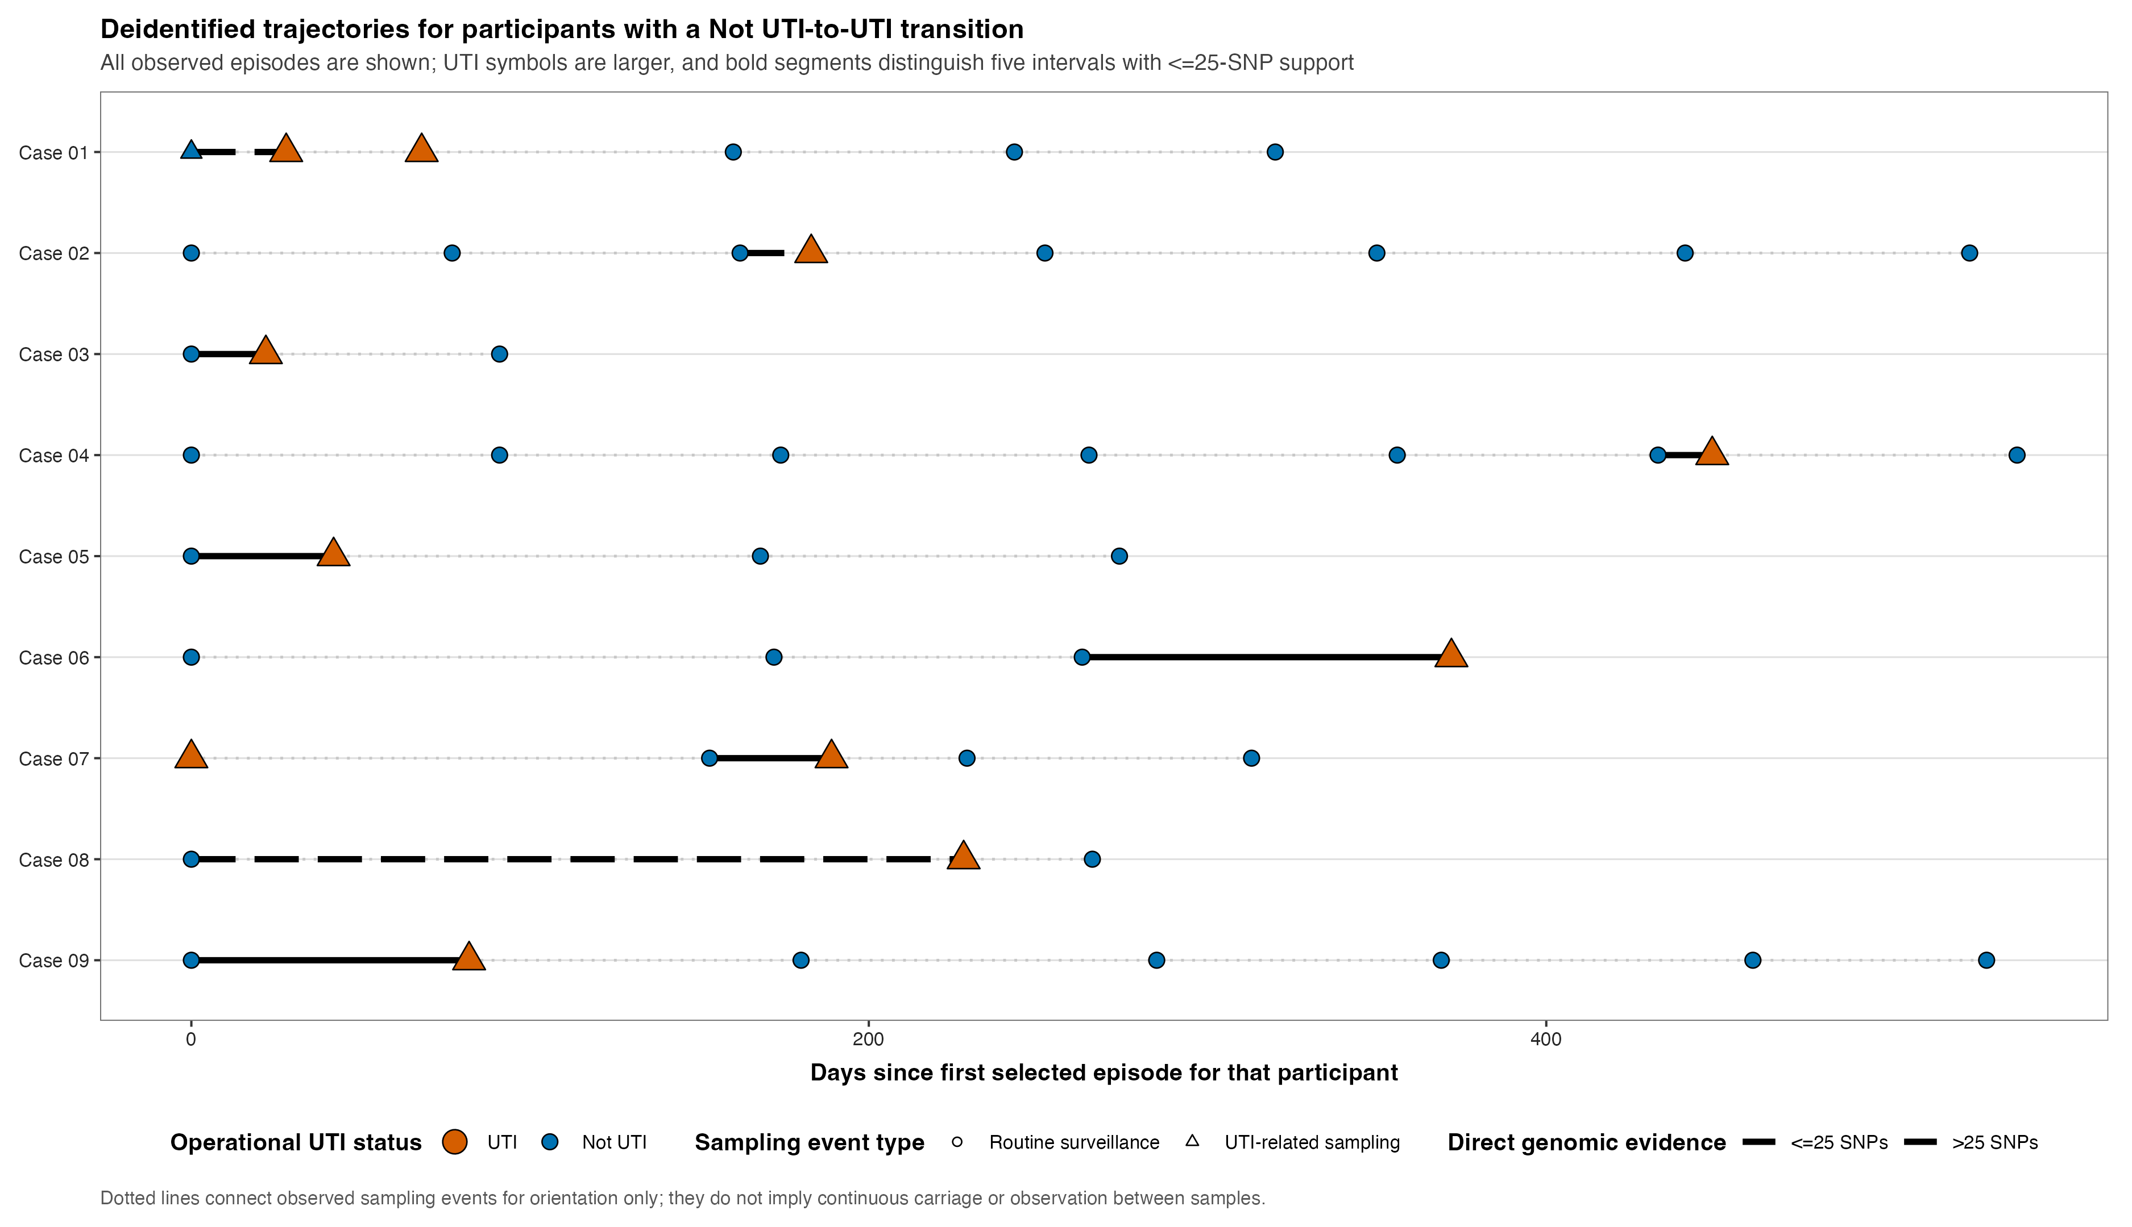
|
BACKUP | FULL LONGITUDINAL CONTEXT
The swimmer plot is a lookup tool, not the main narrative.
Use this only to locate individual participant sequences during discussion.
BACKUP ONLY
Dense by design:
participant-level orientation rather than headline inference.
Return to the casebook for mechanism interpretation.
Source: plots/publication/Fig1_Swimmer_Plot.png | contextual lookup only
BACKUP | 15
Notes:
Release source: /Users/Aamir/Desktop/rUTIs/results/pipeline/longcycler_release_claim_registry.json
Scope: selected QC-passing Longcycler assemblies only.
Clinical phenotype: versioned operational UTI phenotype.
Analytical anchors: 532 episodes; 893 direct pairs; 371 adjacent pairs; RQ01-RQ10.

