Slide 1
LONGCYCLER-ONLY RESULTS REVIEW / ONBOARDING
Recurrent UTI:
clinical state and genomic evidence
Operational UTI versus Not_UTI evidence for a new project colleague
THREE QUESTIONS
01
Which isolates persist across changing clinical states?
UTI
NOT_UTI
02
Does symptom emergence require a new measured VF profile?
Primary comparison throughout
03
What can the sparse UTI denominator support responsibly?
Prepared for scientific review and practical handover | 14 July 2026
Notes:
Release source: /Users/Aamir/Desktop/rUTIs/results/pipeline/longcycler_release_claim_registry.json
Scope: selected QC-passing Longcycler assemblies only.
Clinical phenotype: versioned operational UTI phenotype.
Analytical anchors: 532 episodes; 893 direct pairs; 371 adjacent pairs; RQ01-RQ10.

Slide 2
CLINICAL RATIONALE
Repeated bacteriuria is not equivalent to symptomatic UTI
The versioned operational phenotype separates culture-supported compatible episodes from a heterogeneous remainder.
PRIMARY STATUS
WHY LONGITUDINAL SAMPLING?
UTI
01
Follow the same resident across time
Culture support plus compatible symptoms
02
Separate persistence from replacement
A clinically interpretable symptomatic state.
NOT_UTI
03
Ask whether symptoms emerge without VF gain/loss
Not a single biological condition
May include bacteriuria without compatible symptoms,
negative cultures, or other clinically non-UTI episodes.
Clinical status is the outcome; genomics helps explain transitions.
rUTI clinical-to-genomic review | operational UTI phenotype | Longcycler-only analysis | 14 July 2026
02
Notes:
Release source: /Users/Aamir/Desktop/rUTIs/results/pipeline/longcycler_release_claim_registry.json
Scope: selected QC-passing Longcycler assemblies only.
Clinical phenotype: versioned operational UTI phenotype.
Analytical anchors: 532 episodes; 893 direct pairs; 371 adjacent pairs; RQ01-RQ10.

Slide 3
DESIGN AND STATUS RULE
Repeated clinical episodes link directly to isolate genomes
One selected QC-passing Longcycler genome links to each of 532 analytical episodes.
LONGITUDINAL STUDY DESIGN
CURRENT PRIMARY STATUS RULE
T0
T3
UTI-1
Culture support
>=10^3 CFU/mL
episode
+
baseline
repeat
symptoms
isolate
Compatible symptoms
catheter-aware
DNA
DNA
DNA
Link operational episode status to selected genomes and VF profiles
UTI
NOT_UTI
Then evaluate persistence, replacement and profile stability.
both present
otherwise
rUTI clinical-to-genomic review | operational UTI phenotype | Longcycler-only analysis | 14 July 2026
03
Notes:
Release source: /Users/Aamir/Desktop/rUTIs/results/pipeline/longcycler_release_claim_registry.json
Scope: selected QC-passing Longcycler assemblies only.
Clinical phenotype: versioned operational UTI phenotype.
Analytical anchors: 532 episodes; 893 direct pairs; 371 adjacent pairs; RQ01-RQ10.

Slide 4
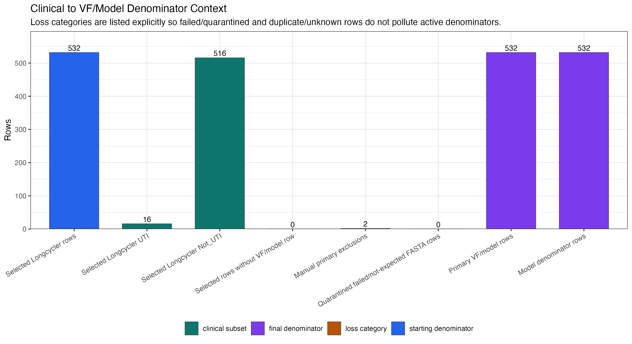
VALIDATED DENOMINATOR
The selected operational UTI denominator is deliberately narrow
Episode-level counts define the interpretation boundary before any biological claim.
DESCRIPTIVE DENOMINATOR AUDIT
rUTI clinical-to-genomic review | operational UTI phenotype | Longcycler-only analysis | 14 July 2026
04
Notes:
Release source: /Users/Aamir/Desktop/rUTIs/results/pipeline/longcycler_release_claim_registry.json
Scope: selected QC-passing Longcycler assemblies only.
Clinical phenotype: versioned operational UTI phenotype.
Analytical anchors: 532 episodes; 893 direct pairs; 371 adjacent pairs; RQ01-RQ10.

Slide 5
PIPELINE WITH COUNTS
From clinical episodes to virulence-factor interpretation
Every analytical count refers to the selected Longcycler-linked cohort; source attrition is excluded from results.
NUMBERED PROCESS MAP
CLINICAL
GENOMIC PROCESSING
01
Selected episodes
02
Operational phenotype
03
Selected assemblies
04
Selected genomes
532
532
532
532
161 residents
16 UTI | 516 Not_UTI
QC-passing Longcycler only
one genome per selected episode
analysis_cohort_longcycler.csv
versioned operational rule
analysis_assembly_manifest.csv
canonical selection
VF ANALYSIS AND LONGITUDINAL OUTPUTS
05
VF feature rows
06
Direct-pair ready
07
VFDB feature space
08
Transitions
532
532
227
9 -> 9
selected episode-level rows
893 within-resident pairs
371 adjacent pairs
binary VF features
module summaries exploratory
operational transitions -> genomically linked
0 endpoints missing
02_gene_presence_analysis.R
pairwise_metrics.csv
current final-run VF outputs
mechanism casebook
rUTI clinical-to-genomic review | operational UTI phenotype | Longcycler-only analysis | 14 July 2026
05
Notes:
Release source: /Users/Aamir/Desktop/rUTIs/results/pipeline/longcycler_release_claim_registry.json
Scope: selected QC-passing Longcycler assemblies only.
Clinical phenotype: versioned operational UTI phenotype.
Analytical anchors: 532 episodes; 893 direct pairs; 371 adjacent pairs; RQ01-RQ10.

Slide 6
VF FRAMEWORK
What the virulence-factor analysis actually measures
Presence/absence features describe measured genomic potential, not expression or host response.
ANALYSIS ARCHITECTURE
INPUT
REPRESENTATION
QUESTIONS ANSWERED
532
227 VF features
Burden
How many detected VF genes?
detected feature columns
descriptive
selected Longcycler-linked
episodes
VF modules
Similarity
Is the profile stable over time?
binary presence / absence
descriptive
exploratory summaries
Association
Does status track VF signals?
exploratory / FDR-controlled
Interpretation boundary
Stable measured VF does not rule out altered expression, regulation, inoculum or host state.
rUTI clinical-to-genomic review | operational UTI phenotype | Longcycler-only analysis | 14 July 2026
06
Notes:
Release source: /Users/Aamir/Desktop/rUTIs/results/pipeline/longcycler_release_claim_registry.json
Scope: selected QC-passing Longcycler assemblies only.
Clinical phenotype: versioned operational UTI phenotype.
Analytical anchors: 532 episodes; 893 direct pairs; 371 adjacent pairs; RQ01-RQ10.

Slide 7
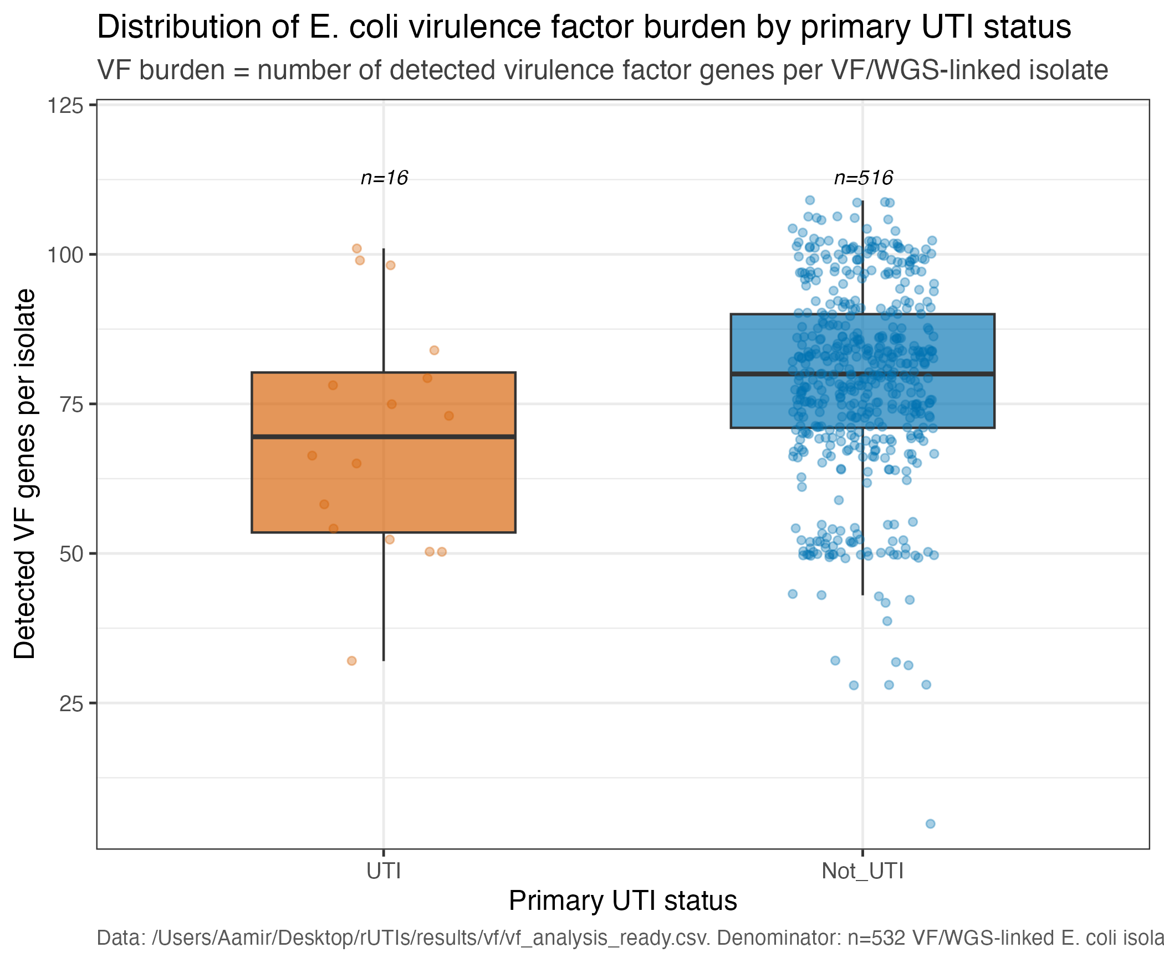
VIRULENCE FACTORS
Observed VF burden is descriptive across operational status groups
The operational UTI group is sparse (n=16), so this remains descriptive rather than causal.
DESCRIPTIVE
rUTI clinical-to-genomic review | operational UTI phenotype | Longcycler-only analysis | 14 July 2026
07
Notes:
Release source: /Users/Aamir/Desktop/rUTIs/results/pipeline/longcycler_release_claim_registry.json
Scope: selected QC-passing Longcycler assemblies only.
Clinical phenotype: versioned operational UTI phenotype.
Analytical anchors: 532 episodes; 893 direct pairs; 371 adjacent pairs; RQ01-RQ10.

Slide 8
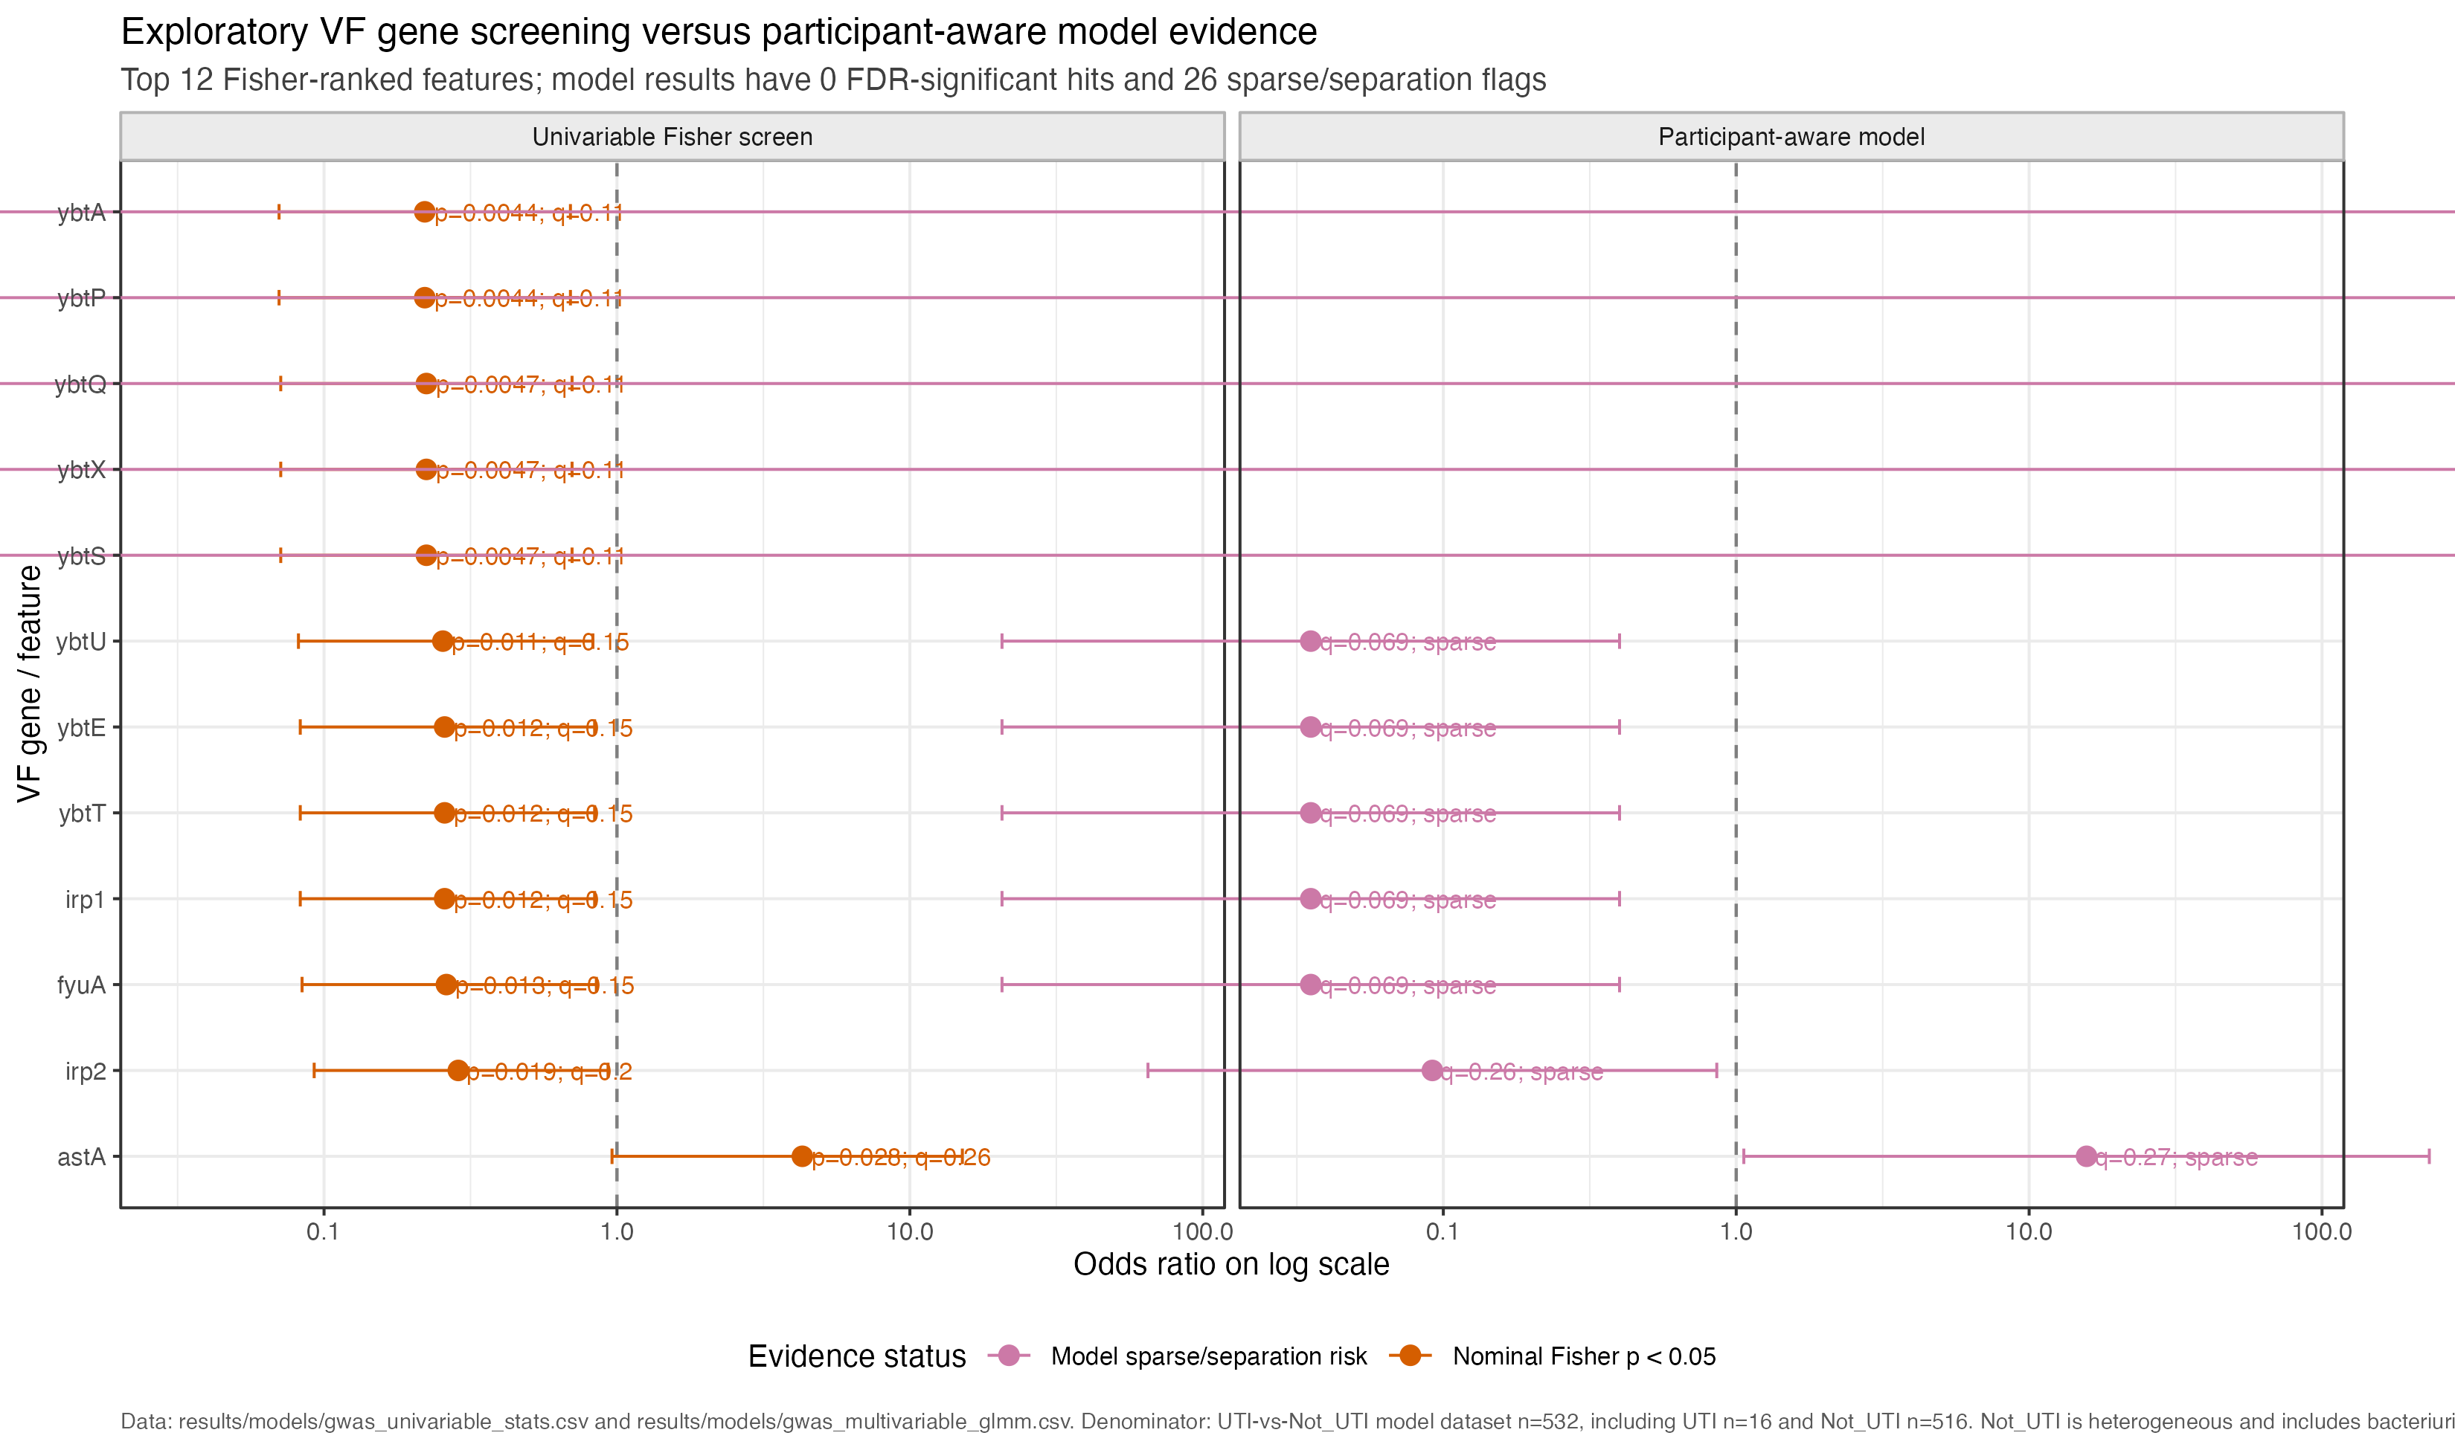
VIRULENCE FACTORS
Participant-aware VF screens remain exploratory
Participant-aware modelling in 532 selected episodes defines the current evidential boundary.
EXPLORATORY / FDR
rUTI clinical-to-genomic review | operational UTI phenotype | Longcycler-only analysis | 14 July 2026
08
Notes:
Release source: /Users/Aamir/Desktop/rUTIs/results/pipeline/longcycler_release_claim_registry.json
Scope: selected QC-passing Longcycler assemblies only.
Clinical phenotype: versioned operational UTI phenotype.
Analytical anchors: 532 episodes; 893 direct pairs; 371 adjacent pairs; RQ01-RQ10.

Slide 9
LONGITUDINAL EXAMPLE
9 operational Not_UTI-to-UTI transitions are all genomically linked
5 of 9 focused direct pairs are at or below 25 SNPs.
DESCRIPTIVE CASE
NOT_UTI
UTI
9 cases
25 SNP CUTOFF
9 linked
5 of 9
operational Not_UTI
starting endpoints
operational UTI
ending endpoints
at or below the operational threshold
MEASURED CHANGE
VF PROFILE
SNP DISTANCE
CLINICAL STATE
140/371
893
9 -> 9
adjacent pairs <= threshold
all direct pairs
cases -> linked
Close direct pairs motivate host-state or regulatory hypotheses; neither close nor distant pairs prove mechanism.
rUTI clinical-to-genomic review | operational UTI phenotype | Longcycler-only analysis | 14 July 2026
09
Notes:
Release source: /Users/Aamir/Desktop/rUTIs/results/pipeline/longcycler_release_claim_registry.json
Scope: selected QC-passing Longcycler assemblies only.
Clinical phenotype: versioned operational UTI phenotype.
Analytical anchors: 532 episodes; 893 direct pairs; 371 adjacent pairs; RQ01-RQ10.

Slide 10
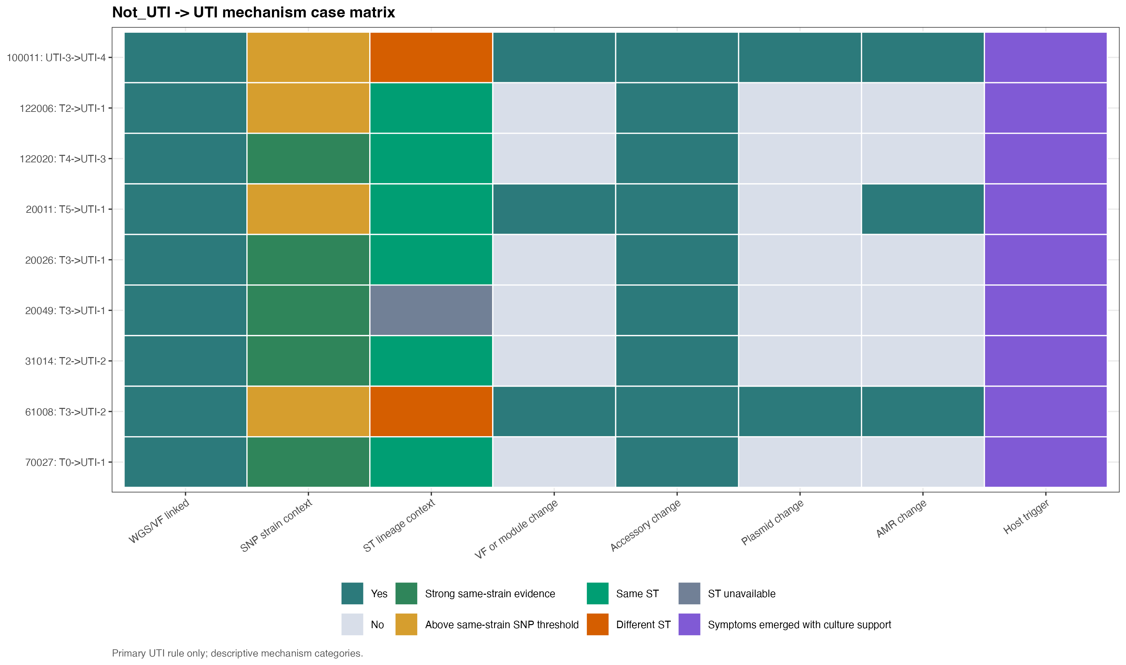
TRANSITION CASEBOOK
Not_UTI-to-UTI transitions are biologically heterogeneous
9 operational transitions are all genomically linked; 0 endpoints are missing.
DESCRIPTIVE CASEBOOK
rUTI clinical-to-genomic review | operational UTI phenotype | Longcycler-only analysis | 14 July 2026
10
Notes:
Release source: /Users/Aamir/Desktop/rUTIs/results/pipeline/longcycler_release_claim_registry.json
Scope: selected QC-passing Longcycler assemblies only.
Clinical phenotype: versioned operational UTI phenotype.
Analytical anchors: 532 episodes; 893 direct pairs; 371 adjacent pairs; RQ01-RQ10.

Slide 11
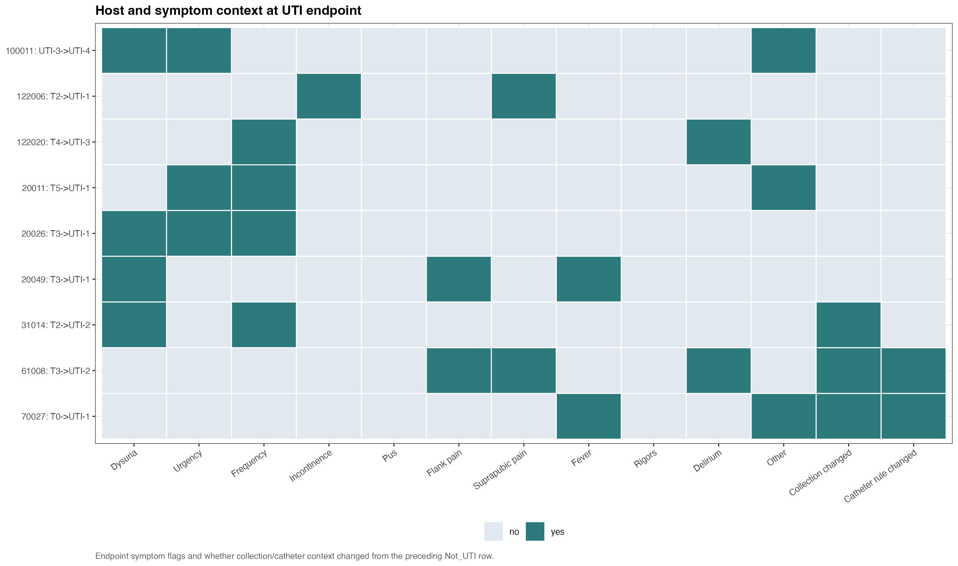
CENTRAL OBSERVATION
Direct paired evidence distinguishes close from distant clinical transitions
5/9 focused transitions and 140/371 adjacent pairs are <=25 SNPs.
DESCRIPTIVE TRANSITION CONTEXT
rUTI clinical-to-genomic review | operational UTI phenotype | Longcycler-only analysis | 14 July 2026
11
Notes:
Release source: /Users/Aamir/Desktop/rUTIs/results/pipeline/longcycler_release_claim_registry.json
Scope: selected QC-passing Longcycler assemblies only.
Clinical phenotype: versioned operational UTI phenotype.
Analytical anchors: 532 episodes; 893 direct pairs; 371 adjacent pairs; RQ01-RQ10.

Slide 12
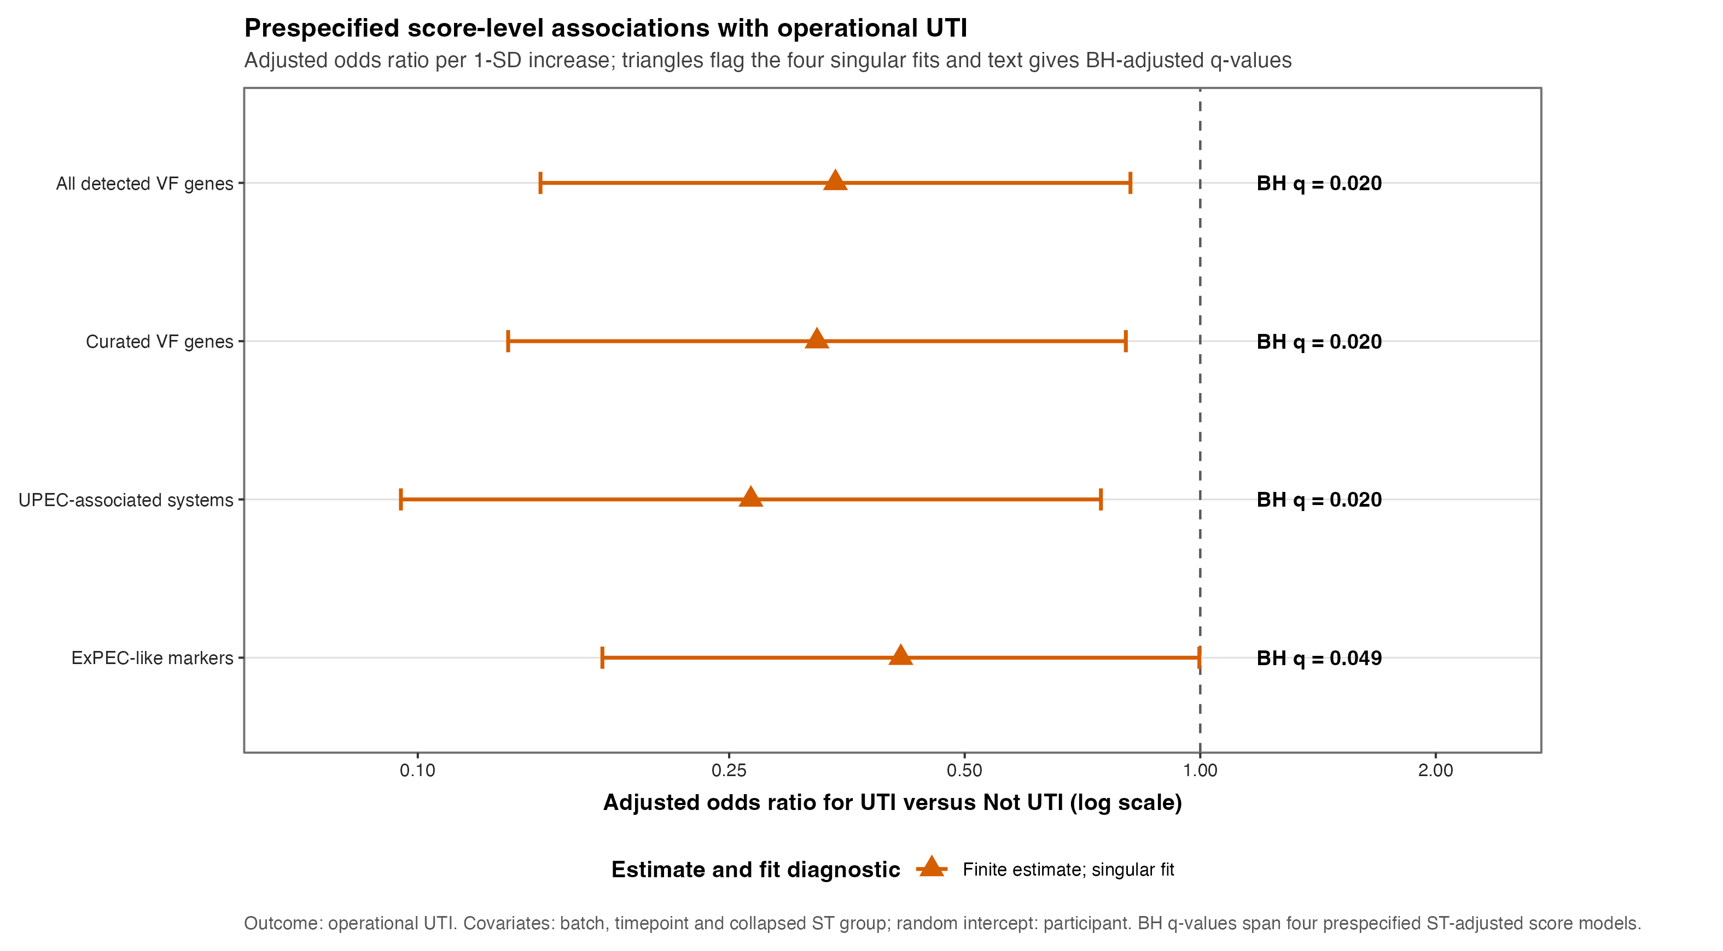
POPULATION-LEVEL INFERENCE
Population-level VF analysis remains exploratory
With 16 operational UTI episodes, participant-aware VF signals remain exploratory and non-causal.
EXPLORATORY ROBUSTNESS
rUTI clinical-to-genomic review | operational UTI phenotype | Longcycler-only analysis | 14 July 2026
12
Notes:
Release source: /Users/Aamir/Desktop/rUTIs/results/pipeline/longcycler_release_claim_registry.json
Scope: selected QC-passing Longcycler assemblies only.
Clinical phenotype: versioned operational UTI phenotype.
Analytical anchors: 532 episodes; 893 direct pairs; 371 adjacent pairs; RQ01-RQ10.

Slide 13
DISCUSSION
What is known, what is limited, what comes next
The current evidence supports a focused next phase rather than a broad association claim.
EVIDENCE
LIMITATION
NEXT STEP
5 of 9 focused direct pairs are <=25 SNPs.
Only 16 selected episodes meet the operational UTI phenotype.
Prioritise within-strain cases for deeper follow-up.
4 focused pairs are above the threshold; no single mechanism is established.
Presence/absence cannot measure expression or host state.
Pair bacterial genomic hypotheses with host/context data.
Discussion prompt: which transition-level experiment would most sharply distinguish host context from unmeasured bacterial regulation?
rUTI clinical-to-genomic review | operational UTI phenotype | Longcycler-only analysis | 14 July 2026
13
Notes:
Release source: /Users/Aamir/Desktop/rUTIs/results/pipeline/longcycler_release_claim_registry.json
Scope: selected QC-passing Longcycler assemblies only.
Clinical phenotype: versioned operational UTI phenotype.
Analytical anchors: 532 episodes; 893 direct pairs; 371 adjacent pairs; RQ01-RQ10.

Slide 14
APPENDIX / HANDOVER
Longcycler release outputs and rerun path
Claim registry -> 893 direct pairs -> 371 adjacent pairs -> RQ01-RQ10.
PURPOSE
SOURCE OF TRUTH
RERUN ORDER
Headline results
results/pipeline/longcycler_release_claim_registry.json
01 Validate selected cohort
Interpretation
results/clinical/analysis_cohort_longcycler.csv
02 Confirm selected manifest
Validated inventory
results/strain_compare/pairwise_metrics.csv
03 Confirm direct pair evidence
04 Run RQ01-RQ10
Transition cases
results/mechanism/not_uti_to_uti_casebook.csv
05 Publish claim registry and decks
Architecture
results/research_questions/RUN_COMPLETE.txt
ENTRY POINT
RUN_COMPLETE_ANALYSIS.sh
Operational note
Use the versioned operational phenotype and selected Longcycler cohort throughout.
rUTI clinical-to-genomic review | operational UTI phenotype | Longcycler-only analysis | 14 July 2026
14
Notes:
Release source: /Users/Aamir/Desktop/rUTIs/results/pipeline/longcycler_release_claim_registry.json
Scope: selected QC-passing Longcycler assemblies only.
Clinical phenotype: versioned operational UTI phenotype.
Analytical anchors: 532 episodes; 893 direct pairs; 371 adjacent pairs; RQ01-RQ10.

Slide 15
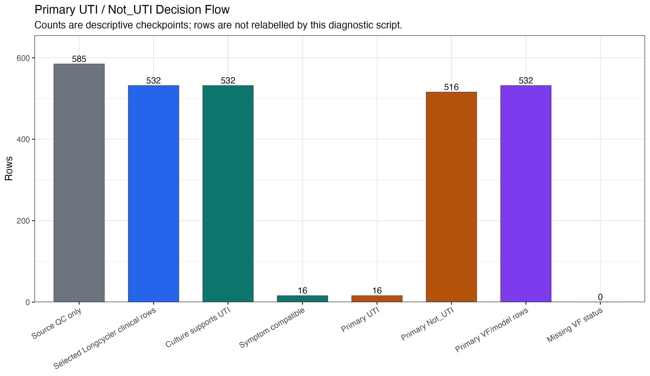
APPENDIX / CLINICAL AUDIT
Operational UTI phenotype audit
Versioned catheter-aware symptom and culture-support rule applied to 532 selected episodes.
DESCRIPTIVE AUDIT
rUTI clinical-to-genomic review | operational UTI phenotype | Longcycler-only analysis | 14 July 2026
15
Notes:
Release source: /Users/Aamir/Desktop/rUTIs/results/pipeline/longcycler_release_claim_registry.json
Scope: selected QC-passing Longcycler assemblies only.
Clinical phenotype: versioned operational UTI phenotype.
Analytical anchors: 532 episodes; 893 direct pairs; 371 adjacent pairs; RQ01-RQ10.

Slide 16
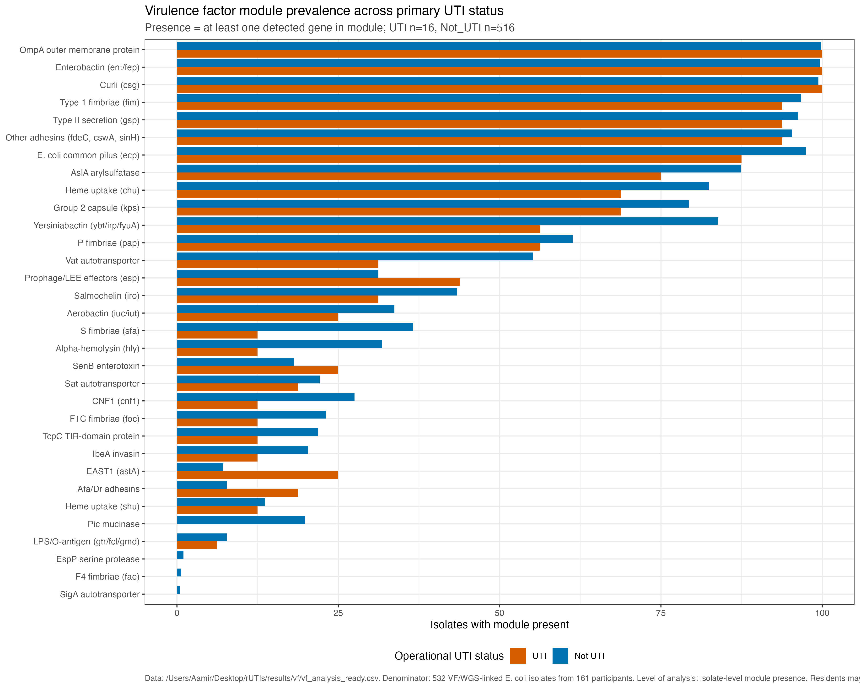
APPENDIX / VIRULENCE FACTORS
VF module prevalence across current clinical status
Module presence is exploratory and does not account for repeated measures or lineage structure.
EXPLORATORY DETAIL
rUTI clinical-to-genomic review | operational UTI phenotype | Longcycler-only analysis | 14 July 2026
16
Notes:
Release source: /Users/Aamir/Desktop/rUTIs/results/pipeline/longcycler_release_claim_registry.json
Scope: selected QC-passing Longcycler assemblies only.
Clinical phenotype: versioned operational UTI phenotype.
Analytical anchors: 532 episodes; 893 direct pairs; 371 adjacent pairs; RQ01-RQ10.

Slide 17
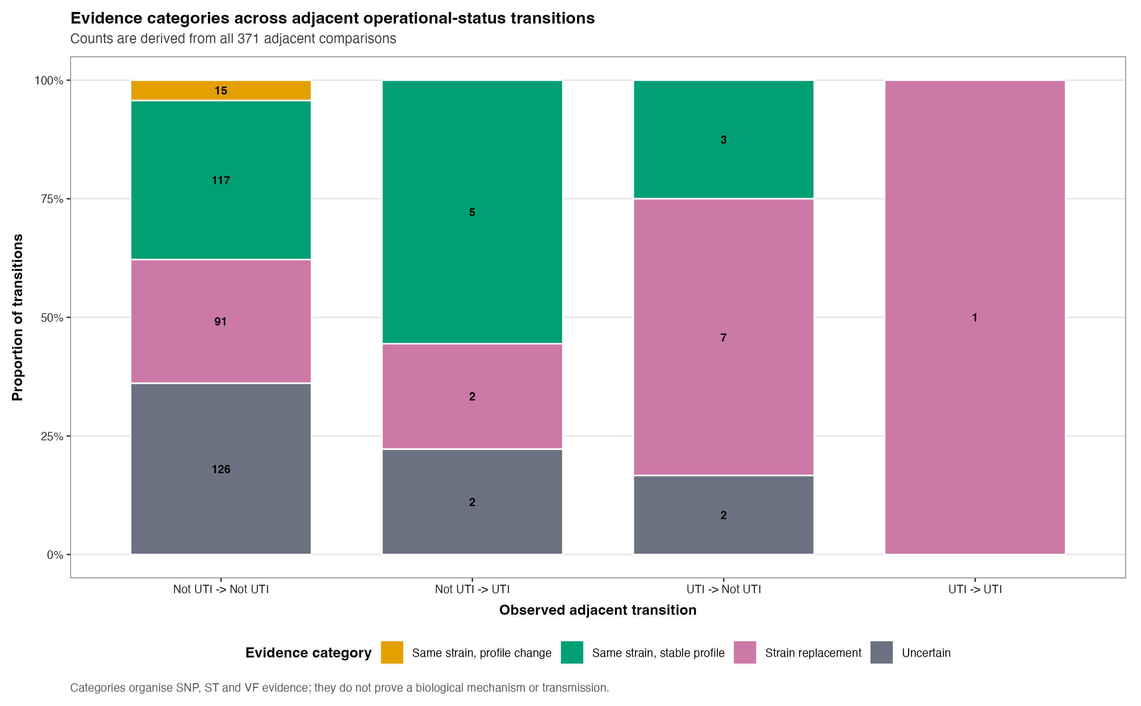
APPENDIX / MECHANISMS
Mechanism composition across transition types
Unequal transition denominators prevent inferential comparison of proportions.
DESCRIPTIVE COMPARISON
rUTI clinical-to-genomic review | operational UTI phenotype | Longcycler-only analysis | 14 July 2026
17
Notes:
Release source: /Users/Aamir/Desktop/rUTIs/results/pipeline/longcycler_release_claim_registry.json
Scope: selected QC-passing Longcycler assemblies only.
Clinical phenotype: versioned operational UTI phenotype.
Analytical anchors: 532 episodes; 893 direct pairs; 371 adjacent pairs; RQ01-RQ10.

Slide 18
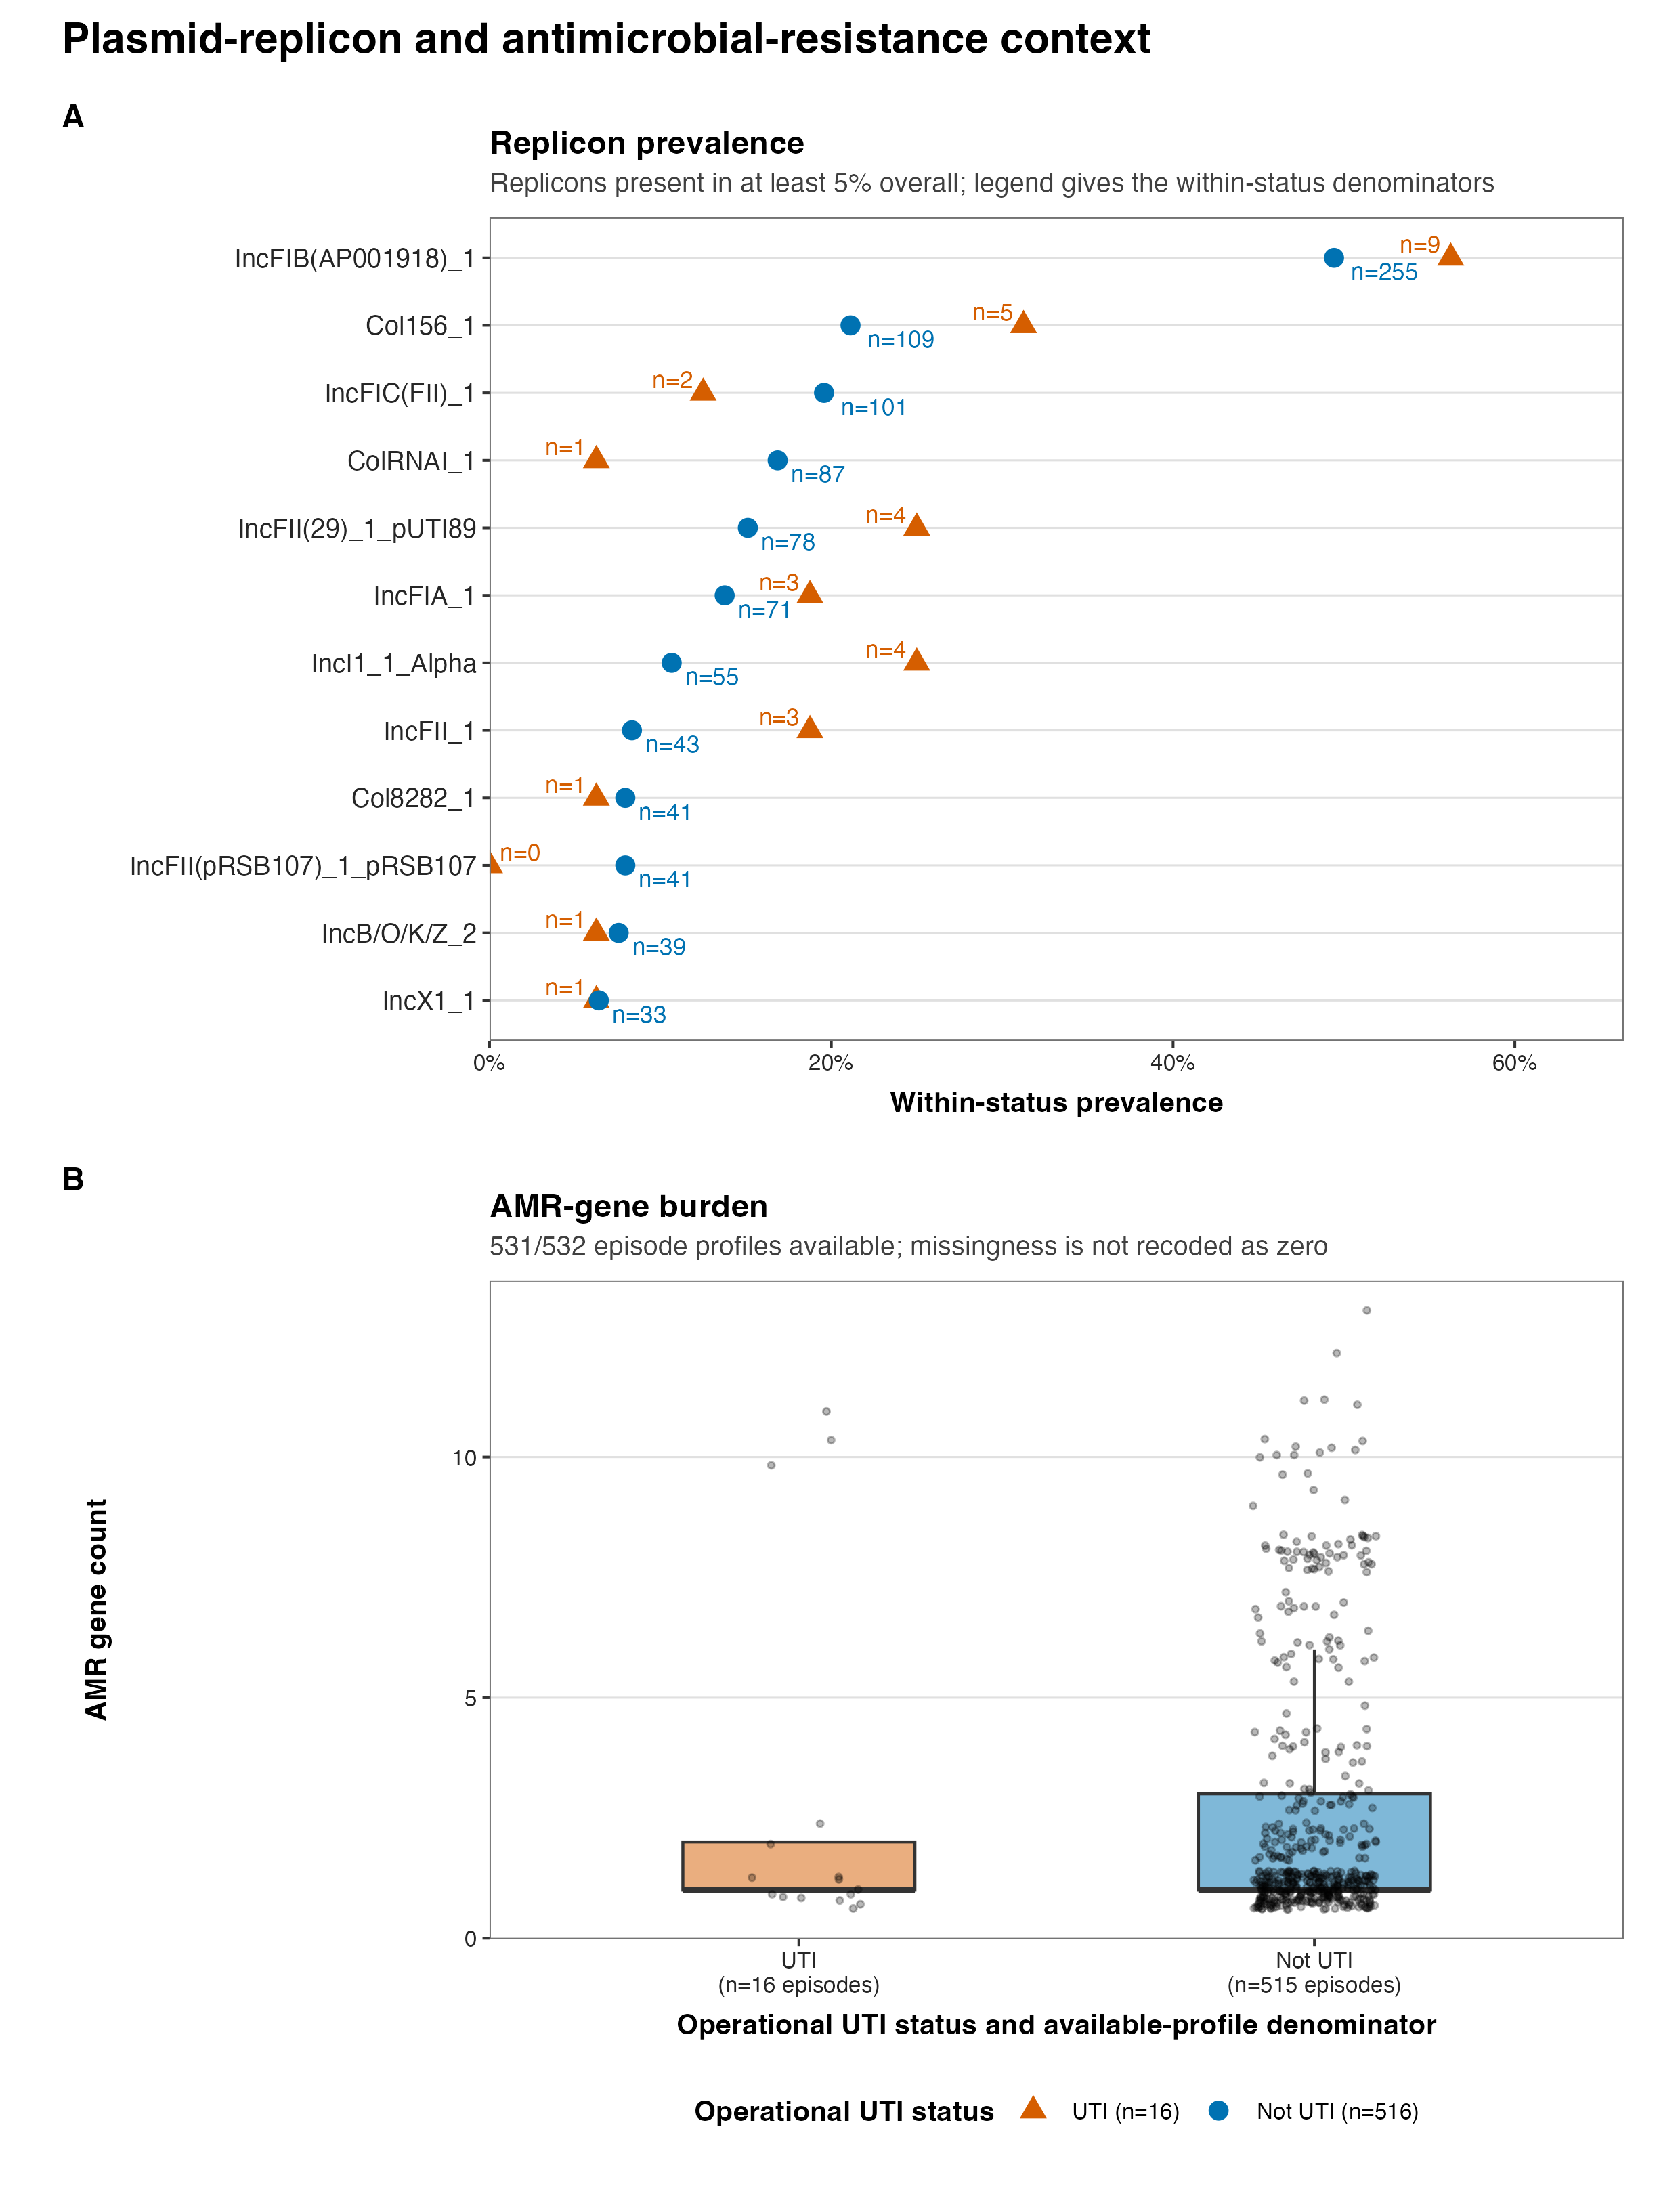
APPENDIX / EXPLORATORY BACKUP
Accessory, plasmid and ResFinder context only
Exploratory transition-level context; not a global VF-plus-AMR association analysis.
EXPLORATORY AMR BACKUP
rUTI clinical-to-genomic review | operational UTI phenotype | Longcycler-only analysis | 14 July 2026
18
Notes:
Release source: /Users/Aamir/Desktop/rUTIs/results/pipeline/longcycler_release_claim_registry.json
Scope: selected QC-passing Longcycler assemblies only.
Clinical phenotype: versioned operational UTI phenotype.
Analytical anchors: 532 episodes; 893 direct pairs; 371 adjacent pairs; RQ01-RQ10.

Slide 19
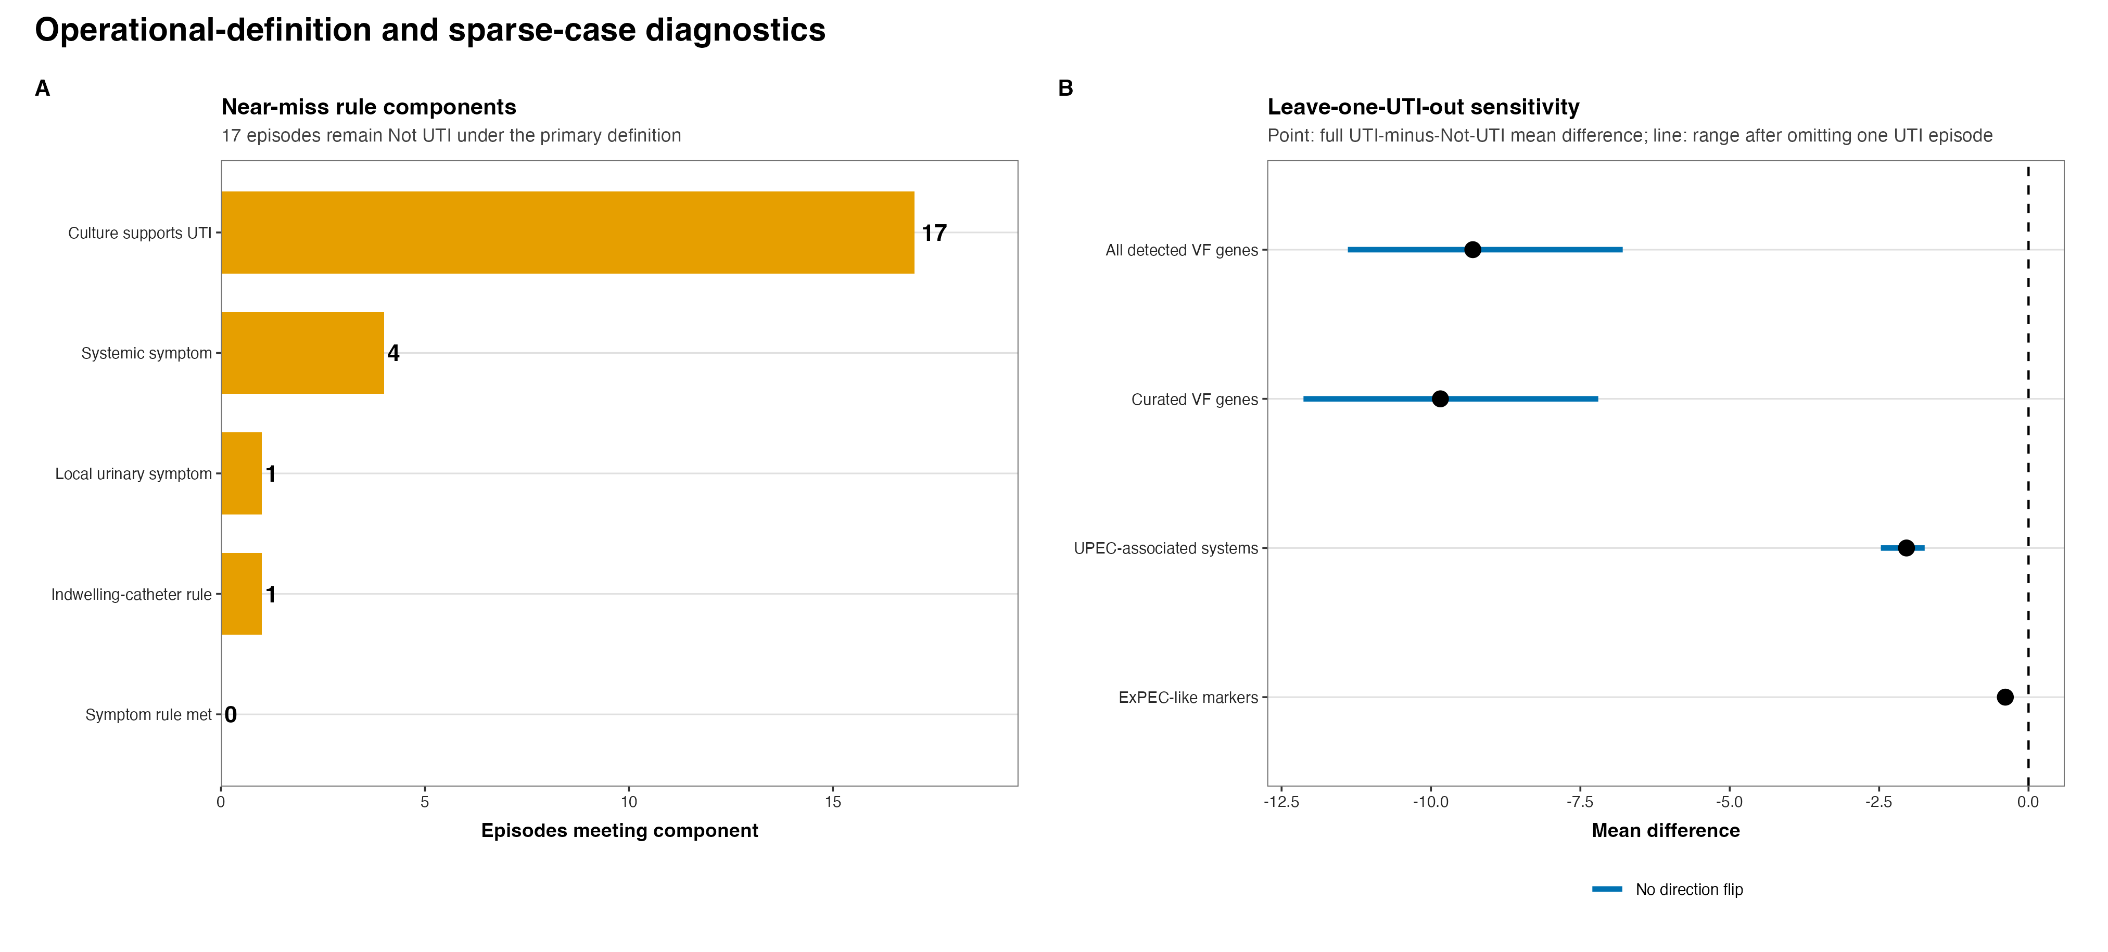
APPENDIX / SENSITIVITY
Near-miss audit and sparse-count precision
17 near-miss rows remain sensitivity-only and do not enter the operational UTI group.
SENSITIVITY DIAGNOSTIC
rUTI clinical-to-genomic review | operational UTI phenotype | Longcycler-only analysis | 14 July 2026
19
Notes:
Release source: /Users/Aamir/Desktop/rUTIs/results/pipeline/longcycler_release_claim_registry.json
Scope: selected QC-passing Longcycler assemblies only.
Clinical phenotype: versioned operational UTI phenotype.
Analytical anchors: 532 episodes; 893 direct pairs; 371 adjacent pairs; RQ01-RQ10.

Slide 20
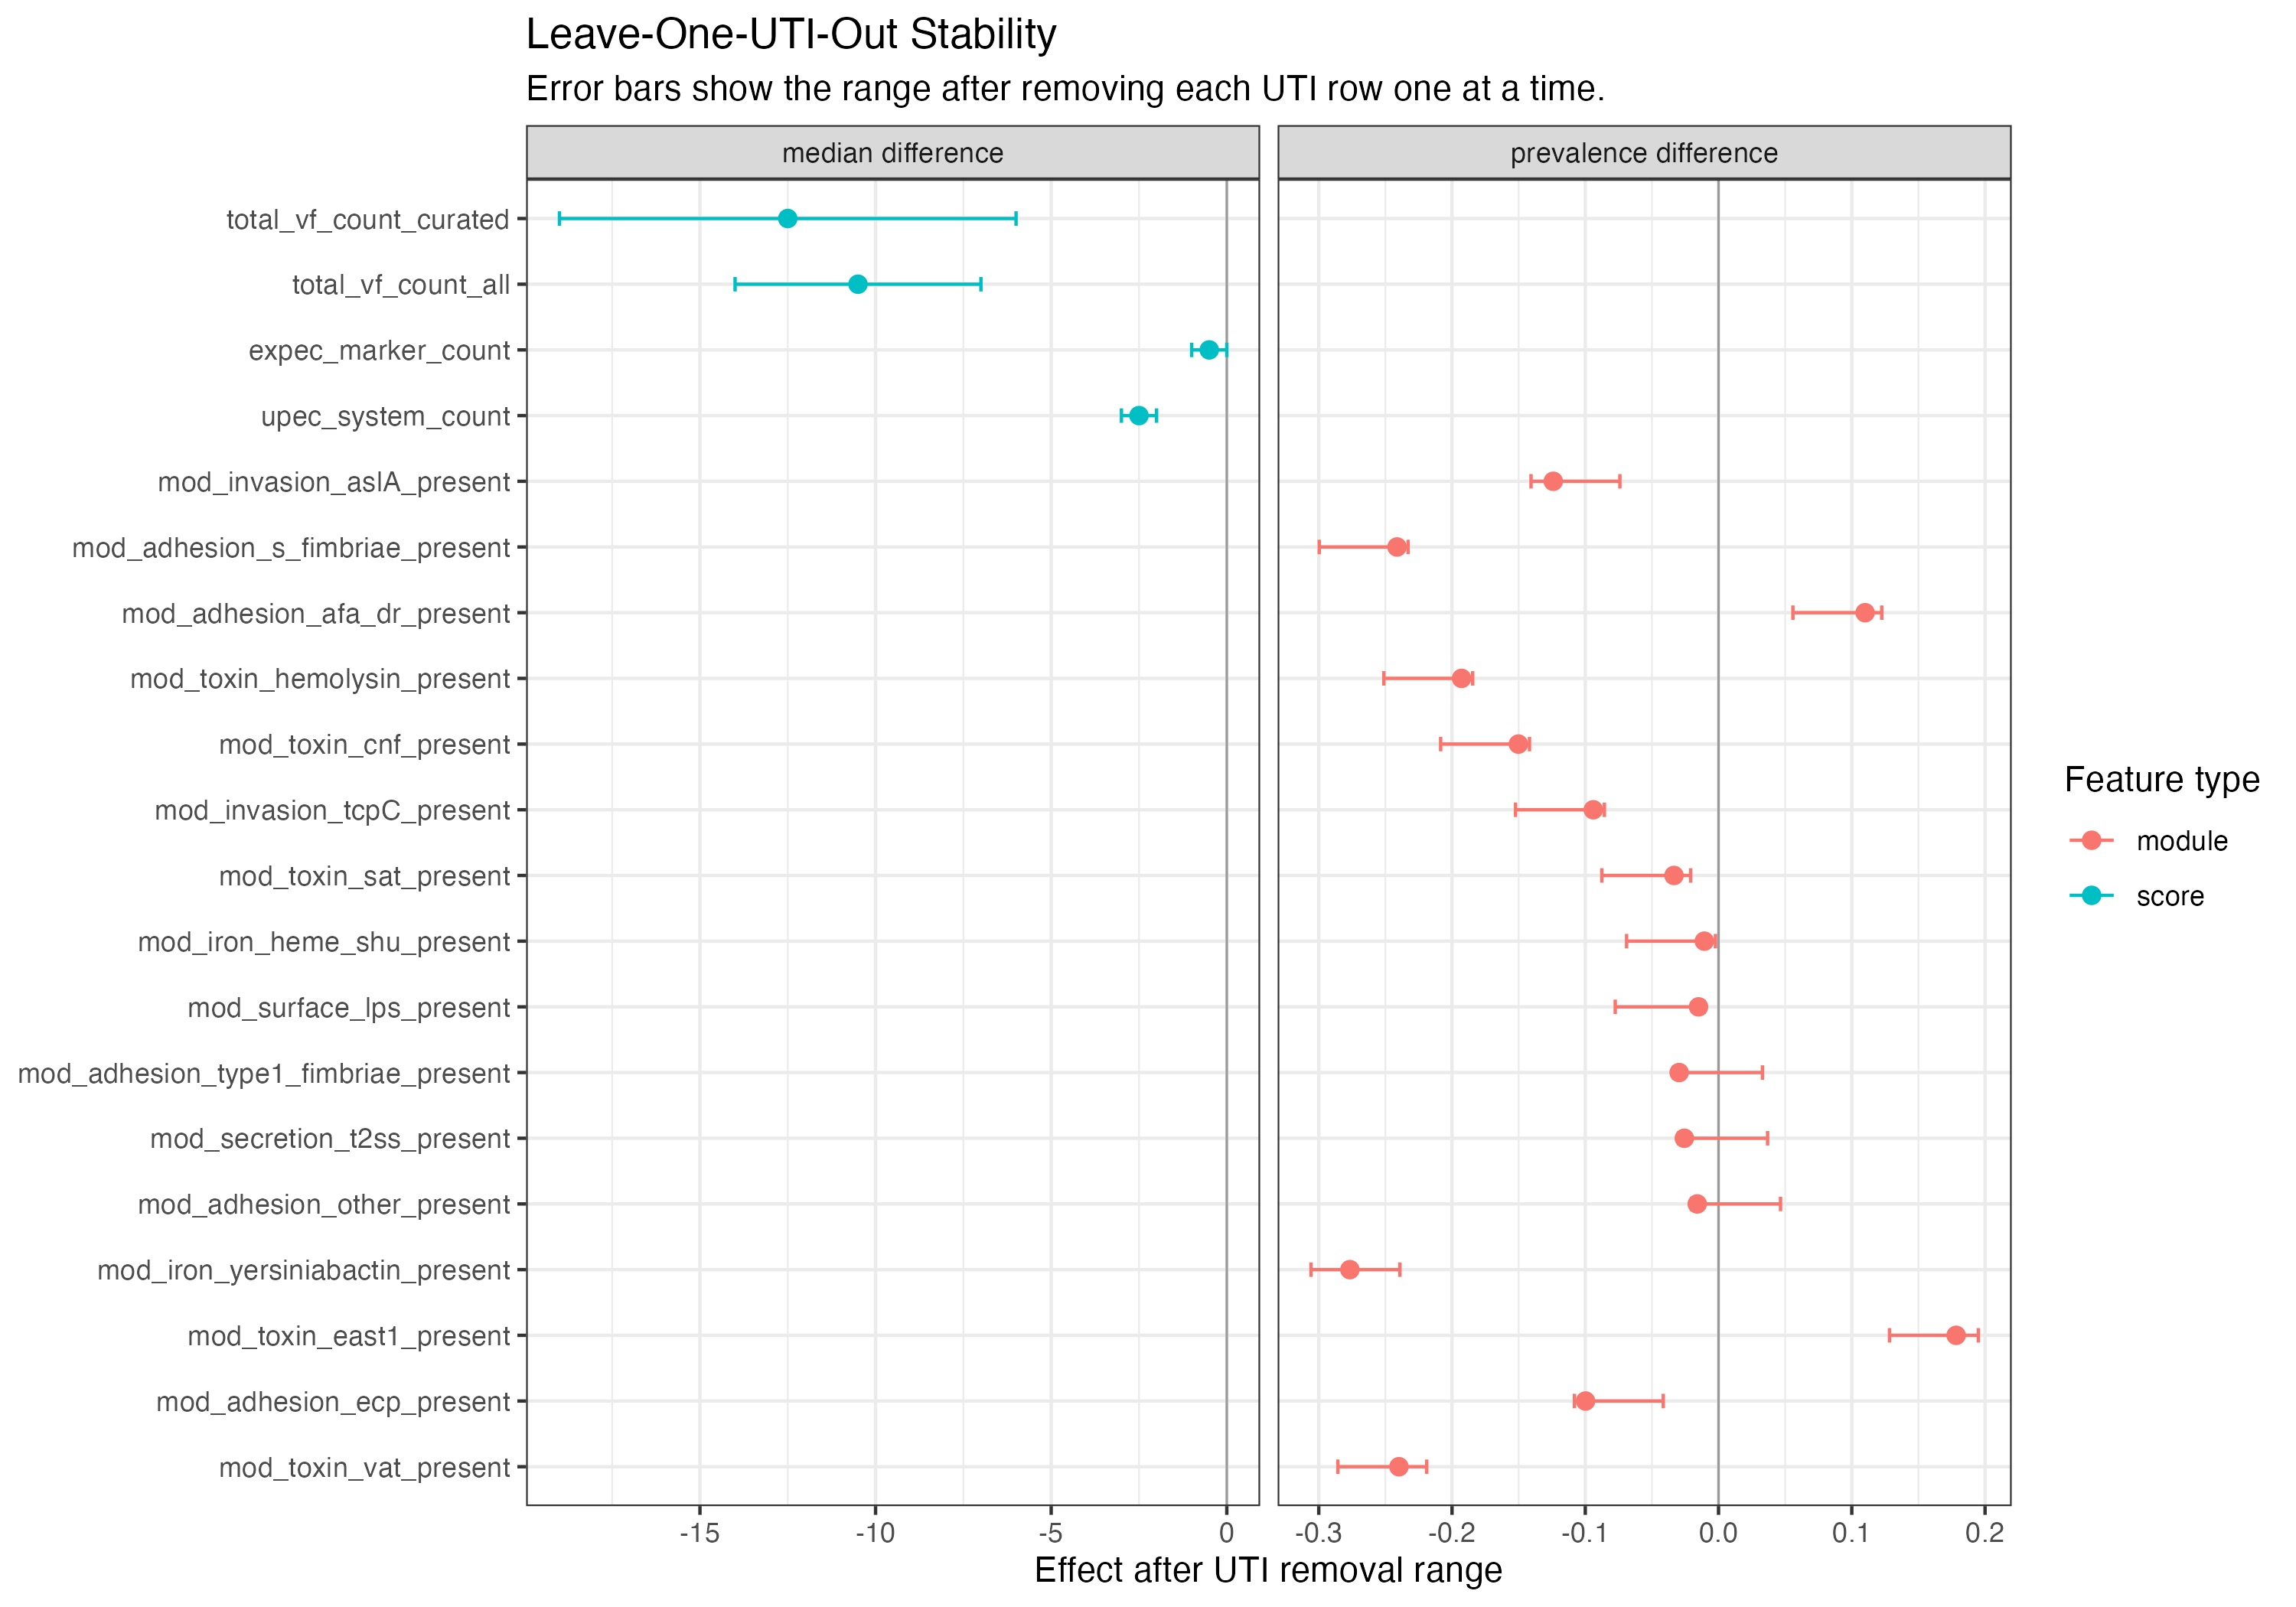
APPENDIX / SENSITIVITY
Leave-one-UTI-out stability
Instability is expected with 16 operational UTI episodes and is not confirmatory association testing.
SPARSE-CASE DIAGNOSTIC
rUTI clinical-to-genomic review | operational UTI phenotype | Longcycler-only analysis | 14 July 2026
20
Notes:
Release source: /Users/Aamir/Desktop/rUTIs/results/pipeline/longcycler_release_claim_registry.json
Scope: selected QC-passing Longcycler assemblies only.
Clinical phenotype: versioned operational UTI phenotype.
Analytical anchors: 532 episodes; 893 direct pairs; 371 adjacent pairs; RQ01-RQ10.

Slide 21
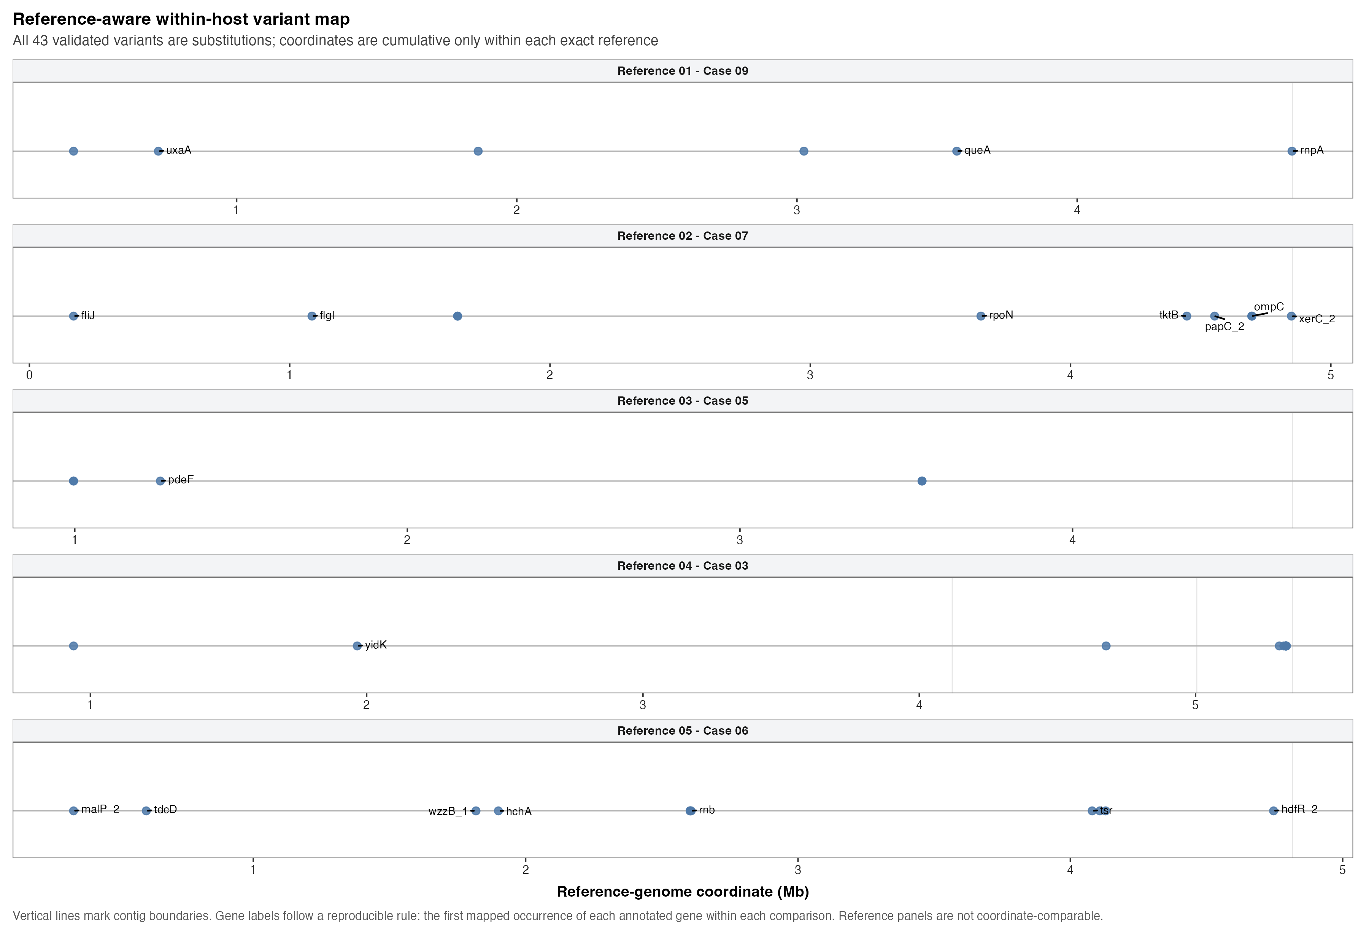
APPENDIX / FOLLOW-UP
Prioritised within-strain variant map
Candidate annotated comparisons only; absence from the panel is not absence of genomic change.
DESCRIPTIVE PRIORITISATION
rUTI clinical-to-genomic review | operational UTI phenotype | Longcycler-only analysis | 14 July 2026
21
Notes:
Release source: /Users/Aamir/Desktop/rUTIs/results/pipeline/longcycler_release_claim_registry.json
Scope: selected QC-passing Longcycler assemblies only.
Clinical phenotype: versioned operational UTI phenotype.
Analytical anchors: 532 episodes; 893 direct pairs; 371 adjacent pairs; RQ01-RQ10.

Slide 22
APPENDIX / EVIDENCE REGISTRY
Interpretation guardrails and lookup resources
Keep current denominators, evidence labels and exploratory boundaries visible when extending this work.
DO SAY
DO NOT CLAIM
- 532 selected episodes: 16 UTI / 516 Not_UTI
- a non-operational phenotype as the current comparison
- 893 direct pairs; 371 adjacent from 139 residents
- named VF or mutation signals as causal evidence
- 9/9/0 focused cases / linked / missing; 5 <=25 SNPs
- global VF-plus-AMR association inference
- 17 near-miss rows are sensitivity-only; RQ01-RQ10 complete
- mechanistic proof from stable VF profiles
ADDITIONAL LOOKUP VISUALS
plots/publication/Fig1_Swimmer_Plot.png | contextual longitudinal lookup
plots/vf/vf_jaccard_by_transition.png | within-resident VF stability
plots/vf/vf_transition_case_timeline.png | transition lookup
rUTI clinical-to-genomic review | operational UTI phenotype | Longcycler-only analysis | 14 July 2026
22
Notes:
Release source: /Users/Aamir/Desktop/rUTIs/results/pipeline/longcycler_release_claim_registry.json
Scope: selected QC-passing Longcycler assemblies only.
Clinical phenotype: versioned operational UTI phenotype.
Analytical anchors: 532 episodes; 893 direct pairs; 371 adjacent pairs; RQ01-RQ10.

