Slide 1
rUTI Clinical-to-Genomic Analysis: Longcycler-Only Operational UTI Evidence
Selected cohort: 532 episodes from 161 residents | RQ01-RQ10 scientific review and handover
Notes:
Release source: /Users/Aamir/Desktop/rUTIs/results/pipeline/longcycler_release_claim_registry.json
Scope: selected QC-passing Longcycler assemblies only.
Clinical phenotype: versioned operational UTI phenotype.
Analytical anchors: 532 episodes; 893 direct pairs; 371 adjacent pairs; RQ01-RQ10.

Slide 2
Clinical motivation: bacteriuria is not synonymous with symptomatic UTI
Repeated bacteriuria does not automatically indicate symptomatic infection.
UTI | Versioned operational phenotype: culture support plus compatible, catheter-aware symptoms.
Not_UTI | Comparator state; clinically heterogeneous by design.
Longitudinal sampling asks what changes before symptoms emerge.
Primary analysis throughout: operational UTI versus Not_UTI in selected Longcycler-linked episodes.
Notes:
Release source: /Users/Aamir/Desktop/rUTIs/results/pipeline/longcycler_release_claim_registry.json
Scope: selected QC-passing Longcycler assemblies only.
Clinical phenotype: versioned operational UTI phenotype.
Analytical anchors: 532 episodes; 893 direct pairs; 371 adjacent pairs; RQ01-RQ10.

Slide 3
Longitudinal study design: clinical episodes connected to bacterial genomes
The selected cohort contains 532 episodes from 161 residents.
Clinical lane: culture, symptoms and catheter context establish the operational phenotype.
Genomic lane: one QC-passing Longcycler assembly per episode supplies VF, SNP/ST and accessory context.
Direct pair evidence comprises 893 within-resident pairs and 371 adjacent pairs.
Notes:
Release source: /Users/Aamir/Desktop/rUTIs/results/pipeline/longcycler_release_claim_registry.json
Scope: selected QC-passing Longcycler assemblies only.
Clinical phenotype: versioned operational UTI phenotype.
Analytical anchors: 532 episodes; 893 direct pairs; 371 adjacent pairs; RQ01-RQ10.

Slide 4
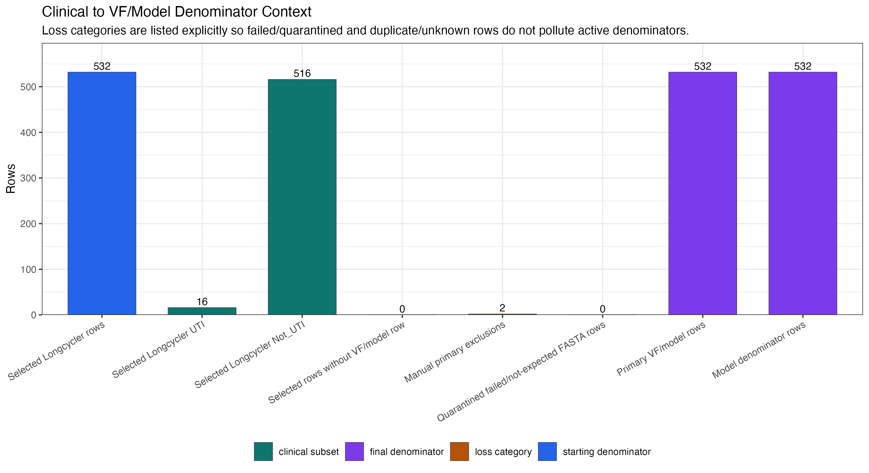
Current analytical denominator: establish the boundary before interpreting biology
ANALYTICAL | Selected cohort: 532 episodes (16 operational UTI; 516 Not_UTI) from 161 residents.
Notes:
Release source: /Users/Aamir/Desktop/rUTIs/results/pipeline/longcycler_release_claim_registry.json
Scope: selected QC-passing Longcycler assemblies only.
Clinical phenotype: versioned operational UTI phenotype.
Analytical anchors: 532 episodes; 893 direct pairs; 371 adjacent pairs; RQ01-RQ10.

Slide 5
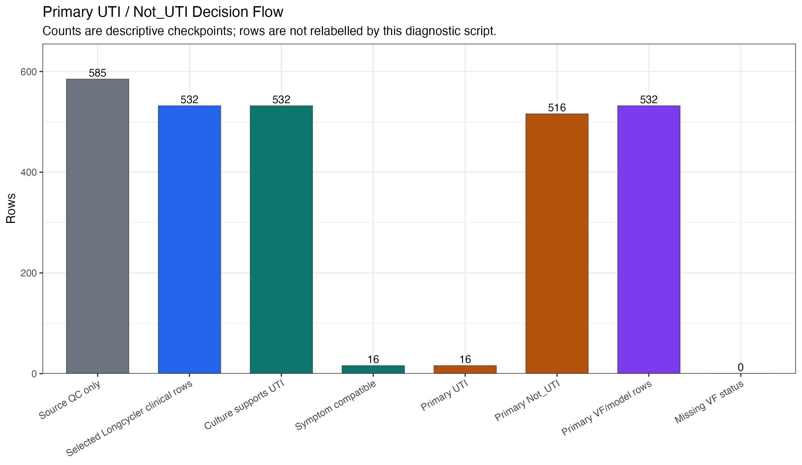
Operational UTI phenotype: culture support plus catheter-aware compatible symptoms
DESCRIPTIVE | Versioned operational rule applied to 532 selected episodes; Not_UTI remains heterogeneous.
Notes:
Release source: /Users/Aamir/Desktop/rUTIs/results/pipeline/longcycler_release_claim_registry.json
Scope: selected QC-passing Longcycler assemblies only.
Clinical phenotype: versioned operational UTI phenotype.
Analytical anchors: 532 episodes; 893 direct pairs; 371 adjacent pairs; RQ01-RQ10.

Slide 6
Selected clinical status and direct genomic evidence meet at transition analysis
SELECTED COHORT
532 episodes
161 residents
16/516 UTI/Not_UTI
SELECTED GENOMES
532 QC-passing
Longcycler assemblies
one per episode
DIRECT EVIDENCE
893 resident pairs
371 adjacent
140 <=25 SNPs
FOCUSED CASEBOOK
9/9/0
cases/linked/missing
5/9 <=25 SNPs
Release layer: operational phenotype -> direct pairs -> adjacent transitions -> RQ01-RQ10
WORKFLOW | 532 selected episodes -> 893 direct pairs -> 371 adjacent pairs -> RQ01-RQ10.
Notes:
Release source: /Users/Aamir/Desktop/rUTIs/results/pipeline/longcycler_release_claim_registry.json
Scope: selected QC-passing Longcycler assemblies only.
Clinical phenotype: versioned operational UTI phenotype.
Analytical anchors: 532 episodes; 893 direct pairs; 371 adjacent pairs; RQ01-RQ10.

Slide 7
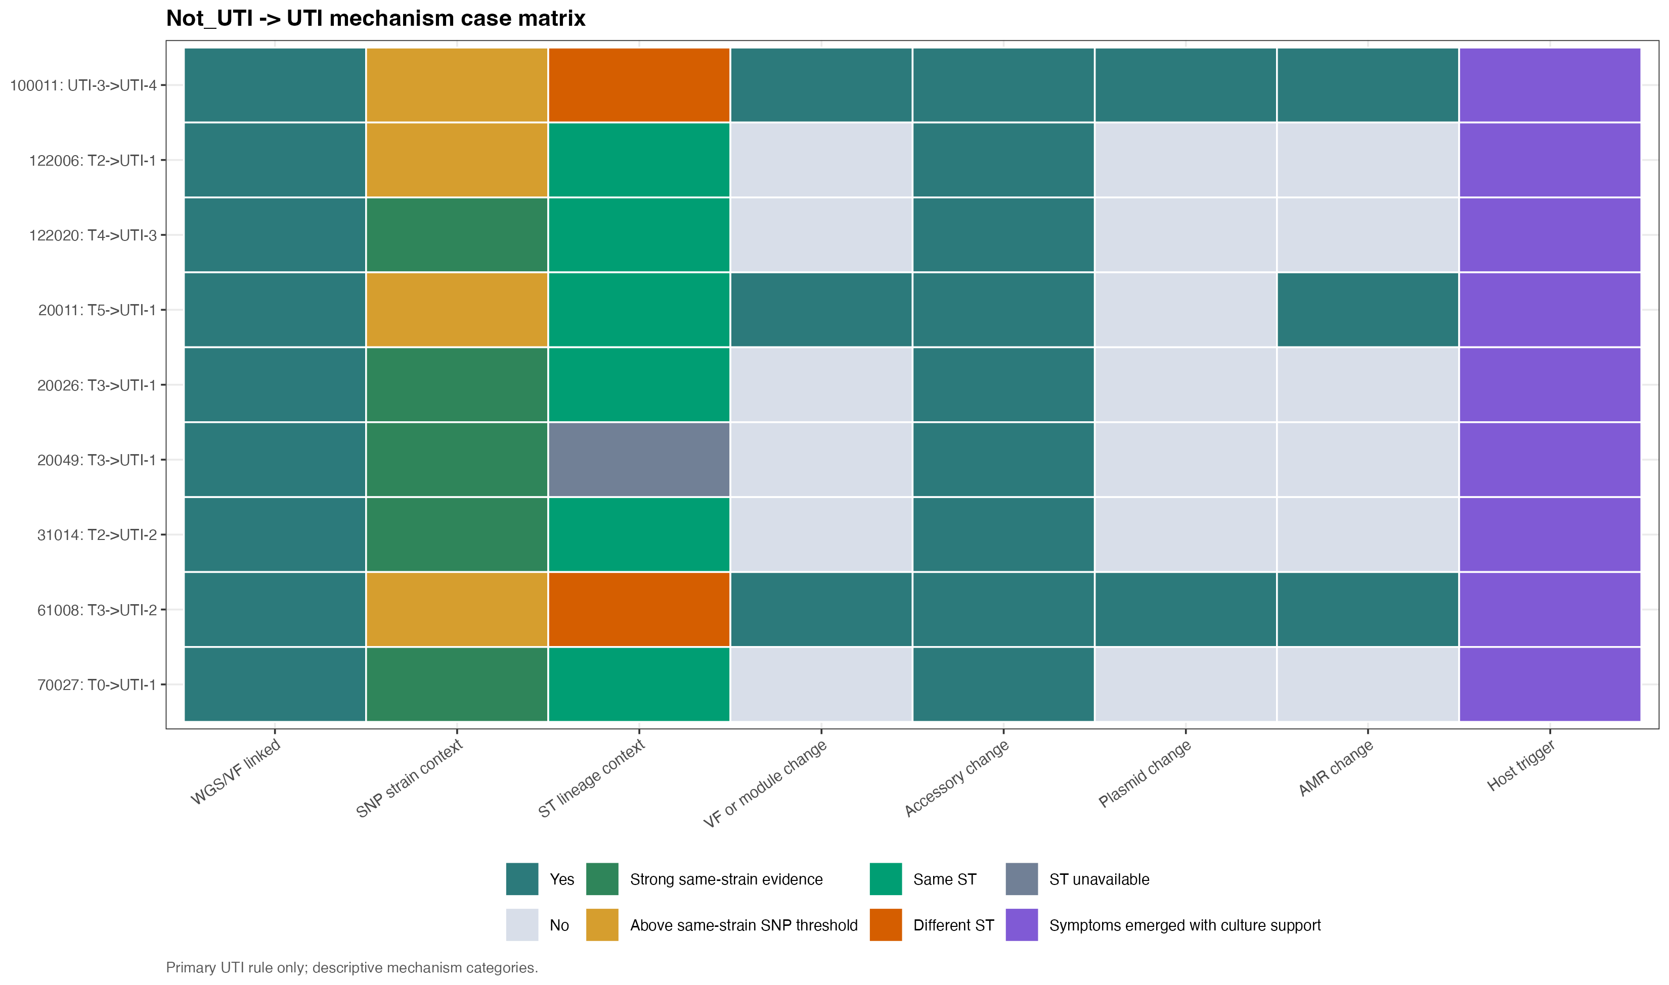
9 operational Not_UTI-to-UTI transitions are all genomically linked
DESCRIPTIVE | 5 of 9 focused direct pairs are at or below 25 SNPs; no mechanism is proved.
Notes:
Release source: /Users/Aamir/Desktop/rUTIs/results/pipeline/longcycler_release_claim_registry.json
Scope: selected QC-passing Longcycler assemblies only.
Clinical phenotype: versioned operational UTI phenotype.
Analytical anchors: 532 episodes; 893 direct pairs; 371 adjacent pairs; RQ01-RQ10.

Slide 8
Transition mechanism casebook: the route into UTI is biologically heterogeneous
DESCRIPTIVE | 9 operational transitions; 9/9 genomically linked; 0 missing endpoint; 5 <=25 SNPs.
Notes:
Release source: /Users/Aamir/Desktop/rUTIs/results/pipeline/longcycler_release_claim_registry.json
Scope: selected QC-passing Longcycler assemblies only.
Clinical phenotype: versioned operational UTI phenotype.
Analytical anchors: 532 episodes; 893 direct pairs; 371 adjacent pairs; RQ01-RQ10.

Slide 9
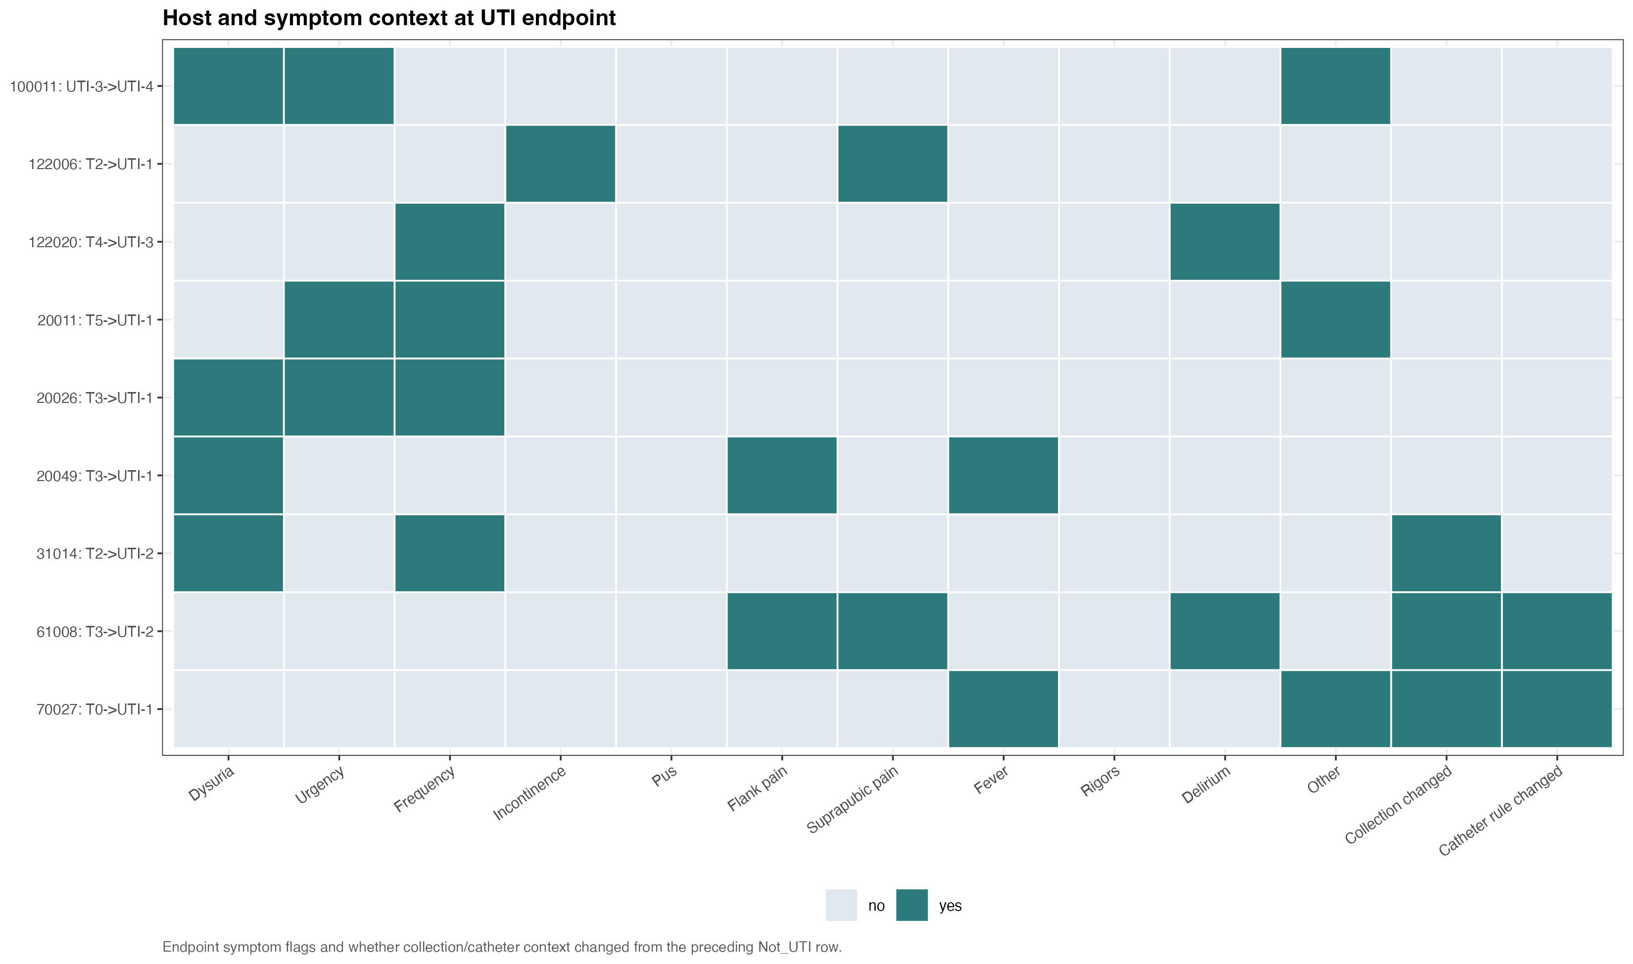
Direct paired evidence distinguishes close from distant clinical transitions
DESCRIPTIVE | 140/371 adjacent pairs are <=25 SNPs; focused transitions: 5/9.
Notes:
Release source: /Users/Aamir/Desktop/rUTIs/results/pipeline/longcycler_release_claim_registry.json
Scope: selected QC-passing Longcycler assemblies only.
Clinical phenotype: versioned operational UTI phenotype.
Analytical anchors: 532 episodes; 893 direct pairs; 371 adjacent pairs; RQ01-RQ10.

Slide 10
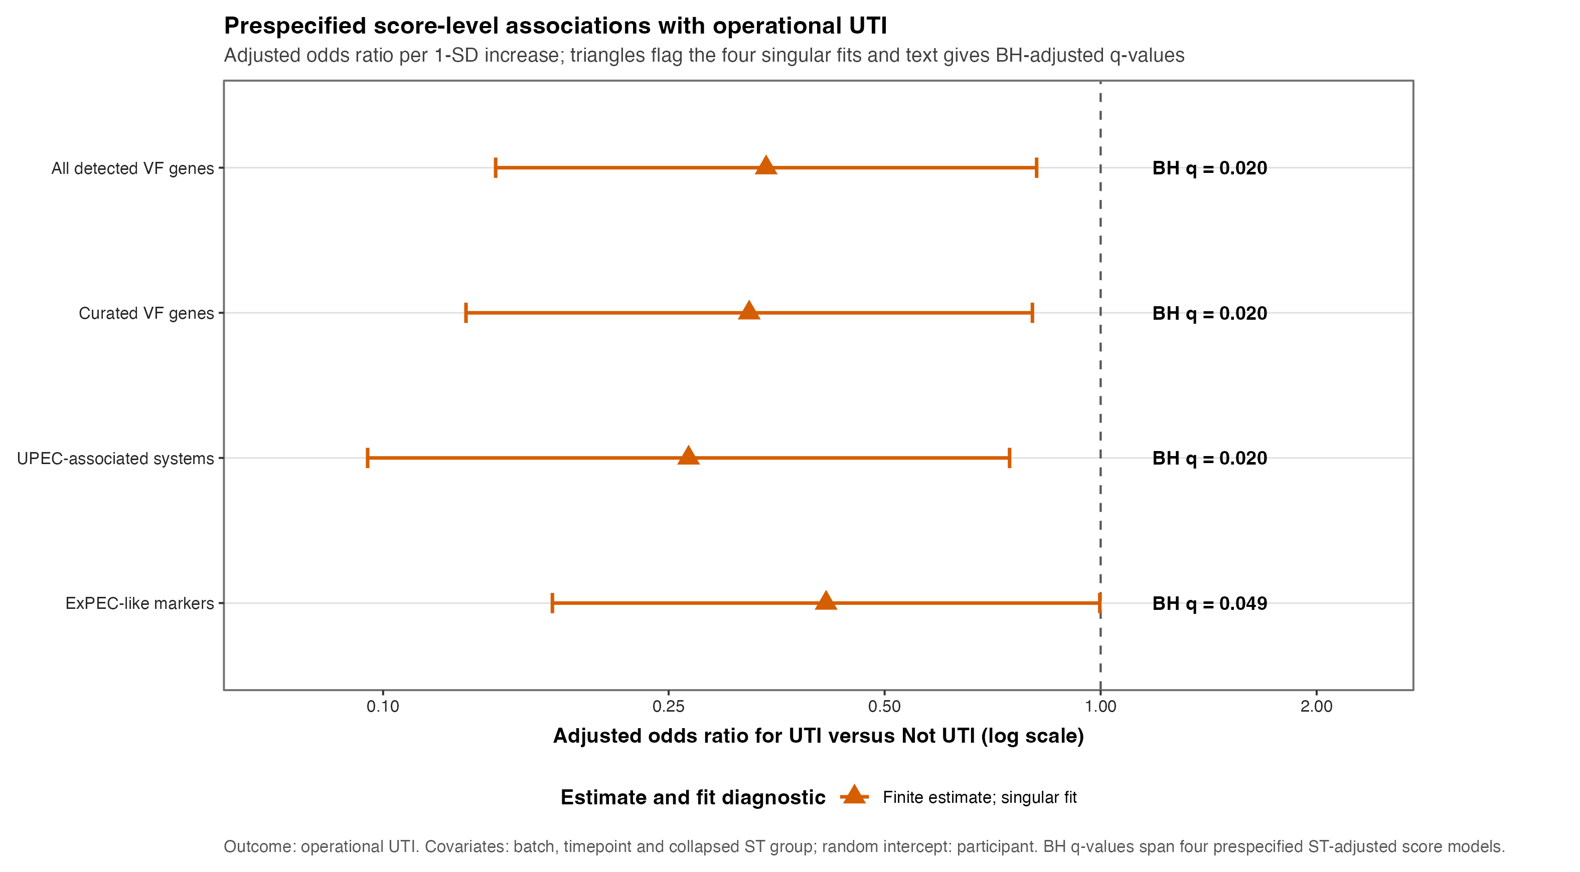
Population-level VF analysis remains exploratory with 16 operational UTI episodes
EXPLORATORY | Participant-aware models and robustness panels are descriptive and do not support causal inference.
Notes:
Release source: /Users/Aamir/Desktop/rUTIs/results/pipeline/longcycler_release_claim_registry.json
Scope: selected QC-passing Longcycler assemblies only.
Clinical phenotype: versioned operational UTI phenotype.
Analytical anchors: 532 episodes; 893 direct pairs; 371 adjacent pairs; RQ01-RQ10.

Slide 11
Evidence boundary: strong descriptive transitions, limited population-wide inference
DESCRIPTIVE DIRECT EVIDENCE
893 within-resident pairs; 371 adjacent pairs from 139 residents.
140/371 adjacent pairs and 5/9 focused pairs are <=25 SNPs.
Casebook: 9/9/0 cases/linked/missing.
EXPLORATORY POPULATION EVIDENCE
16 operational UTI episodes constrain precision.
17 near-miss rows remain sensitivity-only; RQ01-RQ10 reports guardrails.
Notes:
Release source: /Users/Aamir/Desktop/rUTIs/results/pipeline/longcycler_release_claim_registry.json
Scope: selected QC-passing Longcycler assemblies only.
Clinical phenotype: versioned operational UTI phenotype.
Analytical anchors: 532 episodes; 893 direct pairs; 371 adjacent pairs; RQ01-RQ10.

Slide 12
Interpretation and limitations: a plausible biological direction, not a proved mechanism
WHAT THE DATA SUPPORT
Direct genomic distance can identify close and distant clinical transitions.
WHAT THEY DO NOT PROVE
Host state, bacterial regulation/expression and unmeasured changes remain alternatives.
PRIMARY LIMITATIONS
16 operational UTI episodes; observational design; sparse outcome.
All 9 focused transitions are linked, but repeated measures restrict population-level inference.
Notes:
Release source: /Users/Aamir/Desktop/rUTIs/results/pipeline/longcycler_release_claim_registry.json
Scope: selected QC-passing Longcycler assemblies only.
Clinical phenotype: versioned operational UTI phenotype.
Analytical anchors: 532 episodes; 893 direct pairs; 371 adjacent pairs; RQ01-RQ10.

Slide 13
Next research decisions and discussion
EVIDENCE | Preserve the direct-pair and transition-focused narrative.
NEXT ANALYSIS | Prioritise close within-strain pairs and clinically grounded host/context variables.
DESIGN | Analyse distant replacement-consistent pairs separately.
REPORTING | Keep VF and AMR results exploratory; use RQ01-RQ10 as the release index.
DISCUSSION | What should become the next confirmatory question?
Notes:
Release source: /Users/Aamir/Desktop/rUTIs/results/pipeline/longcycler_release_claim_registry.json
Scope: selected QC-passing Longcycler assemblies only.
Clinical phenotype: versioned operational UTI phenotype.
Analytical anchors: 532 episodes; 893 direct pairs; 371 adjacent pairs; RQ01-RQ10.

Slide 14
APPENDIX 1 | Practical handover: current outputs and rerun entry point
1 | CLAIM REGISTRY
Validated counts
plot inventory
source hashes
2 | EVIDENCE TABLES
893 direct pairs
371 adjacent pairs
9 linked cases
3 | RELEASE OUTPUTS
RQ01-RQ10
current final plots
regenerated decks
Single entry point: RUN_COMPLETE_ANALYSIS.sh
Notes:
Release source: /Users/Aamir/Desktop/rUTIs/results/pipeline/longcycler_release_claim_registry.json
Scope: selected QC-passing Longcycler assemblies only.
Clinical phenotype: versioned operational UTI phenotype.
Analytical anchors: 532 episodes; 893 direct pairs; 371 adjacent pairs; RQ01-RQ10.

Slide 15
APPENDIX 2 | Clinical rule audit detail (current status definition)
Notes:
Release source: /Users/Aamir/Desktop/rUTIs/results/pipeline/longcycler_release_claim_registry.json
Scope: selected QC-passing Longcycler assemblies only.
Clinical phenotype: versioned operational UTI phenotype.
Analytical anchors: 532 episodes; 893 direct pairs; 371 adjacent pairs; RQ01-RQ10.

Slide 16
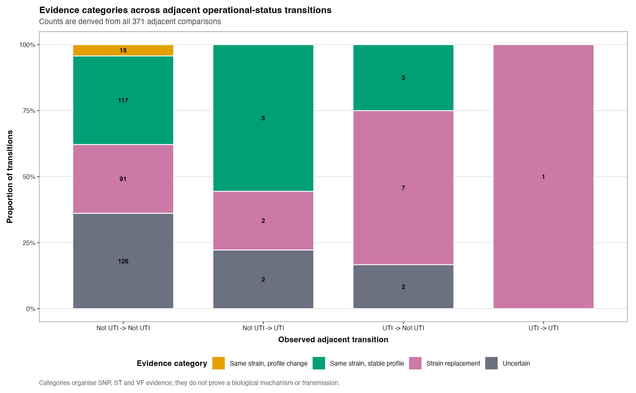
APPENDIX 3 | Transition comparisons (descriptive)
Notes:
Release source: /Users/Aamir/Desktop/rUTIs/results/pipeline/longcycler_release_claim_registry.json
Scope: selected QC-passing Longcycler assemblies only.
Clinical phenotype: versioned operational UTI phenotype.
Analytical anchors: 532 episodes; 893 direct pairs; 371 adjacent pairs; RQ01-RQ10.

Slide 17
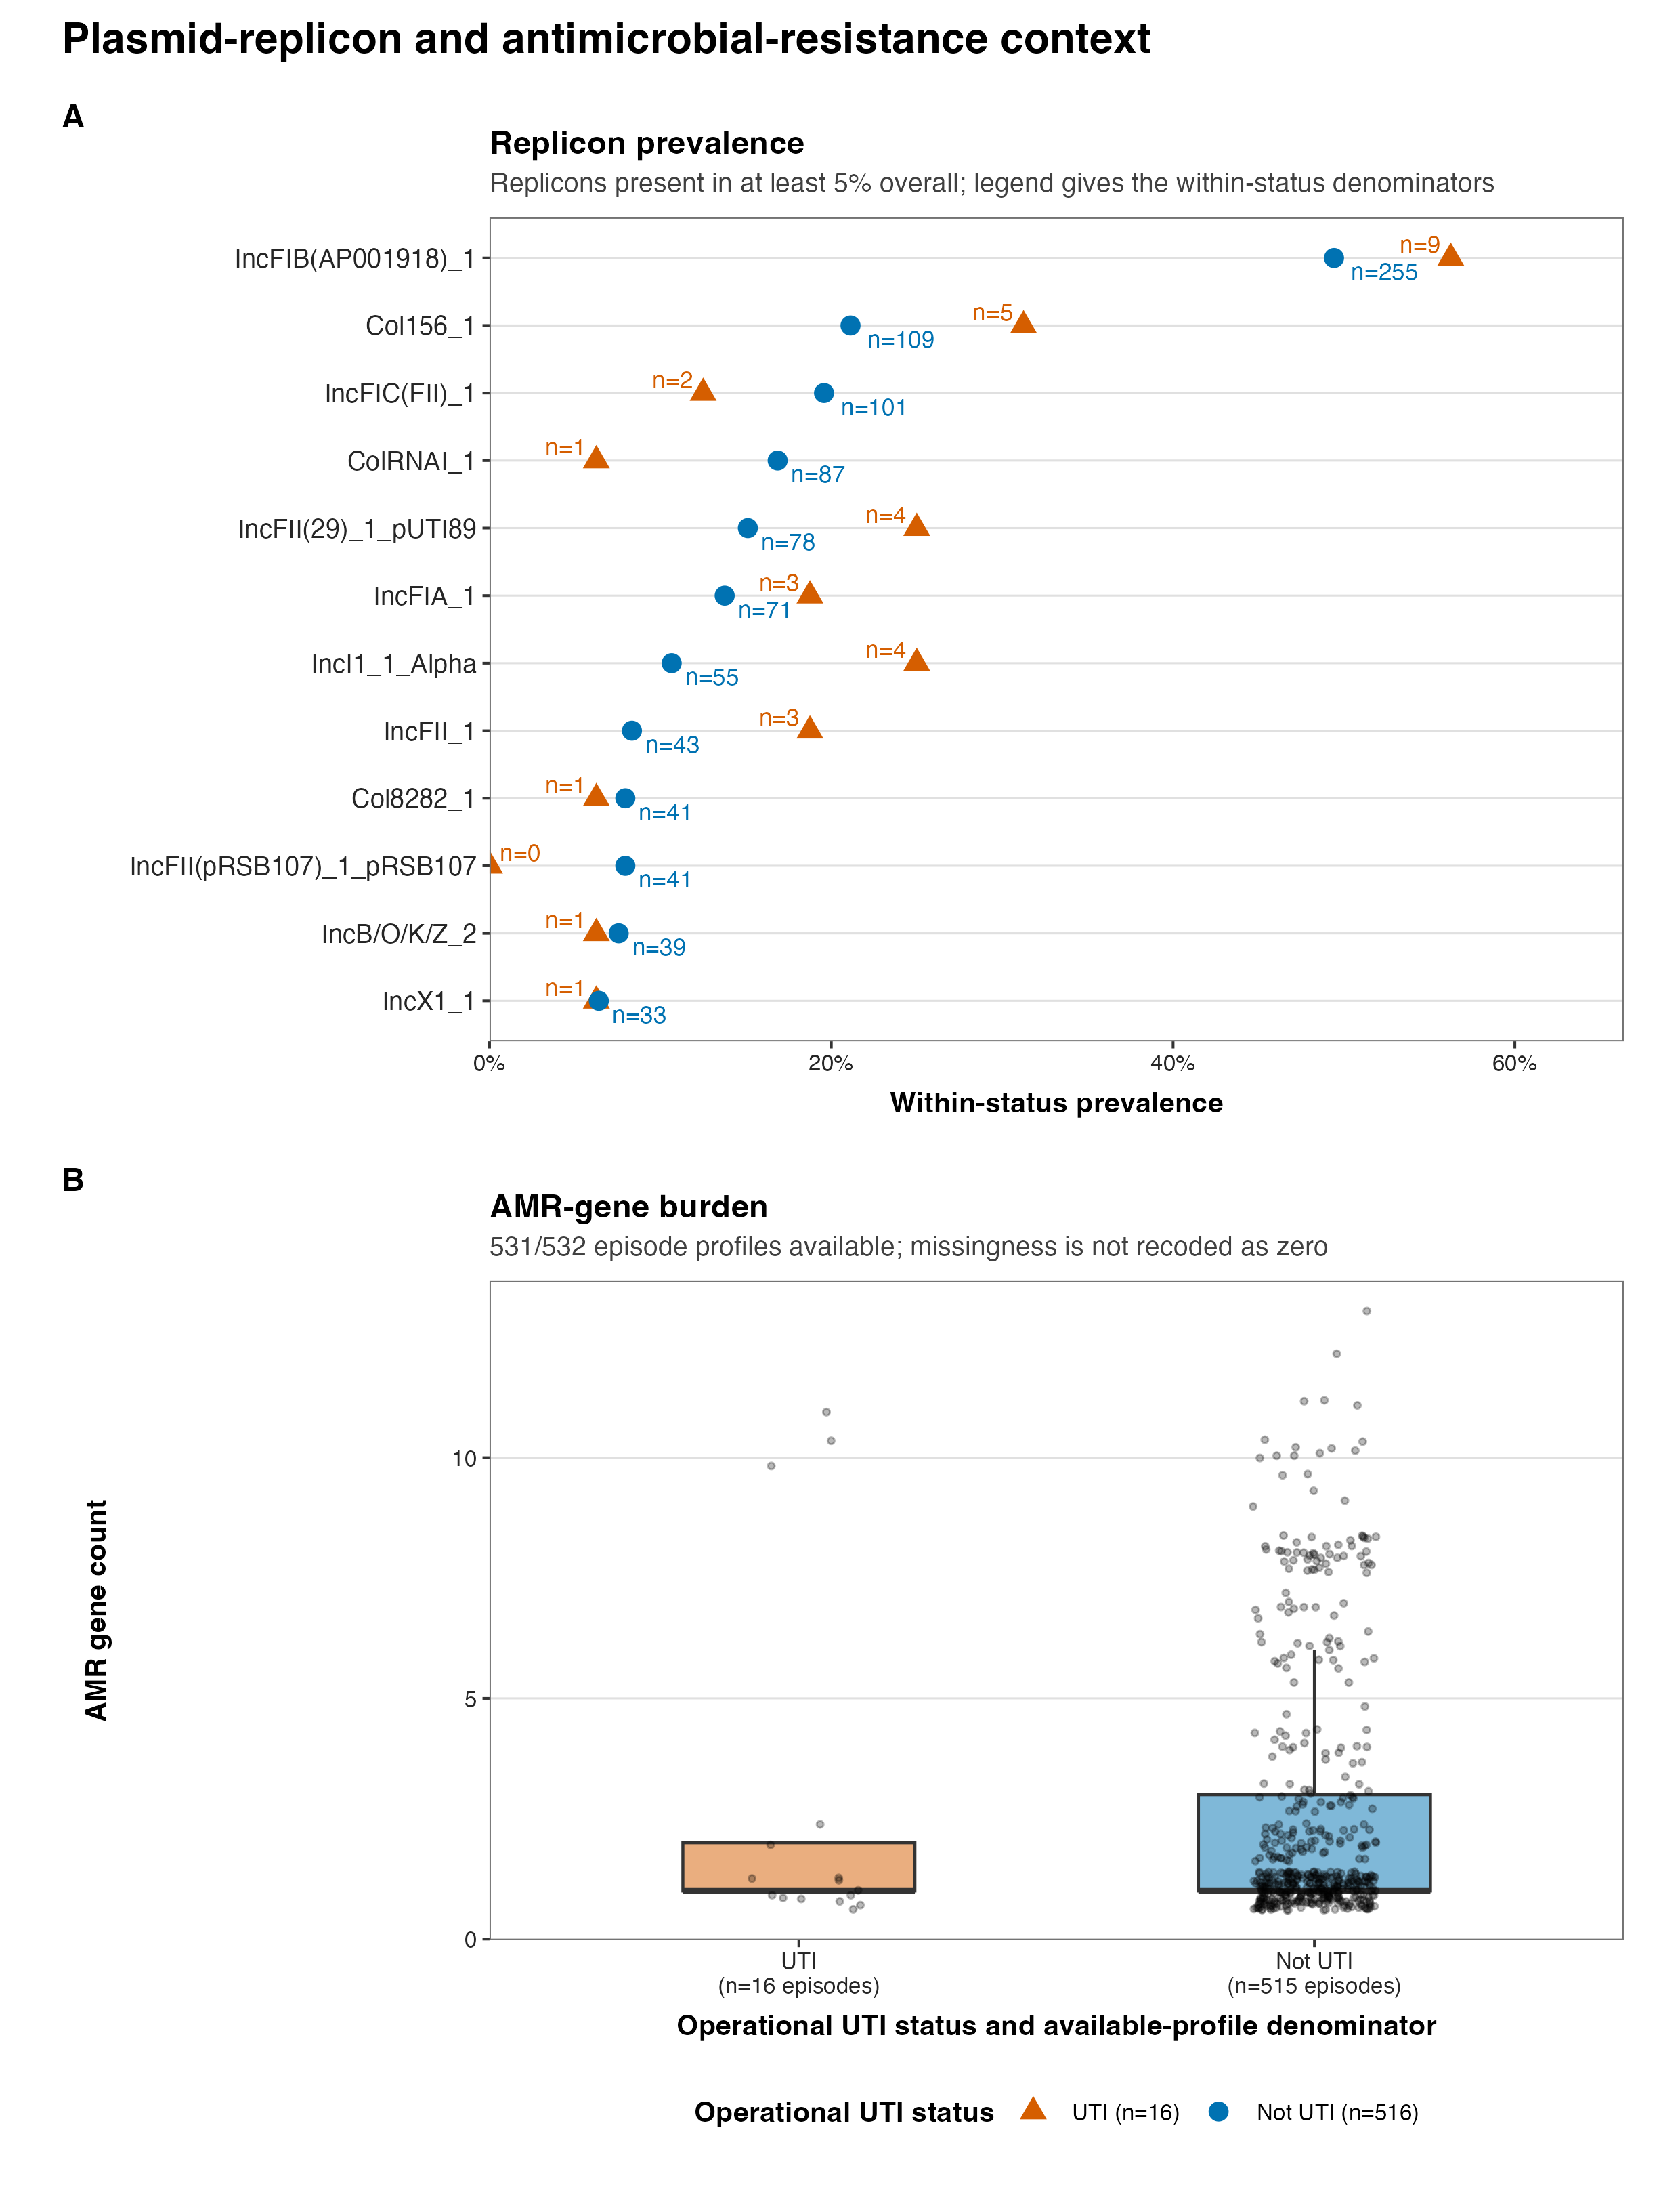
APPENDIX 4 | Accessory, plasmid and AMR context (exploratory only)
Notes:
Release source: /Users/Aamir/Desktop/rUTIs/results/pipeline/longcycler_release_claim_registry.json
Scope: selected QC-passing Longcycler assemblies only.
Clinical phenotype: versioned operational UTI phenotype.
Analytical anchors: 532 episodes; 893 direct pairs; 371 adjacent pairs; RQ01-RQ10.

Slide 18
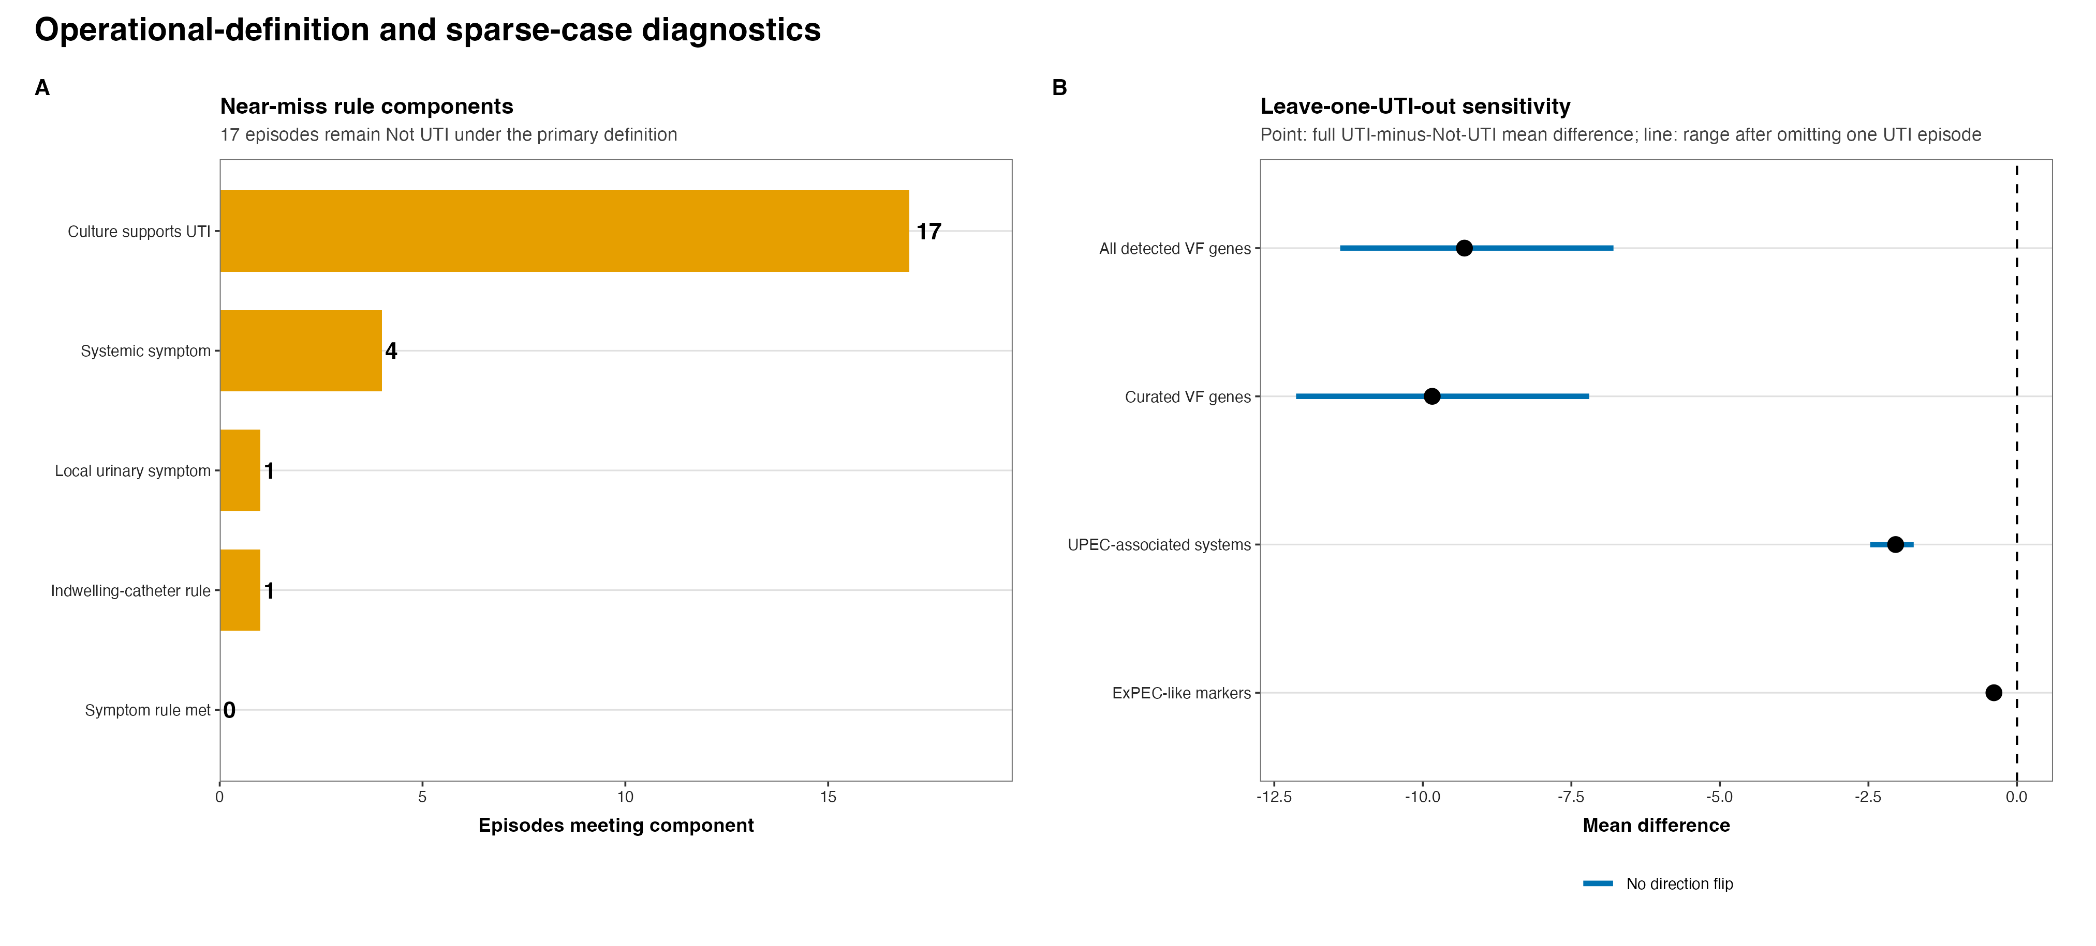
APPENDIX 5 | Near-miss and sparse precision (sensitivity analysis)
Notes:
Release source: /Users/Aamir/Desktop/rUTIs/results/pipeline/longcycler_release_claim_registry.json
Scope: selected QC-passing Longcycler assemblies only.
Clinical phenotype: versioned operational UTI phenotype.
Analytical anchors: 532 episodes; 893 direct pairs; 371 adjacent pairs; RQ01-RQ10.

Slide 19
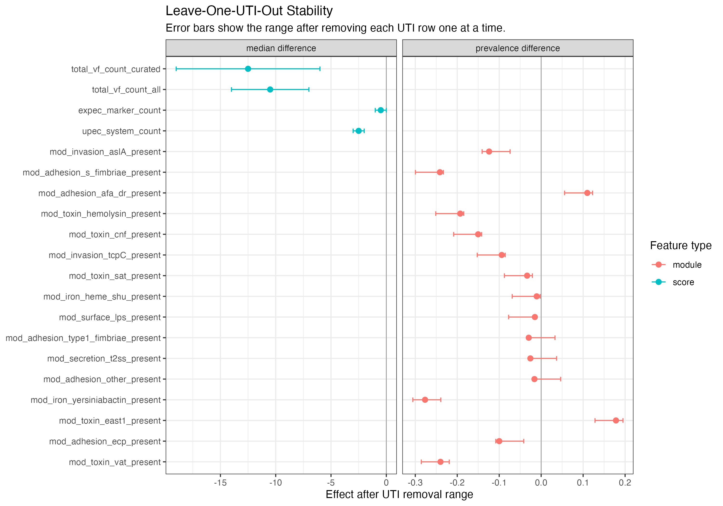
APPENDIX 6 | Leave-one-UTI-out stability (sensitivity analysis)
Notes:
Release source: /Users/Aamir/Desktop/rUTIs/results/pipeline/longcycler_release_claim_registry.json
Scope: selected QC-passing Longcycler assemblies only.
Clinical phenotype: versioned operational UTI phenotype.
Analytical anchors: 532 episodes; 893 direct pairs; 371 adjacent pairs; RQ01-RQ10.

Slide 20
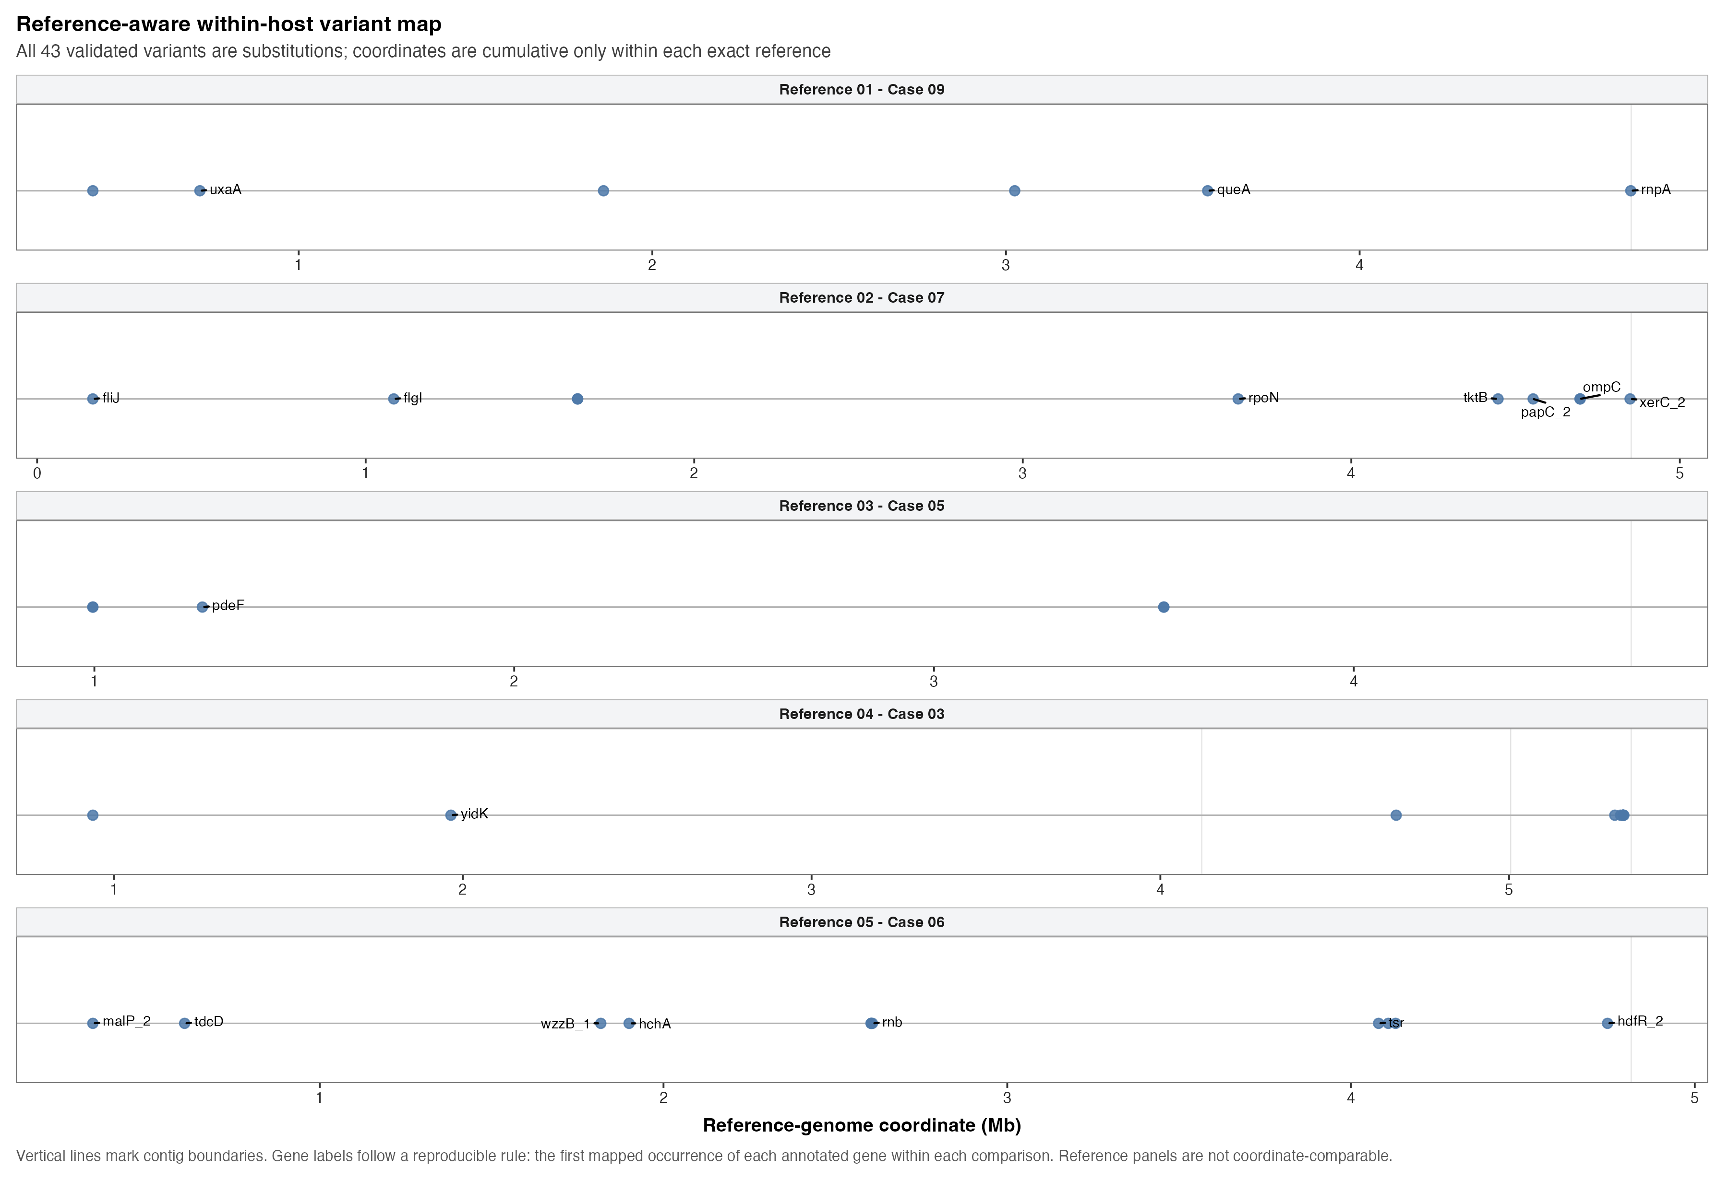
APPENDIX 7 | Prioritised variant follow-up (descriptive)
Notes:
Release source: /Users/Aamir/Desktop/rUTIs/results/pipeline/longcycler_release_claim_registry.json
Scope: selected QC-passing Longcycler assemblies only.
Clinical phenotype: versioned operational UTI phenotype.
Analytical anchors: 532 episodes; 893 direct pairs; 371 adjacent pairs; RQ01-RQ10.

Slide 21
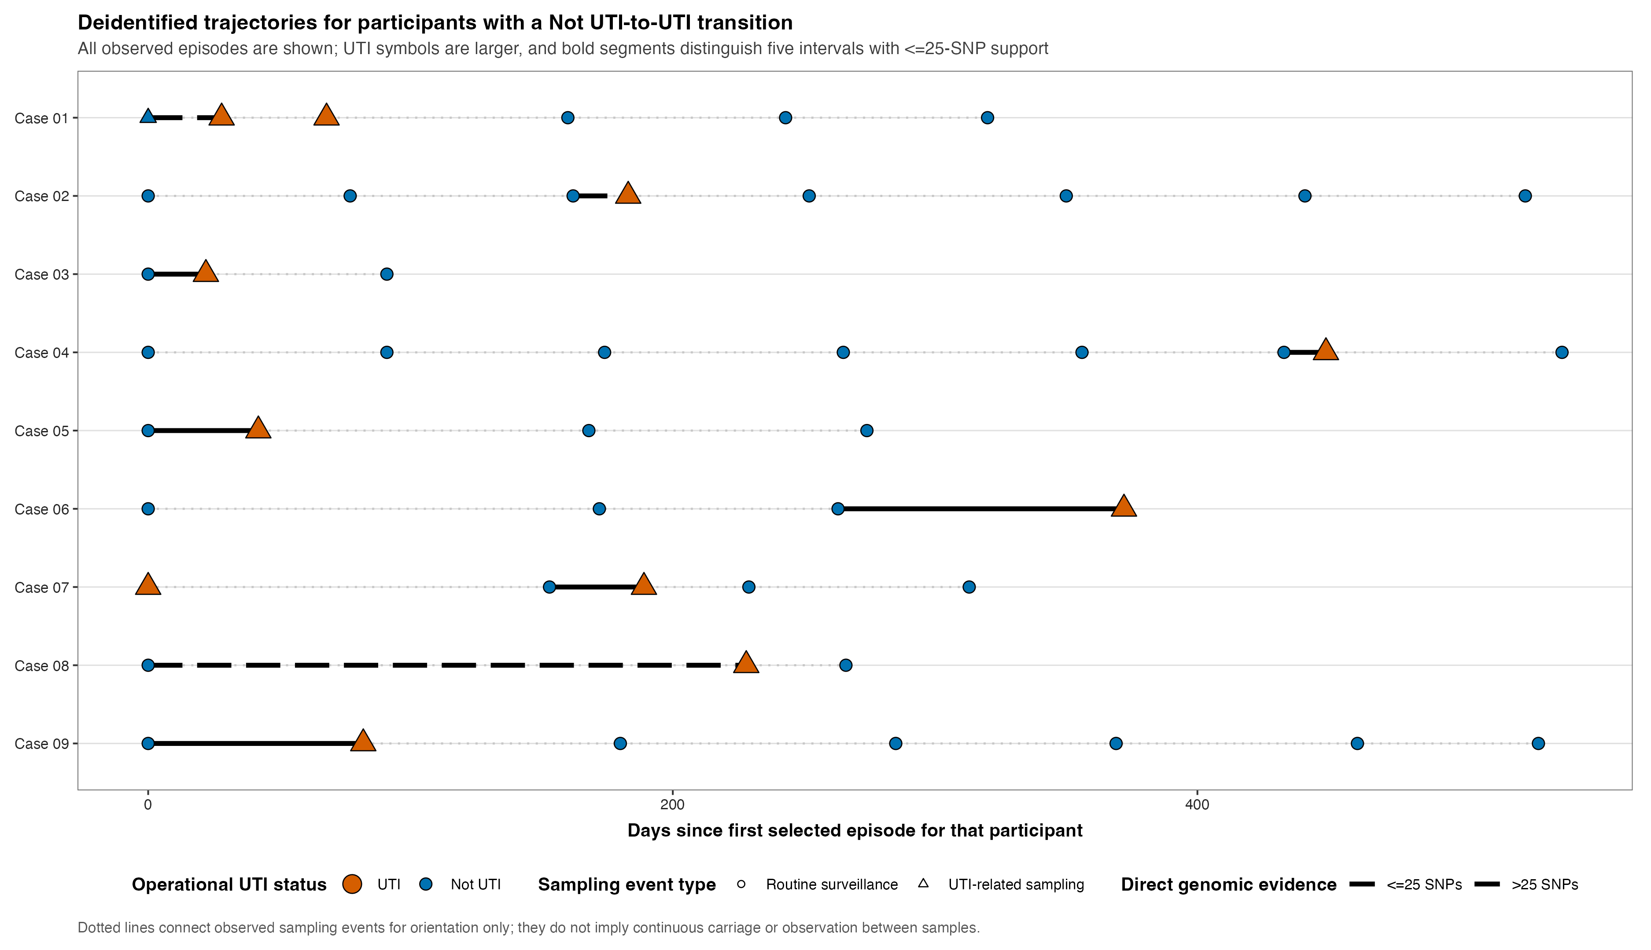
APPENDIX 8 | Full longitudinal lookup (contextual backup only)
Notes:
Release source: /Users/Aamir/Desktop/rUTIs/results/pipeline/longcycler_release_claim_registry.json
Scope: selected QC-passing Longcycler assemblies only.
Clinical phenotype: versioned operational UTI phenotype.
Analytical anchors: 532 episodes; 893 direct pairs; 371 adjacent pairs; RQ01-RQ10.

Slide 22
APPENDIX 9 | Evidence registry and interpretation guardrails
CURRENT SOURCES OF TRUTH
longcycler_release_claim_registry.json | validated claims and plot inventory
analysis_cohort_longcycler.csv | 532 selected episodes
pairwise_metrics.csv | 893 direct pairs
longcycler_transitions.csv | 371 adjacent pairs from 139 residents
not_uti_to_uti_casebook.csv | 9/9/0 cases/linked/missing
RUN_COMPLETE.txt | RQ01-RQ10 complete
GUARDRAILS | Operational UTI phenotype; Longcycler-only analytics; VF and AMR are exploratory.
Notes:
Release source: /Users/Aamir/Desktop/rUTIs/results/pipeline/longcycler_release_claim_registry.json
Scope: selected QC-passing Longcycler assemblies only.
Clinical phenotype: versioned operational UTI phenotype.
Analytical anchors: 532 episodes; 893 direct pairs; 371 adjacent pairs; RQ01-RQ10.

