Slide 1
CURRENT REVIEW / SELECTED LONGCYCLER ANALYSIS
Virulence-factor profiling of longitudinal urinary E. coli isolates
One selected QC-passing assembly per episode; operational UTI overlay remains exploratory
Question 1
Question 2
Question 3
What VF repertoire is present?
How stable are profiles over time?
How should clinical status be overlaid?
532 selected episodes; 227 binary VF features.
893 direct pairs; 371 adjacent transitions.
16 operational UTI and 516 operational Not_UTI episodes.
532
161
371
16
selected episodes
residents
adjacent transitions
operational UTI
Longcycler-only review with onboarding | operational UTI phenotype
01
Notes:
SLIDE: Title
SAY: Set the scope immediately: selected QC-passing Longcycler only.
BOUNDARY: Operational UTI is an exploratory annotation.

Slide 2
PROJECT ORIENTATION
The review follows one plain-English loop
One episode becomes one selected genome profile, then repeated profiles are compared over time.
Clinical episode
Selected genome
VF gene row
Longitudinal pair
Clinical overlay
Apply the operational clinical definition
Use the QC-passing Longcycler assembly
Record binary VF feature presence
Compare profiles within resident
Interpret status cautiously
What we measure
What we compare
Where status enters
VF gene presence/absence in each selected episode-level genome.
Repeated profiles within residents, directly and as adjacent transitions.
Only after the genomic and temporal denominators are explicit.
Longcycler-only review with onboarding | operational UTI phenotype
02
Notes:
SLIDE: Plain-English loop
SAY: Walk through episode, selected genome, VF profile, repeated pair, then clinical overlay.
BOUNDARY: Do not collapse episode, resident, pair, and transition units.

Slide 3
PROJECT ORIENTATION
Unit changes explain denominator changes
Each count answers a different question: episode, resident, profile, pair, or transition.
Source clinical episodes
583
166 residents; retained for attrition/QC only
Selected analytical episodes
532
161 residents; one selected genome per episode
Direct within-resident pairs
893
all available within-resident comparisons
Adjacent transitions
371
139 residents; 140 at or below 25 SNPs
Focused Not_UTI→UTI
9
5 at or below 25 SNPs
Always name the unit beside the count
Longcycler-only review with onboarding | operational UTI phenotype
03
Notes:
SLIDE: Denominator units
SAY: Name the unit beside every count.
BOUNDARY: Source counts are QC context only.

Slide 4
CLINICAL ANNOTATION
How an episode becomes operational UTI in this project
The operational label is a study annotation, not a universal clinical diagnosis.
1. Culture support
2. Symptom rule
The episode passes the project’s culture and isolate evidence rules.
Compatible symptoms are interpreted with the operational definition and available episode context.
Operational UTI
16 selected analytical episodes
Selected analytical denominator
Not_UTI is a mixed comparator
532 episodes: 16 operational UTI and 516 operational Not_UTI.
It means the episode did not meet the operational UTI label; it is not a single biological state.
Longcycler-only review with onboarding | operational UTI phenotype
04
Notes:
SLIDE: Operational phenotype
SAY: Explain the project’s operational UTI annotation.
BOUNDARY: Not_UTI is a mixed comparator, not a single biological state.

Slide 5
SCOPE LOCK
The analytical scope is selected QC-passing Longcycler only
Clinical status is an operational annotation; the scientific object is the repeated isolate profile.
Selected episode-level genomes
Repeated-measures design
Operational clinical overlay
532 episodes from 161 residents contribute one selected QC-passing assembly per episode. The selected manifest is the only analytical genome source.
893 direct within-resident pairs are available for broad profile comparisons. 371 adjacent transitions from 139 residents define the temporal transition layer.
16 episodes are operational UTI and 516 are operational Not_UTI. Interpret status comparisons as exploratory observational analysis; no causal claim.
No alternate assembly source enters the analytical cohort
Longcycler-only review with onboarding | operational UTI phenotype
05
Notes:
SLIDE: Scope
SAY: State the selected Longcycler-only analytical lock.
BOUNDARY: The phenotype overlay is exploratory.

Slide 6
DATA ASSET
VF-ready data link selected genomes to repeated clinical episodes
All analytical denominators are selected Longcycler outputs; source counts appear only as QC context.
532
161
227
16
516
selected episodes
residents
binary VF features
operational UTI
operational Not_UTI
Repeated-isolate design
Not_UTI
Not_UTI
Not_UTI
UTI
Not_UTI
Episode 1
Episode 2
Episode 3
Episode 4
Episode 5
Interpretation stance
Episode profiles are repeated within residents. Status comparisons must account for repeated measures, lineage structure, and the sparse operational UTI denominator.
Longcycler-only review with onboarding | operational UTI phenotype
06
Notes:
SLIDE: Selected cohort
SAY: Anchor 532 episodes, 161 residents, and the operational phenotype split.
BOUNDARY: Source clinical counts are QC context only.

Slide 7
APPENDIX / PIPELINE
Numbered clinical-to-VF pipeline with validated handoff counts
RQ01–RQ10 consume the same selected analytical cohort and current-run outputs.
1
Source/QC context
2
Selected cohort
3
Operational phenotype
4
VF feature matrix
5
MLST context
583 episodes; 166 residents
532 episodes; 161 residents
16 UTI; 516 Not_UTI
227 binary features
493 typed episodes; 76 labels
6
Direct pairs
7
Adjacent transitions
8
Focused transition view
9
Mechanism casebook
10
Research-question release
893 comparisons
371 from 139 residents
9 transitions; 5 ≤25 SNPs
9/9/0: cases/linked/missing
RQ01–RQ10; none retired
Longcycler-only review with onboarding | operational UTI phenotype
07
Notes:
SLIDE: Pipeline
SAY: Walk through the current release handoffs.
BOUNDARY: RQ01–RQ10 use the same selected cohort.

Slide 8
VF REPRESENTATION
VF features are summarised as genes, curated modules, and longitudinal similarity
Module and score outputs support interpretation; they are not validated disease-causality measures.
Binary VF gene matrix
Curated biological modules
Longitudinal outputs
227 presence/absence features per selected episode-level genome.
Genes are grouped to make repertoire patterns navigable without changing the underlying binary evidence.
Prevalence, Jaccard similarity, gain/loss summaries, and exploratory clinical overlays.
Adhesion
Iron acquisition
Interpretation caution
Secretion
Toxin
Gene presence does not establish expression, activity, disease mechanism, or a causal clinical-state effect.
Capsule
Unassigned
Descriptive feature framework
Longcycler-only review with onboarding | operational UTI phenotype
08
Notes:
SLIDE: VF representation
SAY: Explain the descriptive feature framework.
BOUNDARY: Presence/absence is not expression.

Slide 9
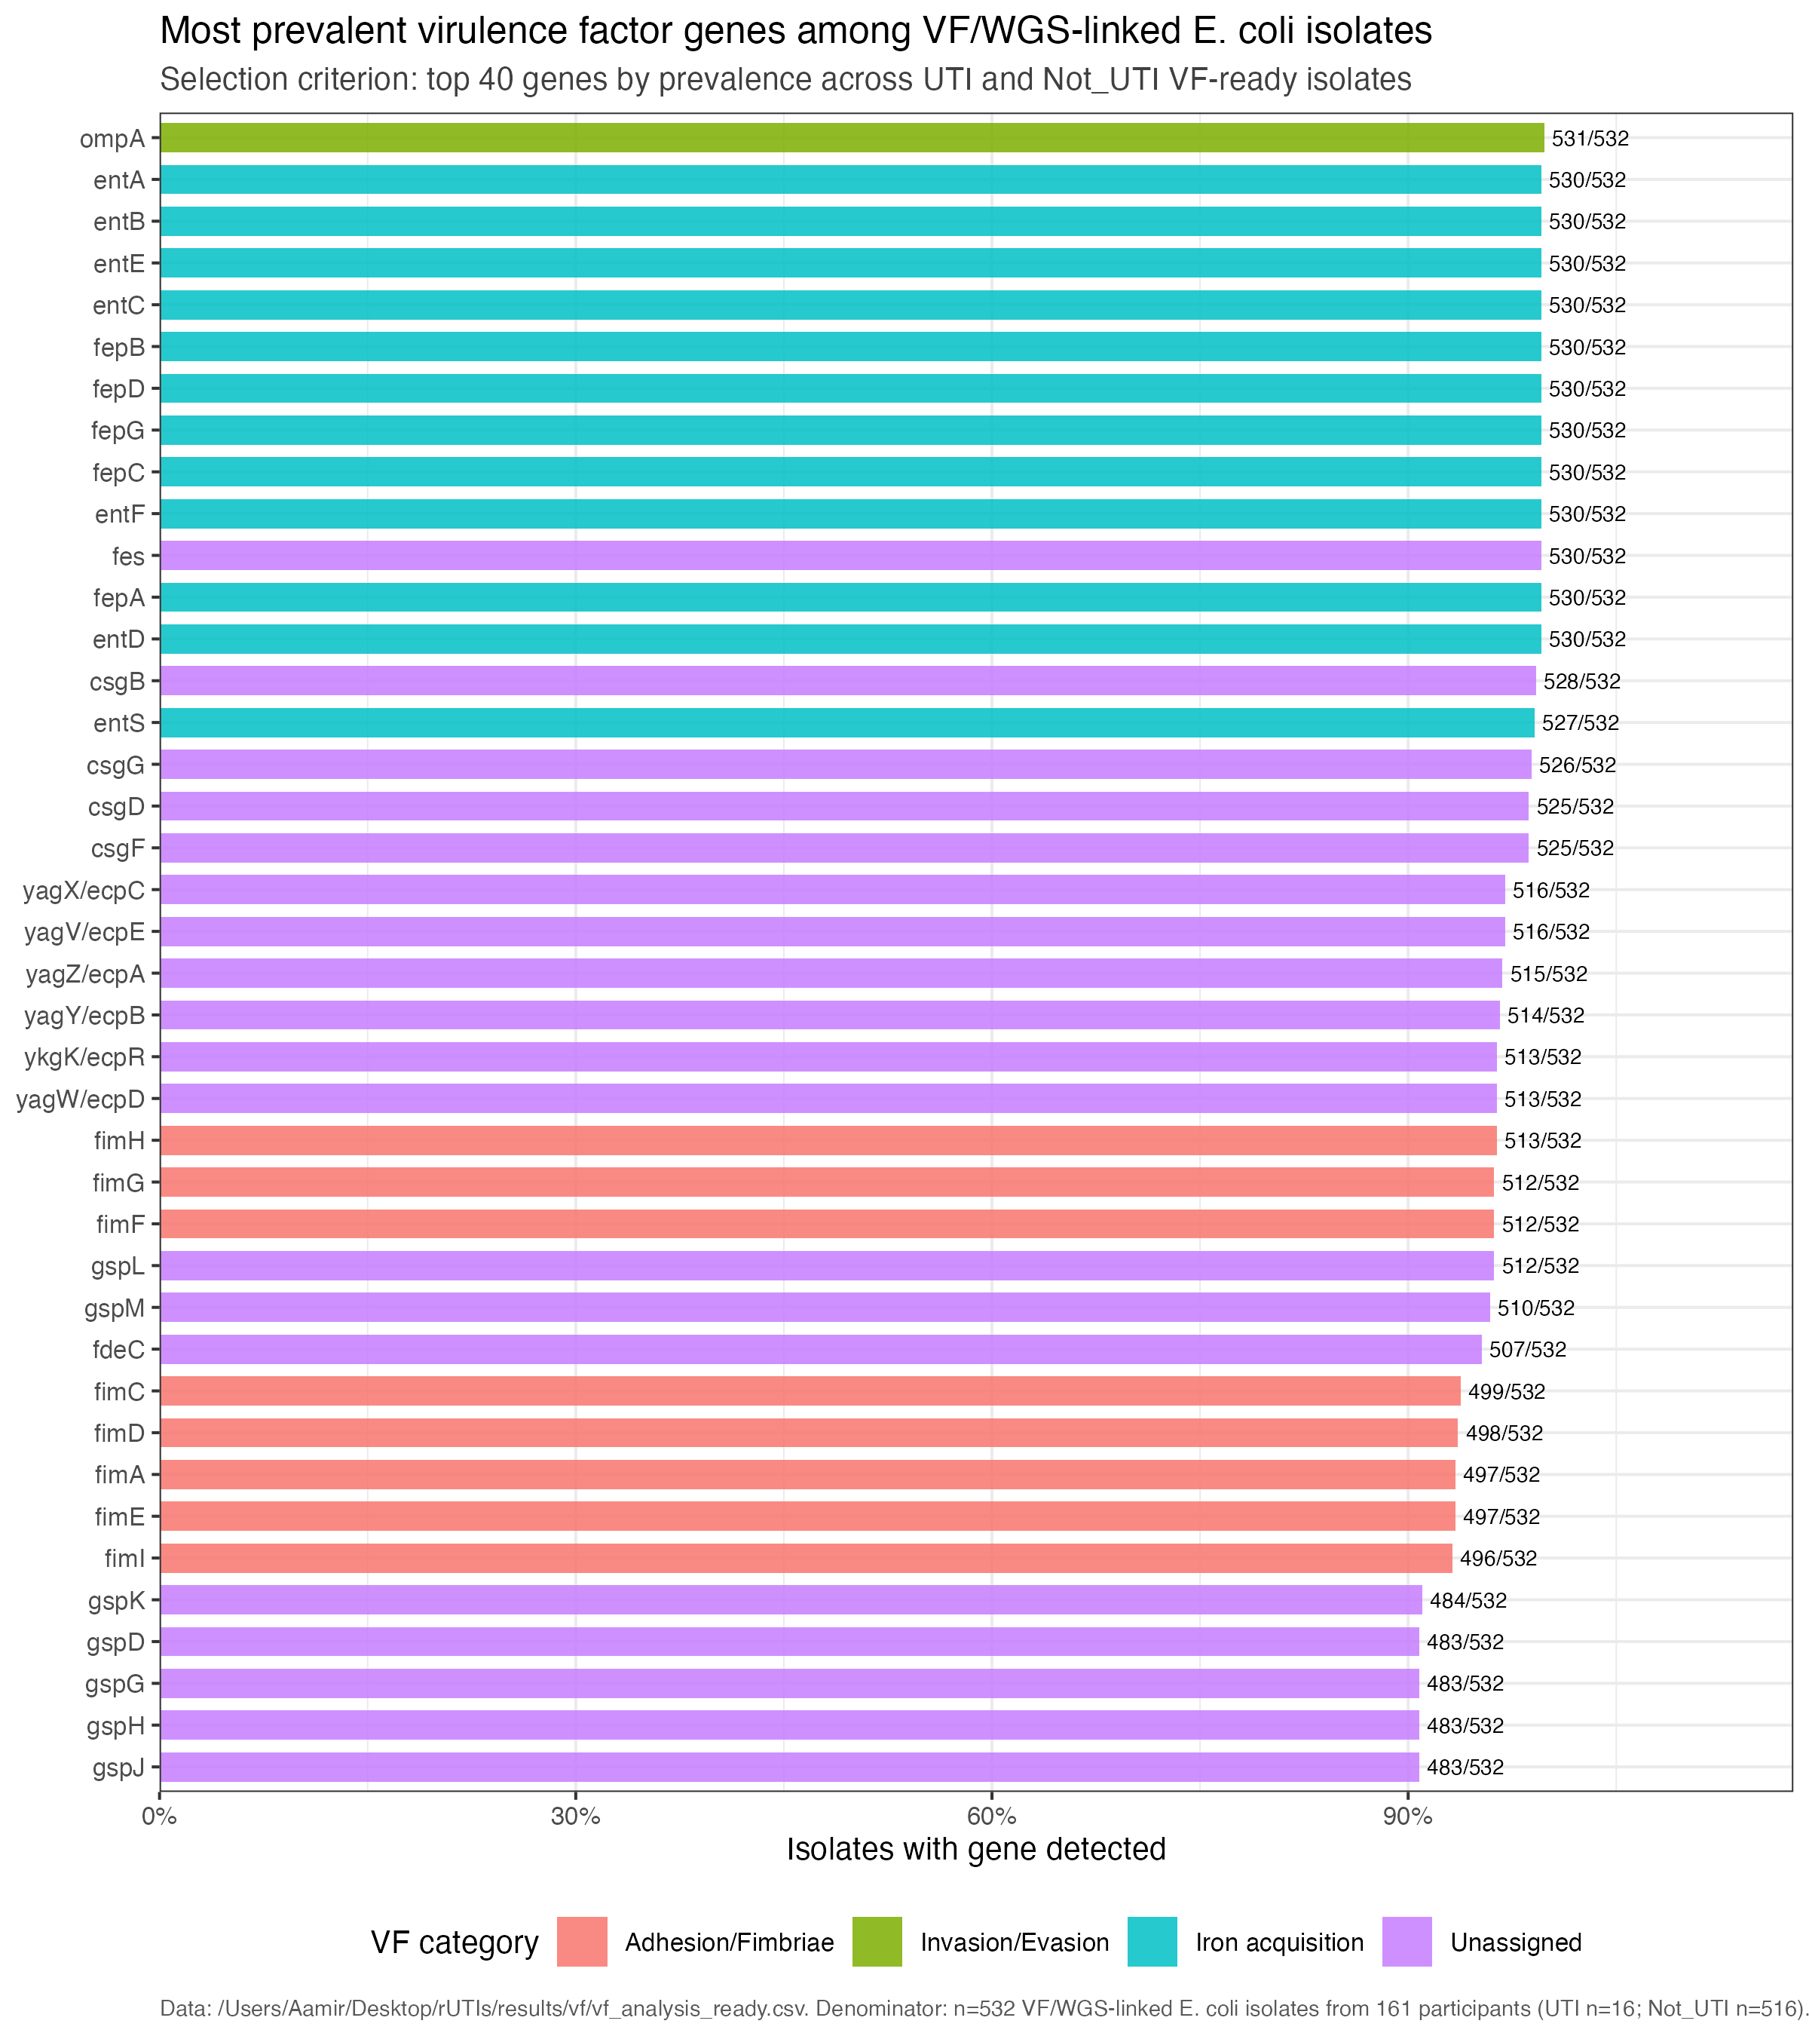
VF REPERTOIRE
Common VF genes describe the observed repertoire, not disease association
Prevalence across 532 selected episode-level genomes.
Read as
Descriptive prevalence ranking only. Gene presence does not imply expression, activity, or UTI association.
Descriptive
Longcycler-only review with onboarding | operational UTI phenotype
09
Notes:
SLIDE: VF repertoire
SAY: Read the top-gene ranking descriptively.
BOUNDARY: Do not infer clinical association.

Slide 10
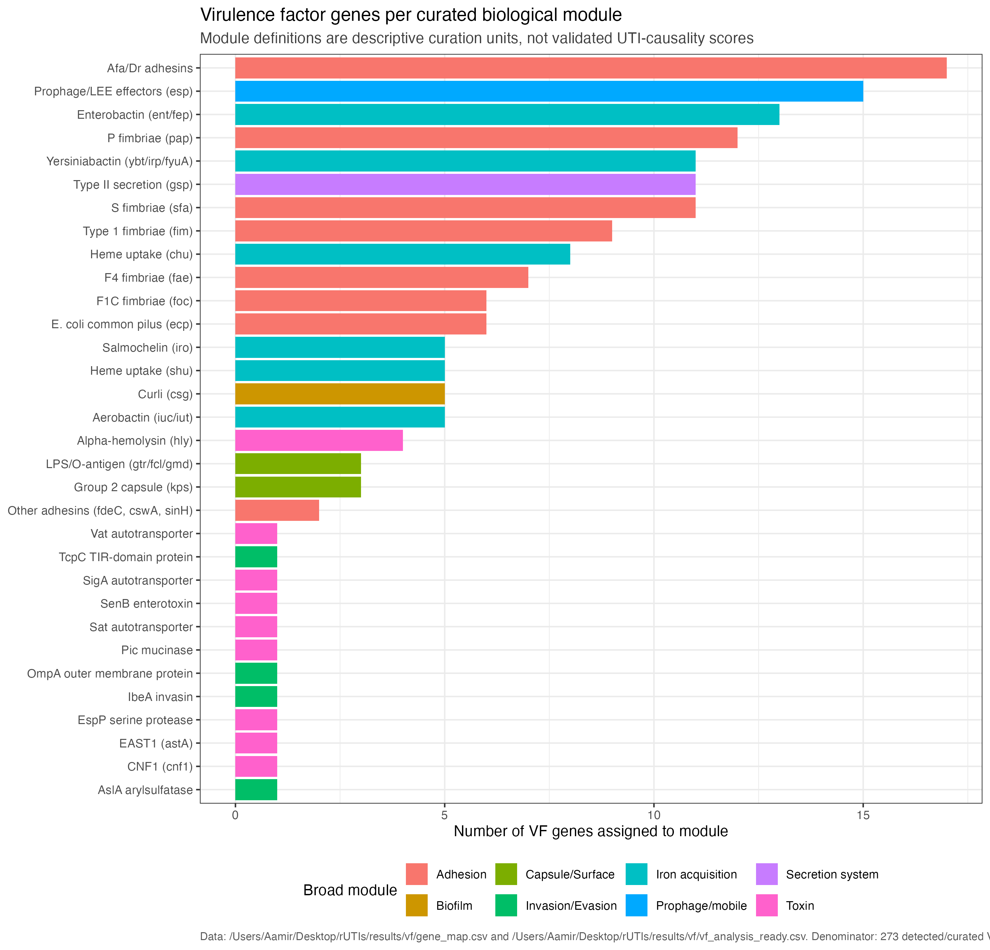
VF FRAMEWORK
Curated modules organise genes into interpretable biological systems
Modules are navigation units; they are not validated disease-causality scores.
Why it matters
The module framework structures descriptive repertoire and longitudinal summaries while retaining the binary gene evidence.
Longcycler-only review with onboarding | operational UTI phenotype
10
Notes:
SLIDE: VF modules
SAY: Use modules for navigation.
BOUNDARY: Modules are not validated disease scores.

Slide 11
LONGITUDINAL DENOMINATOR
Direct pairs and adjacent transitions answer different questions
The transition layer is temporally ordered; the direct-pair layer describes the wider repeated-isolate network.
893
371
139
all direct within-resident pairs
adjacent transitions
residents with adjacent transitions
Broad profile question
Temporal transition question
Genome-distance context
Use all direct pairs to describe how similar episode-level VF profiles are across the available within-resident history.
Use adjacent transitions when asking what changed between successive observed episodes.
140 of 371 adjacent transitions are at or below the operational 25-SNP threshold.
Longcycler-only review with onboarding | operational UTI phenotype
11
Notes:
SLIDE: Pair layers
SAY: Separate 893 direct pairs from 371 adjacent transitions.
BOUNDARY: Name the unit beside each count.

Slide 12
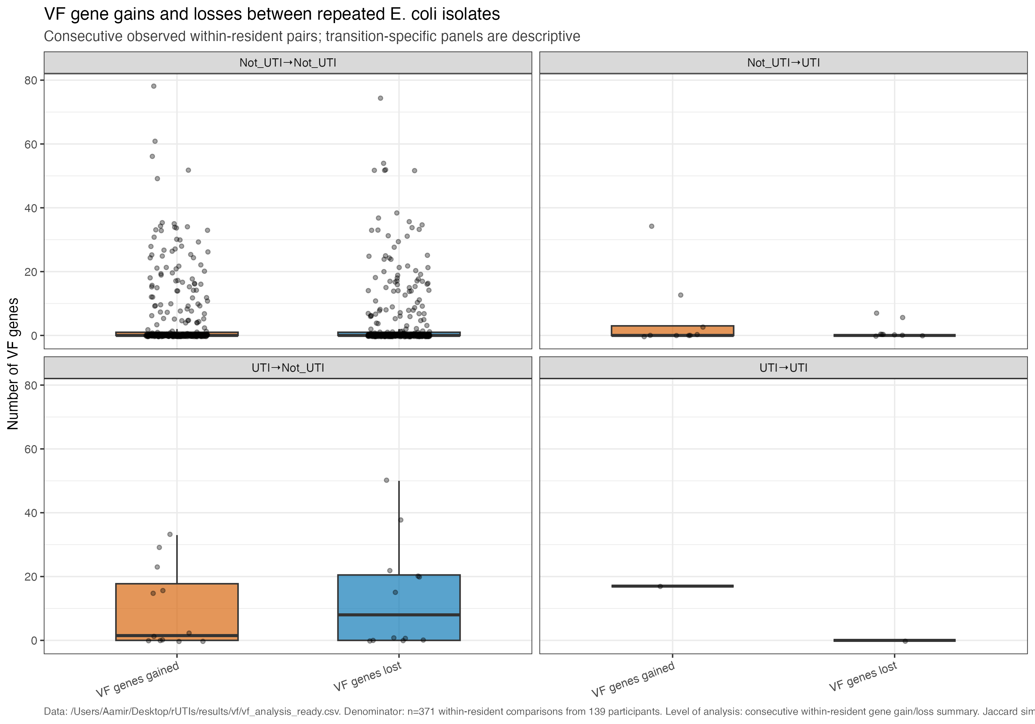
LONGITUDINAL CHANGE
Gain/loss summaries flag candidates for follow-up
Observed changes are reported on 371 adjacent transitions and require lineage plus genome-distance context.
Caution
Change may reflect lineage replacement, calling differences, or true gene-content change.
Longcycler-only review with onboarding | operational UTI phenotype
12
Notes:
SLIDE: Gain/loss
SAY: Show adjacent-transition change candidates.
BOUNDARY: Changes need lineage and QC context.

Slide 13
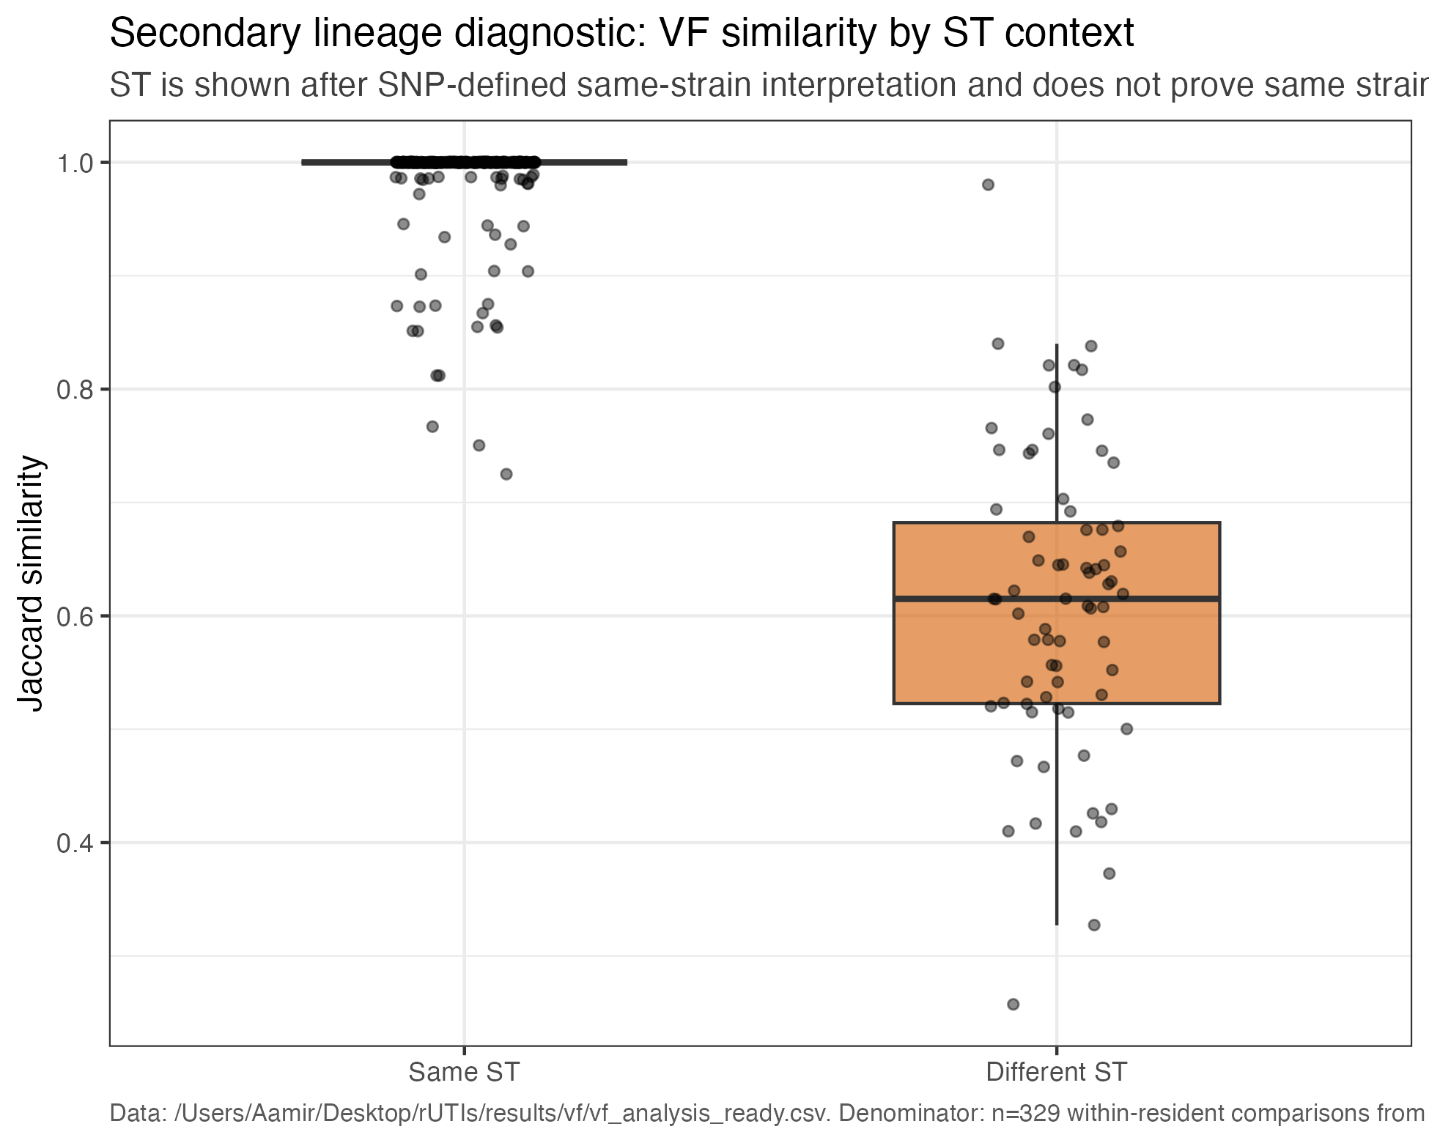
LINEAGE CONTEXT
Sequence-type context helps interpret VF similarity
493 selected episodes have preferred MLST labels spanning 76 distinct labels.
Diagnostic use
ST agreement is context, not proof of the same strain. Pairwise genome distance remains essential.
Longcycler-only review with onboarding | operational UTI phenotype
13
Notes:
SLIDE: Lineage
SAY: Use MLST as contextual evidence.
BOUNDARY: ST agreement is not proof of the same strain.

Slide 14
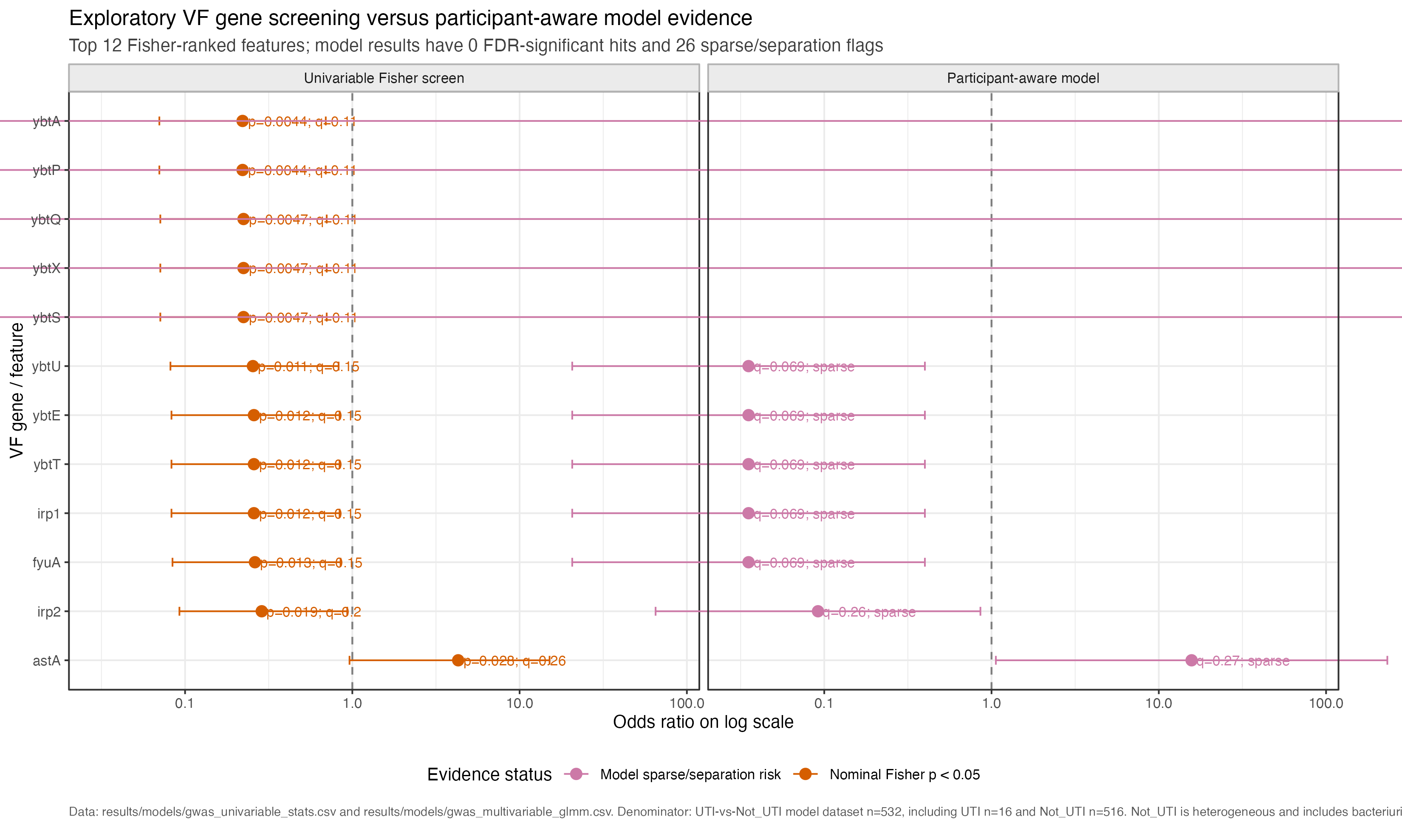
CLINICAL ANNOTATION
Clinical-status VF signals remain exploratory
16 operational UTI and 516 operational Not_UTI selected episodes; no causal interpretation.
Safe claim
Nominal screens and model diagnostics generate hypotheses; they do not establish a robust status association.
Exploratory overlay
Longcycler-only review with onboarding | operational UTI phenotype
14
Notes:
SLIDE: Clinical overlay
SAY: Keep 16 operational UTI and 516 Not_UTI visible.
BOUNDARY: Exploratory observational analysis only.

Slide 15
CLINICAL TRANSITION APPLICATION
Focused transition evidence is aggregate, linked, and deliberately cautious
The release reports the full focused casebook; it does not elevate one anecdote into a mechanism claim.
Focused Not_UTI→UTI transitions
At or below 25 SNPs
Mechanism casebook
5 of 9 focused transitions fall at or below the operational genome-distance threshold.
9 cases; 9 linked; 0 missing endpoints.
9 adjacent transitions enter the focused clinical-transition view.
Interpretation boundary
Low genome distance and stable VF content can support a stable-lineage interpretation, but they cannot by themselves identify host-state change, bacterial regulation, or clinical causation.
Longcycler-only review with onboarding | operational UTI phenotype
15
Notes:
SLIDE: Focused transitions
SAY: Report the aggregate focused transition evidence.
BOUNDARY: Avoid anecdotal mechanism claims.

Slide 16
CLOSE
What the Longcycler-only review establishes and what remains uncertain
Use these as the three discussion anchors.
Evidence
Boundary
Next steps
532 selected profiles from 161 residents support 893 direct comparisons and 371 adjacent transitions. The mechanism casebook is complete (9/9 linked).
Operational UTI is sparse (16/532). VF presence/absence does not measure expression, regulation, pathogenic activity, or a causal clinical-state effect.
Prioritise lineage-aware longitudinal analyses, targeted transition review, and additional evidence that can separate bacterial change from host-state and sampling effects.
Discussion: what extra evidence would distinguish stable carriage plus host-state change from unmeasured bacterial regulation?
Longcycler-only review with onboarding | operational UTI phenotype
16
Notes:
SLIDE: Close
SAY: Land on evidence, boundary, and next steps.
BOUNDARY: Do not cross the causal boundary.

Slide 17
APPENDIX / HANDOVER
Practical map: where to enter and rerun the Longcycler-only pipeline
The numbered research-question layer runs from RQ01 through RQ10.
Selected manifest
results/assembly/canonical_assembly_selection.csv
One QC-passing Longcycler assembly per episode
Clinical key
results/clinical/status_map.csv
Operational UTI annotation and audit fields
VF matrix
results/vf/vf_pa_all.csv
Episode-level binary VF profiles
Direct pairs
results/strain/pairwise_metrics.csv
All within-resident comparisons
Adjacent transitions
results/longitudinal/longcycler_transitions.csv
Temporally ordered comparisons
Focused casebook
results/mechanism/not_uti_to_uti_casebook.csv
Nine linked transition cases
Research questions
scripts/research_questions/run_all.R
RQ01–RQ10 release layer
Longcycler-only review with onboarding | operational UTI phenotype
17
Notes:
SLIDE: Handover
SAY: Show the practical entry points.
BOUNDARY: The research-question layer is RQ01–RQ10.

Slide 18
PROJECT ORIENTATION
Unit changes explain denominator changes
Each count answers a different question: episode, resident, profile, pair, or transition.
Source clinical episodes
583
166 residents; retained for attrition/QC only
Selected analytical episodes
532
161 residents; one selected genome per episode
Direct within-resident pairs
893
all available within-resident comparisons
Adjacent transitions
371
139 residents; 140 at or below 25 SNPs
Focused Not_UTI→UTI
9
5 at or below 25 SNPs
Always name the unit beside the count
Longcycler-only review with onboarding | operational UTI phenotype
18
Notes:
SLIDE: Denominator audit
SAY: Explain that 583/166/18/565 is source/QC context only.
BOUNDARY: Analytical claims use 532/161/16/516.

Slide 19
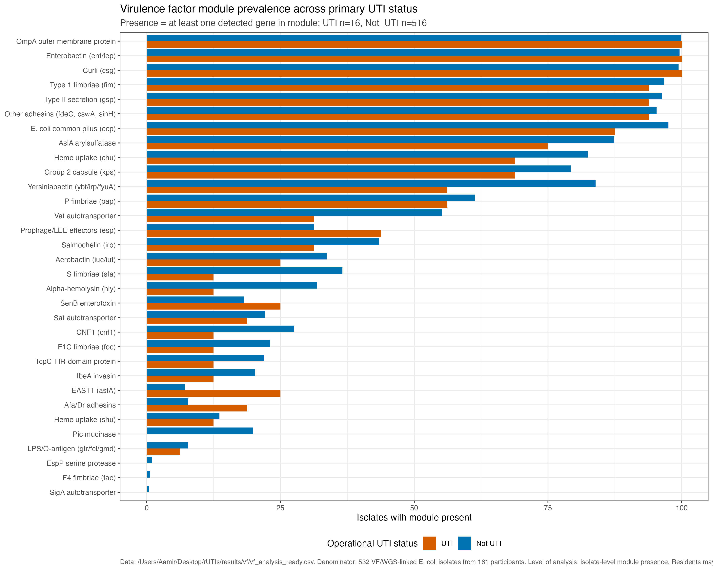
APPENDIX / CLINICAL ANNOTATION
Module prevalence by status is an exploratory annotation view
Operational phenotype denominator: 16 UTI and 516 Not_UTI selected episodes.
Label
Exploratory clinical annotation.
Longcycler-only review with onboarding | operational UTI phenotype
19
Notes:
SLIDE: Module prevalence
SAY: Use only as an exploratory status view.
BOUNDARY: Repeated measures and lineage remain interpretive limits.

Slide 20
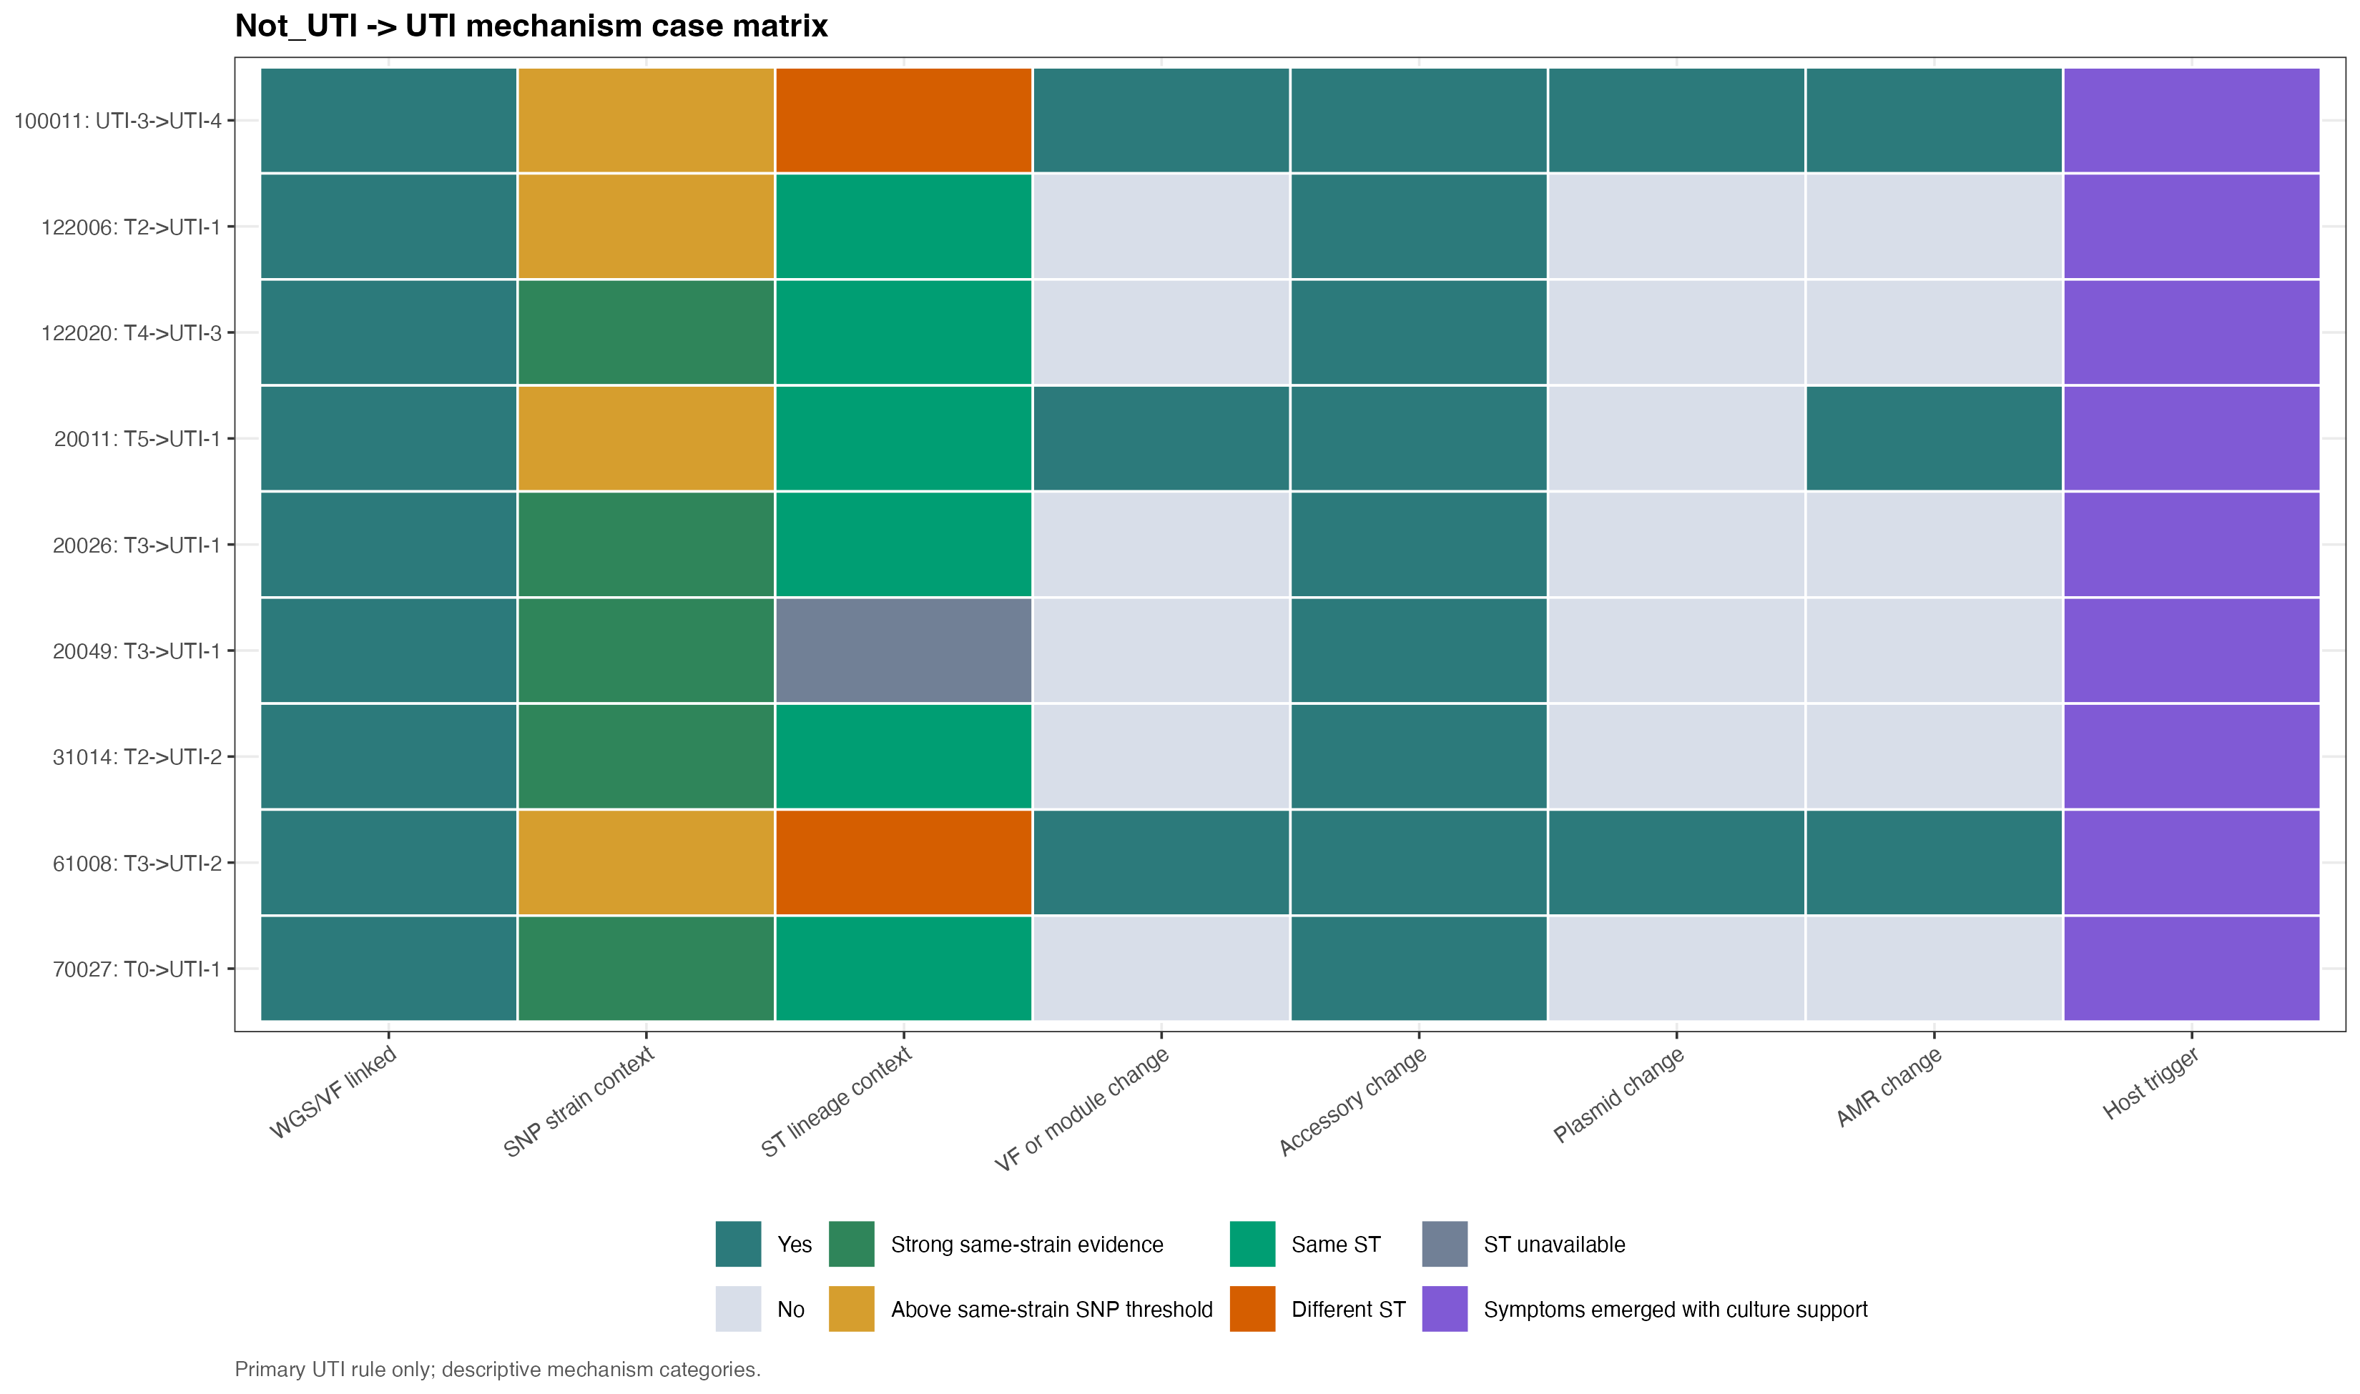
APPENDIX / TRANSITION EVIDENCE
Full focused transition mechanism casebook
9 cases; 9 linked; 0 missing. Buckets organise evidence, not proof.
Longcycler-only review with onboarding | operational UTI phenotype
20
Notes:
SLIDE: Casebook
SAY: Use the full nine-case linked casebook.
BOUNDARY: Casebook buckets do not prove mechanism.

Slide 21
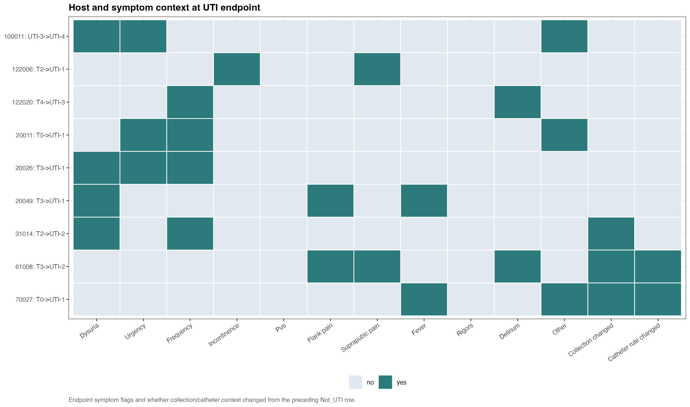
APPENDIX / STABLE-STATE CONTEXT
Stable strain and changing clinical state
5 of 9 focused transitions are at or below 25 SNPs.
Longcycler-only review with onboarding | operational UTI phenotype
21
Notes:
SLIDE: Stable-state context
SAY: Use low distance and stable VF as supporting evidence.
BOUNDARY: Do not claim host-state mechanism from genomic stability alone.

Slide 22
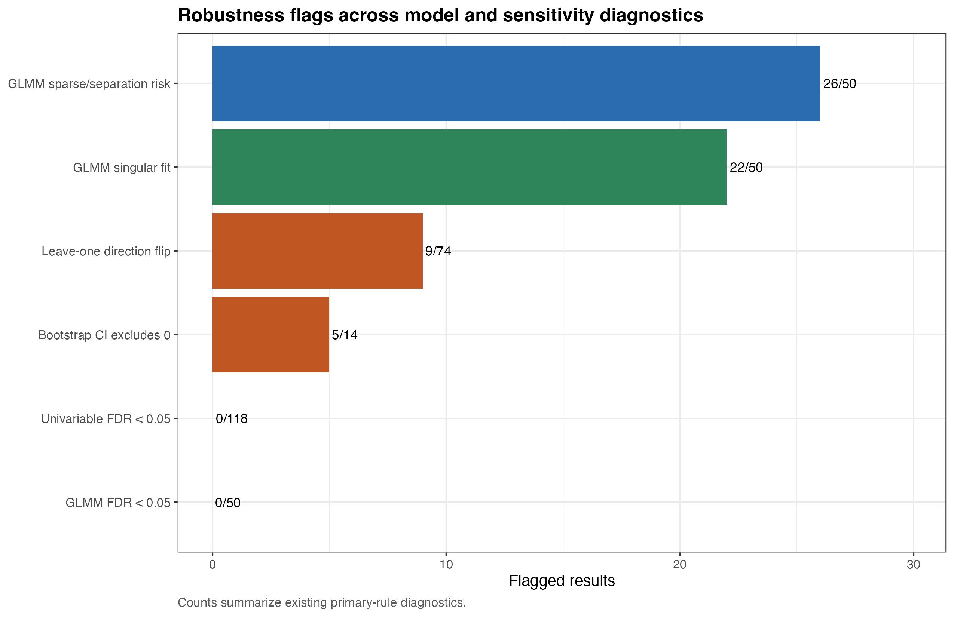
APPENDIX / ROBUSTNESS
Population-level robustness boundary
16 operational UTI episodes limit adjusted inference; the 17-row near-miss audit is separate.
Longcycler-only review with onboarding | operational UTI phenotype
22
Notes:
SLIDE: Robustness
SAY: Keep the sparse operational phenotype denominator explicit.
BOUNDARY: Near-miss rows are not operational UTI cases.

Slide 23
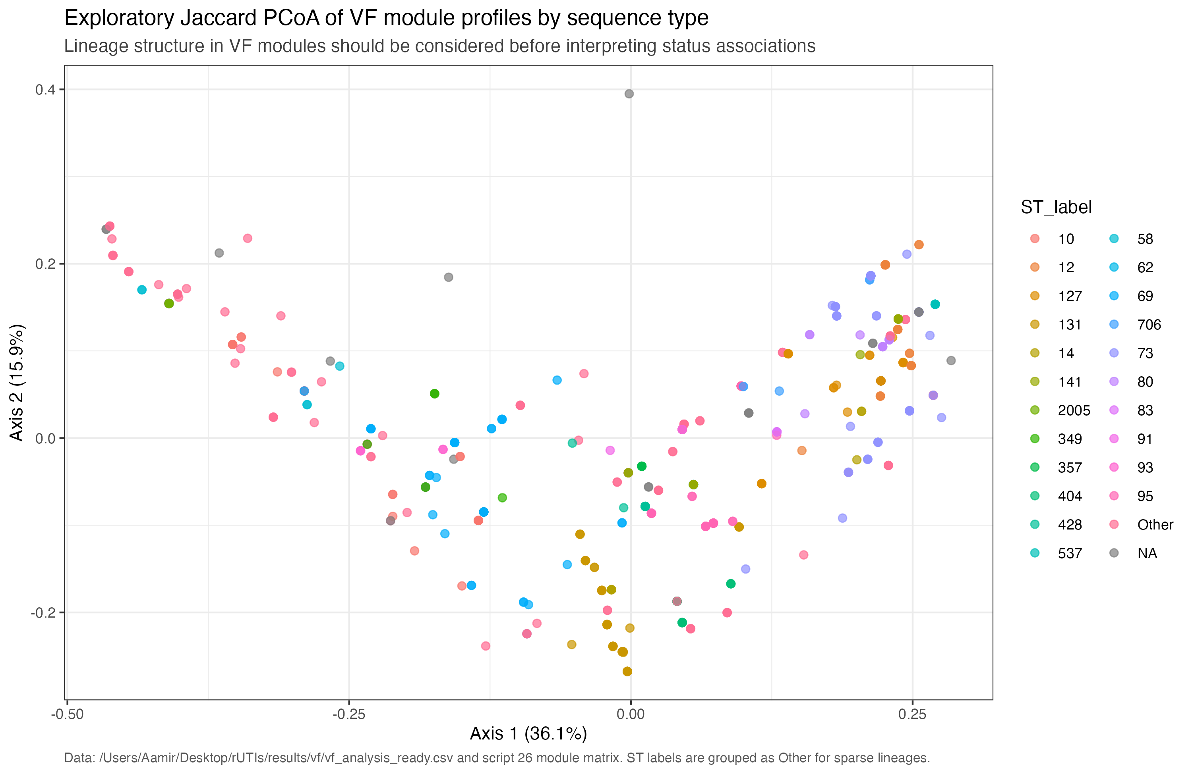
APPENDIX / LINEAGE
Lineage structure is an interpretation check
Virulence-factor profile PCoA by preferred sequence-type label.
Use for
Questions about lineage structure and VF clustering.
Longcycler-only review with onboarding | operational UTI phenotype
23
Notes:
SLIDE: Lineage PCoA
SAY: Use as a diagnostic check before status interpretation.
BOUNDARY: Clustering does not establish causality.

Slide 24
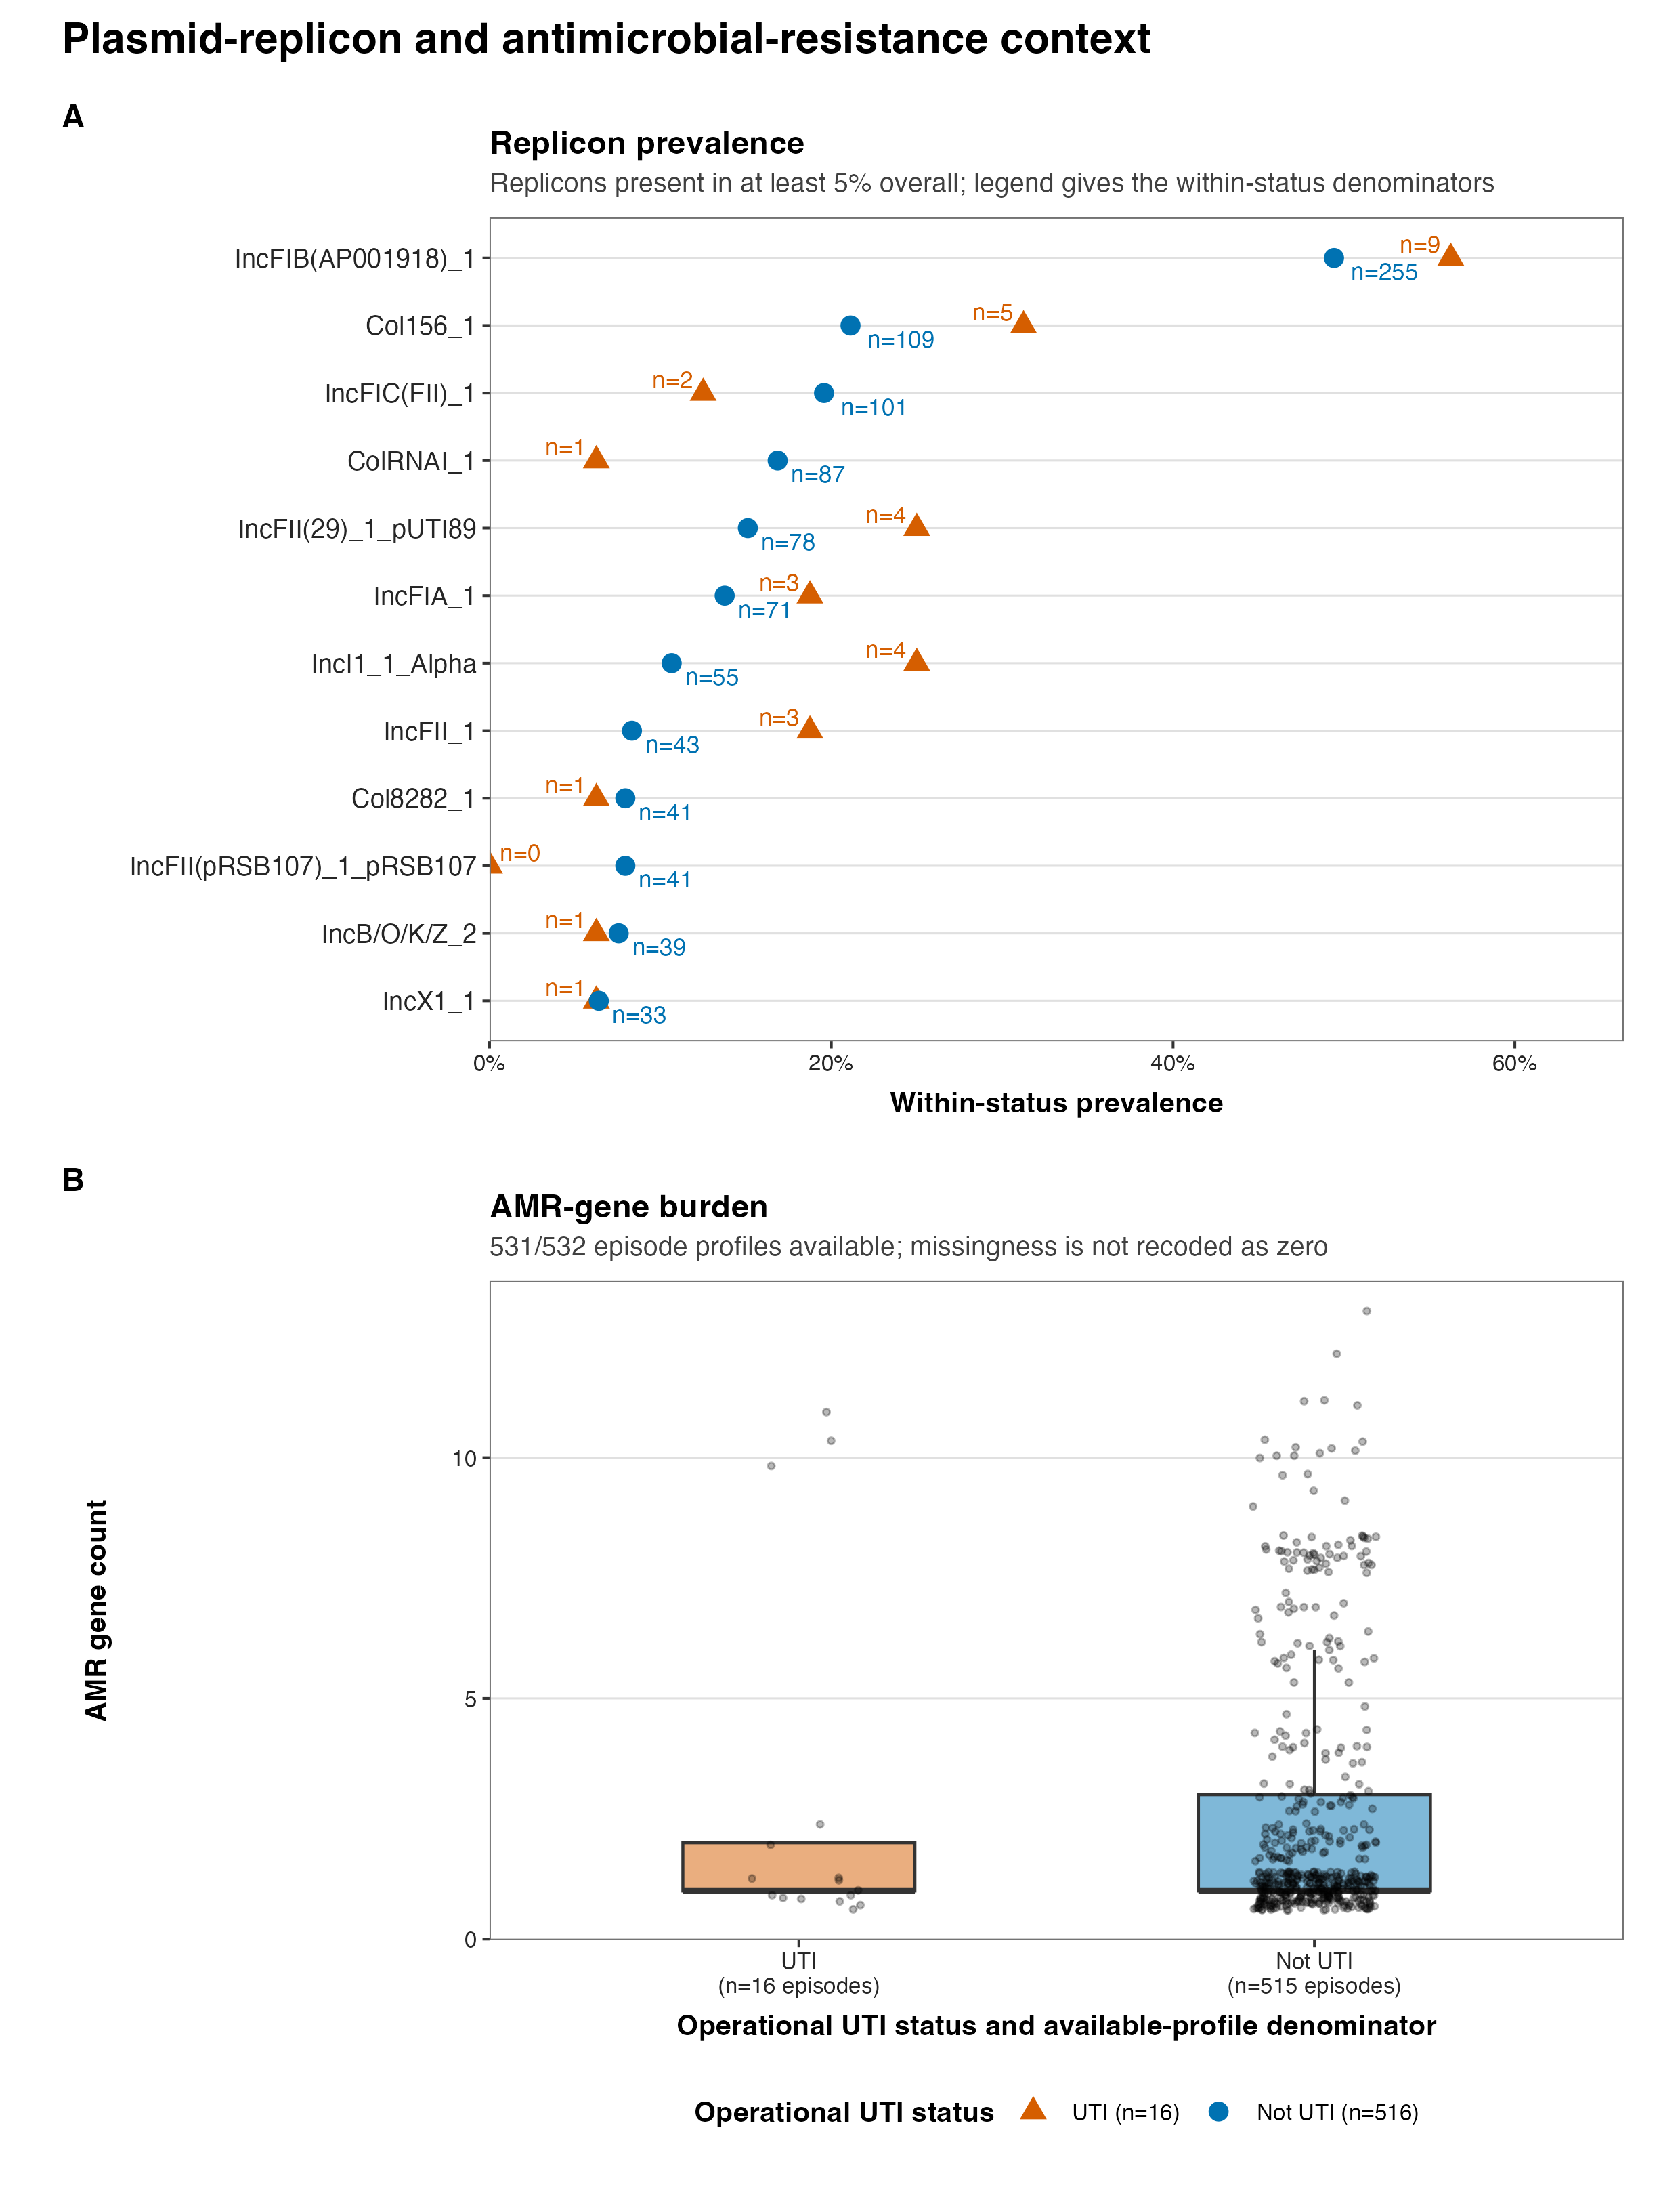
APPENDIX / ACCESSORY CONTEXT
Accessory and mobile-element context remains secondary
Use only when it helps interpret a transition; this review does not make a dedicated AMR or causal accessory claim.
Guardrail
No dedicated AMR association claim. No causal interpretation. Use transition-level context only.
Longcycler-only review with onboarding | operational UTI phenotype
24
Notes:
SLIDE: Accessory context
SAY: Keep accessory information in a supporting role.
BOUNDARY: No dedicated AMR or causal claim.

Slide 25
APPENDIX / EVIDENCE REGISTRY
Sources of truth and lookup resources for questions
Counts and plots are bound to the current Longcycler release claim registry.
Release claim registry
/Users/Aamir/Desktop/rUTIs/results/pipeline/longcycler_release_claim_registry.json
Registry SHA-256
87f65979259a4c92545afbb74b5d3a8efffb8a3d18cd2481df165b97e5c6d30e
Selected cohort
532 episodes / 161 residents / 16 UTI / 516 Not_UTI
Pair layers
893 direct pairs; 371 adjacent transitions from 139 residents
Focused casebook
9 transitions; 5 ≤25 SNPs; 9/9/0 cases/linked/missing
Near-miss audit
17 rows; separate from operational UTI cases
Research questions
RQ01–RQ10
583/166/18/565 is attrition/QC context only
Longcycler-only review with onboarding | operational UTI phenotype
25
Notes:
SLIDE: Sources
SAY: Use the claim registry for provenance.
BOUNDARY: All analytical claims use the selected cohort.

