Slide 1
CURRENT REVIEW / SELECTED LONGCYCLER ANALYSIS
Virulence-factor profiling of longitudinal urinary E. coli isolates
One selected QC-passing assembly per episode; operational UTI overlay remains exploratory
Question 1
Question 2
Question 3
What VF repertoire is present?
How stable are profiles over time?
How should clinical status be overlaid?
532 selected episodes; 227 binary VF features.
893 direct pairs; 371 adjacent transitions.
16 operational UTI and 516 operational Not_UTI episodes.
532
161
371
16
selected episodes
residents
adjacent transitions
operational UTI
Longcycler-only compact onboarding | operational UTI phenotype
01
Notes:
SLIDE: Title
SAY: Set the scope immediately: selected QC-passing Longcycler only.
BOUNDARY: Operational UTI is an exploratory annotation.

Slide 2
PROJECT ORIENTATION
The review follows one plain-English loop
One episode becomes one selected genome profile, then repeated profiles are compared over time.
Clinical episode
Selected genome
VF gene row
Longitudinal pair
Clinical overlay
Apply the operational clinical definition
Use the QC-passing Longcycler assembly
Record binary VF feature presence
Compare profiles within resident
Interpret status cautiously
What we measure
What we compare
Where status enters
VF gene presence/absence in each selected episode-level genome.
Repeated profiles within residents, directly and as adjacent transitions.
Only after the genomic and temporal denominators are explicit.
Longcycler-only compact onboarding | operational UTI phenotype
02
Notes:
SLIDE: Plain-English loop
SAY: Orient the audience before showing analytical plots.
BOUNDARY: Keep the selected assembly and operational phenotype explicit.

Slide 3
PROJECT ORIENTATION
Unit changes explain denominator changes
Each count answers a different question: episode, resident, profile, pair, or transition.
Source clinical episodes
583
166 residents; retained for attrition/QC only
Selected analytical episodes
532
161 residents; one selected genome per episode
Direct within-resident pairs
893
all available within-resident comparisons
Adjacent transitions
371
139 residents; 140 at or below 25 SNPs
Focused Not_UTI→UTI
9
5 at or below 25 SNPs
Always name the unit beside the count
Longcycler-only compact onboarding | operational UTI phenotype
03
Notes:
SLIDE: Units
SAY: Explain why counts change when the unit changes.
BOUNDARY: 583 source episodes are attrition/QC context only.

Slide 4
CLINICAL ANNOTATION
How an episode becomes operational UTI in this project
The operational label is a study annotation, not a universal clinical diagnosis.
1. Culture support
2. Symptom rule
The episode passes the project’s culture and isolate evidence rules.
Compatible symptoms are interpreted with the operational definition and available episode context.
Operational UTI
16 selected analytical episodes
Selected analytical denominator
Not_UTI is a mixed comparator
532 episodes: 16 operational UTI and 516 operational Not_UTI.
It means the episode did not meet the operational UTI label; it is not a single biological state.
Longcycler-only compact onboarding | operational UTI phenotype
04
Notes:
SLIDE: Operational phenotype
SAY: Define how the project labels episodes.
BOUNDARY: The label is not a universal clinical diagnosis.

Slide 5
DATA ASSET
VF-ready data link selected genomes to repeated clinical episodes
All analytical denominators are selected Longcycler outputs; source counts appear only as QC context.
532
161
227
16
516
selected episodes
residents
binary VF features
operational UTI
operational Not_UTI
Repeated-isolate design
Not_UTI
Not_UTI
Not_UTI
UTI
Not_UTI
Episode 1
Episode 2
Episode 3
Episode 4
Episode 5
Interpretation stance
Episode profiles are repeated within residents. Status comparisons must account for repeated measures, lineage structure, and the sparse operational UTI denominator.
Longcycler-only compact onboarding | operational UTI phenotype
05
Notes:
SLIDE: Selected cohort
SAY: Anchor the analytical denominator.
BOUNDARY: All analytical genome content comes from selected Longcycler outputs.

Slide 6
VF REPRESENTATION
VF features are summarised as genes, curated modules, and longitudinal similarity
Module and score outputs support interpretation; they are not validated disease-causality measures.
Binary VF gene matrix
Curated biological modules
Longitudinal outputs
227 presence/absence features per selected episode-level genome.
Genes are grouped to make repertoire patterns navigable without changing the underlying binary evidence.
Prevalence, Jaccard similarity, gain/loss summaries, and exploratory clinical overlays.
Adhesion
Iron acquisition
Interpretation caution
Secretion
Toxin
Gene presence does not establish expression, activity, disease mechanism, or a causal clinical-state effect.
Capsule
Unassigned
Descriptive feature framework
Longcycler-only compact onboarding | operational UTI phenotype
06
Notes:
SLIDE: VF representation
SAY: Explain genes, modules, and longitudinal summaries.
BOUNDARY: Presence/absence is not expression or function.

Slide 7
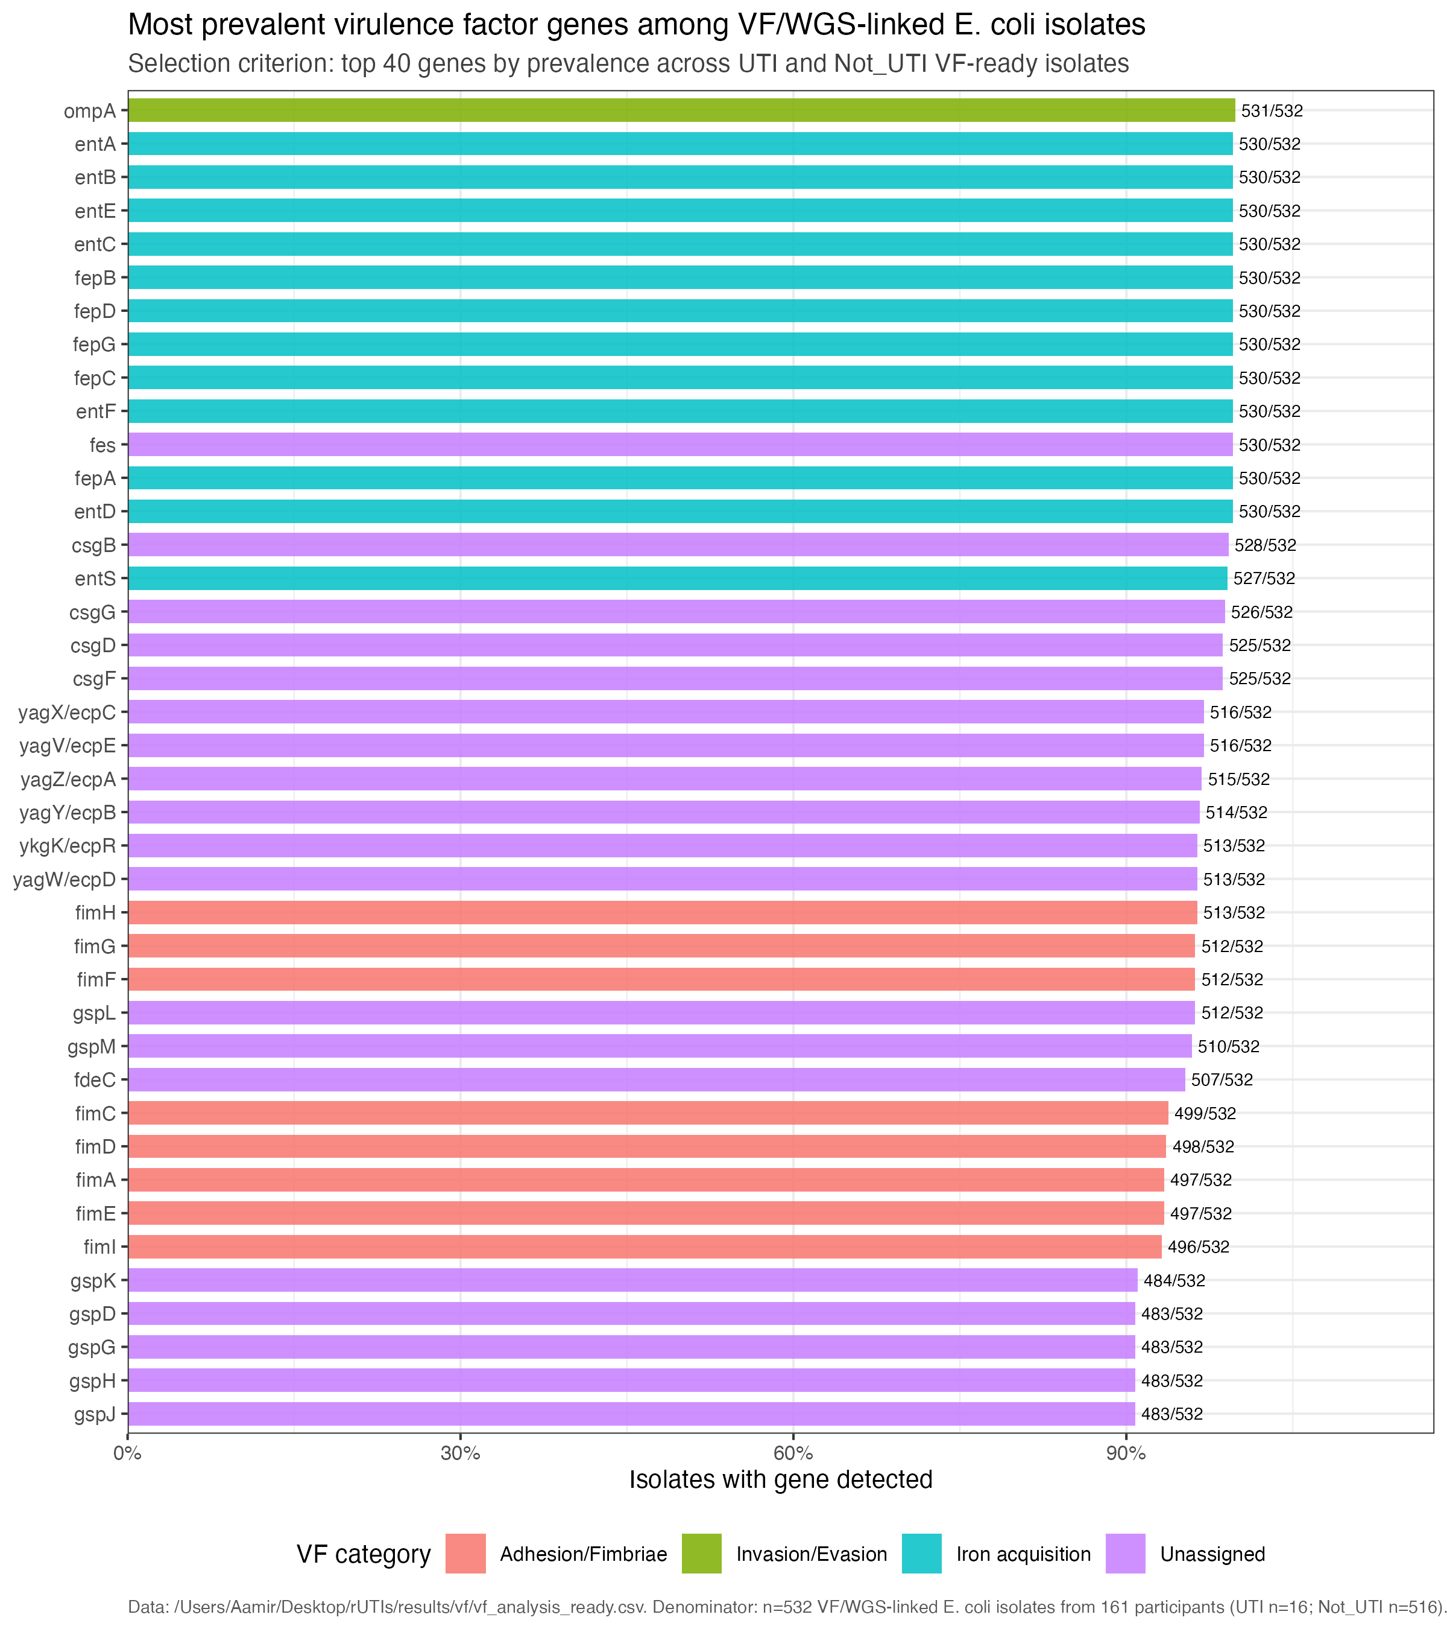
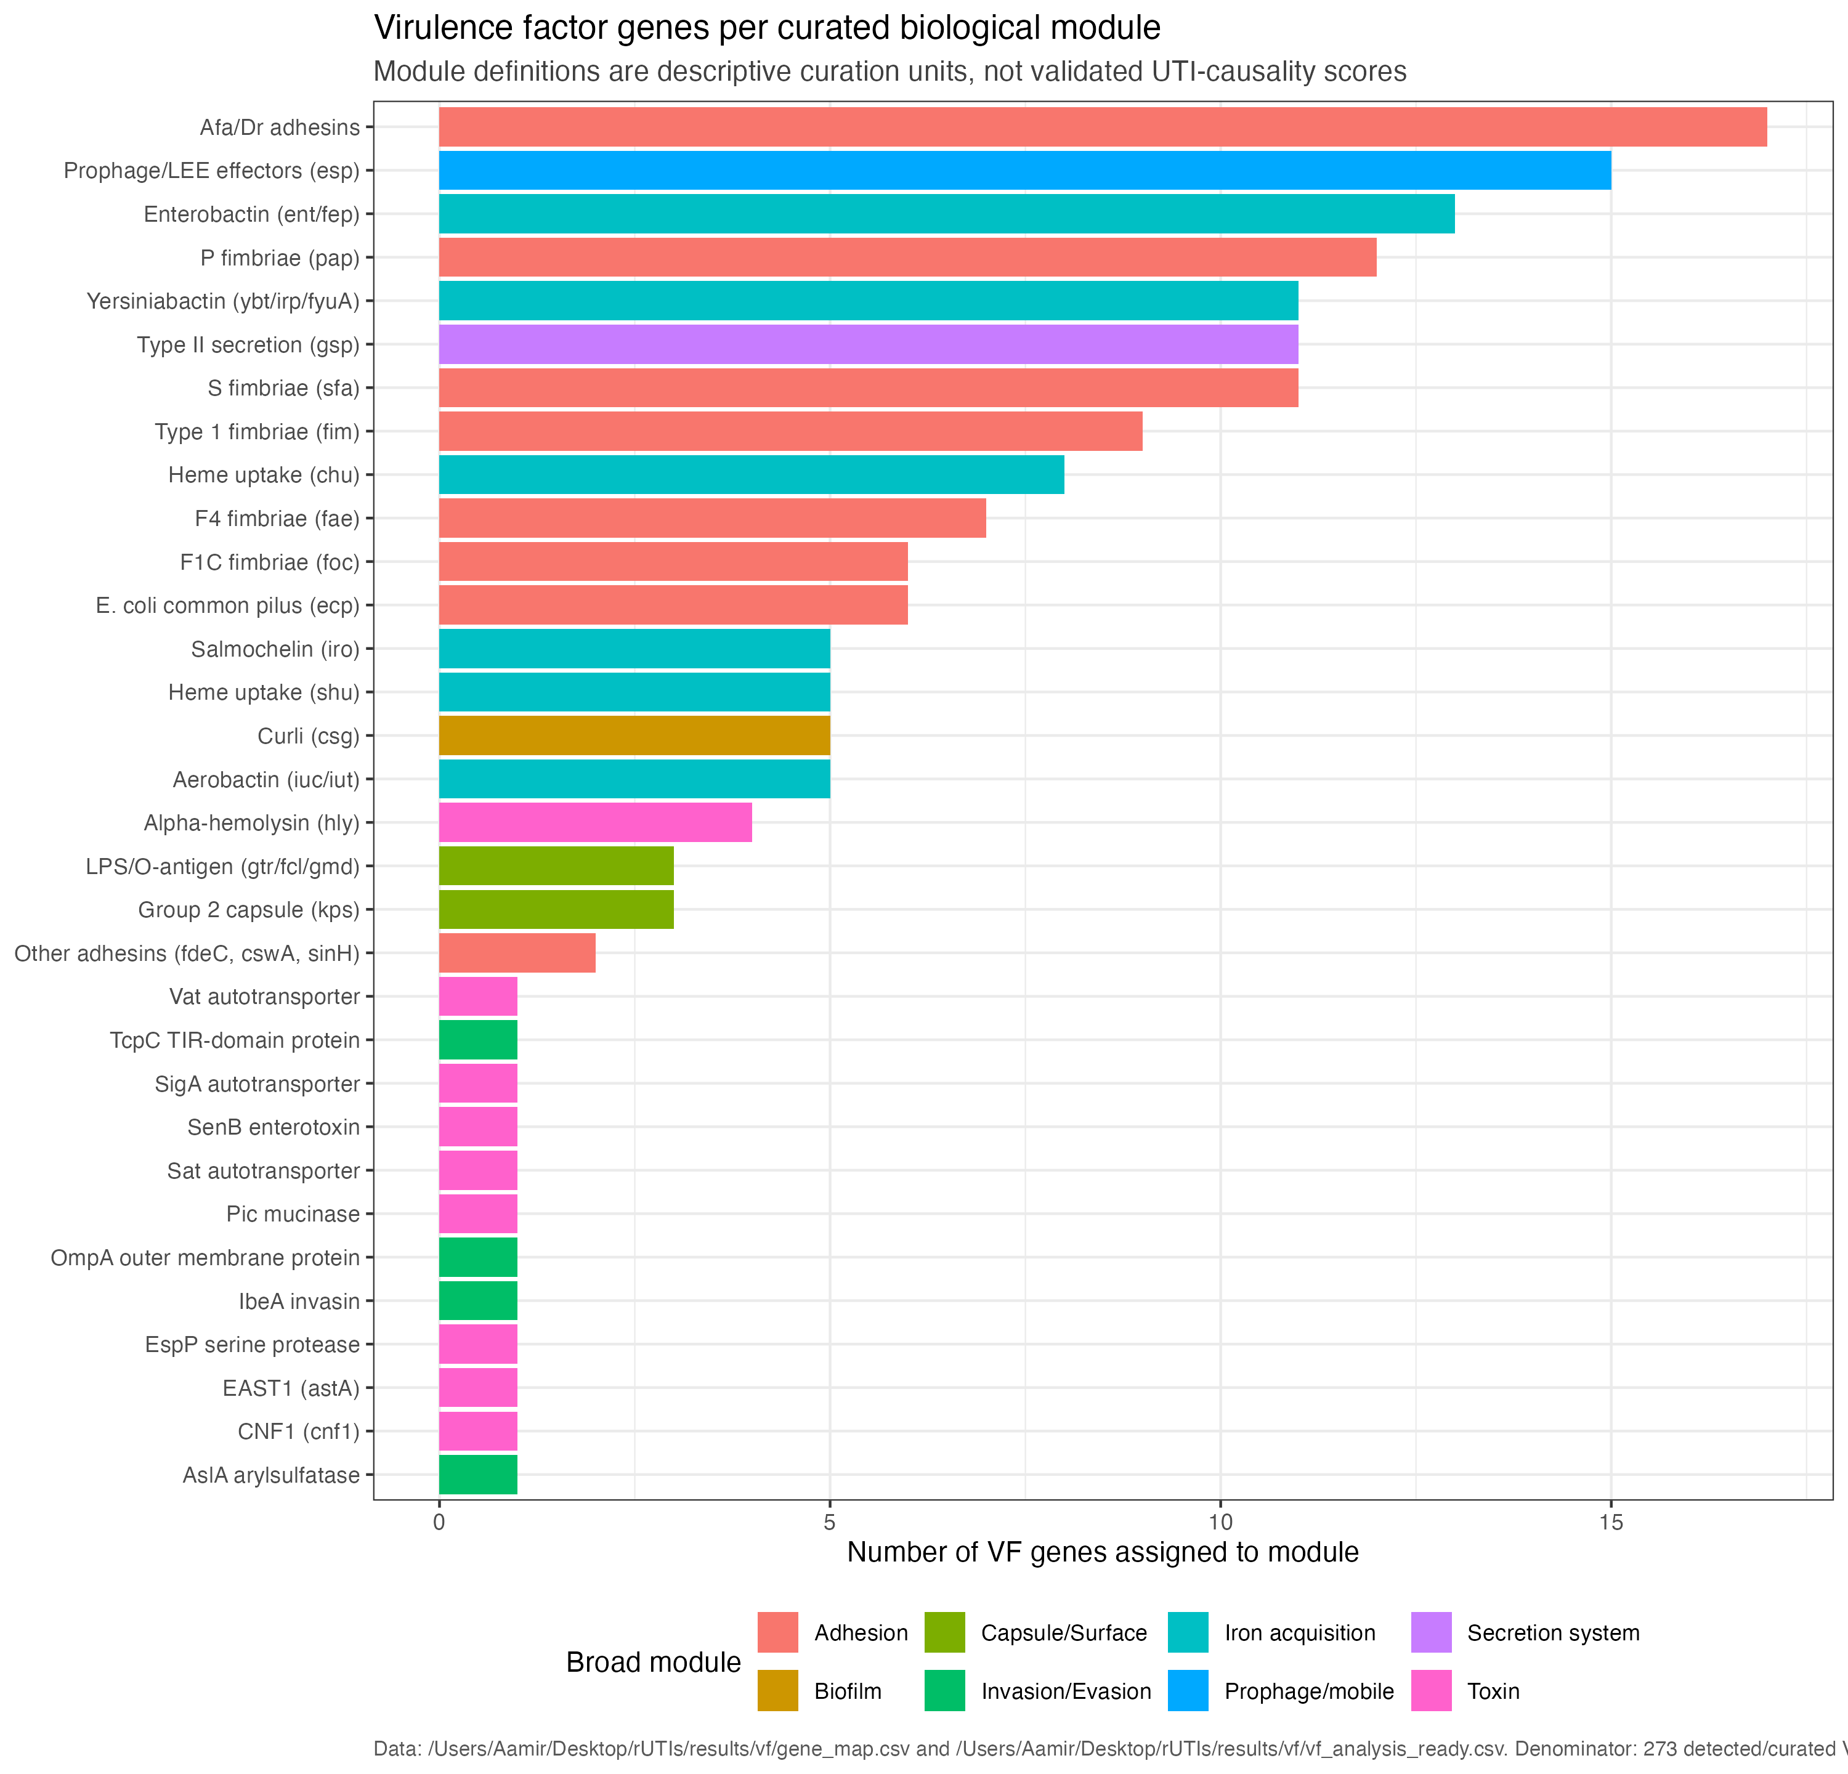
VF FRAMEWORK
VF repertoire is summarised as genes and curated modules
Both plots describe the selected analytical cohort; neither plot is a causal clinical model.
227 binary VF features
Curated module framework
Longcycler-only compact onboarding | operational UTI phenotype
07
Notes:
SLIDE: Paired repertoire views
SAY: Show gene-level and module-level views together.
BOUNDARY: Treat modules as curation units.

Slide 8
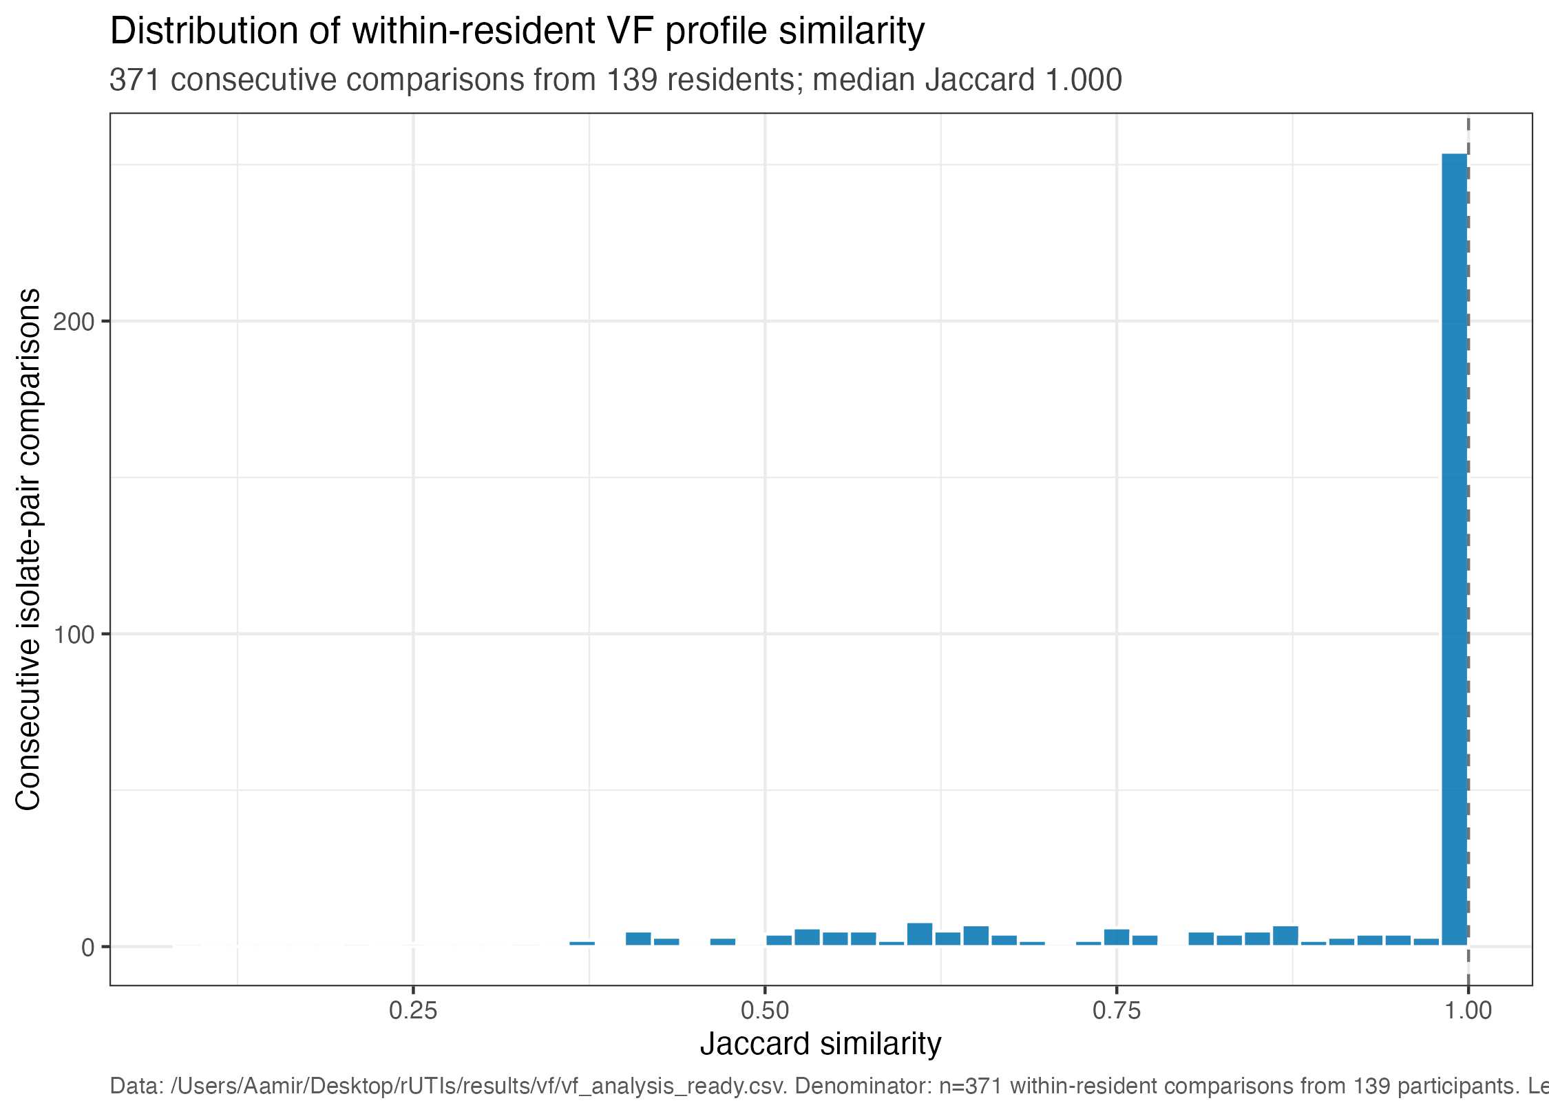
LONGITUDINAL STABILITY
Repeated within-resident VF profiles are assessed on the explicit pair layers
893 direct pairs; 371 adjacent transitions from 139 residents.
Central reading
Profile stability is descriptive evidence. Use adjacent transitions and lineage context before interpreting change.
Descriptive
Longcycler-only compact onboarding | operational UTI phenotype
08
Notes:
SLIDE: Stability
SAY: Use the explicit direct and adjacent pair denominators.
BOUNDARY: Profile stability is descriptive.

Slide 9
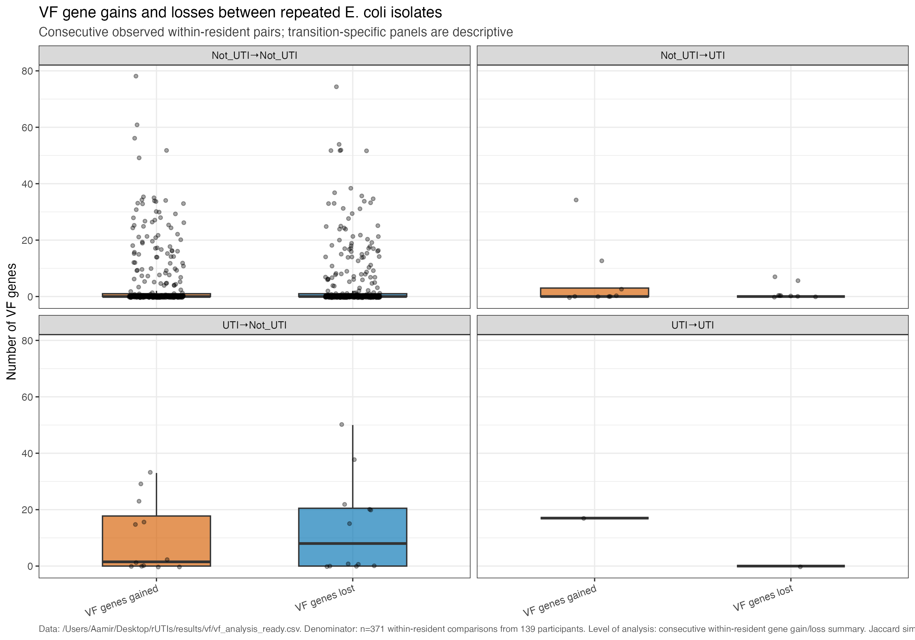
LONGITUDINAL CHANGE
Gain/loss summaries flag candidates for follow-up
Observed changes are reported on 371 adjacent transitions and require lineage plus genome-distance context.
Caution
Change may reflect lineage replacement, calling differences, or true gene-content change.
Longcycler-only compact onboarding | operational UTI phenotype
09
Notes:
SLIDE: Gain/loss
SAY: Flag candidates for follow-up.
BOUNDARY: Change needs lineage and genome-distance context.

Slide 10
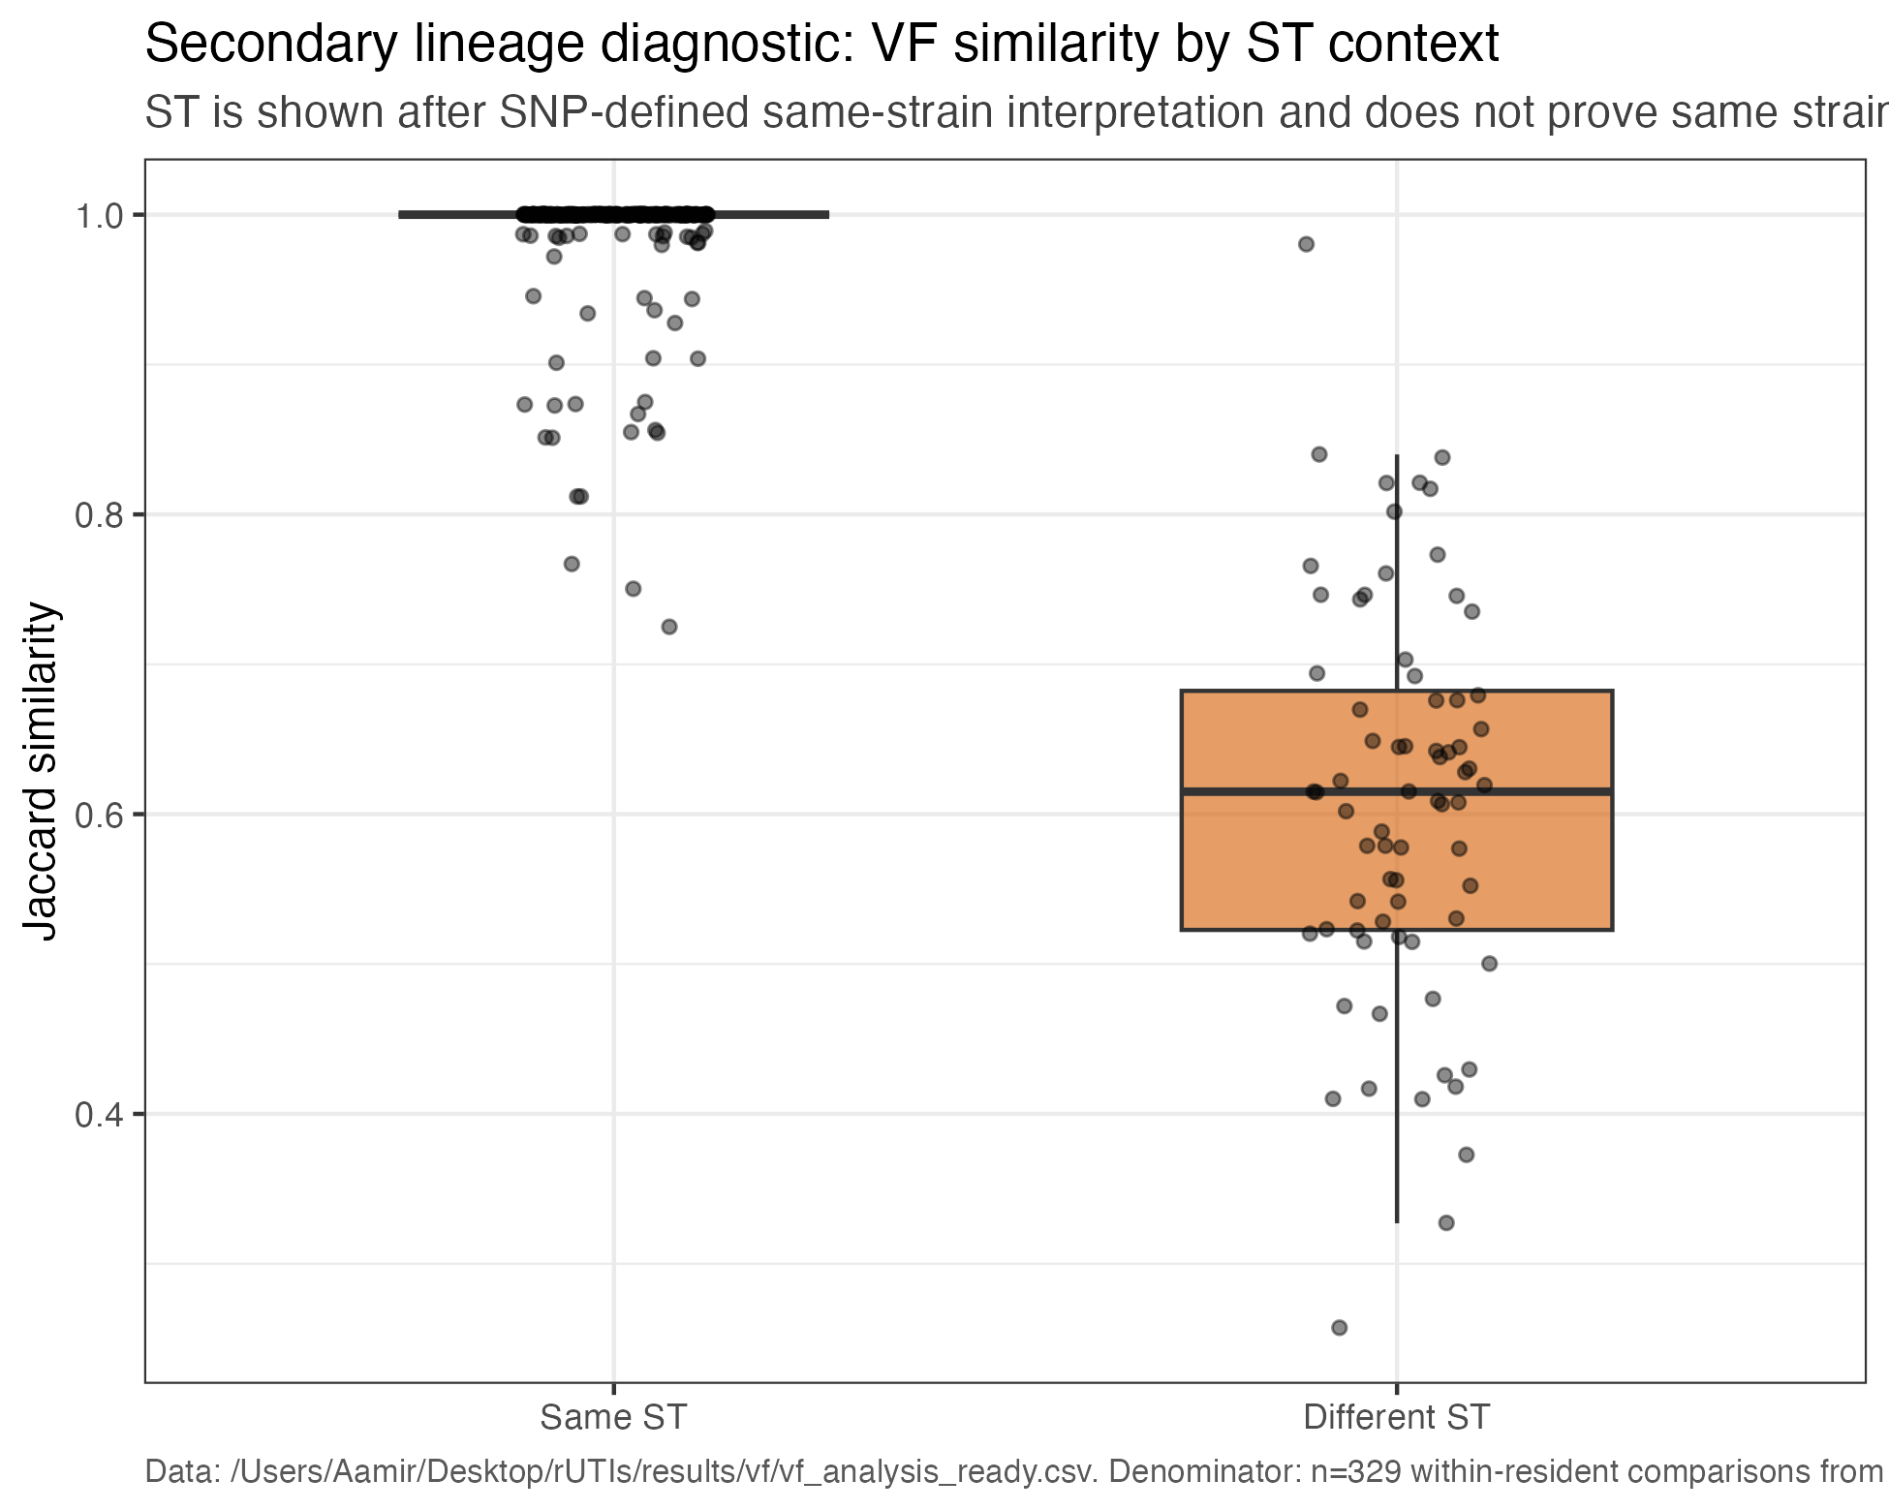
LINEAGE CONTEXT
Sequence-type context helps interpret VF similarity
493 selected episodes have preferred MLST labels spanning 76 distinct labels.
Diagnostic use
ST agreement is context, not proof of the same strain. Pairwise genome distance remains essential.
Longcycler-only compact onboarding | operational UTI phenotype
10
Notes:
SLIDE: Lineage
SAY: Use MLST as a diagnostic layer.
BOUNDARY: ST agreement does not prove the same strain.

Slide 11
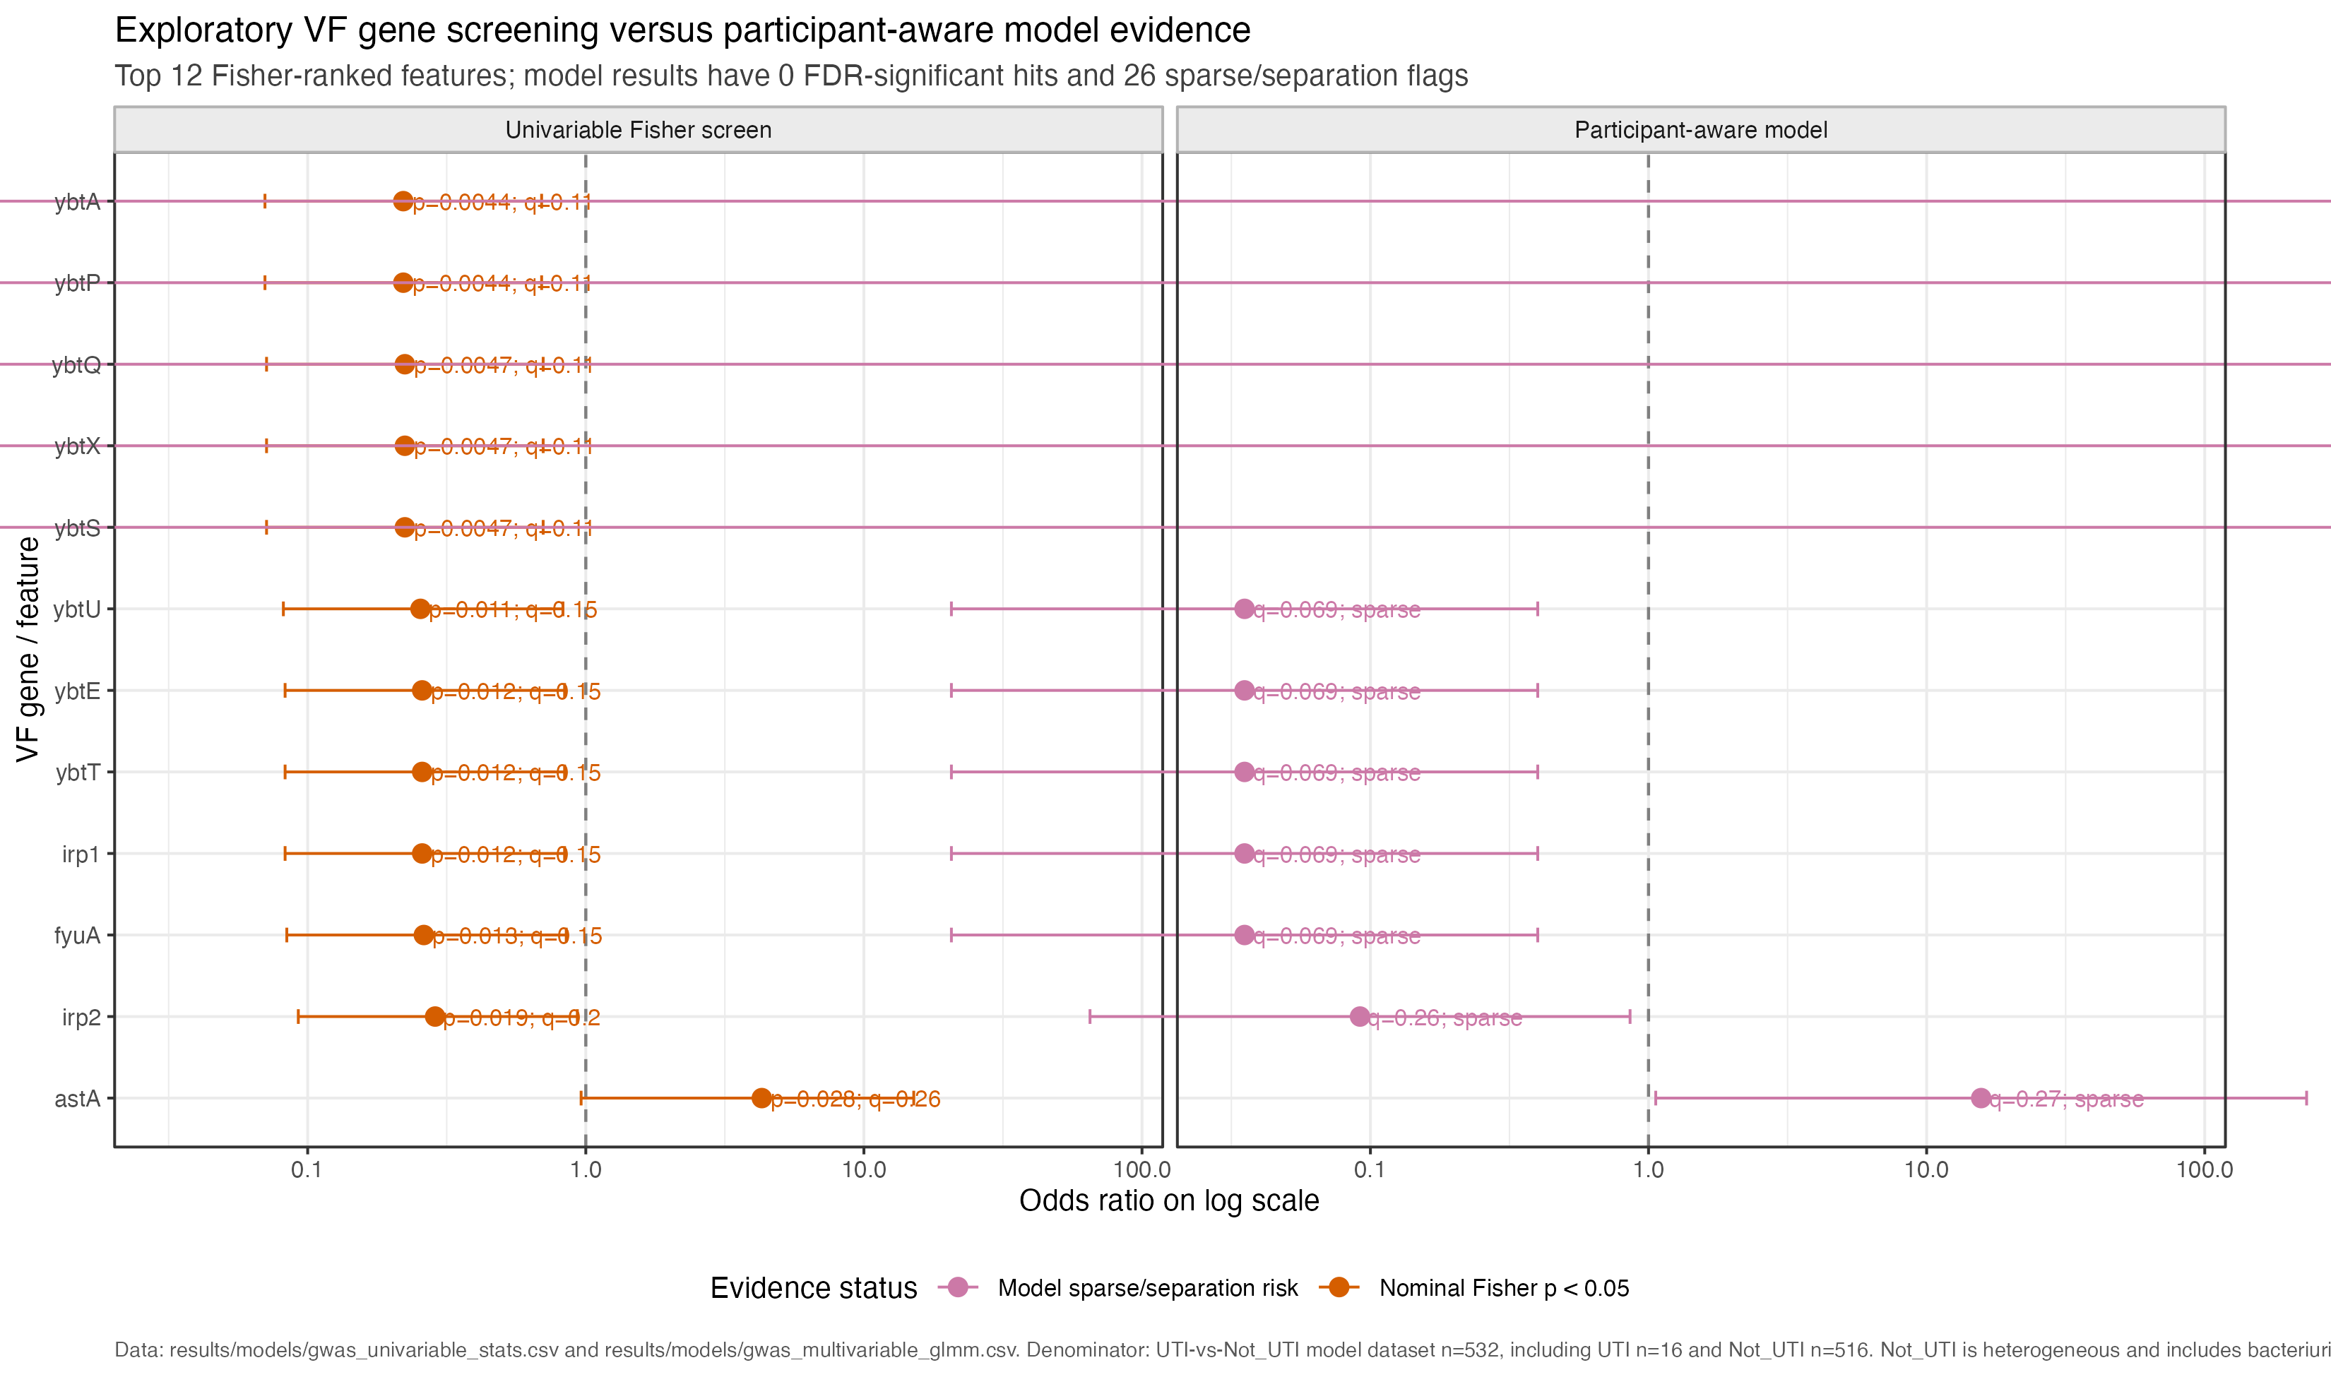
CLINICAL ANNOTATION
Clinical-status VF signals remain exploratory
16 operational UTI and 516 operational Not_UTI selected episodes; no causal interpretation.
Safe claim
Nominal screens and model diagnostics generate hypotheses; they do not establish a robust status association.
Exploratory overlay
Longcycler-only compact onboarding | operational UTI phenotype
11
Notes:
SLIDE: Clinical overlay
SAY: Keep the sparse operational phenotype denominator visible.
BOUNDARY: Exploratory observational analysis only.

Slide 12
CLINICAL TRANSITION APPLICATION
Focused transition evidence is aggregate, linked, and deliberately cautious
The release reports the full focused casebook; it does not elevate one anecdote into a mechanism claim.
Focused Not_UTI→UTI transitions
At or below 25 SNPs
Mechanism casebook
5 of 9 focused transitions fall at or below the operational genome-distance threshold.
9 cases; 9 linked; 0 missing endpoints.
9 adjacent transitions enter the focused clinical-transition view.
Interpretation boundary
Low genome distance and stable VF content can support a stable-lineage interpretation, but they cannot by themselves identify host-state change, bacterial regulation, or clinical causation.
Longcycler-only compact onboarding | operational UTI phenotype
12
Notes:
SLIDE: Focused transitions
SAY: Report 9 transitions, 5 at threshold, and a complete 9-case casebook.
BOUNDARY: Do not infer mechanism from low SNP distance alone.

Slide 13
CLOSE
What the Longcycler-only review establishes and what remains uncertain
Use these as the three discussion anchors.
Evidence
Boundary
Next steps
532 selected profiles from 161 residents support 893 direct comparisons and 371 adjacent transitions. The mechanism casebook is complete (9/9 linked).
Operational UTI is sparse (16/532). VF presence/absence does not measure expression, regulation, pathogenic activity, or a causal clinical-state effect.
Prioritise lineage-aware longitudinal analyses, targeted transition review, and additional evidence that can separate bacterial change from host-state and sampling effects.
Discussion: what extra evidence would distinguish stable carriage plus host-state change from unmeasured bacterial regulation?
Longcycler-only compact onboarding | operational UTI phenotype
13
Notes:
SLIDE: Close
SAY: Summarise evidence, boundary, and next steps.
BOUNDARY: Keep causality outside the supported claim set.

Slide 14
APPENDIX / HANDOVER
Practical map: where to enter and rerun the Longcycler-only pipeline
The numbered research-question layer runs from RQ01 through RQ10.
Selected manifest
results/assembly/canonical_assembly_selection.csv
One QC-passing Longcycler assembly per episode
Clinical key
results/clinical/status_map.csv
Operational UTI annotation and audit fields
VF matrix
results/vf/vf_pa_all.csv
Episode-level binary VF profiles
Direct pairs
results/strain/pairwise_metrics.csv
All within-resident comparisons
Adjacent transitions
results/longitudinal/longcycler_transitions.csv
Temporally ordered comparisons
Focused casebook
results/mechanism/not_uti_to_uti_casebook.csv
Nine linked transition cases
Research questions
scripts/research_questions/run_all.R
RQ01–RQ10 release layer
Longcycler-only compact onboarding | operational UTI phenotype
14
Notes:
SLIDE: Handover
SAY: Show the operational entry points.
BOUNDARY: Research questions run RQ01 through RQ10.

Slide 15
APPENDIX / PIPELINE
Numbered clinical-to-VF pipeline with validated handoff counts
RQ01–RQ10 consume the same selected analytical cohort and current-run outputs.
1
Source/QC context
2
Selected cohort
3
Operational phenotype
4
VF feature matrix
5
MLST context
583 episodes; 166 residents
532 episodes; 161 residents
16 UTI; 516 Not_UTI
227 binary features
493 typed episodes; 76 labels
6
Direct pairs
7
Adjacent transitions
8
Focused transition view
9
Mechanism casebook
10
Research-question release
893 comparisons
371 from 139 residents
9 transitions; 5 ≤25 SNPs
9/9/0: cases/linked/missing
RQ01–RQ10; none retired
Longcycler-only compact onboarding | operational UTI phenotype
15
Notes:
SLIDE: Pipeline
SAY: Use the numbered release pipeline for behind-the-scenes questions.
BOUNDARY: All stages consume the selected analytical cohort.

Slide 16
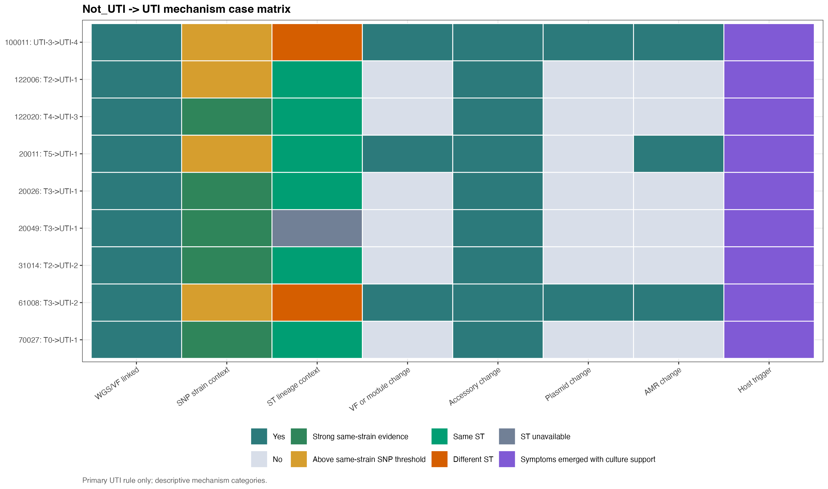
APPENDIX / TRANSITION EVIDENCE
Full focused transition mechanism casebook
9 cases; 9 linked; 0 missing. Buckets organise evidence, not proof.
Longcycler-only compact onboarding | operational UTI phenotype
16
Notes:
SLIDE: Casebook
SAY: Use the complete nine-case casebook for transition questions.
BOUNDARY: Buckets organise evidence; they do not prove mechanism.

Slide 17
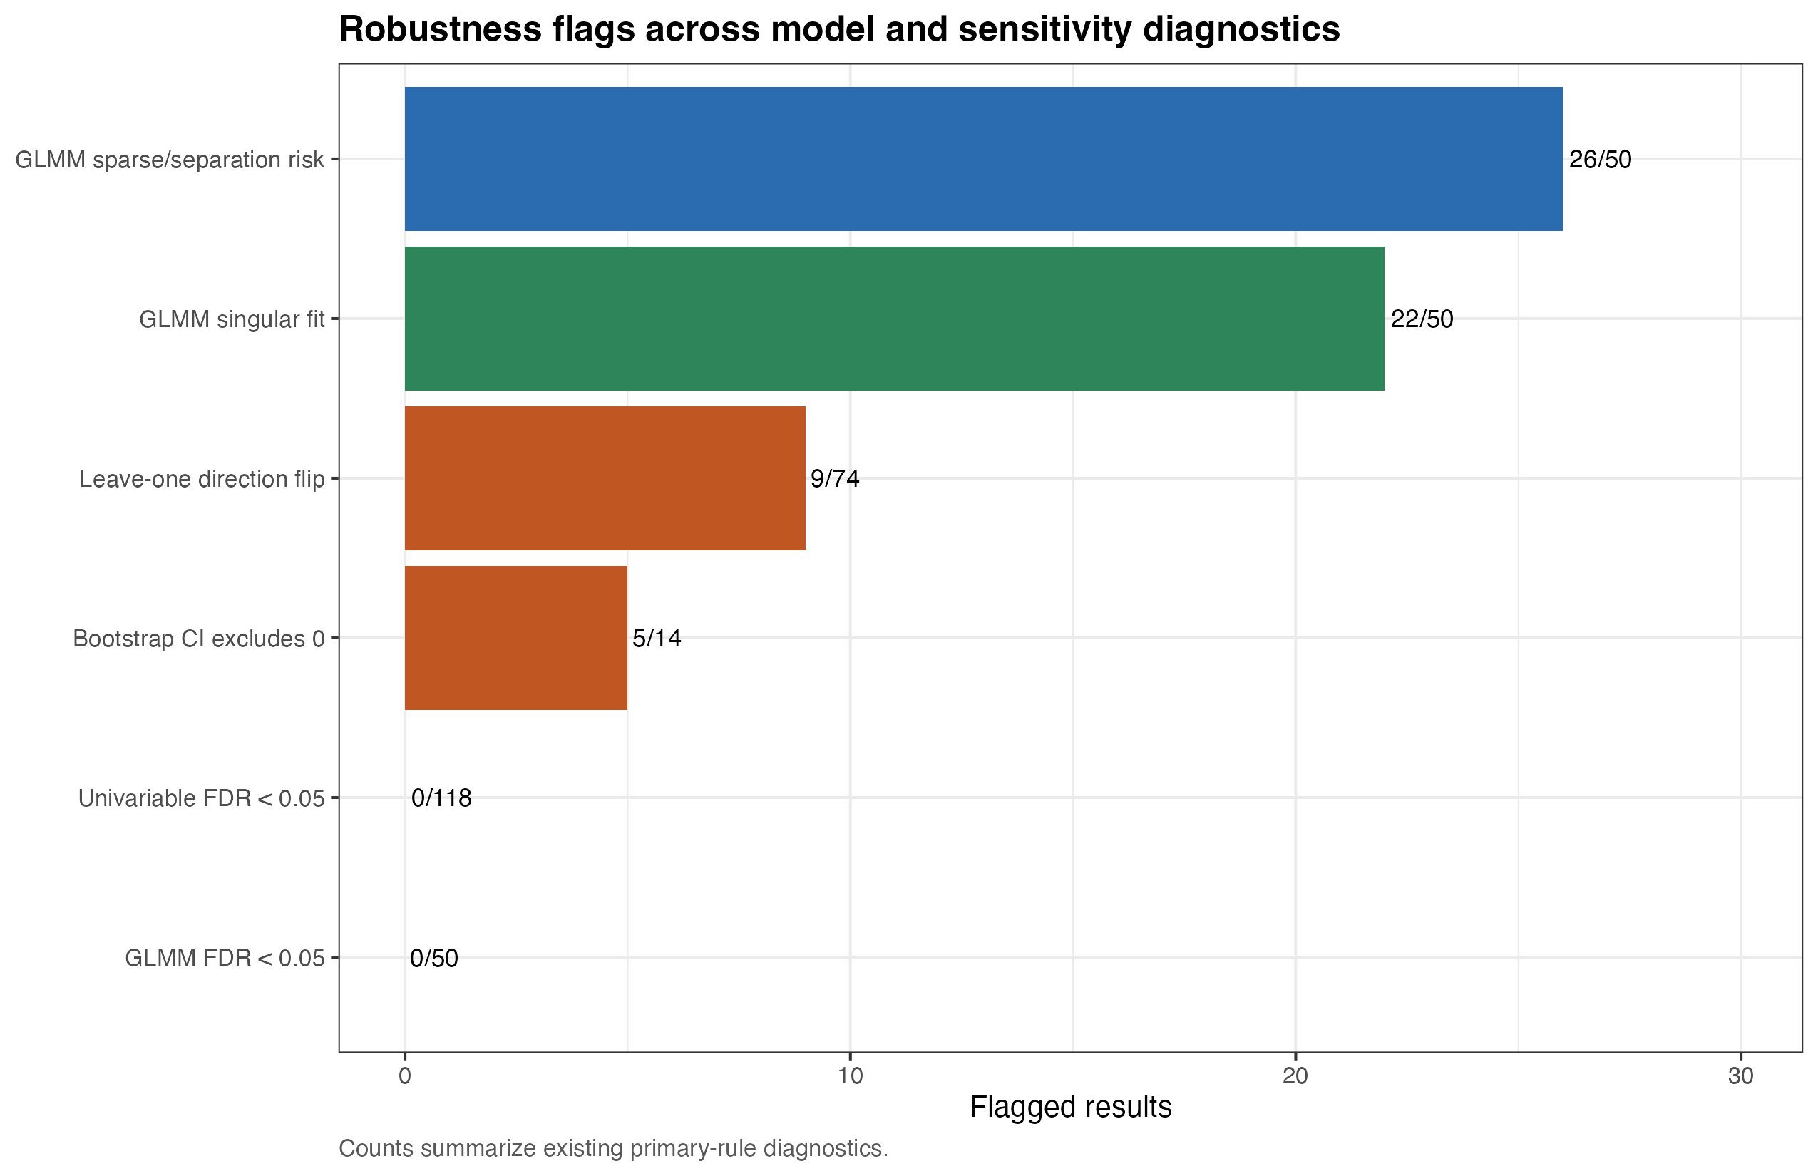
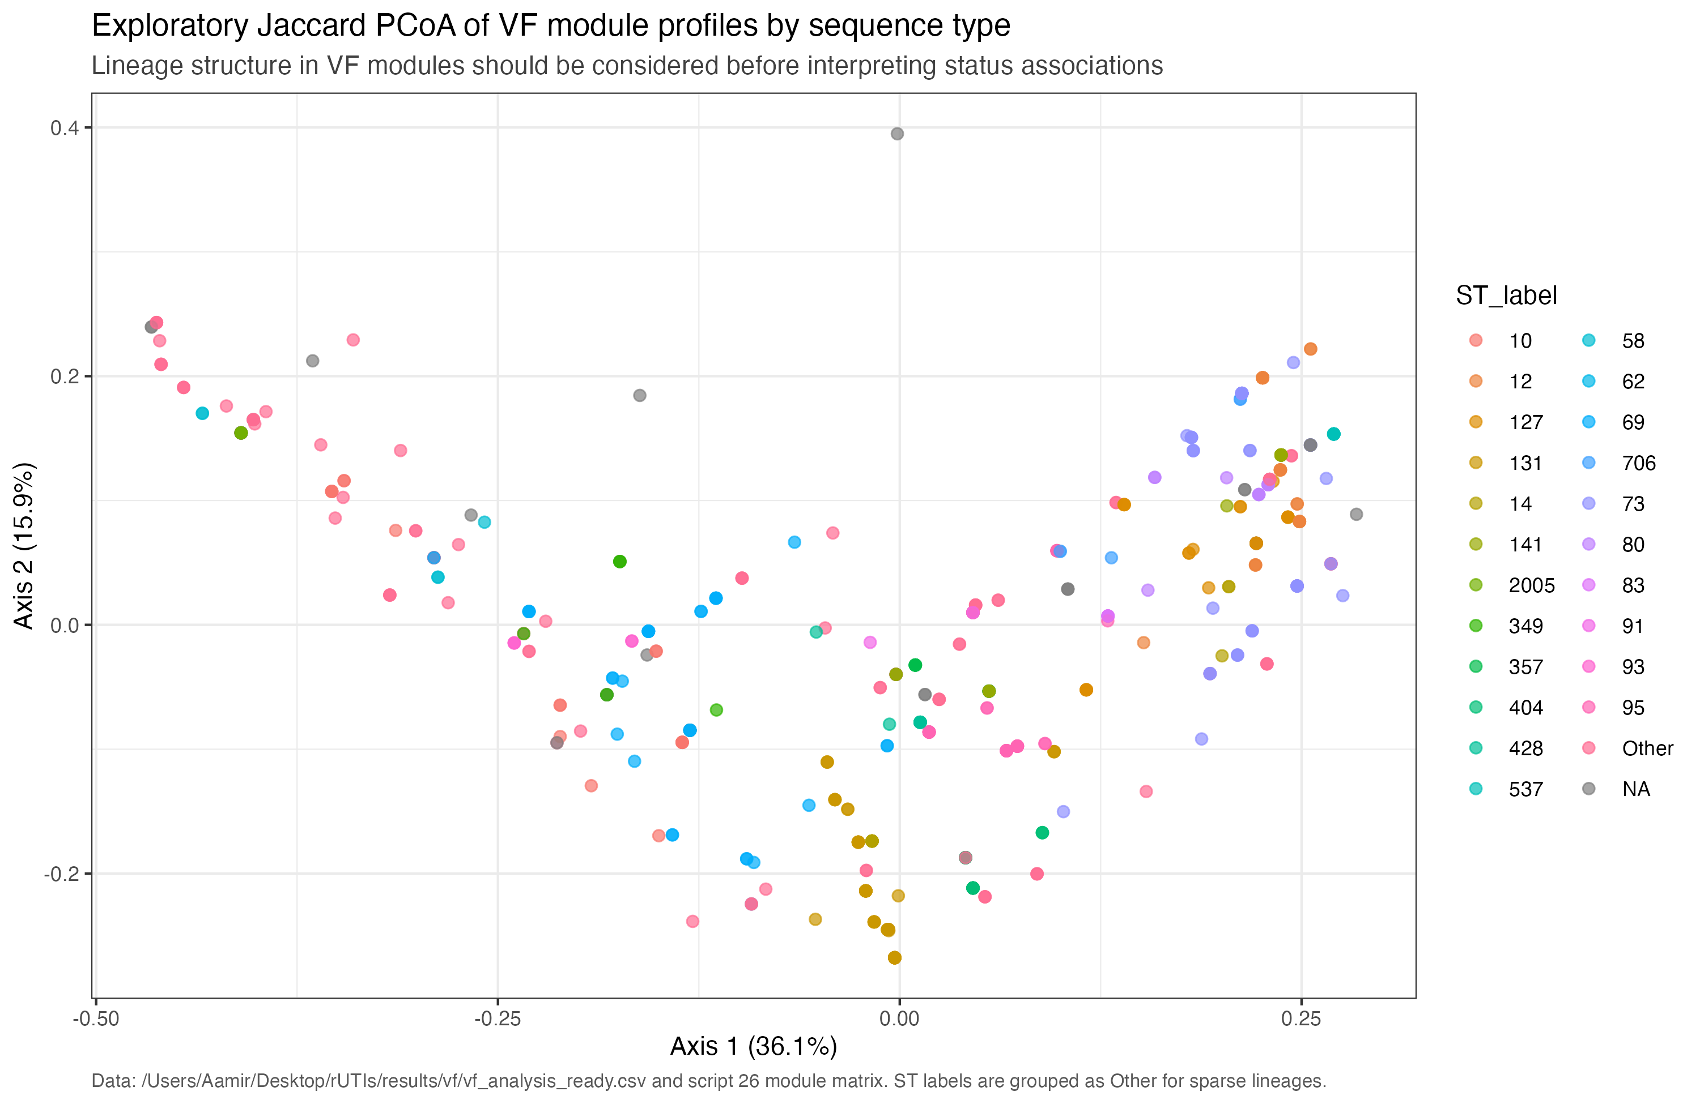
APPENDIX / INTERPRETATION CHECKS
Robustness and lineage diagnostics stay as backup interpretation aids
The 17-row near-miss audit remains separate from operational UTI cases.
16 operational UTI; exploratory
Lineage diagnostic
Longcycler-only compact onboarding | operational UTI phenotype
17
Notes:
SLIDE: Robustness and lineage
SAY: Keep these two diagnostic aids together.
BOUNDARY: Near-miss rows are not operational UTI cases.

