Slide 1
FINAL PROJECT FACE IMAGE GENEARATON USING STYLE GAN
I.P.AHATHA INFANCIYA

Slide 2
PROJECT TITLE
FACE IMAGE GENEARATON USING STYLE GAN

Slide 3
AGENDA
PROBLEM STATEMENT
PROJECT OVERVIEW
END USERS
SOLUTION AND ITS VALUE PROPORTION
UNIQUENESS IN SOLUTION
MODELLING
RESULT

Slide 4
PROBLEM STATEMENT
This project aims to develop a robust face image generation system utilizing StyleGAN. It involves collecting and preprocessing a diverse dataset of facial images, implementing the StyleGAN architecture, and training the model to generate realistic and varied facial images. The challenge lies in optimizing hyperparameters, ensuring model convergence, and achieving high-quality output images that accurately capture facial characteristics such as age, gender, ethnicity, and expressions.

Slide 5
PROJECT OVERVIW
The project focuses on leveraging StyleGAN, a state-of-the-art generative model, for face image generation. By harnessing the power of deep learning and generative adversarial networks (GANs), the aim is to create a system capable of producing high-quality and diverse facial images. The project aims to deliver a functional face image generation system powered by StyleGAN, capable of producing high-fidelity and diverse facial images. The system could find applications in various domains, including entertainment, virtual reality, and computer graphics .Develop a user-friendly interface for generating facial images using the trained StyleGAN model.

Slide 6
END USERS
1. Researchers in Computer Vision and AI
2. Artists and Creatives
3. Game Developers
4. Virtual Reality (VR) and Augmented Reality (AR) Developers
5. Entertainment Industry
6. E-commerce and Fashion Industry
7. Education and Training
8. Medical Imaging and Research
9. Data Scientists and Analysts
10. General Public

Slide 7
SOLUTION AND ITS VALUE PROPORTION
Curate a diverse dataset of facial images covering various demographics, expressions, and poses. Employ data preprocessing techniques to enhance image quality and ensure uniformity.
Implement the StyleGAN architecture using TensorFlow or PyTorch. Customize the model architecture and hyperparameters for facial image generation.
Train the StyleGAN model on the prepared dataset to learn facial feature distributions. Monitor training progress, adjusting parameters for convergence and stability.
Assess the generated images' quality using visual inspection and quantitative metrics. Fine-tune the model based on evaluation results to improve image fidelity.
Develop a user-friendly interface for generating facial images using the trained StyleGAN model. Explore potential applications in virtual avatars, data augmentation, and creative artwork.

Slide 8
UNIQUENESS IN SOLUTION
1. Diverse Dataset: Curating a dataset representing various demographics enhances model performance.
2. Customized StyleGAN: Tailoring StyleGAN parameters optimizes facial image generation.
3. Improvement: Continuous evaluation ensures high-quality outputs through refinement.
4. User-Friendly Interface: Accessible interface promotes broader adoption and usability.
5. Exploration of Applications: Encourages innovative uses beyond traditional domains.

Slide 9
MODELLING
1. Data Representation: Convert facial images into numerical data, ensuring consistency.
2. Customized StyleGAN: Implement StyleGAN, adjusting layers and parameters for facial image generation.
3. Loss Functions: Define adversarial and perceptual loss functions to guide training.
4. Progressive Training: Use progressive training and regularization techniques to prevent overfitting.
5. Evaluation Metrics: Assess image quality using metrics like Inception Score and FID, supplemented by human evaluations.
6. Hyperparameter Optimization: Fine-tune parameters systematically, leveraging optimization techniques.
7. Interpretability: Explore interpretability methods to understand the model's learned representations.
8. Deployment and Scalability: Design the model for efficient deployment and scalability in production environments.

Slide 10
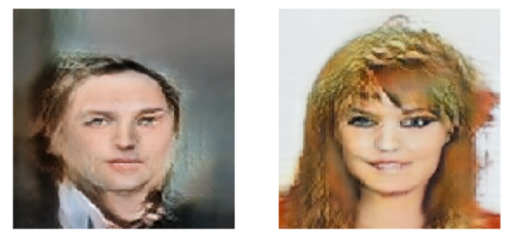
RESULT

Slide 11
THANK YOU
PRESENTED BY : I.P.AHATHA INFANCIYA
DEGREE : BE (Computer science and Engineering)
MAIL ID : richahatha@gmail.com
NM ID : au950021104003
COLLEGE NAME : Anna University Regional Campus - Tirunelveli

