Slide 1
LATENT SEMANTIC INDEXING TO IMPROVE ACCESS TO INFORMATION
-Abhishek Deshpande

Slide 2
MOTIVATION
Building highly efficient search engine.
Retrieving information based on:-
  Conceptual content
  Latent sentiments

Slide 3
Objective
Appropriate document retrieval
Ranking the documents based on user query
Build efficient LSI algorithm for low-rank ,k-dimensional vector space.

Slide 4
What is LSI ?
Latent semantic indexing (LSI) is an indexing and retrieval method that uses a mathematical technique called singular value decomposition (SVD) to identify patterns in the relationships between the terms and concepts contained in an unstructured collection of text.
LSI is based on the principle that words that are used in the same contexts tend to have similar meanings..

Slide 5
Why LSI ?
Takes in account “HIDDEN MEANING”
Synonyms:
  Same concepts using different words
Polysemy:
  words that have more than one meaning
Term Dependence
  Uses the Strong associations between terms.

Slide 6
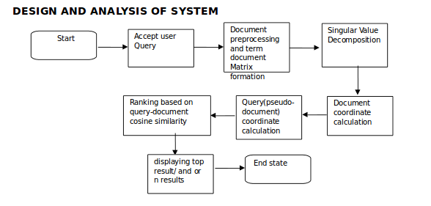
How LSI Works?

Slide 7
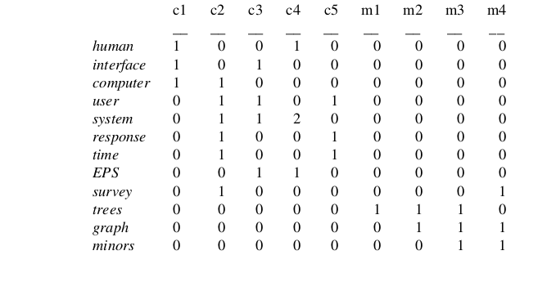
Construct the term-document matrix A and query matrix.

Slide 8
SVD
Unique mathematical decomposition of a matrix into the product of three matrices:
-two with orthonormal columns
-one with singular values on the diagonal
Tool for dimension reduction
Similarity measure based on co-occurrence
Finds optimal projection into low-dimensional space

Slide 9
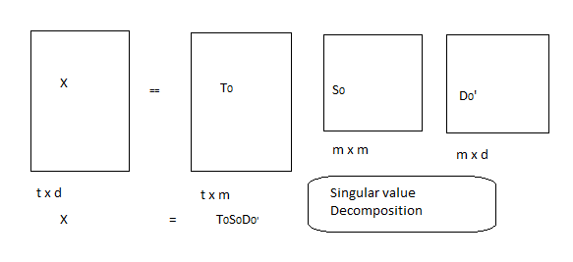
Applying SVD:

Slide 10
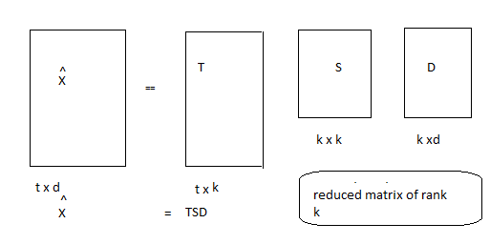
Implement a Rank k Approximation

Slide 11
Technical Memo Titles
c1: Human machine interface for ABC computer applications
c2: A survey of user opinion of computer system response time
c3: The EPS user interface management system
c4: System and human system engineering testing of EPS
c5: Relation of user perceived response time to error measurement
m1: The generation of random, binary, ordered trees
m2: The intersection graph of paths in trees
m3: Graph minors IV: Widths of trees and well-quasi-ordering
m4: Graph minors: A survey

Slide 12
X X_{hihat}

Slide 13
Find the new query vector coordinates in the
Reduced k-dimensional space using
    q^{t}= q T_{k} S_{k}⁻¹

Slide 14
Similarity measures
Comparing two terms.
-The dot product between two row vectors of Xhihat reflects the extent to which two terms have a similar pattern of occurrence across the set of documents.
Comparing two documents:
The analysis for comparing two documents is similar, except,that in this case it is the dot product between two column vectors of the matrix Xhihat which tells the extent to which two documents have a similar profile of terms.

Slide 15
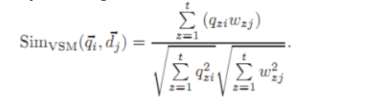
Similarity Measures
Query and documents
The query is represented in as a pseudo-document form
represented as q=(q1,q2,........,qn)^{t}
Cosine similarity

Slide 16
Proposed model:-
Minkowski Distance

Slide 17
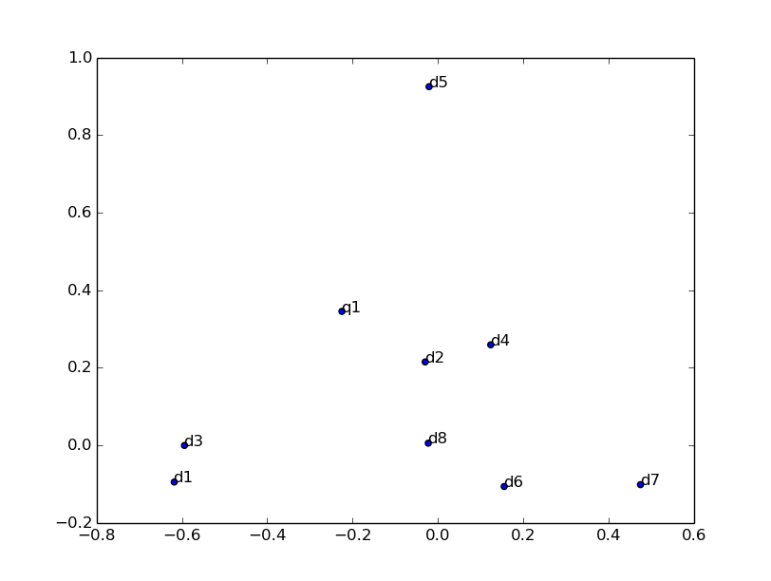
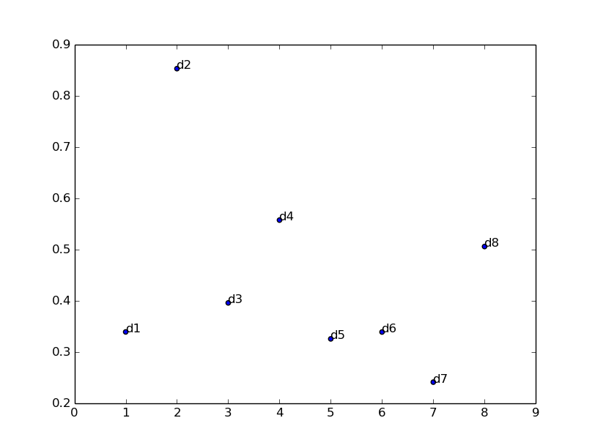
2-D space Rank-graph

Slide 18
Advantages:
Reduced complexity:
The time complexity of computing SVD is normally of order
O(min{MN², NM²}), where M denotes number of rows of the input matrix and N number of columns.
31% more efficient compared with the keyword vector method.

Slide 19
Future Scope for improvment
Stemming:
  Suffix-stripping algorithm
  The Porter Stemmer Algorithm
  Stochastic algorithm(a probabilistic m.l for stemming)
Speed :
  Selecting only a few document for consideration
  Using K-dtree data structure

Slide 20
Applications
Information retrieval
Relevance Feedback
Information Filtering
Cross-Language Retrieval
Application related to image proecessing
Relationship discovery(Government, Intelligence community, Social Networking)

Slide 21
The Big Plus
Google's RankBrain AI
RankBrain is using a combination of lexical grouping and Latent Semantic Indexing to create a result for a brand new search query.

Slide 22
References
1: Ho Chi Minh," An approach to look up documents in a library using singular value decomposition ",IJCSNS International Journal of Computer Science and Network Security, VOL.15 No.1, January 2015.
2: P. Chiranjeevi, T. Supraja, P. Srinivasa Rao,,"A Survey on Extension Techniques for Text Document Clustering ", International Journal of Advanced Research in Computer Science and Software Engineering, Volume 5, Issue 7, July 2015.
3: Sudarsun S, Venkatesh Prabhu, "Finding Optimal Rank for LSI Models", Proceedings ofICAET 2010, pp. 2010
4.Enas Sedki, Abdelfattah Alzaqah, Arafat Awajan, "Arabic Text Dimensionality Reduction Using Semantic Analysis",WSEAS Transaction on Information Sscience and Application, Volume 12, 2015

Slide 23
Thank You

