Slide 1
Amdahl’s Law in the Multicore Era
Mark D. Hill and Michael R. Marty
Univ. of Wisconsin—Madison
February 19, 2008 @ HPCA
To appear in IEEE Computer [?/2008]
Most keynotes complex – This one is simple!
At HPCA’07, IBM’s Dr. Thomas Puzak:
Everyone knows Amdahl’s Law
But quickly forgets it!
Notes:
LogTM: Log-based Transactional Memory
UW-Madison Architecture Seminar

Slide 2
Abstract & Biography
Over the last several decades computer architects have been phenomenally successful turning the transistor bound provided by Moore's Law into chips with ever increasing single-threaded performance. During many of these successful years, however, many researchers paid scant attention to multiprocessor work [1].
Now as vendors turn to multicore chips, researchers are reacting with more papers on multi-threaded ideas. While this is good, we are concerned that further work on single-thread performance will be squashed.
In this talk, based in part on an upcoming paper with Michael Marty [2], we apply Amdahl’s Law to several multicore chips variants: symmetric cores, asymmetric cores, and dynamic techniques that allow cores to work together on sequential execution. Starting with Amdahl’s simple software model, we add a simple hardware model based on fixed chip resources.
Our simple results encourage multicore designers to view performance of the entire chip rather than focusing only on core efficiencies. Moreover, we observe that obtaining optimal multicore chips performance requires further research in both extracting more parallelism and making sequential cores faster.
This talk seeks to stimulate discussion and future work, as well as temper the current pendulum swing from the past’s under-emphasis on parallel research to a future with too little sequential research.
References
[1] Mark D. Hill and Ravi Rajwar, The Rise and Fall of Multiprocessor Papers in the International Symposium on Computer Architecture (ISCA), http://www.cs.wisc.edu/~markhill/mp2001.html, March 2001.
[2] Mark D. Hill and Michael R. Marty, Amdahl’s Law in the Multicore Era, to appear in IEEE Computer, 2008.
Biography
Mark D. Hill (http://www.cs.wisc.edu/~markhill) is professor in both the computer sciences department and the electrical and computer engineering department at the University of Wisconsin-Madison, where he also co-leads the Wisconsin Multifacet project with David Wood. He earned a PhD from University of California, Berkeley. He is an ACM Fellow and a Fellow of the IEEE. His past work ranges from refining multiprocessor memory consistency models to developing the 3C model of cache behavior (compulsory, capacity, and conflict misses).

Slide 3
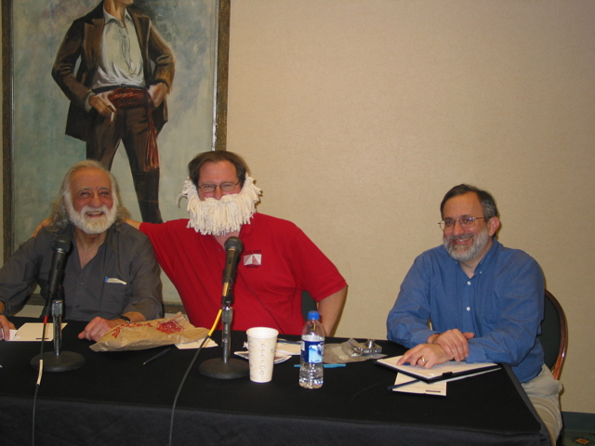
HPCA 2007 Debate [IEEE Micro 11-12/2007]
Single-Threaded vs. Multithreaded:
Where Should We Focus?
Yale Patt vs. Mark Hill w/ Joel Emer, moderator
Today’s talk more balanced than one-handed debate position

Slide 4
Virtuous Cycle, circa 1950 – 2005 (per Larus)
Increased
processor
performance
Slower
programs
Larger, more
feature-full
software
Higher-level
languages &
abstractions
Larger
development
teams
World-Wide Software Market (per IDC):
$212b (2005) → $310b (2010)
Wisconsin Multifacet Project
Notes:
LogTM: Log-based Transactional Memory
UW-Madison Architecture Seminar

Slide 5
Virtuous Cycle, 2005 – ???
X
Increased
processor
performance
Slower
programs
Larger, more
feature-full
software
GAME OVER — NEXT LEVEL?
Higher-level
languages &
abstractions
Larger
development
teams
Thread Level Parallelism & Multicore Chips
World-Wide Software Market $212b (2005) → ?
Wisconsin Multifacet Project
Notes:
LogTM: Log-based Transactional Memory
UW-Madison Architecture Seminar

Slide 6
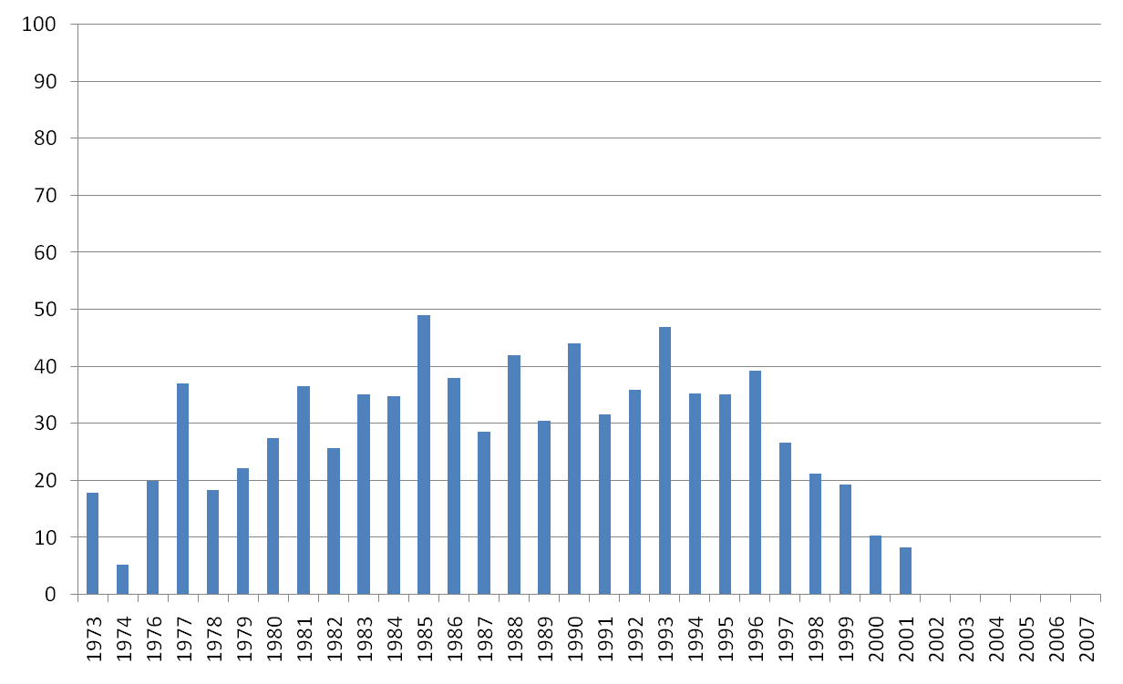
How has Architecture Research Prepared?
Sorry, not HPCA ☹
Lead up
to
Multicore
What
Next?
Percent Multiprocessor Papers in ISCA
Source: Hill & Rajwar, The Rise & Fall of Multiprocessor Papers in ISCA, http://www.cs.wisc.edu/~markhill/mp2001.html (3/2001)
Wisconsin Multifacet Project
Notes:
LogTM: Log-based Transactional Memory
UW-Madison Architecture Seminar

Slide 7
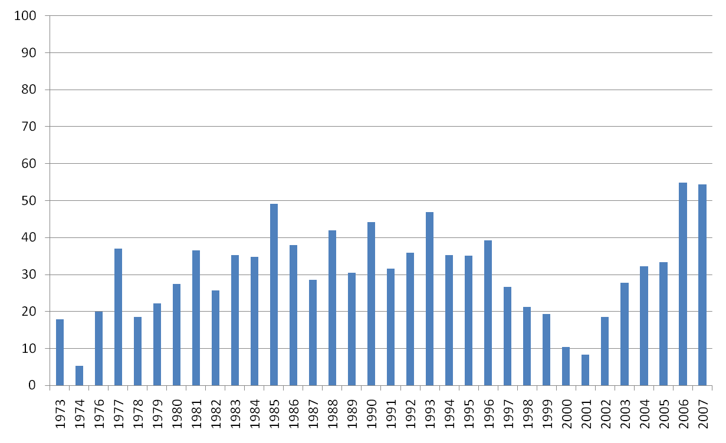
How has Architecture Research Prepared?
Reacted?
Will Architecture Research Overreact?
Percent Multiprocessor Papers in ISCA
HPCA 2008
Source: Hill, 2/2007
Wisconsin Multifacet Project
Notes:
LogTM: Log-based Transactional Memory
UW-Madison Architecture Seminar

Slide 8
ISCA Multiprocessor Papers by Year
Year | Total Papers | MP Papers |  | Year | Total Papers | MP Papers
1973 | 28 | 5 |  | 1991 | 38 | 12
1974 | 38 | 2 |  | 1992 | 39 | 14
1976 | 40 | 8 |  | 1993 | 32 | 15
1977 | 27 | 10 |  | 1994 | 34 | 12
1978 | 38 | 7 |  | 1995 | 37 | 13
1979 | 27 | 6 |  | 1996 | 28 | 11
1980 | 40 | 11 |  | 1997 | 30 | 8
1981 | 41 | 15 |  | 1998 | 33 | 7
1982 | 35 | 9 |  | 1999 | 26 | 5
1983 | 54 | 19 |  | 2000 | 29 | 3
1984 | 46 | 16 |  | 2001 | 24 | 2
1985 | 51 | 25 |  | 2002 | 27 | 5
1986 | 50 | 19 |  | 2003 | 36 | 10
1987 | 35 | 10 |  | 2004 | 31 | 10
1988 | 50 | 21 |  | 2005 | 45 | 15
1989 | 46 | 14 |  | 2006 | 31 | 17
1990 | 34 | 15 |  | 2007 | 46 | 25
Wisconsin Multifacet Project
Notes:
LogTM: Log-based Transactional Memory
UW-Madison Architecture Seminar

Slide 9
Summary: A Corollary to Amdahl’s Law
Develop Simple Model of Multicore Hardware
  Complements Amdahl’s software model
  Fixed chip resources for cores
  Core performance improves sub-linearly with resources
Show Need For Research To
  Increase parallelism (Are you surprised?)
  Increase core performance (especially for larger chips)
  Refine asymmetric designs (e.g., one core enhanced)
  Refine dynamically harnessing cores for serial performance
Need Research for Both Parallel & Serial
Wisconsin Multifacet Project
Notes:
LogTM: Log-based Transactional Memory
UW-Madison Architecture Seminar

Slide 10
Outline
Recall Amdahl’s Law
A Model of Multicore Hardware
Symmetric Multicore Chips
Asymmetric Multicore Chips
Dynamic Multicore Chips
Caveats & Wrap Up
Wisconsin Multifacet Project
Notes:
LogTM: Log-based Transactional Memory
UW-Madison Architecture Seminar

Slide 11
Recall Amdahl’s Law
Begins with Simple Software Assumption (Limit Arg.)
  Fraction F of execution time perfectly parallelizable
  No Overhead for
      Scheduling
      Synchronization
      Communication, etc.
  Fraction 1 – F Completely Serial
Time on 1 core = (1 – F) / 1 + F / 1 = 1
Time on N cores = (1 – F) / 1 + F / N
Wisconsin Multifacet Project
Notes:
LogTM: Log-based Transactional Memory
UW-Madison Architecture Seminar

Slide 12
Recall Amdahl’s Law [1967]
1
Amdahl’s Speedup =
F
1 - F
+
1
N
For mainframes, Amdahl expected 1 - F = 35%
  For a 4-processor speedup = 2
  For infinite-processor speedup < 3
  Therefore, stay with mainframes with one/few processors
Do multicore chips repeal Amdahl’s Law?
Answer: No, But.
Wisconsin Multifacet Project
Notes:
LogTM: Log-based Transactional Memory
UW-Madison Architecture Seminar

Slide 13
Designing Multicore Chips Hard
Designers must confront single-core design options
  Instruction fetch, wakeup, select
  Execution unit configuation & operand bypass
  Load/queue(s) & data cache
  Checkpoint, log, runahead, commit.
As well as additional design degrees of freedom
  How many cores? How big each?
  Shared caches: levels? How many banks?
  Memory interface: How many banks?
  On-chip interconnect: bus, switched, ordered?
Wisconsin Multifacet Project
Notes:
LogTM: Log-based Transactional Memory
UW-Madison Architecture Seminar

Slide 14
Want Simple Multicore Hardware Model
To Complement Amdahl’s Simple Software Model
(1) Chip Hardware Roughly Partitioned into
  Multiple Cores (with L1 caches)
  The Rest (L2/L3 cache banks, interconnect, pads, etc.)
  Changing Core Size/Number does NOT change The Rest
(2) Resources for Multiple Cores Bounded
  Bound of N resources per chip for cores
  Due to area, power, cost ($$$), or multiple factors
  Bound = Power? (but our pictures use Area)
Wisconsin Multifacet Project
Notes:
LogTM: Log-based Transactional Memory
UW-Madison Architecture Seminar

Slide 15
Want Simple Multicore Hardware Model, cont.
(3) Micro-architects can improve single-core performance using more of the bounded resource
A Simple Base Core
  Consumes 1 Base Core Equivalent (BCE) resources
  Provides performance normalized to 1
An Enhanced Core (in same process generation)
  Consumes R BCEs
  Performance as a function Perf(R)
What does function Perf(R) look like?
Wisconsin Multifacet Project
Notes:
LogTM: Log-based Transactional Memory
UW-Madison Architecture Seminar

Slide 16
More on Enhanced Cores
(Performance Perf(R) consuming R BCEs resources)
If Perf(R) > R ➔ Always enhance core
Cost-effectively speedups both sequential & parallel
Therefore, Equations Assume Perf(R) < R
Graphs Assume Perf(R) = square root of R
  2x performance for 4 BCEs, 3x for 9 BCEs, etc.
  Why? Models diminishing returns with “no coefficients”
How to speedup enhanced core?
  <Insert favorite or TBD micro-architectural ideas here>
Wisconsin Multifacet Project
Notes:
LogTM: Log-based Transactional Memory
UW-Madison Architecture Seminar

Slide 17
Outline
Recall Amdahl’s Law
A Model of Multicore Hardware
Symmetric Multicore Chips
Asymmetric Multicore Chips
Dynamic Multicore Chips
Caveats & Wrap Up
Wisconsin Multifacet Project
Notes:
LogTM: Log-based Transactional Memory
UW-Madison Architecture Seminar

Slide 18
How Many (Symmetric) Cores per Chip?
Each Chip Bounded to N BCEs (for all cores)
Each Core consumes R BCEs
Assume Symmetric Multicore = All Cores Identical
Therefore, N/R Cores per Chip — (N/R)*R = N
For an N = 16 BCE Chip:
Sixteen 1-BCE cores
Four 4-BCE cores
One 16-BCE core
Wisconsin Multifacet Project
Notes:
LogTM: Log-based Transactional Memory
UW-Madison Architecture Seminar

Slide 19
Performance of Symmetric Multicore Chips
Serial Fraction 1-F uses 1 core at rate Perf(R)
Serial time = (1 – F) / Perf(R)
Parallel Fraction uses N/R cores at rate Perf(R) each
Parallel time = F / (Perf(R) * (N/R)) = F*R / Perf(R)*N
Therefore, w.r.t. one base core:
Implications?
1
Symmetric Speedup =
F * R
1 - F
+
Perf(R)
Perf(R)*N
Enhanced Cores speed Serial & Parallel
Wisconsin Multifacet Project
Notes:
LogTM: Log-based Transactional Memory
UW-Madison Architecture Seminar

Slide 20
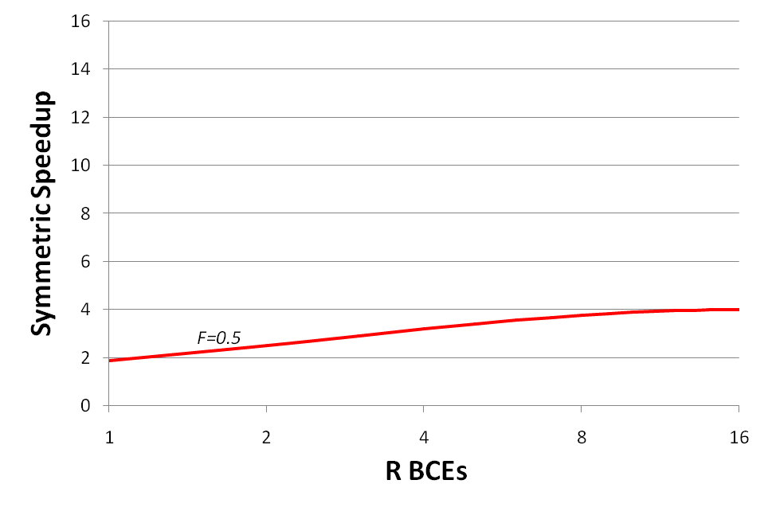
Symmetric Multicore Chip, N = 16 BCEs
F=0.5
R=16,
Cores=1,
Speedup=4
(16 cores)
(8 cores)
(2 cores)
(1 core)
(4 cores)
F=0.5, Opt. Speedup S = 4 = 1/(0.5/4 + 0.5*16/(4*16))
Need to increase parallelism to make multicore optimal!
Wisconsin Multifacet Project
Notes:
LogTM: Log-based Transactional Memory
UW-Madison Architecture Seminar

Slide 21
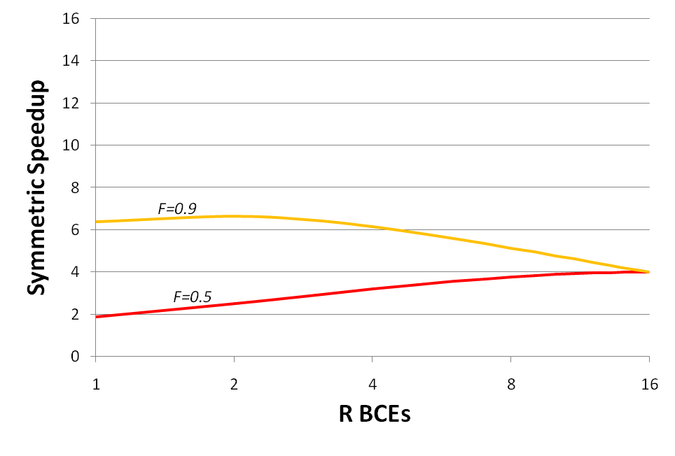
Symmetric Multicore Chip, N = 16 BCEs
F=0.9, R=2, Cores=8, Speedup=6.7
F=0.5
R=16,
Cores=1,
Speedup=4
At F=0.9, Multicore optimal, but speedup limited
Need to obtain even more parallelism!
Wisconsin Multifacet Project
Notes:
LogTM: Log-based Transactional Memory
UW-Madison Architecture Seminar

Slide 22
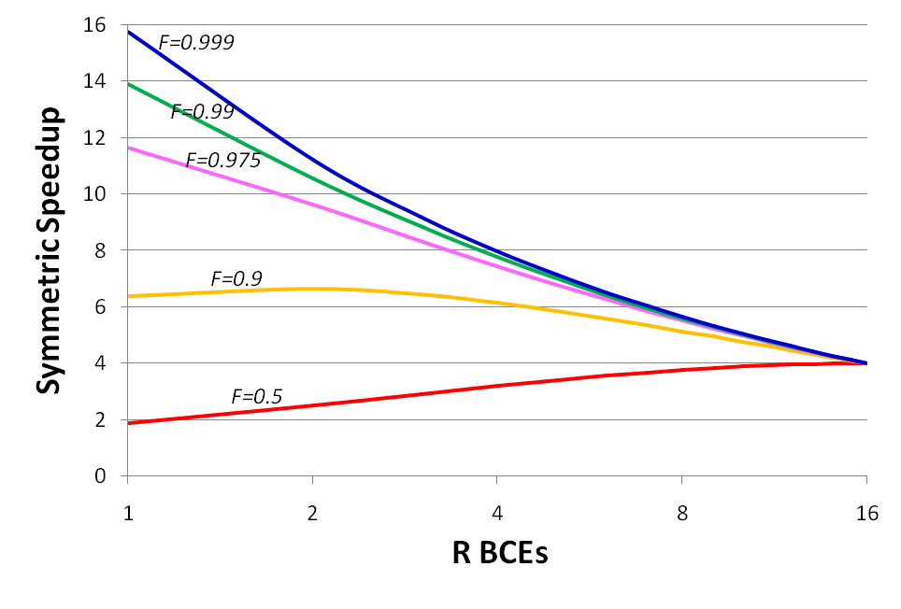
Symmetric Multicore Chip, N = 16 BCEs
F→1, R=1, Cores=16, Speedup→16
F matters: Amdahl’s Law applies to multicore chips
Researchers should target parallelism F first
Wisconsin Multifacet Project
Notes:
LogTM: Log-based Transactional Memory
UW-Madison Architecture Seminar

Slide 23
Symmetric Multicore Chip, N = 16 BCEs
Recall F=0.9, R=2, Cores=8, Speedup=6.7
As Moore’s Law enables N to go from 16 to 256 BCEs,
More core enhancements? More cores? Or both?
Wisconsin Multifacet Project
Notes:
LogTM: Log-based Transactional Memory
UW-Madison Architecture Seminar

Slide 24
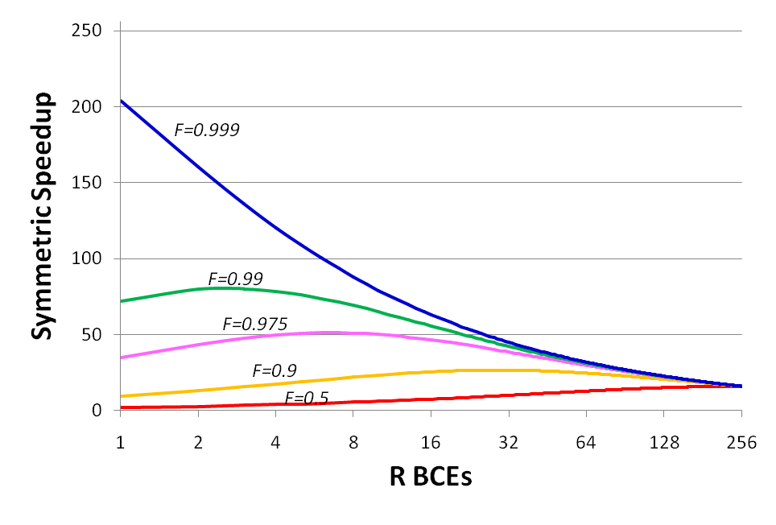
Symmetric Multicore Chip, N = 256 BCEs
F→1
R=1 (vs. 1)
Cores=256 (vs. 16)
Speedup=204 (vs. 16)
MORE CORES!
F=0.99
R=3 (vs. 1)
Cores=85 (vs. 16)
Speedup=80 (vs. 13.9)
CORE ENHANCEMENTS
& MORE CORES!
F=0.9
R=28 (vs. 2)
Cores=9 (vs. 8)
Speedup=26.7 (vs. 6.7)
CORE ENHANCEMENTS!
As Moore’s Law increases N, often need enhanced core designs
Some researchers should target single-core performance
Wisconsin Multifacet Project
Notes:
LogTM: Log-based Transactional Memory
UW-Madison Architecture Seminar

Slide 25
Outline
Recall Amdahl’s Law
A Model of Multicore Hardware
Symmetric Multicore Chips
Asymmetric Multicore Chips
Dynamic Multicore Chips
Caveats & Wrap Up
Wisconsin Multifacet Project
Notes:
LogTM: Log-based Transactional Memory
UW-Madison Architecture Seminar

Slide 26
Asymmetric (Heterogeneous) Multicore Chips
Symmetric Multicore Required All Cores Equal
Why Not Enhance Some (But Not All) Cores?
For Amdahl’s Simple Software Assumptions
  One Enhanced Core
  Others are Base Cores
How?
  <fill in favorite micro-architecture techniques here>
  Model ignores design cost of asymmetric design
How does this effect our hardware model?
Wisconsin Multifacet Project
Notes:
LogTM: Log-based Transactional Memory
UW-Madison Architecture Seminar

Slide 27
How Many Cores per Asymmetric Chip?
Each Chip Bounded to N BCEs (for all cores)
One R-BCE Core leaves N-R BCEs
Use N-R BCEs for N-R Base Cores
Therefore, 1 + N - R Cores per Chip
For an N = 16 BCE Chip:
Symmetric: Four 4-BCE cores
Asymmetric: One 4-BCE core
& Twelve 1-BCE base cores
Wisconsin Multifacet Project
Notes:
LogTM: Log-based Transactional Memory
UW-Madison Architecture Seminar

Slide 28
Performance of Asymmetric Multicore Chips
Serial Fraction 1-F same, so time = (1 – F) / Perf(R)
Parallel Fraction F
  One core at rate Perf(R)
  N-R cores at rate 1
  Parallel time = F / (Perf(R) + N - R)
Therefore, w.r.t. one base core:
1
Asymmetric Speedup =
F
1 - F
+
Perf(R)
Perf(R) + N - R
Wisconsin Multifacet Project
Notes:
LogTM: Log-based Transactional Memory
UW-Madison Architecture Seminar

Slide 29
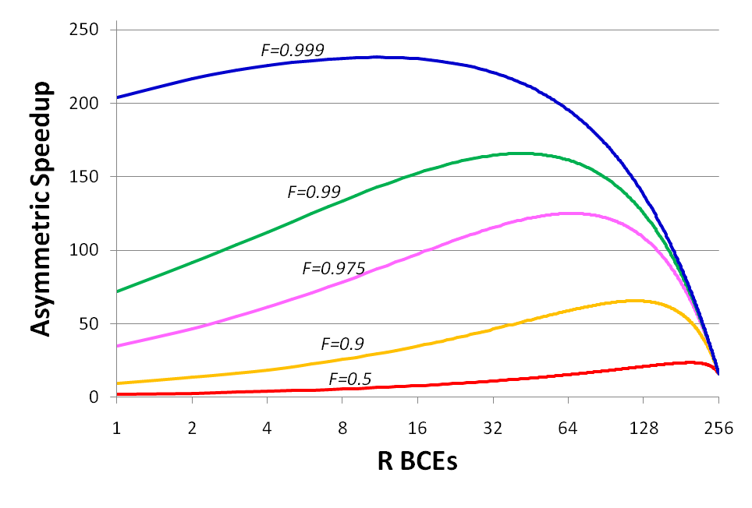
Asymmetric Multicore Chip, N = 256 BCEs
(256 cores)
(253 cores)
(193 cores)
(1 core)
(241 cores)
Number of Cores = 1 (Enhanced) + 256 – R (Base)
How do Asymmetric & Symmetric speedups compare?
Wisconsin Multifacet Project
Notes:
LogTM: Log-based Transactional Memory
UW-Madison Architecture Seminar

Slide 30
Recall Symmetric Multicore Chip, N = 256 BCEs
Recall F=0.9, R=28, Cores=9, Speedup=26.7
Wisconsin Multifacet Project
Notes:
LogTM: Log-based Transactional Memory
UW-Madison Architecture Seminar

Slide 31
Asymmetric Multicore Chip, N = 256 BCEs
F=0.99
R=41 (vs. 3)
Cores=216 (vs. 85)
Speedup=166 (vs. 80)
F=0.9
R=118 (vs. 28)
Cores= 139 (vs. 9)
Speedup=65.6
(vs. 26.7)
Asymmetric offers greater speedups potential than Symmetric
In Paper: As Moore’s Law increases N, Asymmetric gets better
Some researchers should target developing asymmetric multicores
Wisconsin Multifacet Project
Notes:
LogTM: Log-based Transactional Memory
UW-Madison Architecture Seminar

Slide 32
Outline
Recall Amdahl’s Law
A Model of Multicore Hardware
Symmetric Multicore Chips
Asymmetric Multicore Chips
Dynamic Multicore Chips
Caveats & Wrap Up
Wisconsin Multifacet Project
Notes:
LogTM: Log-based Transactional Memory
UW-Madison Architecture Seminar

Slide 33
Dynamic Multicore Chips
Why NOT Have Your Cake and Eat It Too?
N Base Cores for Best Parallel Performance
Harness R Cores Together for Serial Performance
How? DYNAMICALLY Harness Cores Together
  <insert favorite or TBD techniques here>
parallel mode
How would one
model this chip?
sequential mode
Wisconsin Multifacet Project
Notes:
LogTM: Log-based Transactional Memory
UW-Madison Architecture Seminar

Slide 34
Performance of Dynamic Multicore Chips
N Base Cores Where R Can Be Harnessed
Serial Fraction 1-F uses R BCEs at rate Perf(R)
Serial time = (1 – F) / Perf(R)
Parallel Fraction F uses N base cores at rate 1 each
Parallel time = F / N
Therefore, w.r.t. one base core:
1
Dynamic Speedup =
F
1 - F
+
Perf(R)
N
Wisconsin Multifacet Project
Notes:
LogTM: Log-based Transactional Memory
UW-Madison Architecture Seminar

Slide 35
Recall Asymmetric Multicore Chip, N = 256 BCEs
Recall F=0.99
R=41
Cores=216
Speedup=166
What happens with a dynamic chip?
Wisconsin Multifacet Project
Notes:
LogTM: Log-based Transactional Memory
UW-Madison Architecture Seminar

Slide 36
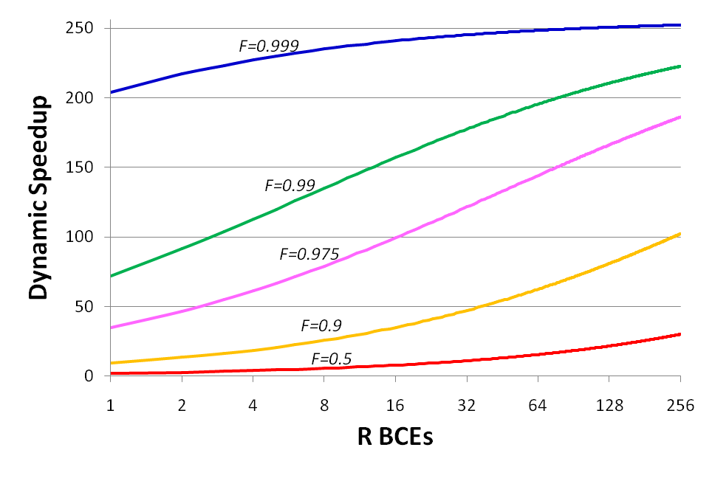
Dynamic Multicore Chip, N = 256 BCEs
F=0.99
R=256 (vs. 41)
Cores=256 (vs. 216)
Speedup=223 (vs. 166)
Note: #Cores always N=256
Dynamic offers greater speedup potential than Asymmetric
Researchers should target dynamically harnessing cores
Wisconsin Multifacet Project
Notes:
LogTM: Log-based Transactional Memory
UW-Madison Architecture Seminar

Slide 37
Outline
Recall Amdahl’s Law
A Model of Multicore Hardware
Symmetric Multicore Chips
Asymmetric Multicore Chips
Dynamic Multicore Chips
Caveats & Wrap Up
Wisconsin Multifacet Project
Notes:
LogTM: Log-based Transactional Memory
UW-Madison Architecture Seminar

Slide 38
Three Multicore Amdahl’s Law
1
Parallel Section
Symmetric Speedup =
F * R
1 - F
+
N/R Enhanced Cores
Sequential Section
1 Enhanced Core
Perf(R)
Perf(R)*N
1
Asymmetric Speedup =
F
1 - F
+
1 Enhanced & N-R Base Cores
Perf(R)
Perf(R) + N - R
1
Dynamic Speedup =
F
1 - F
+
N Base Cores
Perf(R)
N
Wisconsin Multifacet Project
Notes:
LogTM: Log-based Transactional Memory
UW-Madison Architecture Seminar

Slide 39
Software Model Charges 1 of 2
Serial fraction not totally serial
Can extend software model to tree algorithms, etc.
Parallel fraction not totally parallel
Can extend for varying or bounded parallelism
Serial/Parallel fraction may change
Can extend for Weak Scaling [Gustafson, CACM’88]
Run larger, more parallel problem in constant time
But prudent architectures support Strong Scaling
Wisconsin Multifacet Project
Notes:
LogTM: Log-based Transactional Memory
UW-Madison Architecture Seminar

Slide 40
Software Model Charges 2 of 2
Synchronization, communication, scheduling effects?
Can extend for overheads and imbalance
Software challenges for asymmetric multicore worse
Can extend for asymmetric scheduling, etc.
Software challenges for dynamic multicore greater
Can extend to model overheads to facilitate
Wisconsin Multifacet Project
Notes:
LogTM: Log-based Transactional Memory
UW-Madison Architecture Seminar

Slide 41
Hardware Model Charges 1 of 2
Naïve to consider total resources for cores fixed
Can extend hardware model to how core changes effect The Rest
Naïve to bound Cores by one resource (esp. area)
Can extend for Pareto optimal mix of area, dynamic/static power, complexity, reliability, …
Naïve to ignore challenges due to off-chip bandwidth
limits & benefits of last-level caching
Can extend for modeling these
Wisconsin Multifacet Project
Notes:
LogTM: Log-based Transactional Memory
UW-Madison Architecture Seminar

Slide 42
Hardware Model Charges 2 of 2
Naïve to use performance = square root of resources
Can extend as equations can use any function
We architects can’t scale Perf(R) for very large R
True, not yet.
We architects can’t dynamically harness very large R
True, not yet
What if Limit is Dynamic Power, not Area?
Wisconsin Multifacet Project
Notes:
LogTM: Log-based Transactional Memory
UW-Madison Architecture Seminar

Slide 43
Limit from Dynamic Power, but Not Area?
What if DYANMIC POWER Sets Limit to N BCEs?
While Area is Unconstrained (to first order)
What Chip Might One Build?
  Simultaneous Active Fraction (SAF) < ½
  [Chakraborty, Wells, & Sohi, Wisconsin CS-TR-2007-1607]
How Would One
Model This Chip?
parallel mode
sequential mode
Wisconsin Multifacet Project
Notes:
LogTM: Log-based Transactional Memory
UW-Madison Architecture Seminar

Slide 44
Performance With SAF ½ or Less
1 Enhanced Core of R (→ N) BCEs & N Base Cores
Serial Fraction 1-F uses R BCEs at rate Perf(R)
Serial time = (1 – F) / Perf(R)
Parallel Fraction F uses N base cores at rate 1 each
Parallel time = F / N
Look Familiar?
Same as Dynamic Chip!
1
“SAF < ½” Speedup =
F
1 - F
+
Perf(R)
N
Wisconsin Multifacet Project
Notes:
LogTM: Log-based Transactional Memory
UW-Madison Architecture Seminar

Slide 45
Warning, Tale, & Prediction
Just because our models are simple
Does NOT mean our conclusions are wrong
Let me recall a cautionary tale …
Prediction
  While the truth is more complex
  Our basic observations will hold
So what should we do about it?
Wisconsin Multifacet Project
Notes:
LogTM: Log-based Transactional Memory
UW-Madison Architecture Seminar

Slide 46
Four-Part Charge to You
(1) Go out an build better multicore models
Play with & trash our models
  www.cs.wisc.edu/multifacet/amdahl
(2) Importantly, build better multicore software/hardware
Don’t lament that we can’t do, but do it!
(3) Dampen the research pendulum swing
NOT: all serial / no parallel ➔ no serial / all parallel
(4) Dream further out in research & reviewing
Don’t reject, because we don’t want it today
Wisconsin Multifacet Project
Notes:
LogTM: Log-based Transactional Memory
UW-Madison Architecture Seminar

Slide 47
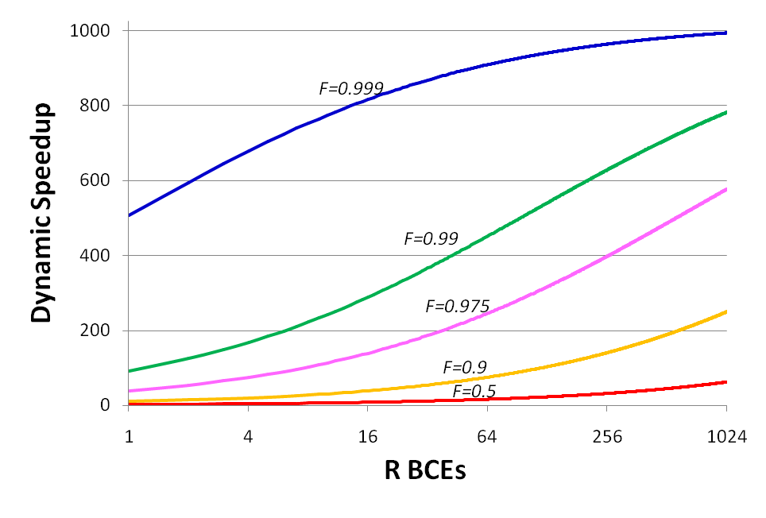
Dynamic Multicore Chip, N = 1024 BCEs
F→1
R→1024
Cores→1024
Speedup→ 1024!
NOT Possible Today
NOT Possible EVER Unless We Dream & Act
Wisconsin Multifacet Project
Notes:
LogTM: Log-based Transactional Memory
UW-Madison Architecture Seminar

Slide 48
Summary: A Corollary to Amdahl’s Law
Develop Simple Model of Multicore Hardware
  Complements Amdahl’s software model
  Fixed chip resources for cores
  Core performance improves sub-linearly with resources
Show Need For Research To
  Increase parallelism (Are you surprised?)
  Increase core performance (especially for larger chips)
  Refine asymmetric design (e.g., one core enhanced)
  Refine dynamically harnessing cores for serial performance
Need Research for Both Parallel & Serial
Wisconsin Multifacet Project
Notes:
LogTM: Log-based Transactional Memory
UW-Madison Architecture Seminar

Slide 49
Backup Slides
Wisconsin Multifacet Project
Notes:
LogTM: Log-based Transactional Memory
UW-Madison Architecture Seminar

Slide 50
Cost-Effective Parallel Computing
Isn’t Speedup(P) < P inefficient? (P = processors)
If only throughput matters, use P computers instead?
But much of a computer’s cost is NOT in the processor [Wood & Hill, IEEE Computer 2/95]
Let Costup(P) = Cost(P)/Cost(1)
Parallel computing cost-effective:
Speedup(P) > Costup(P)
E.g. for SGI PowerChallenge w/ 500MB:
Costup(32) = 8.6

Slide 51
Three Moore’s Laws
Technologist’s Moore’s Law
  Double Transistors per Chip every 2 years
  Slows or stops: TBD
Microarchitect’s Moore’s Law
  Double Performance per Core every 2 years
  Slowed or stopped: Early 2000s
Multicore’s Moore’s Law
  Double Cores per Chip every 2 years
  & Double Parallellism per Workload every 2 years
  & Aided by Architectural Support for Parallelism
  = Double Performance per Chip every 2 years
  Starting now
Or GAME OVER?
Wisconsin Multifacet Project
Notes:
LogTM: Log-based Transactional Memory
UW-Madison Architecture Seminar

Slide 52
How Might Computing Evolve?
Recall 1970s Watergate
  Secret Source Deep Throat (W. Mark Felt @ FBI)
  Helped Reporters Bob Woodward & Carl Bernstein
  Confirmed, but would not provide information
  Frequently recommended: Follow the Money
Today I recommend: Follow the Parallelism!
Computing Center of Gravity Moving To Favor
  Where Parallelism Helps Performance
  Where Parallelism Helps Cost-Performance
Servers to use vast parallelism. Clients? Embedded?
Wisconsin Multifacet Project
Notes:
LogTM: Log-based Transactional Memory
UW-Madison Architecture Seminar

Slide 53

Symmetric Multicore Chip, N = 16 BCEs
Wisconsin Multifacet Project
Notes:
LogTM: Log-based Transactional Memory
UW-Madison Architecture Seminar

Slide 54

Symmetric Multicore Chip, N = 256 BCEs
Wisconsin Multifacet Project
Notes:
LogTM: Log-based Transactional Memory
UW-Madison Architecture Seminar

Slide 55
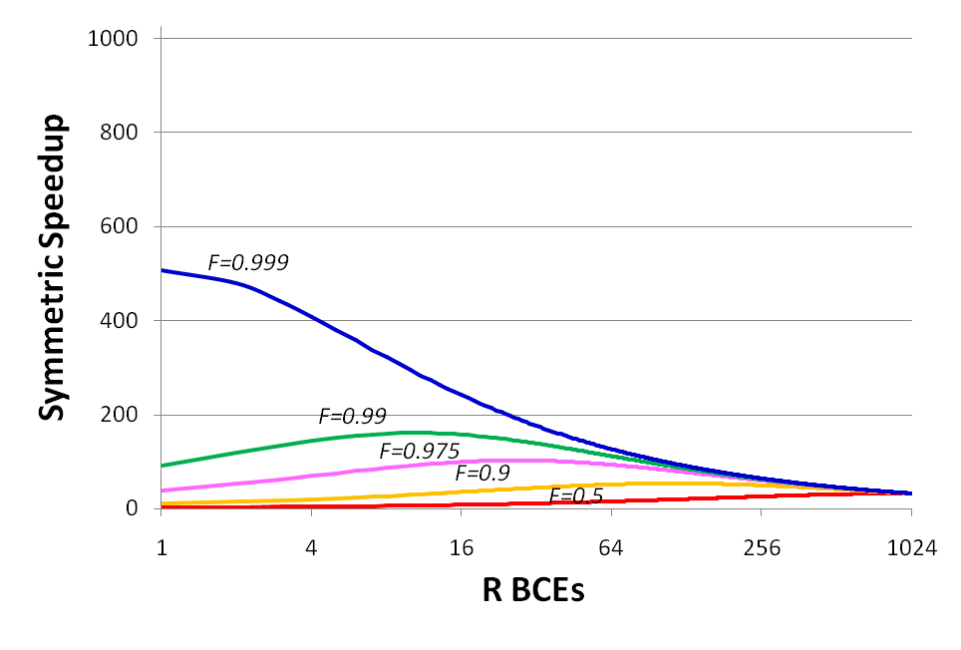
Symmetric Multicore Chip, N = 1024 BCEs
Wisconsin Multifacet Project
Notes:
LogTM: Log-based Transactional Memory
UW-Madison Architecture Seminar

Slide 56
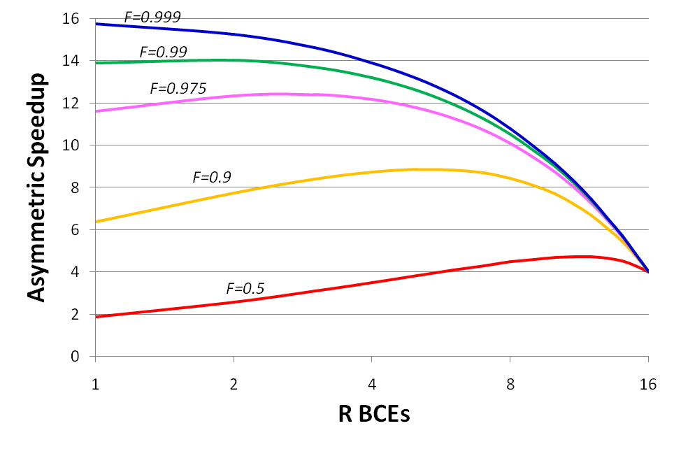
Asymmetric Multicore Chip, N = 16 BCEs
Wisconsin Multifacet Project
Notes:
LogTM: Log-based Transactional Memory
UW-Madison Architecture Seminar

Slide 57

Asymmetric Multicore Chip, N = 256 BCEs
Wisconsin Multifacet Project
Notes:
LogTM: Log-based Transactional Memory
UW-Madison Architecture Seminar

Slide 58
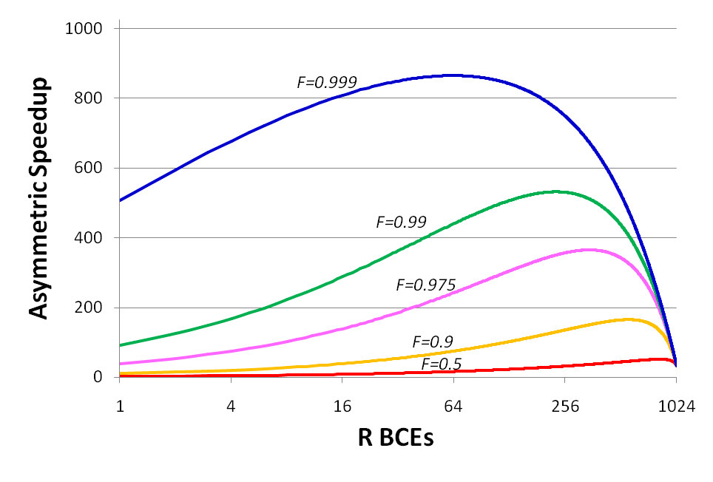
Asymmetric Multicore Chip, N = 1024 BCEs
Wisconsin Multifacet Project
Notes:
LogTM: Log-based Transactional Memory
UW-Madison Architecture Seminar

Slide 59
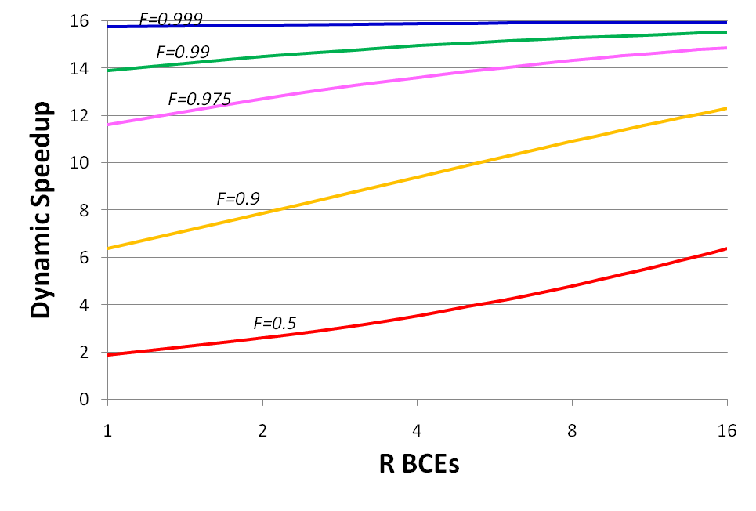
Dynamic Multicore Chip, N = 16 BCEs
Wisconsin Multifacet Project
Notes:
LogTM: Log-based Transactional Memory
UW-Madison Architecture Seminar

Slide 60
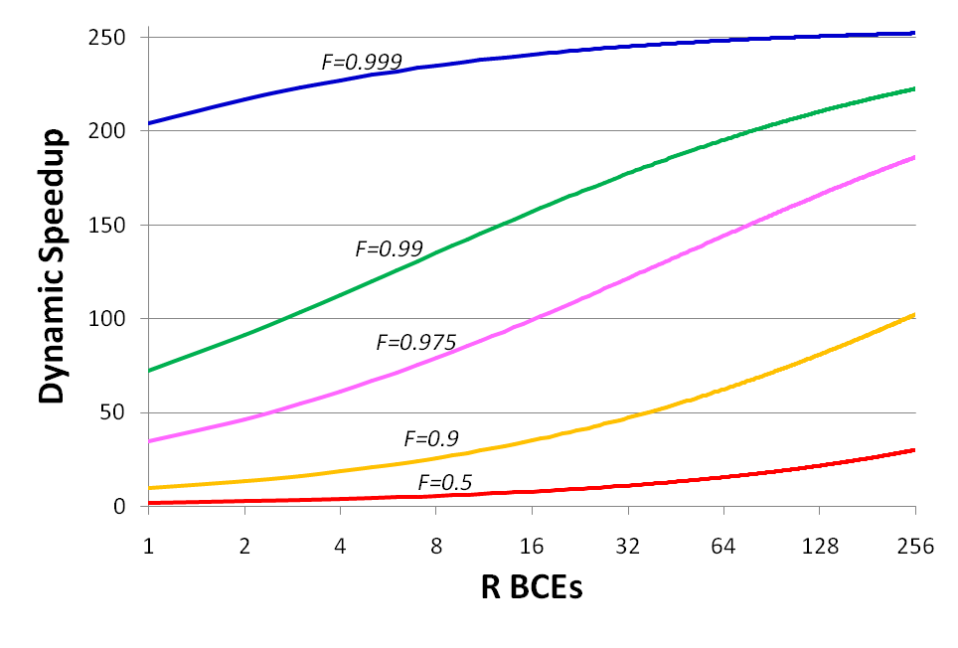
Dynamic Multicore Chip, N = 256 BCEs
Wisconsin Multifacet Project
Notes:
LogTM: Log-based Transactional Memory
UW-Madison Architecture Seminar

Slide 61
Dynamic Multicore Chip, N = 1024 BCEs
Wisconsin Multifacet Project
Notes:
LogTM: Log-based Transactional Memory
UW-Madison Architecture Seminar

