Slide 1

Floor Planning via
Convex Optimization
Final Projection - EEC 254 (Winter 2018)
^{By: Ahmed Mahmoud}

Slide 2
Agenda
Problem Definition & Motivation
Problem Formulation
Project Goal(s)

Slide 3
Problem Definition
Configure some rectangles within a bounding box
Objective function is on the bounding box
Constraints is on the shape and size of rectangles
Notes:
In floor planning problem, we have some rectangles that are to configured and placed in a such a way that they do not overlap. The objective is usually to minimize the area of the bounding box, which is the smallest rectangle that contains the rectangles to be configured and placed. Each rectangle can be reconfigured, within some limits. For example, we might fix the area of each rectangle, but not the width and height separately (this might give very skinny rectangles so we might also limit the aspect ratio to be within some limits).

Slide 4
Problem Definition
Objective:
minimize the size (area, perimeter) of the bounding box
or, maximize the size of the rectangles given a fixed bounding box
Variables:
rectangles’ positions
rectangles’ sizes
bounding box size
Notes:
The objectives we are dealing with here could be either to minimize the size of the bounding box, or having a bounding box with fixed size inside which we are trying to maximize the size of the rectangles. By size here I mean the area or the perimeter. And the variables we are allowed to change is the rectangle positions and their length and width. We are also allowed to change the bounding box width and height.

Slide 5
Problem Definition
Constraints:
no overlap
relative position
Notes:
The constraints always starts with ensuring no overlap between rectangles, but only having this constraint makes the problem complicated combinatorial optimization. For that we add more constraints that help us making the problem a convex optimization one like relative position, so you specify that rectangle A is to be to the left of rectangle B which should be on the top of rectangle C and so on. This can be constructed using a pair of graphs (one for the horizontal relative position and one for the vertical relative position).

Slide 6
Problem Definition
4
Constraints:
no overlap
relative position
5
1
3
2
4
5
5
1
3
3
4
2
1
2
Vertical Graph
Horizontal Graph
Notes:
The constraints always starts with ensuring no overlap between rectangles, but only having this constraint makes the problem complicated combinatorial optimization. For that we add more constraints that help us making the problem a convex optimization one like relative position, so you specify that rectangle A is to be to the left of rectangle B which should be on the top of rectangle C and so on. This can be constructed using a pair of graphs (one for the horizontal relative position and one for the vertical relative position).

Slide 7
Problem Definition
Constraints:
no overlap
relative position (implies no overlap)
all rectangles inside the bounding box
minimum rectangles area/aspect ratio/perimeter
symmetry
alignment
similarity
Notes:
The constraints always starts with ensuring no overlap between rectangles, but only having this constraint makes the problem complicated combinatorial optimization. For that we add more constraints that help us making the problem a convex optimization one like relative position, so you specify that rectangle A is to be to the left of rectangle B which should be on the top of rectangle C and so on. This can be constructed using a pair of graphs (one for the horizontal relative position and one for the vertical relative position).
Giving the relative positions implies the non-overlap constraints. Of course you want all the rectangles to be inside the bounding box. Additional constraints could include the shape and size of the rectangles like their minimum area, aspect ratio (which is the ratio of the length to the width of the rectangles) or the perimeter. It may be needed to have some symmetry along a certain axis of the bounding box (for aesthetic purpose) or alignment between some of the rectangles. Alignment could be along the edges of the rectangles or their centers. Similarity between the rectangles simply means that rectangle A is within a scaling factor of rectangle B.

Slide 8
Motivation
Architecture:
the rectangles are rooms/floors
arrange rooms within fixed bounding box
VLSI:
minimize the area of the blocks which decompose a circuit
Notes:
The two fields that are interested in solving this problem is Architecture and VLSI design. In architecture the rectangles are the rooms are constrained to have a minimum and/or maximum area and the walls should be aligned in certain way. The area of the bounding box is usually fixed so the objective here is to maximize the size of the rooms and utilize the whole area of the bounding box while making sure all constraints are satisfied.
In VLSI design, millions of logic components that build up a circuit are partitioned into blocks. These blocks have a minimum area defined by the component from which it is built up. The goal here is to place the blocks so that the area of the chip is minimized and certain placement constraints are respected (most importantly to have certain clearance between different components).

Slide 9















Formulation
BB
$${ c}_{k}$$
Bounding Box (BB):
width $W$ and height $H$
starts at $\left(0,0\right)$
Cells:
$N$ cells
cell${ c}_{i}$ is defined by its lower left corner $\left({ x}_{i},{ y}_{i}\right)$, width $w_{i}$ and height${ h}_{i}$
$$h_{k}$$
$${ x}_{k},{ y}_{k}$$
$$w_{k}$$
$${ c}_{i}$$
$$H$$
$$h_{i}$$
$$h_{j}$$
$${ c}_{j}$$
$${ x}_{j},{ y}_{j}$$
$$w_{j}$$
$${ x}_{i},{ y}_{i}$$
$$w_{i}$$
$$W$$
Notes:
The formulation starts by defining a bonding box that will contains all the cells. The BB will starts at (0,0) with width W and height H. We will have N cells, each defined by their lower left corner and their width and height.

Slide 10

Formulation
Objective Functions
Minimize BB area:
$A=H.W$
Notes:
The first objective function we can deal with is the area of the bounding box

Slide 11
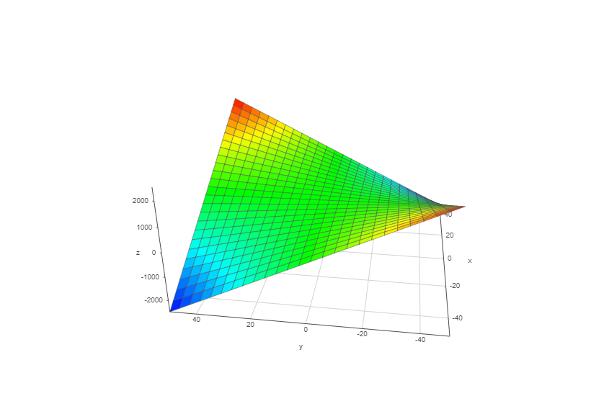

Formulation
Objective Functions
Minimize BB area:
$A=H.W$
Hessian’s minimum eigenvalue <0 non-convex
Take $log$
$log\left(A\right)=\log\left(H\right)+log⁡(W$) concave
Notes:
The function is non convex actually since the hessian as minimum eigenvalue less than zero and so it is not positive semi-definite.
Instead we can take the log of this function and the resulting function is concave, but still we want to minimize this function (not maximize) and so it does not fit into the standard convex optimization formulation.

Slide 12
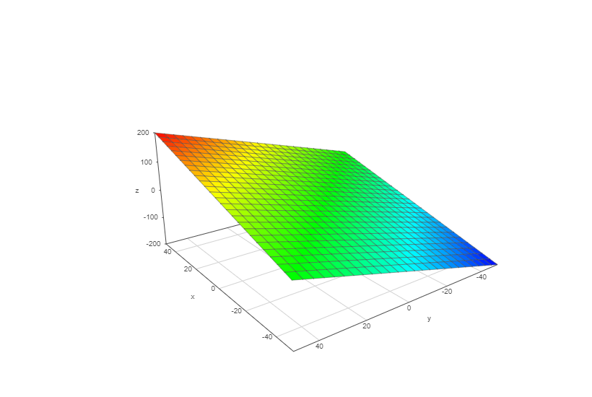

Formulation
Objective Functions
Minimize BB perimeter:
$p=2\left(H+W\right)$
Affine, tend to form equal sides BB
Notes:
Instead we will use the perimeter as the objective when we want to minimize the size of the bounding box which is affine function and looks way nicer than the area function. Additionally, since minimizing the area could lead to very skinny BB, minimizing the perimeter tend actually to have equal sides which is preferred for VLSI design.

Slide 13

Formulation
Objective Functions
Maximize cells area:
concave function
$max{ \left(\log\left(w_{i}\right)+\log\left(h_{i}\right)\right)}, i=1,…, N$
multi-criterion with $N$ objective function
scalarization
$max{ \sum_{i=1}^{N}{\left(\log\left(w_{i}\right)+\log\left(h_{i}\right)\right)}}$
Notes:
The other objective function that we may want to work on is the area of the cells and we usually want to maximize it. Using the log area, and since its concave and we want to maximize it, then it can fit in the standard convex optimization formulation. The problem is then a multi-criterion problem with N objective function. We can do scalarization to this function by choosing to maximize the sum of all area.

Slide 14

Formulation
Constraints
Basic constraints:
- Everything inside the bounding box
$x_{i}≥0$,
,
$x_{i}{+w}_{i}≤W$,
$y_{i}+h_{i}≤H$, $i=1,…, N$
- Widths and length should be positive
$w_{i}≥0$,
$h_{i}≥0$, $i=1,…, N$
Notes:
We now move to talk about the constraints. Not all the constraints I am going to talk about are necessary. For that we start with the few basic constraints and then move to optional constraints.
The first four constraints are set to make sure that everything is inside the bounding box.
Then the other two constraints are make sure that solution is physically realizable
All these constraints are affine function

Slide 15









Formulation
$${ c}_{i}$$
Constraints
No overlap:
$int\left(x_{i}∩x_{i}\right)=∅$, $i≠j$
Use relative position:
$x_{i}+w_{i}≤x_{k}$ →${ c}_{i} to the left of{ c}_{k}$
$y_{k}+h_{k}≤y_{i}$ →${ c}_{k} below{ c}_{i}$
Minimum clearance:
$x_{i}+w_{i}+ ρ≥x_{j}, ρ≥0$
$$h_{i}$$
$${ x}_{i},{ y}_{i}$$
$$w_{i}$$
$${ c}_{k}$$
$$h_{k}$$
$${ x}_{k},{ y}_{k}$$
$$w_{k}$$
Notes:
The second set of basic constraints is the non-overlapping constraints. As we mentioned, it can be imposed used inequality. For example, for these two cells c_i and c_k, we can specify the relative position as an inequality in lower left corner and the length and width of the cells. Of course if we specify all the relative position, we will end up with N^2 inequality and most of which are useless. That is why we use the graph idea to reduce the number of inequality and remove redundant inequalities.
Also we can specify minimum clearance between blocks as well to avoid having the cell tightly packing. So specify the clearance using rhp, and add it to the inequality constraints

Slide 16
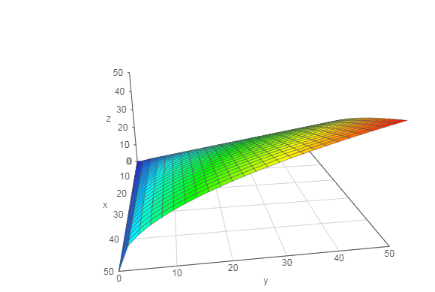

Formulation
Constraints
Minimum area:
Avoid zero area – can be used as equality constraint
$\sqrt{h_{i}w_{i}}≥\sqrt{A_{min}}$or ${log⁡(h}_{i})+{log⁡(w}_{i}) ≥log⁡(A_{min})$
Notes:
In order to avoid the trivial solution of having all cells with zero area, we have to set a minimum area for the cells. It could be different for different cells. We can use either the square root expression (which is convex as shown here) or the log expression. We notice that both expression are not affine function and so we can not use them as equality constraints, means that we can not specify fixed area for the cells

Slide 17

Formulation
Constraints
Aspect ratio:
- Ratio between height to width – can be used as equality constraints
$$σ_{i}^{min}≤h_{i}/w_{i}≤σ_{i}^{max}$$
$$σ_{i}^{min}.w_{i}≤h_{i}≤σ_{i}^{max}.w_{i}$$
Notes:
Aspect ratio makes sure the shapes of the cells are not too skinny or too fat. It is the ratio of the height to the width of the cell. We can easily impose upper and lower bound on the aspect ratio which is an linear inequality and it can be used as an equality constraints as well.

Slide 18




Formulation
Constraints
Symmetry:
Equality constraints
$$x_{axis}+{(y_{i}+h}_{i}/2)=x_{axis}−{(y_{k}+h}_{k}/2)$$
$${ x}_{axis}$$
$$y_{i}+h_{i}/2$$
$$y_{k}+h_{k}/2$$
Notes:
We can require to have some symmetry a long a certain axis. For example, we can impose the symmetry along the x axis using the linear equality constraint shown. Actually we might even make the axis of symmetry floating by giving it as a variable as well.

Slide 19





Formulation
Constraints
Containment:
- Impose that the cell to contain a point or to be contained inside a polyhedron
$$0≤x_{p}−x_{i}≤w_{i}, 0≤y_{p}−y_{i}≤h_{i}$$
$${ x}_{p},{ y}_{p}$$
$$h_{k}$$
$${ x}_{k},{ y}_{k}$$
$$w_{k}$$
Notes:
We may impose containment constraints as well such that a cell contains a certain point or to be contained inside a polyhedron. All of these can be specified using linear inequality

Slide 20

Formulation
Primal Problem
Basic Problem:
Min BB area, no overlapping cells, each block has minimum area
Variables:
- $W, H∈ℝ$
- $(x_{i},y_{i},h_{i},w_{i})$ $∈ℝ4$ for $N$cells

Slide 21

Formulation
Primal Problem
Relative Position (functions):
Using two relations on $\left\{1,…, N\right\}$
ℒ (left to), ꞵ (below)
$C_{i}$ is left to $C_{j}$if $(i,j)∈$ ℒ $C_{i}$is below $C_{j}$if $(i,j)∈$ ꞵ
Relation is anti-symmetric
$(i,j)∈$ ℒ $↔$ $(j,i)∈$ ℒ

Slide 22

Formulation
Primal Problem
Relative Position (matrices):
$L_{i,j}=\left\{\begin{aligned}1,(i,j)∈ \text{ℒ} \\ &0, otherwise\end{aligned}\right. B_{i,j}=\left\{\begin{aligned}1, (i,j)∈\text{ꞵ} \\ &0, otherwise\end{aligned}\right.$
Notes:
Here we define two matrices, L and B, based on the relations we have just defined. This makes it easy to deal with all the relative positions constraints in concise way.

Slide 23

Formulation
Primal Problem
min $2(H+W)$
s.t $−x\text{≼}0, −y\text{≼}0, −w\text{≼}0, −h\text{≼}0, −H≤0, −W≤0$
$x+w−W.1\text{≼}0$, $y+h−H.1\text{≼}0$
$A_{i}/h_{i}\text{-}w_{i}≤0$, $i=1,…,N$
$L_{i,j}.\left(x_{i}\text{+}w_{i}−x_{j}\right)≤0,{ B}_{i,j}.\left(y_{i}\text{+}h_{i}−y_{j}\right)≤0,$ i,j$=1,…,N, i≠j$
Notes:
The first set of constraints make sure all number are positive (x,y,w,h are vectors of length equal to number of cells)
Second constraints makes sure that the BB contains all the cells
Third constraint preserves the minimum area
Last constraints uses L and B matrices to integrate the relative position constraints in the standard convex optimization formulation

Slide 24
Project Goal
Formulate the problem as a geometric programming
Add new constraints
Numerical results using CVX

Slide 25
Thank You!

