Slide 1
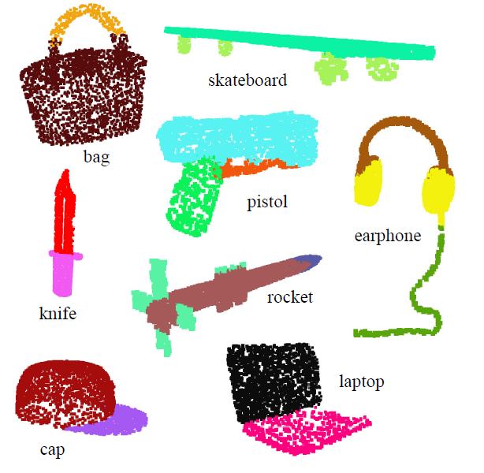
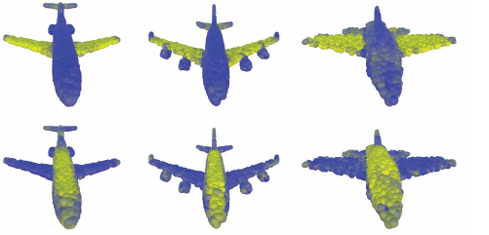
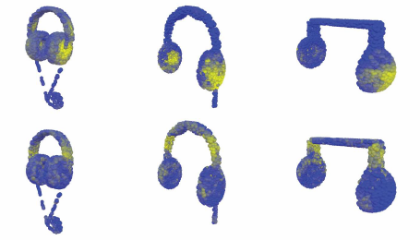

xyzCNN: Convolutional Neural Network for 3D pointcloud classification
Final Project - EEC 289Q (Spring 2018)
^{Ahmed Mahmoud}
^{Muhammad Awad}
Figures: PointNet(2017), Dynamic Graph CNN for Learning on Point Clouds(2018)
Notes:
We are trying to classify 3d pointclouds by using convolutional neural network. The classification is similar to image classification where each input image is given a score to what category it belongs to and we take the maximum but here the input is 3D points so we have x,y,z coordinates of the points. The problem may seem easy or very similar to image classification but actually there are number of challenges that we are going to point out to now and then we will talk about our approach and hypothesis to tackle these challenges.

Slide 2
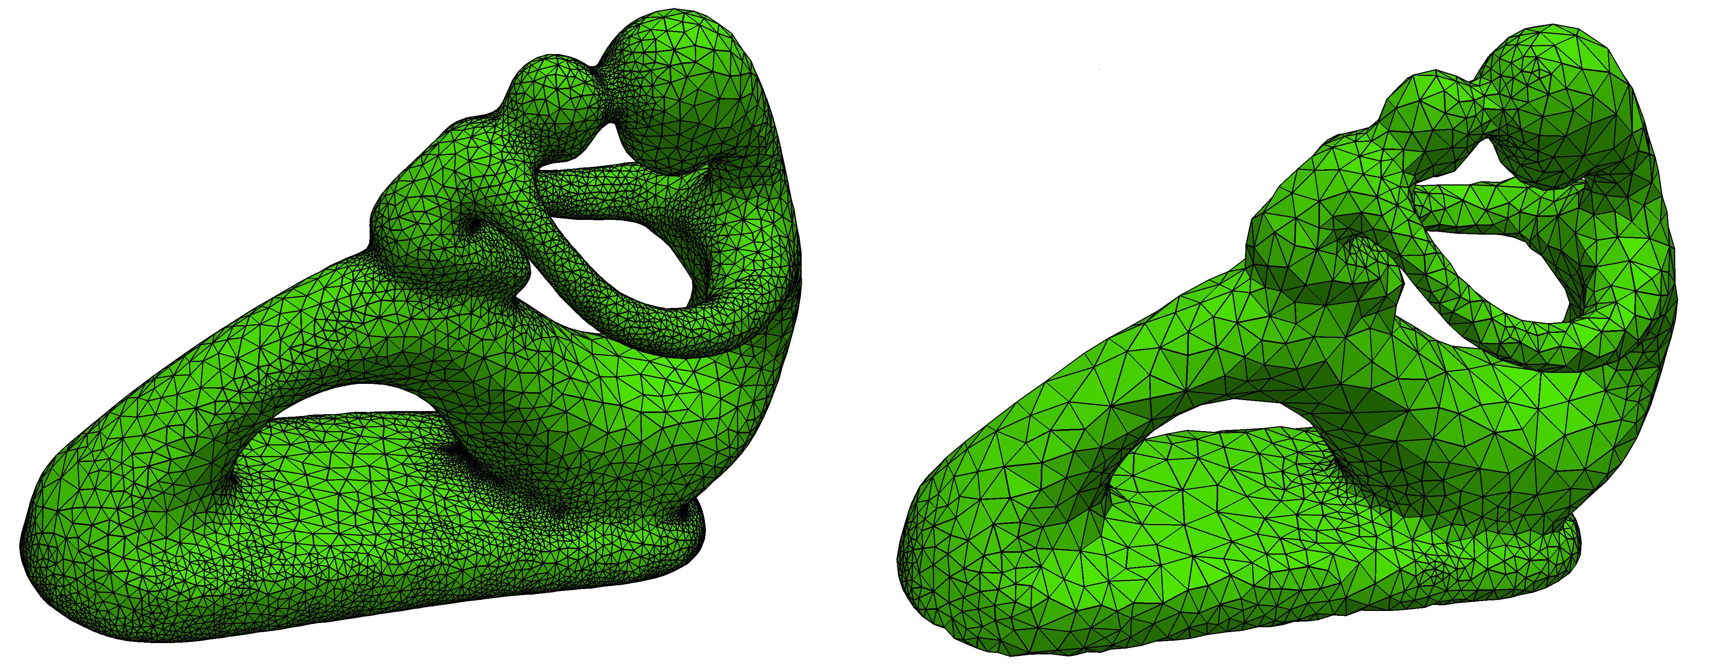
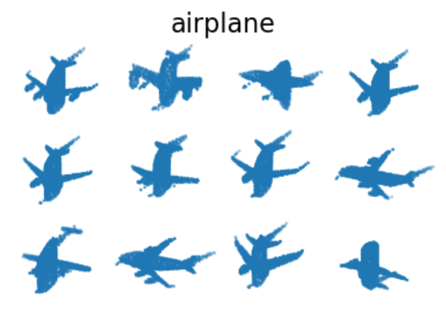
PC Classification – Challenges
Input:
Irregular
Unordered
Shifted or rotated
downsample
Notes:
Most of the challenges is due to
Irregular: unlike images that has a fixed size 512x512 or 128x128, we probably don’t know the size of the input in advance not even the size of the training set because such pointclouds come from scanning operations which is indeterministic in terms of the number of the points
Unorder: images are orders as you always know where the left-bottom corner or the top-right corner of the image from which you can number the pixels. Having a collection of (x,y,z) coordinates in a 3d space has no precious order. In certain input and as you read the input from a file, the first point could be in the middle of the shape or it could be at the bottom.
Shifted or rotated: this is also applicable to images, where the points could be shifted by a fixed factor or rotated. This is sometimes called rigid transformation.

Slide 3
PC Classification – Solutions
Input:
Irregular: pick certain number (1024) uniformly random (uneven clusters)
Unorder: lexicographic ordering
Shifted or rotated: apply shift/rotation-invariant function (norm, dot product)
Notes:
Here we show some solutions we used in our project
Irregular: we can pick certain number of points either when we train or for inference. This worked well and actually all the existing work on classification point cloud do this. However, this is wrong since the underlaying sampling space (the point cloud) are not usually uniform sampled. There always some clustering at certain spaces. If you choose points randomly then we will probably end up picking on this clusters where other features of the shape that poorly samples are not picked which gives misleading information to the network
Unorder: one easy solution is to sort all the input for training in what is called lexicographic order; this is like sorting the names in phone book. But actually there is no consistent ordering that is stable with point perturbation. So, the pointcloud could be contain noise and this noise will definitely affect the ordering
Shifted or rotated: we apply function that invariant to the shifting or rotation for examples the distance or norm generally or dot products.

Slide 4
PC Classification – Model
Feature Extraction
CNN Model
KNN_10
EdgeFeatures_10
conv1 – ReLU – 64Ch
KNN_20
EdgeFeatures_20
conv2 – ReLU – 64Ch
N x 3
Reshape
FC2 – ReLU – 256
FC3 – ReLU – 40
Concatenate - 320
FC1 – ReLU – 512
conv5 – ReLU – 1024Ch
Dropout – 0.5 prop
Dropout – 0.5 prop
KNN_30
EdgeFeatures_30
conv3 – ReLU – 64Ch
KNN_40
EdgeFeatures_40
conv4 – ReLU – 128Ch
Raw Input
Input Feature
Dropout
Conv/FC Layer

Slide 5
PC Classification – Evaluation
Algorithm | #Points | Accuracy
pointnet | 1024 | 89.2
pointnet++ | 1024 | 90.7
deep sets | 1000 | 87.1
ECC | 1000 | 87.4
kd-network | 32K | 91.8
Point cnn by ext. op | 1024 | 92.3
DGCNN | 1024 | 91.2
Ours | 1024 | 91.5
Input:
ModelNet40 (Princeton ModelNet project)
40 categories
12,311 models (9,843 for training and 2,468 for testing)
Notes:
Our hypothesis the

Slide 6
PC Classification – Next Step
Adding normal as raw input:
Distance is not enough
Two pairs of point might have same distance but different normal
p1
p2
p1
p2
Same distance

