Slide 1
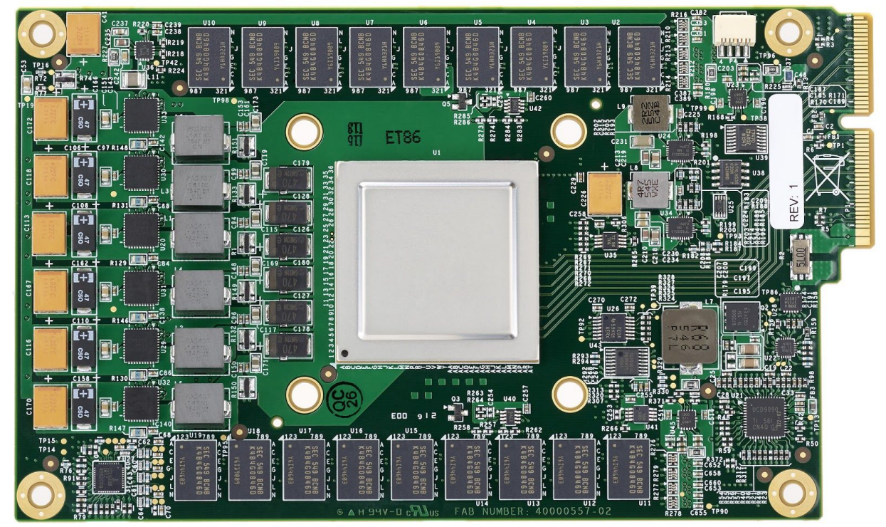
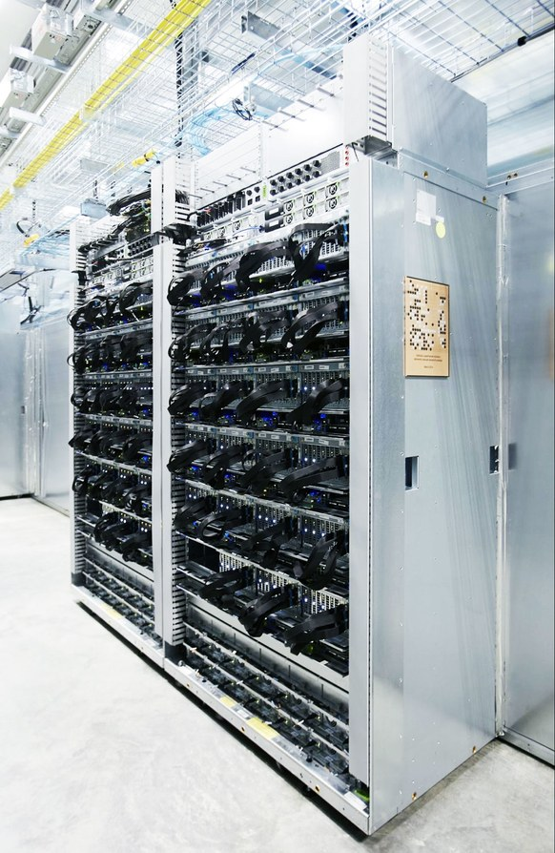
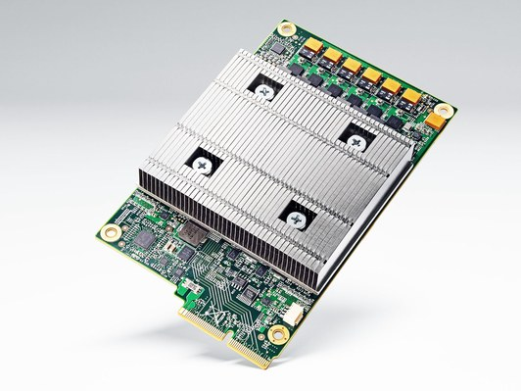

In-Datacenter Performance Analysis of Tensor Processing Unit
Paper Presentation for EEC 289Q (Spring 2018)
^{By: Ahmed Mahmoud}
^{Muhammad Awad}
Notes:
Names
This is our paper
Our talk is organized as follows: I will give an overview of the whole TPU project and important things to keep in mind when we talk about the design and the specifics of the TPU which Muhammad will talk to us about. After that I will a little discussion and will hint to few things that are not in the paper but could be interesting.

Slide 2
TPU - Overview
Introduces and evaluates 1st-gen Tensor Processing Unit (TPU)
Used for Neural Network (NN) inference in Google datacenters since 2015
Focus on improving the response-time not (just) the throughput (like GPU)
The performance is compared to Intel Haswell CPU and Nvidia K80 GPU
Application written in TensorFlow
TPU is 15X-30X faster than GPU or CPU, with 30X-80X TOPS/Watt* higher
*TOPS = TeraOps/second
Notes:
Since machine learning application is compute intensive and time consuming, people started think of how to accelerate it. There are many options for machine learning accelerators including GPU, FPGA, and ASIC (application specific integrated circuits). TPU is one of these ASIC accelerators developed by Google. The paper we will present will talk about TPU design, evolutions and compare it against other accelerators. In most of this presentation, we are going to talk about the first generation which was deployed in Google data centered in 2015. The second generation was announced in May 2017, and the third generation was announced earlier this month. The major components of this paper is that they built TPU for inference on neural network. They focused on response-time (which you can call the user experience) this is a little different than GPU which is high-throughput oriented design. The comparison they make was against Intel Haswell and GPU K80 which are now both old architecture but they have good reasons why they compare with them. The application here are written on TF. In general, TPU is between 15X-30X faster than GPU and CPU and from 30 up to 80 more energy efficient.

Slide 3
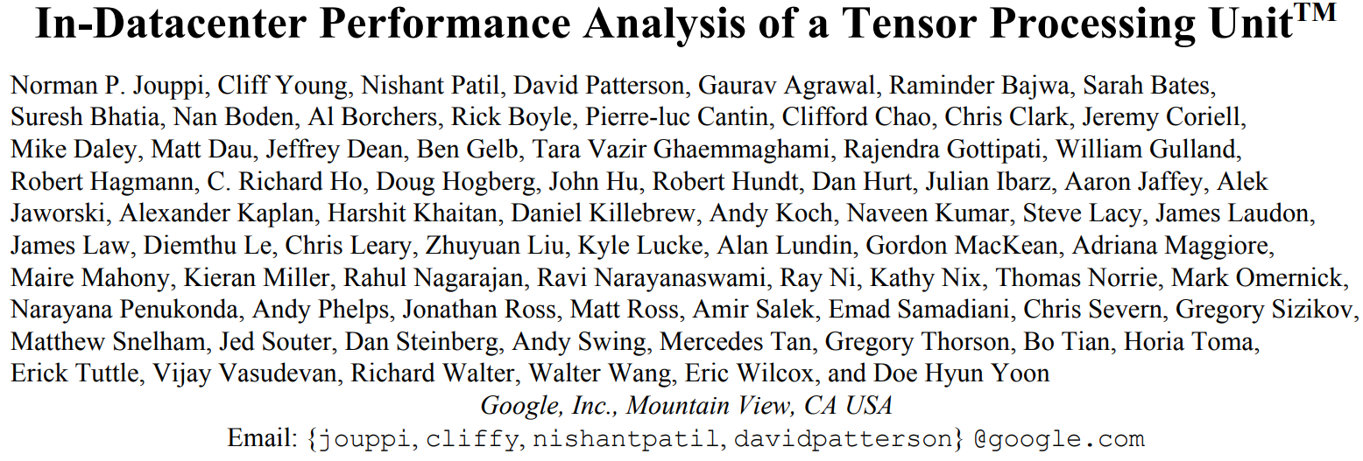
TPU - Overview
The Paper appeared at the 44th International Symposium on Computer Architecture (ISCA) June 26, 2017
More than 70 authors on the paper
Notes:
The paper was presented in the 44th International Symposium on Computer Architecture June last year (which is a little bit weird given that it was deployed and running in Google data-centers since 2015 but maybe they have to be a little secretive for one reason or another)
The paper has more than 70 authors and co-authors. Notable names David Patterson; pioneer computer architect and Jeffery Dean; the head of Google AI. Other are software and hardware engineers. There are also mechanical engineers (I guess they helped with the cooling system).

Slide 4
TPU - Origin
2013: Prepare for success-disaster of new DNN apps
Users speaking to phone 3 minutes a day will require 2x whole datacenter fleet
Custom HW to reduce the TCO* of DNN inference phase by 10x vs. GPU
A very short development cycle
Started 2014, running in datacenter 15 month later
Announced during Google I/O May, 2016 as ‘10x performance/Watt‘
*TCO = Total Cost of Ownership
Notes:
Thinking about build accelerator for the inference of Neural Network started around 2013 when Google made the following projection. If all the Android phone users did a voice search for three minutes per day, Google will have to double its whole datacenters fleet in order to run the machine learning models they have. Again, here we are talk about inference.
They saw that the right path is to build a custom hardware. They set the goal to be a reduction of the Total Cost of Ownership for DNN inference phase by 10x vs. GPU. TCO can be thought of the cost of the initial cost of manufacturing plus the cost of running. Meanwhile, the training would still be done on the off-the-shelf GPU. This changed after the second generation which can be used for both inference and training. They had a very short development and design cycle of 15 months. This included designing, prototyping, testing and deploying to the data centers. This affected some of the design decision as we will see later.

Slide 5
TPU - Origin
Key NN Concepts for Architects:
Training vs. inference
Floating-point vs. Integer (“Quantization”)
Training in floating point on GPU
Inferring in integers is faster, lower energy, smaller
8-bits multiply is 6X less energy and 6X less area than IEEE 754 16-bit multiply
Batch size
Problem: DNNs have millions of weights that take a long time to load from memory (DRAM)
Solution: Large batch → amortize weight-fetch time by inferring (or training) many input examples at a time

Slide 6
TPU - Origin
Focuses on three types of NNs
Multilayer Perceptrons (MLP)
Convolutional Neural Network
Recurrent NN: Long Short-Term Memory (LSTM)
Represents 95% of the workload in Google datacenters
Notes:
There are different NN models that one can focus on. In Google datacenters, there are only three models that make up 95% of the workload and the are the MLP and convolutional neural network and one type of recurrent NN which is the LSTM. Because of that all the benchmark results and comparisons will be focused on these three models.

Slide 7
TPU - Benchmark
Applications written in TensorFlow (short; 100 to 1500 lines)
Comprise small pieces of larger applications run on the host server (large; thousands to millions of lines)
Applications are user-facing → rigid response-time limits
Notes:
TPU was designed to be easily programmed by the TensorFlow which make it easier to be deployed. Most of the application are about 100 to 1500 lines of codes. This is the NN coding part which is small pieces of larger application running on the host server of thousands to millions lines of codes. All the application are user facing and this put a vert strict response-time limit because if the user receives the results of the search query after like a 30 seconds, they might go to another search engine.

Slide 8
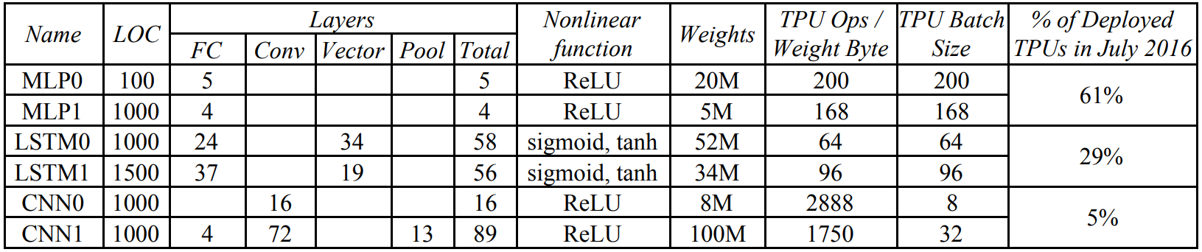
TPU - Benchmark
Six applications; two MLP, two LSTM, and two CNN
Varying number of layers, weights and batch size
CNN is 5% of the workload, MLP is 61% of it
Notes:
In the benchmark, they focused on six applications; two MLP, two LSTM and two CNN. What you should take from this table is the variety of the parameters of these application and how they span a good wide spectrum. For example if you look at the number of layers (RED) MLP1 is about 4 layers and CNN1 89 layers. The weights also vary from 5M to 100M. Batch size for inference is the size of the input for which you are doing the inference. For example, if you have a trained network and want to classify an image, you might instead want to classify more than one image at the same time. The number of images that you want to classify at the same time is called the Batch size. Here we have batch sizes from 8 up to 200. Finally, I guess this is important that more than 60% of the workload on google datacenters is MLP models while CNN models only make up 5%.

Slide 9
SWITCH

Slide 10
Design Key Ideas
CISC (Complex Instruction Set Computer)
Instructions are sent over a slow PCIe bus
Read_Host_Memory
Read_Weights
MatrixMultiply/Convolve
Activate
Write_Host_Memory
>10 CPI
No Caches (Software controlled buffers)
Hide latency with a 4-stage pipeline
In order issuing

Slide 11
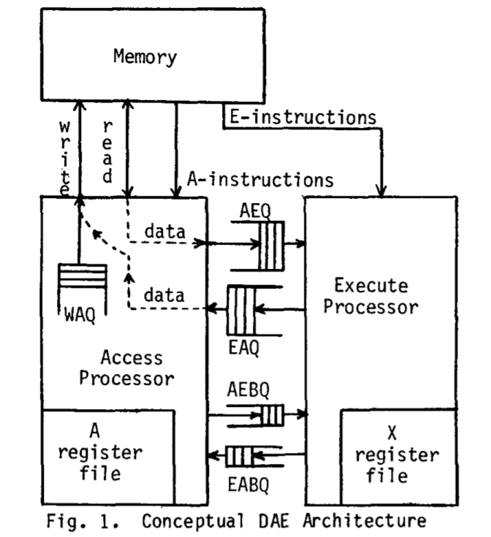
Design Key Ideas
Decoupled-Access/Execute philosophy
Read_Weights fetches data before weights are read from Weight Memory
Decoupled access/execute computer architectures, James E. Smith (1982)

Slide 12
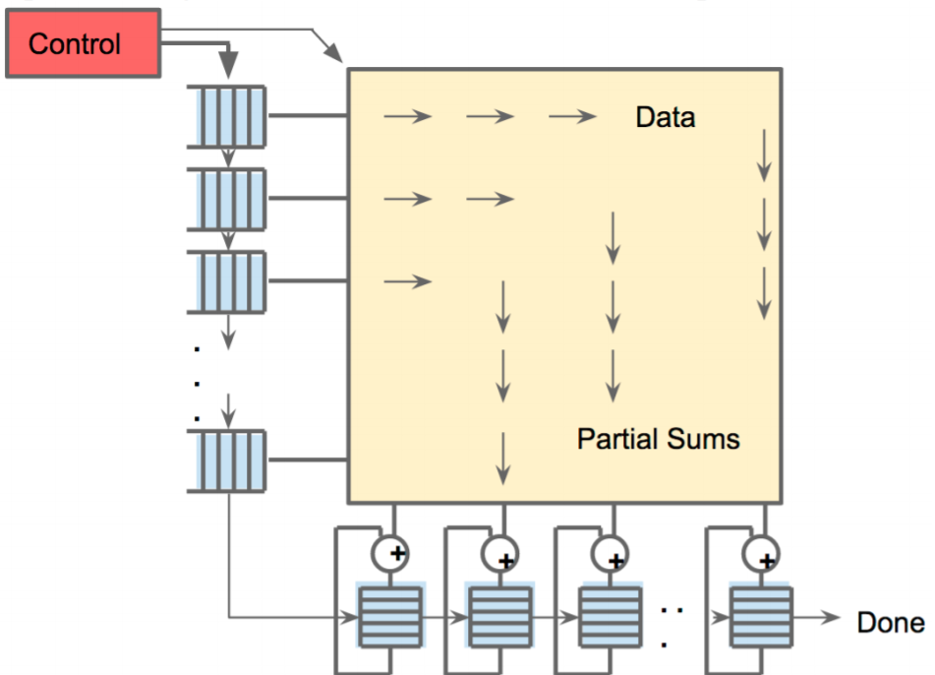
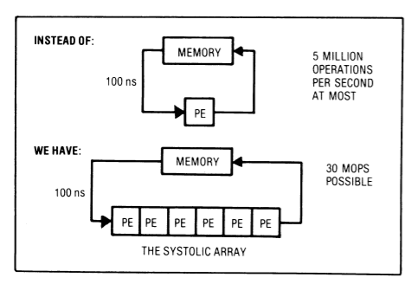
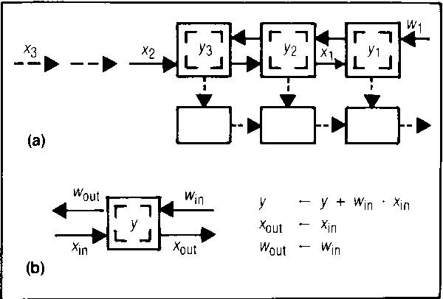
Design Key Ideas
Systolic Execution
Memory transfer is expensive
Reduce reads and writes (reuse)
Illusion that all inputs are read at once
Weights coming from top
Data loaded from the left
Why systolic architectures? H. T. Kung (1982)

Slide 13
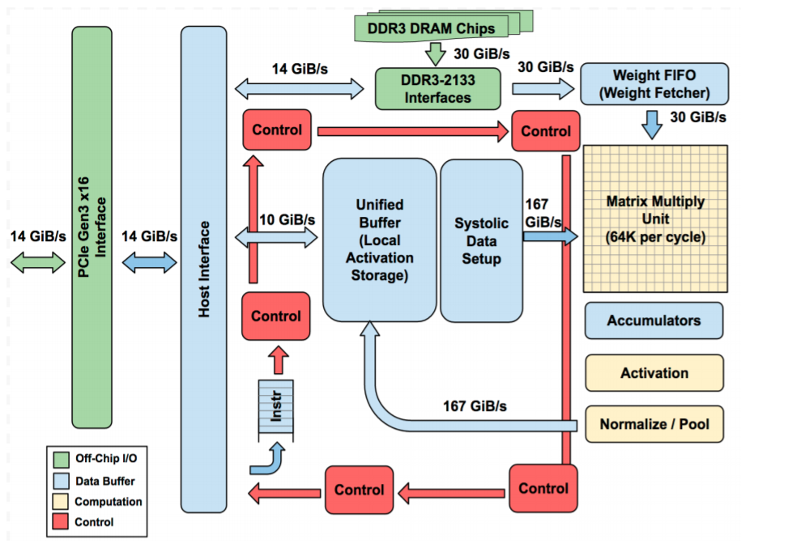
TPU Block Diagram

Slide 14
TPU Block Diagram
Dram off-chip memory
8 GiB
* Decoupled-Access/Execute

Slide 15
TPU Block Diagram
Matrix Unit
256 * 256 8-bit MAC
@700 MHZ clock

Slide 16
TPU Block Diagram
Accumulator Memory
4 MiBs

Slide 17
TPU Block Diagram
Activation
nonlinear function

Slide 18
TPU Block Diagram
Pooling

Slide 19
TPU Block Diagram
Unified Buffer (Activation Memory)
24 MiB (3.5X GPU’s)

Slide 20
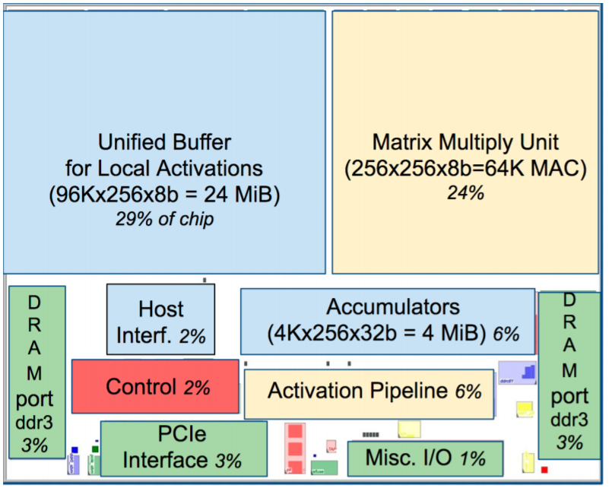
TPU Die Floorplan

Slide 21
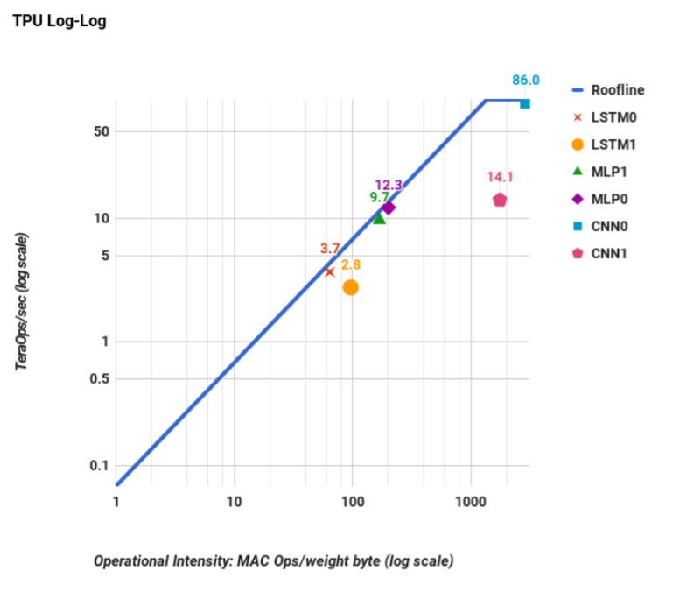
Results
Roofline Model
Compute Bounded
Memory Bounded

Slide 22
Results
Roofline Model
86
Compute Bounded
Memory Bounded

Slide 23
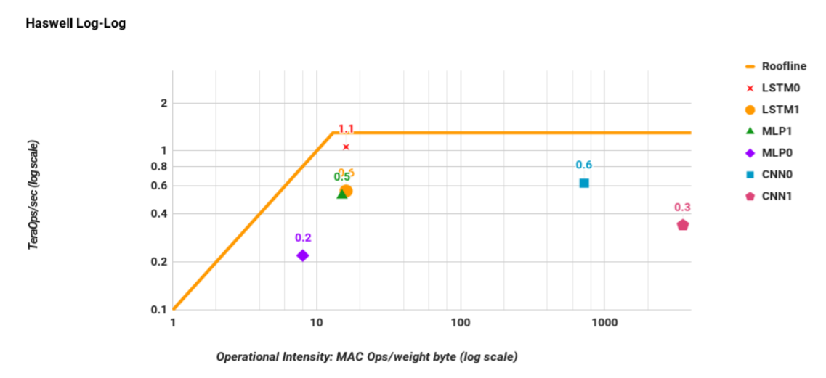
Results
Roofline Model
1.5

Slide 24
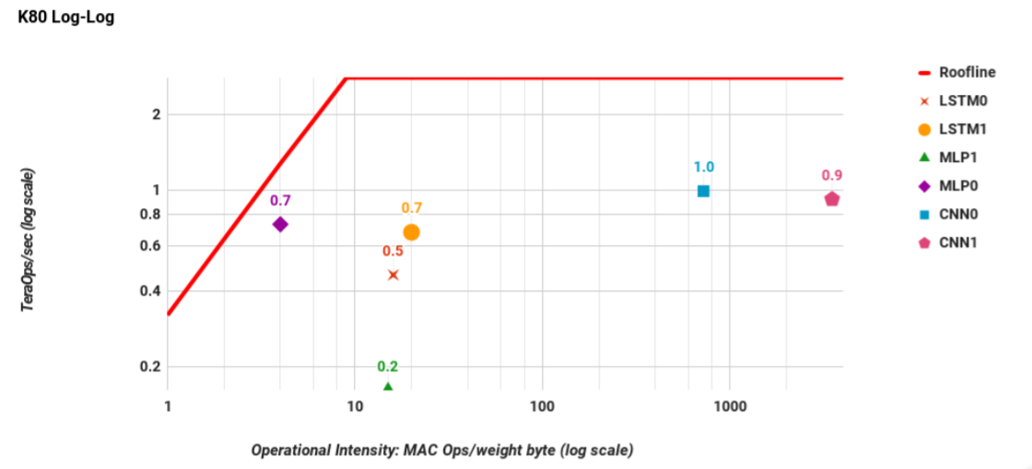
Results
Roofline Model
2.5

Slide 25
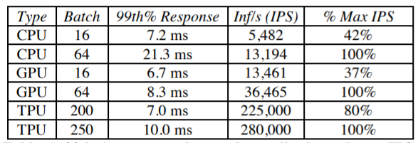
Results
Response Time
* Maximum Allowable is 7 ms
Notes:
What is *

Slide 26
Results
Response Time
* Maximum Allowable is 7 ms
Notes:
What is *

Slide 27
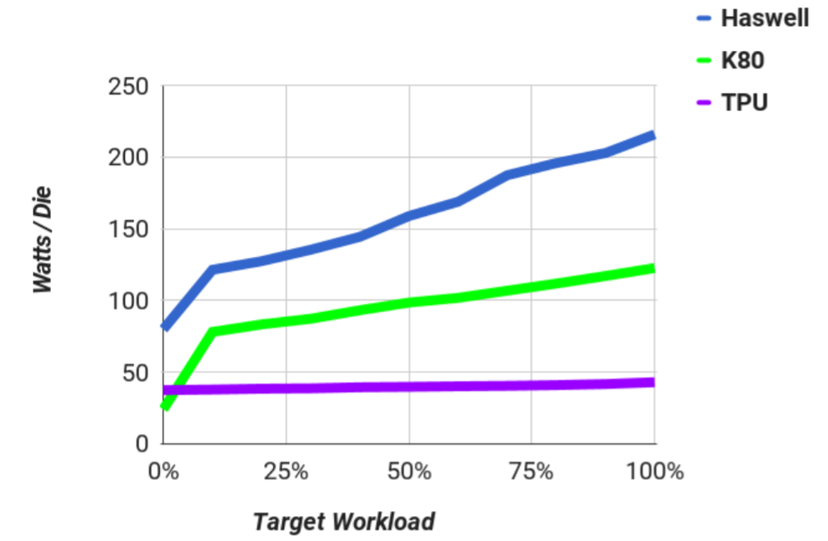
Results
Power
Not Optimized!
Notes:
What is *

Slide 28
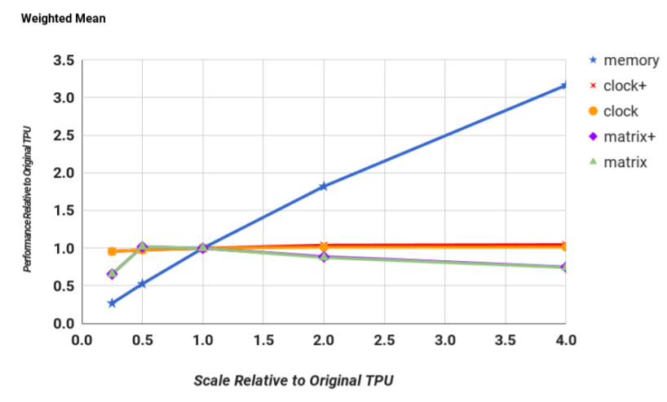
Scaling
Notes:
What is *

Slide 29
Scaling
Notes:
What is *

Slide 30
SWITCH BACK

Slide 31
Discussion
Fallacy: NN inference apps in datacenters value throughput as much as response time
- Beforehand, some said large batch size would allow peak TPU performance
- Cared more about response when ported to TPU (shrank from 10 ms to 7 ms)
- Simple, deterministic execution model of TPU helped match 99th% response time limits
Notes:
In the discussion, the paper David Patterson style in having a set of fallacy and pitfalls that it tries to correct. The first one is NN inference values throughput as much as response time. This is not true. Two years before thinking about TPU, the common belief was that large batches would allow peak performance and everything would work fine and nobody would complain about response time. But now (or at the time of they started thinking of the TPU and future projection of the application back then), the software writers of the applications changed their mind and they cared about the response time. Even the developers who cared about the response time in 2014, 10 ms was the limit and then it shrank to 7 ms when the application ported to the TPU.

Slide 32
Discussion
Fallacy: The K80 GPU architecture is a good match to NN inference
- GPU is high-throughput architecture, meant for training
- The K80 is faster than Haswell but still slower then TPU
- Future GPU should will improve this but it is hard
Notes:
It is a surprise that the GPU is not as good for inference as it is so important for training at least for the K80. However, the GPU is a high-throughput architecture, many threads running in parallel with high bandwidth DRAM. That is why it is faster but than Haswell architecture but still slower than the TPU. They expected that the next generation for the GPU will try to improve the peak the performance but they were skeptical about this given their throughput-oriented architecture approach while there are plenty of chances for the TPU to improve.

Slide 33
Discussion
Pitfall: CPU/GPU results would be comparable to TPU if used more efficiently or compared to newer versions
- Had 8-bit results for one DNN on CPU, since AVX2* integer support was hard to do
- Less confusion to present all CPU results in floating point vs. one exception, with own roofline
- The speedup was ~3.5X
- If all DNNs had similar speedup, perf/Watt ratio would drop from 41-83X to 12-24X
*AVX2 = Advanced Vector Extensions (extensions to the x86 instruction set architecture for microprocessors. AVX2)
Notes:
Only one 8-bit DNN application was available on CPU due to the significant work to use AVX2 integer support efficiently. The problem would be to have to present one integer results and the rest would be in floating points which will be confusing and take a lot of space.
But we can do projection using this one application, so the speed up was 3.5X. If we applied to all of the other applications, the perf/Watt will drop from 40-83X to 12-24X which is still a huge number

Slide 34
Discussion
Pitfall: CPU/GPU results would be comparable to TPU if used more efficiently or compared to newer versions
- New 16-nm, 1.5GHz, 250W Pascal P40 GPU peak performance 47 Tera 8-bit ops/sec
1) Unavailable in early 2015
2) No SECDED* for P40 memory → not for datacenters
3) 0.5 peak of TPU and 3X-6X more power
4) Fraction of P40 peak delivered in 7ms deadline??!
*SECDED =Single-Error Correcting and Double-Error Detecting
Notes:
The second part of this pitfall is that did they compare to the right GPU/CPU devices? So once device they should have compared against is the P40 with 47 Tera 8-bit ops/sec (which is half the peak performance of TPU). First because it came out after the TPU (the paper published in 2017 but the story started in 2013 and announced in the first half of 2015). Second which is more important is that the P40 it does not have SECDED which is short for single-error correcting and double error detecting capability. The big picture here in order to put something in the datacenter what you will worry about is if you bought thousands of this devices that error might happened and you will have to debug them so you have to have error correction codes on the internal memory on the chip so you realize when something wrong. Google strictly does not deploy device that doe not have error correcting or detection and the P40 does not have it. Should be deployed in the datacenters in order to know that.
Even though, the P40 needs power at the half peak of TPU and also we do not know what fraction of its peak performance will be delivered in 7ms deadline.

Slide 35
Discussion
Fallacy: The only path left to increase TPU performance is hardware upgrade
- CNN application can be improved if compiler writers tried to match CNN to TPU hardware
- Reorganize the application too aggregate multiple short batches out of the convolution layers in to a single, deeper batch (from 32 to 128).
Notes:
Deeper batches increased the utilization of the matrix unit.

Slide 36
Discussion
Fallacy: For NN hardware, Inferences Per Seconds (IPS) is an inaccurate summary performance metric
- IPS is the inverse of the complexity of the typical of the typical inference in the application (e.g., number, size, and type of NN layers)
- Example: TPU runs the 4-layers MLP1 at 360K IPS but the 89-layer CNN1 at only 4K, so TPU IPS vary by 75X
- To compare NN machines, benchmark suite is needed on a high-level to port in a wide variety of NN architectures
Notes:
IPS is misleading performance metric for NN accelerators

Slide 37
Beyond TPU
Second-generation:
Train + inference
Up to 180 TOPS (floating-point)
Custom high-speed network
Able to connect 64 2nd-gen TPU to deliver 11.5 petaflops (“TPU pod”)

Slide 38
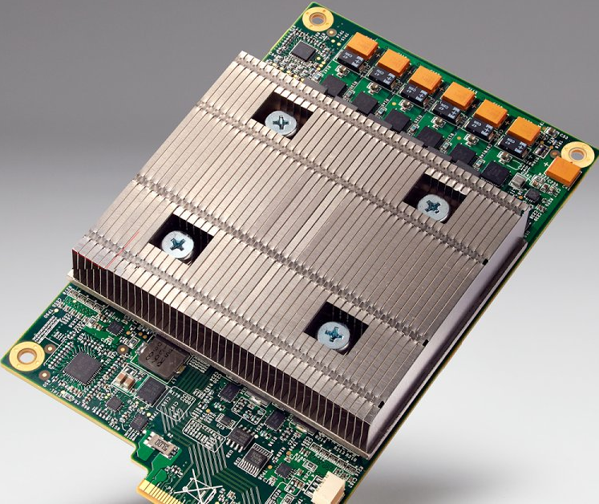
Thank You!
Questions?!
Notes:
Might add a closing slides, or talk about the second generation of TPU

Slide 39
TPU Origin Story
2013: Prepare for success-disaster of new DNN apps
Scenario with users speaking to phones 3 minutes a day:
If only CPUs, need 2X whole datacenter fleet for speech DNNS
Custom HW to reduce the TCO of DNN inference phase by 10X vs. GPU
A very short development cycle
Started project 2014, running in datacenter 15 months later:
Architecture invention, compiler invention, hardware design, build, test and deploying
It was announced during Google I/O May 18, 2016 as ’10X performance/Watt’
3 Types of NNS (represented 95% of the workload in Google data centers)
1. Multilayer Perceptrons (MLP)
Each new layer applied nonlinear function F to weighted sum of all output from prior layers (fully connected)
2. Convolutional Neural Network
Like MLP, but same weights reused on nearby subsets of outputs from prior layer
3. Recurrent NN/”Long Short-Term Memory”
Each new layer a NL function of weighted sums of paste state and prior outputs; same weights reused across time steps
Talks about Table 1: this is the benchmark they will use in the paper. Get an idea about the number of layers (4 up to 90),
number of weights from 5M to 100M, batch sizes varies from 8 up to 200. CNN is just about 5% of the workload, while MLP takes up to 60% of the workload.

Slide 40
TPU Architecture and Implementation
Add as accelerators to existing servers
So connect over I/O bus (“PCIe”)
It can be described as a matrix accelerator on I/O bus
The host sends the instructions to it; it does not fetch the instruction on its own
TALK ABOUT THE ARCHTRUCE IN DETAILS

Slide 41
Relative Performance:
From Table 2
Half the size and the power of Haswell
Roofline Visual Performance Model
Two Limits to performance
1. Peak computation
2. Peak Memory BW (for apps with large data that don’ fit in cache)
Y-axis the floating point operations per second (FLOPS) so the flat line indicates the speed of light or peak performance or maximum FLOPS you can get out of the chip
X-axis is the arithmetic intensity or how many operations per byte fetch. So you are doing many operations of every byte being fetch, you will be on the left side of the curve where you might be limited with the peak performance of the chip. If you are on the left side of the curve, then you are memory bounded since there is not enough operations to carry out for every byte being fetch and thus you will not reach the peak performance; slanted part of the curve.
For apps/ software: the gap between the point and the ceiling of the roofline tells how much room is left to improve what you are doing. So here we will use weight-reuse as the arithmetic intensity for DNN roofline.
The roofline has a very high peak performance but it has a huge area that is memory bounded (compare it to the Haswell and GPU). The six apps are all touching the roofline. Comparing it with CPU and GPU performance, the six apps are falling far below the roofline. That simply means that these devices are not well suited for these applications as they are not limited by the memory or by the compute capabilities. In other words, the GPU or CPU as a lot to offer but these application don’t or can't take advantage of it.

Slide 42
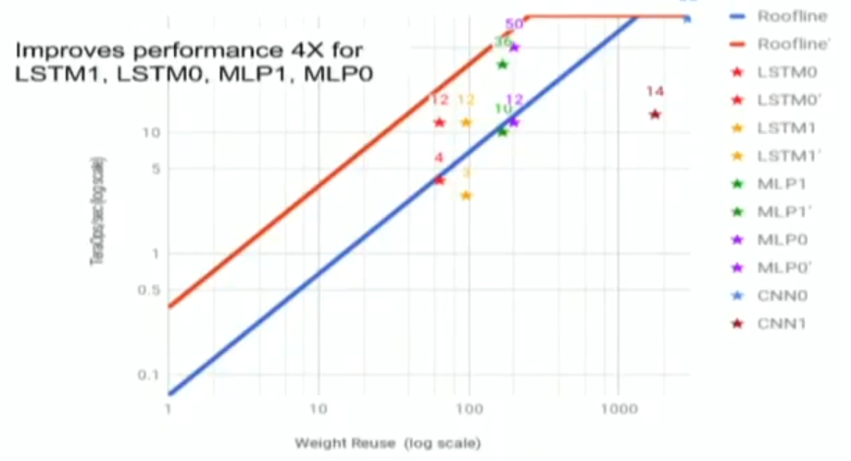
Relative Performance:
Table 4: The application cares a lot about the response time. The green ones are below 7 ms and the red ones is where you can get more performance but you missed the deadline. This is because in production you are dealing always with users and the user does not want to set there waiting for a long for the application to respond. And it is not about just the average response time that we care about, but the 99%th percentile means that we only allow 1% of the customer to have a bad experience.
Figure 8: put all the devices together to see how they behave. All stars are reaching up even above the log scale of the GPU and CPU. This is in a log-log scale.
Figure 9. Comparing the perf/watt as a proxy of perf/$
Since it is built in 15 months, what else has been left undone or can be improved? Memory system. To use a memory system as of the GPU to have the same BW
Current DRAM > 2 DDR3 2133 → 34 GB/s
Replace with GDDR5 like in K80 → 180 GB/s
The ridge point will move to the left. The app that are
compute bounded won’t be affected, but those that
are memory bounded will get some boost

Slide 43
Details not in the paper
Jouppi: “The fundemtnal bargain people make with FPGAs is that they want something that is easy to change but because of the programmability and other hurdles, compared with an ASIC, there ends up being a big difference in performance and performance per watt.” “The TPU is programmable like a CPU or GPU. It is not designed for just one neural network model; it executes CISC instructions on many networks (convolutional, LSTM, fully connected models). So it is still programmable, but uses a matrix as a primitive instead of a vector or scalar.”
https://www.nextplatform.com/2017/04/05/first-depth-look-googles-tpu-architecture/

