Slide 1
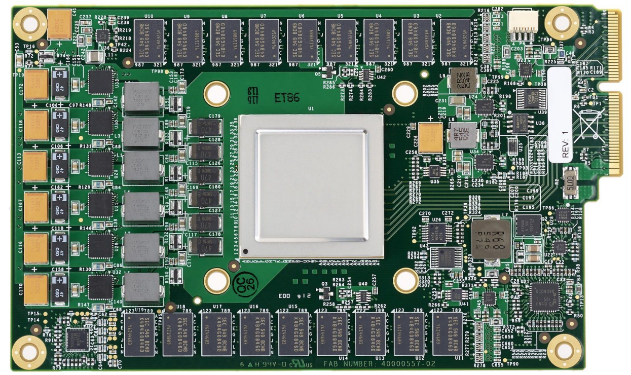
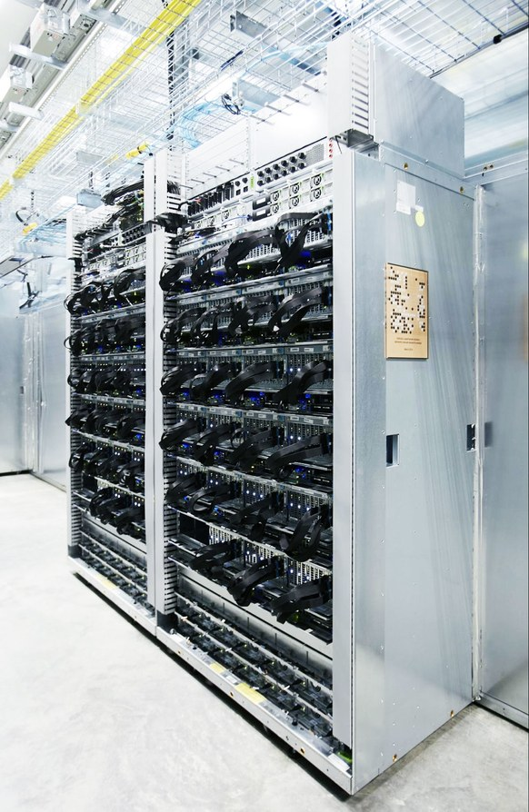
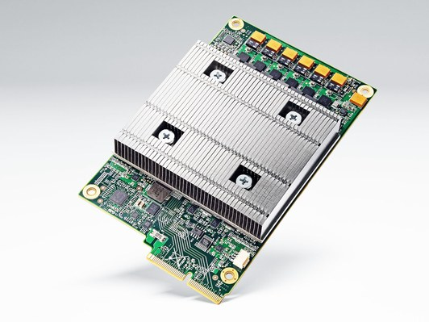

In-Datacenter Performance Analysis of Tensor Processing Unit
Paper Presentation for EEC 289Q (Spring 2018)
^{By: Ahmed Mahmoud}
^{Muhammad Awad}

Slide 2
TPU - Overview
Introduces and evaluates Tensor Processing Unit (TPU)
Used for Neural Network (NN) inference in Google datacenters since 2015
Focus on improving the response-time not (just) the throughput (like GPU)
The performance is compared to Intel Haswell CPU and Nvidia K80 GPU
Application written in TensorFlow
TPU is 15X-30X faster than GPU or CPU, with 30X-80X TOPS/Watt* higher
*TOPS = TeraOps/second

Slide 3
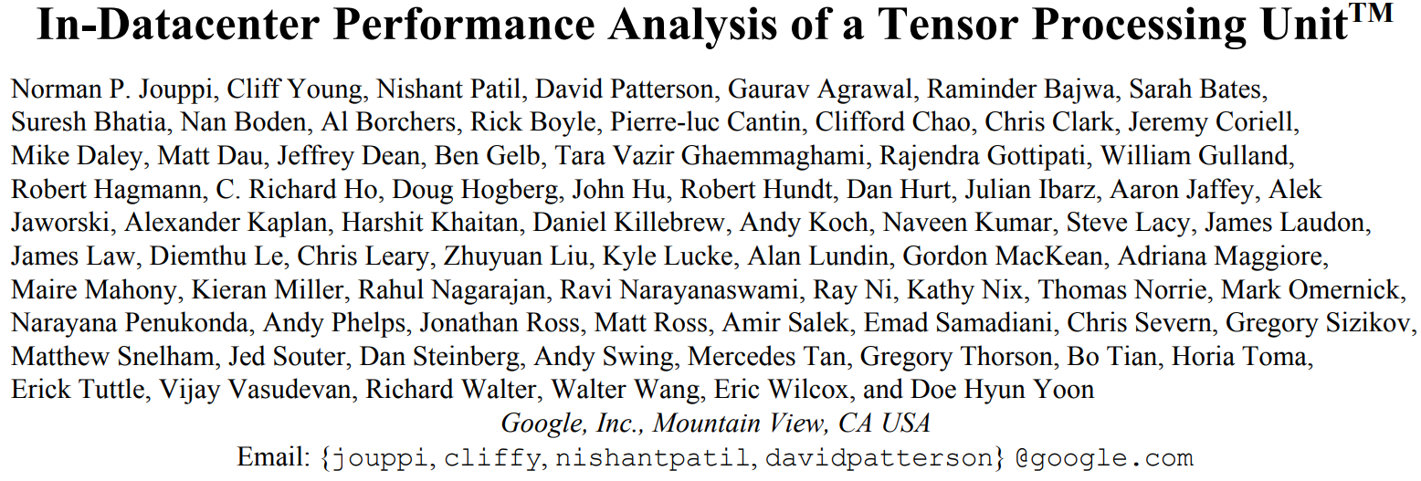
TPU - Overview
The Paper appeared at the 44th International Symposium on Computer Architecture (ISCA) June 26, 2017
More than 60 authors on the paper
Notes:
From software to hardware engineering, to mechanical engineering (for cooling system) to even marketing people

Slide 4
TPU - Origin
2013: Prepare for success-disaster of new DNN apps
Users speaking to phone 3 minutes a day will require 2x whole datacenter fleet
Custom HW to reduce the TCO of DNN inference phase by 10x vs. GPU
A very short development cycle
Started 2014, running in datacenter 15 month later
Announced during Google I/O May, 2016 as ‘10x performance/Watt‘
Notes:
It is CPU datacenters
The custom HW is for inference, while training is still done using off-the-shelf GPU

Slide 5
TPU - Origin
Key NN Concepts for Architects:
Training vs. inference
Floating-point vs. Integer (“Quantization”)
Training in floating point on GPU
Inferring in integers is faster, lower energy, smaller
8-bits multiply is 6X less energy and 6X less area than IEEE 754 16-bit multiply
Batch size
Problem: DNNs have millions of weights that take a long time to load from memory (DRAM)
Solution: Large batch → amortize weight-fetch time by inferring (or training) many input examples at a time

Slide 6
TPU - Origin
Focuses on three types of NNs
Multilayer Perceptrons (MLP)
Convolutional Neural Network
Recurrent NN: Long Short-Term Memory (LSTM)
Represents 95% of the workload in Google datacenters

Slide 7
TPU - Benchmark
Applications written in TensorFlow (short; 100 to 1500 lines)
Comprise small pieces of larger applications run on the host server (large; thousands to millions of lines)
Applications are user-facing → rigid response-time limits

Slide 8
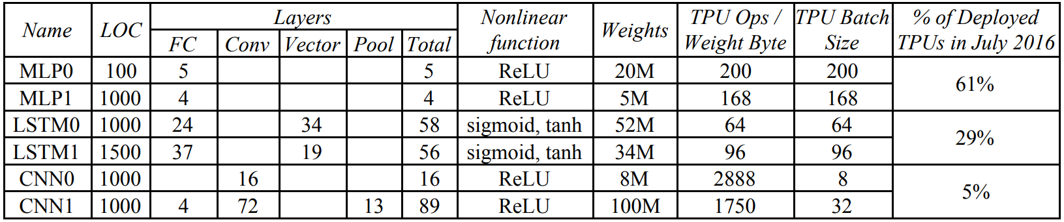
TPU - Benchmark
Six applications; two MLP, two LSTM, and two CNN
Varying number of layers, weights and batch size
CNN is 5% of the workload, MLP is 61% of it

Slide 9
SWITCH

Slide 10
Design Key Ideas
CISC (Complex Instruction Set Computer)
Instructions are sent over a slow PCIe bus
Read_Host_Memory
Read_Weights
MatrixMultiply/Convolve
Activate
Write_Host_Memory
>10 CPI
No Caches (Software controlled buffers)
Hide latency with a 4-stage pipeline
In order issuing

Slide 11
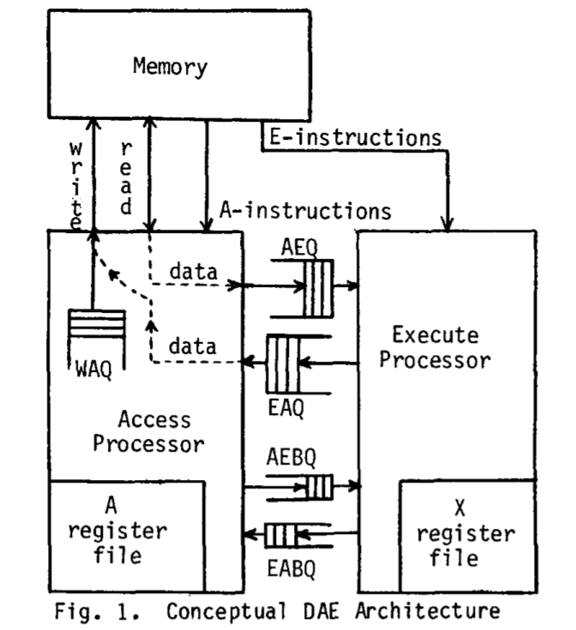
Design Key Ideas
Decoupled-Access/Execute philosophy
Read_Weights fetches data before weights are read from Weight Memory
Decoupled access/execute computer architectures, James E. Smith (1982)

Slide 12
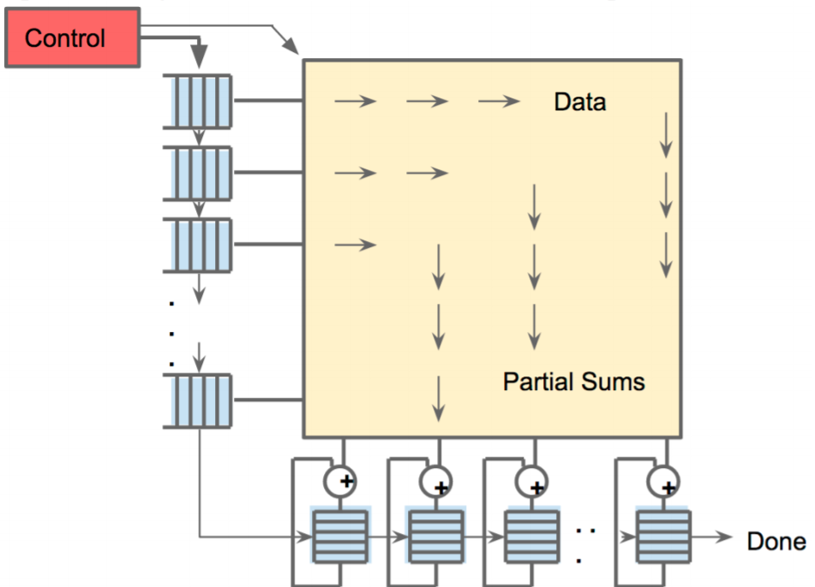
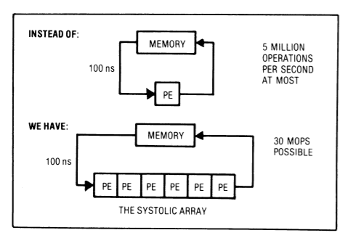
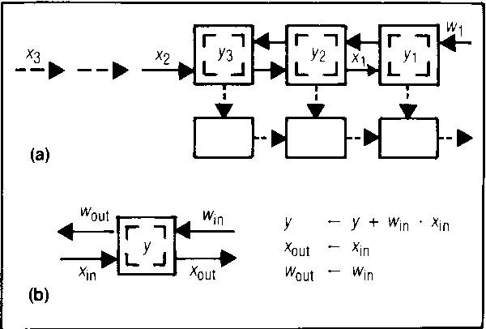
Design Key Ideas
Systolic Execution
Memory transfer is expensive
Reduce reads and writes (reuse)
Illusion that all inputs are read at once
Weights coming from top
Data loaded from the left
Why systolic architectures? H. T. Kung (1982)

Slide 13
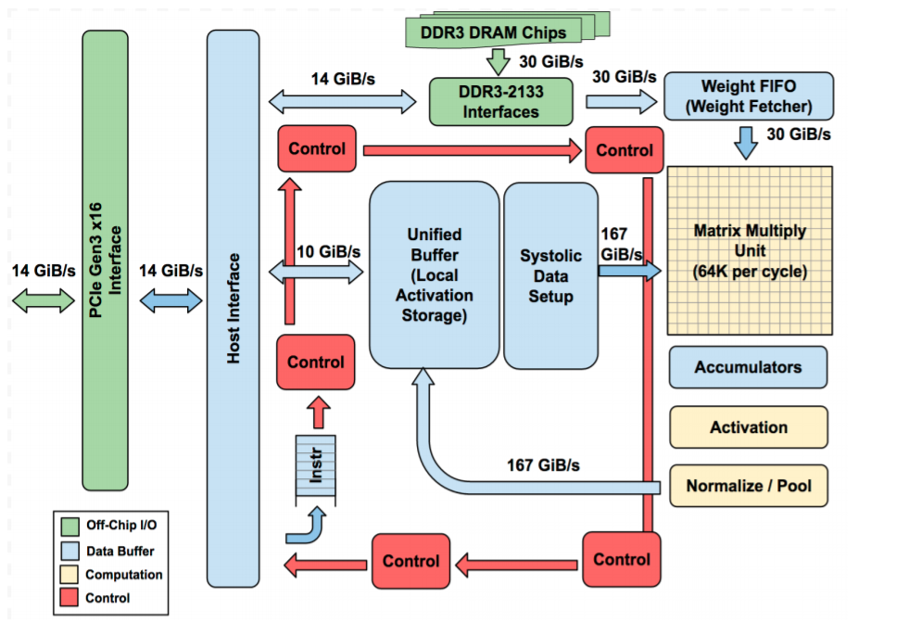
TPU Block Diagram

Slide 14
TPU Block Diagram
Dram off-chip memory
8 GiB
* Decoupled-Access/Execute

Slide 15
TPU Block Diagram
Matrix Unit
256 * 256 8-bit MAC
@700 MHZ clock

Slide 16
TPU Block Diagram
Accumulator Memory
4 MiBs

Slide 17
TPU Block Diagram
Activation
nonlinear function

Slide 18
TPU Block Diagram
Pooling

Slide 19
TPU Block Diagram
Unified Buffer (Activation Memory)
24 MiB (3.5X GPU’s)

Slide 20
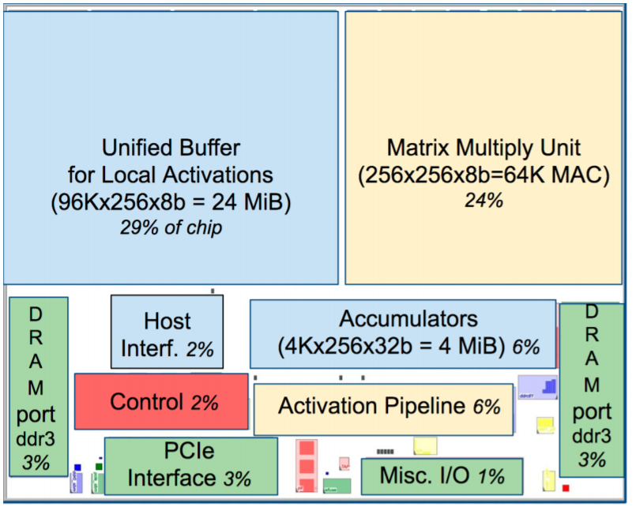
TPU Die Floorplan

Slide 21
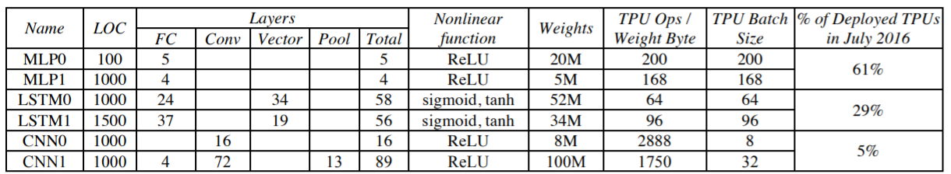
Benchmarking
95% of The Inference Data Center Workload
X

Slide 22
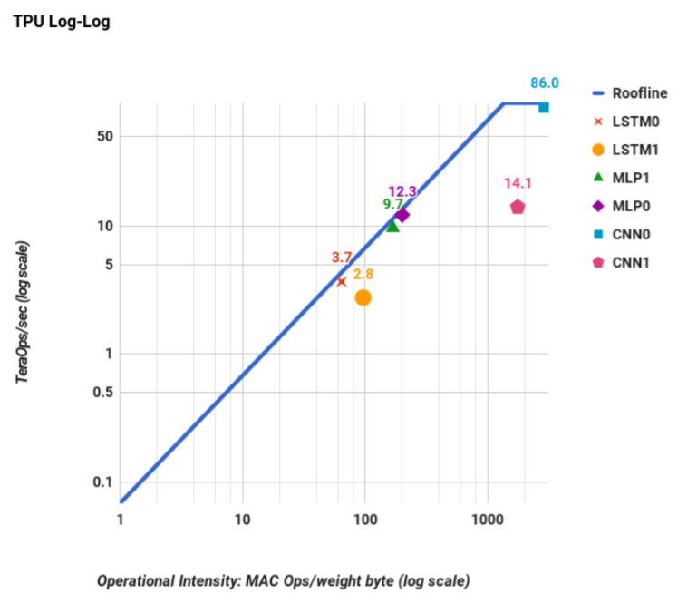
Results
Roofline Model
Compute Bounded
Memory Bounded

Slide 23
Results
Roofline Model
86
Compute Bounded
Memory Bounded

Slide 24
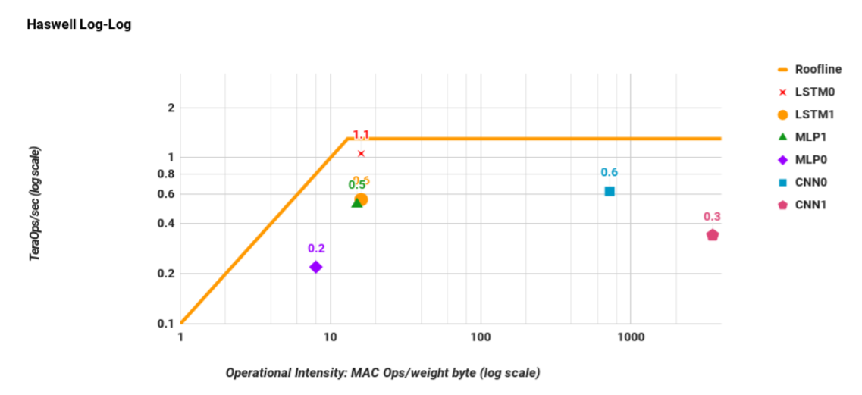
Results
Roofline Model
1.5

Slide 25
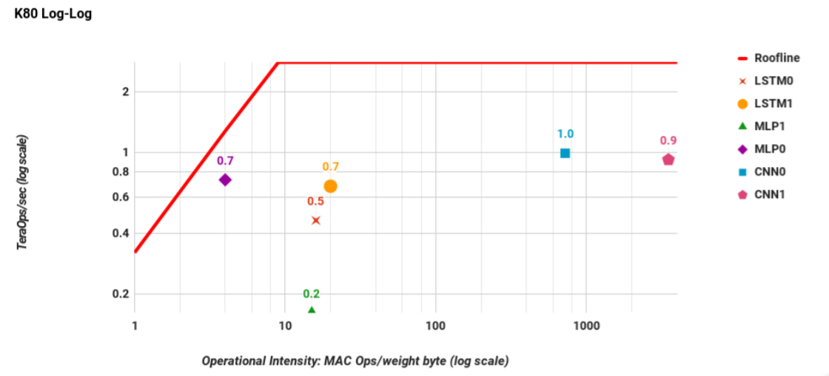
Results
Roofline Model
2.5

Slide 26
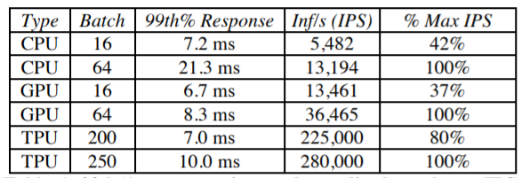
Results
Response Time
* Maximum Allowable is 7 ms
Notes:
What is *

Slide 27
Results
Response Time
* Maximum Allowable is 7 ms
Notes:
What is *

Slide 28
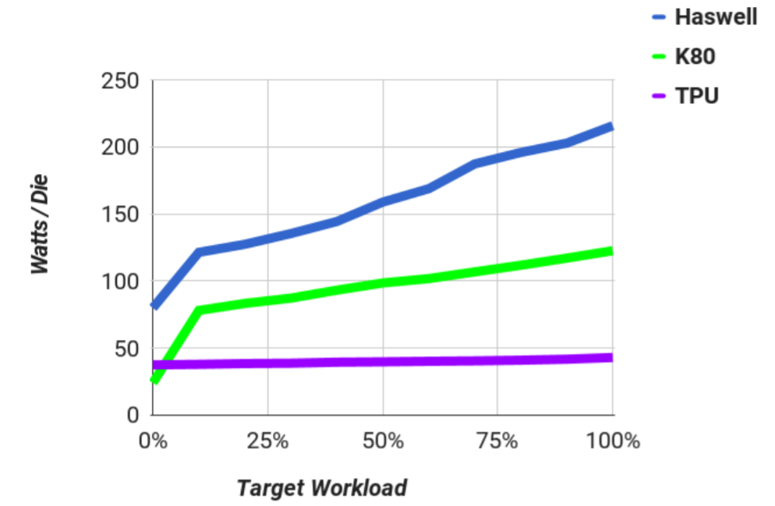
Results
Power
Not Optimized!
Notes:
What is *

Slide 29
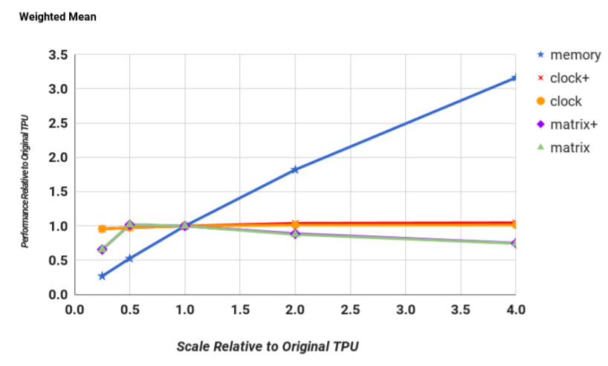
Scaling
Notes:
What is *

Slide 30
Scaling
Notes:
What is *

Slide 31
SWITCH BACK

Slide 32
Discussion
Fallacy: NN inference apps in datacenters value throughput as much as response time
- Beforehand, some said large batch size would allow peak TPU performance
- Cared more about response when ported to TPU (shrank from 10 ms to 7 ms)
- Simple, deterministic execution model of TPU helped match 99th% response time limits
Notes:
In the discussion, the paper David Patterson style in having a set of fallacy and pitfalls that it tries to correct. The first one is NN inference values throughput as much as response time. This is not true. Two years before thinking about TPU, the common belief was that large batches would allow peak performance and everything would work fine and nobody would complain about response time. But now (or at the time of they started thinking of the TPU and future projection of the application back then), the software writers of the applications changed their mind and they cared about the response time. Even the developers who cared about the response time in 2014, 10 ms was the limit and then it shrank to 7 ms when the application ported to the TPU.

Slide 33
Discussion
Fallacy: The K80 GPU architecture is a good match to NN inference
- GPU is high-throughput architecture, meant for training
- The K80 is faster than Haswell but still slower then TPU
- Future GPU should will improve this but it is hard
Notes:
It is a surprise that the GPU is not as good for inference as it is so important for training at least for the K80. However, the GPU is a high-throughput architecture, many threads running in parallel with high bandwidth DRAM. That is why it is faster but than Haswell architecture but still slower than the TPU. They expected that the next generation for the GPU will try to improve the peak the performance but they were skeptical about this given their throughput-oriented architecture approach while there are plenty of chances for the TPU to improve.

Slide 34
Discussion
Pitfall: CPU/GPU results would be comparable to TPU if used more efficiently or compared to newer versions
- Had 8-bit results for one DNN on CPU, since AVX2* integer support was hard to do
- Less confusion to present all CPU results in floating point vs. one exception, with own roofline
- The speedup was ~3.5X
- If all DNNs had similar speedup, perf/Watt ratio would drop from 41-83X to 12-24X
*AVX2 = Advanced Vector Extensions (extensions to the x86 instruction set architecture for microprocessors. AVX2)
Notes:
Only one 8-bit DNN application was available on CPU due to the significant work to use AVX2 integer support efficiently. The problem would be to have to present one integer results and the rest would be in floating points which will be confusing and take a lot of space.
But we can do projection using this one application, so the speed up was 3.5X. If we applied to all of the other applications, the perf/Watt will drop from 40-83X to 12-24X which is still a huge number

Slide 35
Discussion
Pitfall: CPU/GPU results would be comparable to TPU if used more efficiently or compared to newer versions
- New 16-nm, 1.5GHz, 250W Pascal P40 GPU peak performance 47 Tera 8-bit ops/sec
1) Unavailable in early 2015
2) No SECDED* for P40 memory → not for datacenters
3) 0.5 peak of TPU and 3X-6X more power
4) Fraction of P40 peak delivered in 7ms deadline??!
*SECDED =Single-Error Correcting and Double-Error Detecting
Notes:
The second part of this pitfall is that did they compare to the right GPU/CPU devices? So once device they should have compared against is the P40 with 47 Tera 8-bit ops/sec (which is half the peak performance of TPU). First because it came out after the TPU (the paper published in 2017 but the story started in 2013 and announced in the first half of 2015). Second which is more important is that the P40 it does not have SECDED which is short for single-error correcting and double error detecting capability. The big picture here in order to put something in the datacenter what you will worry about is if you bought thousands of this devices that error might happened and you will have to debug them so you have to have error correction codes on the internal memory on the chip so you realize when something wrong. Google strictly does not deploy device that doe not have error correcting or detection and the P40 does not have it. Should be deployed in the datacenters in order to know that.
Even though, the P40 needs power at the half peak of TPU and also we do not know what fraction of its peak performance will be delivered in 7ms deadline.

Slide 36
Discussion
Fallacy: The only path left to increase TPU performance is hardware upgrade
- CNN application can be improved if compiler writers tried to match CNN to TPU hardware
- Reorganize the application too aggregate multiple short batches out of the convolution layers in to a single, deeper batch (from 32 to 128).
Notes:
Deeper batches increased the utilization of the matrix unit.

Slide 37
Discussion
Fallacy: For NN hardware, Inferences Per Seconds (IPS) is an inaccurate summary performance metric
- IPS is the inverse of the complexity of the typical of the typical inference in the application (e.g., number, size, and type of NN layers)
- Example: TPU runs the 4-layers MLP1 at 360K IPS but the 89-layer CNN1 at only 4K, so TPU IPS vary by 75X
- To compare NN machines, benchmark suite is needed on a high-level to port in a wide variety of NN architectures
Notes:
IPS is misleading performance metric for NN accelerators

Slide 38
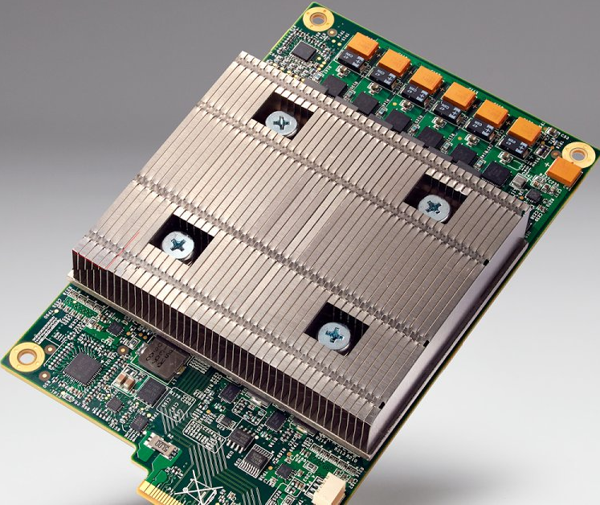
Thank You!
Questions?!
Notes:
Might add a closing slides, or talk about the second generation of TPU

Slide 39
Domain Specific Architecture
Key NN Concepts for Architects:
- Training vs. inference
- Batch size
Problem: DNNs have millions of weights that take a long time to load from memory (DRAM)
Solution: Large batch → amortize weight-fetch time by inferring (or training) many input examples at a time
- Floating-point vs. Integer (“Quantization”)
Training in floating point on GPU
Inferring in Integers faster, lower energy, smaller

Slide 40
TPU Origin Story
2013: Prepare for success-disaster of new DNN apps
Scenario with users speaking to phones 3 minutes a day:
If only CPUs, need 2X whole datacenter fleet for speech DNNS
Custom HW to reduce the TCO of DNN inference phase by 10X vs. GPU
A very short development cycle
Started project 2014, running in datacenter 15 months later:
Architecture invention, compiler invention, hardware design, build, test and deploying
It was announced during Google I/O May 18, 2016 as ’10X performance/Watt’
3 Types of NNS (represented 95% of the workload in Google data centers)
1. Multilayer Perceptrons (MLP)
Each new layer applied nonlinear function F to weighted sum of all output from prior layers (fully connected)
2. Convolutional Neural Network
Like MLP, but same weights reused on nearby subsets of outputs from prior layer
3. Recurrent NN/”Long Short-Term Memory”
Each new layer a NL function of weighted sums of paste state and prior outputs; same weights reused across time steps
Talks about Table 1: this is the benchmark they will use in the paper. Get an idea about the number of layers (4 up to 90),
number of weights from 5M to 100M, batch sizes varies from 8 up to 200. CNN is just about 5% of the workload, while MLP takes up to 60% of the workload.

Slide 41
TPU Architecture and Implementation
Add as accelerators to existing servers
So connect over I/O bus (“PCIe”)
It can be described as a matrix accelerator on I/O bus
The host sends the instructions to it; it does not fetch the instruction on its own
TALK ABOUT THE ARCHTRUCE IN DETAILS

Slide 42
Relative Performance:
From Table 2
Half the size and the power of Haswell
Roofline Visual Performance Model
Two Limits to performance
1. Peak computation
2. Peak Memory BW (for apps with large data that don’ fit in cache)
Y-axis the floating point operations per second (FLOPS) so the flat line indicates the speed of light or peak performance or maximum FLOPS you can get out of the chip
X-axis is the arithmetic intensity or how many operations per byte fetch. So you are doing many operations of every byte being fetch, you will be on the left side of the curve where you might be limited with the peak performance of the chip. If you are on the left side of the curve, then you are memory bounded since there is not enough operations to carry out for every byte being fetch and thus you will not reach the peak performance; slanted part of the curve.
For apps/ software: the gap between the point and the ceiling of the roofline tells how much room is left to improve what you are doing. So here we will use weight-reuse as the arithmetic intensity for DNN roofline.
The roofline has a very high peak performance but it has a huge area that is memory bounded (compare it to the Haswell and GPU). The six apps are all touching the roofline. Comparing it with CPU and GPU performance, the six apps are falling far below the roofline. That simply means that these devices are not well suited for these applications as they are not limited by the memory or by the compute capabilities. In other words, the GPU or CPU as a lot to offer but these application don’t or can't take advantage of it.

Slide 43
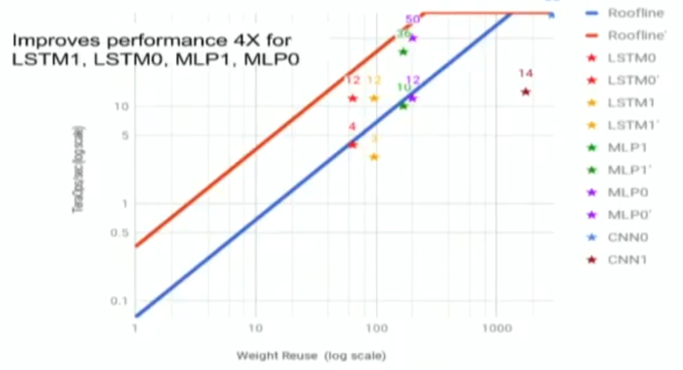
Relative Performance:
Table 4: The application cares a lot about the response time. The green ones are below 7 ms and the red ones is where you can get more performance but you missed the deadline. This is because in production you are dealing always with users and the user does not want to set there waiting for a long for the application to respond. And it is not about just the average response time that we care about, but the 99%th percentile means that we only allow 1% of the customer to have a bad experience.
Figure 8: put all the devices together to see how they behave. All stars are reaching up even above the log scale of the GPU and CPU. This is in a log-log scale.
Figure 9. Comparing the perf/watt as a proxy of perf/$
Since it is built in 15 months, what else has been left undone or can be improved? Memory system. To use a memory system as of the GPU to have the same BW
Current DRAM > 2 DDR3 2133 → 34 GB/s
Replace with GDDR5 like in K80 → 180 GB/s
The ridge point will move to the left. The app that are
compute bounded won’t be affected, but those that
are memory bounded will get some boost

