Slide 2
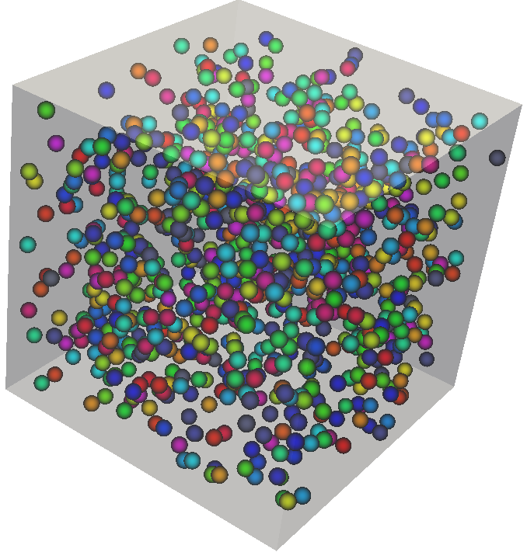
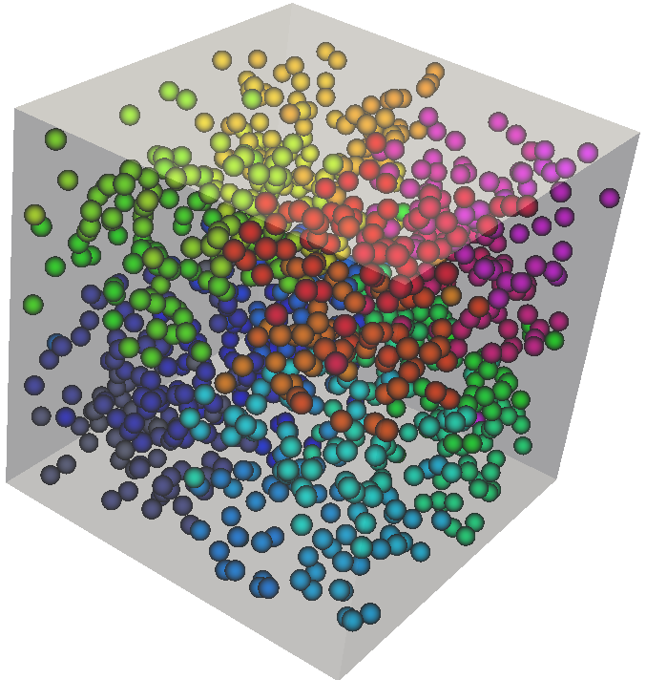
Optimization Choice: Memory Layout
Input
Output (Kernel Input)
Strongly Balanced k-d Tree

Slide 3

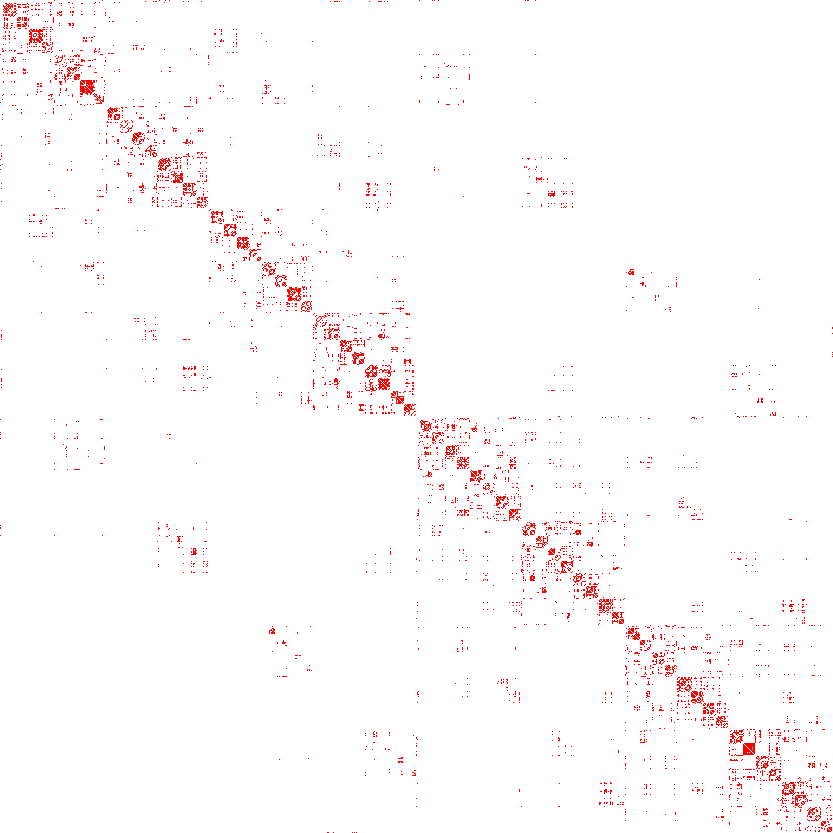
Optimization Choice: Memory Layout
Input
Output (Kernel Input)
Strongly Balanced k-d Tree

Slide 4

Optimization Choice: Memory Layout
Kernel Input
Output
Output
Strongly Balanced k-d Tree
Delaunay Connectivity

