Slide 1
General Physics (2) For Engineering
Textbook:
Physics for Scientists and Engineers, seventh edition, Jewett / Serway
Lecturer: Dr. Maan Salim

Slide 2
Chapter 24
Gauss’s Law

Slide 3
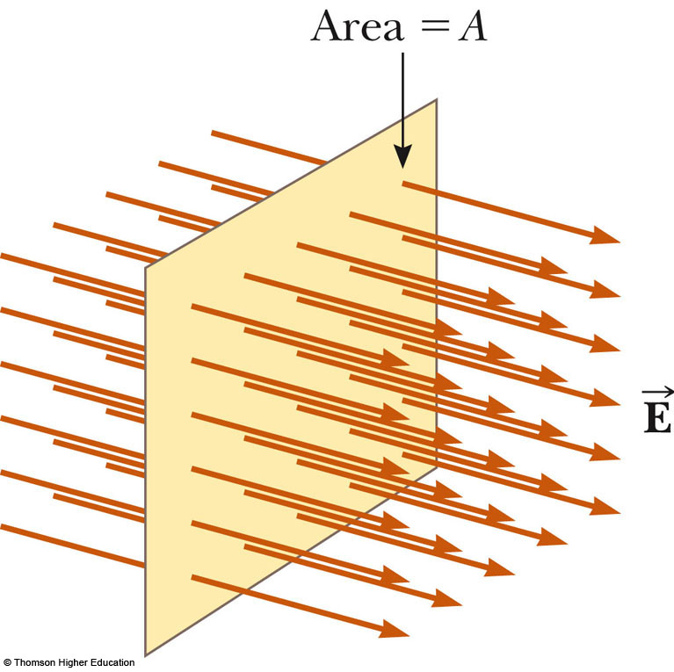
Electric Flux
Electric flux is the product of the magnitude of the electric field and the surface area, A, perpendicular to the field
Φ_{E} = EA

Slide 4
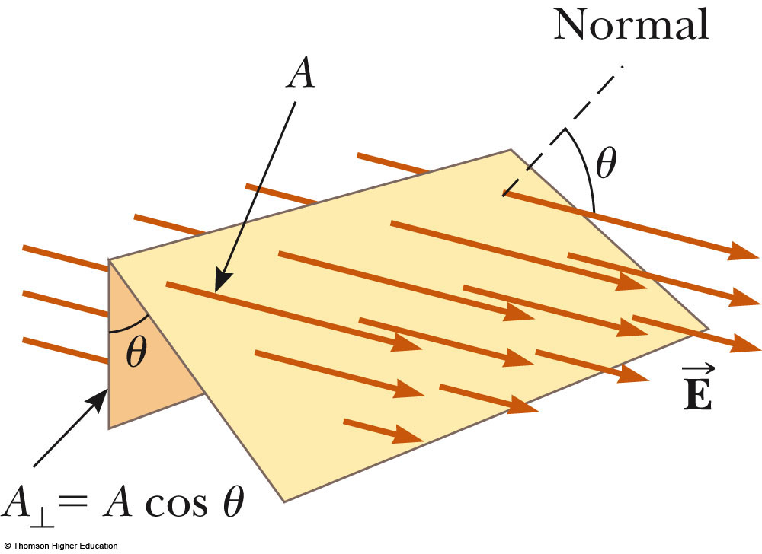
Electric Flux, General Area
The electric flux is proportional to the number of electric field lines penetrating some surface
The field lines may make some angle θ with the perpendicular to the surface
Then Φ_{E} = EA cos θ

Slide 5
Electric Flux, Interpreting the Equation
The flux is a maximum when the surface is perpendicular to the field
The flux is zero when the surface is parallel to the field
If the field varies over the surface, Φ = EA cos θ is valid for only a small element of the area

Slide 6
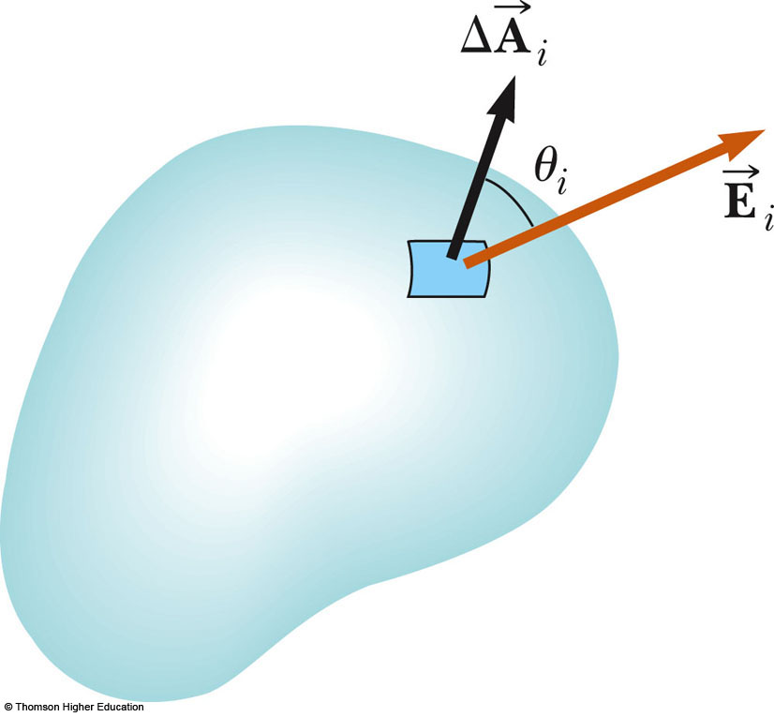
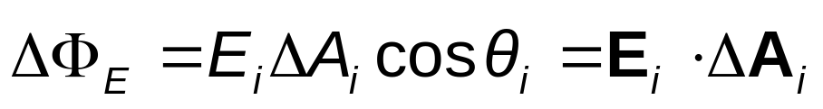
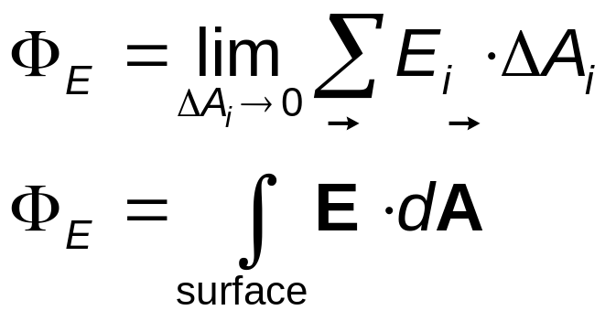
Electric Flux, General
In the more general case, look at a small area element
In general, this becomes

Slide 7
Electric Flux, final
The surface integral means the integral must be evaluated over the surface in question
In general, the value of the flux will depend both on the field pattern and on the surface
The units of electric flux will be N.m²/C²

Slide 8
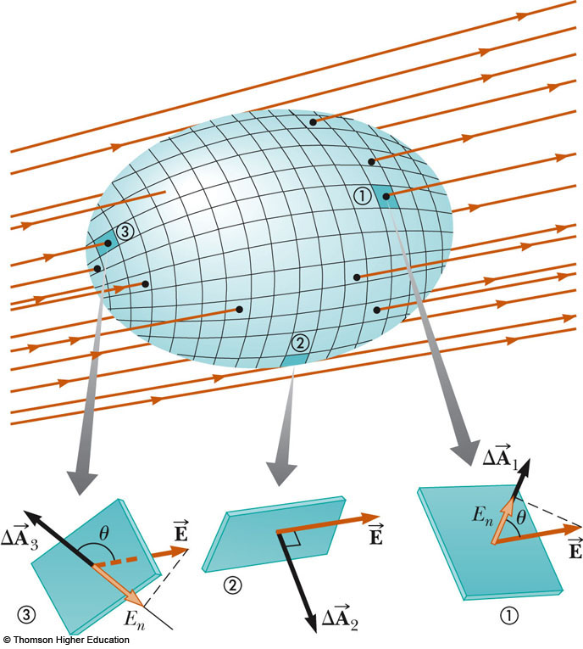
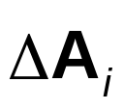
Electric Flux, Closed Surface
Assume a closed surface
The vectors point in different directions
  At each point, they are perpendicular to the surface
  By convention, they point outward
PLAY
ACTIVE FIGURE

Slide 9
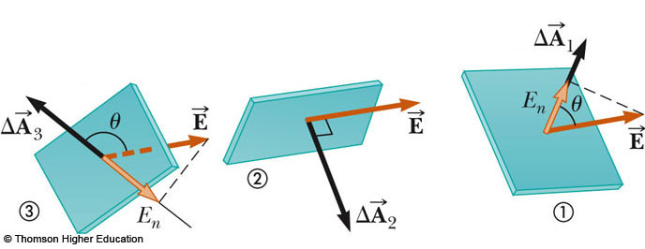
Flux Through Closed Surface, cont.
At (1), the field lines are crossing the surface from the inside to the outside; θ < 90º, Φ is positive
At (2), the field lines graze surface; θ = 90º, Φ = 0
At (3), the field lines are crossing the surface from the outside to the inside;180º > θ > 90º, Φ is negative

Slide 10
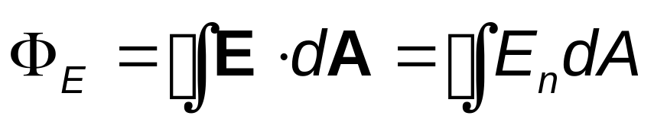
Flux Through Closed Surface, final
The net flux through the surface is proportional to the net number of lines leaving the surface
  This net number of lines is the number of lines leaving the surface minus the number entering the surface
If E_{n} is the component of E perpendicular to the surface, then

Slide 11
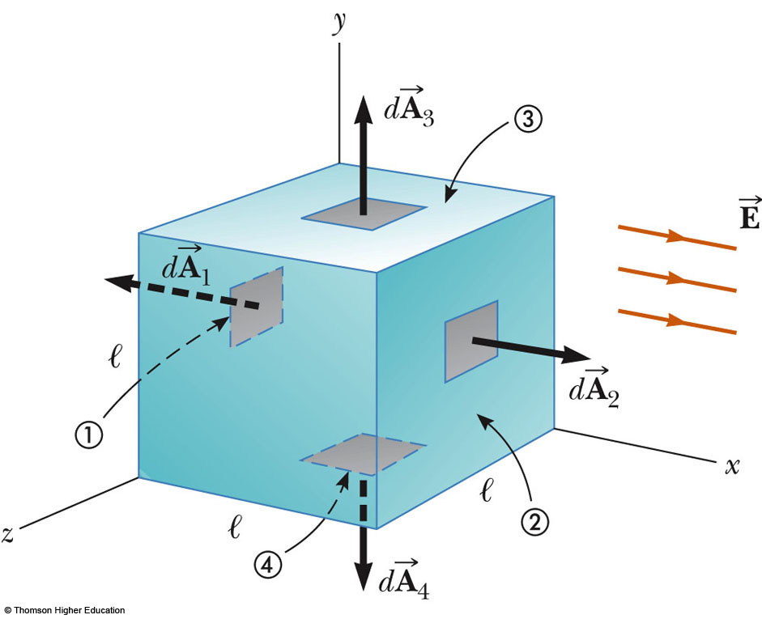
Flux Through a Cube, Example
The field lines pass through two surfaces perpendicularly and are parallel to the other four surfaces
For side 1, E = -El²
For side 2, E = El²
For the other sides, E = 0
Therefore, E_{total} = 0

Slide 12
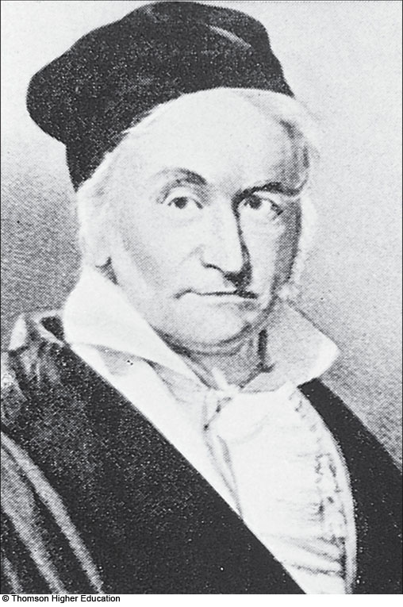
Karl Friedrich Gauss
1777 – 1855
Made contributions in
  Electromagnetism
  Number theory
  Statistics
  Non-Euclidean geometry
  Cometary orbital mechanics
  A founder of the German Magnetic Union
    Studies the Earth’s magnetic field

Slide 13
Gauss’s Law, Introduction
Gauss’s law is an expression of the general relationship between the net electric flux through a closed surface and the charge enclosed by the surface
  The closed surface is often called a gaussian surface
Gauss’s law is of fundamental importance in the study of electric fields

Slide 14
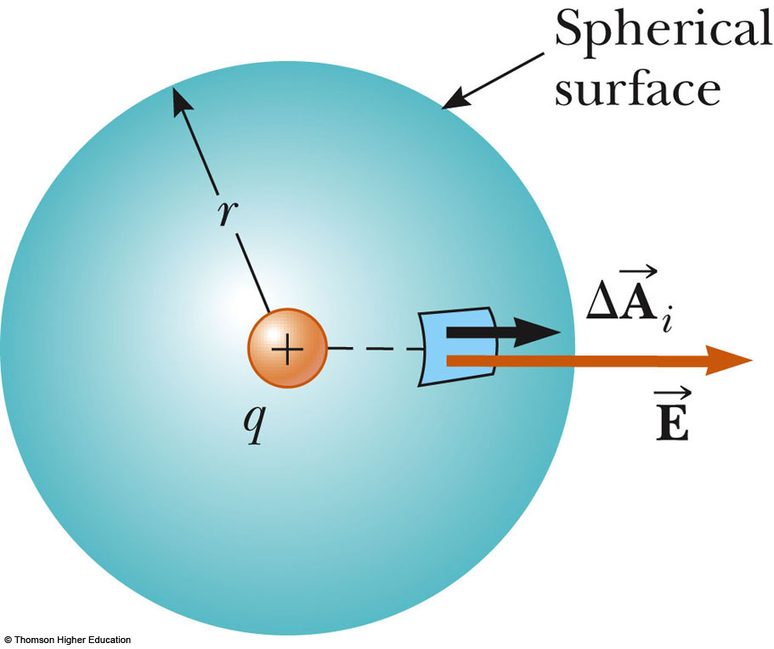
Gauss’s Law – General
A positive point charge, q, is located at the center of a sphere of radius r
The magnitude of the electric field everywhere on the surface of the sphere is
  E = k_{e}q / r²

Slide 15
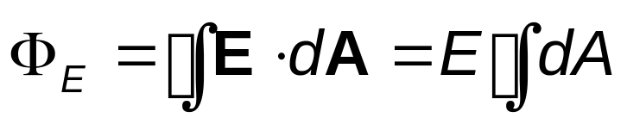
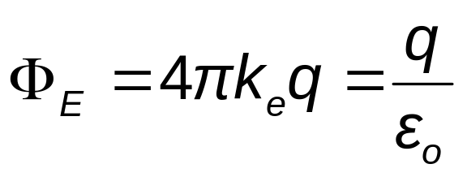
Gauss’s Law – General, cont.
The field lines are directed radially outward and are perpendicular to the surface at every point
This will be the net flux through the gaussian surface, the sphere of radius r
We know E = k_{e}q/r² and A_{sphere} = 4πr²,

Slide 16
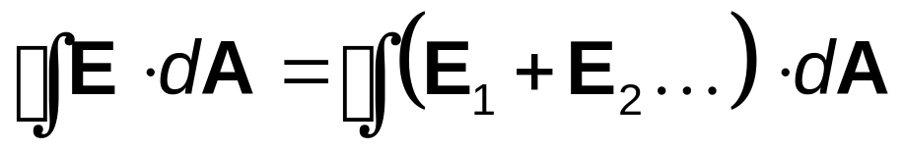
Gauss’s Law – General, notes
The net flux through any closed surface surrounding a point charge, q, is given by q/ε_{o} and is independent of the shape of that surface
The net electric flux through a closed surface that surrounds no charge is zero
Since the electric field due to many charges is the vector sum of the electric fields produced by the individual charges, the flux through any closed surface can be expressed as

Slide 17
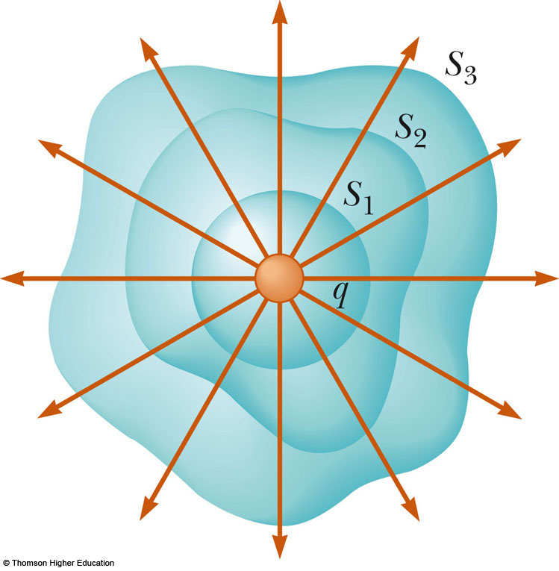
Gaussian Surface, Example
Closed surfaces of various shapes can surround the charge
  Only S₁ is spherical
Verifies the net flux through any closed surface surrounding a point charge q is given by q/ε_{o} and is independent of the shape of the surface

Slide 18
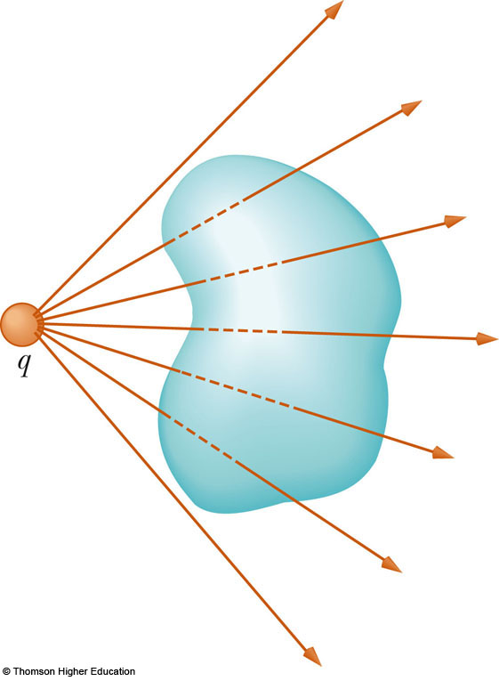
Gaussian Surface, Example 2
The charge is outside the closed surface with an arbitrary shape
Any field line entering the surface leaves at another point
Verifies the electric flux through a closed surface that surrounds no charge is zero

Slide 19
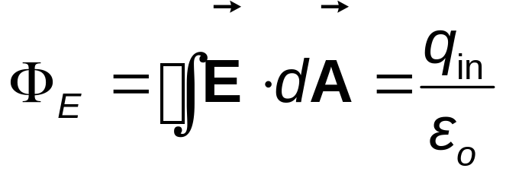

Gauss’s Law – Final
Gauss’s law states
  q_{in} is the net charge inside the surface
represents the electric field at any point on the surface
  is the total electric field and may have contributions from charges both inside and outside of the surface
Although Gauss’s law can, in theory, be solved to find for any charge configuration, in practice it is limited to symmetric situations

Slide 20
Applying Gauss’s Law
To use Gauss’s law, you want to choose a gaussian surface over which the surface integral can be simplified and the electric field determined
Take advantage of symmetry
Remember, the gaussian surface is a surface you choose, it does not have to coincide with a real surface

Slide 21


Conditions for a Gaussian Surface
Try to choose a surface that satisfies one or more of these conditions:
  The value of the electric field can be argued from symmetry to be constant over the surface
  The dot product of can be expressed as a simple algebraic product EdA because and are parallel
  The dot product is 0 because and are perpendicular
  The field is zero over the portion of the surface

Slide 22
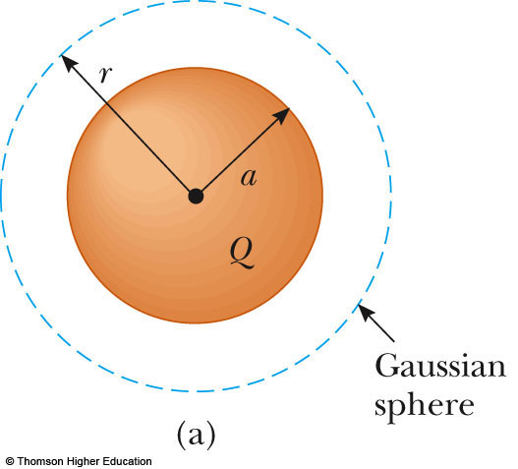
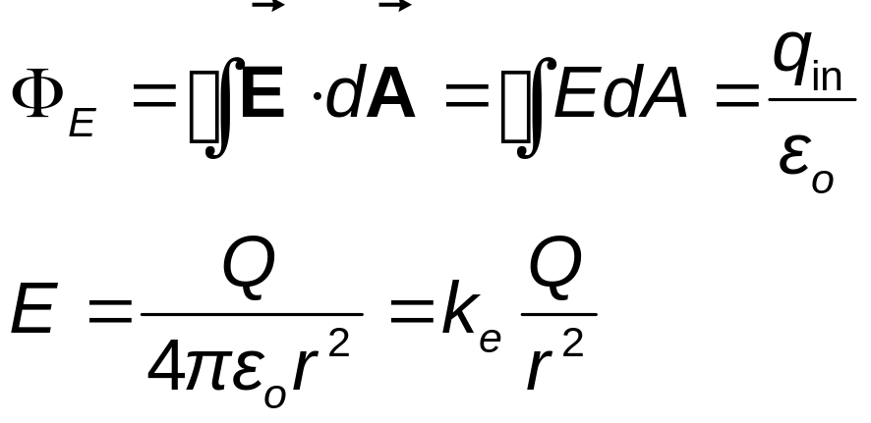
Field Due to a Spherically Symmetric Charge Distribution
Select a sphere as the gaussian surface
For r >a

Slide 23
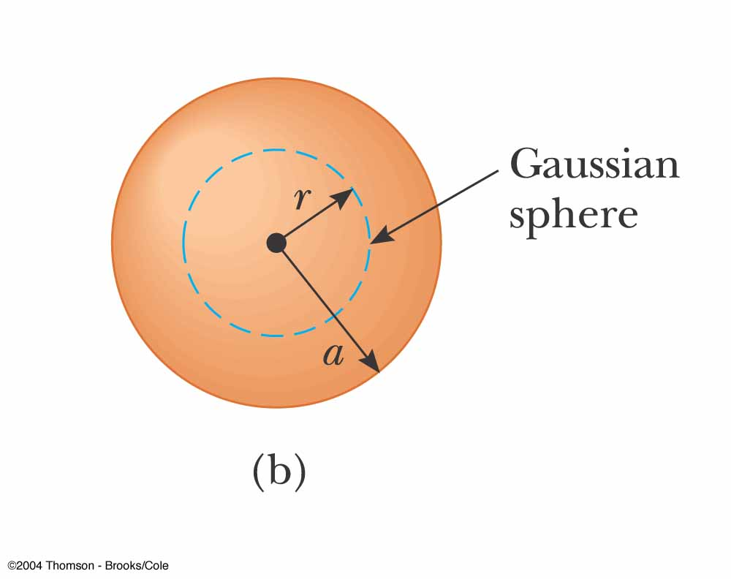
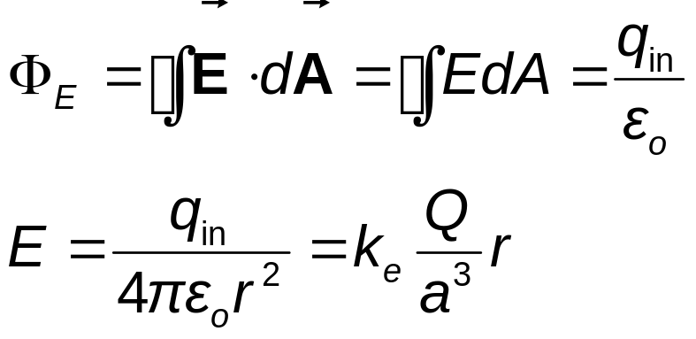
Spherically Symmetric, cont.
Select a sphere as the gaussian surface, r < a
q_{in} < Q
q_{in} = r (4/3πr³)

Slide 24
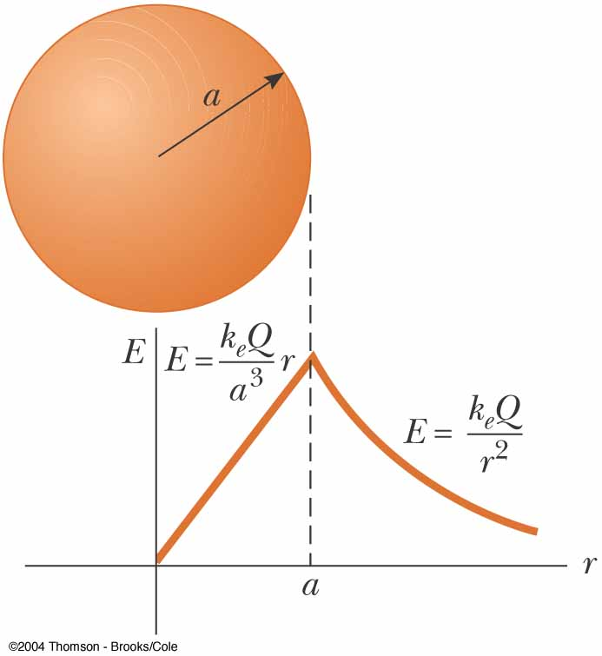
Spherically Symmetric Distribution, final
Inside the sphere, E varies linearly with r
  E → 0 as r → 0
The field outside the sphere is equivalent to that of a point charge located at the center of the sphere

Slide 25
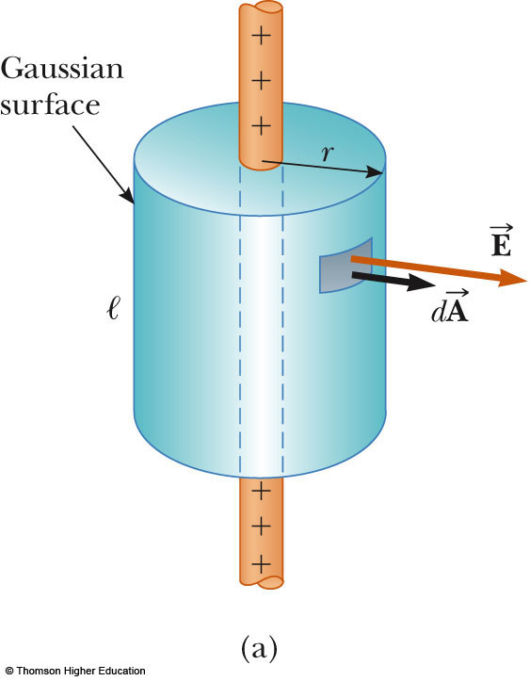
Field at a Distance from a Line of Charge
Select a cylindrical charge distribution
  The cylinder has a radius of r and a length of ℓ
is constant in magnitude and perpendicular to the surface at every point on the curved part of the surface

Slide 26
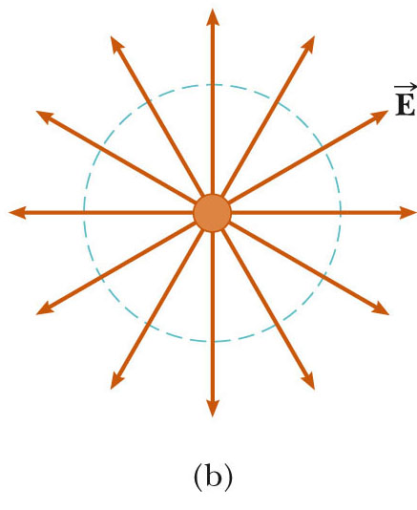
Field Due to a Line of Charge, cont.
The end view confirms the field is perpendicular to the curved surface
The field through the ends of the cylinder is 0 since the field is parallel to these surfaces

Slide 27
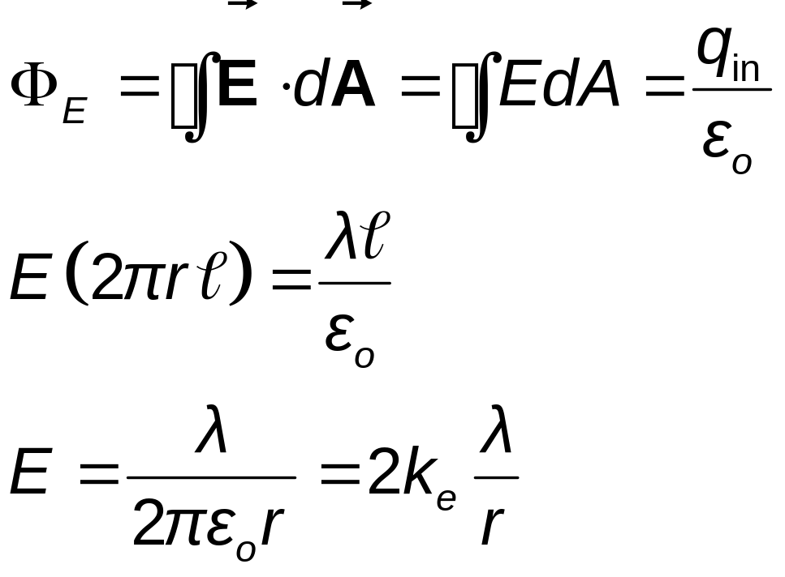
Field Due to a Line of Charge, final
Use Gauss’s law to find the field

Slide 28
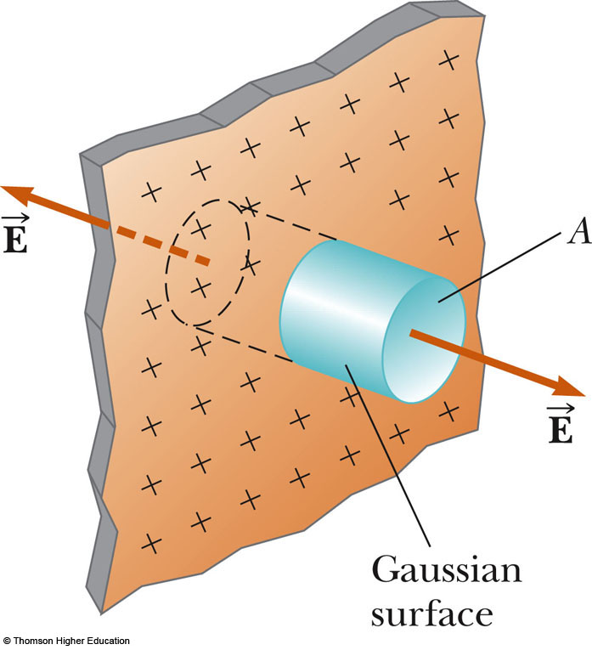
Field Due to a Plane of Charge
must be perpendicular to the plane and must have the same magnitude at all points equidistant from the plane
Choose a small cylinder whose axis is perpendicular to the plane for the gaussian surface

Slide 29
Field Due to a Plane of Charge, cont
is parallel to the curved surface and there is no contribution to the surface area from this curved part of the cylinder
The flux through each end of the cylinder is EA and so the total flux is 2EA

Slide 30
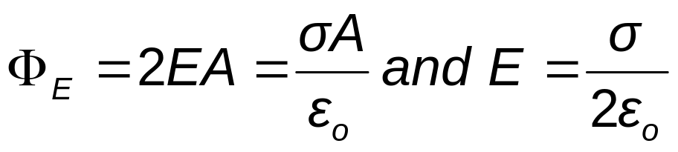
Field Due to a Plane of Charge, final
The total charge in the surface is σA
Applying Gauss’s law
Note, this does not depend on r
Therefore, the field is uniform everywhere

Slide 31
Electrostatic Equilibrium
When there is no net motion of charge within a conductor, the conductor is said to be in electrostatic equilibrium

Slide 32
Properties of a Conductor in Electrostatic Equilibrium
The electric field is zero everywhere inside the conductor
  Whether the conductor is solid or hollow
If an isolated conductor carries a charge, the charge resides on its surface
The electric field just outside a charged conductor is perpendicular to the surface and has a magnitude of σ/ε_{o}
  σ is the surface charge density at that point
On an irregularly shaped conductor, the surface charge density is greatest at locations where the radius of curvature is the smallest

Slide 33
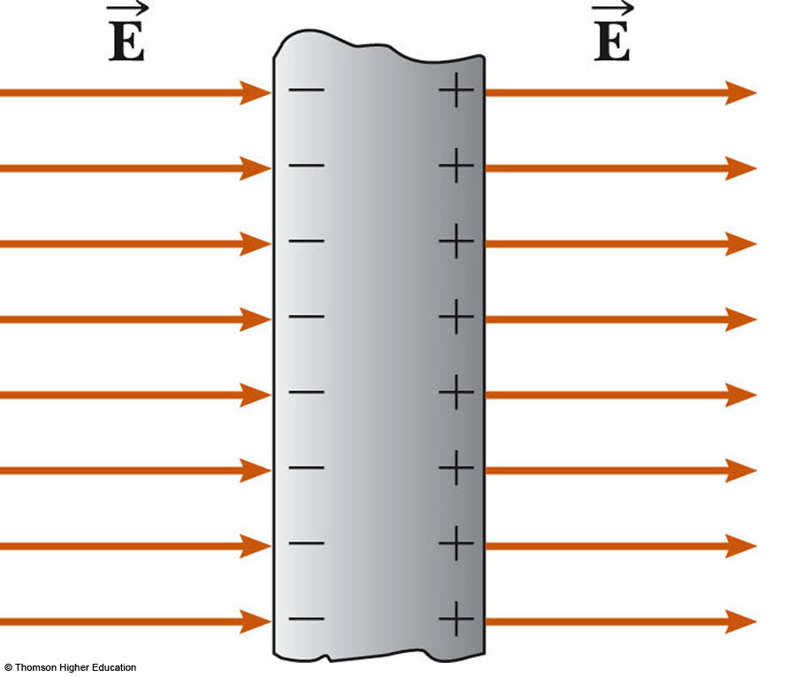
Property 1: Field_{inside} = 0
Consider a conducting slab in an external field
If the field inside the conductor were not zero, free electrons in the conductor would experience an electrical force
These electrons would accelerate
These electrons would not be in equilibrium
Therefore, there cannot be a field inside the conductor

Slide 34
Property 1: Field_{inside} = 0, cont.
Before the external field is applied, free electrons are distributed throughout the conductor
When the external field is applied, the electrons redistribute until the magnitude of the internal field equals the magnitude of the external field
There is a net field of zero inside the conductor
This redistribution takes about 10⁻¹⁶s and can be considered instantaneous

Slide 35
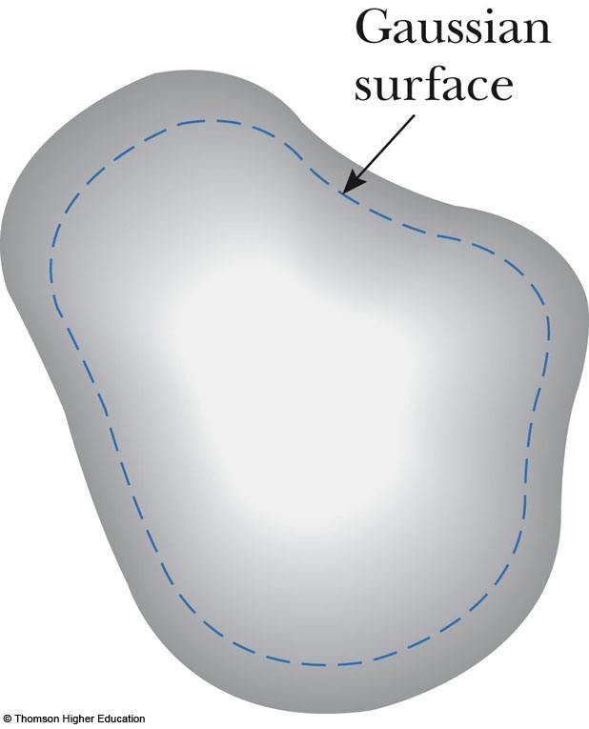
Property 2: Charge Resides on the Surface
Choose a gaussian surface inside but close to the actual surface
The electric field inside is zero (prop. 1)
There is no net flux through the gaussian surface
Because the gaussian surface can be as close to the actual surface as desired, there can be no charge inside the surface

Slide 36
Property 2: Charge Resides on the Surface, cont
Since no net charge can be inside the surface, any net charge must reside on the surface
Gauss’s law does not indicate the distribution of these charges, only that it must be on the surface of the conductor

Slide 37
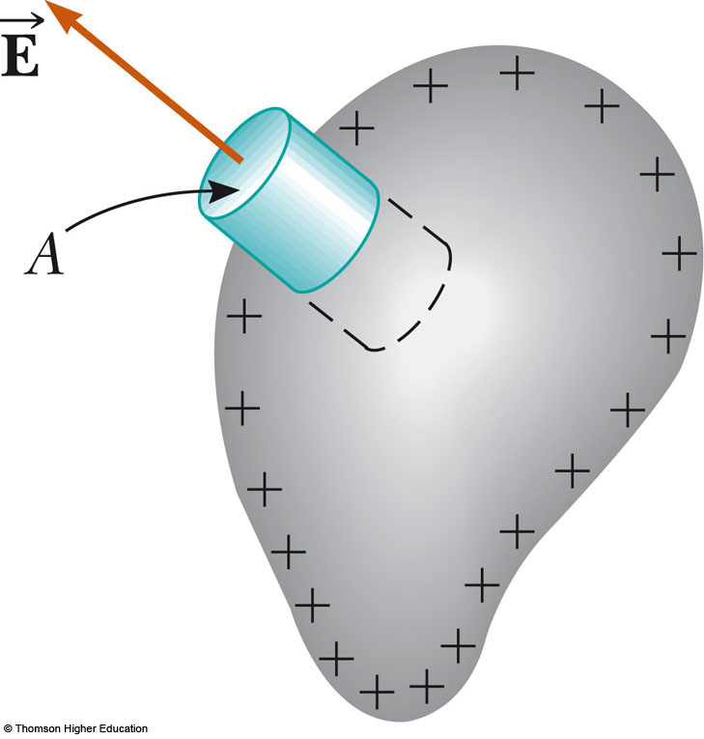
Property 3: Field’s Magnitude and Direction
Choose a cylinder as the gaussian surface
The field must be perpendicular to the surface
  If there were a parallel component to , charges would experience a force and accelerate along the surface and it would not be in equilibrium

Slide 38
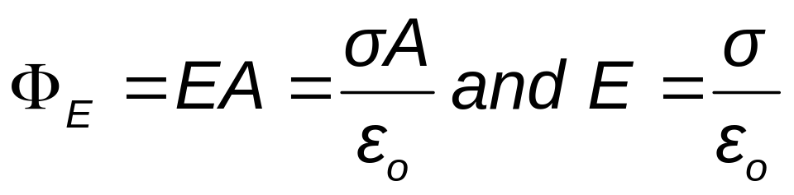
Property 3: Field’s Magnitude and Direction, cont.
The net flux through the gaussian surface is through only the flat face outside the conductor
  The field here is perpendicular to the surface
Applying Gauss’s law

Slide 39
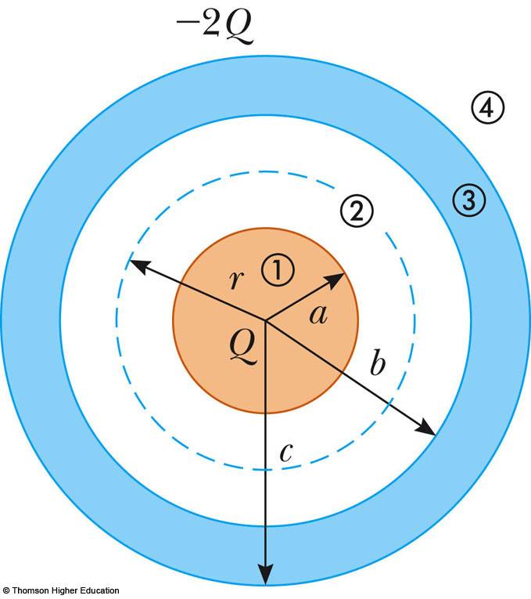
Sphere and Shell Example
Conceptualize
  Similar to the sphere example
  Now a charged sphere is surrounded by a shell
  Note charges
Categorize
  System has spherical symmetry
  Gauss’ Law can be applied
PLAY
ACTIVE FIGURE

Slide 40
Sphere and Shell Example
Analyze
  Construct a Gaussian sphere between the surface of the solid sphere and the inner surface of the shell
  The electric field lines must be directed radially outward and be constant in magnitude on the Gaussian surface

Slide 41
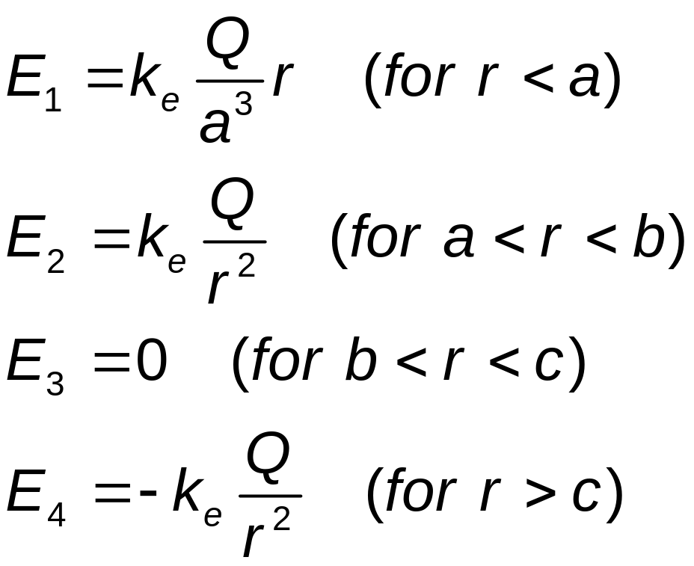
Sphere and Shell Example, 3
Analyze, cont
  The electric field for each area can be calculated

Slide 42
Sphere and Shell Example
Finalize
  Check the net charge
  Think about other possible combinations
    What if the sphere were conducting instead of insulating?

