Slide 1
Chapter 26
Capacitance
and
Dielectrics

Slide 2
Capacitors
Capacitors are devices that store electric charge
Examples of where capacitors are used include:
  radio receivers
  filters in power supplies
  to eliminate sparking in automobile ignition systems
  energy-storing devices in electronic flashes

Slide 3
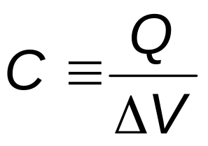
Definition of Capacitance
The capacitance, C, of a capacitor is defined as the ratio of the magnitude of the charge on either conductor to the potential difference between the conductors
The SI unit of capacitance is the farad (F)

Slide 4
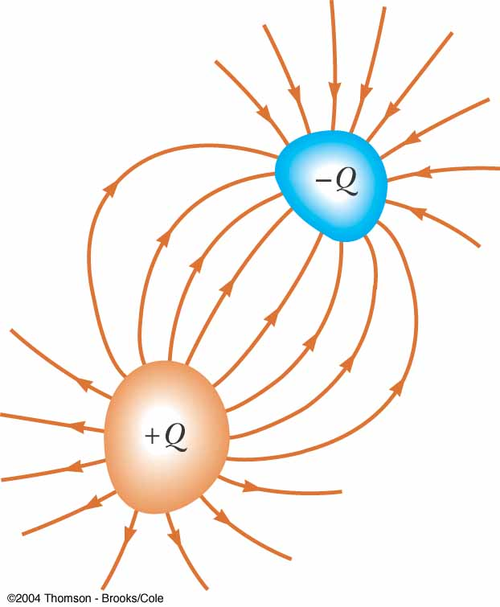
Makeup of a Capacitor
A capacitor consists of two conductors
  These conductors are called plates
  When the conductor is charged, the plates carry charges of equal magnitude and opposite directions
A potential difference exists between the plates due to the charge

Slide 5
More About Capacitance
Capacitance will always be a positive quantity
The capacitance of a given capacitor is constant
The capacitance is a measure of the capacitor’s ability to store charge
The farad is a large unit, typically you will see microfarads (μF) and picofarads (pF)

Slide 6
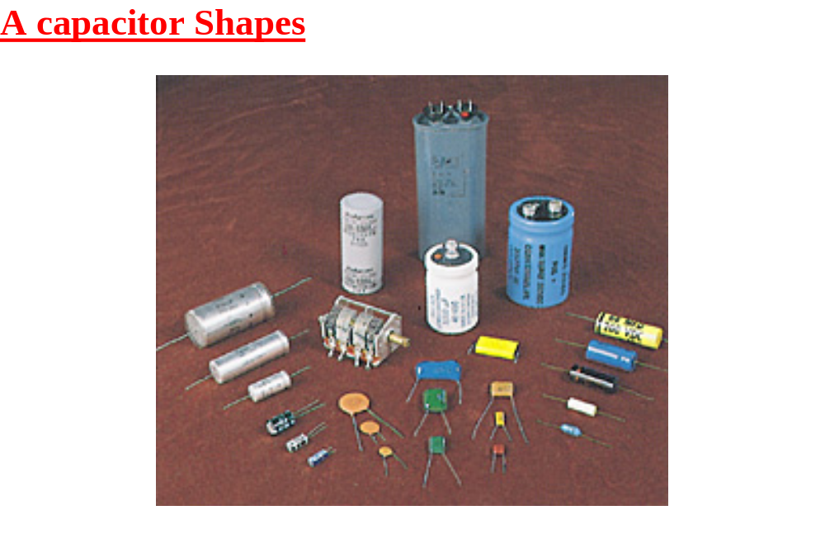

Slide 7
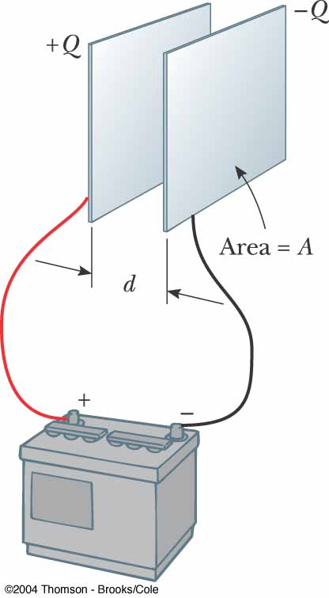
Parallel Plate Capacitor
Each plate is connected to a terminal of the battery
  The battery is a source of potential difference
If the capacitor is initially uncharged, the battery establishes an electric field in the connecting wires

Slide 8
Parallel Plate Capacitor, cont
This field applies a force on electrons in the wire just outside of the plates
The force causes the electrons to move onto the negative plate
This continues until equilibrium is achieved
  The plate, the wire and the terminal are all at the same potential
At this point, there is no field present in the wire and the movement of the electrons ceases

Slide 9
Parallel Plate Capacitor, final
The plate is now negatively charged
A similar process occurs at the other plate, electrons moving away from the plate and leaving it positively charged
In its final configuration, the potential difference across the capacitor plates is the same as that between the terminals of the battery

Slide 10
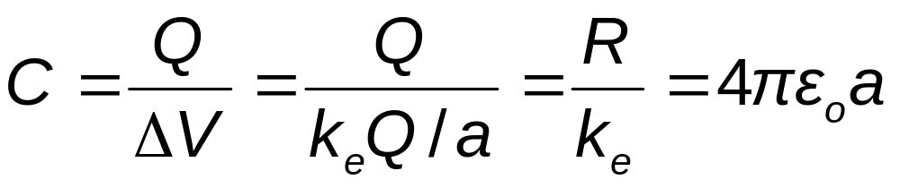
Capacitance – Isolated Sphere
Assume a spherical charged conductor with radius a
The sphere will have the same capacitance as it would if there were a conducting sphere of infinite radius, concentric with the original sphere
Assume V = 0 for the infinitely large shell
Note, this is independent of the charge and the potential difference

Slide 11
Capacitance – Parallel Plates
The charge density on the plates is σ = Q/A
  A is the area of each plate, which are equal
  Q is the charge on each plate, equal with opposite signs
The electric field is uniform between the plates and zero elsewhere

Slide 12
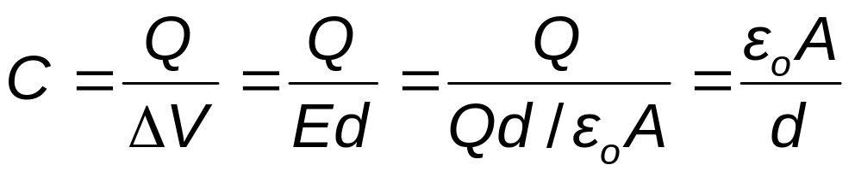
Capacitance – Parallel Plates, cont.
The capacitance is proportional to the area of its plates and inversely proportional to the distance between the plates

Slide 13
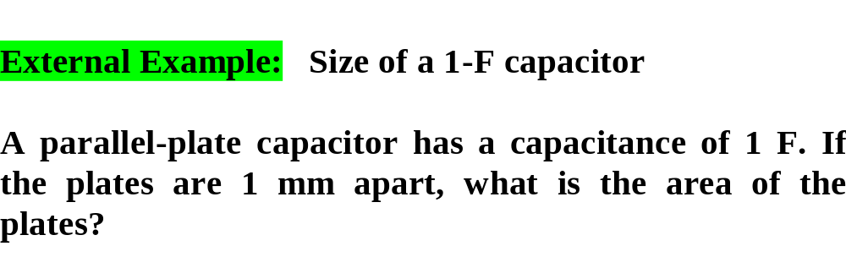
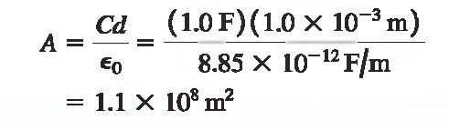

Slide 14
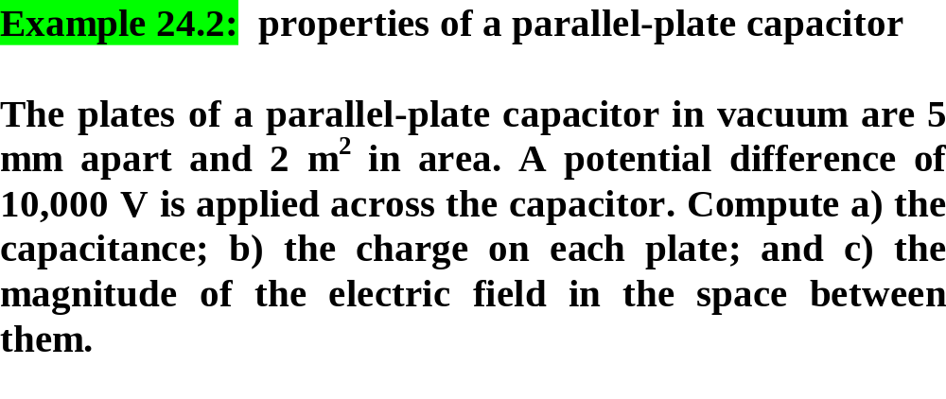

Slide 15
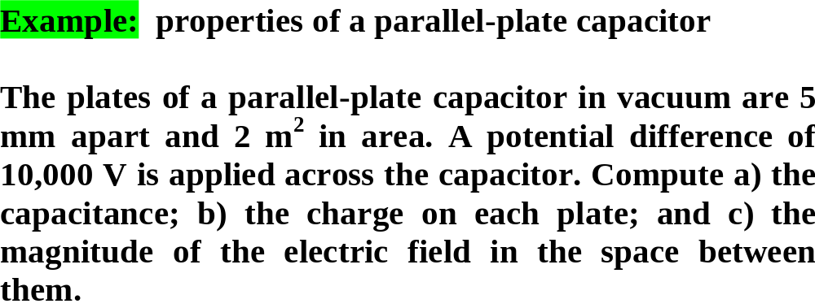
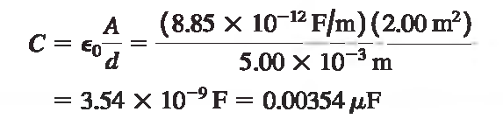
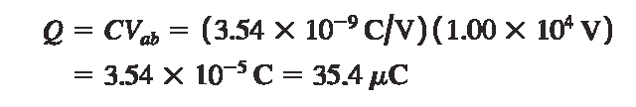


Slide 16
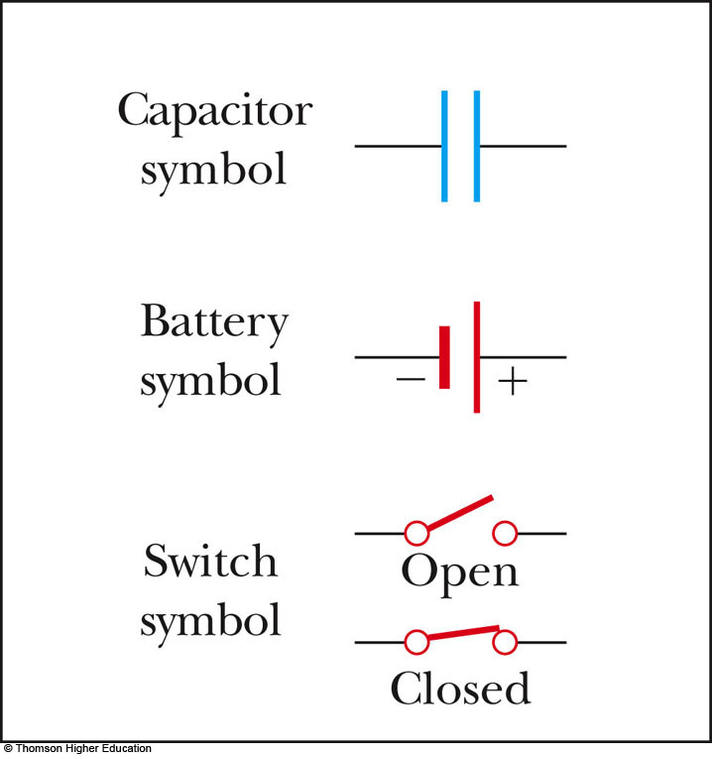
Circuit Symbols
A circuit diagram is a simplified representation of an actual circuit
Circuit symbols are used to represent the various elements
Lines are used to represent wires
The battery’s positive terminal is indicated by the longer line

Slide 17
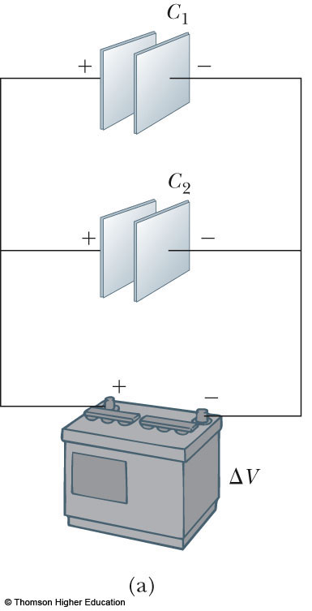
Capacitors in Parallel
When capacitors are first connected in the circuit, electrons are transferred from the left plates through the battery to the right plate, leaving the left plate positively charged and the right plate negatively charged
PLAY
ACTIVE FIGURE

Slide 18
Capacitors in Parallel, 2
The flow of charges ceases when the voltage across the capacitors equals that of the battery
The potential difference across the capacitors is the same
  And each is equal to the voltage of the battery
  ΔV₁ = ΔV₂ = ΔV
    ΔV is the battery terminal voltage
The capacitors reach their maximum charge when the flow of charge ceases
The total charge is equal to the sum of the charges on the capacitors
  Q_{total} = Q₁ + Q₂

Slide 19
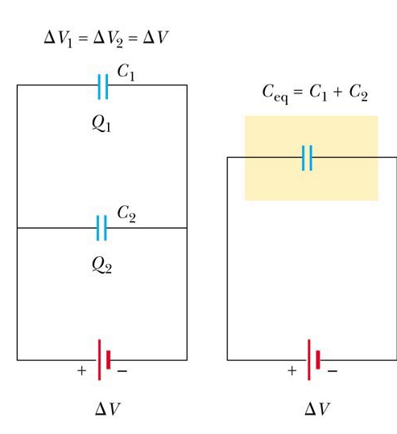
Capacitors in Parallel, 3
The capacitors can be replaced with one capacitor with a capacitance of C_{eq}
  The equivalent capacitor must have exactly the same external effect on the circuit as the original capacitors

Slide 20
Capacitors in Parallel, final
C_{eq} = C₁ + C₂ + C₃ + …
The equivalent capacitance of a parallel combination of capacitors is greater than any of the individual capacitors
  Essentially, the areas are combined
Use the active figure to vary the battery potential and the various capacitors and observe the resulting charges and voltages on the capacitors

Slide 21
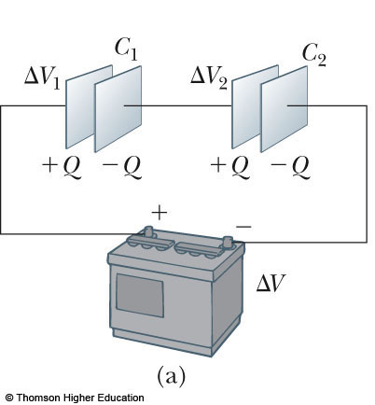
Capacitors in Series
When a battery is connected to the circuit, electrons are transferred from the left plate of C₁ to the right plate of C₂ through the battery
PLAY
ACTIVE FIGURE

Slide 22
Capacitors in Series, 2
As this negative charge accumulates on the right plate of C₂, an equivalent amount of negative charge is removed from the left plate of C₂, leaving it with an excess positive charge
All of the right plates gain charges of –Q and all the left plates have charges of +Q

Slide 23
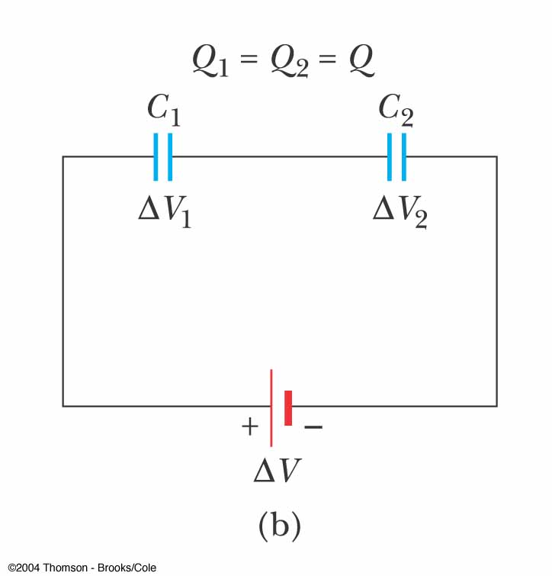
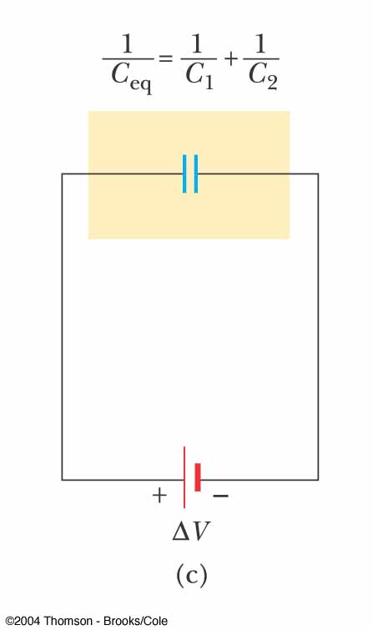
Capacitors in
Series, 3
An equivalent capacitor can be found that performs the same function as the series combination
The charges are all the same
Q₁ = Q₂ = Q

Slide 24
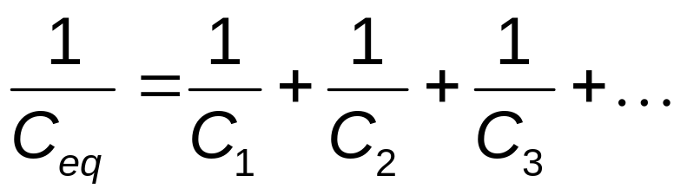
Capacitors in Series, final
The potential differences add up to the battery voltage
ΔV_{tot} = ΔV₁ + ΔV₂ + …
The equivalent capacitance is
The equivalent capacitance of a series combination is always less than any individual capacitor in the combination

Slide 25
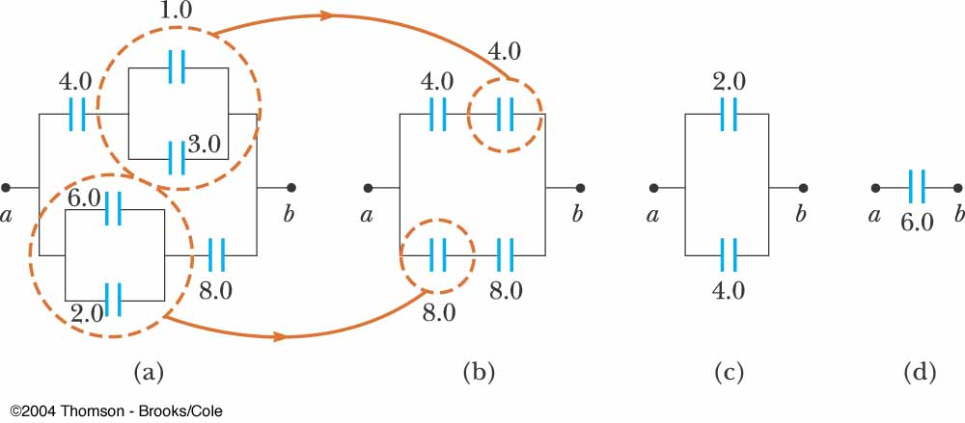
Equivalent Capacitance, Example
The 1.0-μF and 3.0-μF capacitors are in parallel as are the 6.0-μF and 2.0-μF capacitors
These parallel combinations are in series with the capacitors next to them
The series combinations are in parallel and the final equivalent capacitance can be found

Slide 26
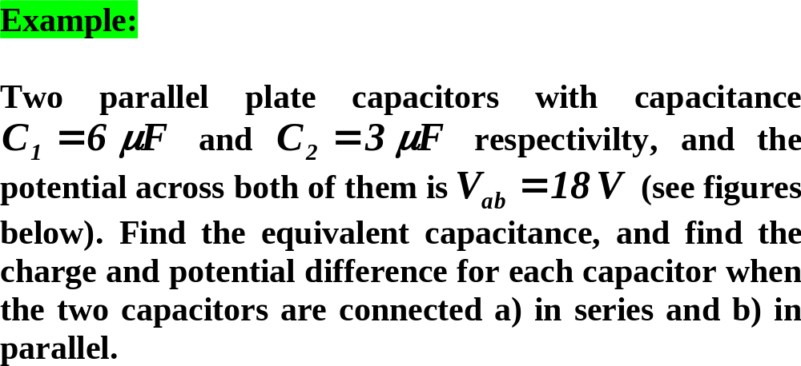
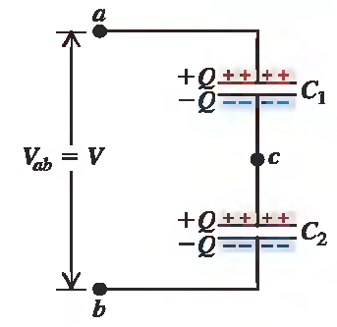
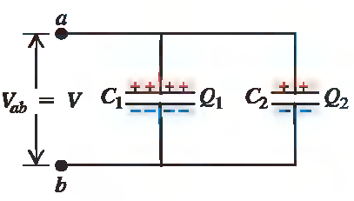

Slide 27


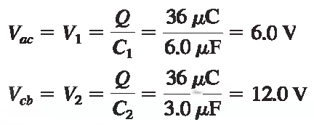
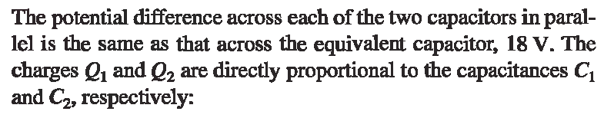

The series combination
The parallel combination

Slide 28
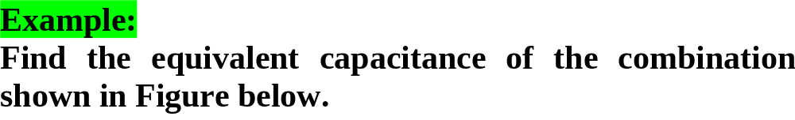

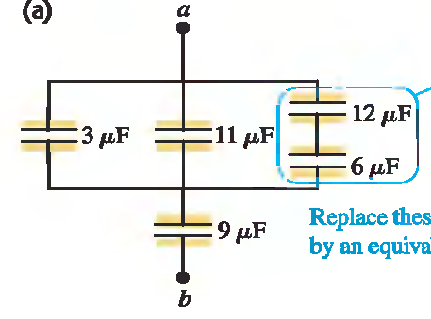



Slide 29
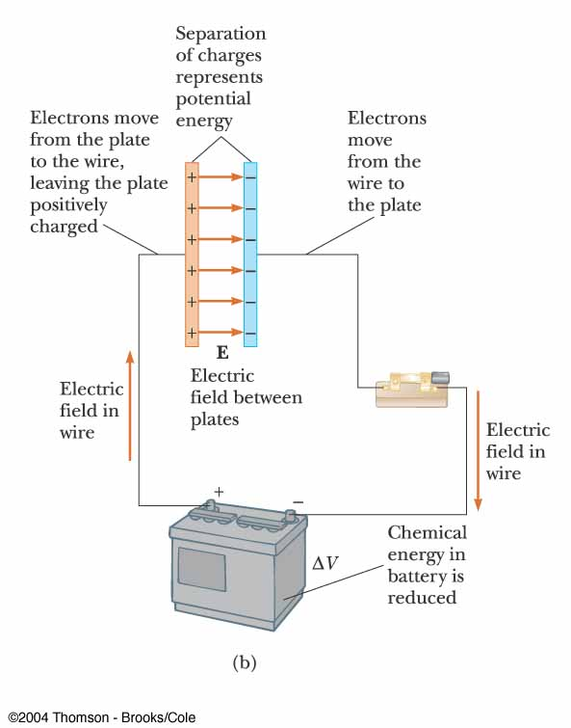
Energy in a Capacitor – Overview
Consider the circuit to be a system
Before the switch is closed, the energy is stored as chemical energy in the battery
When the switch is closed, the energy is transformed from chemical to electric potential energy

Slide 30
Energy in a Capacitor – Overview, cont
The electric potential energy is related to the separation of the positive and negative charges on the plates
A capacitor can be described as a device that stores energy as well as charge

Slide 31
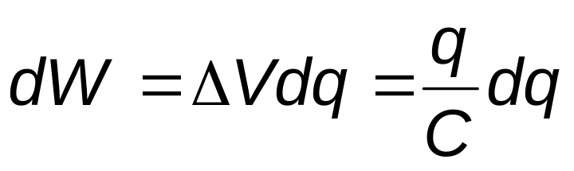
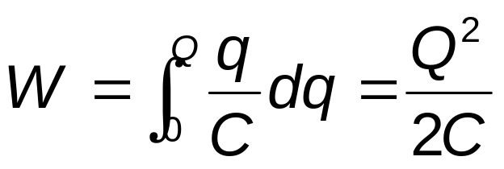
Energy Stored in a Capacitor
Assume the capacitor is being charged and, at some point, has a charge q on it
The work needed to transfer a charge from one plate to the other is
The total work required is

Slide 32
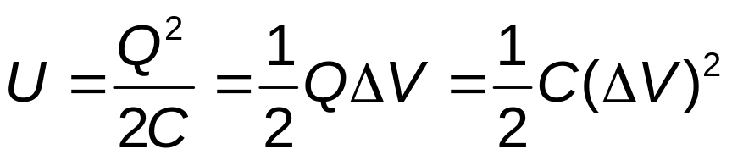
Energy, cont
The work done in charging the capacitor appears as electric potential energy U:
This applies to a capacitor of any geometry
The energy stored increases as the charge increases and as the potential difference increases
In practice, there is a maximum voltage before discharge occurs between the plates

Slide 33
Energy, final
The energy can be considered to be stored in the electric field
For a parallel-plate capacitor, the energy can be expressed in terms of the field as U = ½ (ε_{o}Ad)E²
It can also be expressed in terms of the energy density (energy per unit volume)
u_{E} = ½ ε_{o}E²

Slide 34
Capacitors with Dielectrics
A dielectric is a nonconducting material that, when placed between the plates of a capacitor, increases the capacitance
  Dielectrics include rubber, glass, and waxed paper
With a dielectric, the capacitance becomes C = κC_{o}
  The capacitance increases by the factor κ when the dielectric completely fills the region between the plates
  κ is the dielectric constant of the material

Slide 35
Dielectrics, cont
For a parallel-plate capacitor, C = κε_{o}(A/d)
In theory, d could be made very small to create a very large capacitance
In practice, there is a limit to d
  d is limited by the electric discharge that could occur though the dielectric medium separating the plates
For a given d, the maximum voltage that can be applied to a capacitor without causing a discharge depends on the dielectric strength of the material

Slide 36
Dielectrics, final
Dielectrics provide the following advantages:
  Increase in capacitance
  Increase the maximum operating voltage
  Possible mechanical support between the plates
    This allows the plates to be close together without touching
    This decreases d and increases C

Slide 37
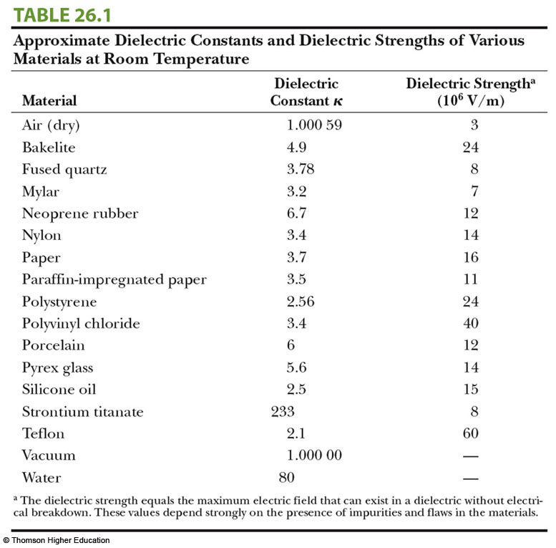

Slide 38
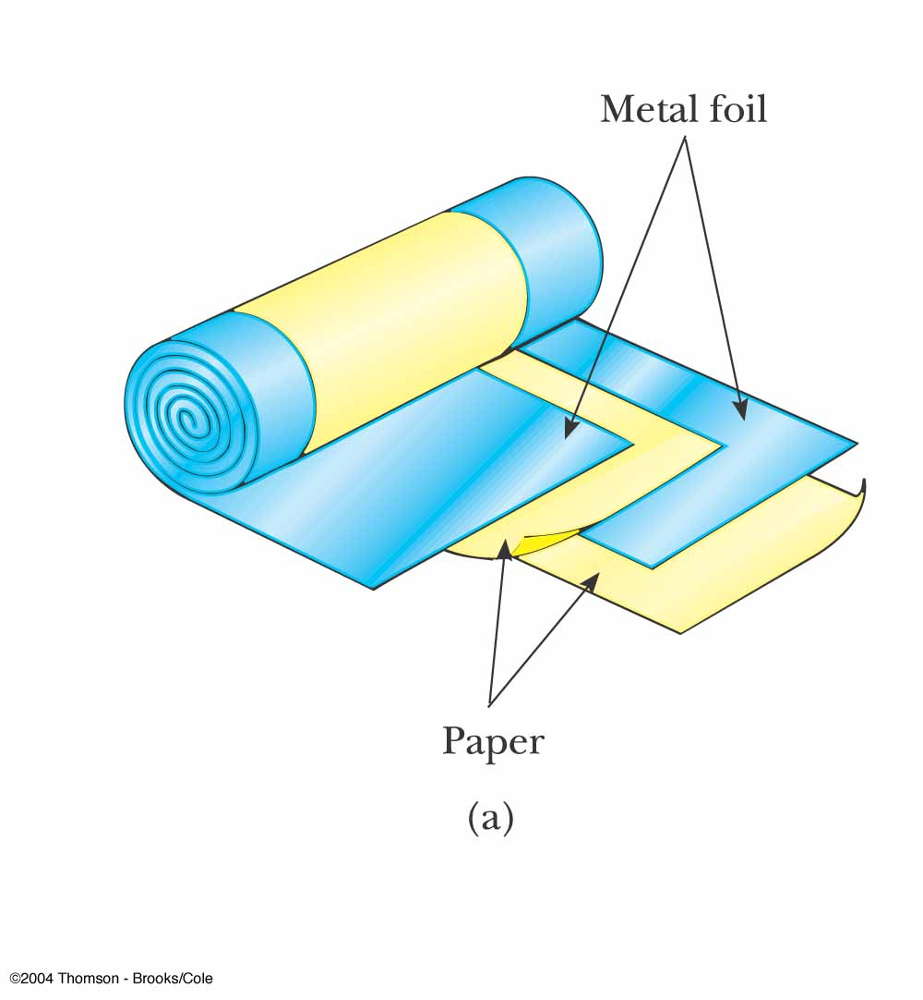
Types of Capacitors – Tubular
Metallic foil may be interlaced with thin sheets of paraffin-impregnated paper or Mylar
The layers are rolled into a cylinder to form a small package for the capacitor

Slide 39
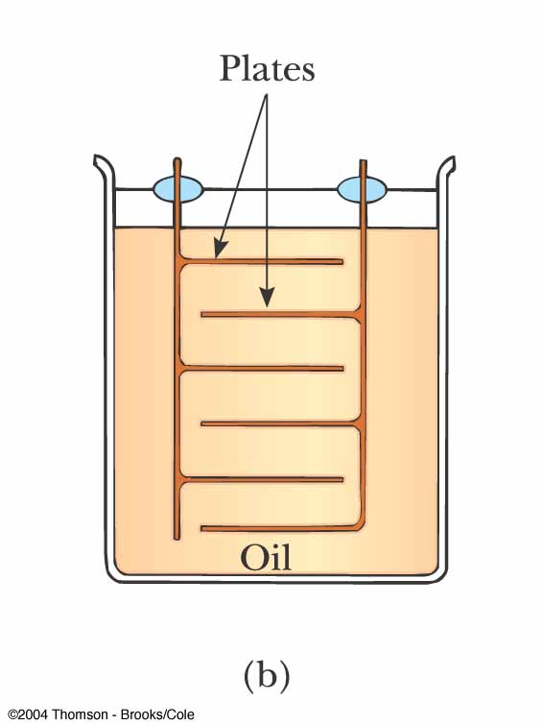
Types of Capacitors – Oil Filled
Common for high- voltage capacitors
A number of interwoven metallic plates are immersed in silicon oil

Slide 40
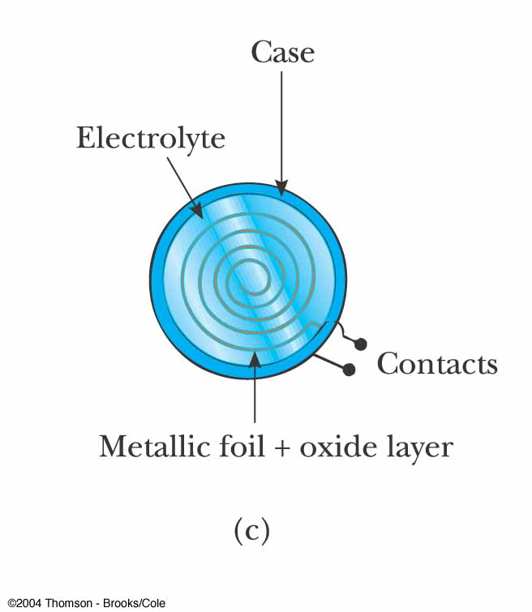
Types of Capacitors – Electrolytic
Used to store large amounts of charge at relatively low voltages
The electrolyte is a solution that conducts electricity by virtue of motion of ions contained in the solution

Slide 41
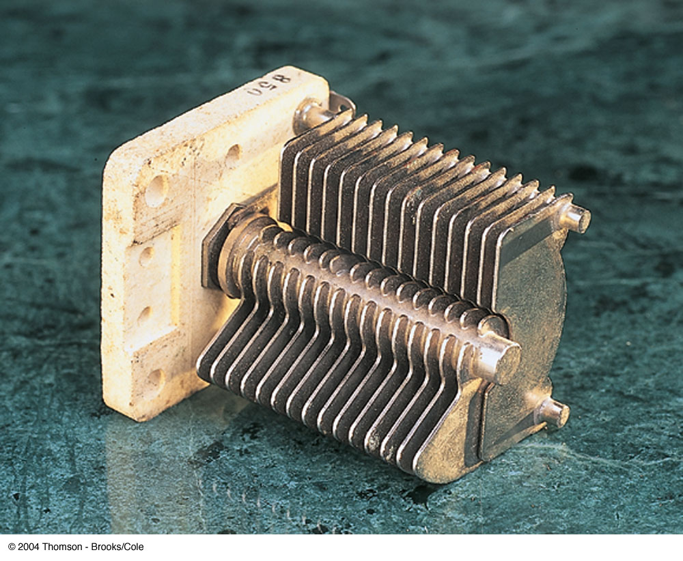
Types of Capacitors – Variable
Variable capacitors consist of two interwoven sets of metallic plates
One plate is fixed and the other is movable
These capacitors generally vary between 10 and 500 pF
Used in radio tuning circuits

Slide 42
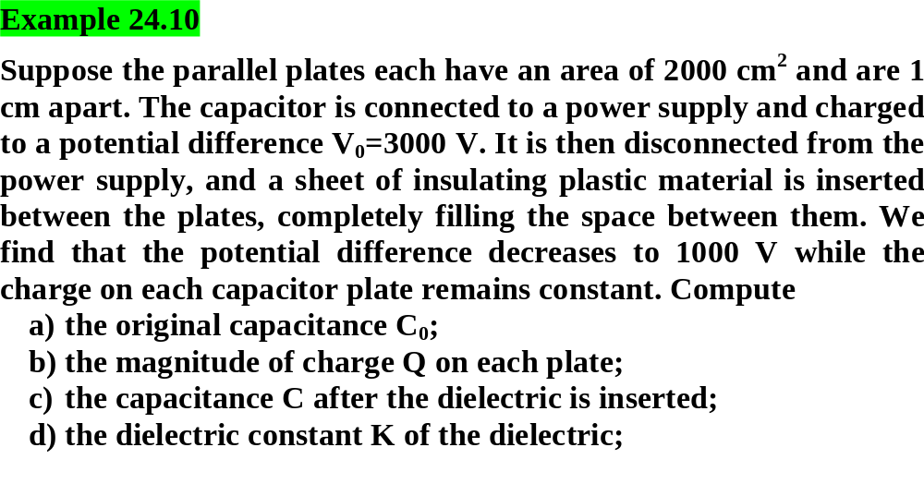

Slide 43
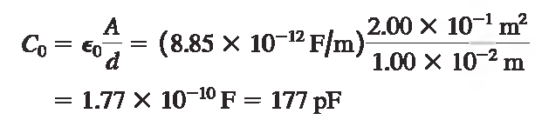


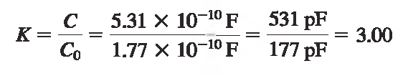

Slide 44
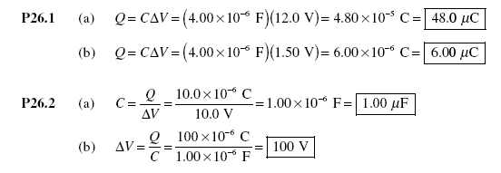
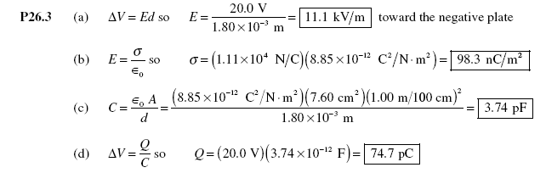

Slide 45
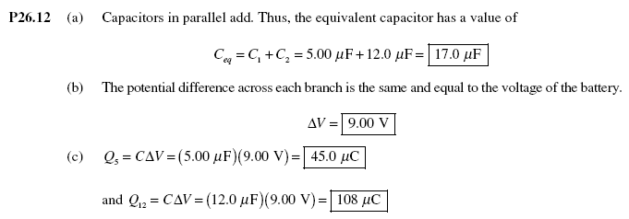

Slide 46
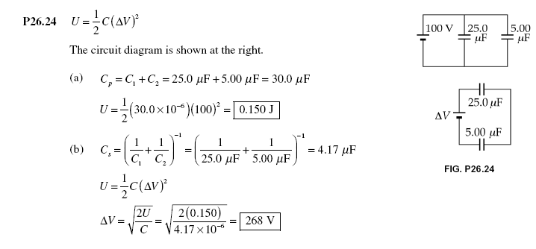

Slide 47
