Slide 1
Chapter 27
Current
And
Resistance

Slide 2
Electric Current
Electric current is the rate of flow of charge through some region of space
The SI unit of current is the ampere (A)
  1 A = 1 C / s
The symbol for electric current is I

Slide 3
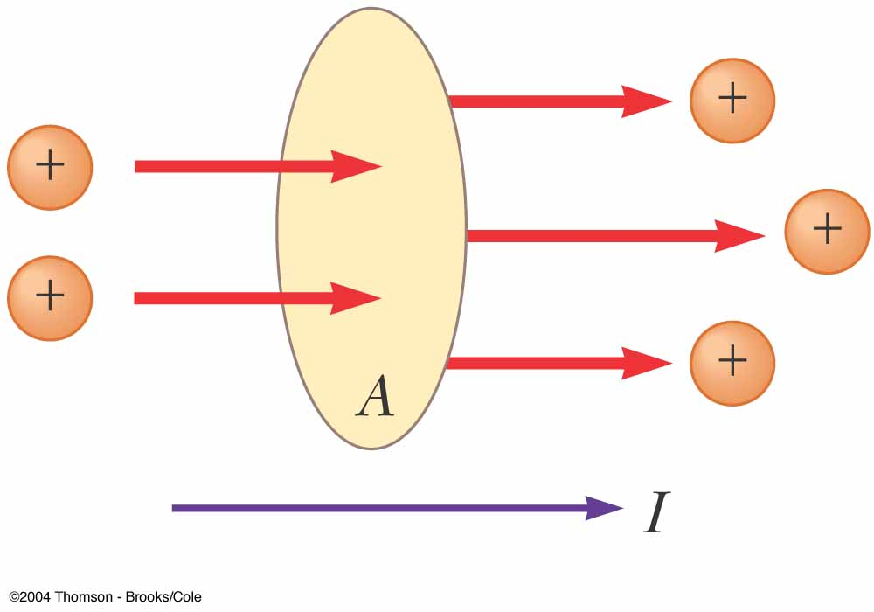
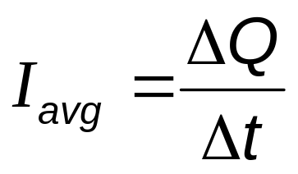
Average Electric Current
Assume charges are moving perpendicular to a surface of area A
If ΔQ is the amount of charge that passes through A in time Δt, then the average current is

Slide 4
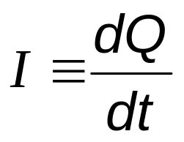
Instantaneous Electric Current
If the rate at which the charge flows varies with time, the instantaneous current, I, can be found

Slide 5
Direction of Current
The charges passing through the area could be positive or negative or both
It is conventional to assign to the current the same direction as the flow of positive charges
The direction of current flow is opposite the direction of the flow of electrons
It is common to refer to any moving charge as a charge carrier

Slide 6
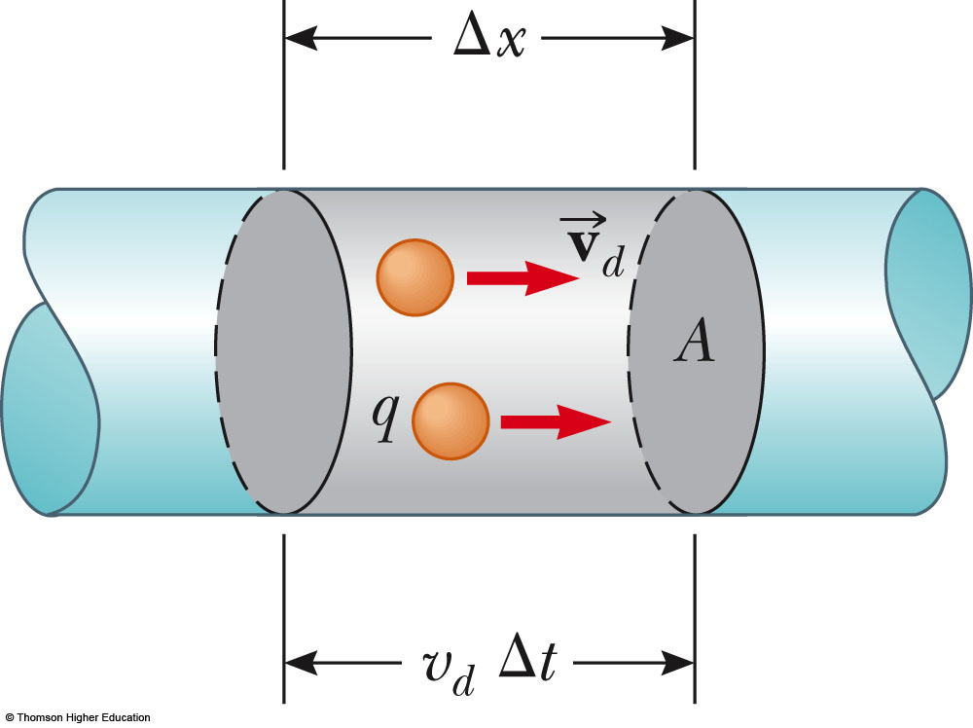
Current and Drift Speed
Charged particles move through a conductor of cross-sectional area A
n is the number of charge carriers per unit volume
nAΔx is the total number of charge carriers

Slide 7
Current and Drift Speed, cont
The total charge is the number of carriers times the charge per carrier, q
  ΔQ = (nAΔx)q
The drift speed, v_{d}, is the speed at which the carriers move
  v_{d} = Δx / Δt and Δx = v_{d} Δt
Rewritten: ΔQ = (nAv_{d} Δt)q
Finally, current, I_{ave} = ΔQ/Δt = nqv_{d}A

Slide 8
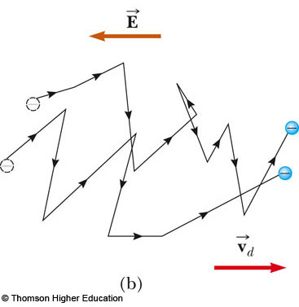
Charge Carrier Motion in a Conductor
The zigzag black lines represents the motion of a charge carrier in a conductor
  The net drift speed is small
The sharp changes in direction are due to collisions
The net motion of electrons is opposite the direction of the electric field
Use the active figure to change the field and observe the effect
PLAY
ACTIVE FIGURE

Slide 9

Motion of Charge Carriers, cont.
In the presence of an electric field, in spite of all the collisions, the charge carriers slowly move along the conductor with a drift velocity,
The electric field exerts forces on the conduction electrons in the wire
These forces cause the electrons to move in the wire and create a current

Slide 10
Motion of Charge Carriers, final
The electrons are already in the wire
They respond to the electric field set up by the battery
The battery does not supply the electrons, it only establishes the electric field

Slide 11
Drift Velocity, Example
Assume a copper wire, with one free electron per atom contributed to the current
The drift velocity for a 12-gauge copper wire carrying a current of 10.0 A is
2.23 x 10⁻⁴ m/s
  This is a typical order of magnitude for drift velocities

Slide 12
Current Density
J is the current density of a conductor
It is defined as the current per unit area
  J = I / A = nqv_{d}
  This expression is valid only if the current density is uniform and A is perpendicular to the direction of the current
J has SI units of A/m²
The current density is in the direction of the positive charge carriers

Slide 13
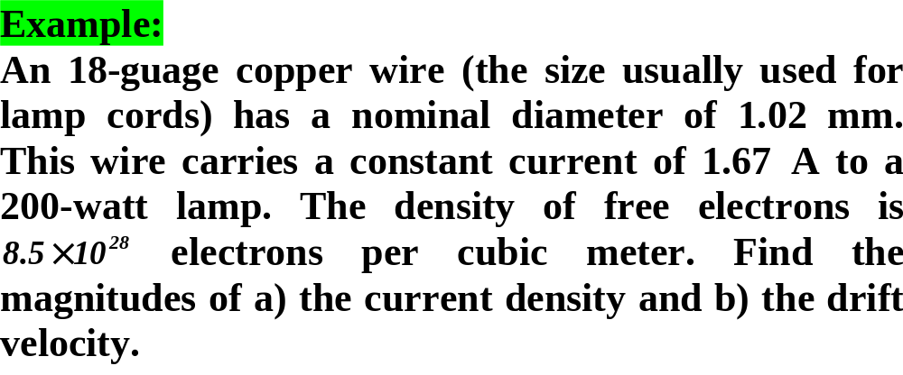


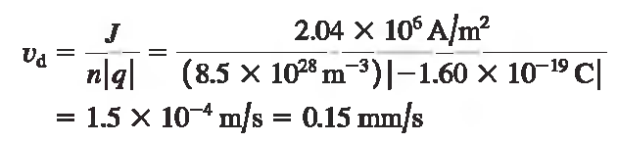

Slide 14
Conductivity
A current density and an electric field are established in a conductor whenever a potential difference is maintained across the conductor
For some materials, the current density is directly proportional to the field
The constant of proportionality, σ, is called the conductivity of the conductor

Slide 15
Ohm’s Law
Ohm’s law states that for many materials, the ratio of the current density to the electric field is a constant σ that is independent of the electric field producing the current
  Most metals obey Ohm’s law
  Mathematically, J = σ E
  Materials that obey Ohm’s law are said to be ohmic

Slide 16
Ohm’s Law, cont.
Not all materials follow Ohm’s law
  Materials that do not obey Ohm’s law are said to be nonohmic
Ohm’s law is not a fundamental law of nature
Ohm’s law is an empirical relationship valid only for certain materials

Slide 17
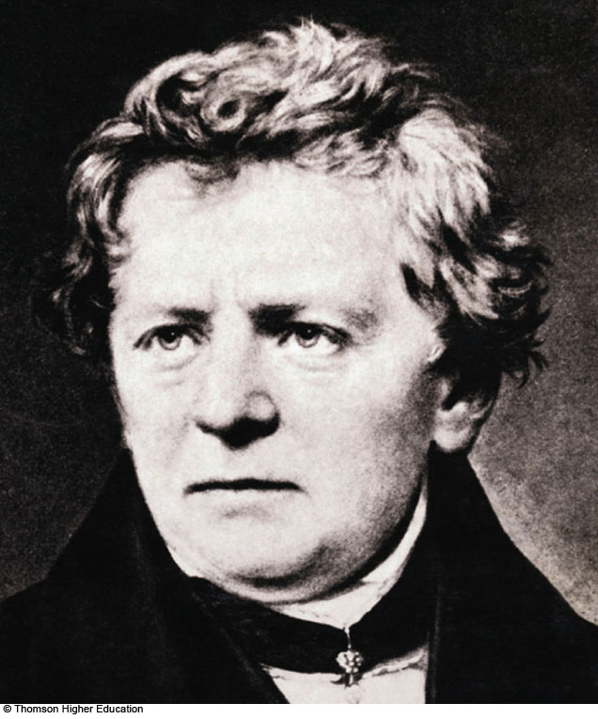
Georg Simon Ohm
1789 -1854
German physicist
Formulated idea of resistance
Discovered the proportionalities now known as forms of Ohm’s Law

Slide 18
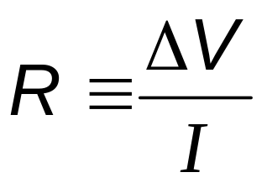
Resistance
In a conductor, the voltage applied across the ends of the conductor is proportional to the current through the conductor
The constant of proportionality is called the resistance of the conductor

Slide 19
Resistance, cont.
SI units of resistance are ohms (Ω)
  1 Ω = 1 V / A
Resistance in a circuit arises due to collisions between the electrons carrying the current with the fixed atoms inside the conductor

Slide 20
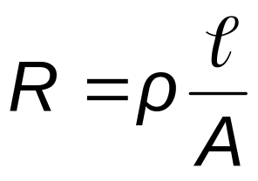
Resistivity
The inverse of the conductivity is the resistivity:
  ρ = 1 / σ
Resistivity has SI units of ohm-meters (Ω . m)
Resistance is also related to resistivity:

Slide 21
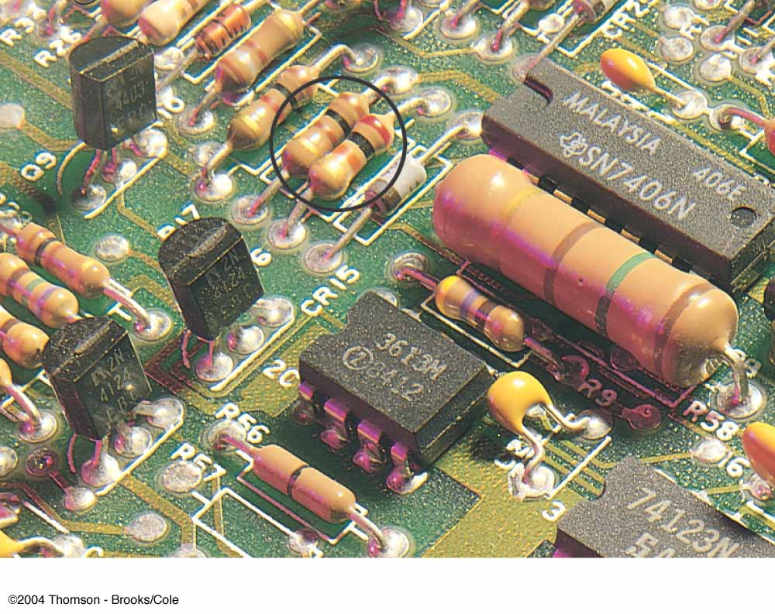
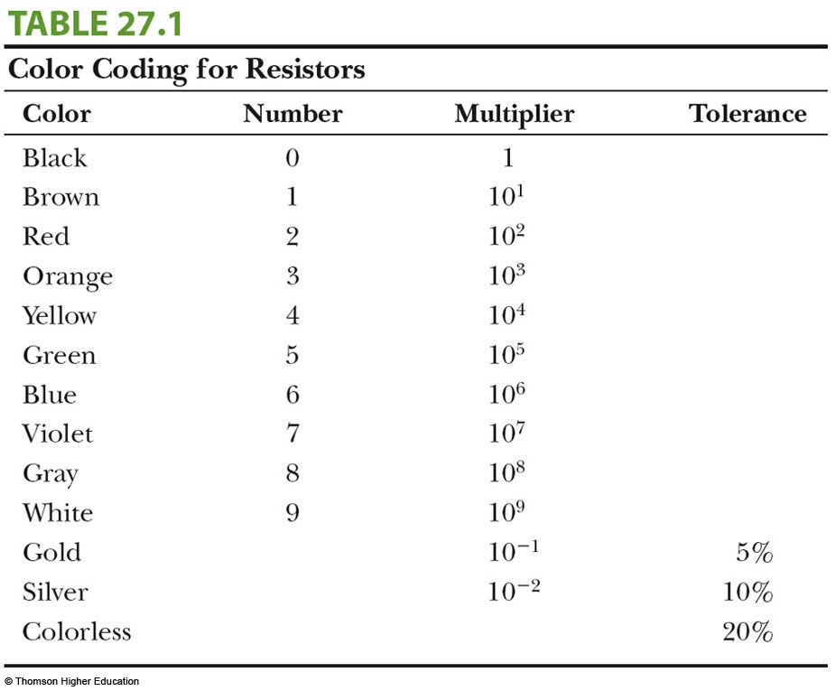
Resistor Values
Values of resistors are commonly marked by colored bands

Slide 22
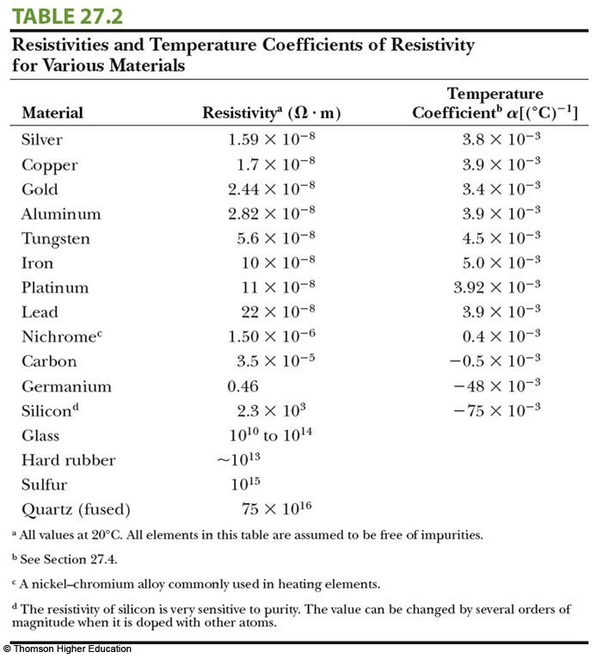
Resistivity
Values

Slide 23
Resistance and Resistivity, Summary
Every ohmic material has a characteristic resistivity that depends on the properties of the material and on temperature
  Resistivity is a property of substances
The resistance of a material depends on its geometry and its resistivity
  Resistance is a property of an object
An ideal conductor would have zero resistivity
An ideal insulator would have infinite resistivity

Slide 24
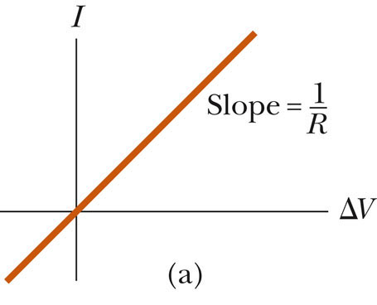
Ohmic Material, Graph
An ohmic device
The resistance is constant over a wide range of voltages
The relationship between current and voltage is linear
The slope is related to the resistance

Slide 25
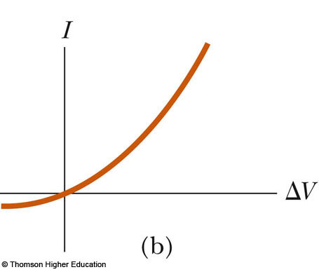
Nonohmic Material, Graph
Nonohmic materials are those whose resistance changes with voltage or current
The current-voltage relationship is nonlinear
A junction diode is a common example of a nonohmic device

Slide 26
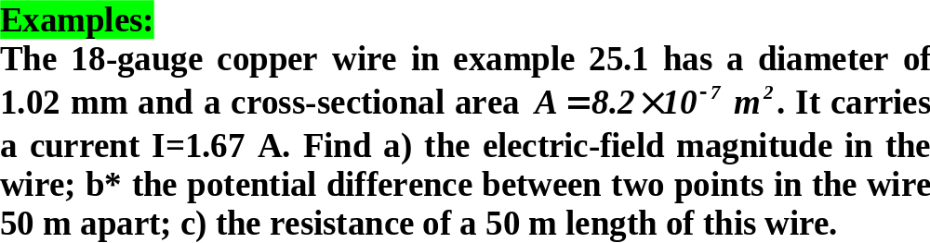
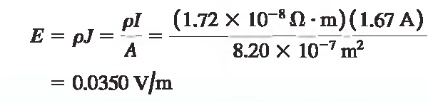
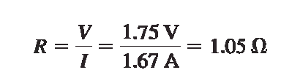


Slide 27
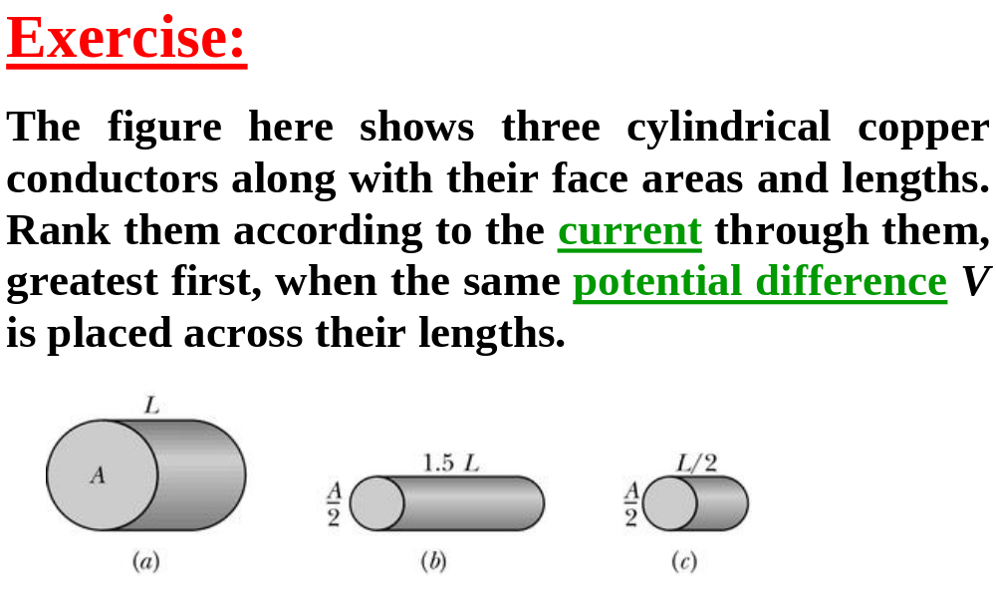

Slide 28
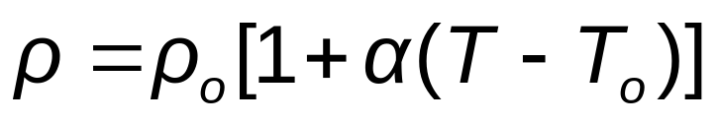
Resistance and Temperature
Over a limited temperature range, the resistivity of a conductor varies approximately linearly with the temperature
  ρ_{o} is the resistivity at some reference temperature T_{o}
    T_{o} is usually taken to be 20° C
    α is the temperature coefficient of resistivity
      SI units of α are ºC⁻¹

Slide 29
Temperature Variation of Resistance
Since the resistance of a conductor with uniform cross sectional area is proportional to the resistivity, you can find the effect of temperature on resistance
R = R_{o}[1 + α(T - T_{o})]
Use of this property enables precise temperature measurements through careful monitoring of the resistance of a probe made from a particular material

Slide 30
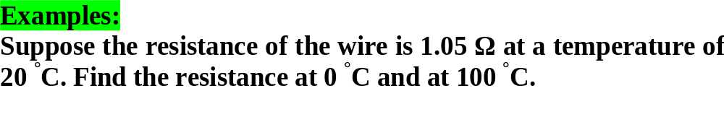
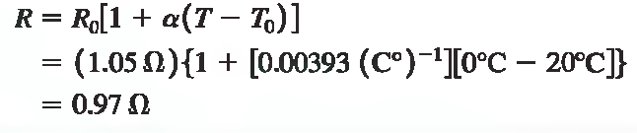
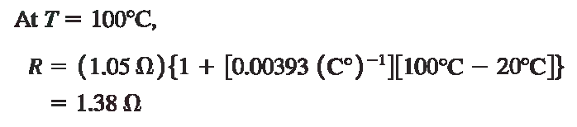

Slide 31
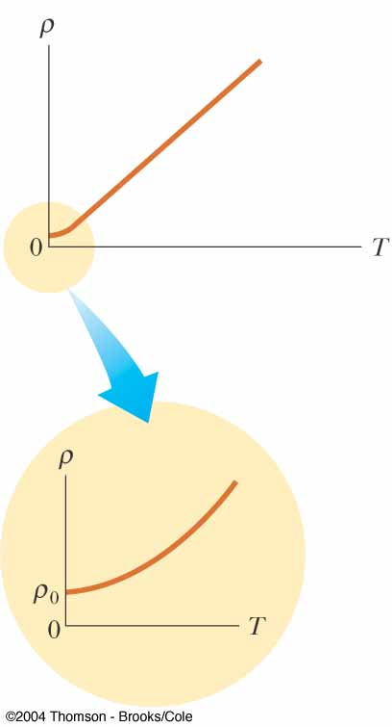
Resistivity and Temperature, Graphical View
For some metals, the resistivity is nearly proportional to the temperature
A nonlinear region always exists at very low temperatures
The resistivity usually reaches some finite value as the temperature approaches absolute zero

Slide 32
Residual Resistivity
The residual resistivity near absolute zero is caused primarily by the collisions of electrons with impurities and imperfections in the metal
High temperature resistivity is predominantly characterized by collisions between the electrons and the metal atoms
  This is the linear range on the graph

Slide 33
Semiconductors
Semiconductors are materials that exhibit a decrease in resistivity with an increase in temperature
α is negative
There is an increase in the density of charge carriers at higher temperatures

Slide 34
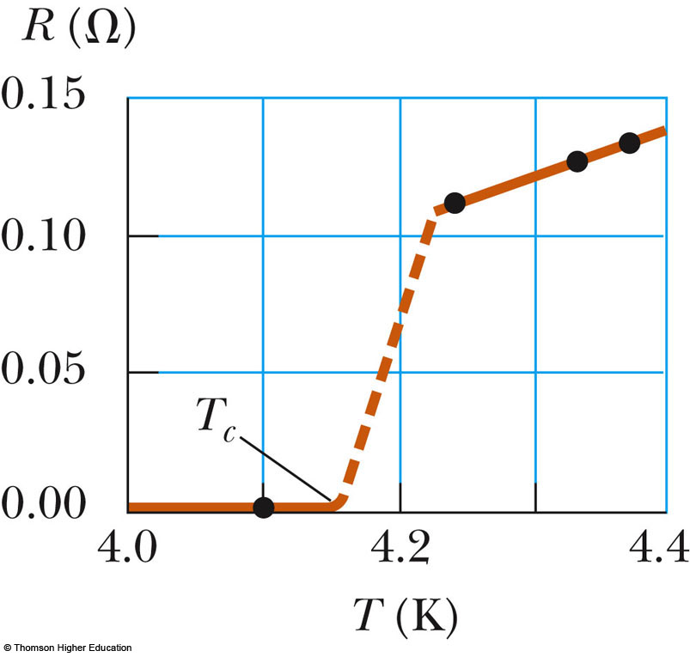
Superconductors
A class of materials and compounds whose resistances fall to virtually zero below a certain temperature, T_{C}
  T_{C} is called the critical temperature
The graph is the same as a normal metal above T_{C}, but suddenly drops to zero at T_{C}

Slide 35
Superconductors, cont
The value of T_{C} is sensitive to:
  chemical composition
  pressure
  molecular structure
Once a current is set up in a superconductor, it persists without any applied voltage
  Since R = 0

Slide 36
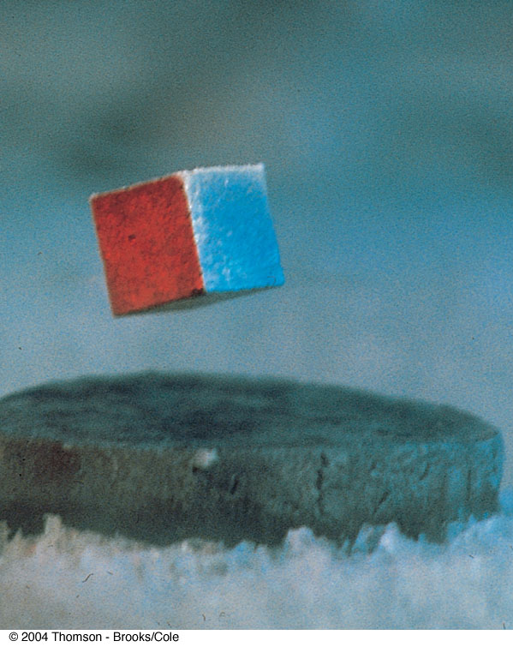
Superconductor Application
An important application of superconductors is a superconducting magnet
The magnitude of the magnetic field is about 10 times greater than a normal electromagnet
Used in MRI units

Slide 37
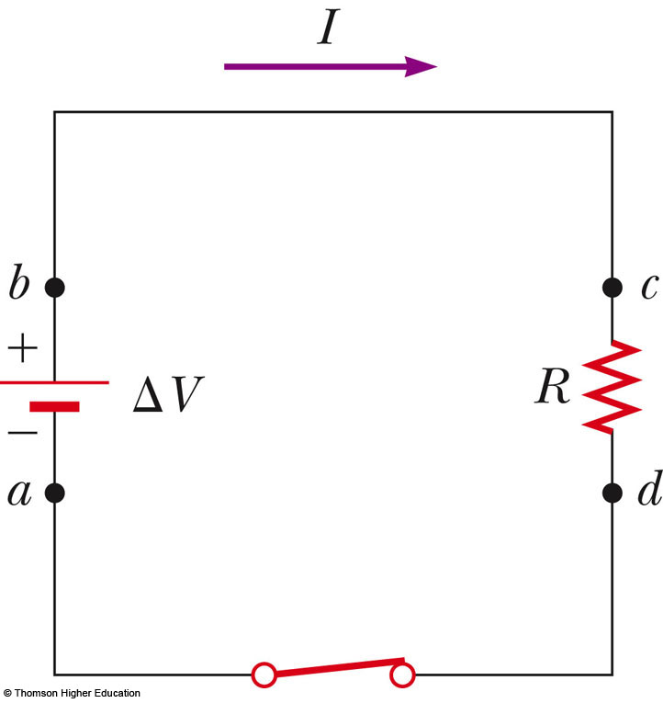
Electrical Power
Assume a circuit as shown
As a charge moves from a to b, the electric potential energy of the system increases by QΔV
  The chemical energy in the battery must decrease by this same amount
  Use the active figure to adjust the voltage or resistance, observe current and power
PLAY
ACTIVE FIGURE

Slide 38
Electrical Power, 2
As the charge moves through the resistor (c to d), the system loses this electric potential energy during collisions of the electrons with the atoms of the resistor
This energy is transformed into internal energy in the resistor
  Corresponds to increased vibrational motion of the atoms in the resistor

Slide 39
Electric Power, 3
The resistor is normally in contact with the air, so its increased temperature will result in a transfer of energy by heat into the air
The resistor also emits thermal radiation
After some time interval, the resistor reaches a constant temperature
  The input of energy from the battery is balanced by the output of energy by heat and radiation

Slide 40
Electric Power, 4
The rate at which the system loses potential energy as the charge passes through the resistor is equal to the rate at which the system gains internal energy in the resistor
The power is the rate at which the energy is delivered to the resistor

Slide 41
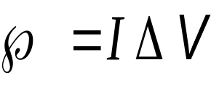
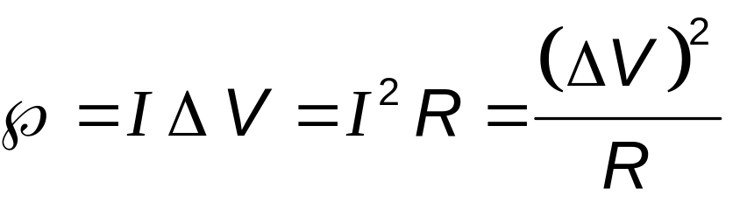

Electric Power, final
The power is given by the equation:
Applying Ohm’s Law, alternative expressions can be found:
Units: I is in A, R is in Ω, V is in V, and is in W

Slide 42
Some Final Notes About Current
A single electron is moving at the drift velocity in the circuit
  It may take hours for an electron to move completely around a circuit
The current is the same everywhere in the circuit
  Current is not “used up” anywhere in the circuit
The charges flow in the same rotational sense at all points in the circuit

Slide 43
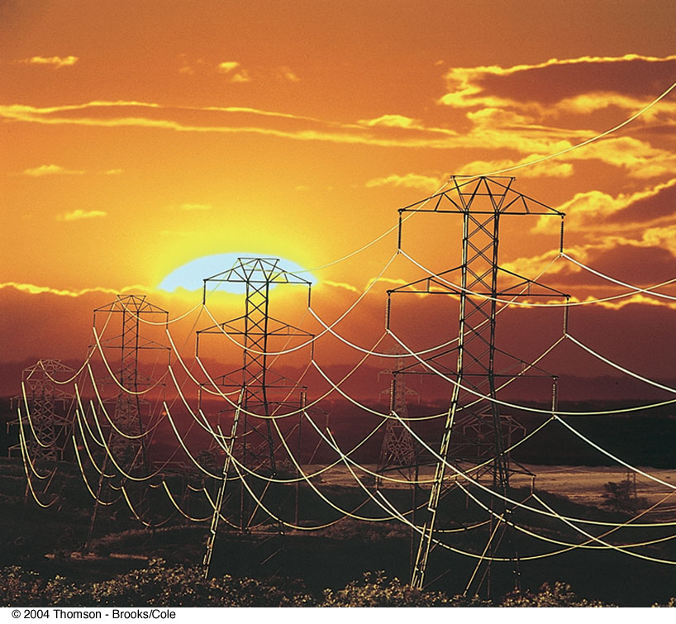
Electric Power Transmission
Real power lines have resistance
Power companies transmit electricity at high voltages and low currents to minimize power losses

Slide 44
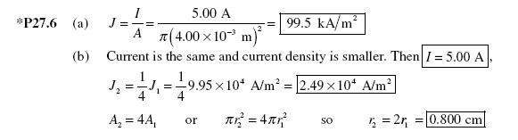
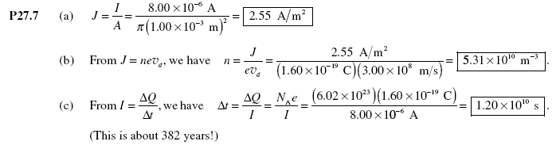

Slide 45
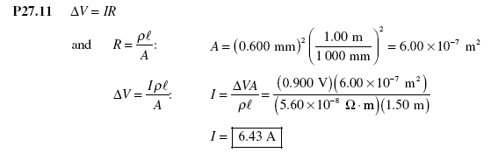

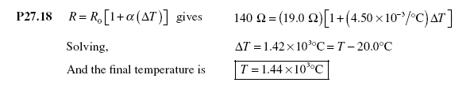

Slide 46
