Slide 1
Chapter 28
Direct Current Circuits

Slide 2
Direct Current
When the current in a circuit has a constant direction, the current is called direct current
  Most of the circuits analyzed will be assumed to be in steady state, with constant magnitude and direction
Because the potential difference between the terminals of a battery is constant, the battery produces direct current
The battery is known as a source of emf

Slide 3
Electromotive Force
The electromotive force (emf), ε, of a battery is the maximum possible voltage that the battery can provide between its terminals
  The emf supplies energy, it does not apply a force
The battery will normally be the source of energy in the circuit
The positive terminal of the battery is at a higher potential than the negative terminal
We consider the wires to have no resistance

Slide 4
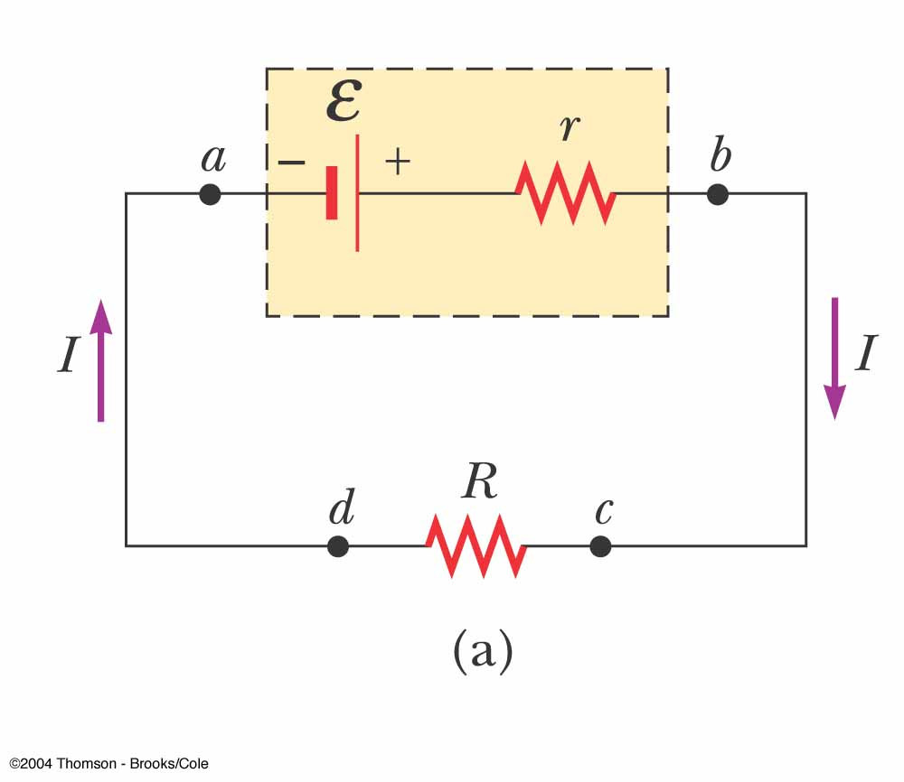
Internal Battery Resistance
If the internal resistance is zero, the terminal voltage equals the emf
In a real battery, there is internal resistance, r
The terminal voltage, ΔV = ε – Ir
  Use the active figure to vary the emf and resistances and see the effect on the graph

Slide 5
EMF, cont
The emf is equivalent to the open-circuit voltage
  This is the terminal voltage when no current is in the circuit
  This is the voltage labeled on the battery
The actual potential difference between the terminals of the battery depends on the current in the circuit

Slide 6
Load Resistance
The terminal voltage also equals the voltage across the external resistance
  This external resistor is called the load resistance
  In the previous circuit, the load resistance is just the external resistor
  In general, the load resistance could be any electrical device
    These resistances represent loads on the battery since it supplies the energy to operate the device containing the resistance

Slide 7
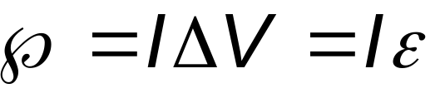
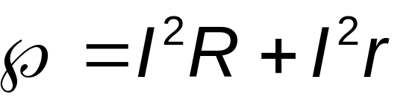
Power
The total power output of the battery is
This power is delivered to the external resistor (I ² R) and to the internal resistor (I² r)

Slide 8
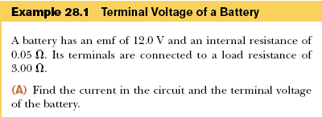



Slide 9
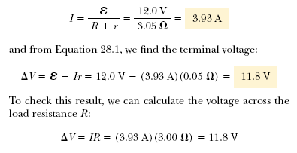

Slide 10
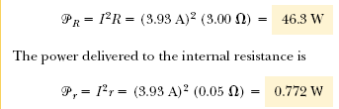


Slide 11
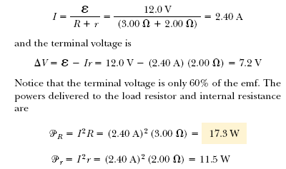

Slide 12
Resistors in Series
When two or more resistors are connected end-to-end, they are said to be in series
For a series combination of resistors, the currents are the same in all the resistors because the amount of charge that passes through one resistor must also pass through the other resistors in the same time interval
The potential difference will divide among the resistors such that the sum of the potential differences across the resistors is equal to the total potential difference across the combination

Slide 13
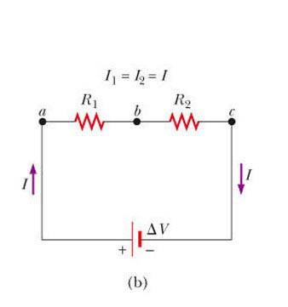
Resistors in Series, cont
Potentials add
  ΔV = IR₁ + IR₂
  = I (R₁+R₂)
  Consequence of Conservation of Energy
The equivalent resistance has the same effect on the circuit as the original combination of resistors

Slide 14
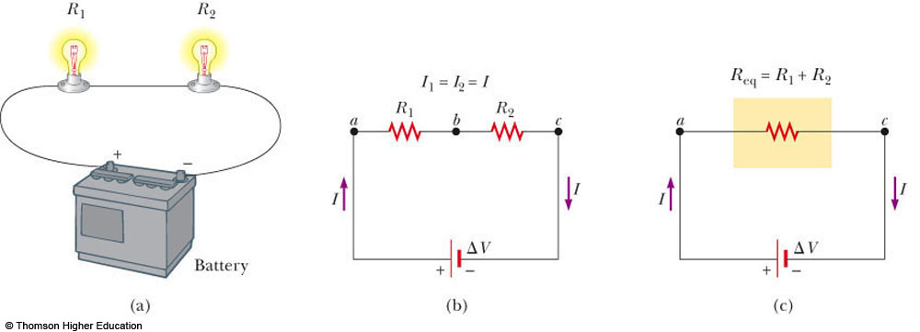
Resistors in Series – Example
Use the active figure to vary the battery voltage and the resistor values
Observe the effect on the currents and voltages of the individual resistors
PLAY
ACTIVE FIGURE

Slide 15
Equivalent Resistance – Series
R_{eq} = R₁ + R₂ + R₃ + …
The equivalent resistance of a series combination of resistors is the algebraic sum of the individual resistances and is always greater than any individual resistance
If one device in the series circuit creates an open circuit, all devices are inoperative

Slide 16
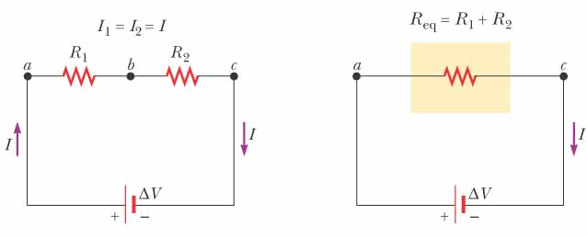
Equivalent Resistance – Series – An Example
Two resistors are replaced with their equivalent resistance

Slide 17
Some Circuit Notes
A local change in one part of a circuit may result in a global change throughout the circuit
  For example, changing one resistor will affect the currents and voltages in all the other resistors and the terminal voltage of the battery
In a series circuit, there is one path for the current to take
In a parallel circuit, there are multiple paths for the current to take

Slide 18
Resistors in Parallel
The potential difference across each resistor is the same because each is connected directly across the battery terminals
A junction is a point where the current can split
The current, I, that enters a point must be equal to the total current leaving that point
  I = I ₁ + I ₂
  The currents are generally not the same
  Consequence of Conservation of Charge

Slide 19
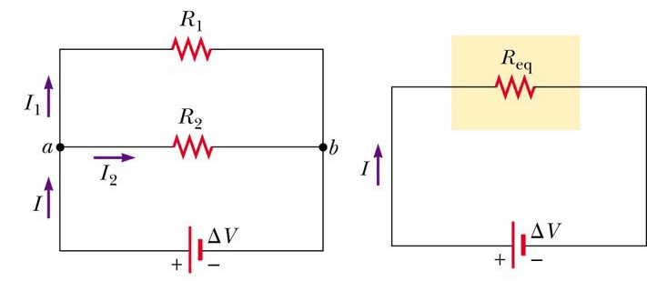
Equivalent Resistance – Parallel, Examples
Equivalent resistance replaces the two original resistances

Slide 20
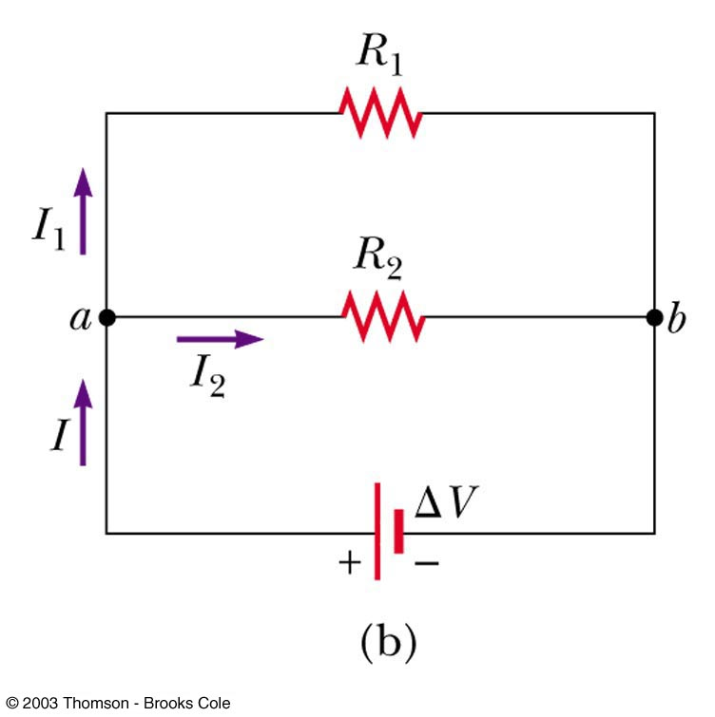
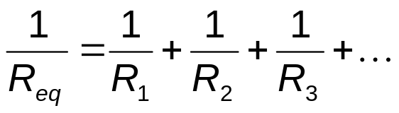
Equivalent Resistance – Parallel
Equivalent Resistance
The inverse of the equivalent resistance of two or more resistors connected in parallel is the algebraic sum of the inverses of the individual resistance
  The equivalent is always less than the smallest resistor in the group

Slide 21
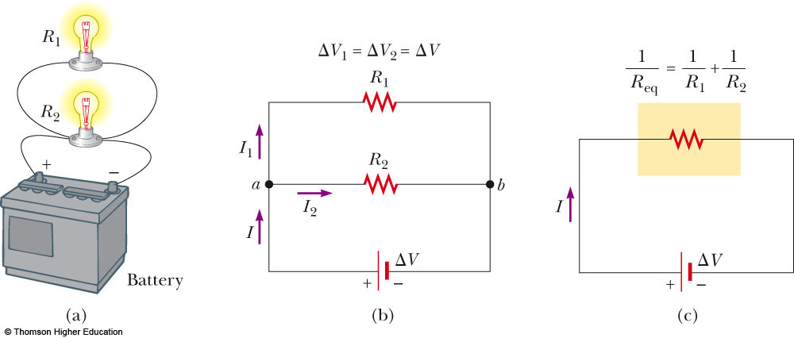
Resistors in Parallel – Example
Use the active figure to vary the battery voltage and the resistor values
Observe the effect on the currents and voltages of the individual resistors
PLAY
ACTIVE FIGURE

Slide 22
Resistors in Parallel, Final
In parallel, each device operates independently of the others so that if one is switched off, the others remain on
In parallel, all of the devices operate on the same voltage
The current takes all the paths
  The lower resistance will have higher currents
  Even very high resistances will have some currents
Household circuits are wired so that electrical devices are connected in parallel

Slide 23
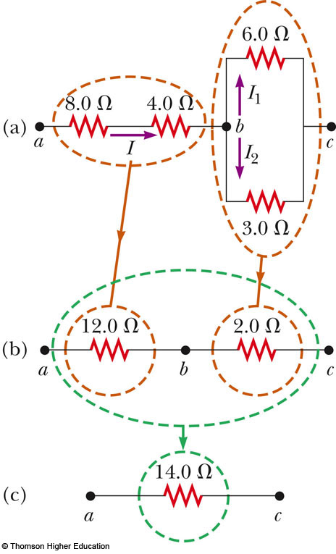
Combinations of Resistors, Example 28.4
The 8.0-Ω and 4.0-Ω resistors are in series and can be replaced with their equivalent, 12.0 Ω
The 6.0-Ω and 3.0-Ω resistors are in parallel and can be replaced with their equivalent, 2.0 Ω
These equivalent resistances are in series and can be replaced with their equivalent resistance, 14.0 Ω

Slide 24
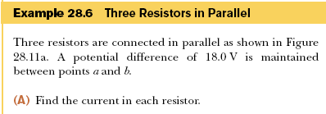

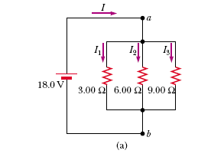
Example 28.5

Slide 25
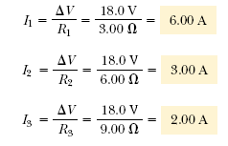
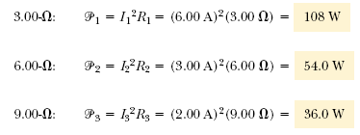
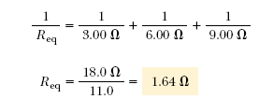

Slide 26
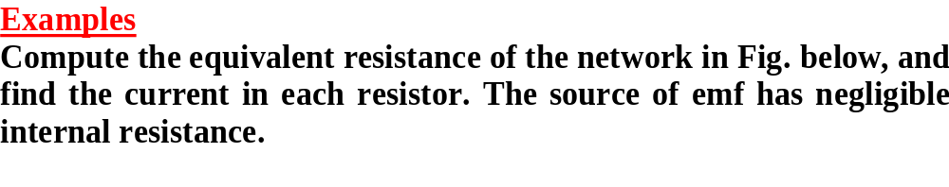
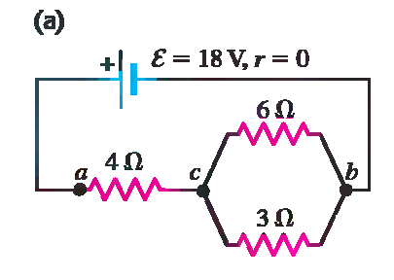

Slide 27
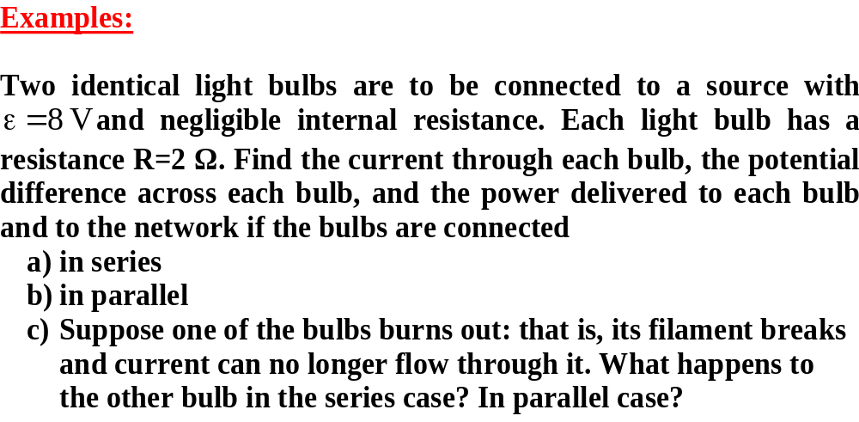
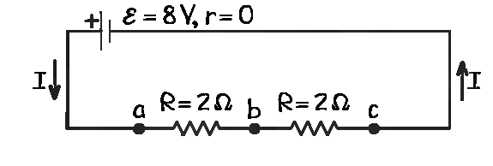
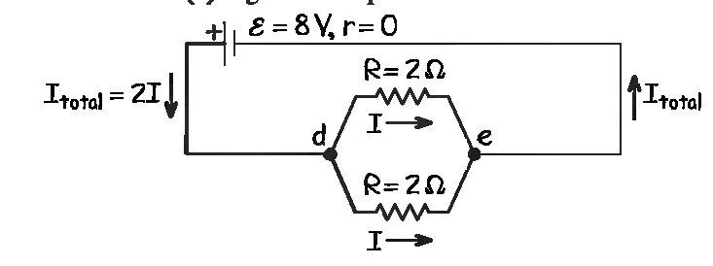

Slide 28
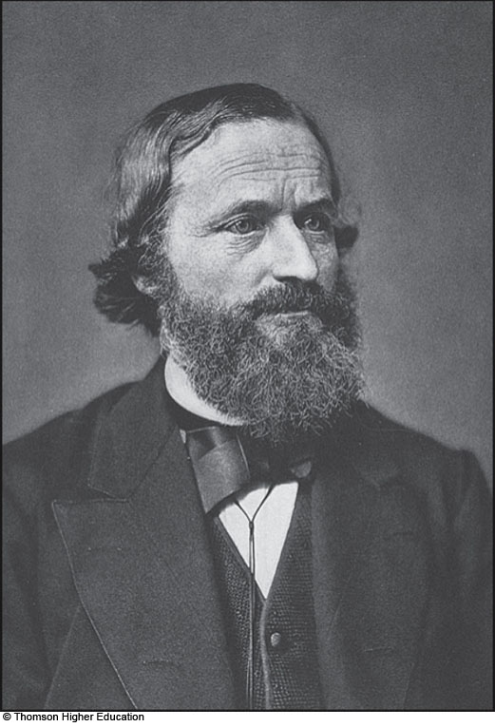
Gustav Kirchhoff
1824 – 1887
German physicist
Worked with Robert Bunsen
They
  Invented the spectroscope and founded the science of spectroscopy
  Discovered the elements cesium and rubidium
  Invented astronomical spectroscopy

Slide 29
Kirchhoff’s Rules
There are ways in which resistors can be connected so that the circuits formed cannot be reduced to a single equivalent resistor
Two rules, called Kirchhoff’s rules, can be used instead

Slide 30
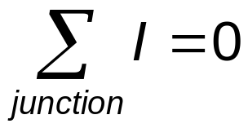
Kirchhoff’s Junction Rule
Junction Rule
  The sum of the currents at any junction must equal zero
    Currents directed into the junction are entered into the -equation as +I and those leaving as -I
    A statement of Conservation of Charge
  Mathematically,

Slide 31
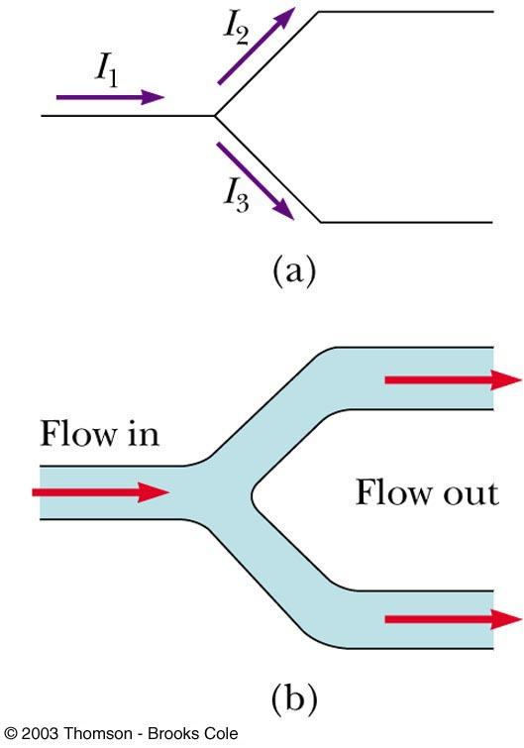
More about the Junction Rule
I₁ - I₂ - I₃ = 0
Required by Conservation of Charge
Diagram (b) shows a mechanical analog

Slide 32
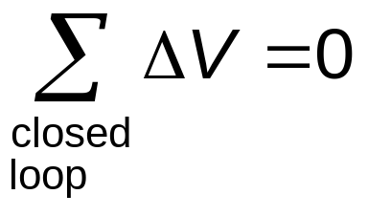
Kirchhoff’s Loop Rule
Loop Rule
  The sum of the potential differences across all elements around any closed circuit loop must be zero
    A statement of Conservation of Energy
Mathematically,

Slide 33
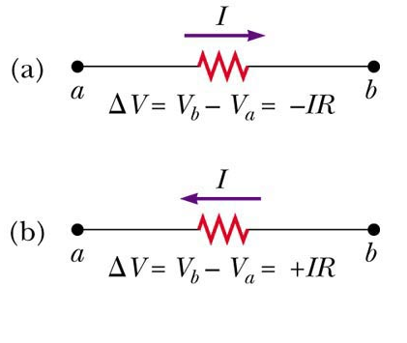
More about the Loop Rule
Traveling around the loop from a to b
In (a), the resistor is traversed in the direction of the current, the potential across the resistor is – IR
In (b), the resistor is traversed in the direction opposite of the current, the potential across the resistor is is + IR

Slide 34
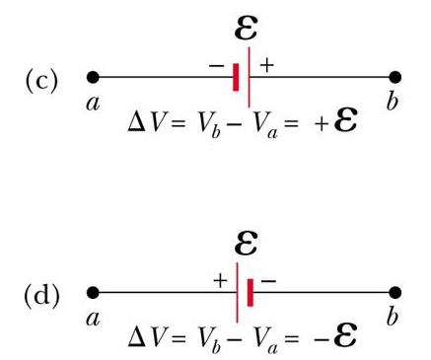
Loop Rule, final
In (c), the source of emf is traversed in the direction of the emf (from – to +), and the change in the electric potential is +ε
In (d), the source of emf is traversed in the direction opposite of the emf (from + to -), and the change in the electric potential is -ε

Slide 35
Junction Equations from Kirchhoff’s Rules
Use the junction rule as often as needed, so long as each time you write an equation, you include in it a current that has not been used in a previous junction rule equation
  In general, the number of times the junction rule can be used is one fewer than the number of junction points in the circuit

Slide 36
Loop Equations from Kirchhoff’s Rules
The loop rule can be used as often as needed so long as a new circuit element (resistor or battery) or a new current appears in each new equation
You need as many independent equations as you have unknowns

Slide 37
Kirchhoff’s Rules Equations, final
In order to solve a particular circuit problem, the number of independent equations you need to obtain from the two rules equals the number of unknown currents
Any capacitor acts as an open branch in a circuit
  The current in the branch containing the capacitor is zero under steady-state conditions

Slide 38
Problem-Solving Strategy – Kirchhoff’s Rules
Conceptualize
  Study the circuit diagram and identify all the elements
  Identify the polarity of the battery
  Imagine the directions of the currents in each battery
Categorize
  Determine if the circuit can be reduced by combining series and parallel resistors
    If so, proceed with those techniques
    If not, apply Kirchhoff’s Rules

Slide 39
Problem-Solving Strategy, 2
Analyze
  Assign labels and symbols to all known and unknown quantities
  Assign directions to the currents
    The direction is arbitrary, but you must adhere to the assigned directions when applying Kirchhoff’s rules
  Apply the junction rule to any junction in the circuit that provides new relationships among the various currents

Slide 40
Problem-Solving Strategy, 3
Analyze, cont
  Apply the loop rule to as many loops as are needed to solve for the unknowns
    To apply the loop rule, you must choose a direction in which to travel around the loop
    You must also correctly identify the potential difference as you cross various elements
  Solve the equations simultaneously for the unknown quantities
Draw the circuit diagram and assign labels and symbols to all known and unknown quantities. Assign directions to the currents.
  The direction is arbitrary, but you must adhere to the assigned directions when applying Kirchhoff’s rules
Apply the junction rule to any junction in the circuit that provides new relationships among the various currents

Slide 41
Problem-Solving Strategy, final
Finalize
  Check your numerical answers for consistency
  If any current value is negative, it means you guessed the direction of that current incorrectly
    The magnitude will still be correct

Slide 42
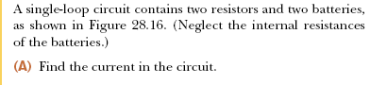

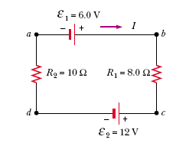
Example 28.6

Slide 43
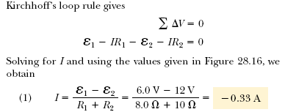
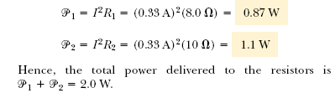

Slide 44
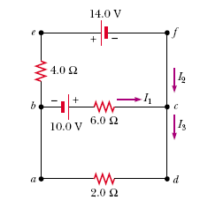
Example 28.7

Slide 45






Slide 46
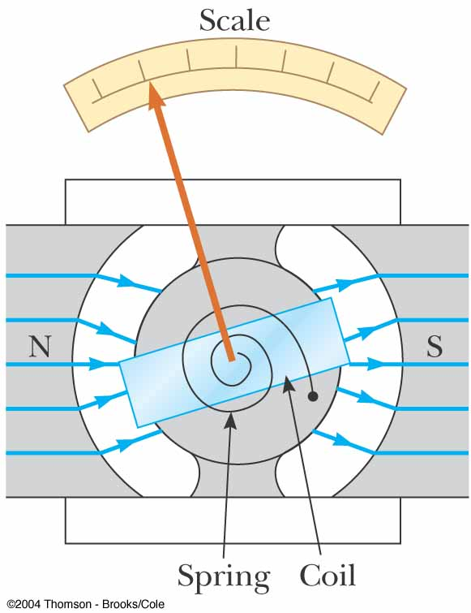
Galvanometer
A galvanometer is the main component in analog meters for measuring current and voltage
Digital meters are in common use
  Digital meters operate under different principles

Slide 47
Galvanometer, cont
A galvanometer consists of a coil of wire mounted so that it is free to rotate on a pivot in a magnetic field
The field is provided by permanent magnets
A torque acts on a current in the presence of a magnetic field

Slide 48
Galvanometer, final
The torque is proportional to the current
  The larger the current, the greater the torque
  The greater the torque, the larger the rotation of the coil before the spring resists enough to stop the rotation
The deflection of a needle attached to the coil is proportional to the current
Once calibrated, it can be used to measure currents or voltages

Slide 49
Ammeter
An ammeter is a device that measures current
The ammeter must be connected in series with the elements being measured
  The current must pass directly through the ammeter

Slide 50
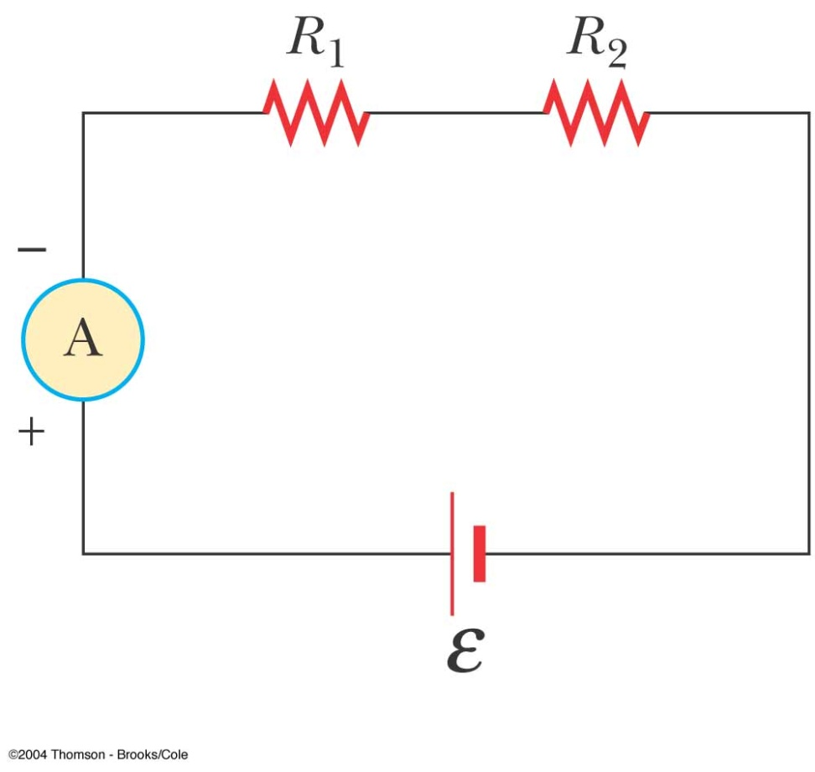
Ammeter in a Circuit
The ammeter is connected in series with the elements in which the current is to be measured
Ideally, the ammeter should have zero resistance so the current being measured is not altered

Slide 51
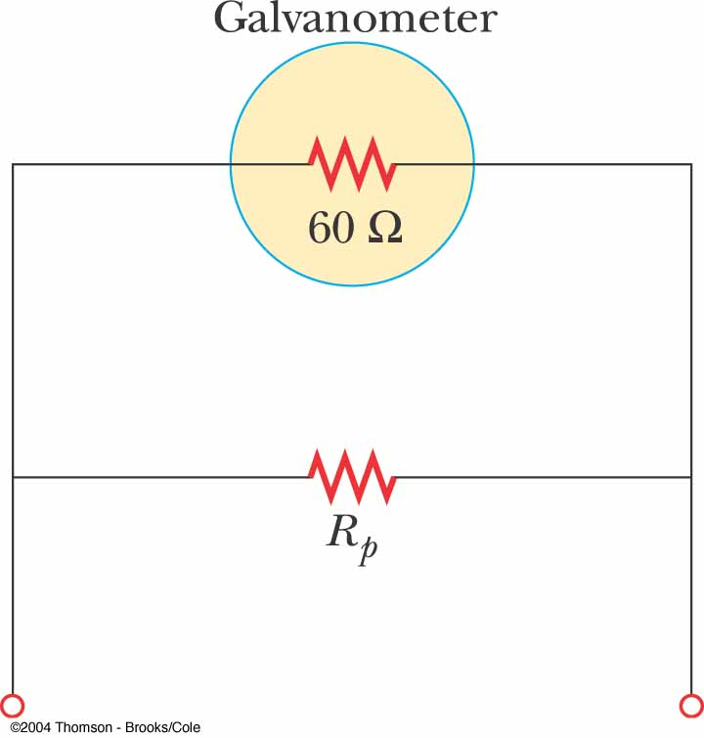
Ammeter from Galvanometer
The galvanometer typically has a resistance of 60 Ω
To minimize the resistance, a shunt resistance, R_{p}, is placed in parallel with the galvanometer

Slide 52
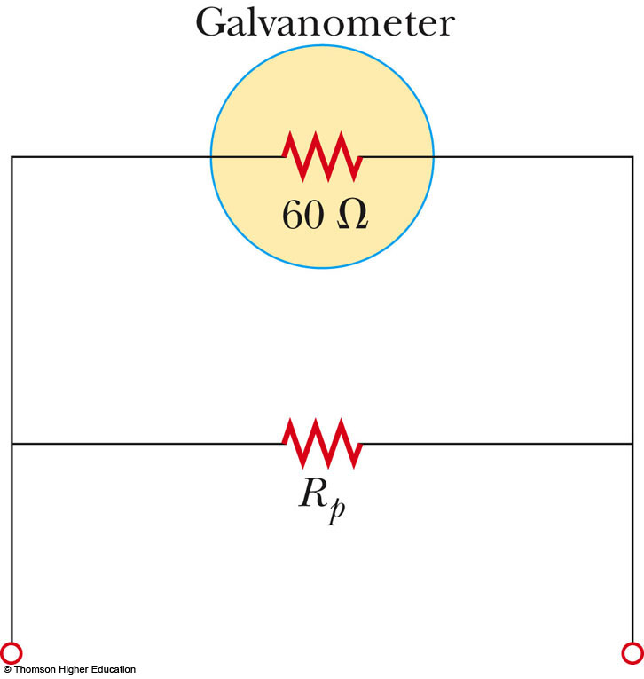
Constructing An Ammeter
Predict the value of the shunt resistor, R_{s}, needed to achieve full scale deflection on the meter
Use the active figure to test your result
PLAY
ACTIVE FIGURE

Slide 53
Ammeter, final
The value of the shunt resistor must be much less than the resistance of the galvanometer
  Remember, the equivalent resistance of resistors in parallel will be less than the smallest resistance
Most of the current will go through the shunt resistance, this is necessary since the full scale deflection of the galvanometer is on the order of 1 mA

Slide 54
Voltmeter
A voltmeter is a device that measures potential difference
The voltmeter must be connected in parallel with the elements being measured
  The voltage is the same in parallel

Slide 55
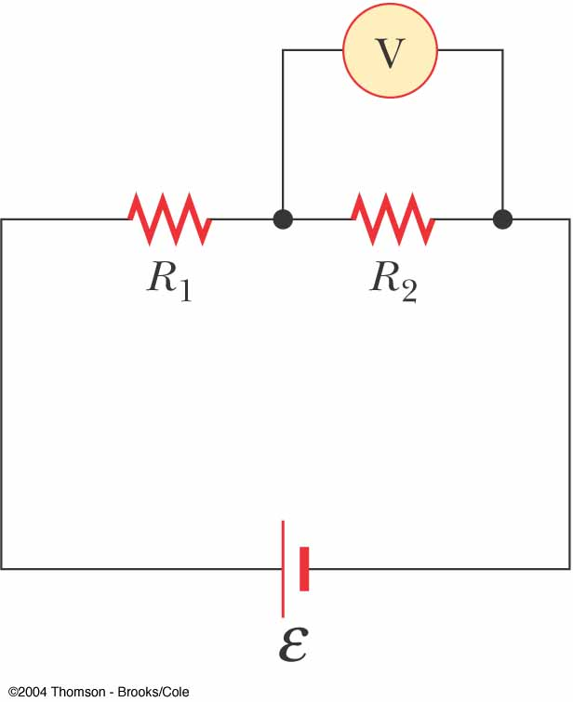
Voltmeter in a Circuit
The voltmeter is connected in parallel with the element in which the potential difference is to be measured
  Polarity must be observed
Ideally, the voltmeter should have infinite resistance so that no current would pass through it
  Corrections can be made to account for the known, non-infinite, resistance of the voltmeter

Slide 56
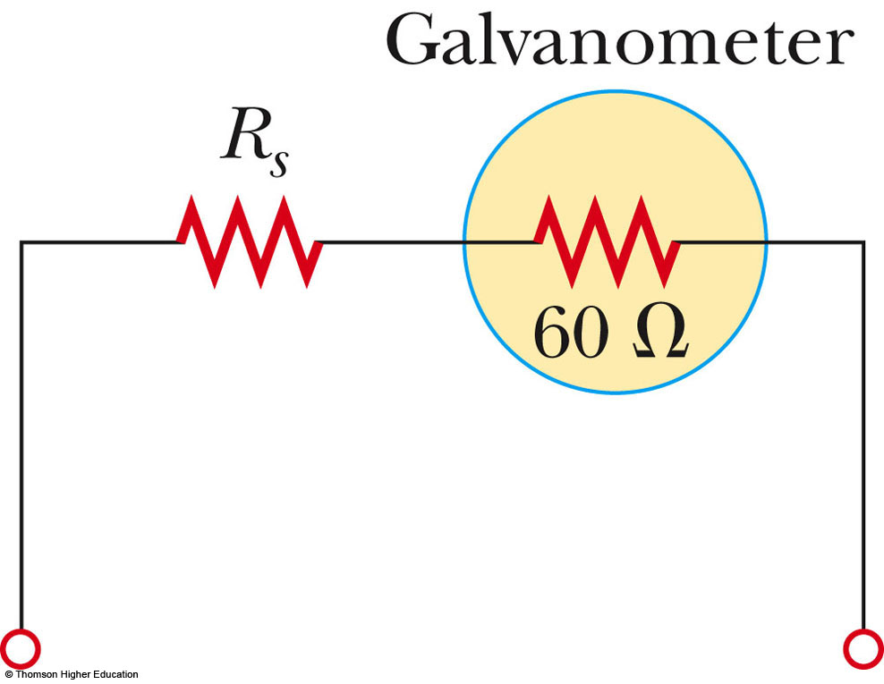
Voltmeter from Galvanometer
The galvanometer typically has a resistance of 60 Ω
To maximize the resistance, another resistor, R_{s}, is placed in series with the galvanometer
Calculate R_{s} and use the active figure to check your result
PLAY
ACTIVE FIGURE

Slide 57
Voltmeter, final
The value of the added resistor must be much greater than the resistance of the galvanometer
  Remember, the equivalent resistance of resistors in series will be greater than the largest resistance
Most of the current will go through the element being measured, and the galvanometer will not alter the voltage being measured

Slide 58
Short Circuit
A short circuit occurs when almost zero resistance exists between two points at different potentials
This results in a very large current
In a household circuit, a circuit breaker will open the circuit in the case of an accidental short circuit
  This prevents any damage
A person in contact with ground can be electrocuted by touching the live wire

Slide 59
Electrical Safety
Electric shock can result in fatal burns
Electric shock can cause the muscles of vital organs (such as the heart) to malfunction
The degree of damage depends on:
  the magnitude of the current
  the length of time it acts
  the part of the body touching the live wire
  the part of the body in which the current exists

Slide 60
Effects of Various Currents
5 mA or less
  can cause a sensation of shock
  generally little or no damage
10 mA
  muscles contract
  may be unable to let go of a live wire
100 mA
  if passing through the body for 1 second or less, can be fatal
  paralyzes the respiratory muscles

Slide 61
More Effects
In some cases, currents of 1 A can produce serious burns
  Sometimes these can be fatal burns
No contact with live wires is considered safe whenever the voltage is greater than 24 V

Slide 62
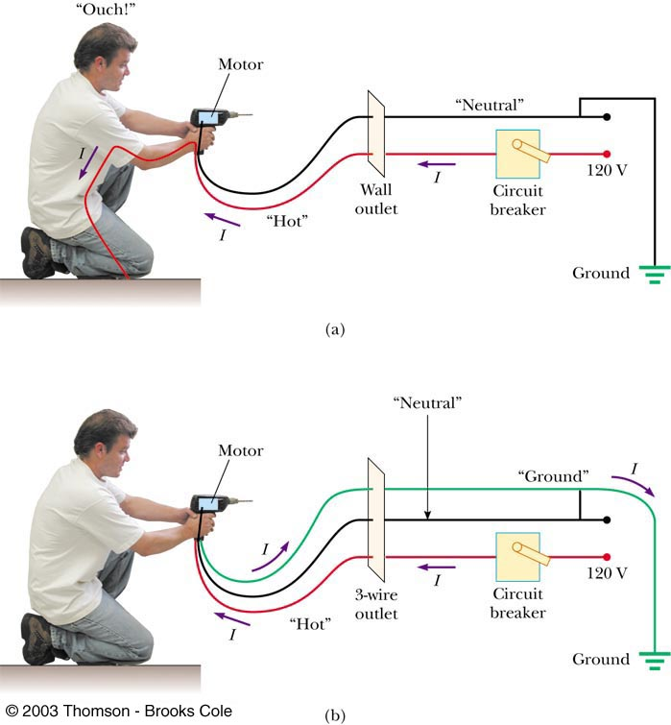
Ground Wire
Electrical equipment manufacturers use electrical cords that have a third wire, called a ground
This safety ground normally carries no current and is both grounded and connected to the appliance

Slide 63
Ground Wire, cont
If the live wire is accidentally shorted to the casing, most of the current takes the low-resistance path through the appliance to the ground
If it was not properly grounded, anyone in contact with the appliance could be shocked because the body produces a low-resistance path to ground

Slide 64
The following slides are some External examples

Slide 65
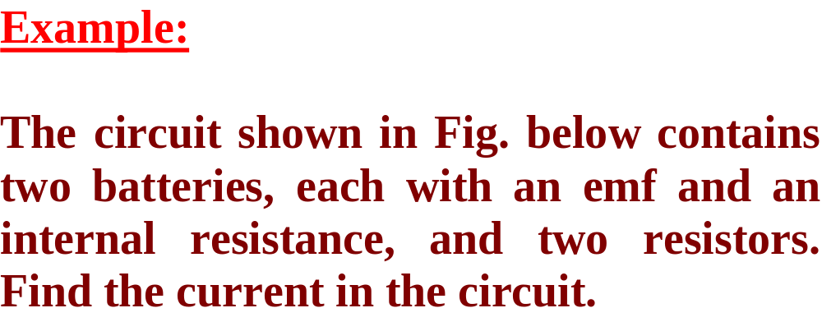
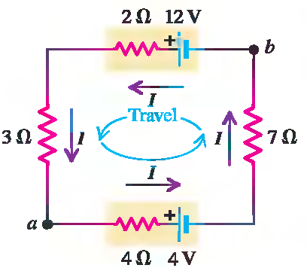

Slide 66
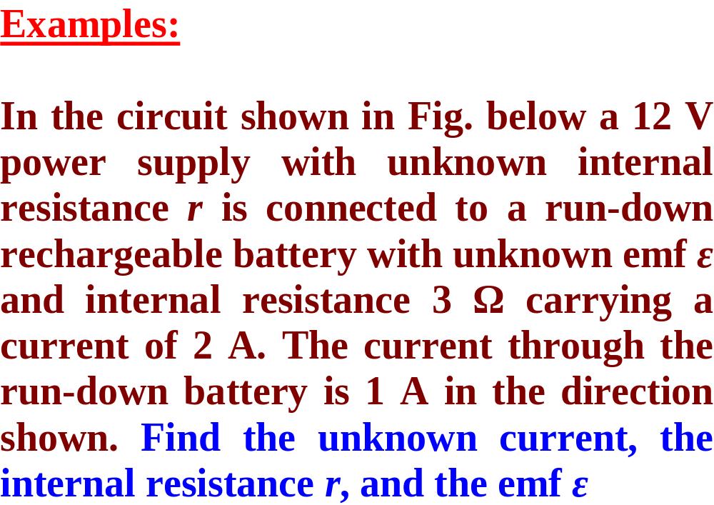

Slide 67
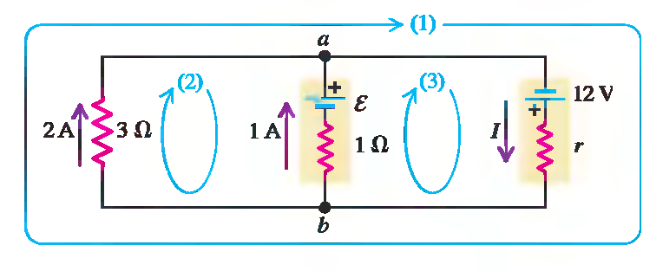

Slide 68
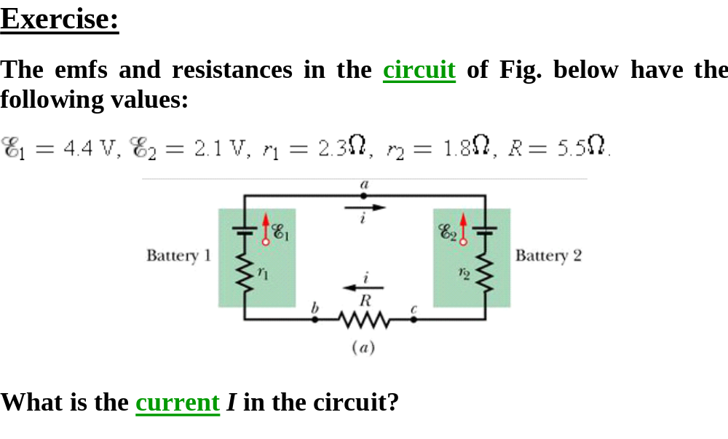

Slide 69
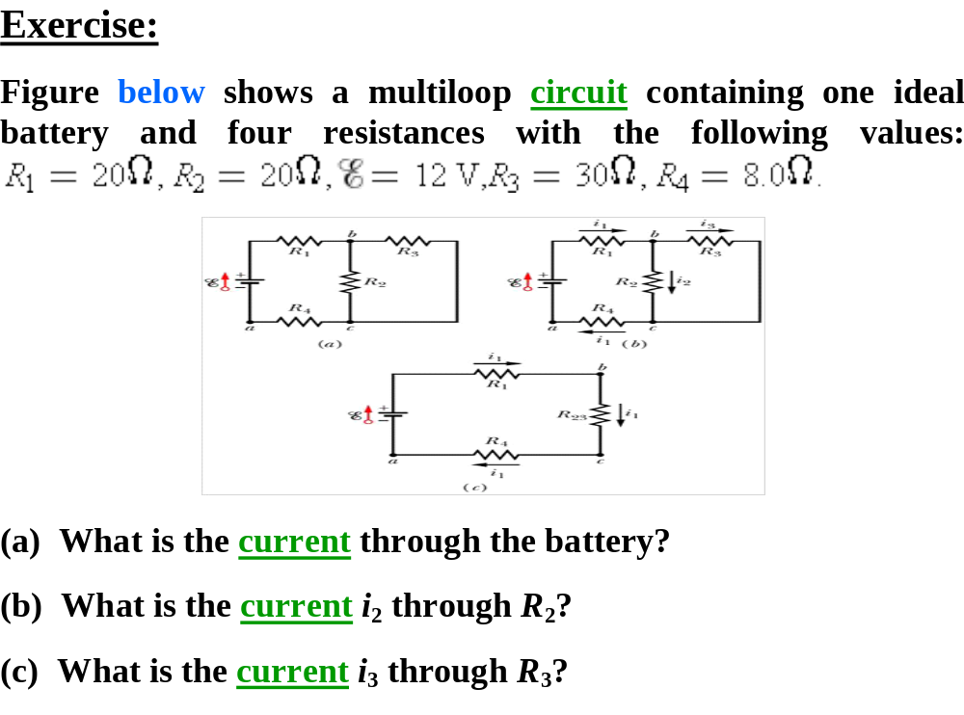

Slide 70
