Slide 1
General Physics (2) For Engineering
Textbook:
Physics for Scientists and Engineers, seventh edition, Jewett / Serway
Lecturer: Dr. Al Jghami Issam Fawaz

Slide 2
Chapter 29
Magnetic Fields

Slide 3
A Brief History of Magnetism
13th century BC
  Chinese used a compass
    Uses a magnetic needle
    Probably an invention of Arabic or Indian origin
800 BC
  Greeks
    Discovered magnetite (Fe₃O₄) attracts pieces of iron

Slide 4
A Brief History of Magnetism, 2
1269
  Pierre de Maricourt found that the direction of a needle near a spherical natural magnet formed lines that encircled the sphere
  The lines also passed through two points diametrically opposed to each other
  He called the points poles

Slide 5
A Brief History of Magnetism, 3
1600
  William Gilbert
    Expanded experiments with magnetism to a variety of materials
    Suggested the Earth itself was a large permanent magnet

Slide 6
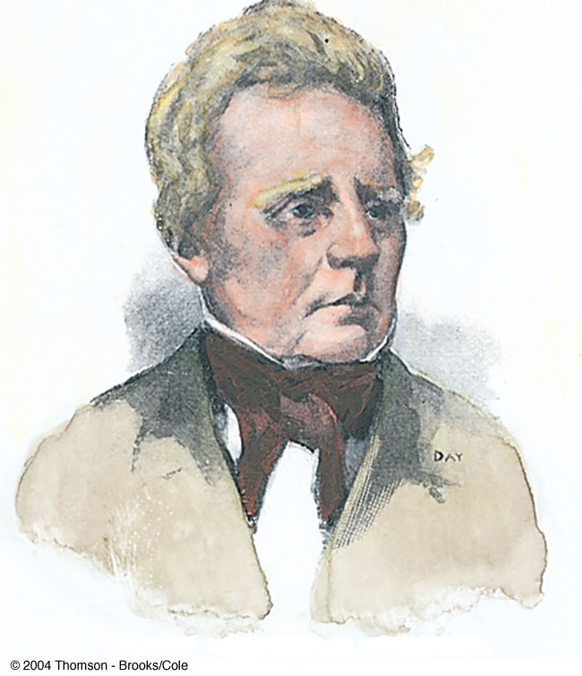
A Brief History of Magnetism, 4
1819
  Hans Christian Oersted
    Discovered the relationship between electricity and magnetism
    An electric current in a wire deflected a nearby compass needle

Slide 7
A Brief History of Magnetism, final
1820’s
  Faraday and Henry
    Further connections between electricity and magnetism
    A changing magnetic field creates an electric field
  Maxwell
    A changing electric field produces a magnetic field

Slide 8
Magnetic Poles
Every magnet, regardless of its shape, has two poles
  Called north and south poles
  Poles exert forces on one another
    Similar to the way electric charges exert forces on each other
    Like poles repel each other
      N-N or S-S
    Unlike poles attract each other
      N-S

Slide 9
Magnetic Poles, cont.
The poles received their names due to the way a magnet behaves in the Earth’s magnetic field
If a bar magnet is suspended so that it can move freely, it will rotate
  The magnetic north pole points toward the Earth’s north geographic pole
    This means the Earth’s north geographic pole is a magnetic south pole
    Similarly, the Earth’s south geographic pole is a magnetic north pole

Slide 10
Magnetic Poles, final
The force between two poles varies as the inverse square of the distance between them
A single magnetic pole has never been isolated
  In other words, magnetic poles are always found in pairs
  All attempts so far to detect an isolated magnetic pole has been unsuccessful
    No matter how many times a permanent magnetic is cut in two, each piece always has a north and south pole

Slide 11
Magnetic Fields
Reminder: an electric field surrounds any electric charge
The region of space surrounding any moving electric charge also contains a magnetic field
A magnetic field also surrounds a magnetic substance making up a permanent magnet

Slide 12

Magnetic Fields, cont.
A vector quantity
Symbolized by
Direction is given by the direction a north pole of a compass needle points in that location
Magnetic field lines can be used to show how the field lines, as traced out by a compass, would look

Slide 13
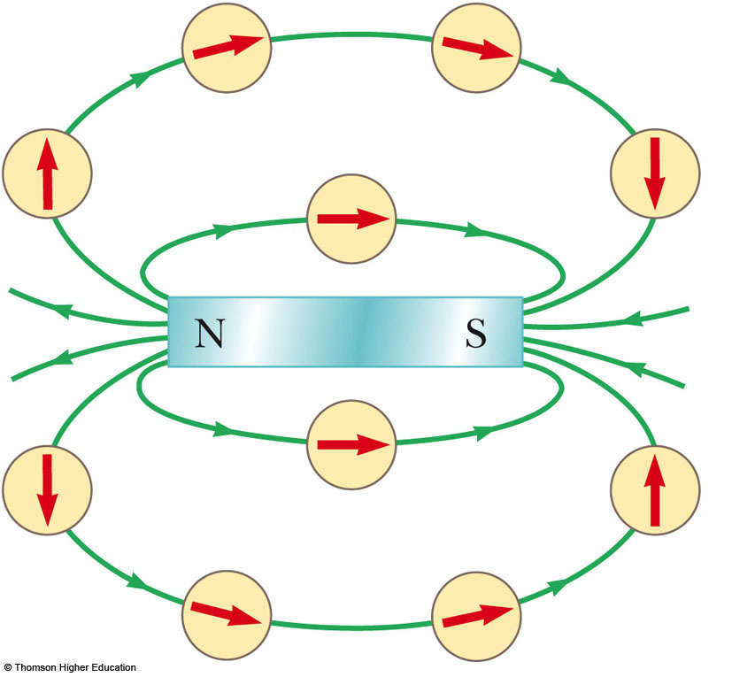
Magnetic Field Lines, Bar Magnet Example
The compass can be used to trace the field lines
The lines outside the magnet point from the North pole to the South pole
Use the active figure to trace the field lines
PLAY
ACTIVE FIGURE

Slide 14
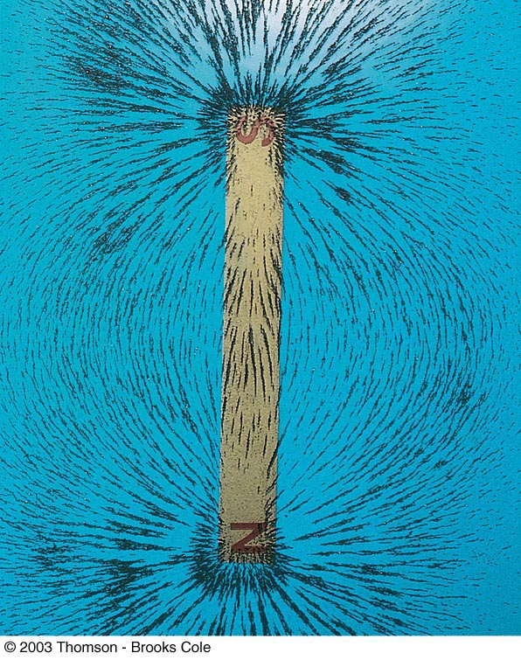
Magnetic Field Lines, Bar Magnet
Iron filings are used to show the pattern of the electric field lines
The direction of the field is the direction a north pole would point

Slide 15
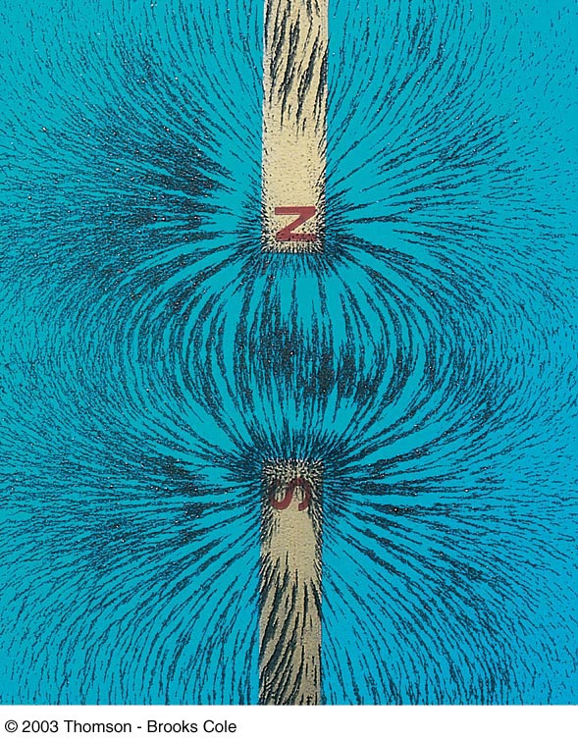
Magnetic Field Lines, Unlike Poles
Iron filings are used to show the pattern of the electric field lines
The direction of the field is the direction a north pole would point
  Compare to the electric field produced by an electric dipole

Slide 16
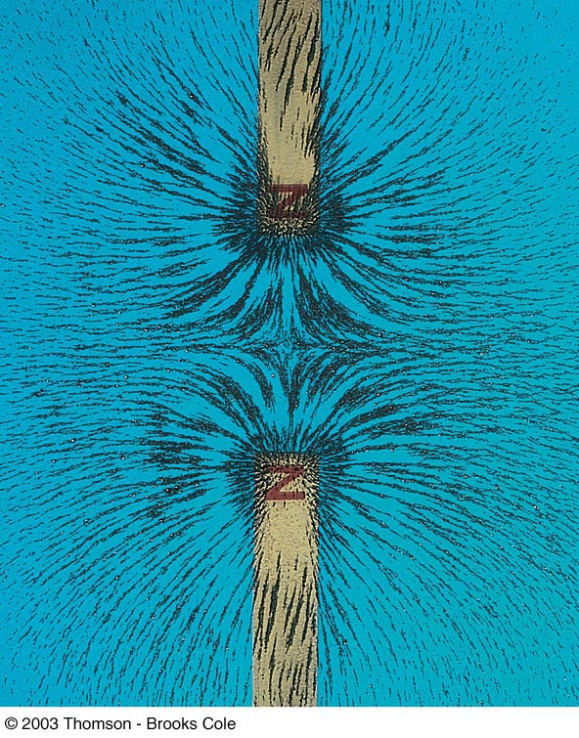
Magnetic Field Lines, Like Poles
Iron filings are used to show the pattern of the electric field lines
The direction of the field is the direction a north pole would point
  Compare to the electric field produced by like charges

Slide 17


Definition of Magnetic Field
The magnetic field at some point in space can be defined in terms of the magnetic force,
The magnetic force will be exerted on a charged particle moving with a velocity,
  Assume (for now) there are no gravitational or electric fields present

Slide 18
Force on a Charge Moving in a Magnetic Field
The magnitude F_{B} of the magnetic force exerted on the particle is proportional to the charge, q, and to the speed, v, of the particle
When a charged particle moves parallel to the magnetic field vector, the magnetic force acting on the particle is zero
When the particle’s velocity vector makes any angle θ ≠ 0 with the field, the force acts in a direction perpendicular to both the velocity and the field

Slide 19
F_{B} on a Charge Moving in a Magnetic Field, final
The magnetic force exerted on a positive charge is in the direction opposite the direction of the magnetic force exerted on a negative charge moving in the same direction
The magnitude of the magnetic force is proportional to sin θ, where θ is the angle the particle’s velocity makes with the direction of the magnetic field

Slide 20
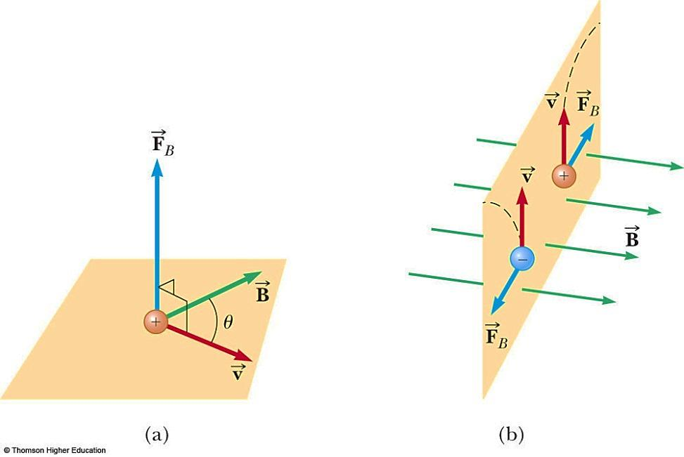
More About Direction
is perpendicular to the plane formed by and
Oppositely directed forces exerted on oppositely charged particles will cause the particles to move in opposite directions

Slide 21
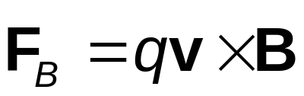

Force on a Charge Moving in a Magnetic Field, Formula
The properties can be summarized in a vector equation:
  is the magnetic force
  q is the charge
  is the velocity of the moving charge
  is the magnetic field

Slide 22
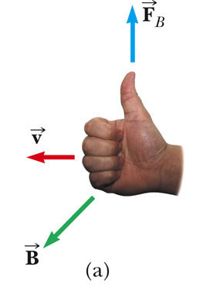

Direction: Right-Hand Rule #1
The fingers point in the direction of
comes out of your palm
  Curl your fingers in the direction of
The thumb points in the direction of which is the direction of

Slide 23
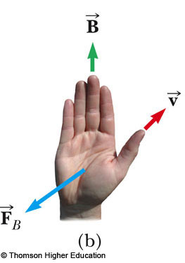
Direction: Right-Hand Rule #2
Alternative to Rule #1
Thumb is in the direction of
Fingers are in the direction of
Palm is in the direction of
  On a positive particle
  You can think of this as your hand pushing the particle

Slide 24
More About Magnitude of F
The magnitude of the magnetic force on a charged particle is F_{B} = |q| v B sin θ
  θ is the smaller angle between v and B
  F_{B} is zero when the field and velocity are parallel or antiparallel
    θ = 0 or 180º
  F_{B} is a maximum when the field and velocity are perpendicular
    θ = 90º

Slide 25
Differences Between Electric and Magnetic Fields
Direction of force
  The electric force acts along the direction of the electric field
  The magnetic force acts perpendicular to the magnetic field
Motion
  The electric force acts on a charged particle regardless of whether the particle is moving
  The magnetic force acts on a charged particle only when the particle is in motion

Slide 26
More Differences Between Electric and Magnetic Fields
Work
  The electric force does work in displacing a charged particle
  The magnetic force associated with a steady magnetic field does no work when a particle is displaced
    This is because the force is perpendicular to the displacement

Slide 27
Work in Fields, cont.
The kinetic energy of a charged particle moving through a magnetic field cannot be altered by the magnetic field alone
When a charged particle moves with a given velocity through a magnetic field, the field can alter the direction of the velocity, but not the speed or the kinetic energy

Slide 28
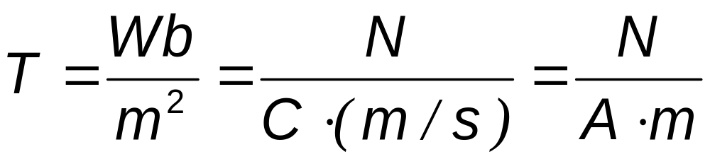
Units of Magnetic Field
The SI unit of magnetic field is the tesla (T)
  Wb is a weber
A non-SI commonly used unit is a gauss (G)
  1 T = 10⁴ G

Slide 29
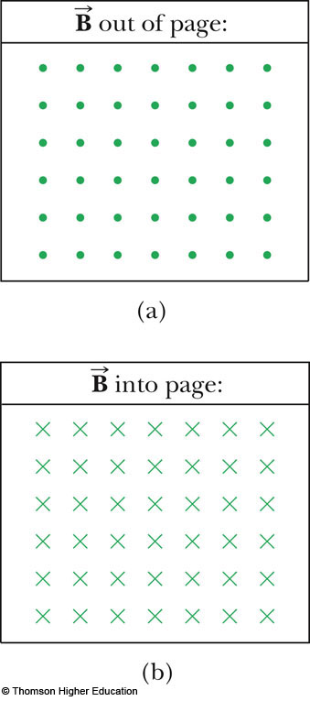
Notation Notes
When vectors are perpendicular to the page, dots and crosses are used
  The dots represent the arrows coming out of the page
  The crosses represent the arrows going into the page

Slide 30
Magnetic Force on a Current Carrying Conductor
A force is exerted on a current-carrying wire placed in a magnetic field
  The current is a collection of many charged particles in motion
The direction of the force is given by the right-hand rule

Slide 31
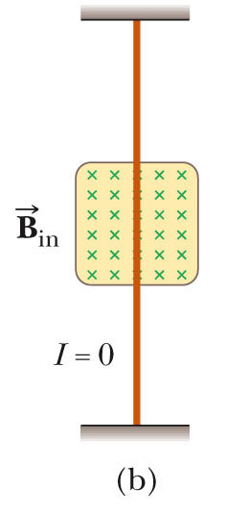
Force on a Wire
In this case, there is no current, so there is no force
Therefore, the wire remains vertical

Slide 32
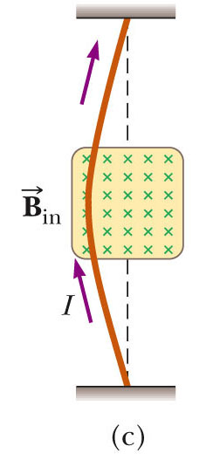
Force on a Wire (2)
The magnetic field is into the page
The current is up the page
The force is to the left

Slide 33
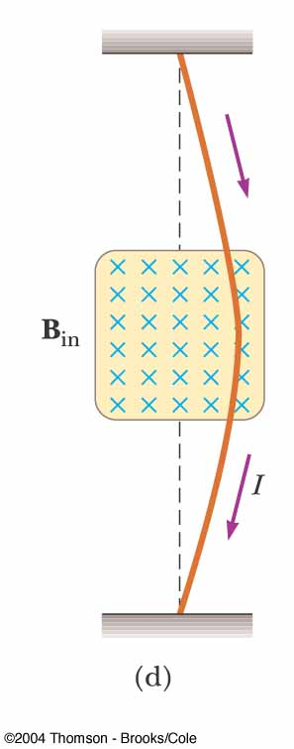
Force on a Wire, (3)
The magnetic field is into the page
The current is down the page
The force is to the right

Slide 34
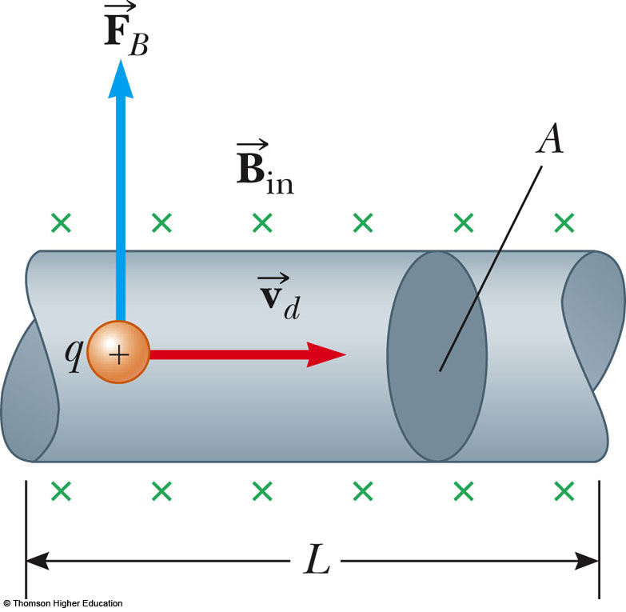
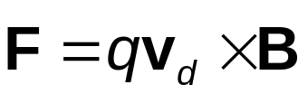
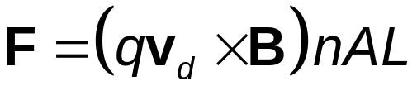
Force on a Wire, equation
The magnetic force is exerted on each moving charge in the wire
The total force is the product of the force on one charge and the number of charges

Slide 35
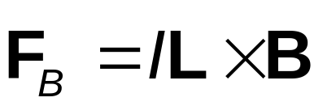

Force on a Wire, (4)
In terms of the current, this becomes
  I is the current
  is a vector that points in the direction of the current
    Its magnitude is the length L of the segment
  is the magnetic field

Slide 36

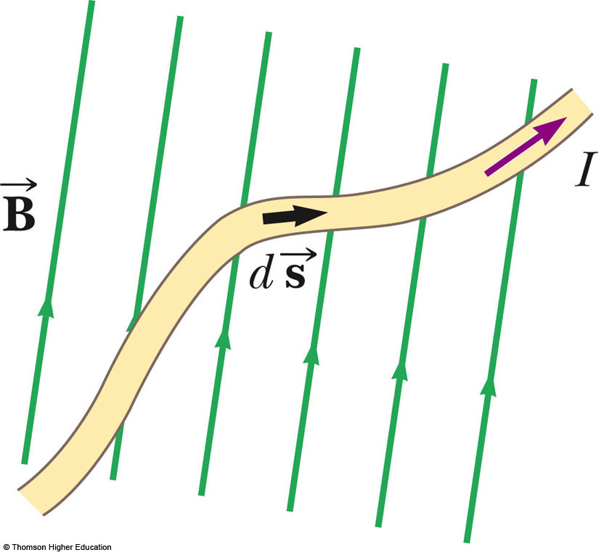

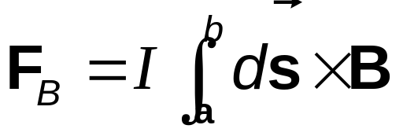
Force on a Wire, Arbitrary Shape
Consider a small segment of the wire,
The force exerted on this segment is
The total force is

Slide 37
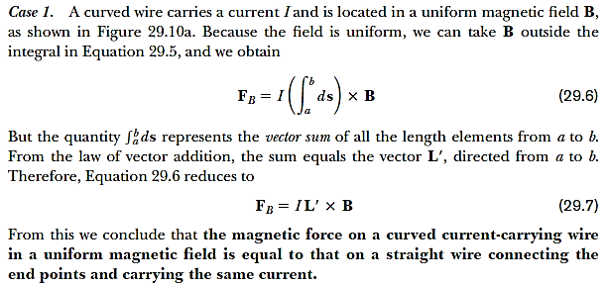
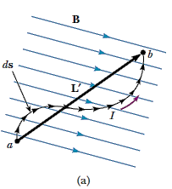

Slide 38
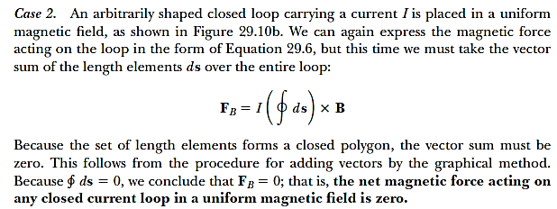
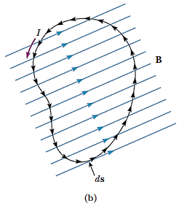

Slide 39



29-1 A proton moving at 4.00 m / s through a magnetic field of magnitude 1.70 T experiences a magnetic force of magnitude 8.2x10⁻¹³ N . What is the angle between the proton s velocity and the field?

Slide 40
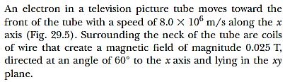


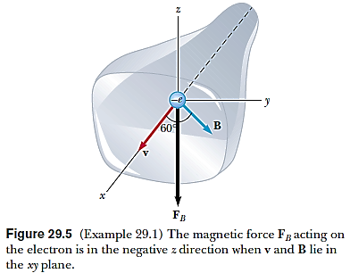
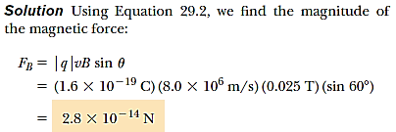


Slide 41


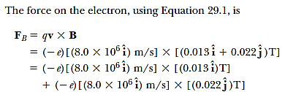


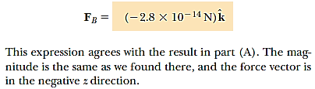

Slide 42

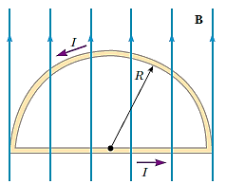



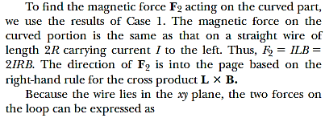





Slide 43

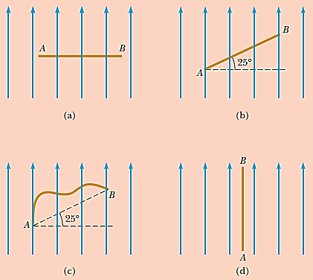

Slide 44

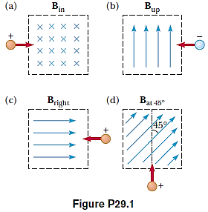
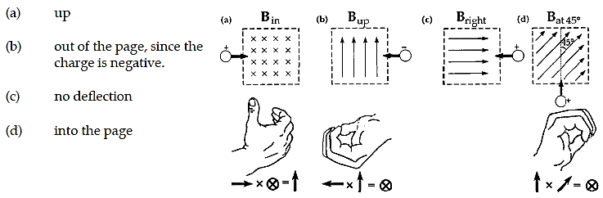

Slide 45

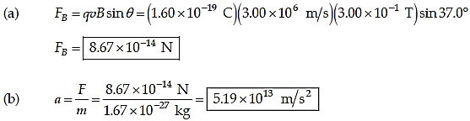
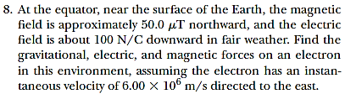
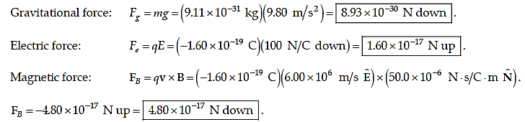

Slide 46

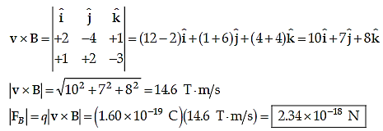

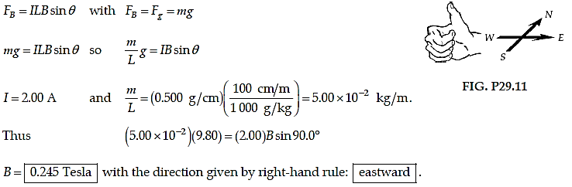

Slide 47
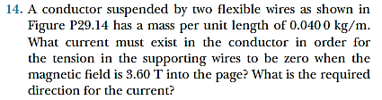
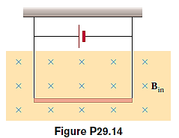
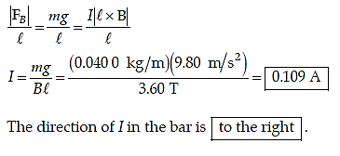
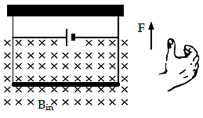

Slide 48
