Slide 1
General Physics (1) For Engineering
Textbook:
Physics for Scientists and Engineers, seventh edition, Jewett / Serway
Dr. Awos Alsalman

Slide 2
Final mark will be divided as follows:
10% Homework and Quiz
20% First exam.
20% Second exam.
50% Final exam.

Slide 3
Physics for Scientists and Engineers
Introduction
and
Chapter 1

Slide 4
Physics
The study of Physics can be divided into six main areas:
  Classical mechanics, Concerning the motion of objects that are large relative to atoms and move at speeds much slower than the speed of light.
  Relativity, a theory describing objects moving at any speed, even speeds approaching the speed of light.
  Thermodynamics, dealing with heat, work, temperature, and the statistical behavior of systems with large numbers of particles.

Slide 5
Physics
The study of Physics can be divided into six main areas:
  Electromagnetism, concerned with electricity, magnetism, and electromagnetic fields.
  Optics, the study of the behavior of light and its interaction with materials.
  Quantum mechanics, a collection of theories connecting the behavior of matter at the submicroscopic level to microscopic observations.

Slide 6
Objectives of Physics
To find the limited number of fundamental laws that govern natural phenomena
To use these laws to develop theories that can predict the results of future experiments
Express the laws in the language of mathematics
  Mathematics provides the bridge between theory and experiment

Slide 7
Measurements
Used to describe natural phenomena
Needs defined standards
Characteristics of standards for measurements
  Readily accessible
  Possess some property that can be measured reliably
  Must yield the same results when used by anyone anywhere
  Cannot change with time

Slide 8
Standards of Fundamental Quantities
Standardized systems
  Agreed upon by some authority, usually a governmental body
SI – Systéme International
  Agreed to in 1960 by an international committee
  Main system used in this text

Slide 9
Fundamental Quantities and Their Units
Quantity | SI Unit
Length | meter
Mass | kilogram
Time | second
Temperature | Kelvin
Electric Current | Ampere
Luminous Intensity | Candela
Amount of Substance | mole

Slide 10
Quantities Used in Mechanics
In mechanics, three basic quantities are used
  Length
  Mass
  Time
Will also use derived quantities
  These are other quantities that can be expressed in terms of the basic quantities
    Example: Area is the product of two lengths
      Area is a derived quantity
      Length is the fundamental quantity

Slide 11
Length
Length is the distance between two points in space
Units
  SI – meter, m
Defined in terms of a meter – the distance traveled by light in a vacuum during a given time
See Table 1.1 for some examples of lengths

Slide 12
Mass
Units
  SI – kilogram, kg
Defined in terms of a kilogram, based on a specific cylinder kept at the International Bureau of Standards
See Table 1.2 for masses of various objects

Slide 13
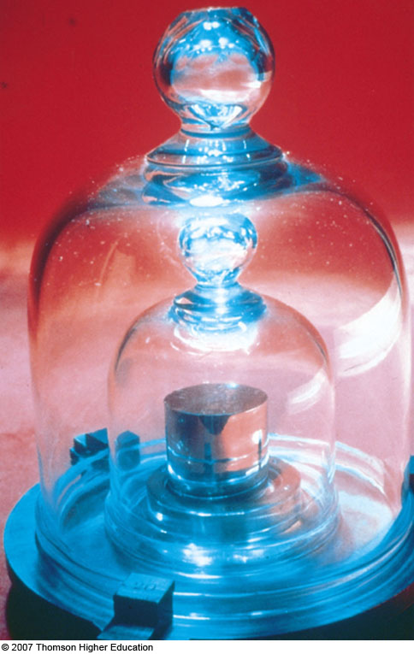
Standard Kilogram

Slide 14
Time
Units
  seconds, s
Defined in terms of the oscillation of radiation from a cesium atom
See Table 1.3 for some approximate time intervals

Slide 15
US Customary System
Still used in the US, but text will use SI
Quantity | Unit
Length | foot
Mass | slug
Time | second

Slide 16
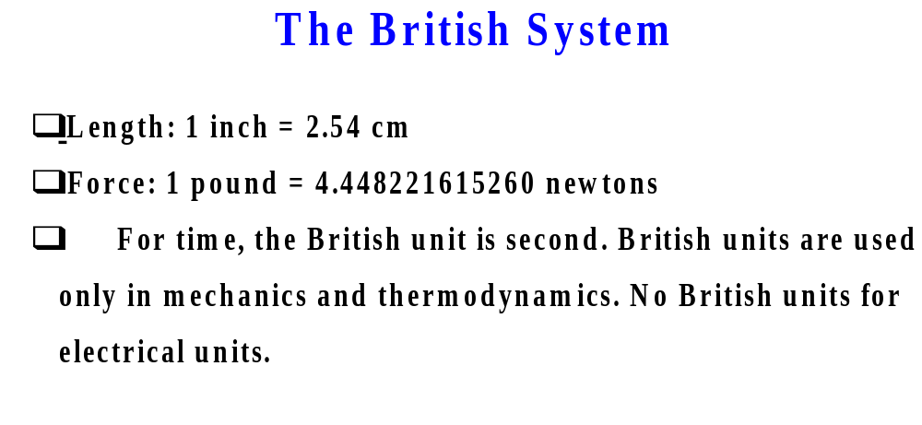

Slide 17
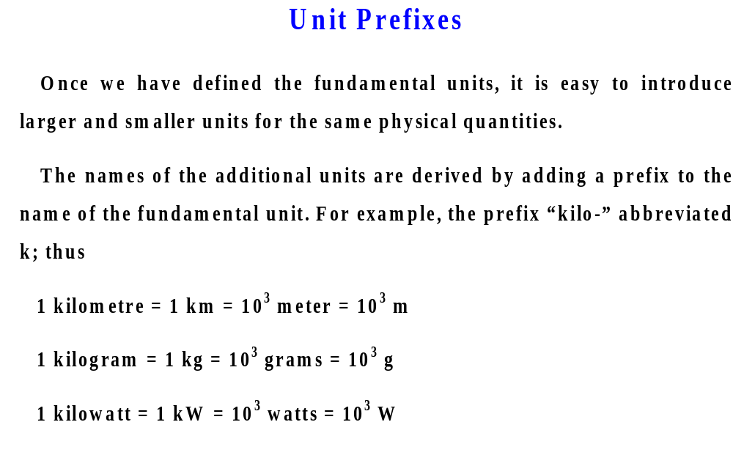

Slide 18
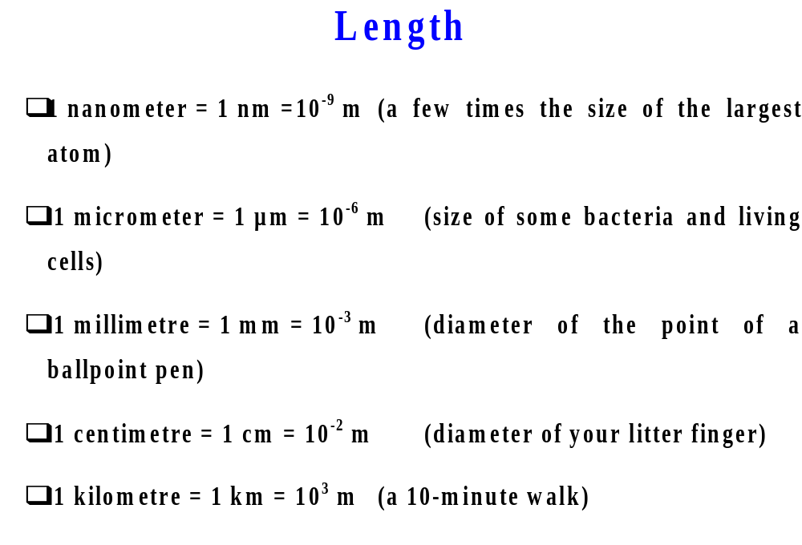

Slide 19
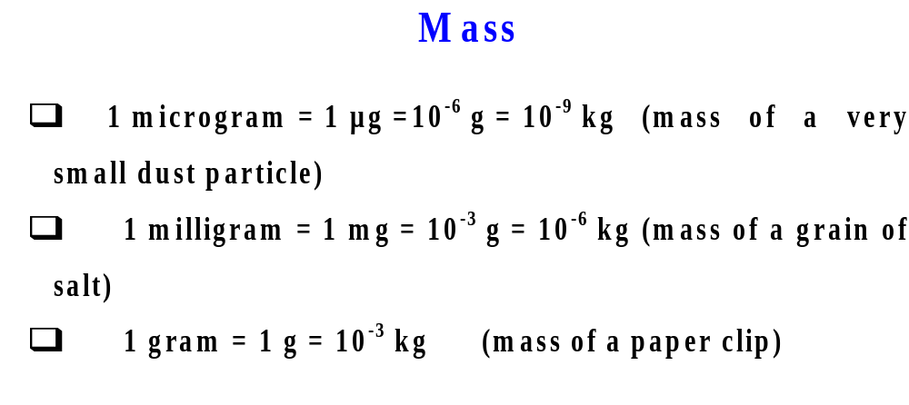

Slide 20
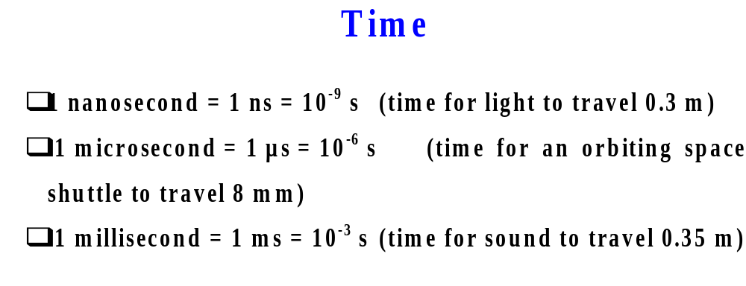

Slide 21
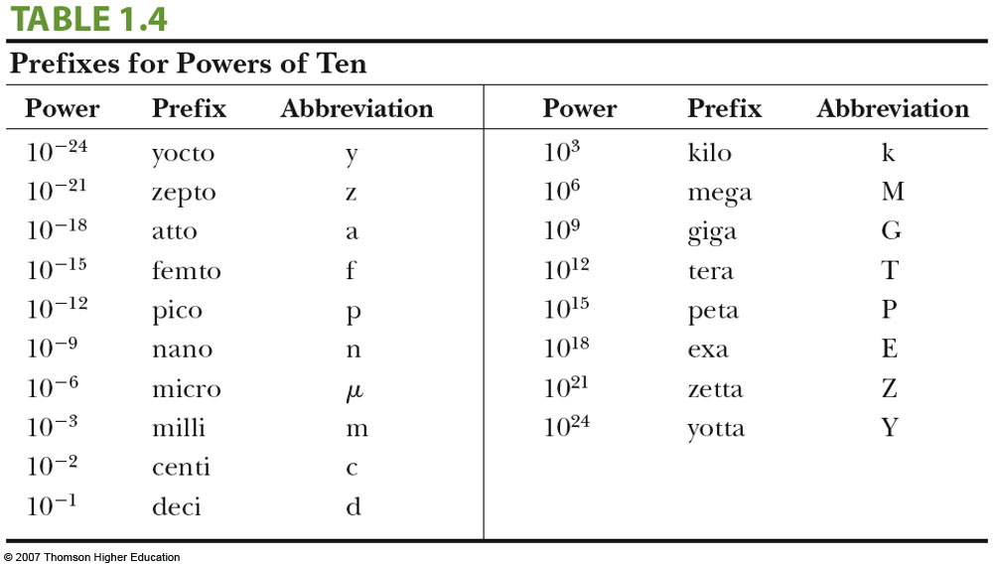
Prefixes, some more examples

Slide 22
Basic Quantities and Their Dimension
Dimensions are denoted with square brackets
  Length [L]
  Mass [M]
  Time [T]

Slide 23
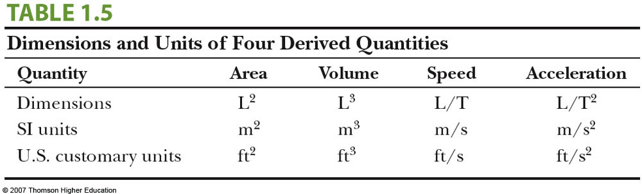
Dimensions and Units
Each dimension can have many actual units
Table 1.5 for the dimensions and units of some derived quantities

Slide 24
Dimensional Analysis
Technique to check the correctness of an equation or to assist in deriving an equation
Dimensions (length, mass, time, combinations) can be treated as algebraic quantities
  add, subtract, multiply, divide
Both sides of equation must have the same dimensions
Any relationship can be correct only if the dimensions on both sides of the equation are the same

Slide 25
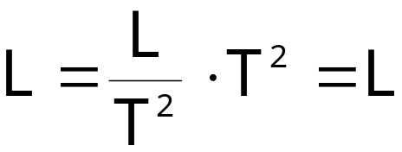
Dimensional Analysis, example
Given the equation: x = ½ at ²
Check dimensions on each side:
The T²’s cancel, leaving L for the dimensions of each side
  The equation is dimensionally correct
  There are no dimensions for the constant

Slide 26


Dimensional Analysis to Determine a Power Law
Determine powers in a proportionality
  Example: find the exponents in the expression
    You must have lengths on both sides
    Acceleration has dimensions of L/T²
    Time has dimensions of T
    Analysis gives

Slide 27
Conversion of Units
When units are not consistent, you may need to convert to appropriate ones
See Appendix A for an extensive list of conversion factors
Units can be treated like algebraic quantities that can cancel each other out

Slide 28
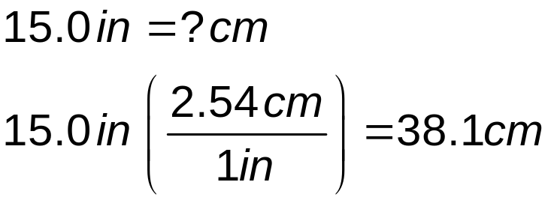
Conversion
Always include units for every quantity, you can carry the units through the entire calculation
Multiply original value by a ratio equal to one
Example
  Note the value inside the parentheses is equal to 1 since 1 in. is defined as 2.54 cm

Slide 29
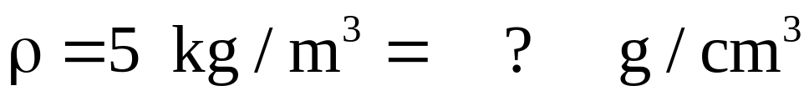
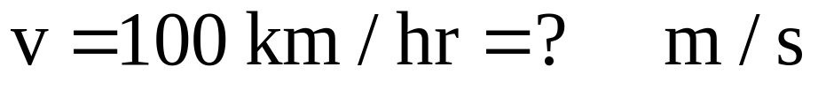
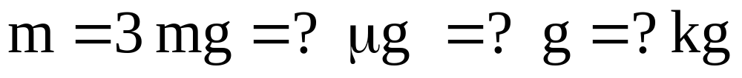
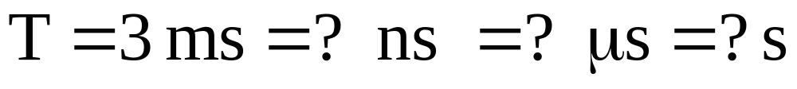
Conversion, Examples:

