Slide 1
General Physics (1) For Engineering
Textbook:
Physics for Scientists and Engineers, seventh edition, Jewett / Serway
Dr. Awos Alsalman

Slide 2
Chapter 12
Elasticity
And Static Equilibrium

Slide 3
Elasticity
So far we have assumed that objects remain rigid when external forces act on them
  Except springs
Actually, objects are deformable
  It is possible to change the size and/or shape of the object by applying external forces
Internal forces resist the deformation

Slide 4
Definitions Associated With Deformation
Stress
  Is proportional to the force causing the deformation
  It is the external force acting on the object per unit area
Strain
  Is the result of a stress
  Is a measure of the degree of deformation

Slide 5
Elastic Modulus
The elastic modulus is the constant of proportionality between the stress and the strain
  For sufficiently small stresses, the elastic modulus is directly proportional to the stress
  It depends on the material being deformed
  It also depends on the nature of the deformation

Slide 6
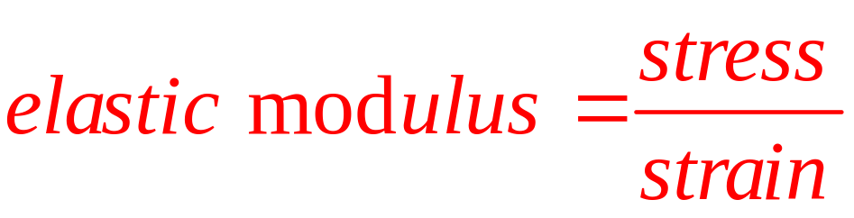
Elastic Modulus, cont
The elastic modulus, in general, relates what is done to a solid object to how that object responds
Various types of deformation have unique elastic moduli

Slide 7
Three Types of Moduli
Young’s Modulus
  Measures the resistance of a solid to a change in its length
Shear Modulus
  Measures the resistance of motion of the planes within a solid parallel to each other
Bulk Modulus
  Measures the resistance of solids or liquids to changes in their volume

Slide 8
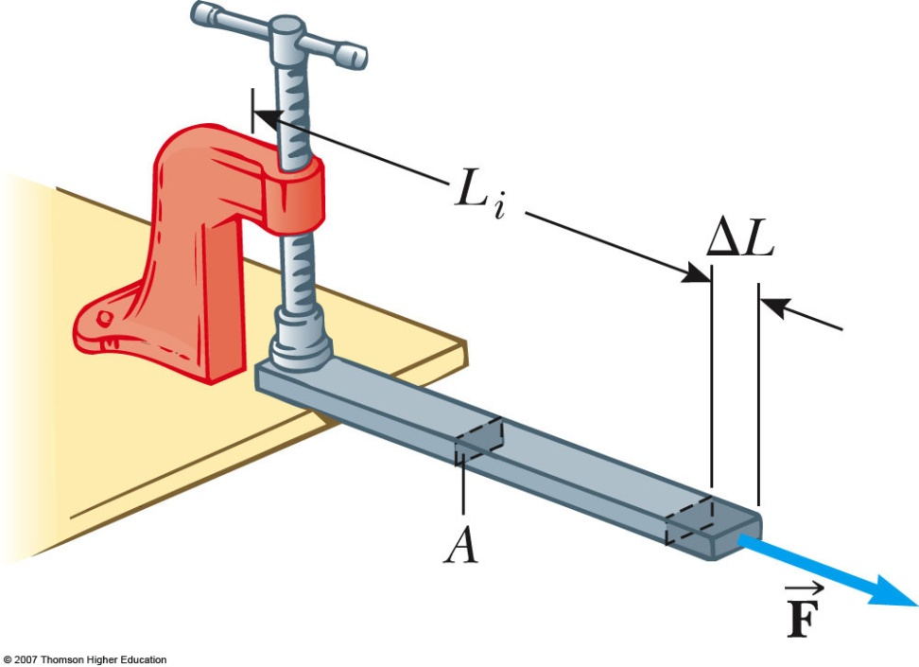
Young’s Modulus
The bar is stretched by an amount ΔL under the action of the force F
  See the active figure for variations in values
The tensile stress is the ratio of the magnitude of the external force to the cross-sectional area A

Slide 9
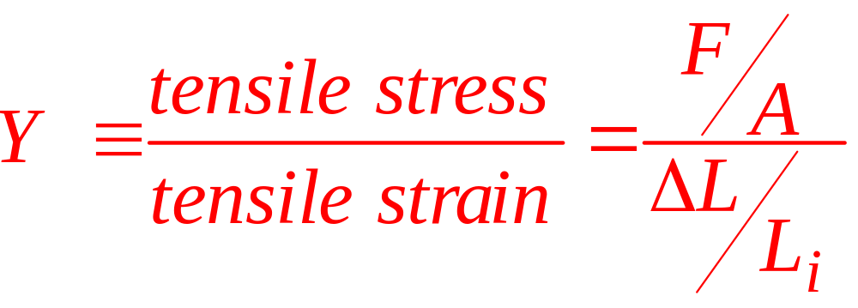
Young’s Modulus, cont
The tension strain is the ratio of the change in length to the original length
Young’s modulus, Y, is the ratio of those two ratios: tensile
Units are N / m²

Slide 10
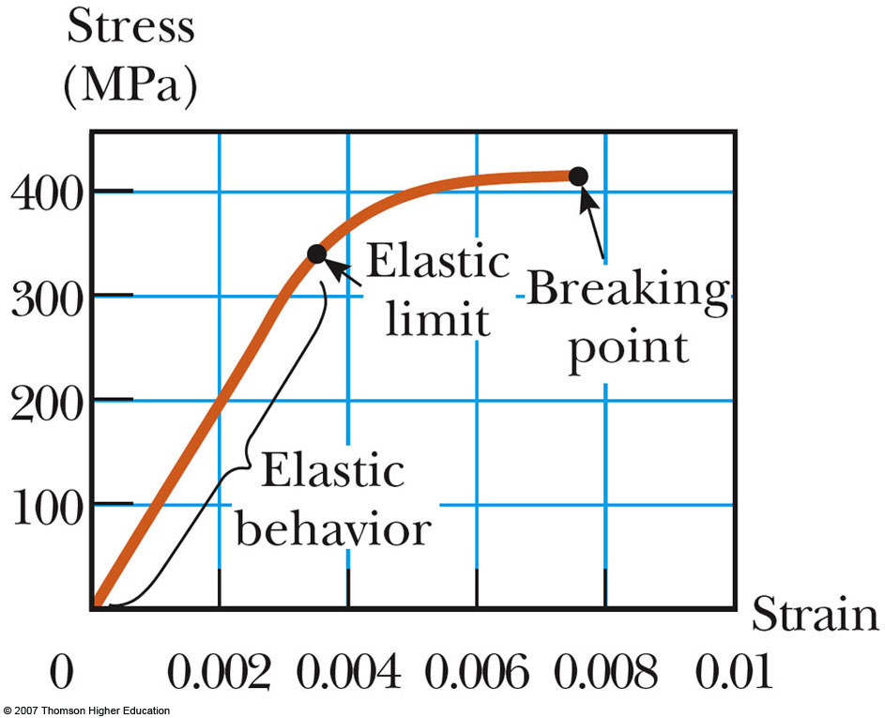
Stress vs. Strain Curve
Experiments show that for certain stresses, the stress is directly proportional to the strain
  This is the elastic behavior part of the curve

Slide 11
Stress vs. Strain Curve, cont
The elastic limit is the maximum stress that can be applied to the substance before it becomes permanently deformed
When the stress exceeds the elastic limit, the substance will be permanently deformed
  The curve is no longer a straight line
With additional stress, the material ultimately breaks

Slide 12
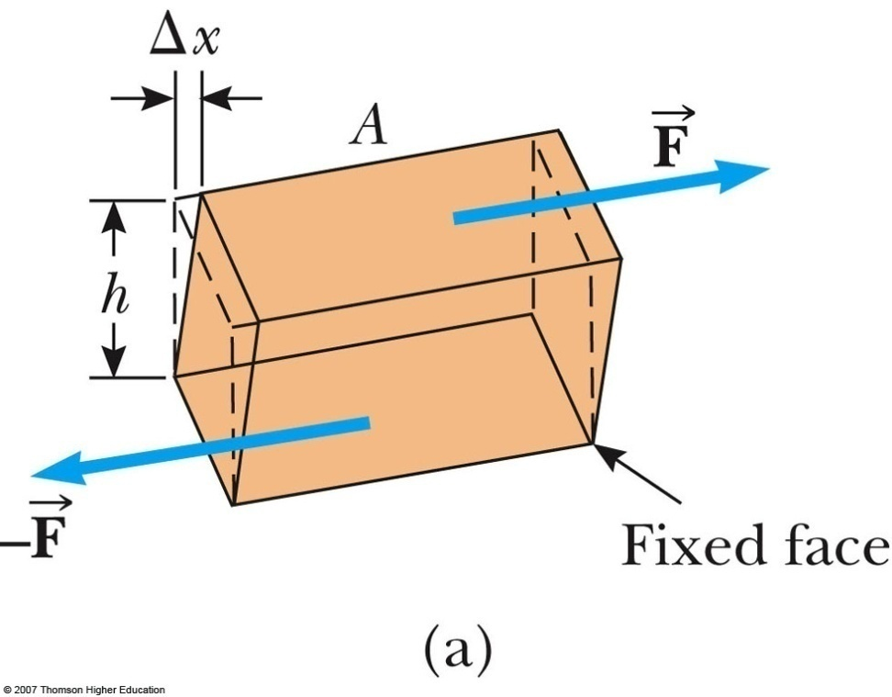
Shear Modulus
Another type of deformation occurs when a force acts parallel to one of its faces while the opposite face is held fixed by another force
  See the active figure to vary the values
This is called a shear stress

Slide 13
Shear Modulus, cont
For small deformations, no change in volume occurs with this deformation
  A good first approximation
The shear stress is F / A
  F is the tangential force
  A is the area of the face being sheared
The shear strain is Δx / h
  Δx is the horizontal distance the sheared face moves
  h is the height of the object

Slide 14
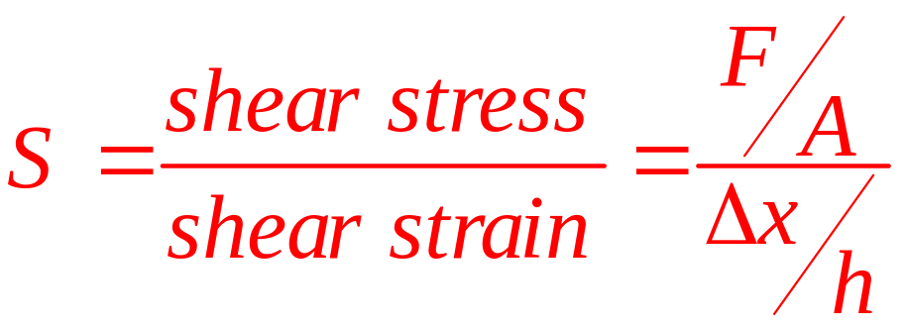
Shear Modulus, final
The shear modulus is the ratio of the shear stress to the shear strain
Units are N / m²

Slide 15
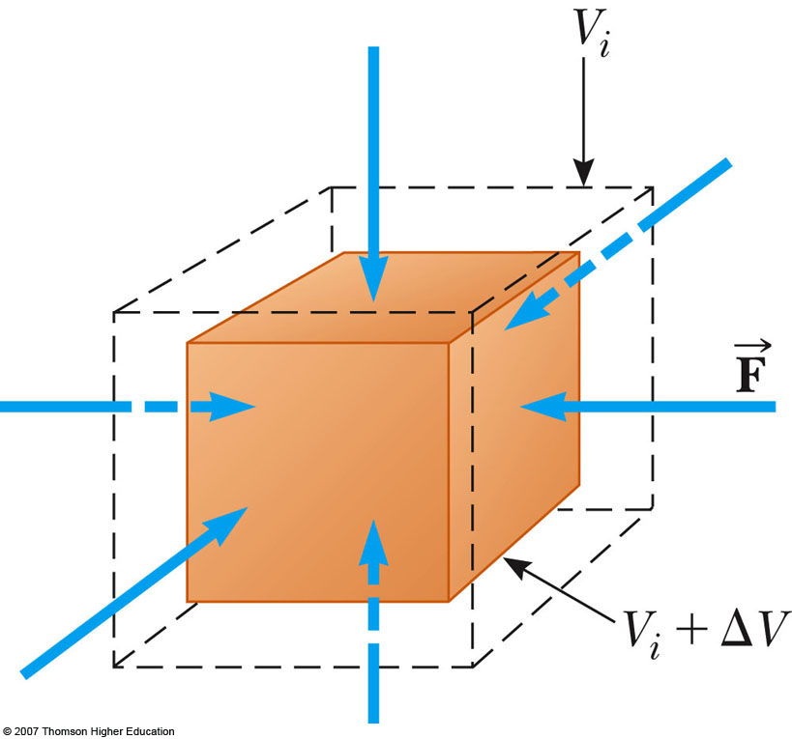
Bulk Modulus
Another type of deformation occurs when a force of uniform magnitude is applied perpendicularly over the entire surface of the object
  See the active figure to vary the values
The object will undergo a change in volume, but not in shape

Slide 16
Bulk Modulus, cont
The volume stress is defined as the ratio of the magnitude of the total force, F, exerted on the surface to the area, A, of the surface
  This is also called the pressure
The volume strain is the ratio of the change in volume to the original volume

Slide 17
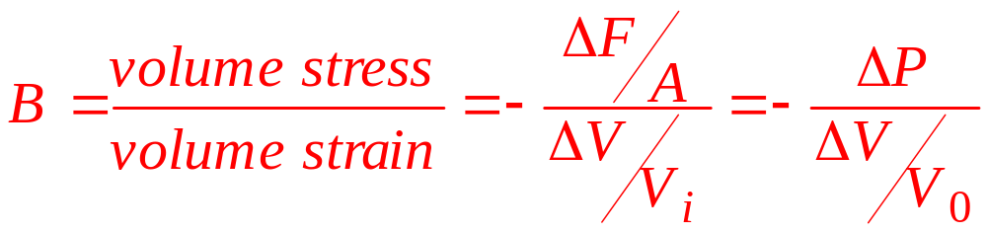
Bulk Modulus, final
The bulk modulus is the ratio of the volume stress to the volume strain
The negative indicates that an increase in pressure will result in a decrease in volume

Slide 18
Compressibility
The compressibility is the inverse of the bulk modulus
It may be used instead of the bulk modulus

Slide 19
Moduli and Types of Materials
Both solids and liquids have a bulk modulus
Liquids cannot sustain a shearing stress or a tensile stress
  If a shearing force or a tensile force is applied to a liquid, the liquid will flow in response

Slide 20
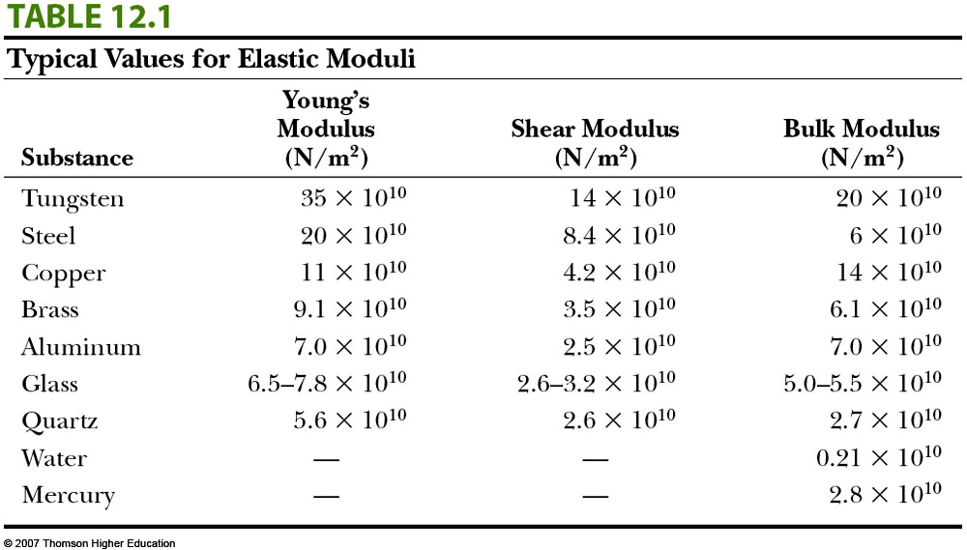
Moduli Values

Slide 21
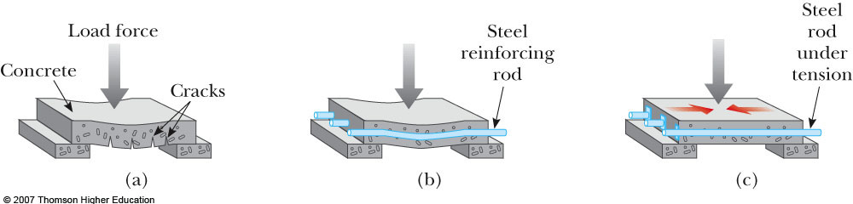
Prestressed Concrete
If the stress on a solid object exceeds a certain value, the object fractures
The slab can be strengthened by the use of steel rods to reinforce the concrete
The concrete is stronger under compression than under tension

Slide 22
Prestressed Concrete, cont
A significant increase in shear strength is achieved if the reinforced concrete is prestressed
As the concrete is being poured, the steel rods are held under tension by external forces
These external forces are released after the concrete cures
This results in a permanent tension in the steel and hence a compressive stress on the concrete
This permits the concrete to support a much heavier load

Slide 23
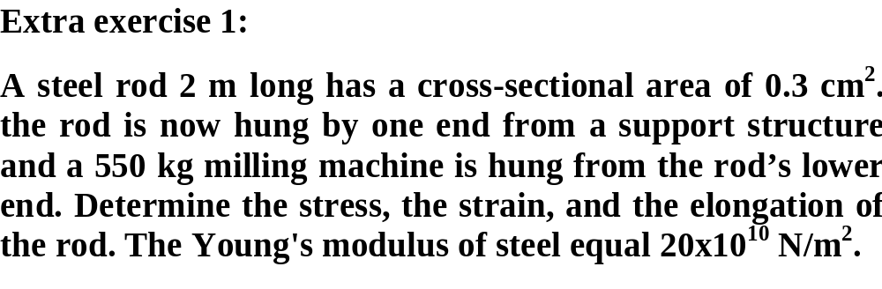

Slide 24
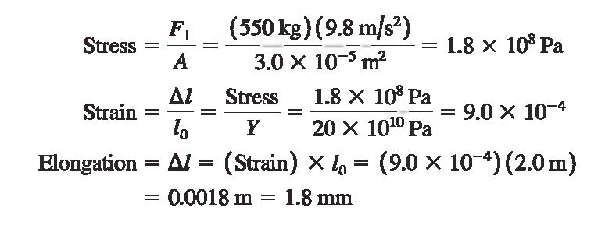
Solution of exercise 1

Slide 25
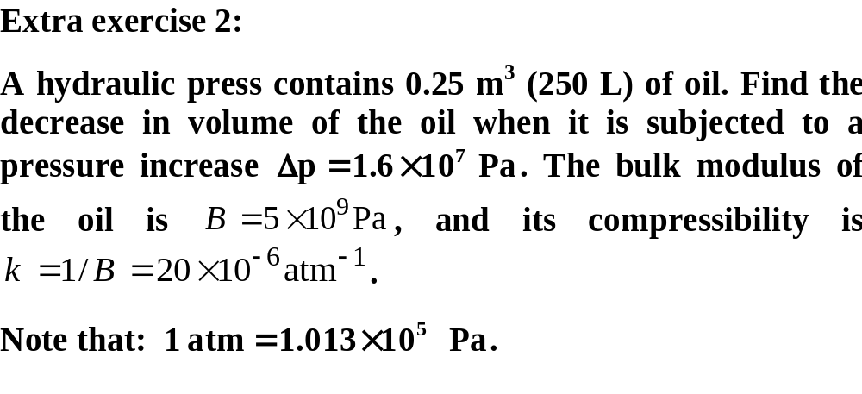

Slide 26
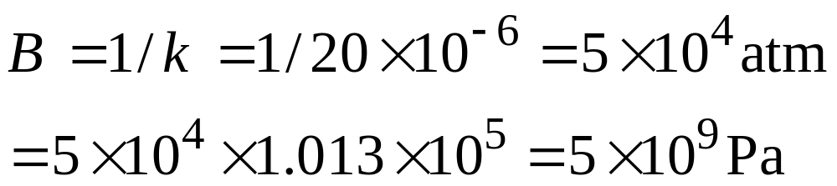
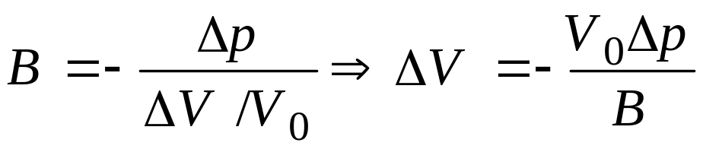
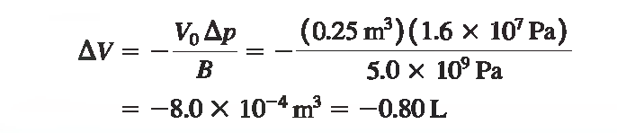
Solution of exercise 2

Slide 27
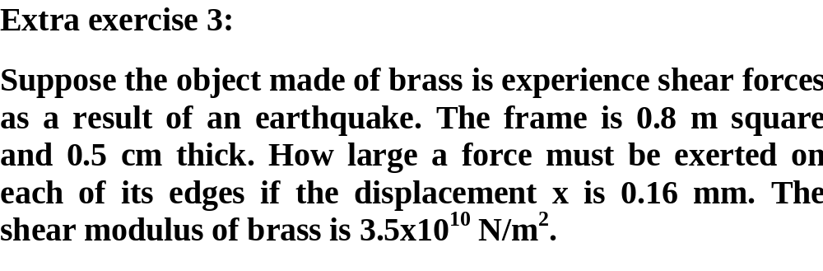
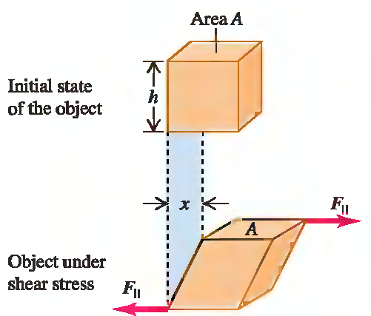

Slide 28

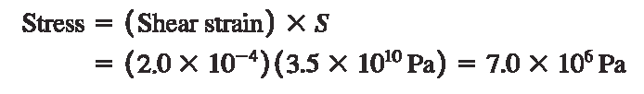

Solution of exercise 3

Slide 29

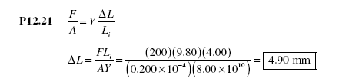
Problem

Slide 30

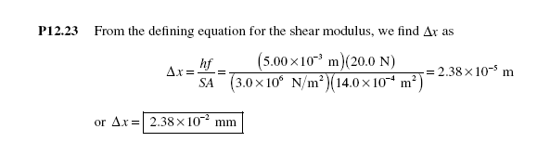
Problem

Slide 31
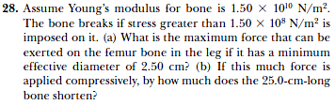
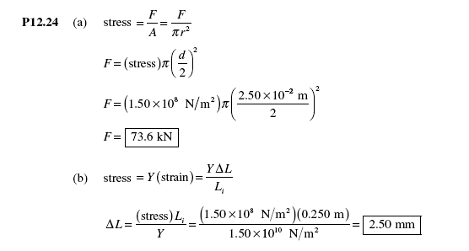
Problem

Slide 32
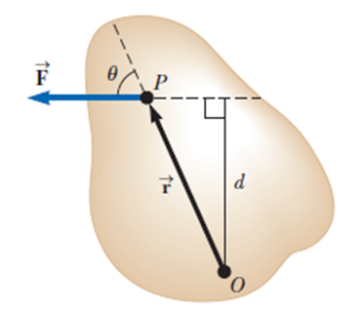
Torque
Torque, τ, is the tendency of a force to rotate an object about some axis
  Torque is a vector, but we will deal with its magnitude here
  τ = r F sin φ = F d
    F is the force
    φ is the angle the force makes with the horizontal
    d is the moment arm (or lever arm) of the force

Slide 33
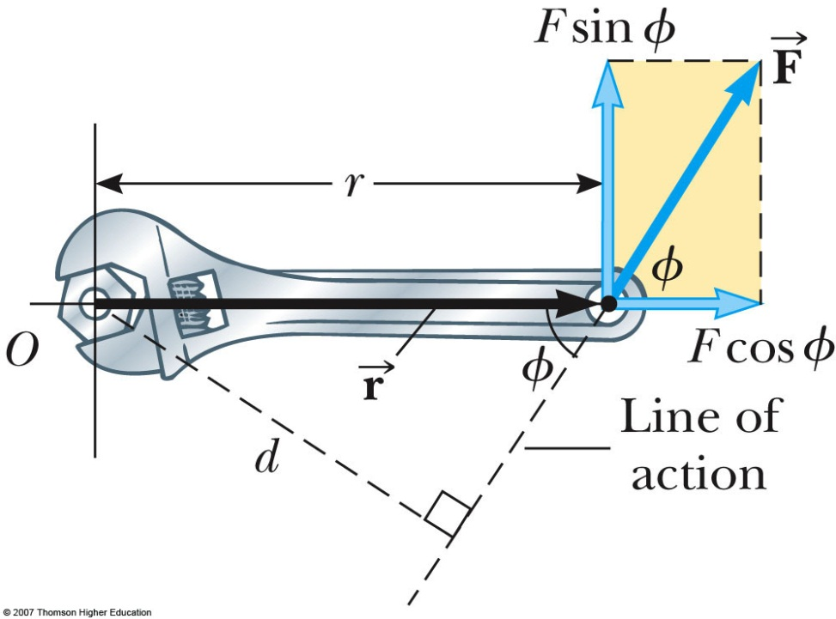
Torque, cont
The moment arm, d, is the perpendicular distance from the axis of rotation to a line drawn along the direction of the force
  d = r sin Φ

Slide 34
Torque, final
The horizontal component of the force (F cos φ) has no tendency to produce a rotation
Torque will have direction
  If the turning tendency of the force is counterclockwise, the torque will be positive
  If the turning tendency is clockwise, the torque will be negative

Slide 35

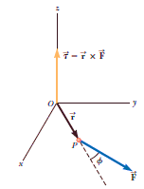


We now have two necessary conditions for equilibrium of an object:
The net external force on the object must equal zero:
The net external torque on the object about any axis must be zero:
In the special case of static equilibrium, which is the main subject of this chapter, the object in equilibrium is at rest relative to the observer and so has no translational or angular speed.

Slide 36

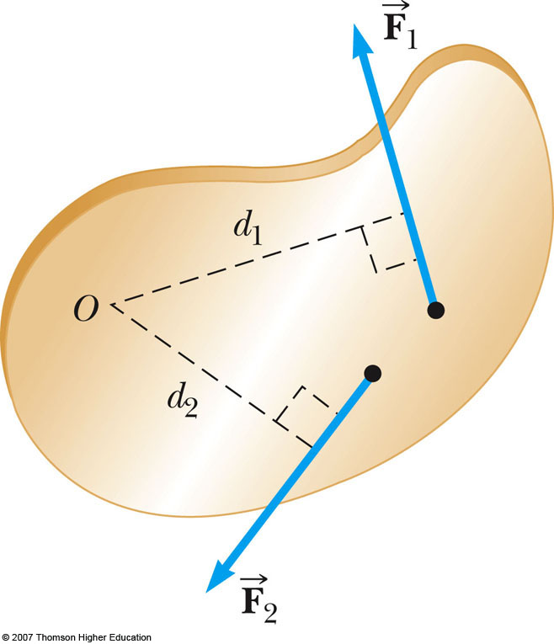

Net Torque
The force will tend to cause a counterclockwise rotation about O
The force will tend to cause a clockwise rotation about O
Στ = τ₁ + τ₂ = F₁d₁ – F₂d₂

Slide 37
Torque vs. Force
Forces can cause a change in translational motion
  Described by Newton’s Second Law
Forces can cause a change in rotational motion
  The effectiveness of this change depends on the force and the moment arm
  The change in rotational motion depends on the torque

Slide 38
Torque Units
The SI units of torque are N.m
  Although torque is a force multiplied by a distance, it is very different from work and energy
  The units for torque are reported in N.m and not changed to Joules

Slide 39



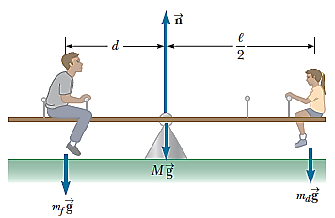
Example 12.1 The Seesaw Revisited
A seesaw consisting of a uniform board of mass M and length supports
at rest a father and daughter with masses m_{f} and m_{d}, respectively.
The support (called the fulcrum) is under the center of gravity of the board, the father is a distance d from the center, and the daughter is a distance from the center.
(A) Determine the magnitude of the upward force exerted by the support on the board.
(B) Determine where the father should sit to balance the system at rest.

Slide 40
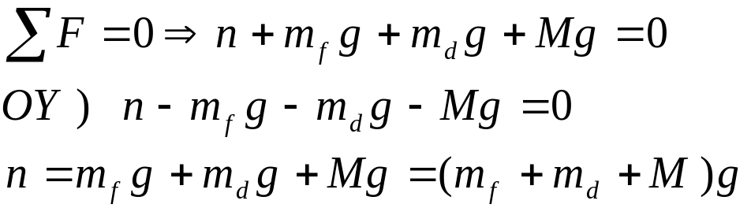
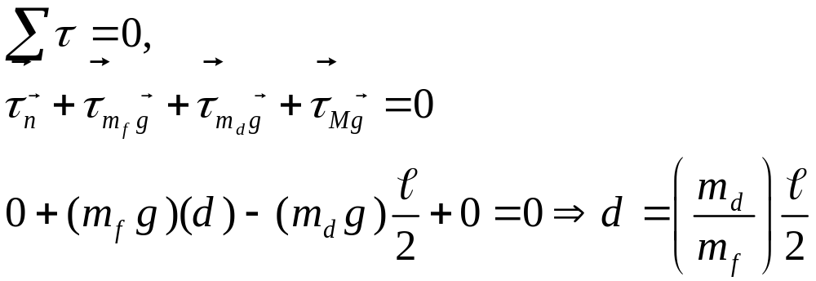
SOLUTION
(A) Because the system is at rest, we model the board as a rigid object in equilibrium. Define upward as the positive y direction and substitute the forces on the board:
(B) This part requires the introduction of torque. We choose a rotation axis perpendicular to the page through the center of gravity of the board.

Slide 41
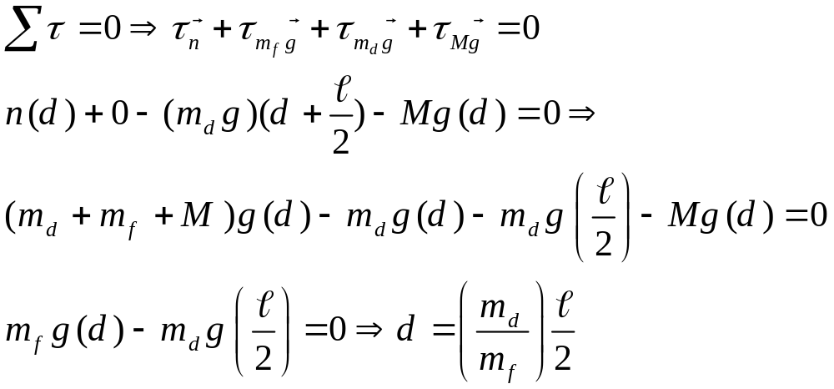
WHAT IF? Suppose we had chosen another point through which the rotation axis were to pass. For example, suppose the axis is perpendicular to the page and passes through the location of the father. Does that change the results to parts (A) and (B)?
Answer Part (A) is unaffected.
In part (B), we would conceptually expect there to be no change if a different rotation axis is chosen because the second condition of equilibrium claims that the torque is zero about any rotation axis.
Let’s verify this answer mathematically. Let’s choose a rotation axis passing through the location of the father.

Slide 42


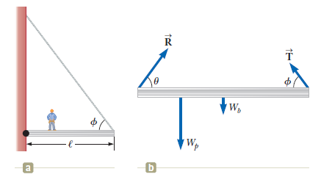
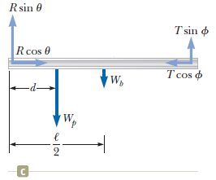
Example 12.2 Standing on a Horizontal Beam
A uniform horizontal beam with a length of and a weight of Wb = 200 N is attached to a wall by a pin connection. Its far end is supported
by a cable that makes an angle of with the beam. A person of weight Wp = 600 N stands a distance d = 2.00 m from the wall. Find the tension in the cable as well as the magnitude and direction of the force exerted by the wall on the beam.

Slide 43
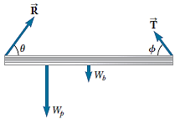
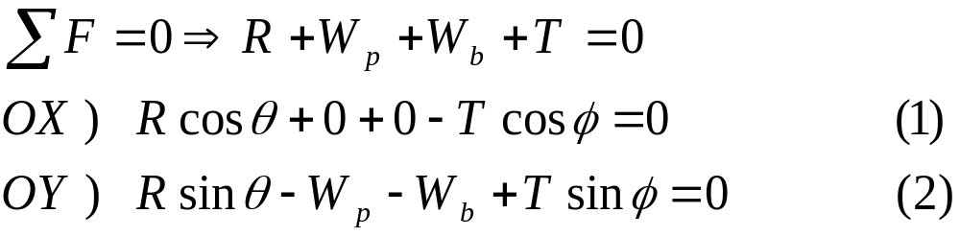
SOLUTION
Conceptualize. Because the system is at rest, we categorize the beam as a rigid object in equilibrium
We identify all the external forces acting on the beam:
1- The 200 N gravitational force.
2- The force T exerted by the cable.
3- The force R exerted by the wall at the pivot.
4- The 600 N force that the person exerts on the beam.
When we assign directions for forces, it is sometimes helpful to imagine what would happen if a force were suddenly removed. For example, if the wall were to vanish suddenly, the left end of the beam would move to the left as it begins to fall. This scenario tells us that the wall is not only holding the beam up but is also pressing outward against it. Therefore, we draw the vector R in the direction shown in Figure. The Figure shows the horizontal and vertical components of T and R.
The condition for static equilibrium:

Slide 44
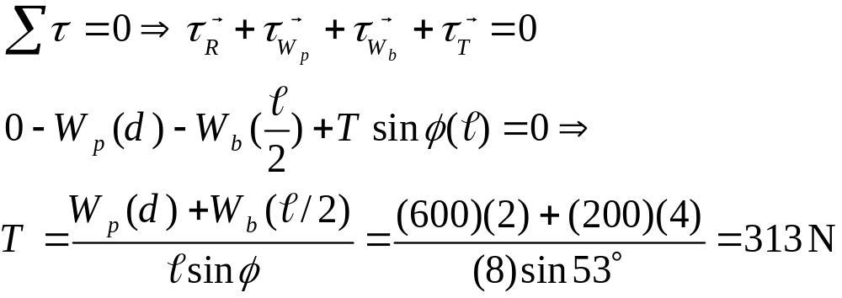
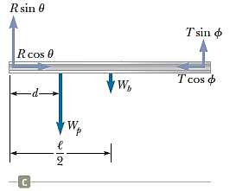
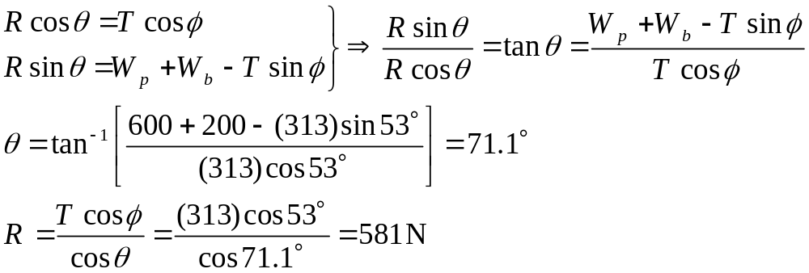
Now the condition for rotational equilibrium. A convenient axis to choose for our torque equation is the one that passes through the pin connection. The feature that makes this axis so convenient is that the force R and the horizontal component of T both have a moment arm of zero; hence, these forces produce no torque about this axis.
Rearrange Equations (1) and (2) and then divide:

Slide 45
What if the person walks farther out on the beam? Does T change? Does R change? Does θ change?
Answer T must increase because the weight of the person exerts a larger torque about the pin connection, which must be countered by a larger torque in the opposite direction due to an increased value of T.
If T increases, the vertical component of R decreases to maintain force equilibrium in the vertical direction. Force equilibrium in the horizontal direction, however, requires an increased horizontal component of R to balance the horizontal component of the increased T.
This fact suggests that θ becomes smaller, but it is hard to predict what happens to R.

Slide 46

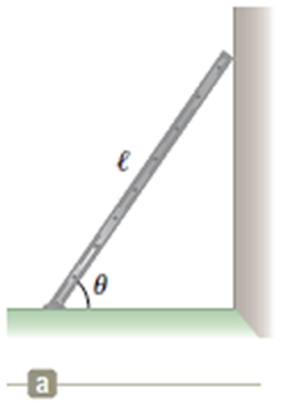
Example 12.3 The Leaning Ladder
A uniform ladder of length rests against a smooth, vertical wall as shown in Fig. The mass of the ladder is m, and the coefficient of static friction between the ladder and the ground is μ_{s} = 0.40. Find the minimum angle at which the ladder does not slip.
SOLUTION:
We do not wish the ladder to slip, so we model it as a rigid object in equilibrium. The external forces acting on the ladder is illustrated in Figure.
1- The force exerted by the ground on the ladder is the vector sum of a normal force and the force of static friction.
2- The force P exerted by the wall on the ladder is horizontal
because the wall is frictionless.
3- The weight of ladder.

Slide 47
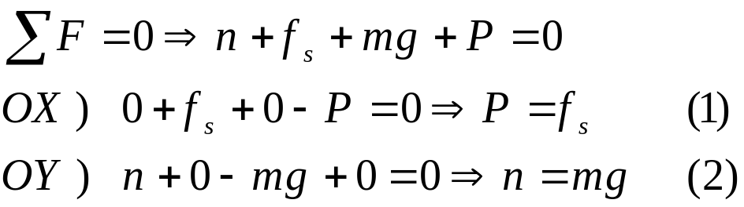

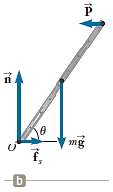

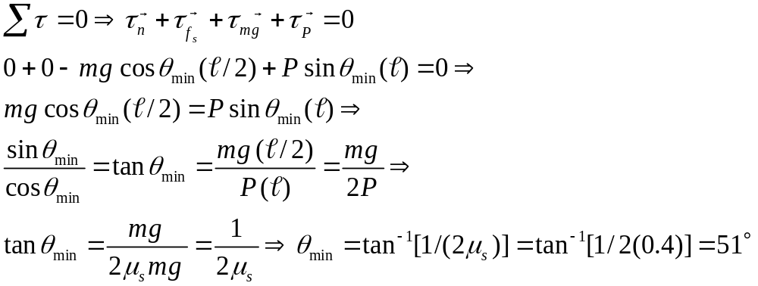
When the ladder is on the verge of slipping, the force of static friction must have its maximum value, which is given by:
From (1) and (2):
For rotational equilibrium, we take torques about an axis through O:
The angle depends only on the coefficient of friction, not on the mass or length of the ladder.

