Slide 1
General Physics (1) For Engineering
Textbook:
Physics for Scientists and Engineers, seventh edition, Jewett / Serway
Dr. Awos Alsalman

Slide 2
Chapter 2
Motion in One Dimension

Slide 3
Kinematics
Describes motion while ignoring the agents that caused the motion
For now, will consider motion in one dimension
  Along a straight line
Will use the particle model
  A particle is a point-like object, has mass but infinitesimal size

Slide 4
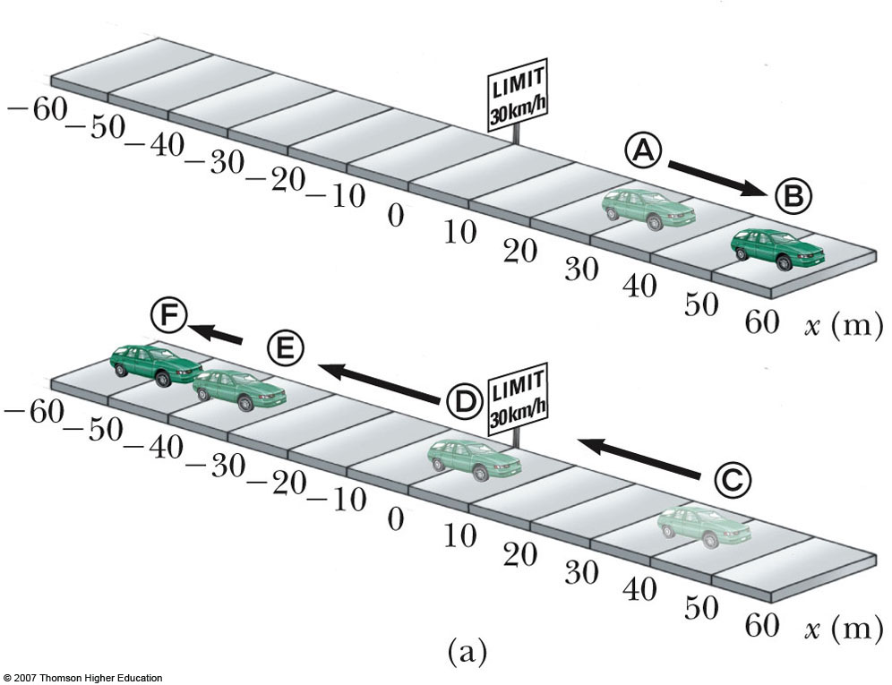
Position
The object’s position is its location with respect to a chosen reference point
  Consider the point to be the origin of a coordinate system
In the diagram, allow the road sign to be the reference point

Slide 5
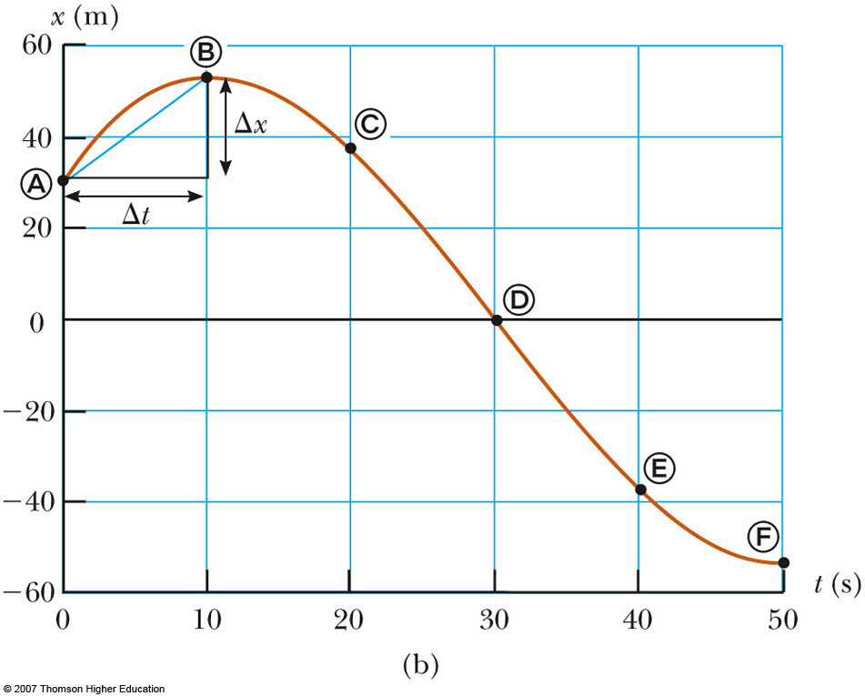
Position-Time Graph
The position-time graph shows the motion of the particle (car)
The smooth curve is a guess as to what happened between the data points

Slide 6
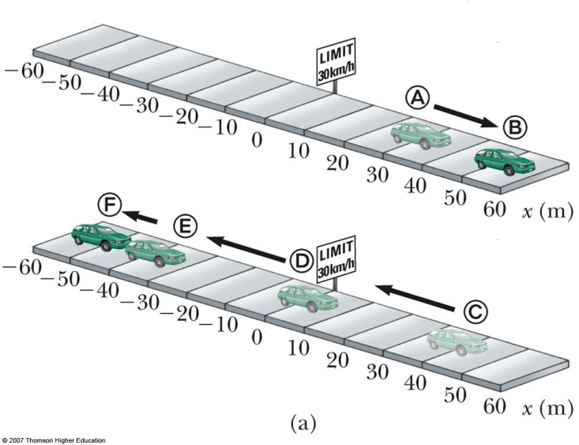
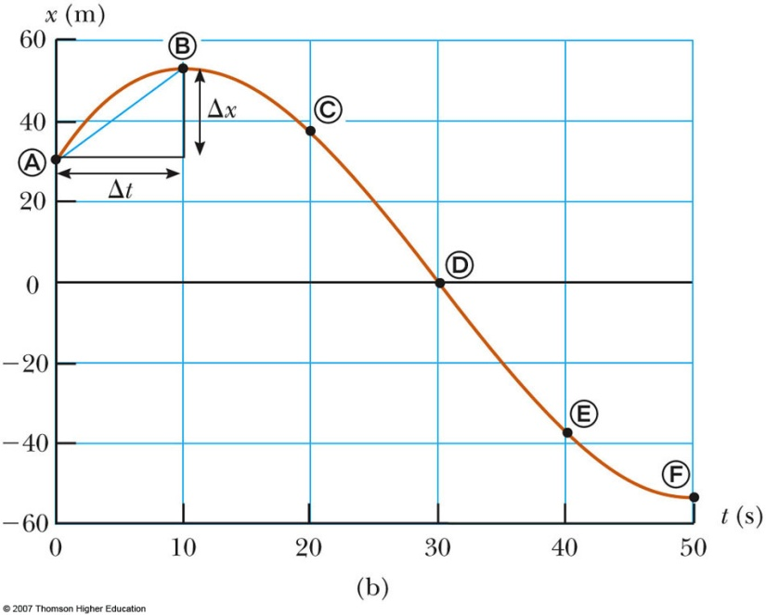
Motion of Car
Note the relationship between the position of the car and the points on the graph
Compare the different representations of the motion

Slide 7
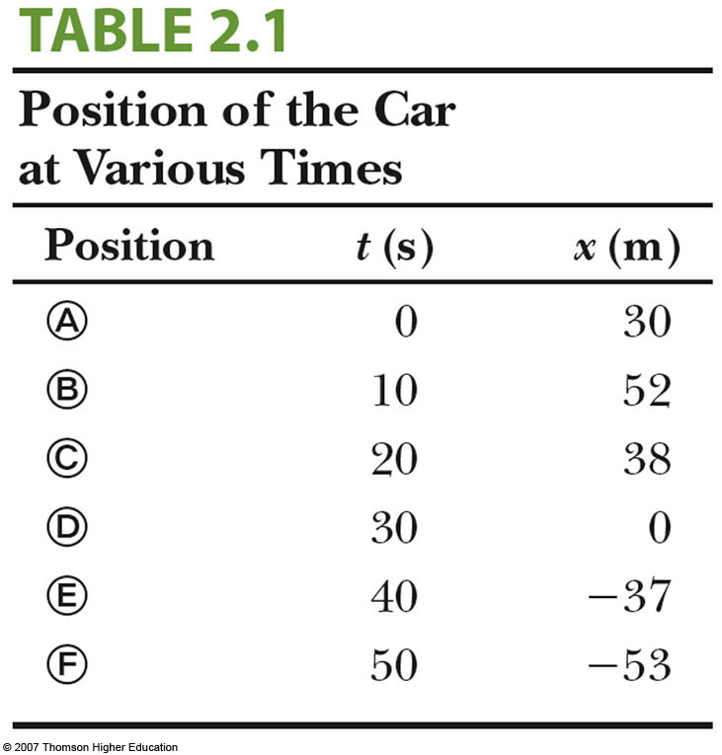
Data Table
The table gives the actual data collected during the motion of the object (car)
Positive is defined as being to the right

Slide 8
Displacement
Defined as the change in position during some time interval
  Represented as Δx
  Δx ≡ x_{f} - x_{i}
  SI units are meters (m)
  Δx can be positive or negative
Different than distance – the length of a path followed by a particle, and the distance is always positive.

Slide 9
Distance vs. Displacement – An Example
Assume a player moves from one end of the court to the other and back
Distance is twice the length of the court
  Distance is always positive
Displacement is zero
  Δx = x_{f} – x_{i} = 0 since
  x_{f} = x_{i}

Slide 10
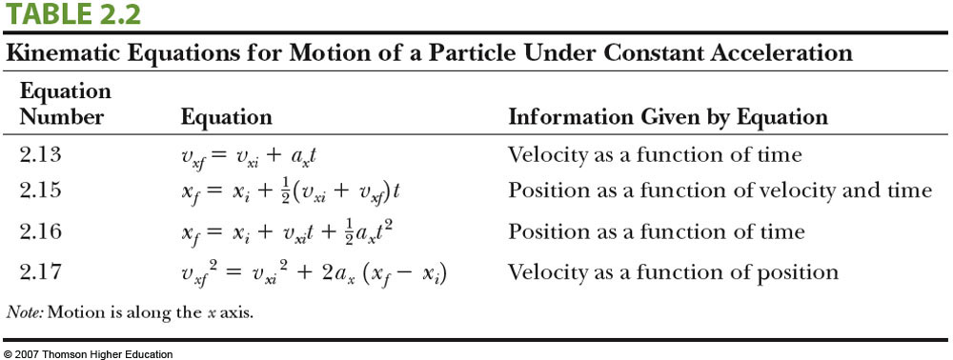
Distance vs. Displacement – An Example

Slide 11
Vectors and Scalars
Vector quantities need both magnitude (size or numerical value) and direction to completely describe them
  Will use + and – signs to indicate vector directions
Scalar quantities are completely described by magnitude only

Slide 12
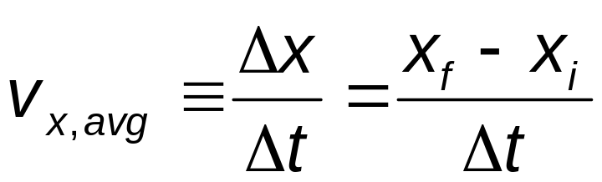
Average Velocity
The average velocity is is rate at which the displacement occurs :
  The x indicates motion along the x-axis
The dimensions are length / time [L/T]
The SI units are m/s
It is a vector quantity
Is also the slope of the line in the position – time graph

Slide 13
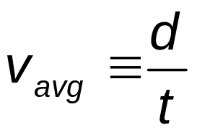
Average Speed
Speed is a scalar quantity
  same units as velocity
  total distance / total time:
The speed has no direction and is always expressed as a positive number
Neither average velocity nor average speed gives details about the trip described

Slide 14
Example 2.1:
Find the displacement, average velocity, and average speed of the car in Figure 2.1a between position (A) and (F) .

Slide 15
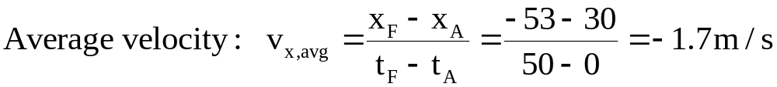
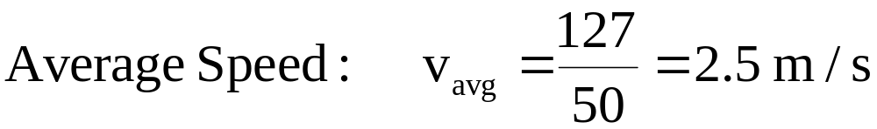
Example 2.1:Solution:

Slide 16
Instantaneous Velocity
The limit of the average velocity as the time interval becomes infinitesimally short, or as the time interval approaches zero
The instantaneous velocity indicates what is happening at every point of time
Instantaneous velocity is a vector quantity.

Slide 17
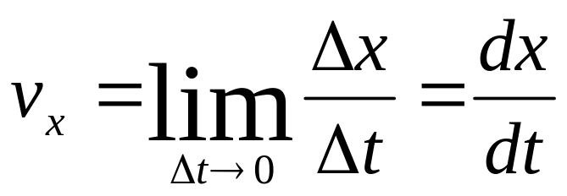
Instantaneous Velocity, equations
The general equation for instantaneous velocity is
The instantaneous velocity can be positive, negative, or zero

Slide 18
Instantaneous Speed
The instantaneous speed is the magnitude of the instantaneous velocity
The instantaneous speed has no direction associated with it

Slide 19
Vocabulary Note
“Velocity” and “speed” will indicate instantaneous values
Average will be used when the average velocity or average speed is indicated

Slide 20
Example 2.3:
A particle moves along the x-axis. Its position varies with time according to the expression x=-4t+2t². where x is in meters and t is in seconds. The position-time graph for this motion is shown in figure 2.4. Notice that the particle moves in the negative x direction for the first second of motion, is momentarily at rest at the moment t=1 s, and moves in the positive x direction at times t>1 s.
(A)- Determine the displacement of the particle in the time intervals t=0 s to t=1 s and t=1 s to t=3 s.
(B)- Calculate the average velocity during these two time intervals.
(C)- Find the instantaneous velocity of the particle at t=2.5 s.

Slide 21
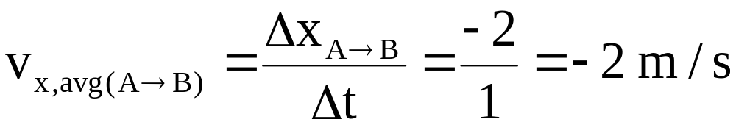
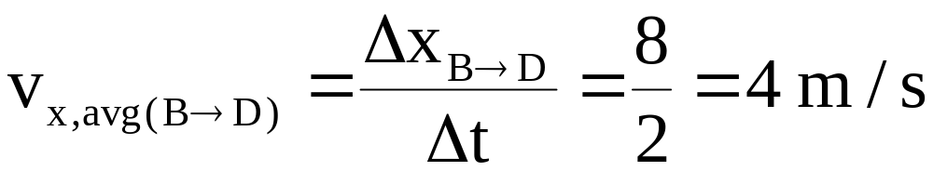
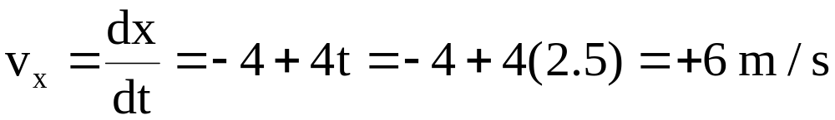
Example 2.3: Solution:

Slide 22
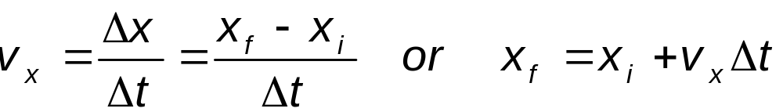
Particle Under Constant Velocity
Constant velocity indicates the instantaneous velocity at any instant during a time interval is the same as the average velocity during that time interval
  v_{x} = v_{x, avg}
  The mathematical representation of this situation is the equation
  Common practice is to let t_{i} = 0 and the equation becomes: x_{f} = x_{i} + v_{x} t (for constant v_{x})

Slide 23
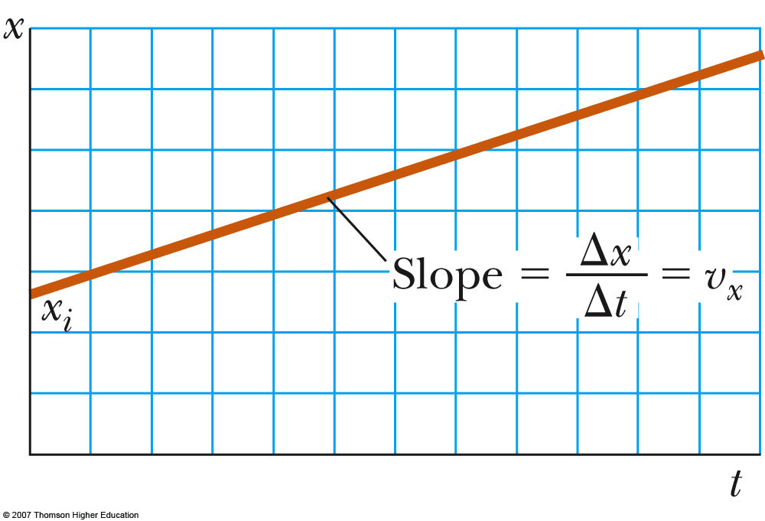
Particle Under Constant Velocity, Graph
The graph represents the motion of a particle under constant velocity
The slope of the graph is the value of the constant velocity
The y-intercept is x_{i}

Slide 24
Example 2.4:
A scientist is studying the biomechanics of the human body. She determines the velocity of an experimental subject while he runs along a straight line at a constant rate. The scientist starts the stopwatch at the moment the runner passes a given point and stops it after the runner has passed another point 20 m away. The time interval indicated on the stopwatch is 4 s.
(A)- what is the runner’s velocity?
(B)- If the runner continues his motion after the stopwatch is stopped, what is his position after 10 s has passed?

Slide 25
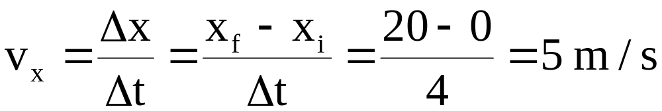
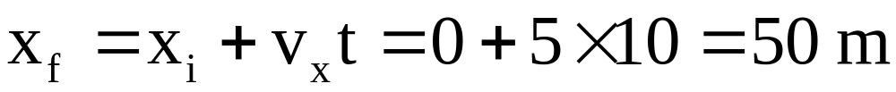
Example 2.4: Solution:
(A)- what is the runner’s velocity?
(B)- If the runner continues his motion after the stopwatch is stopped, what is his position after 10 s has passed?

Slide 26
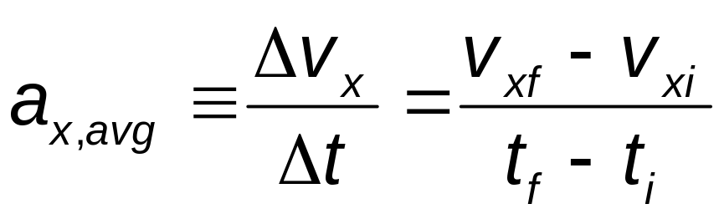
Average Acceleration
Acceleration is the rate of change of the velocity
Dimensions are L/T²
SI units are m/s²
In one dimension, positive and negative can be used to indicate direction

Slide 27
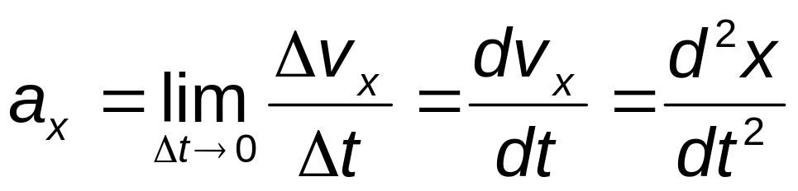
Instantaneous Acceleration
The instantaneous acceleration is the limit of the average acceleration as Δt approaches 0
The term acceleration will mean instantaneous acceleration
  If average acceleration is wanted, the word average will be included

Slide 28
Example 2.6
The velocity of a particle moving along the x axis varies according to the expression v_{x}=(40-5t²) m/s, where t is in seconds.
(A)- Find the average acceleration in the time interval t=0 to t=2 s.
(B)- Determine the acceleration at t=2 s.

Slide 29
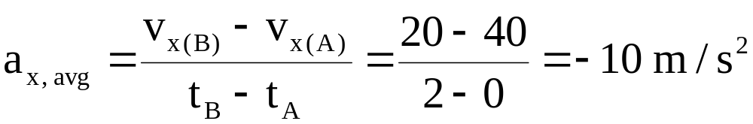
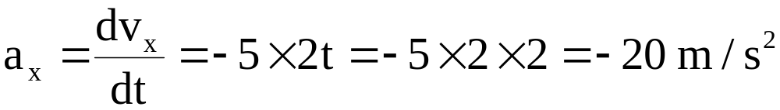
Example 2.6: Solution:
(A)- Find the average acceleration in the time interval t=0 to t=2 s.
(B)- Determine the acceleration at t=2 s.

Slide 30
Acceleration and Velocity, 1
When an object’s velocity and acceleration are in the same direction, the object is speeding up
When an object’s velocity and acceleration are in the opposite direction, the object is slowing down

Slide 31
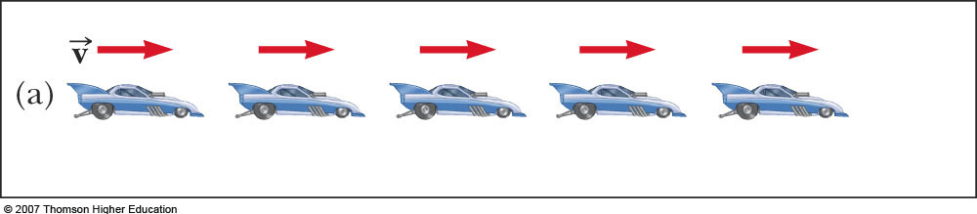
Acceleration and Velocity, 2
Images are equally spaced. The car is moving with constant positive velocity (shown by red arrows maintaining the same size)
Acceleration equals zero

Slide 32
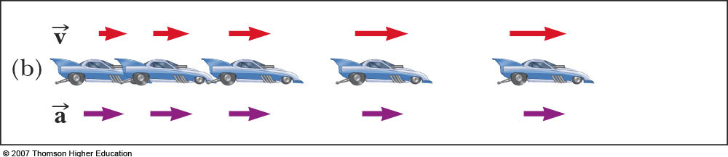
Acceleration and Velocity, 3
Images become farther apart as time increases
Velocity and acceleration are in the same direction
Acceleration is uniform (violet arrows maintain the same length)
Velocity is increasing (red arrows are getting longer)
This shows positive acceleration and positive velocity

Slide 33
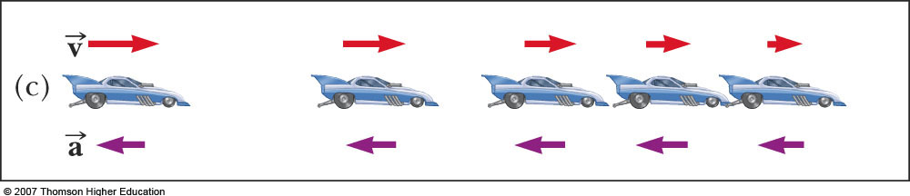
Acceleration and Velocity, 4
Images become closer together as time increases
Acceleration and velocity are in opposite directions
Acceleration is uniform (violet arrows maintain the same length)
Velocity is decreasing (red arrows are getting shorter)
Positive velocity and negative acceleration

Slide 34
Kinematic Equations – summary

Slide 35
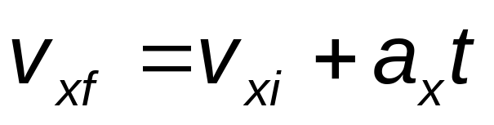
Kinematic Equations, specific
For constant a,
Can determine an object’s velocity at any time t when we know its initial velocity and its acceleration
  Assumes t_{i} = 0 and t_{f} = t
Does not give any information about displacement

Slide 36
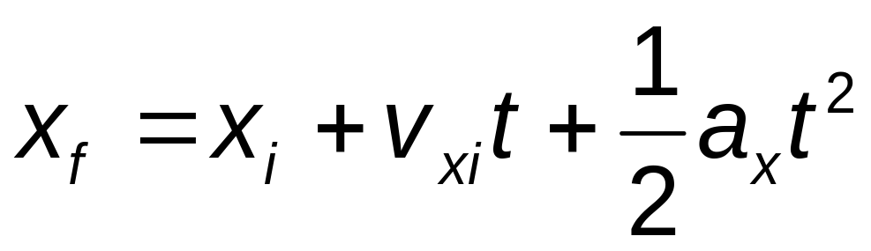
Kinematic Equations, specific
For constant acceleration,
Gives final position in terms of velocity and acceleration
Doesn’t tell you about final velocity

Slide 37
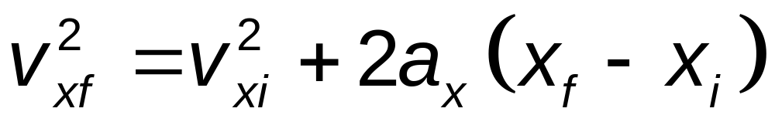
Kinematic Equations, specific
For constant a,
Gives final velocity in terms of acceleration and displacement
Does not give any information about the time

Slide 38
When a = 0
When the acceleration is zero,
  v_{xf} = v_{xi} = v_{x}
  x_{f} = x_{i} + v_{x} t
The constant acceleration model reduces to the constant velocity model

Slide 39
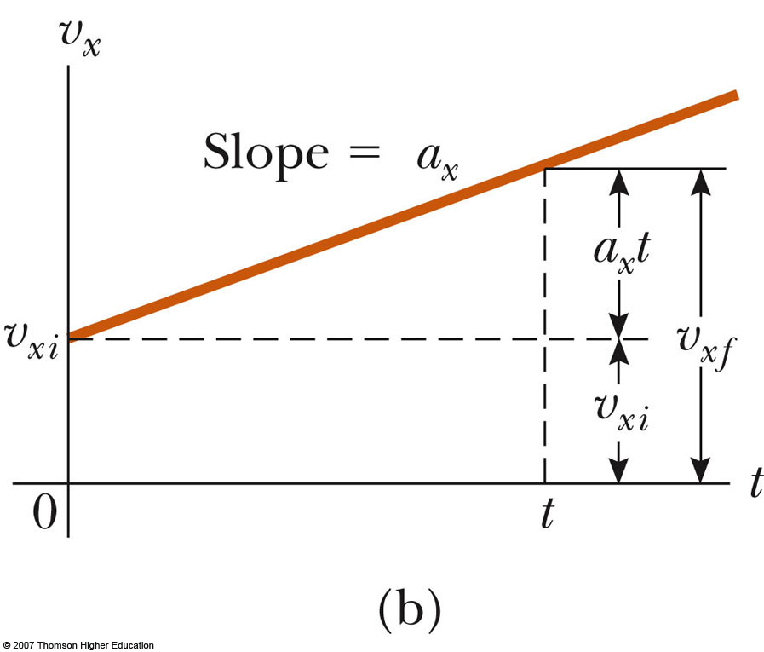
Graphical Look at Motion: velocity – time curve
The slope gives the acceleration
The straight line indicates a constant acceleration

Slide 40
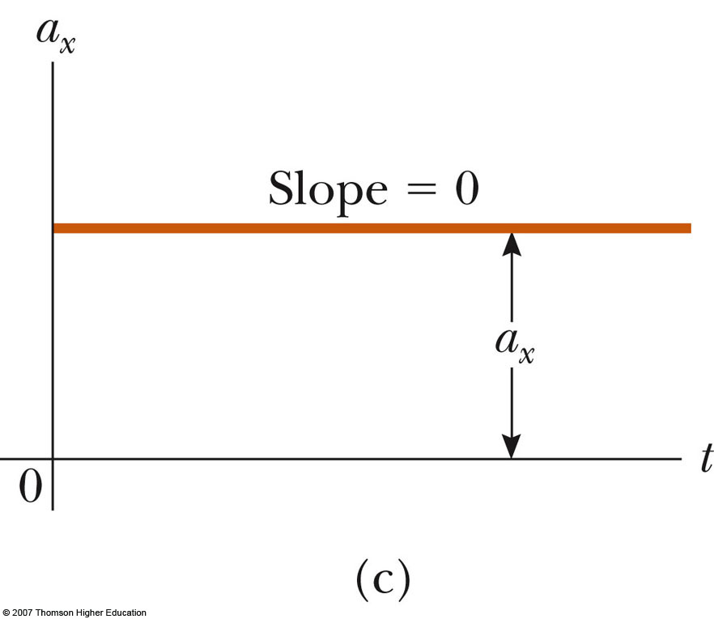
Graphical Look at Motion: acceleration – time curve
The zero slope indicates a constant acceleration

Slide 41
Example 2.7:
A jet lands on an aircraft carrier at 140 mi/h = 63m/s.
(A)- what is its acceleration (assumed constant) if it stops in 2 s due to an arresting cable that snags the jet and brings it to a stop?
(B)- If the jet touches down at position x_{i}=0, what is its final position?

Slide 42
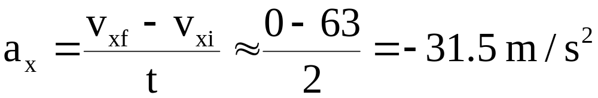
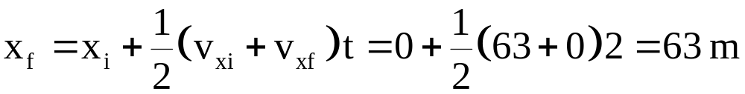
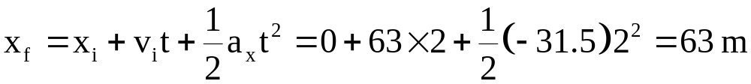
Example 2.7: Solution:
(A)- what is its acceleration (assumed constant) if it stops in 2 s due to an arresting cable that snags the jet and brings it to a stop?
(B)- If the jet touches down at position x_{i}=0, what is its final position?

Slide 43
Example 2.8:
A car travelling at a constant speed of 45 m/s passes a trooper on a motorcycle hidden behind a billboard. One second after the speeding car passes the billboard, the trooper sets out from the billboard to catch the car, accelerating at a constant rate of 3 m/s².
How long does it take her to overtake the car?

Slide 44
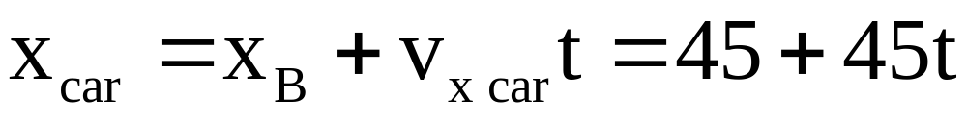
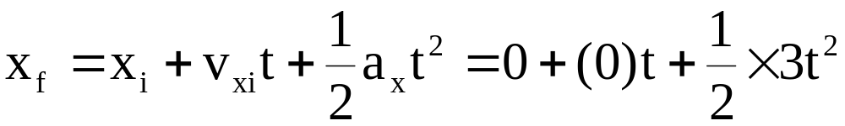
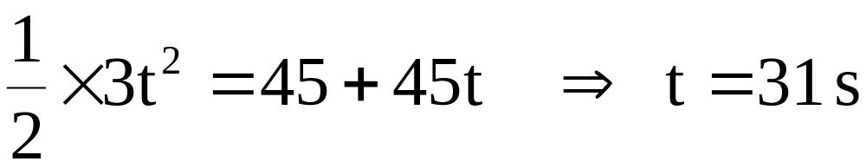
Example 2.8: Solution:
How long does it take her to overtake the car?
See figure 2.13

Slide 45
Example
3- A person walks first at a constant speed of 5.00 m/s along a straight line from point A to point B and then back along the line from B to A at a constant speed of 3.00 m/s.
(a) What is her average speed over the entire trip?
(b) What is her average velocity over the entire trip?

Slide 46
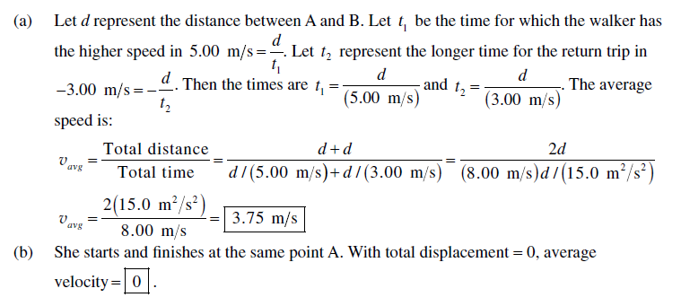
Solution

Slide 47
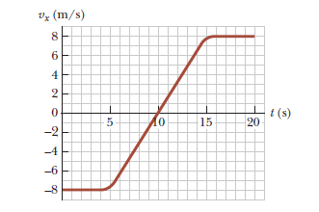
Example
13- A velocity–time graph for an object moving along the x axis is shown in NEXT Figure
a) Plot a graph of the acceleration versus time.
Determine the average acceleration of the Object
(b) in the time interval t = 5.00 s to t = 15.0 s and
(c) in the time interval t = 0 to t = 20.0 s.

Slide 48
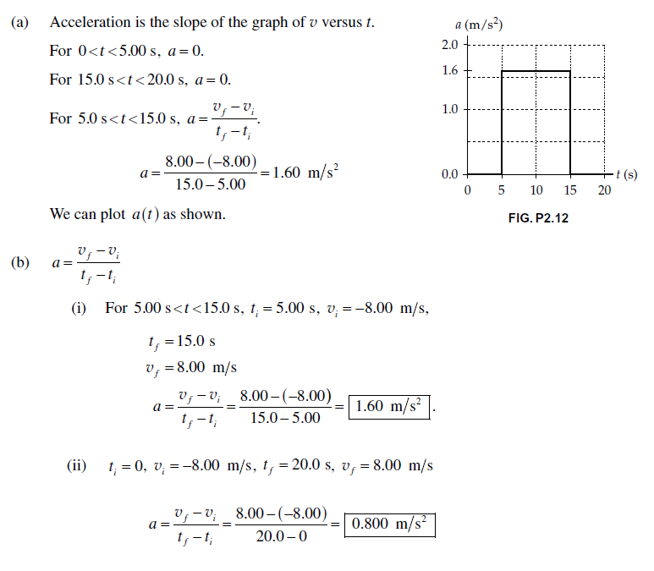

Slide 49
Example
18- An object moves along the x axis according to the equation x = 3.00t ² - 2.00t + 3.00,
where x is in meters and t is in seconds. Determine
(a) the average speed between t = 2.00 s and t = 3.00 s, (b) the instantaneous speed at t = 2.00 s and at t = 3.00 s,
(c) the average acceleration between t = 2.00 s and t = 3.00 s, and
(d) the instantaneous acceleration at t = 2.00 s and t = 3.00 s.

Slide 50
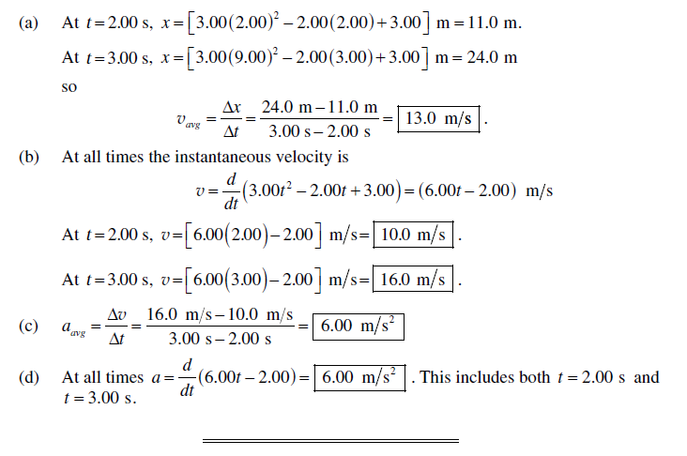

Slide 51
Example
32- A particle moves along the x axis. Its position is given by the equation
x = 2 + 3t - 4t ²,
with x in meters and t in seconds. Determine (a) its position when it changes direction and
(b) its velocity when it returns to the position it had at t =0.

Slide 52
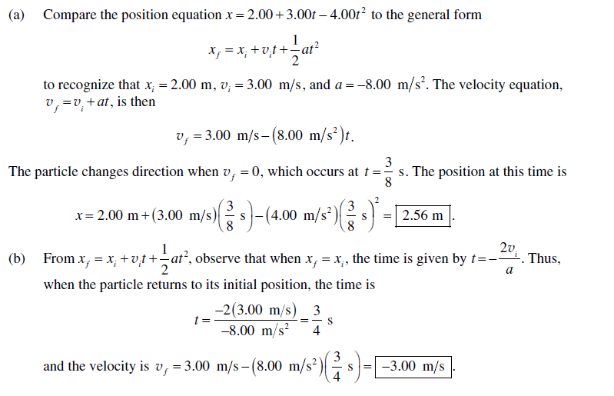

Slide 53
Example
Speedy Sue, driving at 30.0 m/s, enters a one-lane tunnel. She then observes a slow-moving van 155 m ahead traveling at 5.00 m/s. Sue applies her brakes but can accelerate only at -2.00 m/s² because the road is wet. Will there be a collision? If yes,
determine how far into the tunnel and at what time the collision occurs. If no,
determine the distance of closest approach between Sue’s car and the van.

Slide 54
