Slide 1
General Physics (1) For Engineering
Textbook:
Physics for Scientists and Engineers, seventh edition, Jewett / Serway
Dr. Awos Alsalman

Slide 2
Chapter 3
Vectors

Slide 3
Coordinate Systems
Used to describe the position of a point in space
Coordinate system consists of
  A fixed reference point called the origin
  Specific axes with scales and labels
  Instructions on how to label a point relative to the origin and the axes

Slide 4
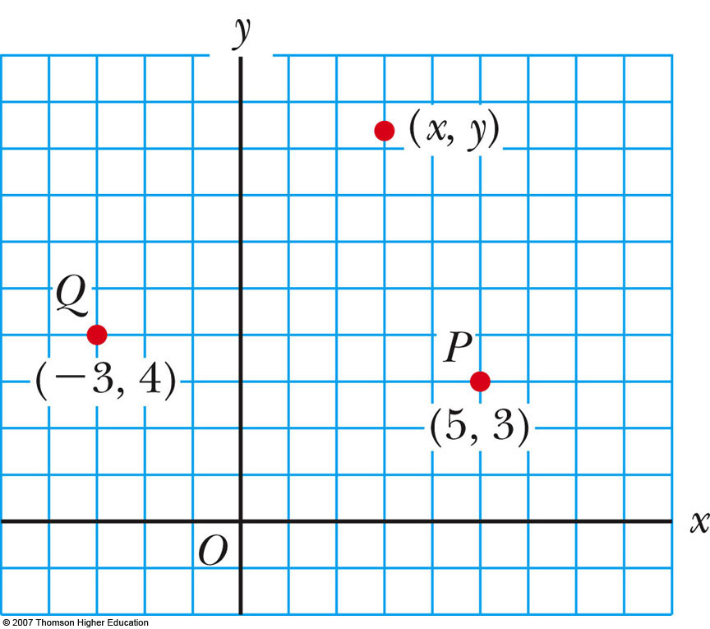
Cartesian Coordinate System
Also called rectangular coordinate system
x- and y- axes intersect at the origin
Points are labeled (x,y)

Slide 5
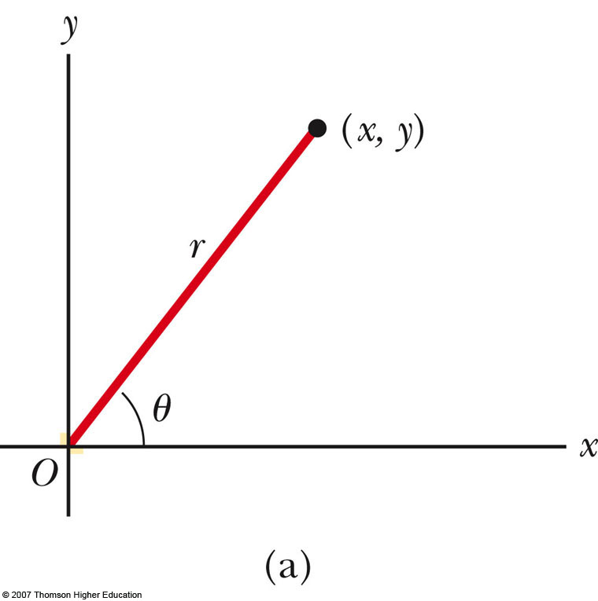
Polar Coordinate System (r, θ)
  r is the distance from the origin to the point having Cartesian coordinates (x,y).
  θ is the angle between a fixed axis (+x axis) and a line drawn from the origin to the point. θ usually measured counterclockwise
  Origin and reference line are noted
  Points are labeled (r,θ)

Slide 6
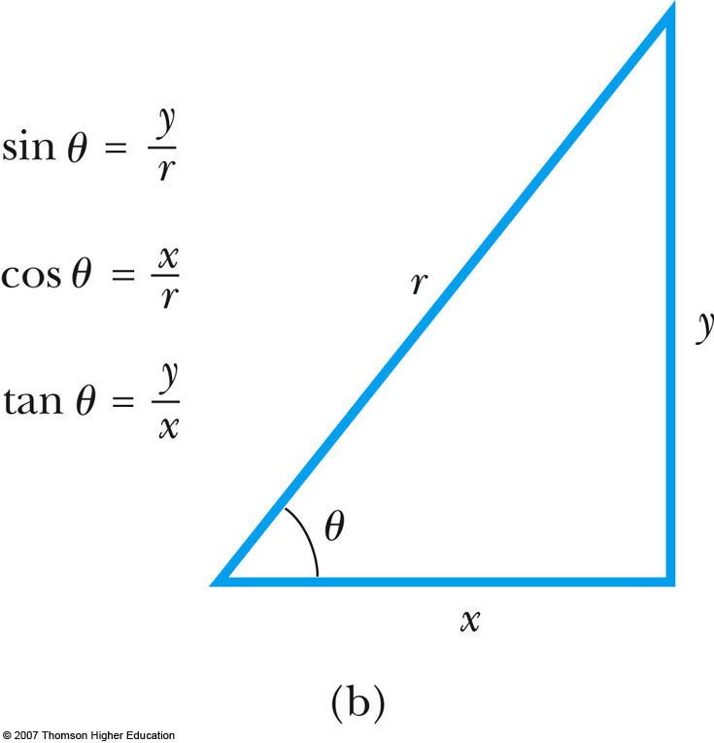
Polar to Cartesian Coordinates
Based on forming a right triangle from r and θ
x = r cos θ
y = r sin θ

Slide 7
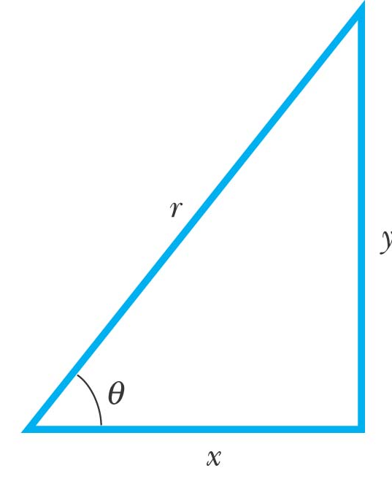
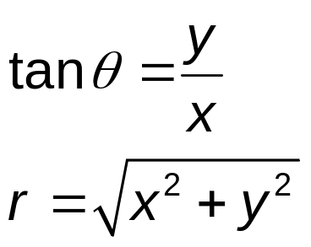
Cartesian to Polar Coordinates
r is the hypotenuse and θ an angle
θ must be counterclockwise from positive x axis for these equations to be valid

Slide 8
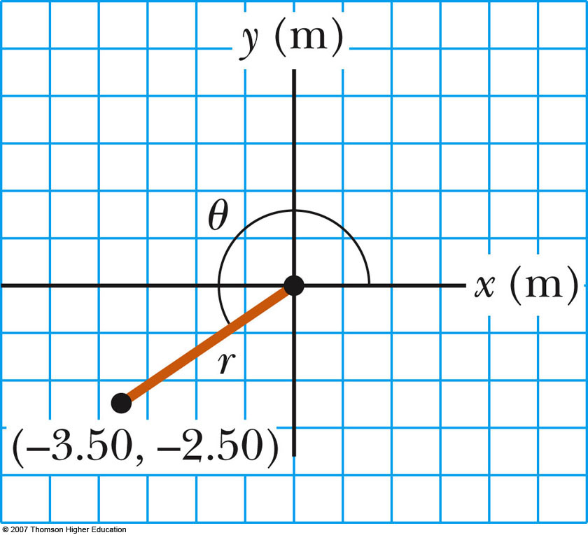
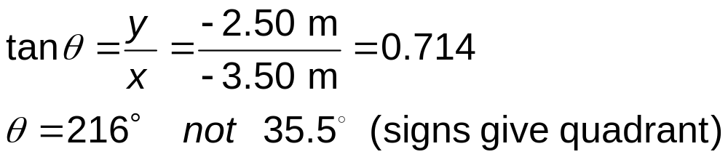
Example 3.1
The Cartesian coordinates of a point in the xy plane are (x,y) = (-3.50, -2.50) m, as shown in the figure. Find the polar coordinates of this point.
Solution: From Equation 3.4,
and from Equation 3.3,

Slide 9
Example 3.1, cont.
Change the point in the x-y plane
Note its Cartesian coordinates
Note its polar coordinates
Please insert active fig. 3.3 here

Slide 10
Vectors and Scalars
A scalar quantity is completely specified by a single value with an appropriate unit and has no direction.
A vector quantity is completely described by a number and appropriate units plus a direction.

Slide 11
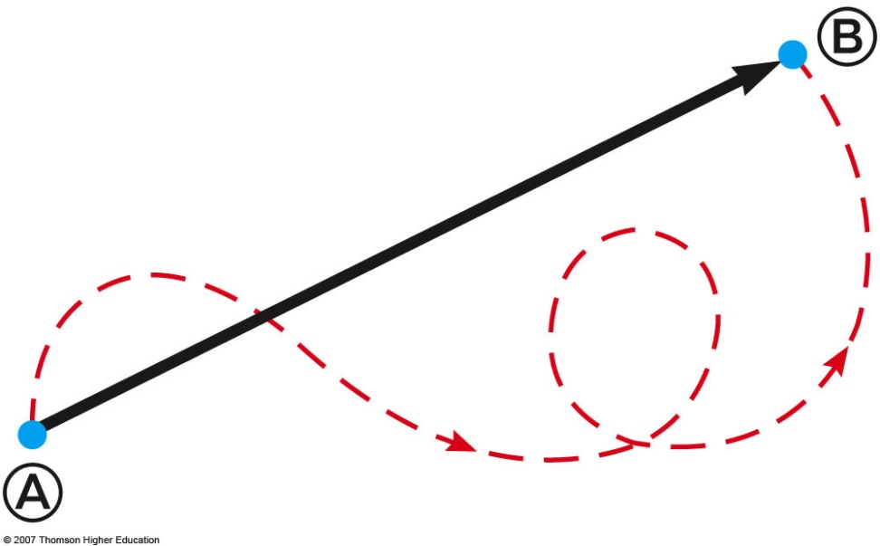
Vector Example
A particle travels from A to B along the path shown by the dotted red line
  This is the distance traveled and is a scalar
The displacement is the solid line from A to B
  The displacement is independent of the path taken between the two points
  Displacement is a vector

Slide 12


Vector Notation
Text uses bold with arrow to denote a vector:
Also used for printing is simple bold print: A
When dealing with just the magnitude of a vector in print, an italic letter will be used: A or
| |
  The magnitude of the vector has physical units
  The magnitude of a vector is always a positive number
When handwritten, use an arrow:

Slide 13
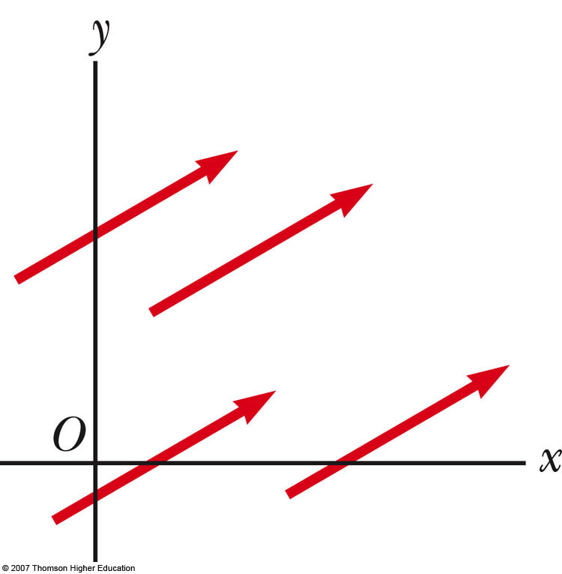
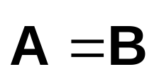
Equality of Two Vectors
Two vectors are equal if they have the same magnitude and the same direction
if A = B and they point along parallel lines
All of the vectors shown are equal

Slide 14
Adding Vectors
When adding vectors, their directions must be taken into account
Units must be the same
Graphical Methods
  Use scale drawings
Algebraic Methods
  More convenient

Slide 15
Adding Vectors Graphically
Choose a scale
Draw the first vector, , with the appropriate length and in the direction specified, with respect to a coordinate system
Draw the next vector with the appropriate length and in the direction specified, with respect to a coordinate system whose origin is the end of vector

Slide 16
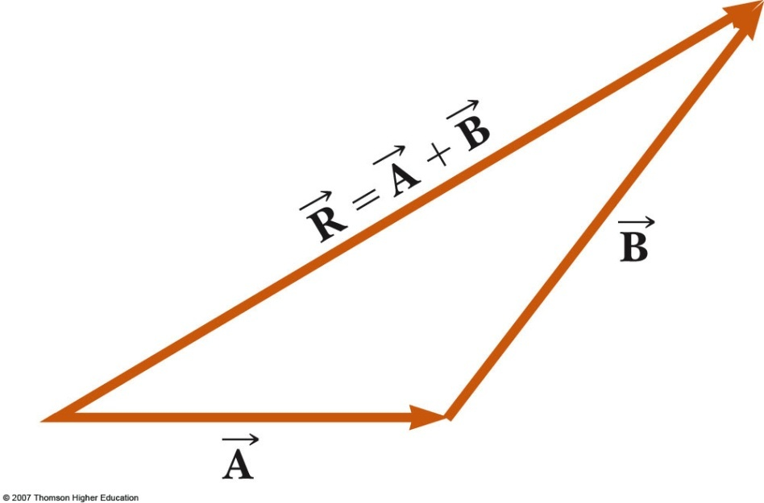

Adding Vectors Graphically, cont.
Continue drawing the vectors “tip-to-tail”
The resultant is drawn from the origin of to the end of the last vector
Measure the length of and its angle
  Use the scale factor to convert length to actual magnitude

Slide 17
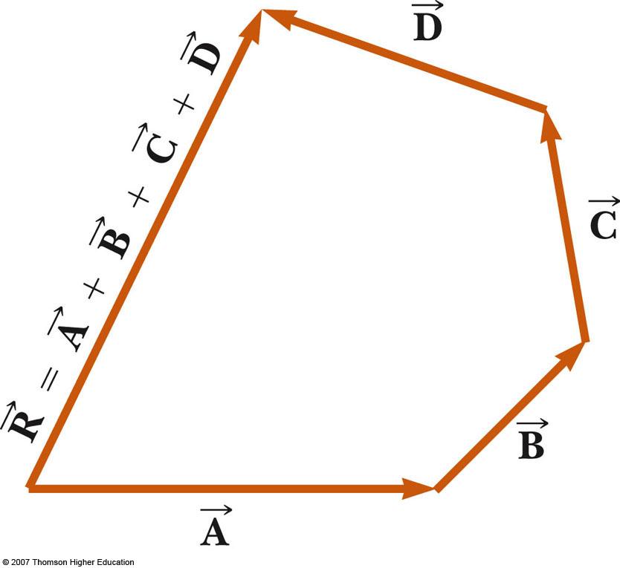
Adding Vectors Graphically, final
When you have many vectors, just keep repeating the process until all are included
The resultant is still drawn from the tail of the first vector to the tip of the last vector

Slide 18
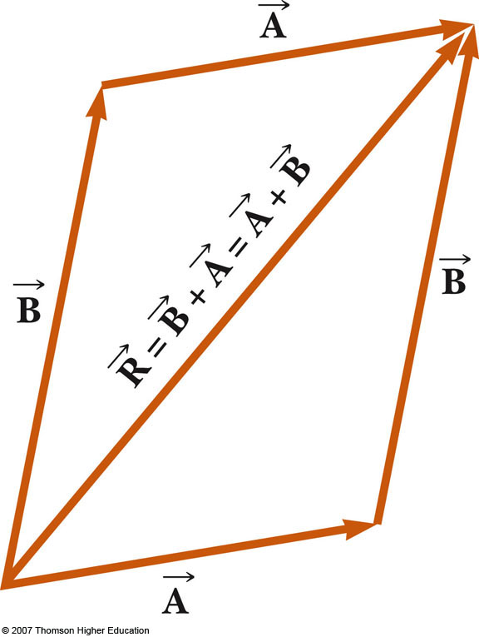
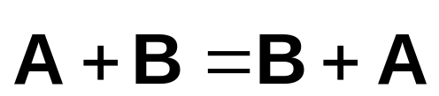
Adding Vectors, Rules
When two vectors are added, the sum is independent of the order of the addition.
  This is the Commutative Law of Addition

Slide 19
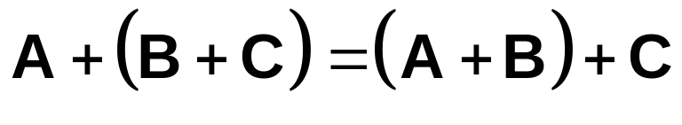
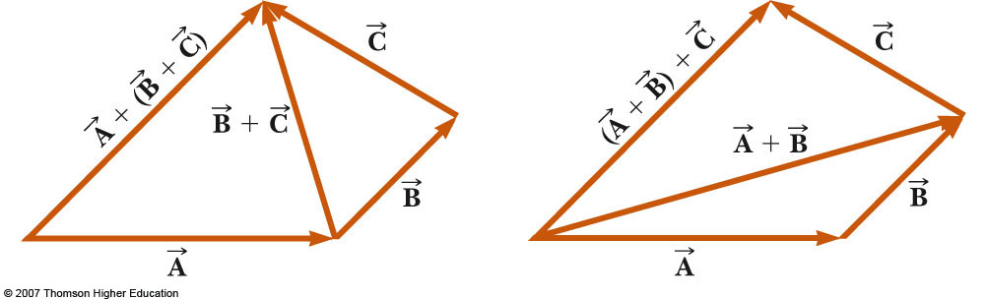
Adding Vectors, Rules cont.
When adding three or more vectors, their sum is independent of the way in which the individual vectors are grouped
  This is called the Associative Property of Addition

Slide 20
Adding Vectors, Rules final
When adding vectors, all of the vectors must have the same units
All of the vectors must be of the same type of quantity
  For example, you cannot add a displacement to a velocity

Slide 21
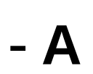
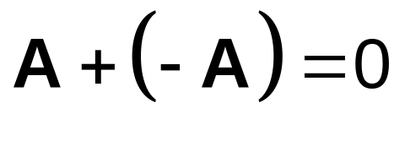
Negative of a Vector
The negative of a vector is defined as the vector that, when added to the original vector, gives a resultant of zero
  Represented as
The negative of the vector will have the same magnitude, but point in the opposite direction

Slide 22

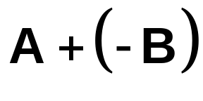
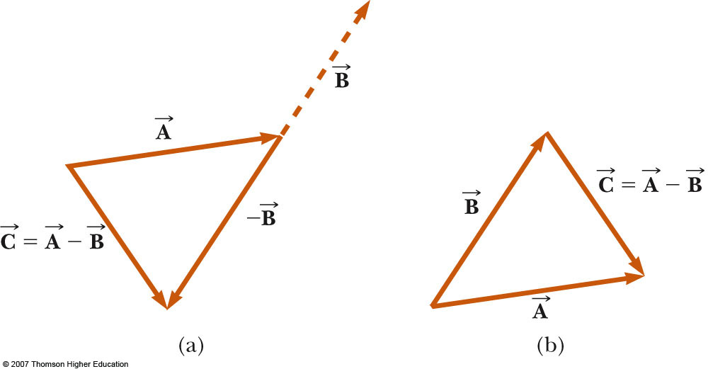
Subtracting Vectors
Special case of vector addition
If , then use
Continue with standard vector addition procedure

Slide 23
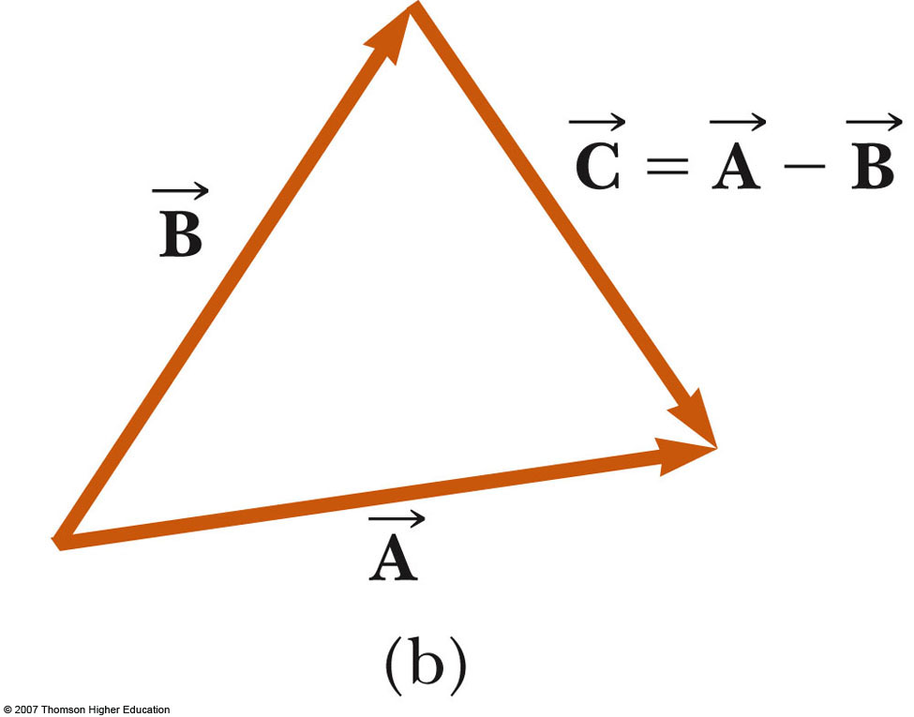
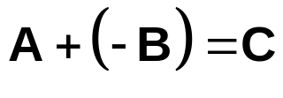
Subtracting Vectors, Method 2
Another way to look at subtraction is to find the vector that, added to the second vector gives you the first vector
  As shown, the resultant vector points from the tip of the second to the tip of the first

Slide 24
Multiplying or Dividing a Vector by a Scalar
The result of the multiplication or division of a vector by a scalar is a vector
The magnitude of the vector is multiplied or divided by the scalar
If the scalar is positive, the direction of the result is the same as of the original vector
If the scalar is negative, the direction of the result is opposite that of the original vector

Slide 25
Component Method of Adding Vectors
Graphical addition is not recommended when
  High accuracy is required
  If you have a three-dimensional problem
Component method is an alternative method
  It uses projections of vectors along coordinate axes

Slide 26
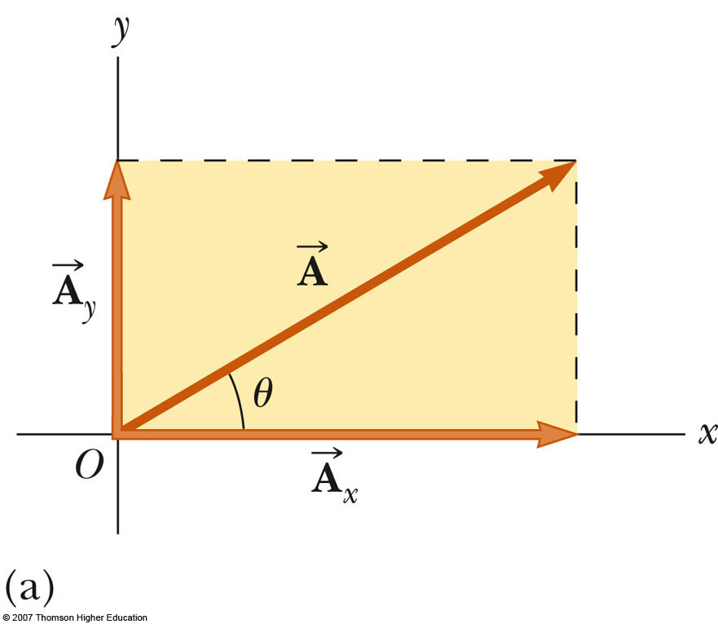
Components of a Vector, Introduction
A component is a projection of a vector along an axis
  Any vector can be completely described by its components
It is useful to use rectangular components
  These are the projections of the vector along the x- and y-axes

Slide 27
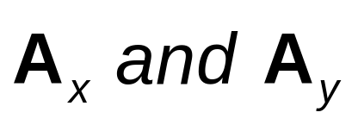
Vector Component Terminology
are the component vectors of
  They are vectors and follow all the rules for vectors
A_{x} and A_{y} are scalars, and will be referred to as the components of

Slide 28
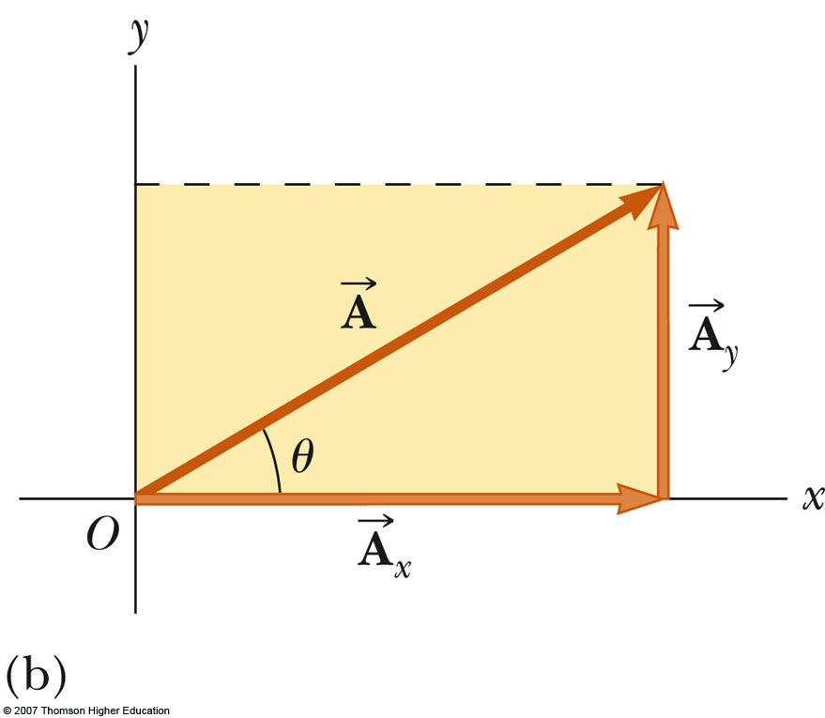
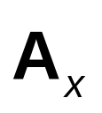
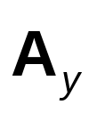
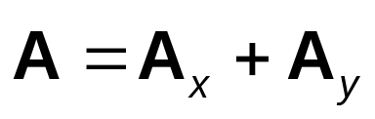
Components of a Vector
Assume you are given a vector
It can be expressed in terms of two other vectors, and
These three vectors form a right triangle

Slide 29
Components of a Vector, 2
The y-component is moved to the end of the x-component
This is due to the fact that any vector can be moved parallel to itself without being affected
  This completes the triangle

Slide 30
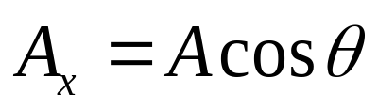
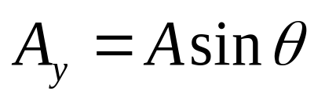
Components of a Vector, 3
The x-component of a vector is the projection along the x-axis
The y-component of a vector is the projection along the y-axis
This assumes the angle θ is measured with respect to the x-axis
  If not, do not use these equations, use the sides of the triangle directly

Slide 31
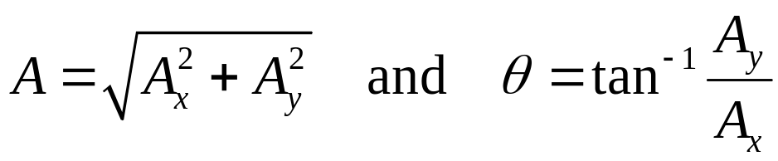
Components of a Vector, 4
The components are the legs of the right triangle whose hypotenuse is the length of A
  May still have to find θ with respect to the positive x-axis

Slide 32
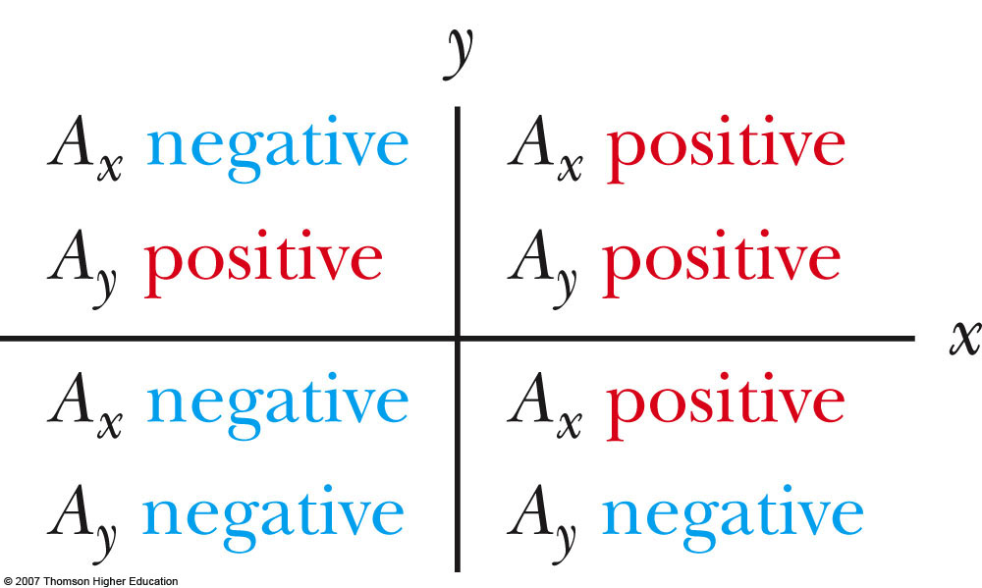
Components of a Vector, final
The components can be positive or negative and will have the same units as the original vector
The signs of the components will depend on the angle

Slide 33
Unit Vectors
A unit vector is a dimensionless vector with a magnitude of exactly 1.
Unit vectors are used to specify a direction and have no other physical significance

Slide 34
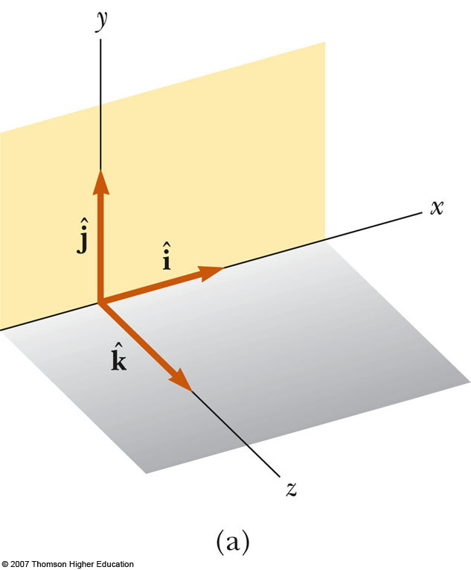
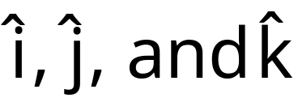
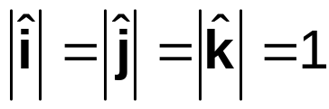
Unit Vectors, cont.
The symbols
represent unit vectors
They form a set of mutually perpendicular vectors in a right-handed coordinate system
Remember,

Slide 35
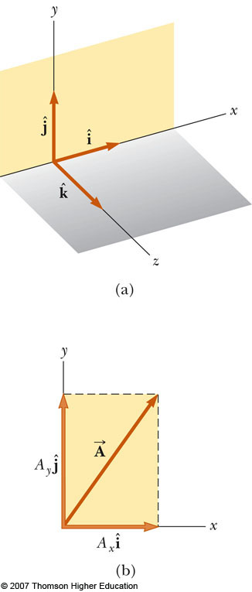
Viewing a Vector and Its Projections
Rotate the axes for various views
Study the projection of a vector on various planes
  x, y
  x, z
  y, z

Slide 36

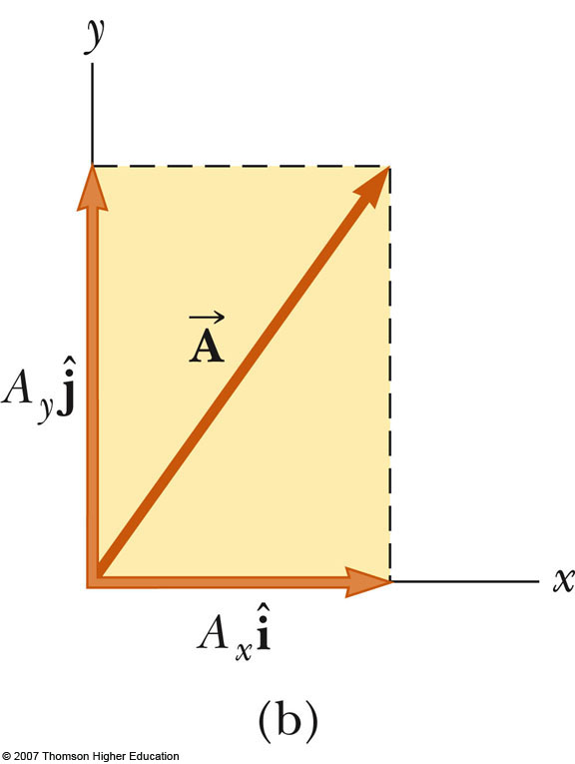

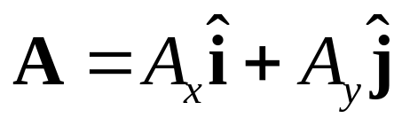
Unit Vectors in Vector Notation
A_{x} is the same as A_{x} and A_{y} is the same as A_{y} etc.
The complete vector can be expressed as

Slide 37
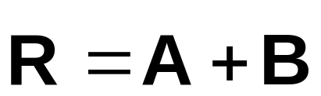
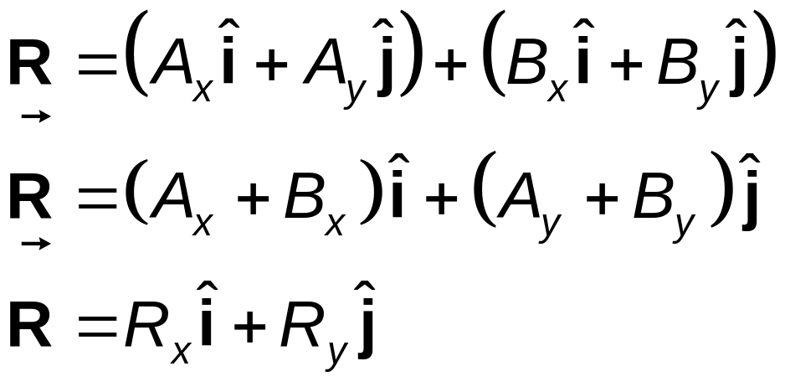
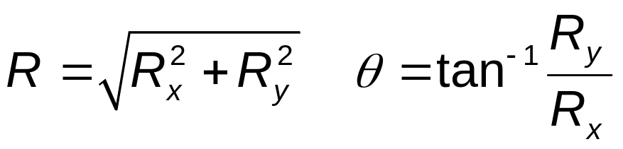
Adding Vectors Using Unit Vectors
Using
Then
and so R_{x} = A_{x} + B_{x} and R_{y} = A_{y} + B_{y}

Slide 38
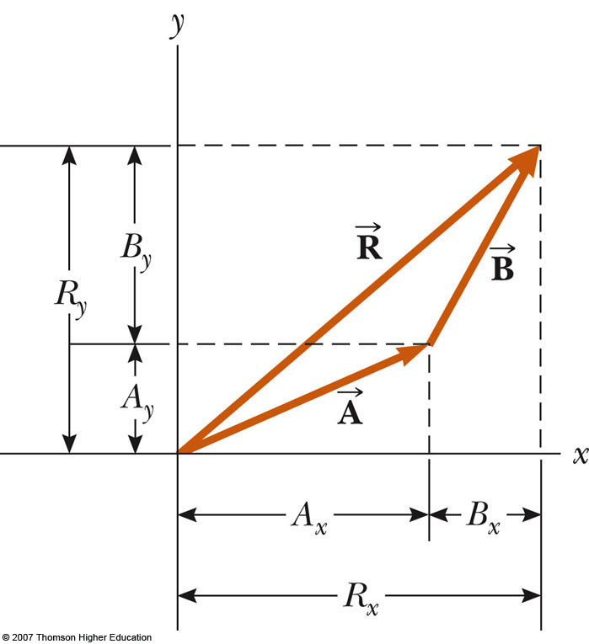
Adding Vectors with Unit Vectors
Note the relationships among the components of the resultant and the components of the original vectors
R_{x} = A_{x} + B_{x}
R_{y} = A_{y} + B_{y}

Slide 39
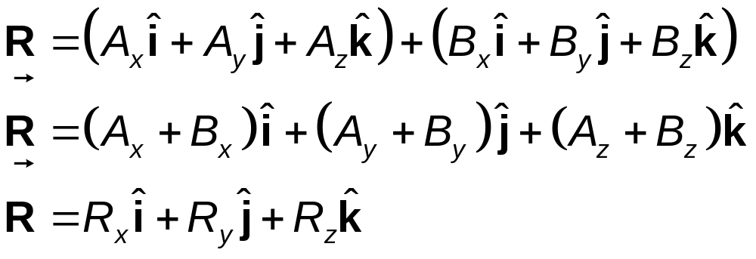
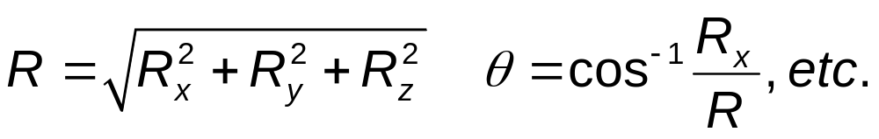
Three-Dimensional Extension
Using
Then
and so R_{x}= A_{x}+B_{x}, R_{y}= A_{y}+B_{y}, and R_{z} =A_{x}+B_{z}

Slide 40


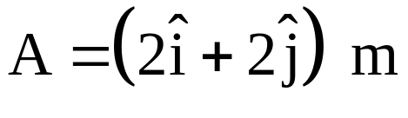
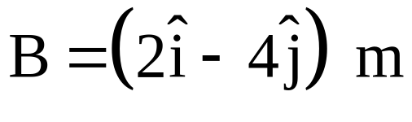
Example 3.3
Find the sum of two vectors and lying in the xy plane and given by

Slide 41
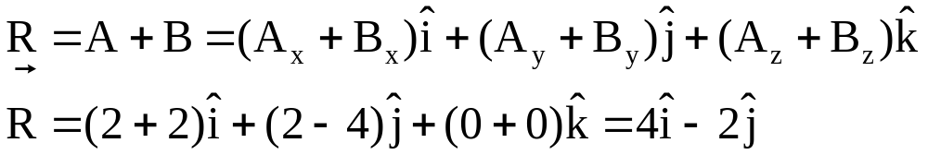
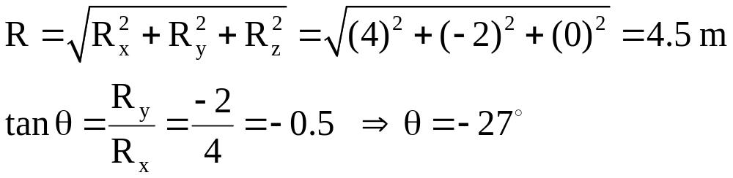
Example 3.3, Solution:

Slide 42
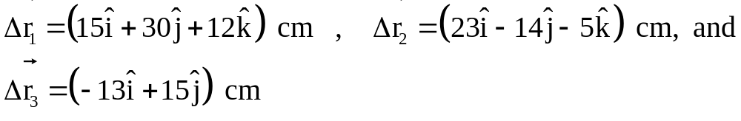
Example 3.4
Aparticle undergoes three consecutive displacements:
Find the components of the resultant displacement and its magnitude.

Slide 43
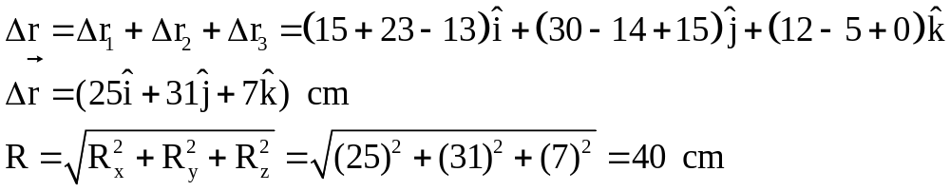
Example 3.4, Solution:

Slide 44
Example 3.5 – Taking a Hike
A hiker begins a trip by first walking 25.0 km southeast from her car. She stops and sets up her tent for the night. On the second day, she walks 40.0 km in a direction 60.0° north of east, at which point she discovers a forest ranger’s tower.

Slide 45


Example 3.5
(A) Determine the components of the hiker’s displacement for each day.
Solution: We conceptualize the problem by drawing a sketch as in the figure above. If we denote the displacement vectors on the first and second days by and respectively, and use the car as the origin of coordinates, we obtain the vectors shown in the figure. Drawing the resultant , we can now categorize this problem as an addition of two vectors.

Slide 46

Example 3.5
We will analyze this problem by using our new knowledge of vector components. Displacement has a magnitude of 25.0 km and is directed 45.0° below the positive x axis.
From Equations 3.8 and 3.9, its components are:
The negative value of A_{y} indicates that the hiker walks in the negative y direction on the first day. The signs of A_{x} and A_{y} also are evident from the figure above.

Slide 47

Example 3.5
The second displacement has a magnitude of 40.0 km and is 60.0° north of east.
Its components are:

Slide 48

Example 3.5
(B) Determine the components of the hiker’s resultant displacement for the trip. Find an expression for in terms of unit vectors.
Solution: The resultant displacement for the trip has components given by Equation 3.15:
R_{x} = A_{x} + B_{x} = 17.7 km + 20.0 km = 37.7 km
R_{y} = A_{y} + B_{y} = -17.7 km + 34.6 km = 16.9 km
In unit-vector form, we can write the total displacement as

Slide 49
Example 3.5
Using Equations 3.16 and 3.17, we find that the resultant vector has a magnitude of 41.3 km and is directed 24.1° north of east.
Let us finalize. The units of are km, which is reasonable for a displacement. Looking at the graphical representation in the figure above, we estimate that the final position of the hiker is at about (38 km, 17 km) which is consistent with the components of in our final result. Also, both components of are positive, putting the final position in the first quadrant of the coordinate system, which is also consistent with the figure.

Slide 50


Slide 51



Scalar Product of Two Vectors
Page: 167
The scalar product of two vectors is written as
  It is also called the dot product
  θ is the angle between A and B

Slide 52


Scalar Product, cont
The scalar product is commutative
The scalar product obeys the distributive law of multiplication

Slide 53


Dot Products of Unit Vectors
Using component form with vectors:

Slide 54



Slide 55



Example 7.2
The vectors and are given by
(A) Determine the scalar product
(B) Find the angle θ between and

Slide 56

Example 7.2, Solution:

Slide 57


Slide 58


Slide 59
The Vector Product
Page: 311
There are instances where the product of two vectors is another vector
  Earlier we saw where the product of two vectors was a scalar
    This was called the dot product
The vector product of two vectors is also called the cross product

Slide 60



The Vector Product Defined
Given two vectors, and
The vector (cross) product of and is defined as a third vector,
  C is read as “A cross B”
The magnitude of vector C is AB sin θ
  θ is the angle between and

Slide 61


More About the Vector Product
The quantity AB sin θ is equal to the area of the parallelogram formed by and
The direction of is perpendicular to the plane formed by and
The best way to determine this direction is to use the right-hand rule

Slide 62



Properties of the Vector Product
The vector product is not commutative. The order in which the vectors are multiplied is important
  To account for order, remember
If is parallel to (θ = 0º or 180º), then
  Therefore

Slide 63


More Properties of the Vector Product
If is perpendicular to , then
The vector product obeys the distributive law

Slide 64

Final Properties of the Vector Product
The derivative of the cross product with respect to some variable such as t is
where it is important to preserve the multiplicative order of and

Slide 65

Vector Products of Unit Vectors

Slide 66


Vector Products of Unit Vectors, cont
Signs are interchangeable in cross products
  and

Slide 67

Using Determinants
The cross product can be expressed as
Expanding the determinants gives

Slide 68



Slide 69



Vector Product Example
Given
Find
Result

Slide 70



Slide 71

Example
The helicopter view in next Fig. shows two people pulling
on a stubborn mule.
Find (a) the single force that is equivalent to the two forces shown, and
(b) the force that a third person would have to exert on the mule to make the resultant force equal to zero. The forces are measured in units of Newtons (abbreviated N).

Slide 72


Slide 73

Example
A force F₁ of magnitude 6.00 units
acts on an object at the origin in a
direction Ɵ = 30.0° above the positive
x axis ( next Fig.). A second force F₂
of magnitude 5.00 units acts on the object in the direction of the positive y axis. Find graphically and analytically
the magnitude and direction
of the resultant force F

Slide 74

Solution

Slide 75


Slide 76

Solution

Slide 77

Example

