Slide 1
General Physics (1) For Engineering
Textbook:
Physics for Scientists and Engineers, seventh edition, Jewett / Serway
Dr. Awos Alsalman

Slide 2
Chapter 4
Motion in Two Dimensions

Slide 3
Motion in Two Dimensions
Using + or – signs is not always sufficient to fully describe motion in more than one dimension
  Vectors can be used to more fully describe motion
  Will look at vector nature of quantities in more detail
Still interested in displacement, velocity, and acceleration
Will serve as the basis of multiple types of motion in future chapters

Slide 4
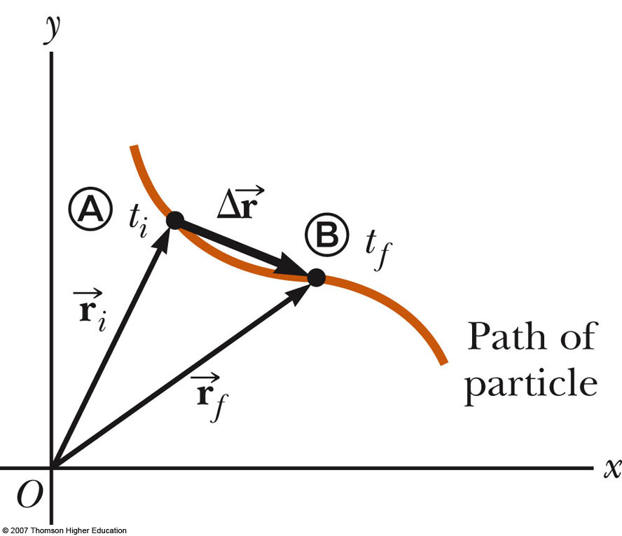

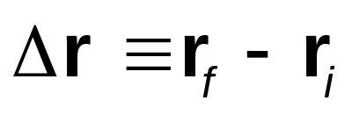
Position and Displacement
The position of an object is described by its position vector,
The displacement of the object is defined as the change in its position

Slide 5
General Motion Ideas
In two- or three-dimensional kinematics, everything is the same as as in one-dimensional motion except that we must now use full vector notation
  Positive and negative signs are no longer sufficient to determine the direction

Slide 6
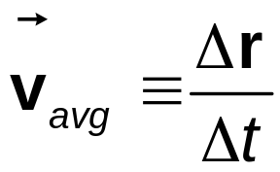
Average Velocity
The average velocity is the ratio of the displacement to the time interval for the displacement
The direction of the average velocity is the direction of the displacement vector
The average velocity between points is independent of the path taken
  This is because it is dependent on the displacement, also independent of the path

Slide 7
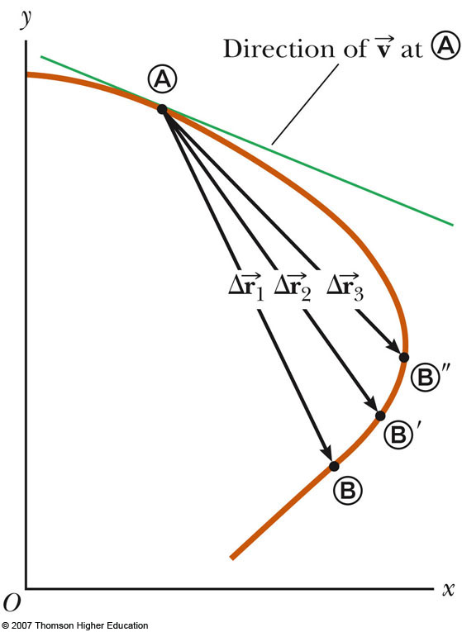
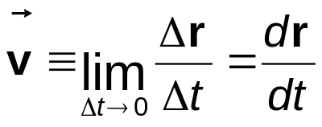
Instantaneous Velocity
The instantaneous velocity is the limit of the average velocity as Δt approaches zero
  As the time interval becomes smaller, the direction of the displacement approaches that of the line tangent to the curve

Slide 8
Instantaneous Velocity, cont
The direction of the instantaneous velocity vector at any point in a particle’s path is along a line tangent to the path at that point and in the direction of motion
The magnitude of the instantaneous velocity vector is the speed
  The speed is a scalar quantity

Slide 9
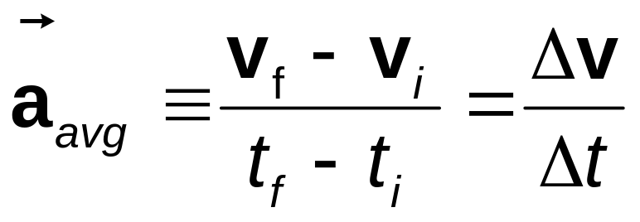
Average Acceleration
The average acceleration of a particle as it moves is defined as the change in the instantaneous velocity vector divided by the time interval during which that change occurs.

Slide 10
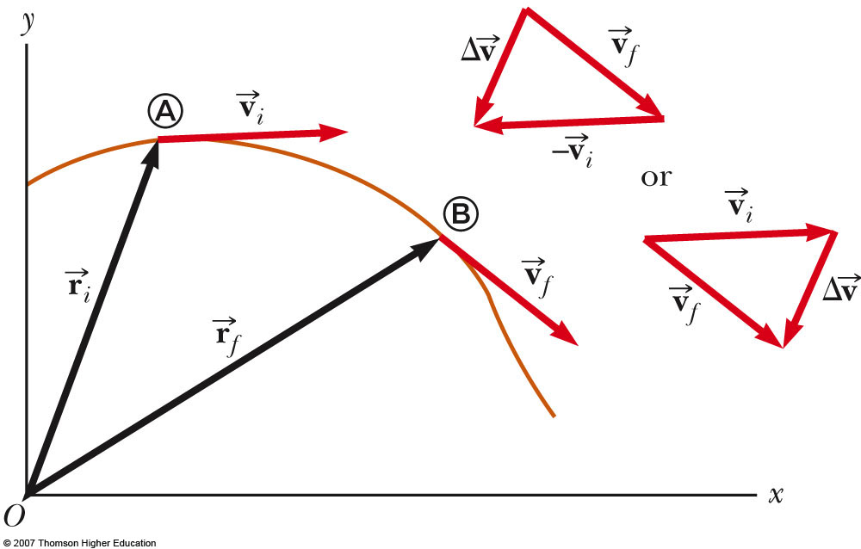
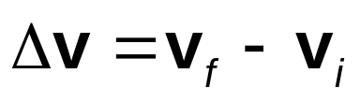

Average Acceleration, cont
As a particle moves, the direction of the change in velocity is found by vector subtraction
The average acceleration is a vector quantity directed along

Slide 11
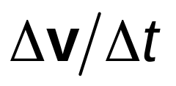
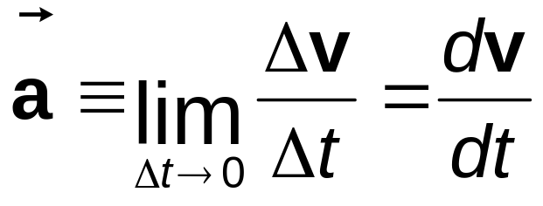
Instantaneous Acceleration
The instantaneous acceleration is the limiting value of the ratio as Δt approaches zero
  The instantaneous equals the derivative of the velocity vector with respect to time

Slide 12
Kinematic Equations for Two-Dimensional Motion
When the two-dimensional motion has a constant acceleration, a series of equations can be developed that describe the motion
These equations will be similar to those of one-dimensional kinematics
Motion in two dimensions can be modeled as two independent motions in each of the two perpendicular directions associated with the x and y axes
  Any influence in the y direction does not affect the motion in the x direction

Slide 13
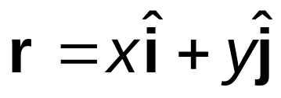
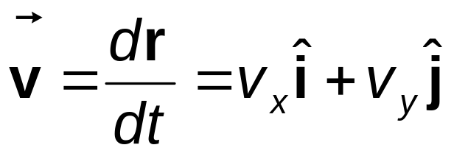
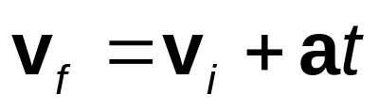
Kinematic Equations, 2
Position vector for a particle moving in the xy plane
The velocity vector can be found from the position vector
  Since acceleration is constant, we can also find an expression for the velocity as a function of time:

Slide 14
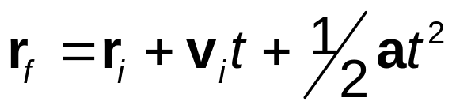
Kinematic Equations, 3
The position vector can also be expressed as a function of time:
  This indicates that the position vector is the sum of three other vectors:
    The initial position vector
    The displacement resulting from the initial velocity
    The displacement resulting from the acceleration

Slide 15
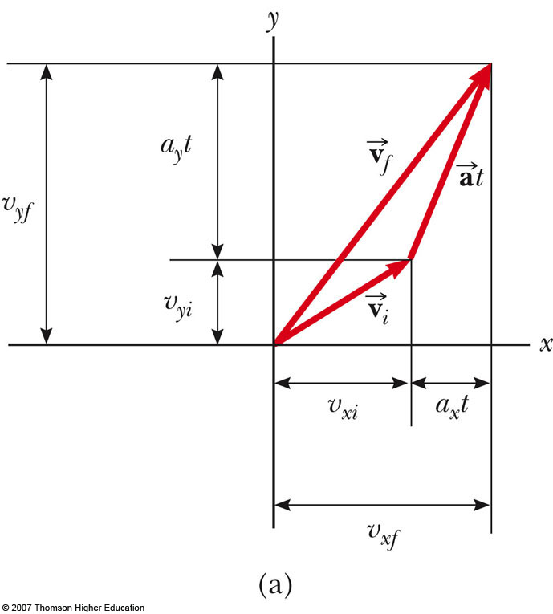



Kinematic Equations, Graphical Representation of Final Velocity
The velocity vector can be represented by its components
is generally not along the direction of either or

Slide 16
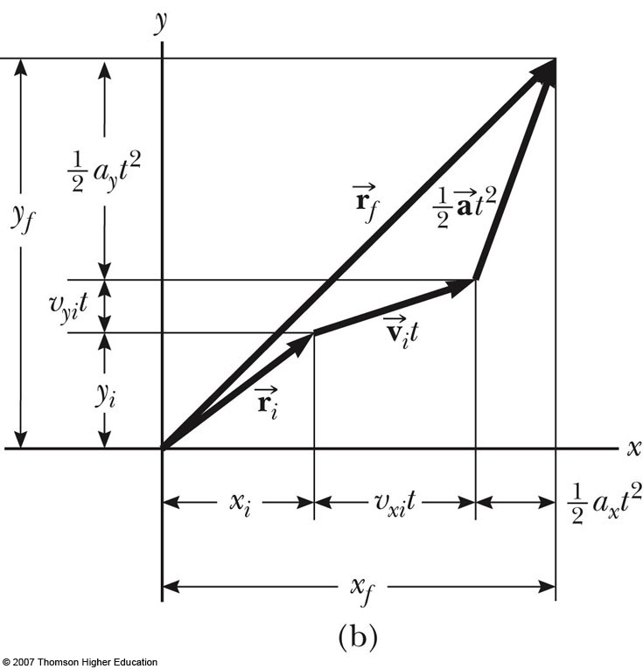

Kinematic Equations, Graphical Representation of Final Position
The vector representation of the position vector
is generally not along the same direction as or as
and are generally not in the same direction

Slide 17
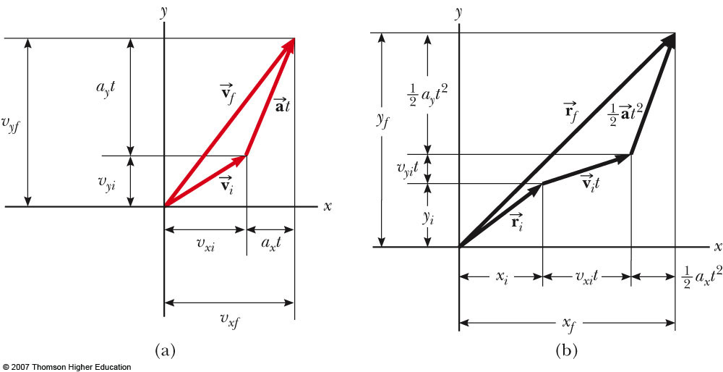
Graphical Representation Summary
Various starting positions and initial velocities can be chosen
Note the relationships between changes made in either the position or velocity and the resulting effect on the other

Slide 18
Example 4.1 Motion in a Plane
A particle starts from the origin at t=0 with an initial velocity having an x component of 20 m/s and a y component of -15 m/s. The particle moves in the xy plane with an x component of acceleration only, given by a_{x}=4.0 m/s².
(A) Determine the total velocity at any time.
(B) Calculate the velocity and speed of the particle at t=5.0 s.
(C) Determine the x and y coordinates of the particle at any time t and its position vector at this time

Slide 19
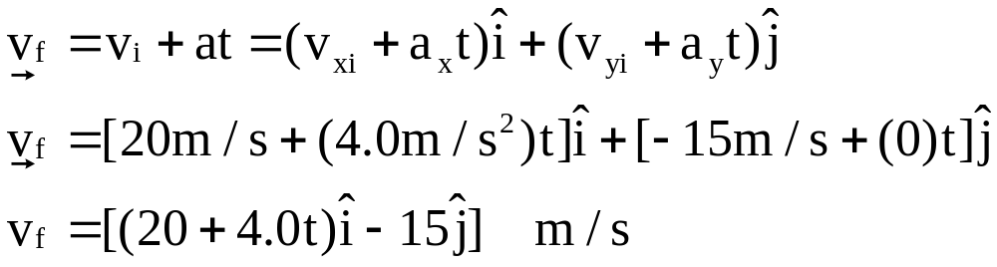
Solution
(A) Determine the total velocity at any time.

Slide 20
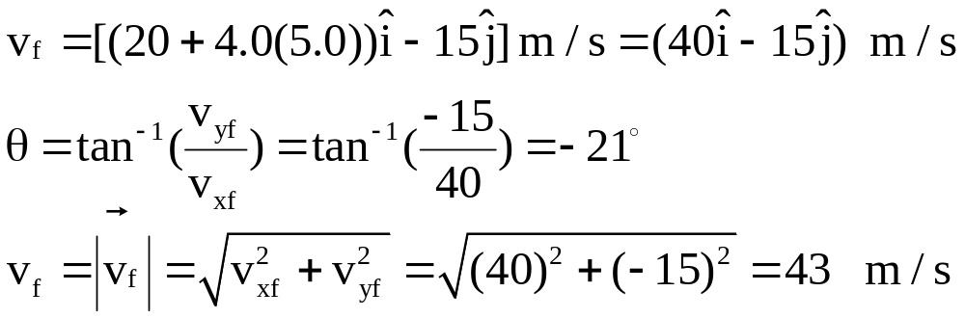
Example 4.1 Motion in a Plane
(B) Calculate the velocity and speed of the particle at t=5.0 s.

Slide 21
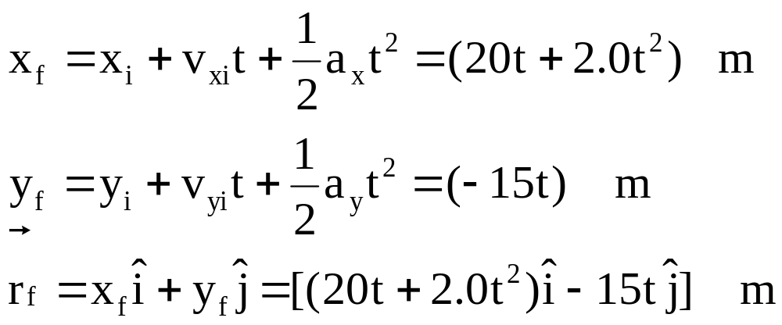
Example 4.1 Motion in a Plane
(C) Determine the x and y coordinates of the particle at any time t and its position vector at this time

Slide 22
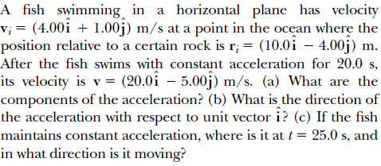
Example

Slide 23
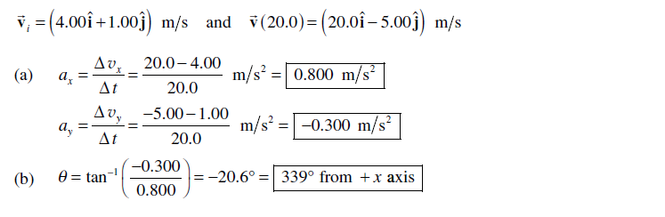
solution

Slide 24
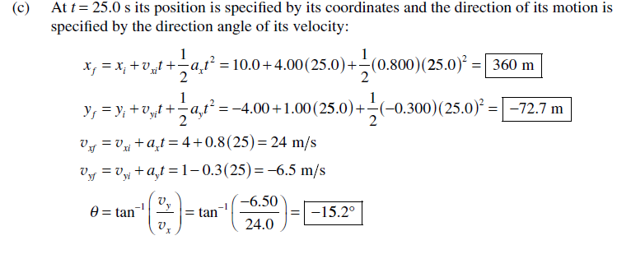
solution

Slide 25
A car moving in xy-plane. This car has x- and y-coordinates that vary with time ( t) according to: x(t)= 4t-0.75t³
and ; y(t)=-t²-0.03t³
where x and y in meter and t in second.
Find the car position (r ) at t=2 s.
Find the Displacement of the car during time intervals from t=0 s to t=1 s.
Find the average velocity of the car during time intervals from t=0 s to t=1 s.
Find the average acceleration of the car during time intervals from t=0s to t=1s.
Find the magnitude of the instantaneous velocity of the car at t=2 s.
Find the magnitude of the instantaneous acceleration of the car at t=2 s.

Slide 26
Example
A particle initially located at the origin has an acceleration of a=3.00j m/s²
and an initial velocity of v_{i}=5.00i m/s.
Find (a) the vector position of the particle at any time t,
(b) the velocity of the particle at any time t,
(c) the coordinates of the particle at t = 2.00 s, and
(d) the speed of the particle at t = 2.00 s.

Slide 27
