Slide 1
General Physics (1) For Engineering
Textbook:
Physics for Scientists and Engineers, seventh edition, Jewett / Serway
Dr. Awos Alsalman
IUST-2008/2009-Physics I

Slide 2
Chapter 5
The Laws of Motion
IUST-2008/2009-Physics I

Slide 3
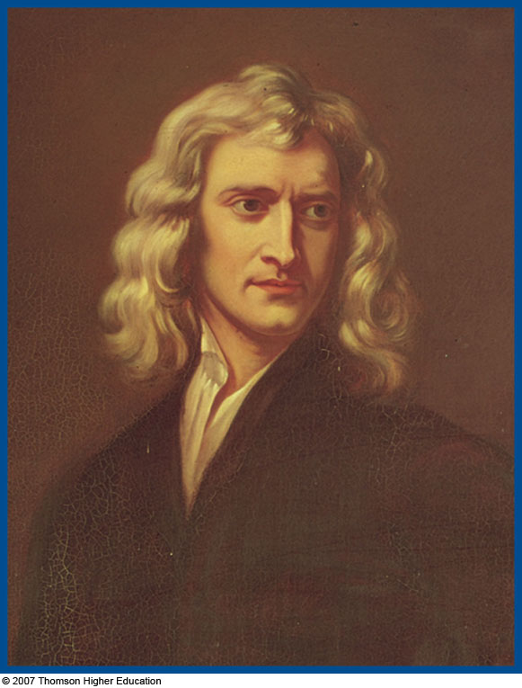
Sir Isaac Newton
1642 – 1727
Formulated basic laws of mechanics
Discovered Law of Universal Gravitation
Invented form of calculus
Many observations dealing with light and optics
IUST-2008/2009-Physics I

Slide 4
Force
Forces are what cause any change in the velocity of an object
  Newton’s definition
  A force is that which causes an acceleration
IUST-2008/2009-Physics I

Slide 5
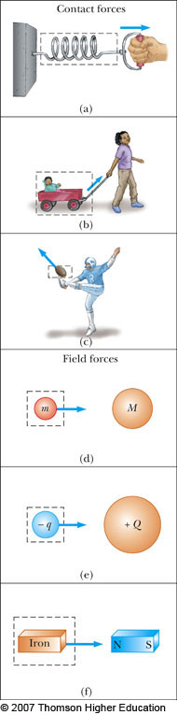
Classes of Forces
Contact forces involve physical contact between two objects
  Examples a, b, c
Field forces act through empty space
  No physical contact is required
  Examples d, e, f
IUST-2008/2009-Physics I

Slide 6
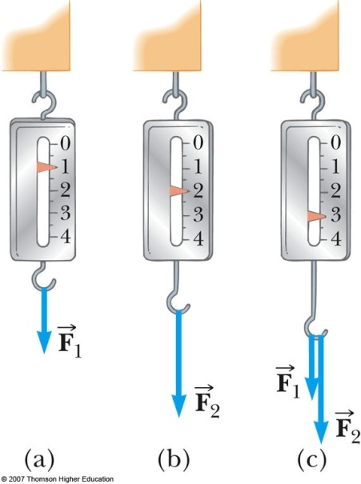
More About Forces
A spring can be used to calibrate the magnitude of a force
Doubling the force causes double the reading on the spring
When both forces are applied, the reading is three times the initial reading
IUST-2008/2009-Physics I

Slide 7
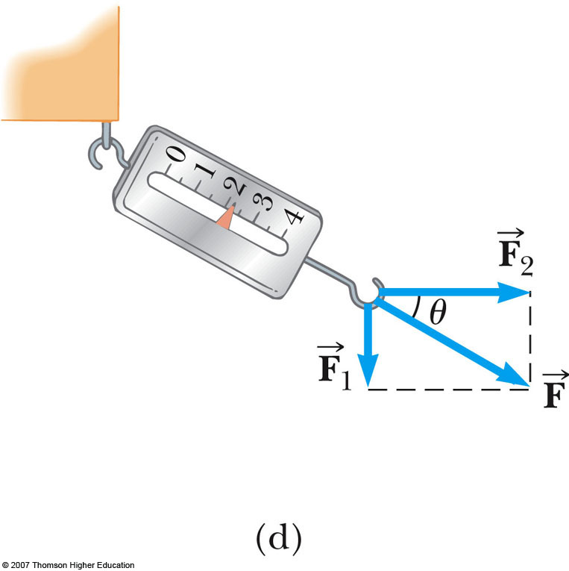
Vector Nature of Forces
The forces are applied perpendicularly to each other
The resultant (or net) force is the hypotenuse
Forces are vectors, so you must use the rules for vector addition to find the net force acting on an object
IUST-2008/2009-Physics I

Slide 8
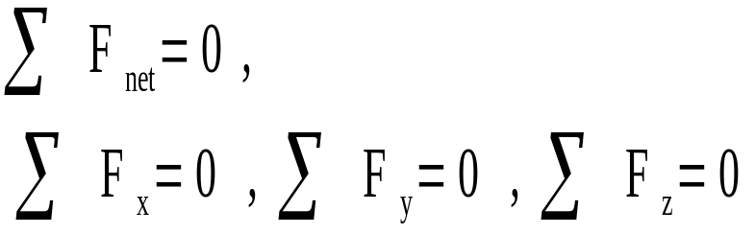
Newton’s First Law – Alternative Statement
In the absence of external forces, an object at rest remains at rest and an object in motion continues in motion with a constant velocity
  Newton’s First Law describes what happens in the absence of a force
    Does not describe zero net force
  Also tells us that when no force acts on an object, the acceleration of the object is zero
IUST-2008/2009-Physics I

Slide 9
Mass
Mass is a scalar quantity
The SI unit of mass is kg
IUST-2008/2009-Physics I

Slide 10
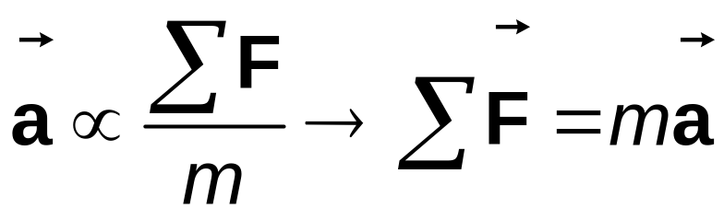
Newton’s Second Law
The acceleration of an object is directly proportional to the net force acting on it and inversely proportional to its mass
  Force is the cause of change in motion, as measured by the acceleration
Algebraically,
  With a proportionality constant of 1 and speeds much lower than the speed of light
IUST-2008/2009-Physics I

Slide 11
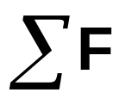
More About Newton’s Second Law
is the net force
  This is the vector sum of all the forces acting on the object
Newton’s Second Law can be expressed in terms of components:
  ΣF_{x} = m a_{x}
  ΣF_{y} = m a_{y}
  ΣF_{z} = m a_{z}
IUST-2008/2009-Physics I

Slide 12
Units of Force
The SI unit of force is the newton (N)
  1 N = 1 kg·m / s²
The US Customary unit of force is a pound (lb)
  1 lb = 1 slug·ft / s²
1 N ~ ¼ lb
IUST-2008/2009-Physics I

Slide 13
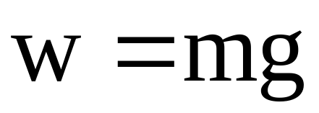
Mass vs. Weight
Mass and weight are two different quantities
Weight is equal to the magnitude of the gravitational force exerted on the object
  Weight will vary with location
IUST-2008/2009-Physics I

Slide 14
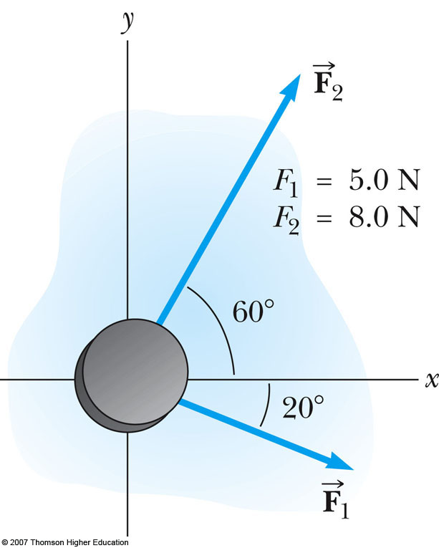
Example 5.1
A hockey puck having a mass of 0.30 kg slide on a horizontal, frictionless surface of an ice rink. Two hockey sticks strike the puck simultaneously, exerting the forces on the puck shown in figure 5.4. The force F₁ has a magnitude of 5.0 N, and the force F₂ has a magnitude of 8.0 N. Determine both the magnitude and the direction of the puck’s acceleration
IUST-2008/2009-Physics I

Slide 15
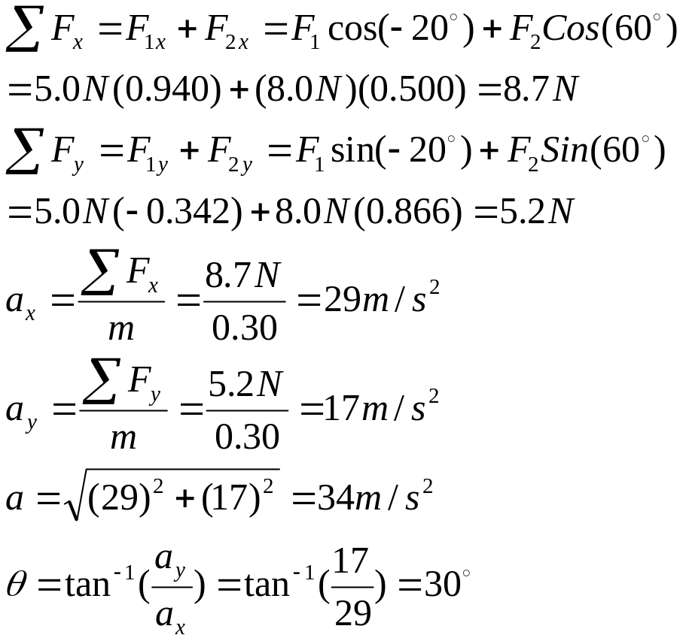
Example 5.1
IUST-2008/2009-Physics I

Slide 16

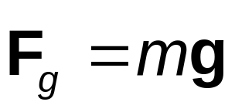
Gravitational Force
The gravitational force, , is the force that the earth exerts on an object
This force is directed toward the center of the earth
From Newton’s Second Law
Its magnitude is called the weight of the object
  Weight = F_{g}= mg
IUST-2008/2009-Physics I

Slide 17
More About Weight
Because it is dependent on g, the weight varies with location
  g, and therefore the weight, is less at higher altitudes
  This can be extended to other planets, but the value of g varies from planet to planet, so the object’s weight will vary from planet to planet
IUST-2008/2009-Physics I

Slide 18
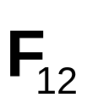
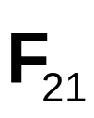
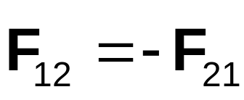
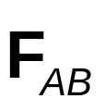
Newton’s Third Law
If two objects interact, the force exerted by object 1 on object 2 is equal in magnitude and opposite in direction to the force exerted by object 2 on object 1
  Note on notation: is the force exerted by A on B
IUST-2008/2009-Physics I

Slide 19
Newton’s Third Law, Alternative Statements
Forces always occur in pairs
A single isolated force cannot exist
The action force is equal in magnitude to the reaction force and opposite in direction
  One of the forces is the action force, the other is the reaction force
  It doesn’t matter which is considered the action and which the reaction
  The action and reaction forces must act on different objects and be of the same type
IUST-2008/2009-Physics I

Slide 20
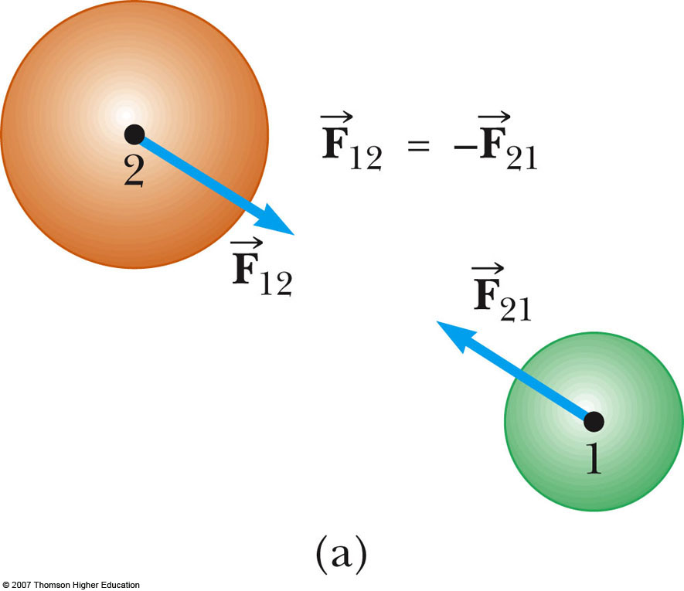
Action-Reaction Examples, 1
The force exerted by object 1 on object 2 is equal in magnitude and opposite in direction to exerted by object 2 on object 1
IUST-2008/2009-Physics I

Slide 21
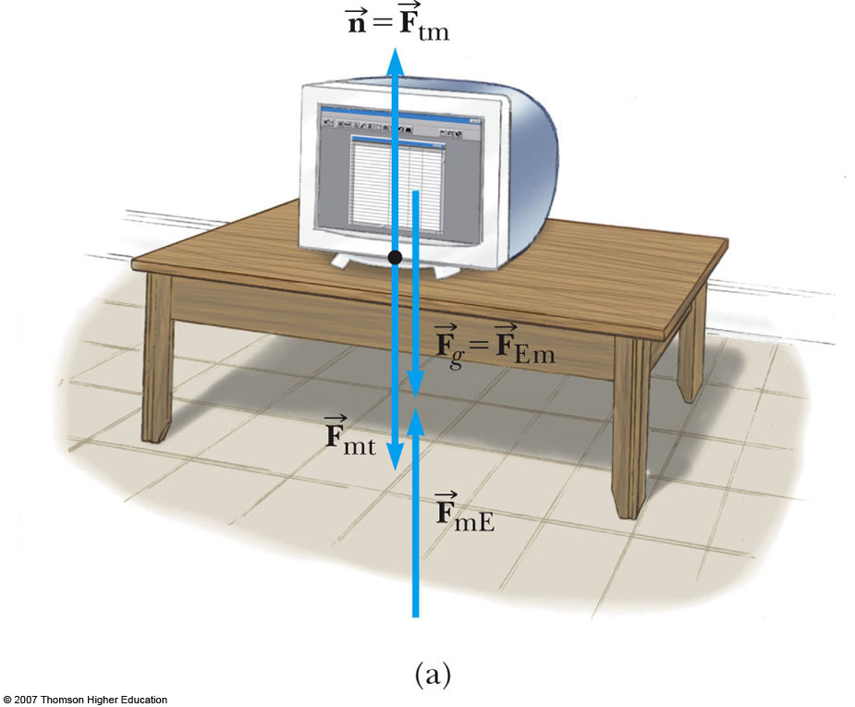
Action-Reaction Examples, 2
The normal force (table on monitor) is the reaction of the force the monitor exerts on the table
  Normal means perpendicular, in this case
The action (Earth on monitor) force is equal in magnitude and opposite in direction to the reaction force, the force the monitor exerts on the Earth
IUST-2008/2009-Physics I

Slide 22
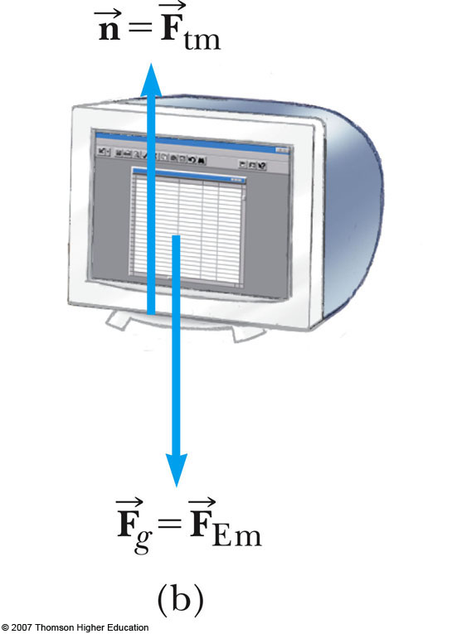
Free Body Diagram
In a free body diagram, you want the forces acting on a particular object
  Model the object as a particle
The normal force and the force of gravity are the forces that act on the monitor
IUST-2008/2009-Physics I

Slide 23
Free Body Diagram, cont.
The most important step in solving problems involving Newton’s Laws is to draw the free body diagram
Be sure to include only the forces acting on the object of interest
Include any field forces acting on the object
Do not assume the normal force equals the weight
IUST-2008/2009-Physics I

Slide 24
Applications of Newton’s Law
Assumptions
  Objects can be modeled as particles
  Interested only in the external forces acting on the object
    can neglect reaction forces
  Initially dealing with frictionless surfaces
  Masses of strings or ropes are negligible
    The force the rope exerts is away from the object and parallel to the rope
    When a rope attached to an object is pulling it, the magnitude of that force is the tension in the rope
IUST-2008/2009-Physics I

Slide 25
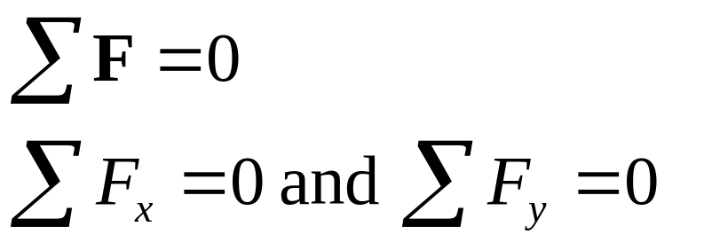
Particles in Equilibrium
If the acceleration of an object that can be modeled as a particle is zero, the object is said to be in equilibrium
  The model is the particle in equilibrium model
Mathematically, the net force acting on the object is zero
IUST-2008/2009-Physics I

Slide 26
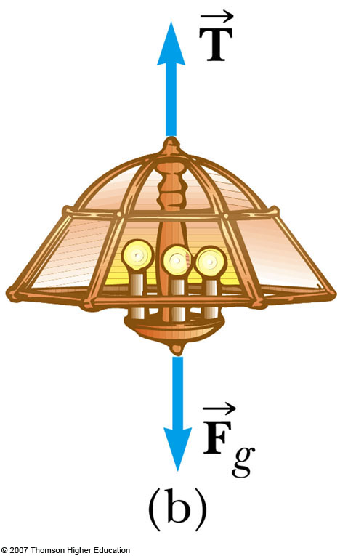
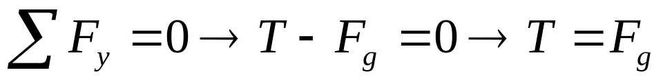
Equilibrium, Example 1a
A lamp is suspended from a chain of negligible mass
The forces acting on the lamp are
  the downward force of gravity
  the upward tension in the chain
Applying equilibrium gives
IUST-2008/2009-Physics I

Slide 27
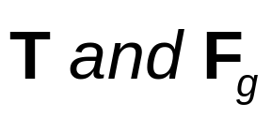
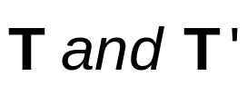

Equilibrium, Example 1b
  Not an action-reaction pair
  Both act on the lamp
  Action-reaction forces
  Lamp on chain and chain on lamp
  Action-reaction forces
  Chain on ceiling and ceiling on chain
Only the forces acting on the lamp are included in the free body diagram
IUST-2008/2009-Physics I

Slide 28
Example 5.4 The Traffic Light
A traffic light weighing 122 N hangs from a cable tied to two other cables fastened to a support as in figure 5.10a. The upper cables make angles of 37.0⁰ and 53.0⁰ with the horizontal. These upper cables are not as strong as the vertical cable and will break if the tension in them exceeds 100 N. Does the traffic light remain hanging in this situation, or will one of the cables break?
IUST-2008/2009-Physics I

Slide 29
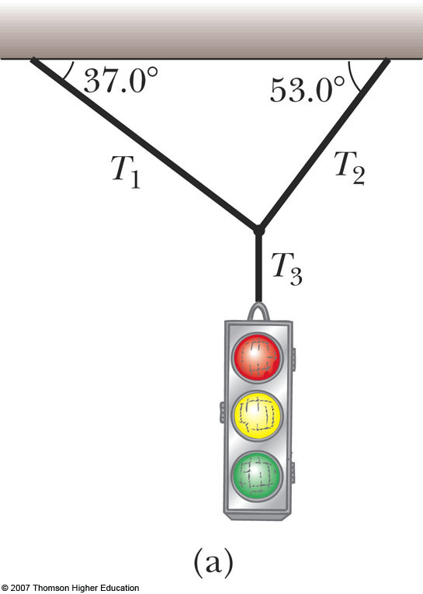
Equilibrium, Example 2a
Example 5.4
Conceptualize the traffic light
  Assume cables don’t break
  Nothing is moving
Categorize as an equilibrium problem
  No movement, so acceleration is zero
  Model as a particle in equilibrium
IUST-2008/2009-Physics I

Slide 30
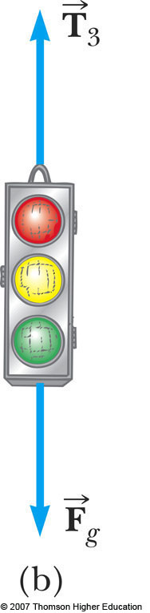
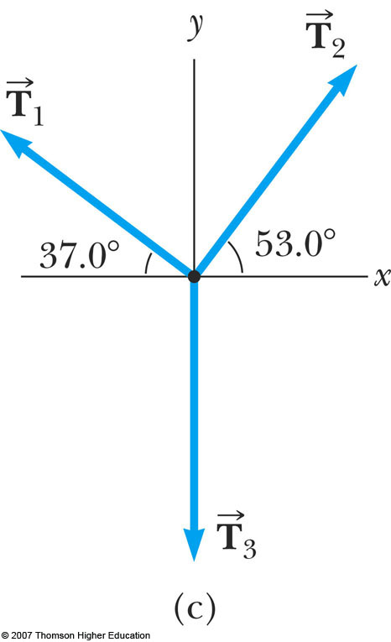
Equilibrium, Example 2b
Analyze
  Need two free-body diagrams
  Apply equilibrium equation to the light
  Apply equilibrium equations to the knot
IUST-2008/2009-Physics I

Slide 31
Equilibrium, Example 2 c
Analyze, cont.
  Find T₃ from applying equilibrium in the y-direction to the light
  Find T₁ and T₂ from applying equilibrium in the x- and y-directions to the knot
Finalize
  Think about different situations and see if the results are reasonable
IUST-2008/2009-Physics I

Slide 32
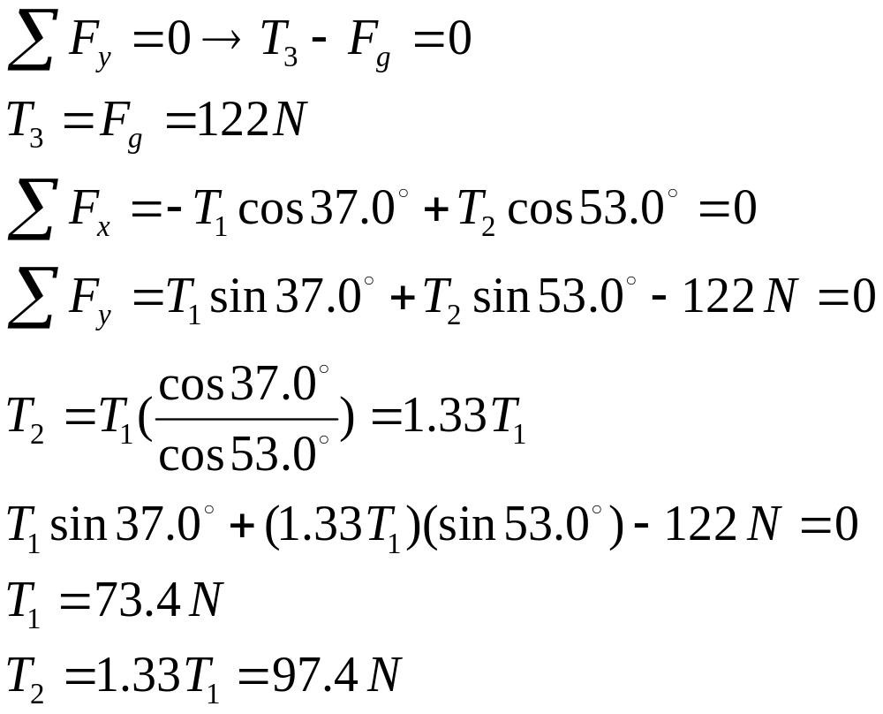
Example 5.4
IUST-2008/2009-Physics I

Slide 33
Particles Under a Net Force
If an object that can be modeled as a particle experiences an acceleration, there must be a nonzero net force acting on it
  Model is particle under a net force model
Draw a free-body diagram
Apply Newton’s Second Law in component form
IUST-2008/2009-Physics I

Slide 34
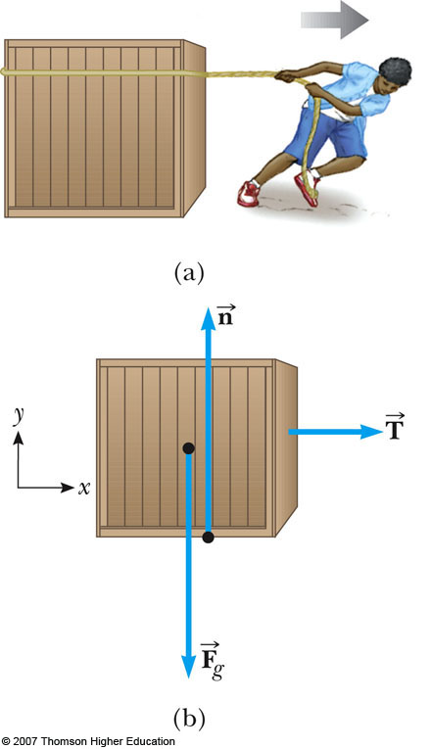



Newton’s Second Law, Example 1a
Forces acting on the crate:
  A tension, acting through the rope, is the magnitude of force
  The gravitational force,
  The normal force, , exerted by the floor
IUST-2008/2009-Physics I

Slide 35
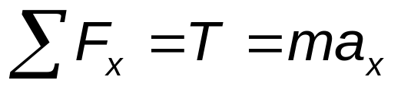
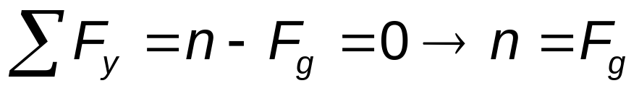
Newton’s Second Law, Example 1b
Apply Newton’s Second Law in component form:
Solve for the unknown(s)
If the tension is constant, then a is constant and the kinematic equations can be used to more fully describe the motion of the crate
IUST-2008/2009-Physics I

Slide 36
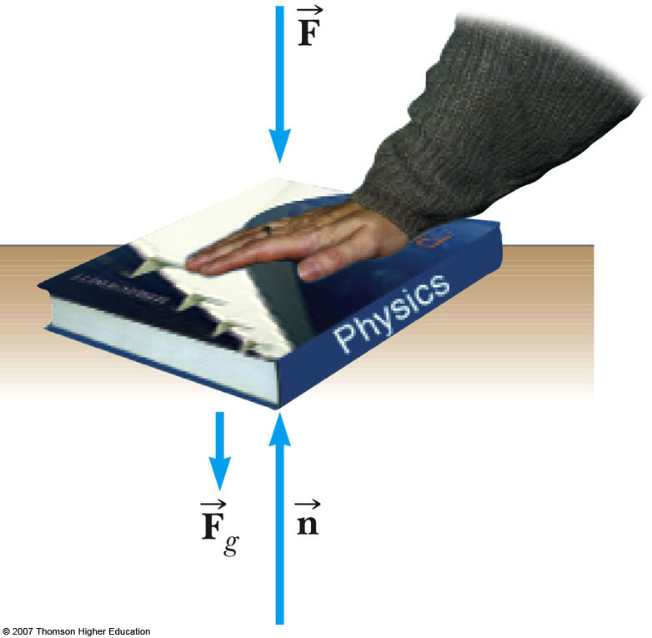
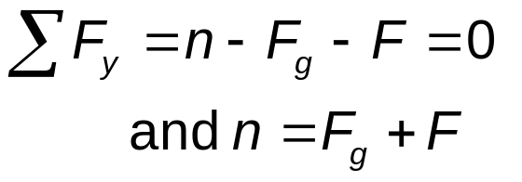

Note About the Normal Force
The normal force is not always equal to the gravitational force of the object
For example, in this case
may also be less than
IUST-2008/2009-Physics I

Slide 37
Example 5.6 The Runaway Car
A car of mass m is on an icy driveway inclined at an angle θ as in Figure 5.11a
(A) Find the acceleration of the car, assuming that the driveway is frictionless.
(B) Suppose the car is released from rest at the top of the incline and the distance from the car’s front bumper to the bottom of the incline is d. How long does it take the front bumper to reach the bottom of the hill, and what is the car’s speed as it arrives there?
IUST-2008/2009-Physics I

Slide 38
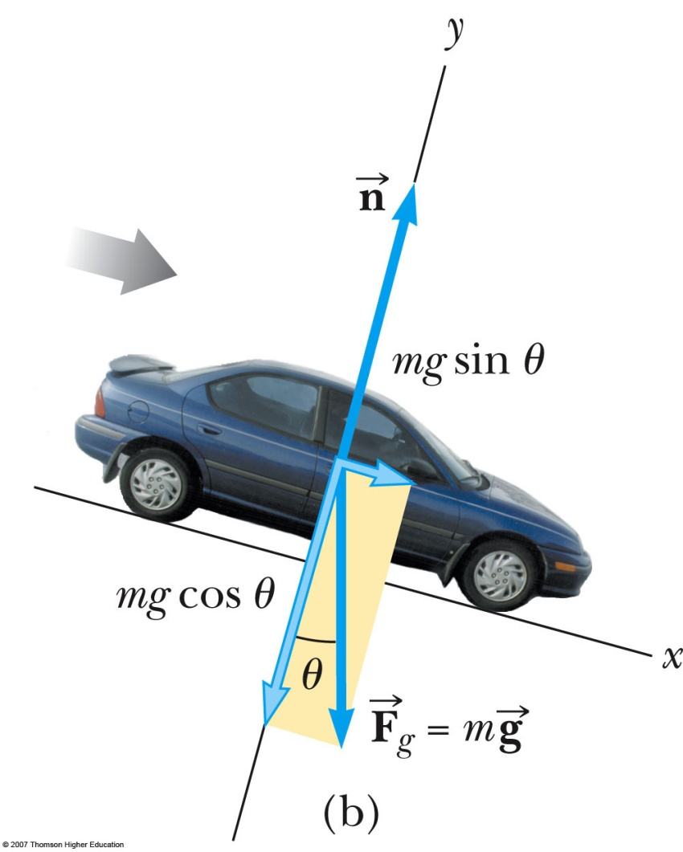
Inclined Planes
Forces acting on the object:
  The normal force acts perpendicular to the plane
  The gravitational force acts straight down
Choose the coordinate system with x along the incline and y perpendicular to the incline
Replace the force of gravity with its components
IUST-2008/2009-Physics I

Slide 39
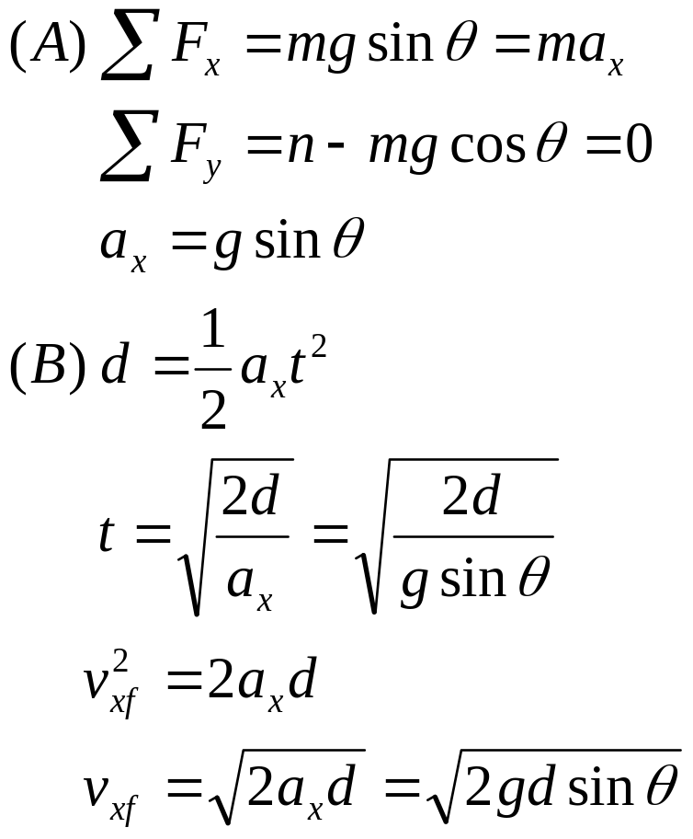
Example 5.6 The Runaway Car
IUST-2008/2009-Physics I

Slide 40
Example 5.9 The Atwood Machine
When two objects of unequal mass are hung vertically over a frictionless pulley of negligible mass as in Figure 5.14a, the arrangement is called an Atwood machine. The device is sometimes used in the laboratory to calculate the value of g. Determine the magnitude of the acceleration of the two objects and the tension in the lightweight cord.
IUST-2008/2009-Physics I

Slide 41
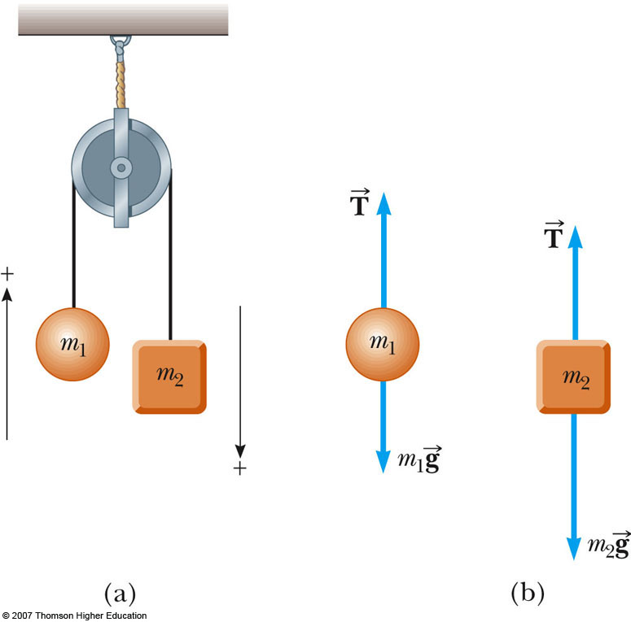
Multiple Objects, Example 2 – Atwood’s Machine
Forces acting on the objects:
  Tension (same for both objects, one string)
  Gravitational force
Each object has the same acceleration since they are connected
Draw the free-body diagrams
Apply Newton’s Laws
Solve for the unknown(s)
IUST-2008/2009-Physics I

Slide 42
Exploring the Atwood’s Machine
Vary the masses and observe the values of the tension and acceleration
  Note the acceleration is the same for both objects
  The tension is the same on both sides of the pulley as long as you assume a massless, frictionless pulley
IUST-2008/2009-Physics I

Slide 43
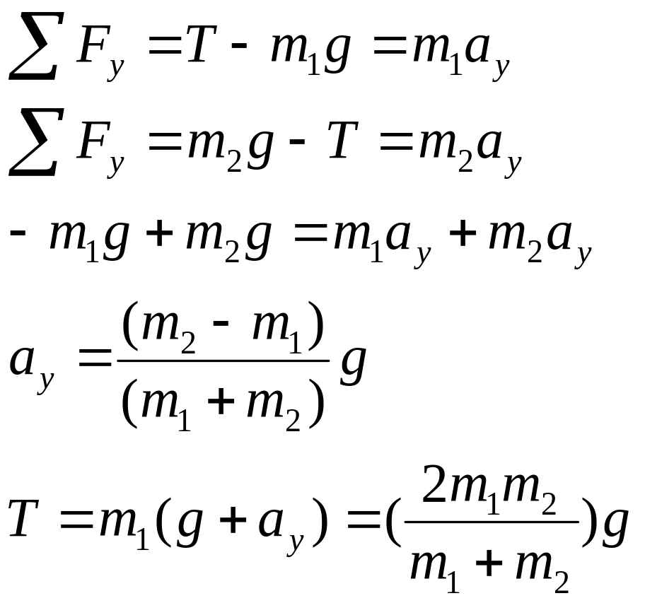
Example 5.9 The Atwood Machine
IUST-2008/2009-Physics I

Slide 44
Example 5.10
A ball of mass m₁ and a block of mass m₂ are attached by a lightweight cord that passes over a frictionless pulley of negligible mass as in Figure 5.15a. The block lies on a frictionless incline of angle θ. Find the magnitude of the acceleration of the two objects and the tension in the cord.
IUST-2008/2009-Physics I

Slide 45
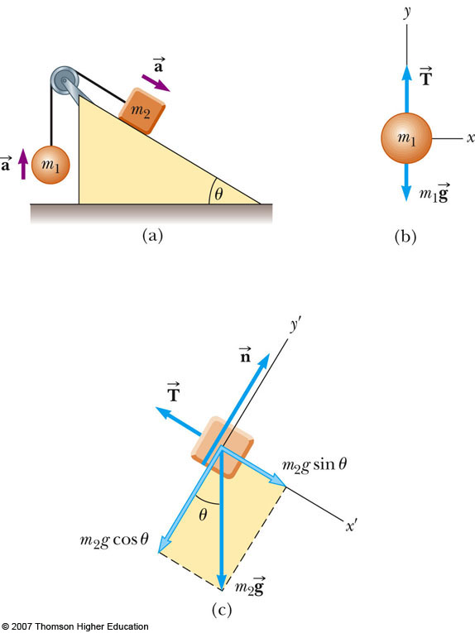
Multiple Objects, Example 3
Draw the free-body diagram for each object
  One cord, so tension is the same for both objects
  Connected, so acceleration is the same for both objects
Apply Newton’s Laws
Solve for the unknown(s)
IUST-2008/2009-Physics I

Slide 46
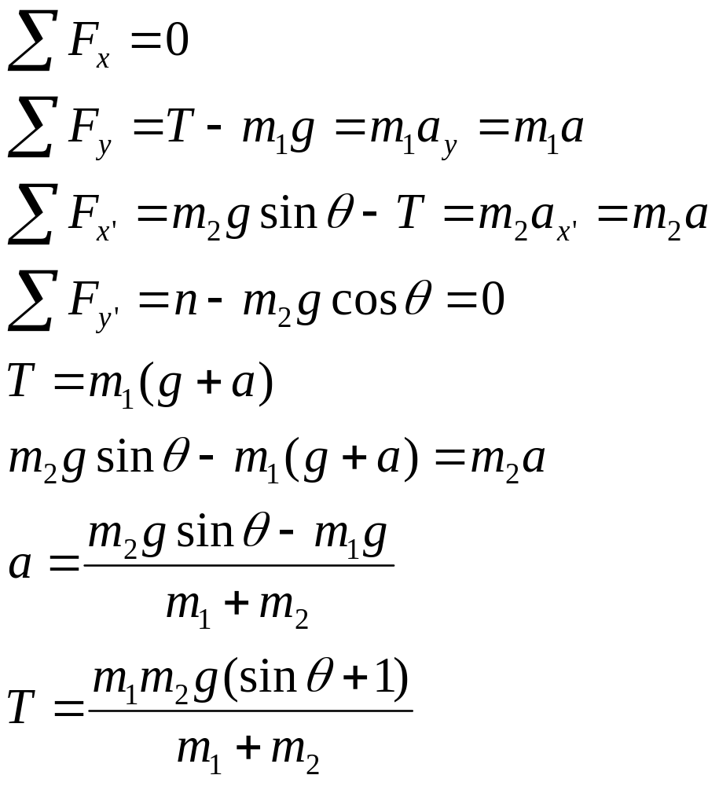
Example 5.10
IUST-2008/2009-Physics I

Slide 47
Problem-Solving Hints
Newton’s Laws
  Draw a diagram
  Choose a convenient coordinate system for each object
Is the model a particle in equilibrium?
    If so, ΣF = 0
  Is the model a particle under a net force?
    If so, ΣF = m a
IUST-2008/2009-Physics I

Slide 48
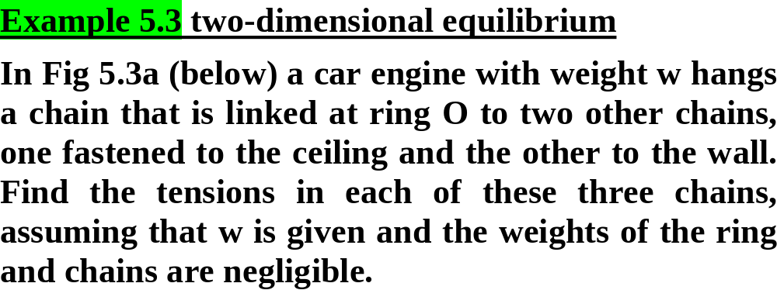
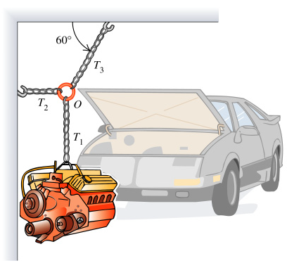
IUST-2008/2009-Physics I

Slide 49
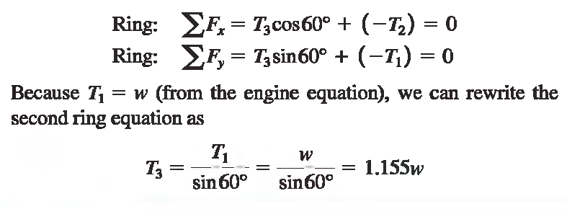
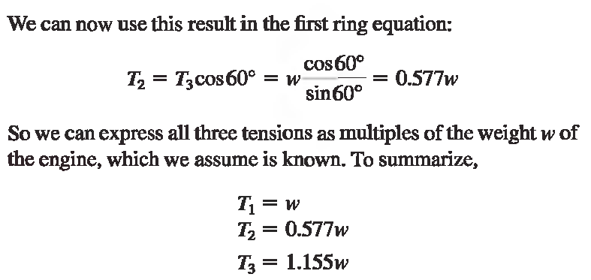
IUST-2008/2009-Physics I

Slide 50
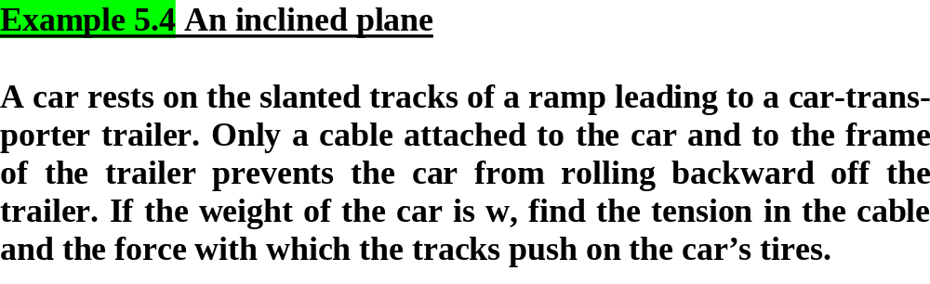
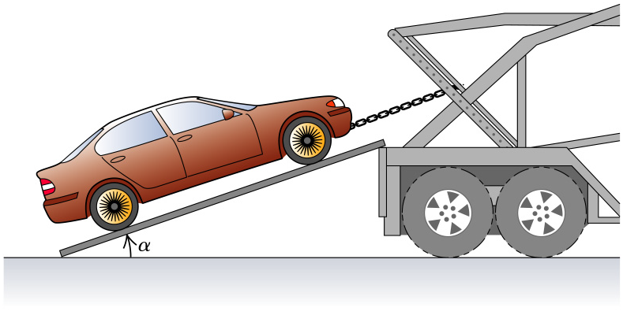
IUST-2008/2009-Physics I

Slide 51
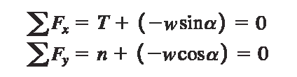
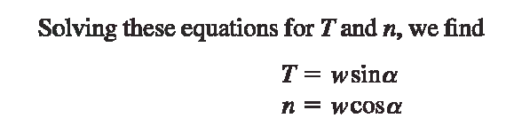
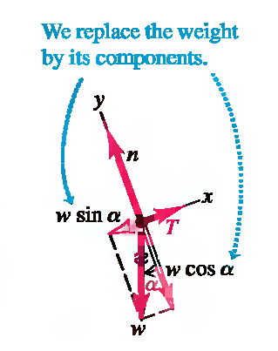
IUST-2008/2009-Physics I

Slide 52
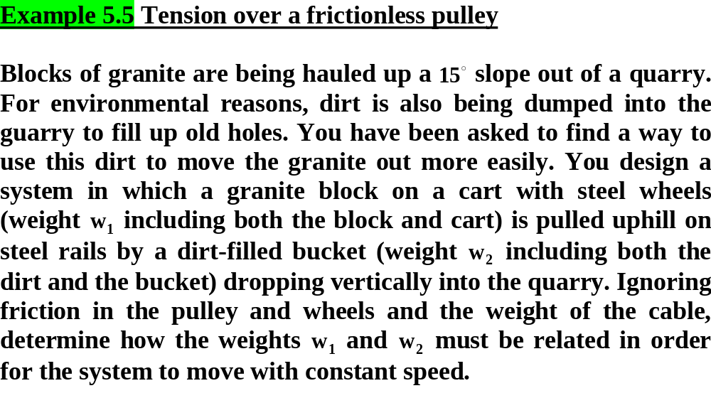
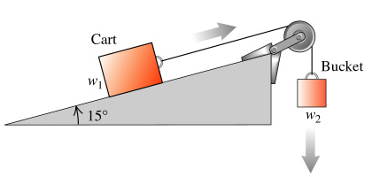
IUST-2008/2009-Physics I

Slide 53

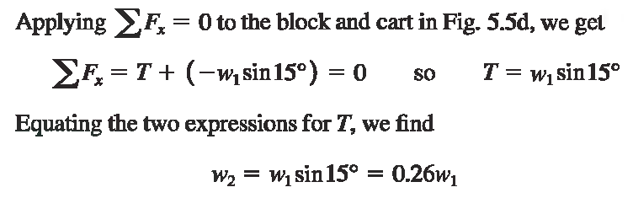

IUST-2008/2009-Physics I

Slide 54



IUST-2008/2009-Physics I

Slide 55


IUST-2008/2009-Physics I

Slide 56
Forces of Friction
When an object is in motion on a surface or through a viscous medium, there will be a resistance to the motion
  This is due to the interactions between the object and its environment
This resistance is called the force of friction
IUST-2008/2009-Physics I

Slide 57
Forces of Friction, cont.
Friction is proportional to the normal force
  ƒ_{s} ≤ µ_{s} n and ƒ_{k}= µ_{k} n
    μ is the coefficient of friction
  These equations relate the magnitudes of the forces, they are not vector equations
  For static friction, the equals sign is valid only at impeding motion, the surfaces are on the verge of slipping
  Use the inequality if the surfaces are not on the verge of slipping
IUST-2008/2009-Physics I

Slide 58
Forces of Friction, final
The coefficient of friction depends on the surfaces in contact
The force of static friction is generally greater than the force of kinetic friction
The direction of the frictional force is opposite the direction of motion and parallel to the surfaces in contact
The coefficients of friction are nearly independent of the area of contact
IUST-2008/2009-Physics I

Slide 59



Static Friction
Static friction acts to keep the object from moving
If increases, so does
If decreases, so does
ƒ_{s} ≤ µ_{s} n
  Remember, the equality holds when the surfaces are on the verge of slipping
IUST-2008/2009-Physics I

Slide 60

Kinetic Friction
The force of kinetic friction acts when the object is in motion
Although µ_{k} can vary with speed, we shall neglect any such variations
ƒ_{k} = µ_{k} n
IUST-2008/2009-Physics I

Slide 61

Explore Forces of Friction
Vary the applied force
Note the value of the frictional force
  Compare the values
Note what happens when the can starts to move
IUST-2008/2009-Physics I

Slide 62

Some Coefficients of Friction
IUST-2008/2009-Physics I

Slide 63

Friction in Newton’s Laws Problems
Friction is a force, so it simply is included in the in Newton’s Laws
The rules of friction allow you to determine the direction and magnitude of the force of friction
IUST-2008/2009-Physics I

Slide 64

Friction Example, 1
The block is sliding down the plane, so friction acts up the plane
This setup can be used to experimentally determine the coefficient of friction
µ = tan θ
  For µ_{s}, use the angle where the block just slips
  For µ_{k}, use the angle where the block slides down at a constant speed
IUST-2008/2009-Physics I

Slide 65

Friction, Example 2
Draw the free-body diagram, including the force of kinetic friction
  Opposes the motion
  Is parallel to the surfaces in contact
Continue with the solution as with any Newton’s Law problem
This example gives information about the motion which can be used to find the acceleration to use in Newton’s Laws
IUST-2008/2009-Physics I

Slide 66

Friction, Example 3
Friction acts only on the object in contact with another surface
Draw the free-body diagrams
Apply Newton’s Laws as in any other multiple object system problem
IUST-2008/2009-Physics I

Slide 67

IUST-2008/2009-Physics I

Slide 68

IUST-2008/2009-Physics I

Slide 69

IUST-2008/2009-Physics I

Slide 70

IUST-2008/2009-Physics I

Slide 71

IUST-2008/2009-Physics I

